Slide 1
Introduction to Redux Saga
By Chaitanya Katore
AK

Slide 2


What is React Saga?
1
Definition: Redux-Saga is a middleware library specifically designed to handle side effects in Redux-managed React applications.
2
Purpose: Manages asynchronous actions such as: Making API calls, Handling
WebSocket connections, Managing complex asynchronous workflows
3
Foundation: Built on ES6 generator functions, which allow functions to pause and resume execution, making it ideal for non-blocking asynchronous operations.
4
Functionality: Facilitates async communication between the Redux store and external resources (e.g., APIs, local storage).Efficiently handles input/output services and async tasks like HTTP requests.
5
Middleware Example: Redux-Saga is a type of Redux middleware, alongside others like Redux Thunk, for handling custom dispatch behaviors and async flows.

Slide 3
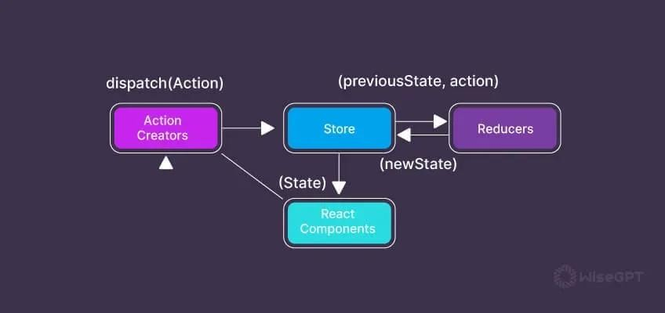
Redux
Definition: Redux is a centralized state management library that allows all components in an application to access shared data efficiently.
Challenges with Prop Drilling:
Managing data through props becomes unwieldy in large applications with many components.
Frequent changes to any component can trigger re- renders in all connected components, negatively impacting performance and user experience.
Solution with Redux:
Redux provides a centralized store for managing application state.
By using Redux, components can access the data they need directly from the central store, reducing the need for prop drilling and improving optimization.
This approach
leads state
better performance in larger
to more efficient
management and applications.

Slide 4
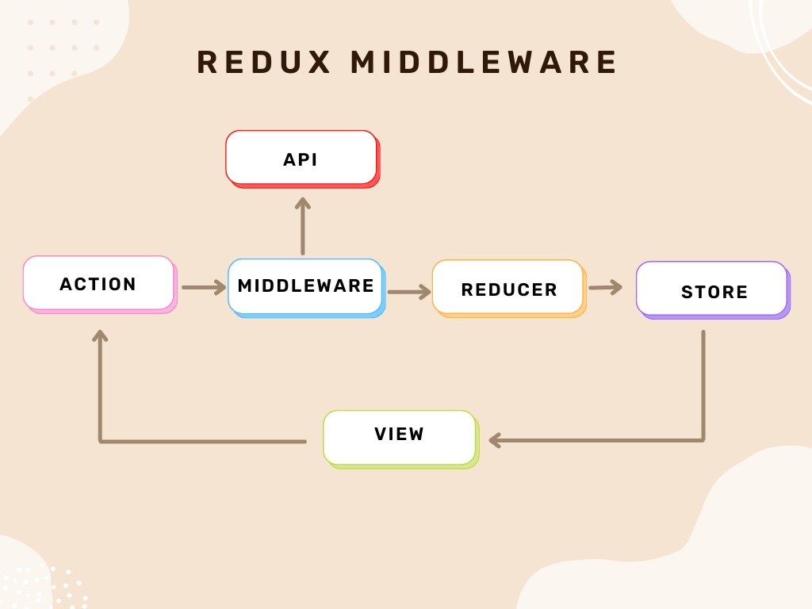
Middleware
Middleware in Redux
Definition: Middleware in Redux is a way to extend the functionality of the Redux store, allowing for additional features to be integrated into the application.
Functionality:
  Acts as an intermediary between the dispatching of an action and its
arrival at the reducer.
  Enables third-party extensions and custom behaviors during the dispatch process.
Use Cases:
  Crash Reporting: Capture errors and send reports.
  Logging: Track dispatched actions and state changes for debugging.
  Asynchronous Operations: Manage async tasks such as API calls and delayed actions.
Customization:
  Enhancers are used to modify the dispatch function, but middleware
allows for deeper customization.
  Similar to middleware in other frameworks (e.g., Express), Redux middleware customizes specific behaviors within an application.

Slide 5

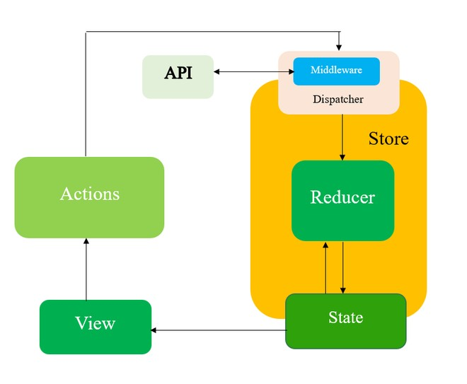
Redux WorkFlow with Middleware
State
View
Definition: The UI components or pages in an application, often represented by React components.Role: Reads data from the state and displays it to users; also triggers actions in response to user interactions.Relationship: Re-renders whenever the state updates, providing the latest data to users.
Dispatcher
Definition: A function (dispatch) that sends actions to the Redux store.Role: Connects actions to the Redux store, triggering state changes.Relationship: When the view calls dispatch, it sends the action to middleware (if any) and then to the reducers
Reducer
Definition: Pure functions that take the current state and an action, returning a new state based on the action’s type and payload.Role: Determines how the state should change in response to actions.Relationship: Receives actions after they pass through any middleware, applies the action logic, and returns an updated state to the store.
Definition: The single source of truth in Redux,
representing the entire application’s data. Role: Centralized in the Redux store, it can be accessed by any component. Relationship: When an action changes the state, the view re- renders based on the new state.
Actions
Definition: Plain JavaScript objects describing an event that has occurred (e.g., fetching data, updating an item).Role: Contains a type field (indicating the event type) and, often, a payload (additional data for the reducer).Relationship: Actions are dispatched to the store, initiating the flow to update the state.
API
Definition: External services or endpoints accessed for data (e.g., fetching product lists, saving user information).Role: Provides data or processing services for the application, typically accessed through asynchronous actions.Relationship: Middleware (e.g., Redux Saga) makes API calls when an action is dispatched, fetching or updating data before it flows to reducers
Store
Definition: The centralized place where the application state lives in Redux.Role: Holds the current state, provides dispatch for actions, and allows subscription to state updates.Relationship: Coordinates between all elements, updating the state and notifying the view to re-render based on changes.

Slide 6
Why use Redux Saga?
Declarative Syntax/Readability
Sagas use a declarative approach, making your application's business logic more readable and understandable.
Error Handling
Provides robust mechanisms for handling failures
in async operations, improving application reliability.
Scalability
Sagas help manage complex
workflows and scale your application
as it grows in complexity.
Simplification of Async Handling
Redux Saga simplifies the management of complex asynchronous flows in applications, making code more manageable and readable.
Testability
Sagas can be easily tested in isolation, making your application more robust and maintainable. The design of Redux Saga allows for easy testing of asynchronous logic through its generator functions, enabling step-by-step execution and simulation of side effects.

Slide 7
Sagas And their Functions
Dispatching Actions
Sagas listen for actions dispatched from your components and handle the associated side effects.
Sagas in Redux-Saga are generator functions that manage asynchronous side effects in a Redux application, like making API calls, handling complex business logic, or managing non-blocking operations such as animations or
1
timeout events. Redux-Saga uses these
generator functions to “watch” for specific
2
Asynchronous Flows
Sagas use generator functions to describe complex asynchronous flows, like data fetching and error handling.
actions and then execute related asynchronous code in a controlled, predictable way.
3
Coordinating Effects
Sagas can coordinate multiple effects, like race conditions
and parallel executions, to manage complex workflows.

Slide 8
Core Concepts in Redux Saga
1.Effects: The building blocks for handling asynchronous tasks. Key effects include:
call:
  Used to invoke asynchronous functions or methods.
  Can take parameters for the function being called, allowing flexibility.
put:
  Dispatches actions to the Redux store.
  Useful for sending updates back to the store after an async operation is complete.
take:
  Pauses the saga execution until a specific action is dispatched.
  Useful for waiting for user interactions or specific events before proceeding.
fork:
  Creates a non-blocking task that runs independently.
  Allows concurrent execution of tasks without waiting for them to complete.
race:
  Runs multiple effects concurrently and cancels all except the first one that completes.
  Useful for managing timeouts or handling scenarios where only one response is needed.

Slide 9
2.Advanced Effects: Enhance control over asynchronous operations.
takeLatest:
  Ignores all previous actions of the same type if a new action is dispatched before the previous one finishes.
  Ensures that only the latest request is processed, ideal for scenarios like user input where only the most recent action matters.
takeEvery:
  Allows handling every dispatched action of a specific type.
  Useful for scenarios where each action needs to be processed independently, like logging or analytics.
debounce:
  Delays execution until a specified time has passed since the last time it was invoked.
  Useful for scenarios like search inputs where you want to reduce the number of API calls based on user input frequency.
throttle:
  Limits the number of times a function can be called over a specified period.
  Useful for preventing performance issues caused by rapid user interactions, like button clicks.

Slide 10
Setting up a React Project using React Saga….

Slide 11
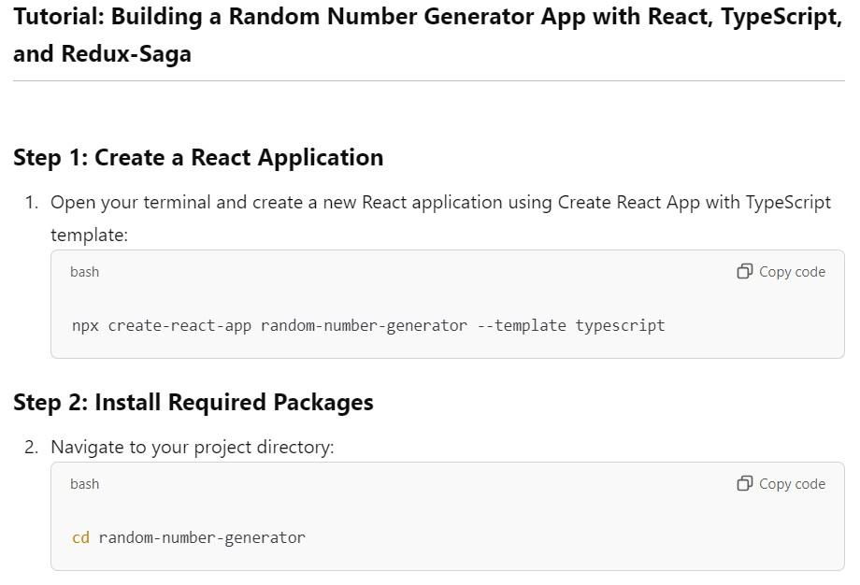

Slide 12
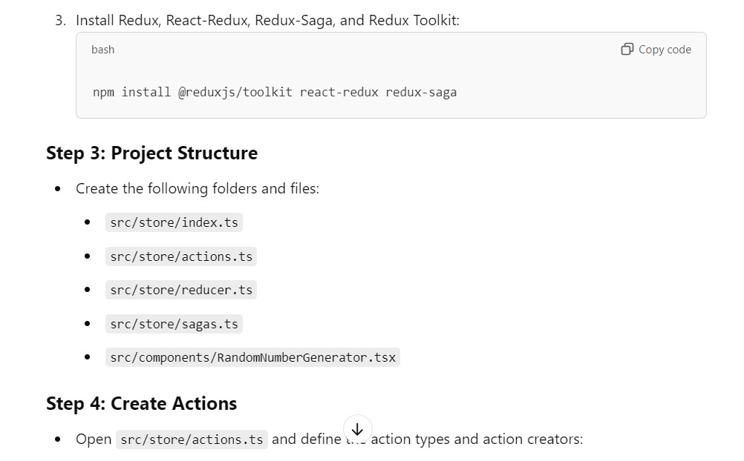

Slide 13
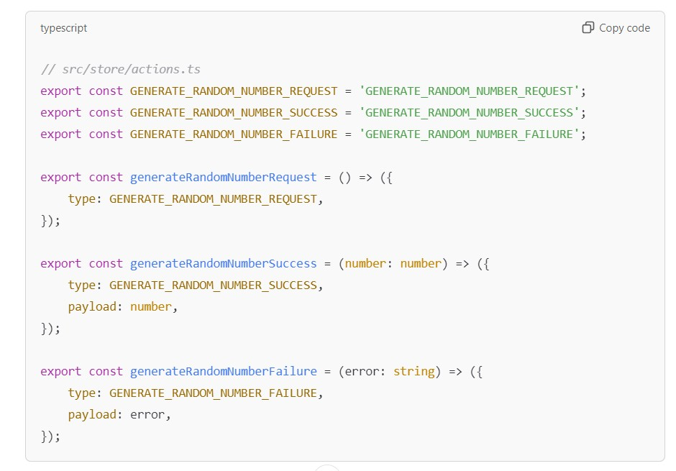

Slide 14
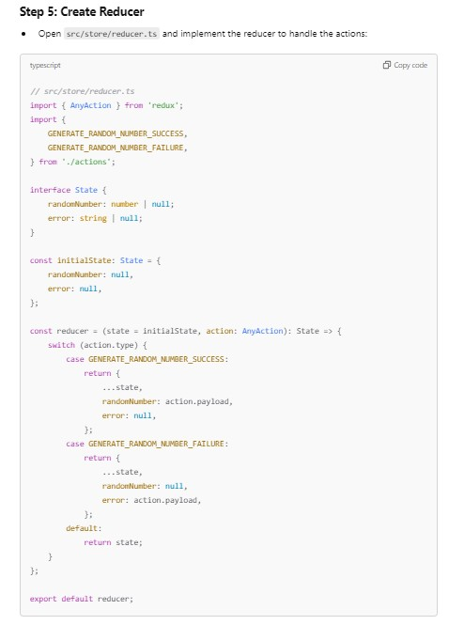

Slide 15
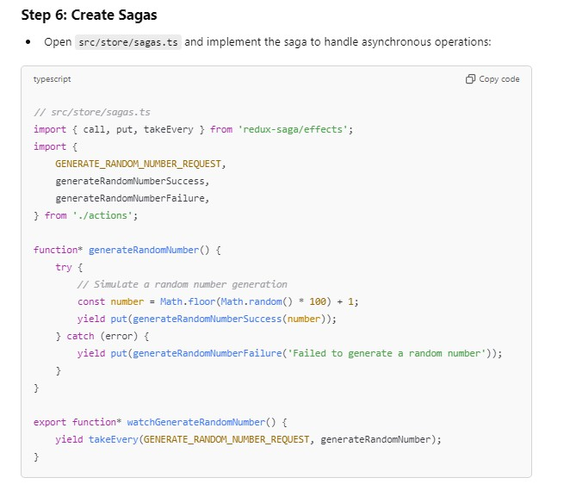

Slide 16
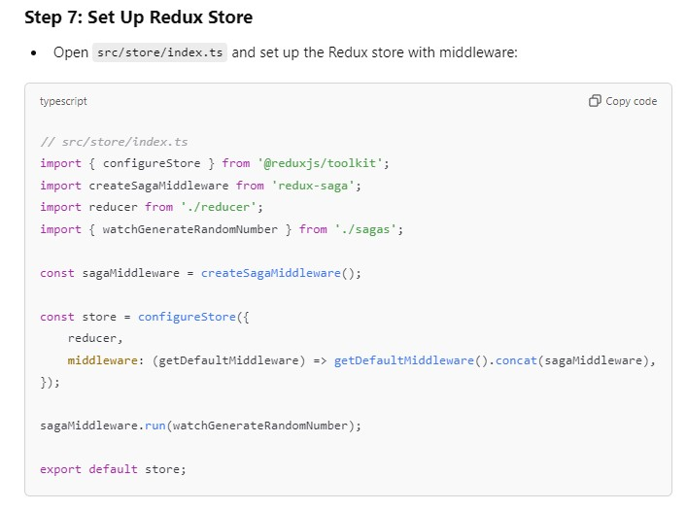

Slide 17
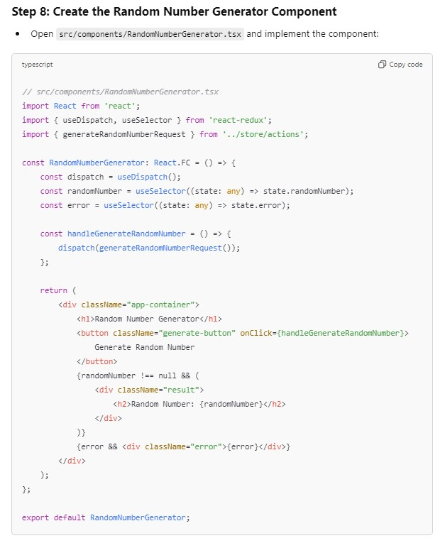

Slide 18
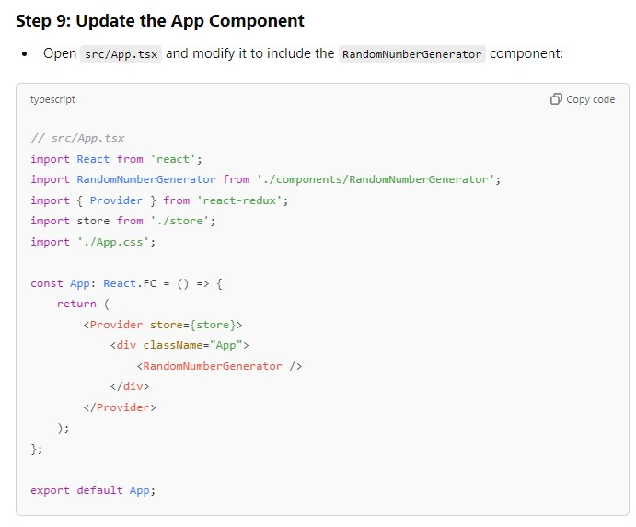

Slide 19
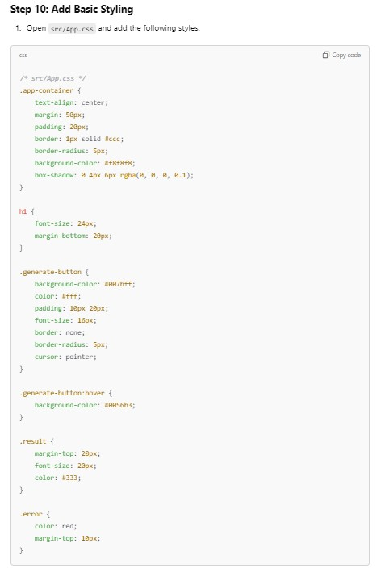

Slide 20
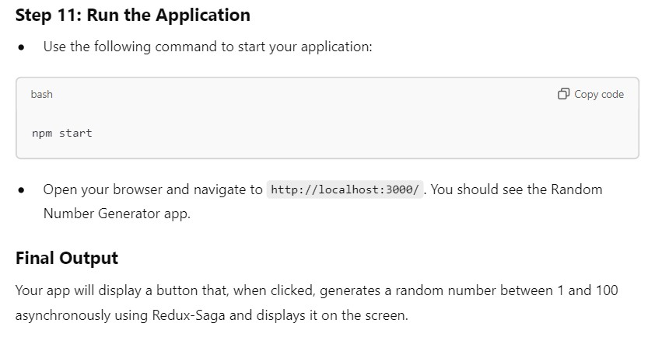

Slide 21
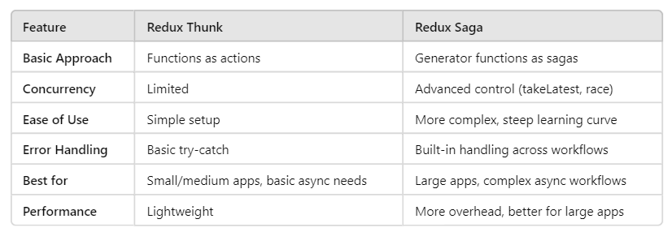
Comparison B/w Thunks and Saga

Slide 22


Thank you
This presentation has provided an overview of React Saga and how it can simplify the management of side effects in your React applications. By using Sagas, you can build more scalable, maintainable, and testable applications.

