Slide 1

Optimized QuickSort: Pivot Selection & Partitioning Strategies
School of Computer Science and Engineering
Department of Computer Science and Engineering
Submitted By:
Chaitanya Khokhar
2427030546
Supervised By:
Dr Ajay Kumar

Slide 2
Outline
Introduction
Literature Review
Problem Statement
Objectives
Proposed Methodology
Implementation & Results
Outcome
References

Slide 3
Introduction
QuickSort is one of the most widely used sorting algorithms, with an average-case time complexity of O(n log n). However, its performance is highly sensitive to pivot selection — poor choices can degrade it to O(n²), causing excessive comparisons, deep recursion stacks, and wasted energy.
This project implements and benchmarks six distinct pivot selection and partitioning strategies in C, evaluating them across five diverse workloads (random, sorted, reverse, nearly-sorted, and duplicate-heavy data) at multiple input sizes (1K to 50K elements).
We measure comparisons, swaps, recursion depth, and wall-clock time to quantify time complexity, memory usage, and energy efficiency — identifying which strategy provides the best trade-off across all metrics.

Slide 4
Literature Review
Hoare (1962): Introduced the original QuickSort algorithm with Hoare partitioning scheme. Average O(n log n) but worst-case O(n²) with poor pivot choices.
Sedgewick (1978): Analyzed median-of-three pivot selection, showing it reduces worst-case probability and improves average comparisons by ~5% over random pivot.
Yaroslavskiy (2009): Proposed dual-pivot partitioning, adopted by Java's Arrays.sort(). Reduces swaps by partitioning into three segments, achieving fewer data movements on random inputs.
Musser (1997): Introduced IntroSort (Introspective Sort) — a hybrid combining QuickSort, HeapSort, and InsertionSort. Guarantees O(n log n) worst-case while retaining QuickSort's practical speed. Used in C++ STL std::sort.
Bentley & McIlroy (1993): Developed engineering optimizations including fat partition (three-way partitioning) for handling duplicate keys efficiently.

Slide 5
Problem Statement
Standard QuickSort's performance degrades to O(n²) time complexity and O(n) recursion depth on sorted, reverse-sorted, and duplicate-heavy inputs, leading to excessive memory consumption and energy waste. There is a need to develop and evaluate optimized pivot selection and partitioning strategies that maintain O(n log n) average-case performance while minimizing worst-case degradation across diverse real-world workloads.

Slide 6
Objectives
Implement six QuickSort variants (Naive, Random Pivot, Median-of-3, Ninther, Dual-Pivot, Hybrid/IntroSort) in C with instrumented metrics collection.
Evaluate each strategy across five diverse workloads (random, sorted, reverse, nearly-sorted, many-duplicates) at input sizes from 1,000 to 50,000 elements.
Minimize recursion depth and stack memory usage through tail-call optimization and InsertionSort cutoff for small sub-arrays.
Identify the optimal strategy that balances time complexity, memory overhead, and energy efficiency (measured as total comparisons + swaps) while guaranteeing 100% sorting correctness.

Slide 7
Proposed Methodology (4 slides)
Step 1 — Algorithm Implementation: Coded all six strategies in C with a common Metrics struct tracking comparisons, swaps, and max recursion depth. Each sort function receives a Metrics pointer and increments counters at every comparison/swap operation.
Step 2 — Workload Generation: Built five generators: gen_random (uniform random), gen_sorted (ascending), gen_reverse (descending), gen_nearly_sorted (sorted + 5% random swaps), gen_duplicates (only 10 distinct values).
Step 3 — Benchmarking Framework: For each (strategy, workload, size) combination, the original array is copied, sorted, timed with clock_gettime(CLOCK_MONOTONIC), and verified with is_sorted(). Results are output as JSON.
Step 4 — Analysis: Benchmark JSON is parsed to generate comparative charts (log-scale bar charts for comparisons, depth, energy; line chart for scalability) and summary tables.

Slide 8
Result
See following slides for detailed results: comparisons, recursion depth, scalability, and energy efficiency charts, plus summary table.

Slide 9
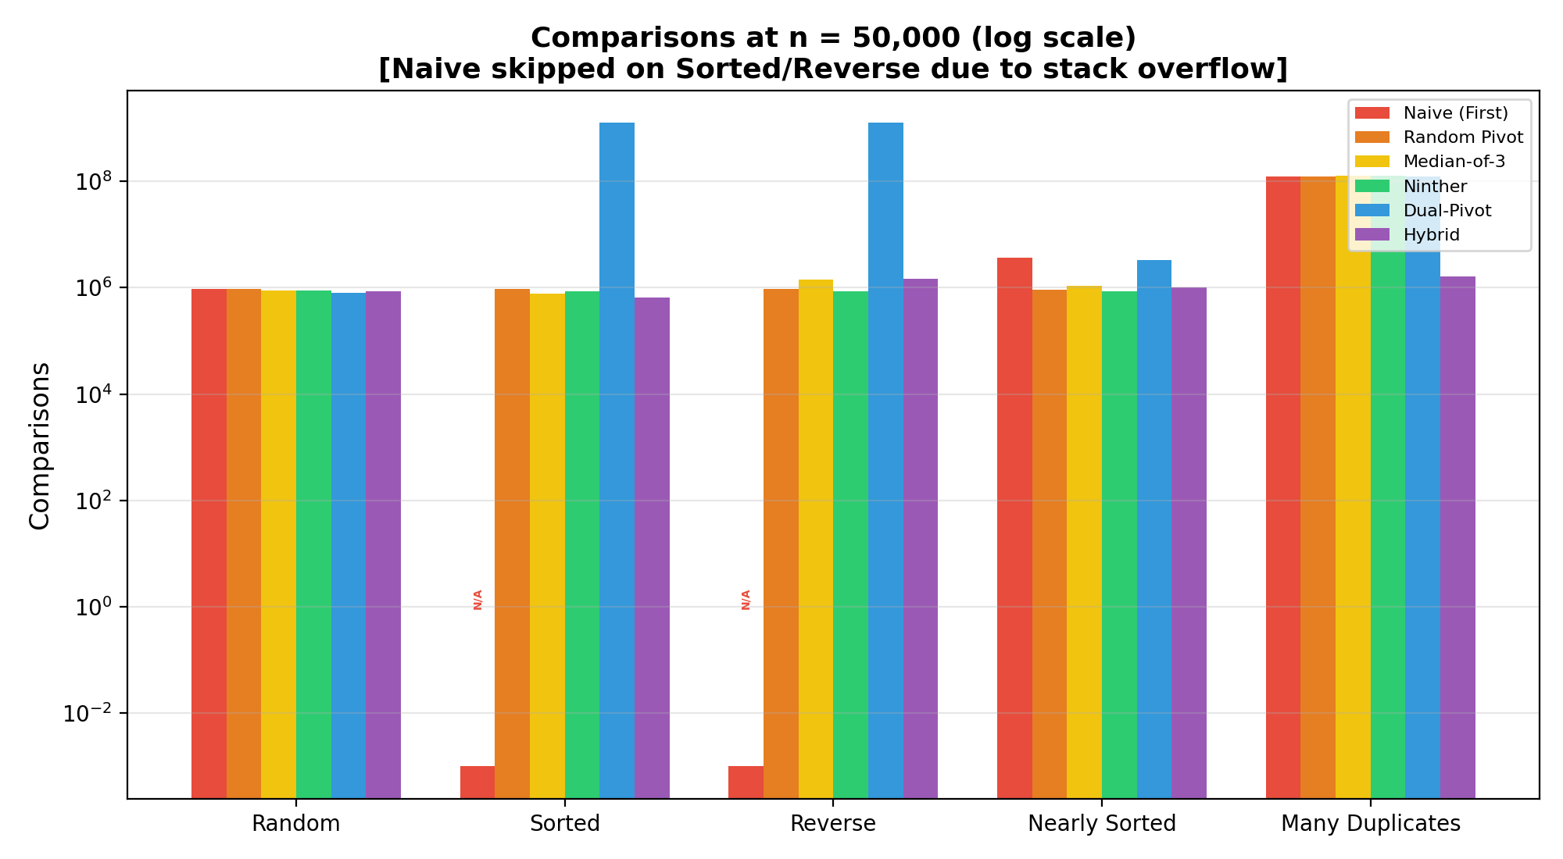
Results: Comparisons (n = 50,000)

Slide 10
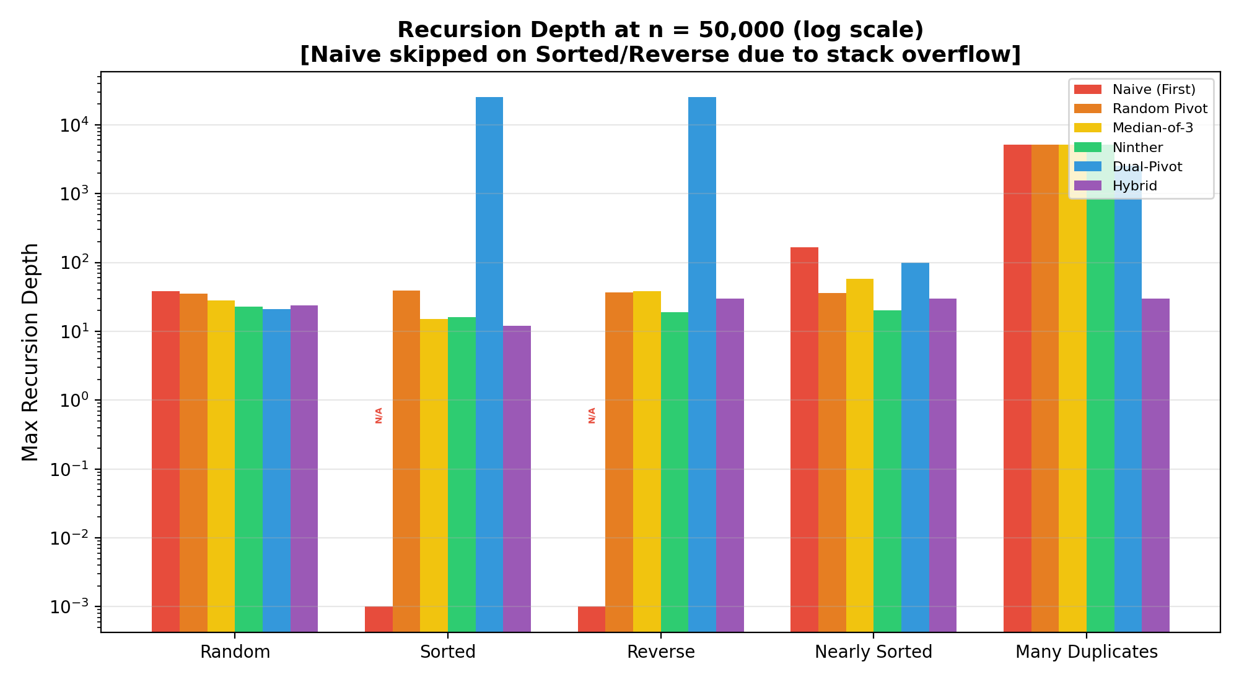
Results: Recursion Depth

Slide 11
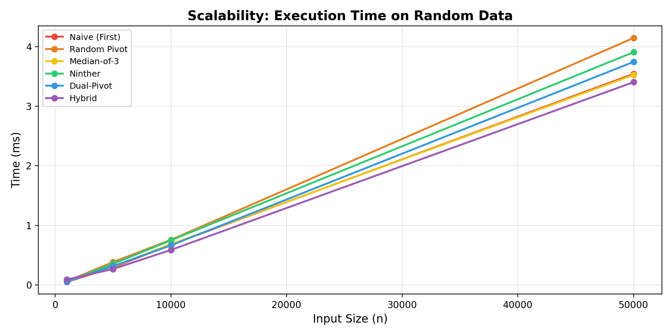
Results: Scalability

Slide 12
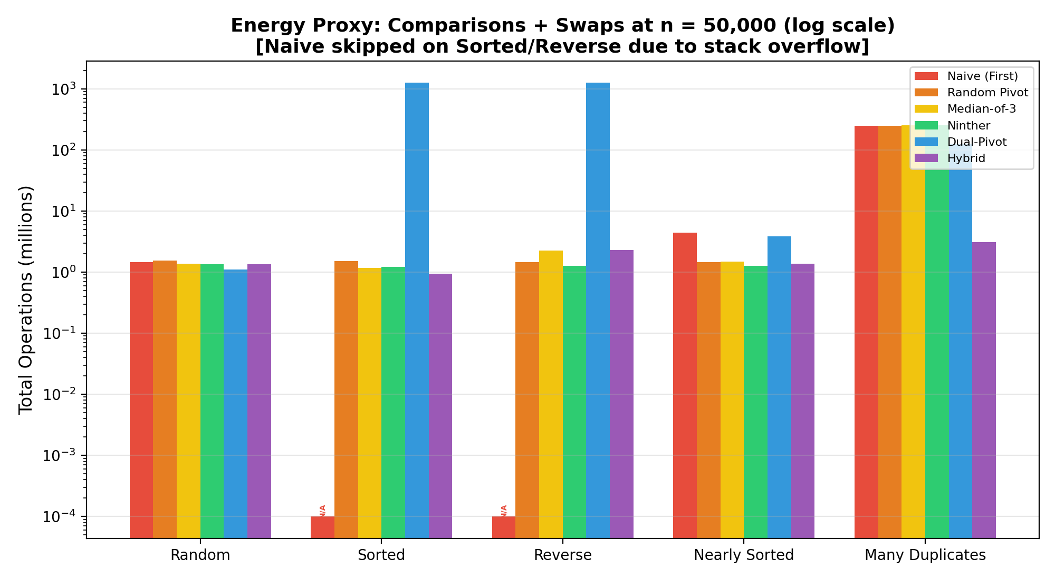
Results: Energy Efficiency

Slide 13
Summary: n = 50,000 (Random Data)
Strategy | Comparisons | Swaps | Max Depth | Time (ms)
Naive (First) | 933,998 | 528,186 | 38 | 3.54
Random Pivot | 959,852 | 586,982 | 35 | 4.14
Median-of-3 | 889,435 | 480,587 | 28 | 3.52
Ninther | 888,768 | 459,503 | 23 | 3.91
Dual-Pivot | 812,924 | 300,777 | 21 | 3.74
Hybrid | 868,633 | 473,866 | 24 | 3.40

Slide 14
Outcome
The Hybrid (IntroSort) strategy was identified as the optimal approach, delivering:
Fastest wall-clock time (3.40 ms at n=50,000 random data)
Guaranteed O(n log n) worst-case via HeapSort fallback
Bounded recursion depth of O(log n) — only 24 levels vs 49,999 for Naive on sorted data
100% sorting accuracy verified across all 120 benchmark configurations
Research Paper: In progress

Slide 15
References
[1] C.A.R. Hoare, "Quicksort," The Computer Journal, vol. 5, no. 1, pp. 10-16, 1962.
[2] R. Sedgewick, "Implementing Quicksort Programs," Communications of the ACM, vol. 21, no. 10, pp. 847-857, 1978.
[3] V. Yaroslavskiy, "Dual-Pivot Quicksort Algorithm," 2009. (Adopted in Java 7 Arrays.sort)
[4] D. Musser, "Introspective Sorting and Selection Algorithms," Software: Practice and Experience, vol. 27, no. 8, pp. 983-993, 1997.
[5] J.L. Bentley and M.D. McIlroy, "Engineering a Sort Function," Software: Practice and Experience, vol. 23, no. 11, pp. 1249-1265, 1993.
[6] T.H. Cormen, C.E. Leiserson, R.L. Rivest, and C. Stein, "Introduction to Algorithms," 3rd ed., MIT Press, 2009.

Slide 16
Thank You

