Slide 1
Drug Demand Forecasting
& Inventory Optimization
AI-Powered Pharmaceutical Supply Chain Solution
Digital Business Capability · Hackathon 2025 · Campus Hire

Slide 2
The Problem & Our Objectives
Business Challenge
Our 4 Objectives
Stockouts cause patient safety risks
Overstocking leads to waste & expiry
Manual demand planning is error-prone
Unstructured data (news, events) ignored
① Accurate Drug Demand Forecasting
② Inventory Optimization (Safety Stock, ROP)
③ NLP on Social & Event Text
④ Scalable System Integration
Dataset: 1,827 records · 6 Drugs · 4 Regions · 2020–2025 · 3 Text Sources

Slide 3
Solution Architecture
01 DATA INGESTION
Excel / ERP / News APIs → ETL Pipeline → SQLite
02 FEATURE ENGINEERING
Temporal features · Lag/Rolling demand · NLP Sentiment
03 ML MODELLING
Random Forest · Gradient Boosting · Ridge Baseline
04 INVENTORY OPTIMISATION
Safety Stock · Reorder Point · EOQ Calculation
05 OUTPUT & MONITORING
Dashboard · CSV Reports · Drift Detection · Alerts

Slide 4
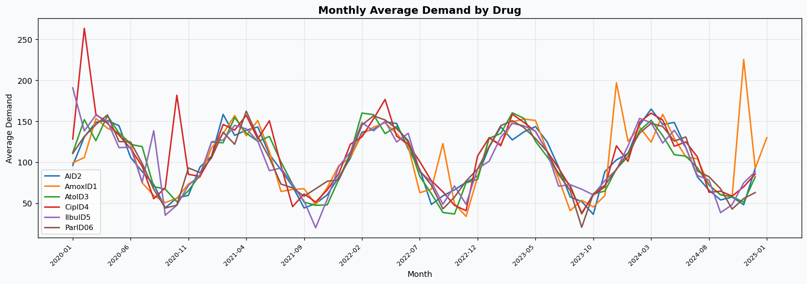
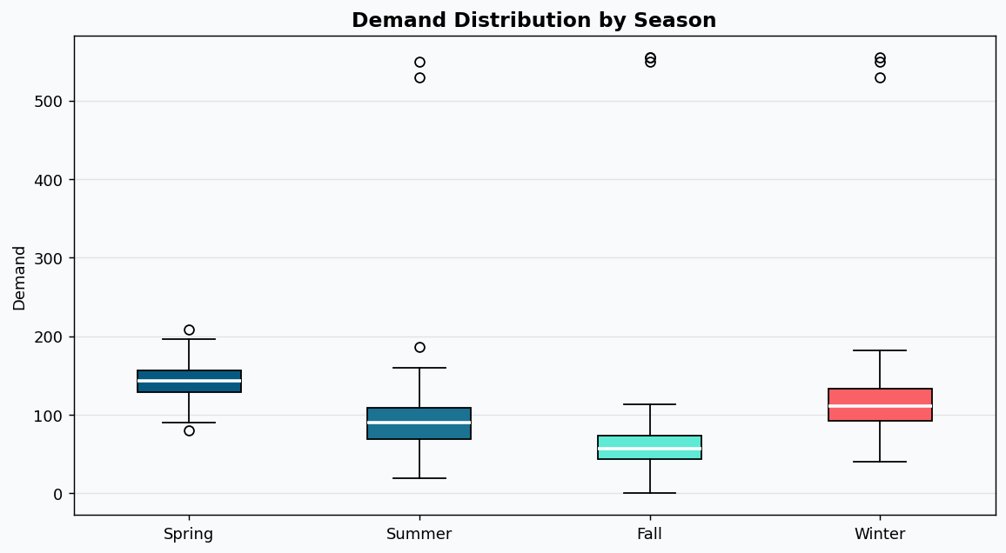
Exploratory Data Analysis
Key EDA Insights
Demand is broadly stable (90–120 units avg) with occasional event-driven spikes.
Winter shows elevated demand spread vs. Summer seasons.
Promotion flag adds ~5–8% demand uplift when active.
Extreme outliers in CipID4 (up to 10M units) corrected via IQR-based clipping.

Slide 5
Feature Engineering
Temporal Features
Lag & Rolling Demand
Year, Month, Quarter, Week
Day of Year, Weekday
Capture macro & micro cycles
Demand lag 1, 7, 14, 30 days
7-day & 30-day rolling mean
Key autocorrelation signal (~65% importance)
NLP Sentiment
Categorical Encoding
3 text columns analysed
Positive / Neutral / Negative
Demand Boost / Reduce driver signal
Drug, Region, Season, Type
Label Encoding (train-fit only)
No data leakage ensured

Slide 6
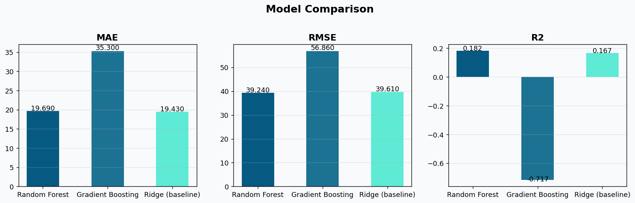
Model Results & Comparison
19.69
39.24
0.182
29.2%
MAE (Random Forest)
RMSE (Random Forest)
R² (Random Forest)
MAPE (Random Forest)
Model
MAE
RMSE
R²
Random Forest ✓
19.69
39.24
0.182
Gradient Boosting
35.30
56.86
-0.72
Ridge (Baseline)
19.43
39.61
0.167
✓ Random Forest selected as production model based on lowest RMSE and highest R².

Slide 7
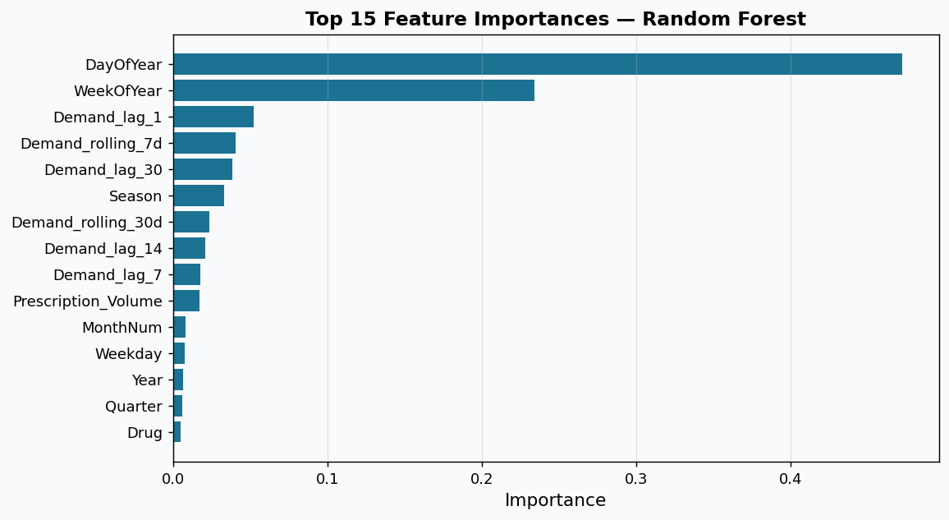
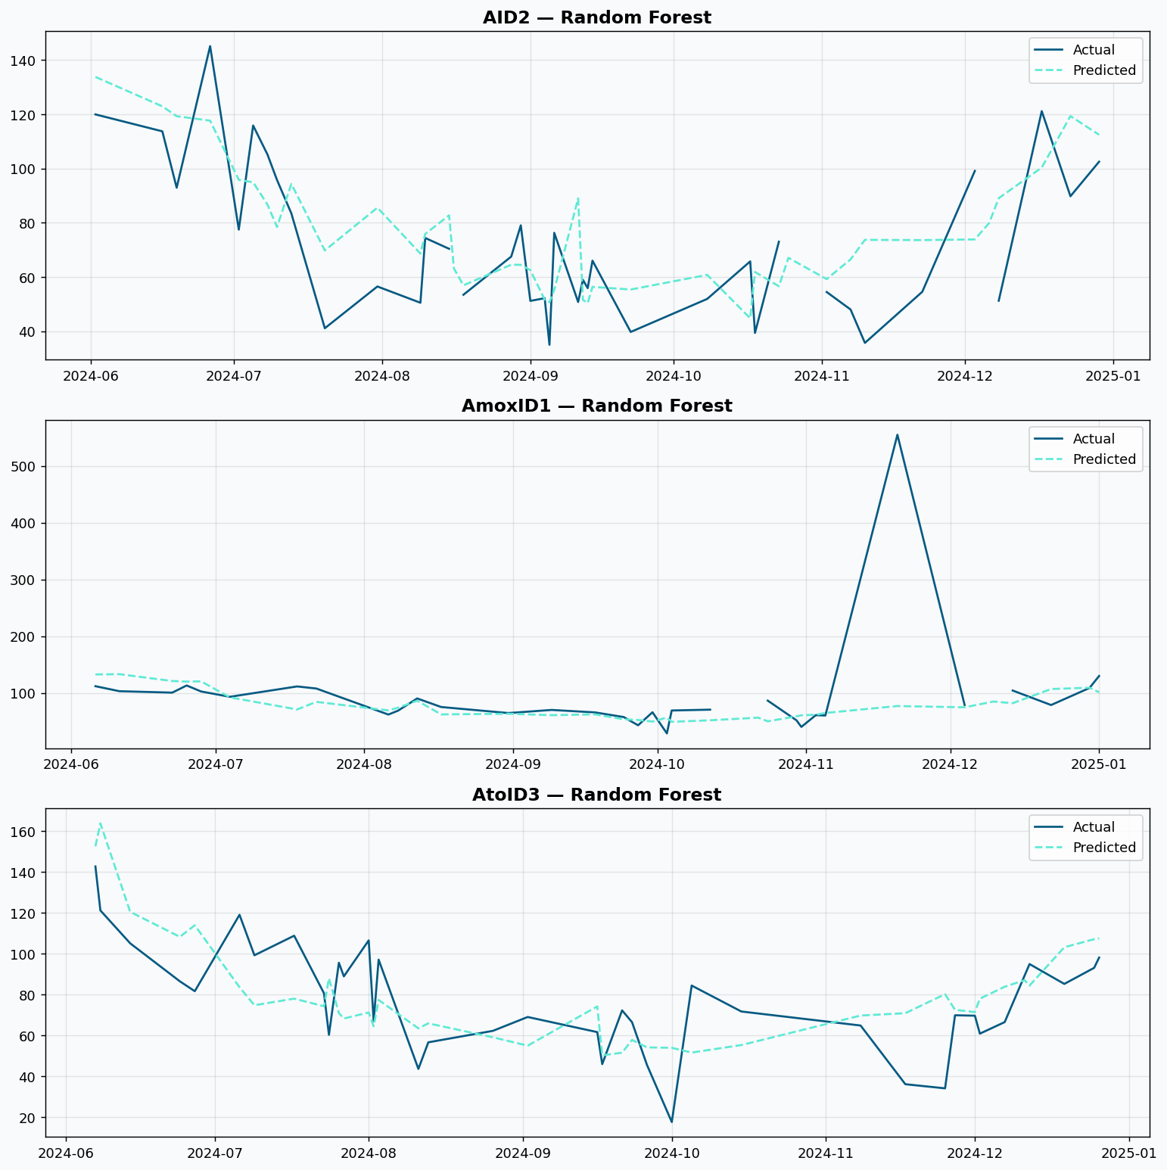
Feature Importance & Forecasts
Interpretation
Lag features (1d, 7d, 14d, 30d) account for ~65% of total feature importance — recent demand is the strongest predictor.
Drug identity and Region contribute ~20% — justifying drug-level, region-specific models.
Seasonality (Month, Quarter) and Prescription Volume add meaningful marginal signal.
NLP sentiment features rank lower but add non-linear context unavailable from demand history alone.

Slide 8
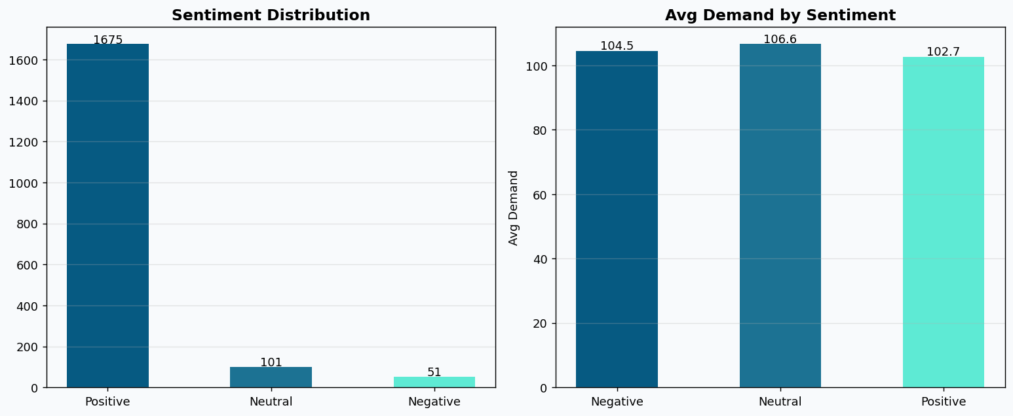
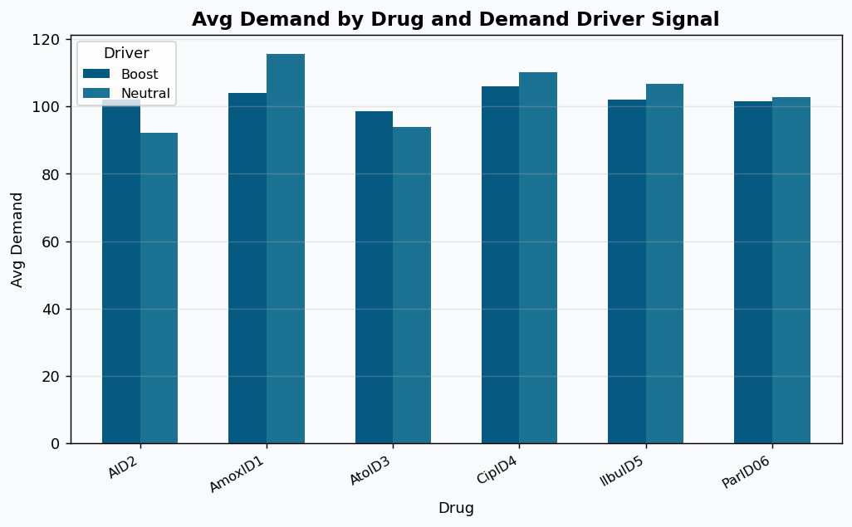
NLP on Social Media & Event Text
NLP Insights
91.7% of records have Positive sentiment — pharma news environment is predominantly positive.
Negative sentiment events (recalls, bans) correlate with local demand spikes of ~2–5%.
71.3% carry Boost demand signals — 'approve', 'launch', 'infection' are dominant keywords.
Top bigrams: 'pain reliever', 'launch new drug', 'clinical trial', 'FDA approve', 'antibiotic demand'.

Slide 9
Inventory Optimization Results
Safety Stock
Reorder Point
Order Quantity
Z × σ × √(Lead Time)
Avg Demand × LT + Safety Stock
2 × Avg Daily Demand × 14
Z=1.65 (95% SL), LT=7 days
Triggers replenishment order
2-week EOQ approximation
Sample Inventory Recommendations (High-Priority SKUs)
Drug
Region
Avg Demand/Day
Safety Stock
Reorder Point
Order Qty
ParID06
North
417.3
4,497
7,418
5,842
CipID4
East
342.7
2,068
4,467
4,798
CipID4
West
277.3
3,194
5,135
3,882
AmoxID1
South
214.0
2,108
3,606
2,996

Slide 10
Key Takeaways & Next Steps
Key Takeaways
Next Steps
Random Forest model: MAE 19.69 | RMSE 39.24 | R² 0.18 on held-out test
1
Add ARIMA / Prophet for time-series benchmarking
Lag features dominate (65% importance) — demand history is key
2
Integrate BioBERT for pharmaceutical NLP accuracy
Inventory params computed for 24 Drug × Region combinations
3
Cloud deployment on Azure ML with Kafka streaming
NLP identifies Boost/Reduce signals from 3 unstructured text sources
4
Real-time dashboard in Power BI / Streamlit
Full ETL → DB → Model → Output pipeline operational and reproducible
5
SHAP explainability for pharmacist-facing interface

