Slide 1

Detection of Malicious URL using Deep LSTM Neural Network
Chaitanya Varma
10538971

Slide 2
What is Malicious URL?
A URL link that is created with the purpose of promoting scams, attacks and frauds.
The most common scams with malicious URLs involve spam and phishing.

Slide 3
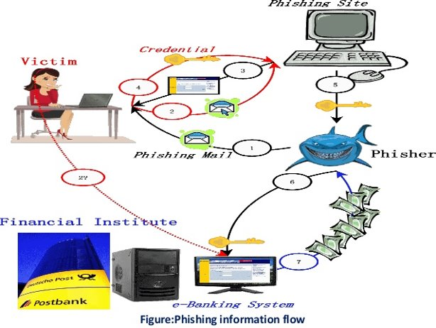
How does this Happen ??

Slide 4




Various Malicious Websites
Trojan Downloads
Spam Advertising Goods
Phishing : Which one is real ?

Slide 5
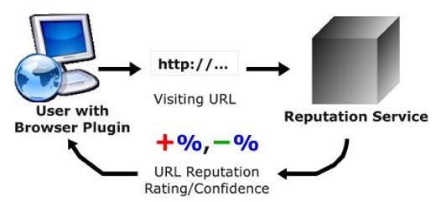
What we Need ?

Slide 6
Dataset Description
URL reputation dataset taken from UCI Machine Learning repository.
Contains 2.3 million number of samples with 3.2 million number of features.
Classifiy the URL as Malicious or benign.

Slide 7
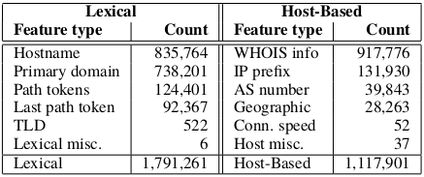
Features of Dataset

Slide 8
Existing Solutions :
Black List Methods.
Heuristic Apporaches

Slide 9
Disadvantages of Black List Methods
Tough to maintain an exhaustive list of all possible malicious URLs.
1
It is impossible to detect the new URL’s which are generated everyday.
2

Slide 10
Disadvantages of Heuristic Approaches
Designed for limited number of common threats.
1
It cannot generalize all type of attacks.
2

Slide 11
Literature Review
Justin Ma et al applied various batch processing methods using machine learning and trained over a small dataset.
In their other paper, They considered the online algorithms to detect malicious URLs.

Slide 12
Literature Survey
Doyen Sahoo and their team used content based features along with lexical and host based feature to detect malicious URL.
Frank Vanhoenshoven address the detection of malicious URLs as a binary classification problem and study the performance of several well-known classifiers, namely Na¨ıve Bayes, Support Vector Machines, Multi-Layer Perceptron, Decision Trees, Random Forest and k-Nearest Neighbors.

Slide 13
Limitations
High rate of False positive and false negative prediction values have been found
01
Only a small subset of data have been taken into consideration
02
More accurate algorithms are required for classification
03

Slide 14
Research Questions
How efficiently Deep LSTM neural network reduces the false positive and false negative prediction rate and improves the model performance?
Does high accurate machine learning algorithm requires, high amount of time to train the model ?

Slide 15
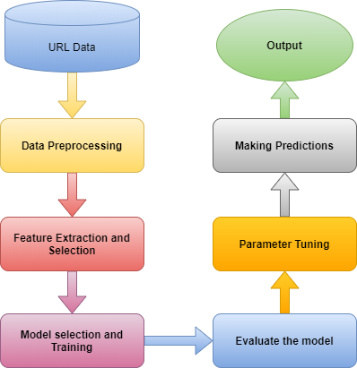
Proposed Methodology

Slide 16
Models implemented
Logistic regression (LR)
Support Vector Machine (SVM)
Naïve Bayes (NB)
Random Forest (RF)
LSTM Neural Network

Slide 17
Performance Metrics
Precision
Recall
F1-Score
Accuracy
Training Time

Slide 18
Implementation & Setup
Operating system : Windows
Main Memory : 8GB (DDR4)
GPU : Ryzen 5 2400G
Hard disk : 30GB
Programming Language : Python
Libraries used : Keras, pandas, numpy, matplotlib and scikit-learn

Slide 19
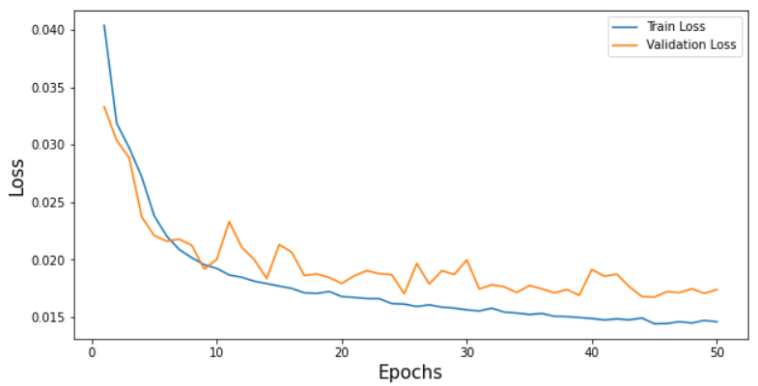
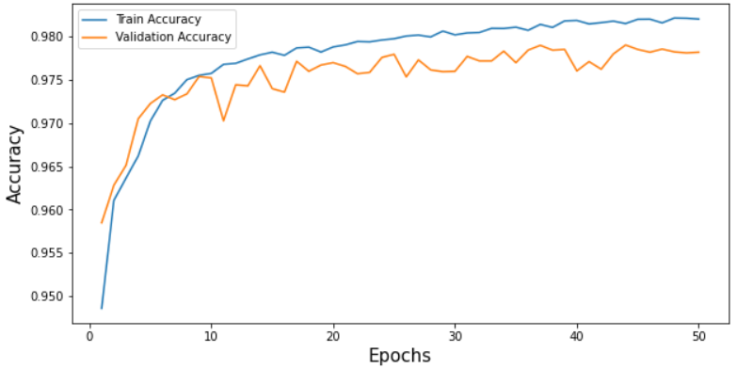
Results and Evaluation (LSTM Neural Network)
Loss graph for LSTM neural network
Accuracy graph for LSTM neural network

Slide 20
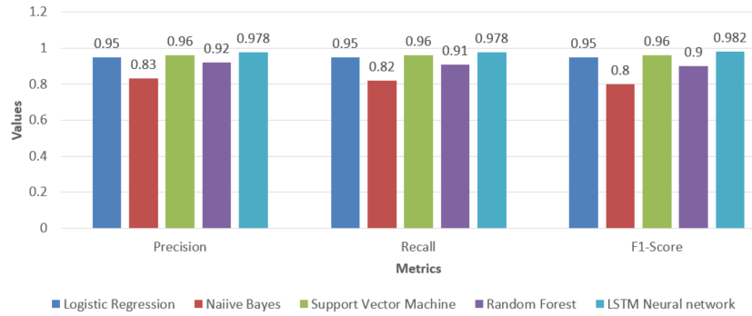
PRF Comparison Graph

Slide 21
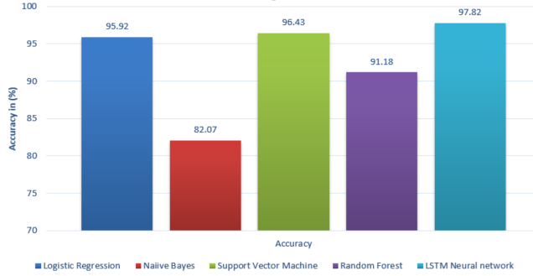
Accuracy Comparison Graph

Slide 22
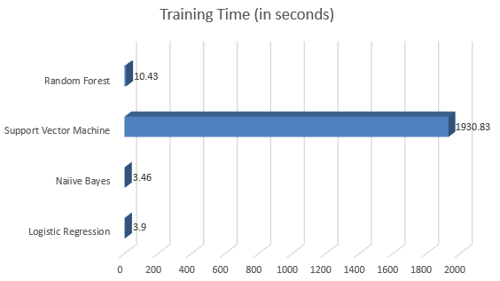
Training Time Comparison Graph
Note : The training time of Deep LSTM neural network depends on the number of epochs. Therefore, it has not been considered

Slide 23
Conclusion
Using LSTM Model a higher accuracy of 97.82% has been achieved. With high precision and recall rate
Among machine learning algorithms, logistic regression is an efficient algorithm.
SVM algorithm Takes higher training time, As high number of Support vectors increases the complexity of model.
Its not necessary that, high accurate results requires high training time, it depends on individual algorithm architecture and resources capability.

Slide 24
Future Work
As the URL data is generating at a faster rate. Relying on single machine or server for production use is not a feasible option.
Combination of different deep learning models can be explored and results can be compared.
Scalable solutions such as Hadoop and spark can be utilized for large datasets.

Slide 25
Thank You

