Slide 1
CLR/CoreCLR How We Got Here & Where We're Going
Mei-Chin Tsai
Jared Parsons
Notes:
Mei-Chin introduction slide

Slide 2










Your platform for building anything
DESKTOP
WEB
CLOUD
MOBILE
GAMING
IoT
AI
.NET
Notes:
This slide shows you our goal and journey. We want to be your platform for building anything.
We started as desktop workload where internet barely exist. We enabled Web/cloud such as our ASP.NET workload. Mobile and Gaming was the next wave. We are now working on enabling workloads like IoT and AI.
Developer knowledge and skillset are asset. .NET is a general purpose programming platform that enables all kinds of scenarios. Once you learn one, you can easily pick up another.

Slide 3
Innovating on Desktop (Full .NET) is hard
.NET Framework installed on one billion machines
Every change is a compat risk
Forces a slower pace of innovation
Notes:
Full .NET is machine wide. It ships with Windows and service with Windows. It has a push model for servicing. When update happens, everyone gets it. Billion machines get the change. Regardless if change are relevant to you or not.
Unfortunately, this put App and framework into situation where they are serviced separately. When you built your app, you tested it on your machine and shipped it happily. However, you don’t get to test your app when we service our framework. You just get the change. If you are not compatible with our change, there is no opt-out.
And compatibility is hard….
A couple examples on why compatibility is hard –
We changed the Array.Sort implementation.
Array.sort moved from quick sort to introspection sort. Really there should be no change here other than perf: neither sort is stable. But at the same time they were unstable in different ways. This caused subtle ordering changes, found different invalid comparers. In one case a Windows Form control ended up appearing upside down.
StackTrace performance is degraded…
This put a high bar on any change that we are putting into Full .NET.
Shipping with Windows also put us into a slow shipping cycle with high overhead.

Slide 4
But… we really need to innovate. Just look at modern workload diversity
Servers with 128 cores vs Raspberry pi
Long running processes vs short running services
Strong reliability guarantee vs aggregated fault tolerance
What should we optimize for?
Notes:
World keeps changing. It is no longer just a desktop or just a server.
What do we optimize for? Many different factors.
Startup/Throughput/Latency
Size in memory, size on disk, size over wire
Network speed?
Power efficiency
And more

Slide 5
Needs for the runtime
Cross platform deployment
Open source
Give customer choice
Application local
Side by side installations
Innovate fast and ship fast
Notes:
Many of our existing partners and customers were looking into Linux. We must have a story on Linux. Or we will lose our customer base.
To make our Linux story creditable, open source is a must.
We must take what we learned from desktop and not repeat the same mistakes.
With what we learned from full .NET, the new solution must give developers choices. Choices on deployment. Application will not break underneath them after shipping.
World is changing fast. We need to be able to innovate and ship fast to be relevant.
With that, I will pass the talk to Jared. He will share our .NET Core Journey.

Slide 6
How We Got to .NET Core

Slide 7


.NET Open Source Journey
.NET
2001
ECMA 335
2008
ASP.NET MVC (web platform) open source
April 2014
.NET Compiler Platform (“Roslyn”) open source
.NET Foundation founded
2016
Mono project joins .NET Foundation
June 2018
.NET Core 2.1 released
2002
NET 1.0 for Windows released. Mono project begins
Aug. 2017
.NET Core 2.0 released
Nov. 2014
.NET Core (cross-platform) project begins
Notes:
As Mei-Chin noted one of our priorities was creating a sustainable OSS community. Here is a timeline of the .NET ecosystem OSS Journey. As you can see it stretches back long before we began work on .NET Core.
The ECMA specification for the .NET runtime was released way back in 2001. The .NET 1.0 release followed shortly after. At the same time ECMA spec gave others the ability to create their own .NET implementations. Even though Microsoft built the first .NET Framework for Windows-only, the spec was intentionally portable across OSes and chipsets. The Mono project began, spearheaded by Miguel de Icaza, with the goal to implement Microsoft's new .NET development platform on Linux and Unix-like platforms
In 2008 ASP.NET MVC went open source. This was the first application development framework from Microsoft to be released as open source. Yet the underlying runtime and compilers were still closed however. So the ability to fundamentally change thngis was a bit limited.
In 2014 is when the .NET Core journey began. At Microsoft’s BUILD conference we released the C# compiler as OSS on stage. Later in November, .NET Core project begins in the open.
Since then we’ve been building on this foundation. We’ve continued to release the core parts of .NET in the open. In 2016 Mono joined our .NET Foundation. Since then we’ve continued to deliver releases of .NET Core in the open.

Slide 8
Stubbing our toe
C# compiler goes “OSS” on CodePlex
Source Open not Open Source
Roslyn team still worked primarily in TFS
Only 1/3 of the code base was available
Regularly pushed updates to CodePlex
Results were mixed
Did receive a number of PRs
No sustained contribution
Notes:
https://blogs.msdn.microsoft.com/dotnet/2014/11/12/net-core-is-open-source/
C# was our first project that was OSS as part of our CoreCLR journey. A few other projects had gone open before but this was our first complete product that was a part of the core developer toolchain and focused on .NET Core efforts. But it was only the compiler that we put in the open. The rest of the C# experience, Intellisense, debugging, refactoring, etc …. Were all still closed as well as their tests.
The day to day life of a Roslyn developer was still in TFS: development, code reviews, tests and process were all internal. The only visible activity the team had on CodePlex was our commit history when we pushed changes fro mTFS to CodePlex. That is when we remembered to actually publish it. The push was not automated but rather a script that we manually ran. So the community did get updates, but only when we remembered to push the button.
Having the code and history available is certainly valuable but it’s not fostering a vibrant community of contributors. Yes we did get a number of PRs from the community. But these were providing small bug fixes and document updates. Often times the PRs were simply incomplete because they couldn’t see or fix the Visual Studio parts of the code base. Hence these PRs actually ended up creating work for us because we had to merge them, then do the fixup work in the IDE before we could push them to the main branch. Definitely not an ideal situation.
The other problem this creates is the community sees everything on a time delay. By the time they see the code we’ve had the design debates, done the code reviews and everything is pretty much settled. These changes more or less end up getting dumped on the community. There’s no participation on their side, no opportunity to shift the debate or benefit from seeing our decision process.
Great to have community involvement but we’re not setup to get the type of contributions that are necessary to have sustained success in OSS.

Slide 9
Move to GitHub
This is where our customers were
Embraced living on GitHub
No more working in closed and pushing to open
All development done on GitHub
Work how you want your contributors to work
Learn the Github way
How to compose a product
Developer work flow
How to ship/service a product
Notes:
As we looked to making the .NET Core stack open source we decided that we needed to change our approach. What we were doing before was simply not sustainable.
The first step is moving from CodePlex to GitHub. There is a very simple reason for this: that’s where the community was. There were other Microsoft projects besides Roslyn on CodePlex and we all had the same lackluster community involvement. So instead of trying to get the community to move, and jump into new giant code bases, we decided to simply move to them. The .NET Core stack started this with the release of the CLR and CoreFX code bases and we quickly moved all of our other assets there too.
We didn’t stop at moving our community facing page to GitHub. We moved our entire operation over to GitHub. That meant everything from switching to Git from TFS (yay!), using GitHub for issue tracking, doing all of our changes through Pull Requests. This required a lot of investment on our part too. A lot of our engineers knew Git but there were plenty who didn’t. Also we had to build up a CI system from essentially scratch. This was doubly hard given all our teams were using a different system internally. We chose Jenkins because at the time it was the only one that met the needs of the entire .NET Core organization. Still though had to bring up the infrastructure around it, move all of our existing CI infrastructure over. The community got to wake up to a couple of splashy blog posts about .Net moving to GitHub. Behind the scenes though there was months of work.
At the same time we also moved all of our code into the open. This meant the community could see and participate in the entirety of our operation.

Slide 10
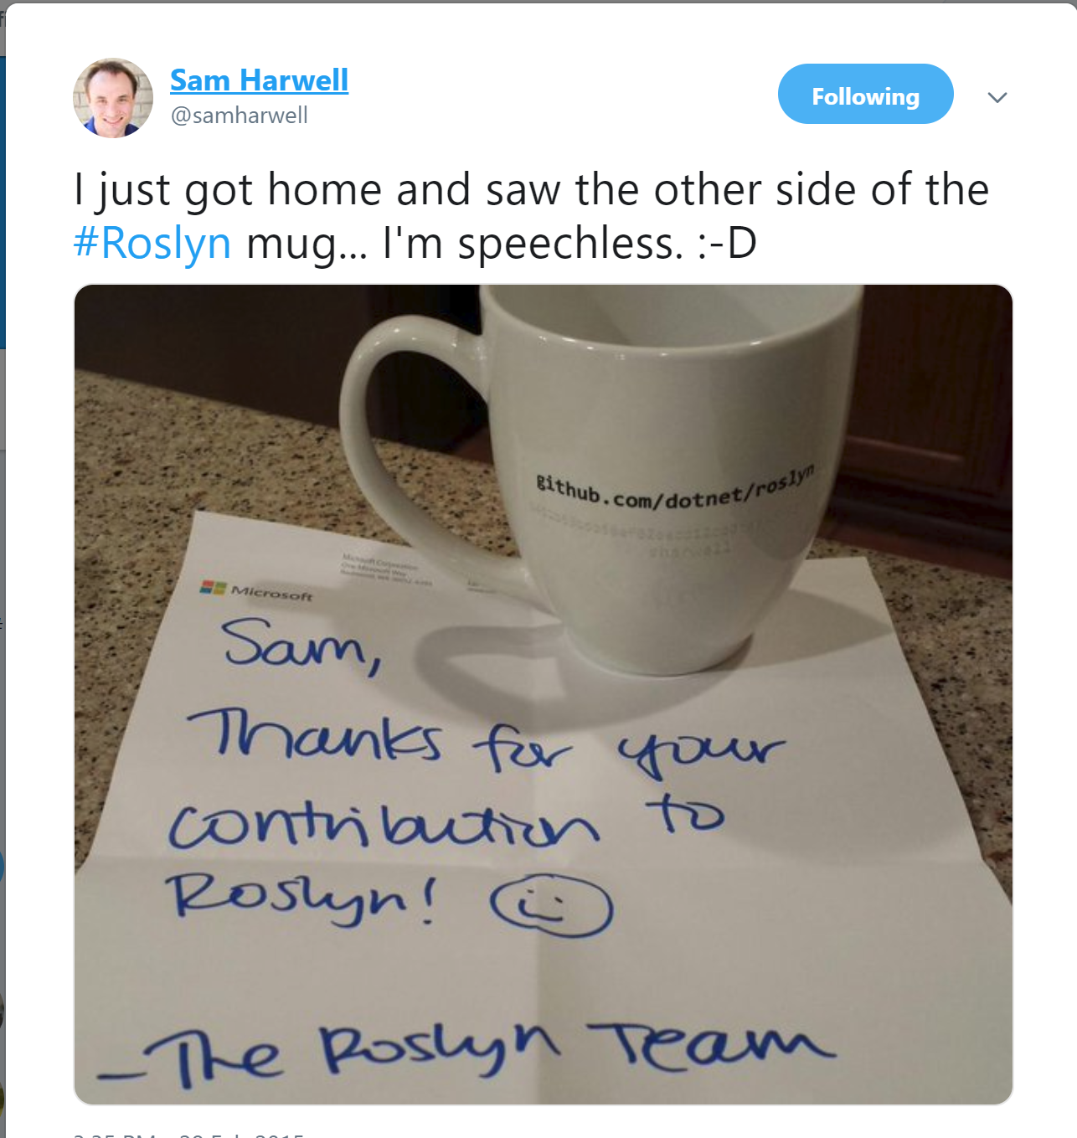
Thanking the community
Notes:
https://blogs.msdn.microsoft.com/dotnet/2015/07/02/thank-you-for-your-contributions/
One other thing we wanted to do was thank the community for coming with us on this journey. As we’ve talked about here it’s been a long journey. We wanted to show appreciation to the community members that came with us along the way.
So for about the first year of us being on GitHub we started sending out thank you mugs to contributors to our repository when they had a PR merged. The mugs were customized to have the GitHub user name and SHA1 of their commit on them. We didn’t tell anyone we were doing this but instead just sent them out quietly. As community members received them they started posting pictures of them on twitter. That generated a bit of a momentum for developers to get a PR merged before we ran out of them.
This was great at getting the community involved in our open source efforts and generating positive sentiments around our effort.
Transition: The question was whether or not this would generate the sustained contributions we felt were necessary to survive.

Slide 11

.NET Open Source Success
“Samsung is embracing .NET because it is a completely open source project.” — Samsung
".NET is open source; that allows us to contribute back to it if we have any performance issues which Microsoft review and together we make a better product.“ — Illyriad Games
20,000+ Community Contributions from 3700+ Companies outside Microsoft
Notes:
Looking at this chart it’s easy to see that we were able to succeed on that mark.
This slide actually has two different charts on it. In the foreground you’ll see the accepted PRs every monvth from the community since we’ve gone open source. This is not just a rush of developers trying to get a nice piece of swag. This is sustained effort and deep involvement from our community. At this point community PRs outperform FTE. Want to say that again: we get more PRs from the community than our FTE.
When we drill down and look at the specific repositories we can see individual contributors who’ve stuck with us and shown great growth over this time. On the C# compiler we’ve had one contributor, alrz, who started out with simple bug fixes and has slowly worked up to participating in C# language design meetings and submitting implementations of medium sized language features. We see this type of involvement all over the .NET Core landscape (even ended up hiring several contributors).
In the background what we have a hit map showing where our contributions are coming from. These are users who submitted a PR or created an issue in our repository. As you can see we’re getting lots fo contributions and we’re getting them from all over the globe. That’s really encouraging for us to see.
Overall we’ve seen companies taking a bet on .NET because it’s a completely open source project now. More than 20,000 contributors* from 3700 companies have contributed to .NET Core and related open source repositories, with over half of the contributions coming from outside Microsoft.
Transition line: all this OSS work was done so we could actually sustainably build .NET Core as an open product
Notes:
This data is from March 2018

Slide 12
.NET Core 1.X
Deliver a cross platform runtime: Windows, Linux and OSX
Slim down our runtime/framework
Flexible deployment
Open source
Notes:
.NET Core 1 was our first deliverable of our CoreClr runtime. The goals here were to:
Deliver a cross platform runtime for Windows, Linux and OSX. Particularly what we wanted to enable here is cloud workloads in Linux. This was one of our more motivating scenarios from our ASP.NET customers.
Slimming down our runtime and framework. Our starting point was a full desktop runtime and framework that included a lot of now deprecated technologies and crudgy old APIs. Some that just didn’t make sense in a cross platform environment. We removed those pieces, as well as removing a number of other APIs in order get our payloads smaller and make it easier to complete our port. Additionally having less baggage meant we could innovate faster in the future
.NET Core has a very flexible deployment story. It can be bundled with your application. Or multiple versions can be installed side by side for a particular user or machine.
https://blogs.msdn.microsoft.com/dotnet/2016/06/27/announcing-net-core-1-0/
https://blogs.msdn.microsoft.com/dotnet/2016/11/16/announcing-net-core-1-1/

Slide 13
Lessons Learned
Only new code can target 1.X
Trimmed down the API set too far
Porting existing applications extremely difficult
netstandard insufficient for writing portable applications
We went too far away from existing customers
.NET Standard 1.X not ideal for portable applications
Notes:
The version one release of .NET Core accomplished our main goals. It delivered on the cross platform promise and a number of teams and companies used it in production. At the same time it taught us a few lessons about what we needed to do going forward.
The first was that we trimmed down the API set too far. The provided API was very reasonable for creating new applications on .NET Core. But it was too different from .NET framework to enable porting applications and libraries over easily. It also caused a bit of frustration for .NET developers used to the API set offered by the full framework. They couldn’t take a lot of their understanding and intuition and use it to target .NET Core.
.NET standard is the portable target for .NET. When developers want to author code that runs on a variety of .NET runtimes like .NET Framework, .NET Core, Mono and Unity, the compile against the .NET standard API set. The initial .NET standard release had the same limited set as .NET Core. This meant it hurt developers ability to write portable code and move existing portable code to .NET standard.

Slide 14
.NET Core 2.X
Performance
Expand the API set
Developer tooling experience
Notes:
Looking to the second version of .NET we had a number of priorities.
The first was performance. After all one of the reasons we started this project was to have a platform for rapid innovation. Performance is one area we were eager to dig into 2.0. Particularly in areas that crossed the entire stack and would’ve been deemed too risky for doing in desktop.
We also wanted to close the API gap with the desktop framework. Needed to turn this from a source of friction when porting to a smooth experience.
There is also a focus on beefing up our developer tooling experience.
https://blogs.msdn.microsoft.com/dotnet/2018/05/30/announcing-net-core-2-1/
https://blogs.msdn.microsoft.com/dotnet/2017/08/14/announcing-net-core-2-0/

Slide 15
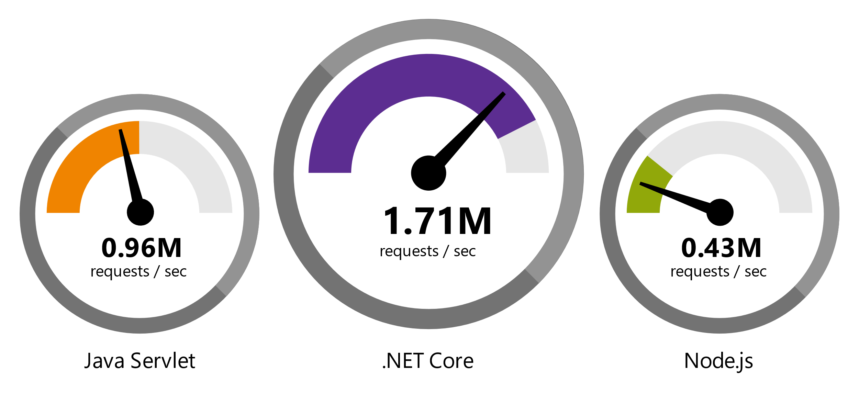
.NET Core 2 is Fast
Data sourced from official tests available at TechEmpower Round 14.
“Using the same-size server, we were able to go from 1,000 requests per second per node with Node.js to 20,000 requests per second with .NET Core.“ — Raygun
https://www.microsoft.com/net/customers
Notes:
Performance is definitely big focus for us in .NET Core. In the 2.0 release we made a lot of strides here. What this slide is showing is our performance on the techempower benchmark. Specifically this is from round 14. As you can see we’re a bit over twice as fast as Java Servlet and almost four times as fast as Node.js.
Customers are seeming similar wins in their real world applications. Raygun for example was able to go from 1,000 requests per second per node with Node.js to 20,000 with .NET Core

Slide 16
.NET Core 2.1 is Faster!
REQUESTS / SECOND
+12%
+11%
+123%
Data sourced from tests in our labs on same hardware as TechEmpower
Notes:
In the 2.1 release we’ve continued to make strides. This benchmark is an internal one we’ve developed but runs on the same hardware as TechEmpower. As you can see we were able to increase our plain text workload by 12%, our JSON workload by 11% and the Fortunes data access benchmark by 123%. This is good to see because it emphasizes that we’re pushing the envelope on every single release.

Slide 17
Expanding the API Set
.NET Standard 2.0
Brought back ~20,000 APIs
Supported on all the major .NET Runtimes
. Windows Compatibility Pack
Brings back additional ~20,000 APIs
Windows only and cross platform
NET Framework Compatibility mode
Target .NET Framework libraries on .NET Core
Notes:
One of our other focuses for the second release of .NET Core was closing the API gap. We wanted to make the platform feel more much natural for .NET Framework developers and at the same make it easier to port existing .NET assets onto .NET Standard or .NET Core.
As mentioned before .NET standard is what .NET developers target when they want to write portable libraries. In version 2 we brought back 20,000 APIs from desktop. This really lowered the bar for developers who wanted to write portable libraries.
Additionally we released the Windows compatibility package which brought a further 20,000 APIs back to .NET Core. This is primarily for Windows based development although some of the APIs do work cross platform.
These additions made .NET Core a much more comfortable platform for all of the developers coming from the desktop framework. It was now actually fairly easy to port existing libraries and code bases to target Net Standard and be portable. Or to simply go all the way to .NET Core.
https://blogs.msdn.microsoft.com/dotnet/2017/08/14/announcing-net-standard-2-0/
https://blogs.msdn.microsoft.com/dotnet/2017/11/16/announcing-the-windows-compatibility-pack-for-net-core/

Slide 18
.NET Core 3.X
Desktop workloads
WPF
WinForms
Runtime Innovation
Performance
Evolve language + runtime together
Notes:
Looking forward to version three there a couple of themes that we’re targeting.
The first is enabling desktop workloads. That is making it possible to author WPF and WinForms applications on top of .NET Core. Just as the runtime is side by side, so will be the UI frameworks. This means we can innovate in them without the back compat constraints that we face today. I don’t know if you’ve ever taken a peak into how some of the WPF controls are authored but they’re complex. Maintaining compat is hard.
The second is further innovation in the runtime. We’ve seen a lot of wins in version 2 from this work and we plan to keep moving on it in the future. Particularly in improving performance and evolving the language and runtime together.
Transition: We’ve talked a lot about our emphasis on performance. Wanted to take a bit of a deeper look at one of the features that was key to our performance story: Span<T>
https://blogs.msdn.microsoft.com/dotnet/2018/05/07/net-core-3-and-support-for-windows-desktop-applications/
https://blogs.msdn.microsoft.com/dotnet/2018/10/04/update-on-net-core-3-0-and-net-framework-4-8/

Slide 19
Allocations …
Leveraging the insight to various applications
Web request parsing code many allocations
Slicing on sub-region of buffer/text
Framework pushed developers into allocations
No common type between arrays, strings and unmanaged memory
Notes:
When looking at performance of managed applications one theme that . Allocations in managed code are cheap but not free. A short lived allocation is cheap the majority of the time but. Lets say you have a string that you call substring on in order to get a number that you can then pass to int.parse. Typically that allocation is a simple increment on a bump pointer. But there is always the chance that it will trigger a collection, possibly even a gen 2 collection which is relatively expensive. Often times improving performance of scale applications comes down to simply reducing allocations in critical paths: either by converting critical types to structs, using object pooling are changing hot paths to simply avoid them at all.
When looking across the ecosystem we saw a pattern of problems here: too many string and array allocations. There are a number of reasons for this, sometimes it was just that the customer had chosen an approach that forced a lot of allocations. In many cases though we found it’s because we were giving the customer little other choice. The .NET APIs as a whole prefer string and arrays as input parameters: int.parse, character encoding, string manipulation APIs, etc .... This mean the only way customers could use our APIs was to allocate these item. For example: This meant in order to parse a number out of a web request body of text you first had to allocate a string which you then immediately throw away. That’s fairly wasteful. There are examples of this up and down the stack.
Furthermore text based applications, like web sites, often deal with data in terms of strings and char[]. These types simply don’t mix. Hence when a customer wrote an algorithm that operated on text, they ended up having to allocate in order to convert one type to the other, or write the algorithm twice. Some even resorted to unsafe code and pointers to fix this and that says a lot about what position we were putting the customer in.
The individual allocations are small here but in aggregate can be quite expensive.

Slide 20
Span<T>
Block of contiguous memory
Unified representation of arrays, strings and unmanaged memory
Usability, performance and safety of arrays
Enables no allocation slicing
Safe array allocation on the stack
ReadOnlySpan<T>
Notes:
Span<T> is our solution to this. At it’s core it simply represents a block of contiguous memory. It’s a pretty simple concept but it’s also quite powerful. It is the unified representation for all of our existing contiguous memory types. No longer do I have to write the same API for string, character arrays. I can just write it once and feed both represetantions in.
It has the performance and safety of arrays. It still has bounds checks and the Jit will optimize it in the same way it optimizes array
It also enables no allocation slicing. Today if you have a string and you want to extract a portion of that string you really have no choice except Substring which forces an allocation. The same is true for arrays. Now with Span<T> I can just create a smaller Span<T> over the same memory and because it’s a struct there is no alloctaoin involved.
Due to the escape analysis we’ve done in the compiler you can actually allocate arrays safely on the stack. This is not some JIT optimization that comes along later. You can write code which declaratively allocates arrays on the stack. It’s all safe.
There is also a non-mutating version called ReadOnlySpan<T>. This is when you want to provide a view of memory but not allow any modifications

Slide 21
Span<T> Implementation
readonly ref struct Span<T> {
readonly ref T _pointer;
readonly int _length;
public ref T this[int index] =>...
}
Span<int> span = new int[42];
span[0] = 13;
Console.WriteLine(span.Length);
Notes:
It’s important to dig into the implementation of Span<T> to understand why we can get such a performance benefit out of it. The type is simply a reference and a length. For those who aren’t familiar with reference types, think of it as a safe pointer. Or simply: a pointer and a length. This is powerful though because that reference can refer to a string, array or even unmanaged memory.
This type though isn’t actually representable in C#. This is instead a runtime intrinsic type in much the same way arrays, strings, int and so forth are intrinsic. This code is a good approximation of how it works.
Being an intrinsic though allows the runtime to heavily optimize the type. This allows it to have the same performance characteristics and optimizations as arrays and strings do today. Hence moving your code to use a ReadOnlySpan<char> instead of a string can save you allocations without sacrificing any performance.

Slide 22
Span<T> example (1)
static (int, int) Parse(string line) {
var index = line.IndexOf(',');
var x = int.Parse(line.Substring(0, index));
var y = int.Parse(line.Substring(index + 1));
return (x, y);
}
Notes:
Here is a simple function that parses two numbers separated by a comma from a string. This is the type of function you’d write if you were for instance writing a CSV parser. The code here is pretty straight forward. Find the separator, then get the text of the numbers with SubString call and let int.Parse do the work. Then return the numbers back as a tuple.
But this code which is just converting existing text to numbers causes two allocations that are immediately discarded. Because it takes a string input it’s possible the caller was forced to allocate a third throw away string just to call this function. Again calling this once isn’t that problematic. But imagine you’re handling a file that is thousands of lines long and calling this for every single line. That starts to be meaningful.

Slide 23
Span<T> example (2)
static (int, int) Parse(ReadOnlySpan<char> line) {
var index = line.IndexOf(',');
var x = int.Parse(line.Slice(0, index));
var y = int.Parse(line.Slice(index + 1));
return (x, y);
}
Notes:
Using Span<T> we can remove all these allocations without having to change anything about the algorithm. The Slice method is returning a ReadONySpan<T> now instead of before when we allocated a string. This means our conversion is now allocation free. Additionally now that our input is a span as well it’s possible we could go to the callsites and find more opportunities to remove allocations by moving to Slice over Substring.
But there is nothing forcing us to go look at the callsites. String has a conversion to ReadOnySpan<char>. So all the existing callsites just continue to work with no changes here. This is great because I saved some allocations with a small targeted change and didn’t have go back and fix up a ton of call sites.

Slide 24
Span<T> is invocation across the stack
C#
Introduce the notion of ref structs
Escape analysis to allow safe use of stackalloc
CoreClr
Make Span<T> / ReadOnlySpan<T> an intrinsic
JIT gets same optimizations for Span<T> that it has for array
Framework
Add Span<T> overloads throughout the framework
Add conversions for string, ArraySegment<T>, arrays, etc …
Notes:
Span<T> is a great example of how we can innovate across the entire stack in order to enable productivity for our customers. Developing this feature and making it successful required that we change the entire stack to do so:
The C# language had to introduce new features: ref struct. This is necessary to provide memory safety for uses. Also it added escape analysis rules to ensure we could safely use stack allocated arrays in C#.
The Runtime had to introduce new intrinsic types: Span<T> and ReadOnlySpan<T>. This gave them the capability to optimize it in the same way that we optimize arrays.
The Framework had to provide new overloads of hundreds of APIs to take Span<T> thus removing the need for allocations further up the stack.
This allowed the framework and upstream applications, like Kestrel (the ASP.NET web server), to rebuild around this feature. They were able to remove huge amounts of unsafe code and lots of allocation. The result is those performance wins we were showing earlier.
Earlier we noted how hard it was to innovate on our desktop runtime. Deeply integrating a feature like Span<T> couldn’t be done there because it requires such whole sale change to be successful. Desktop just isn’t set up for that due to the compat constraints.
We’re not doing this now because Span<T> is some feature we discovered recently, I’ve actually been involved in experiments with starting almost eight years ago.We had a pretty good idea how much of a win we could get with this. The problem was even with the gains it was too risky to bring back to desktop. Now that we have CoreCLR though we have a vehicle where such innovation is possible and can be done rather quickly.

Slide 25
Performance PRs with Span<T>
https://github.com/dotnet/coreclr/pull/16994/files
Notes:
We’ve talked a lot about how we were able to use Span<T> to remove lots of unsafe code. I feel like you can’t really get across the magnitude of this without seeing the type of change I’m talking about. Lets take a look at some changes we made to use Span<T> in our string equals implementation.
Looking at this code you can see that it’s entirely pointer magic. There is also some hand unrolled loops, #if defs for different platforms. This is not being done to support anything fancy like doing case insensitive comparison. This is straight forward ordinal string comparison (the equivalent of the C function memcmp). This code was written in unsafe, with all these hand optimizations, not because it was fun but because it was the only way to do it efficiently.
Now with Span<T> we’re calling into a simple wrapper that compares a range of bytes. Gone is all the unsafe pointer usage. Back to the simple memory range comparison.
The best part is: the code got faster, not slower.
# string.equals is a workhorse of .NET applications

Slide 26
Performance .NET Core 2.0 vs 2.1
 | 2.0 elapsed | 2.1 elapsed | 2.0 allocations | 2.1 allocations
String.Equals | 16.16ns | 10.20ns | N/A | N/A
String.Split | 459.5ns | 305.2ns | 1,216B | 480B
String.Format | 196.1ns | 151.3ns | 128B | 80B
StringBuilder.Append | 6.523ms | 3.268ms | 3,992KB | 0KB
Int32.Format | 65.27ns | 34.88ns | 48B | 48B
Int32.Parse | 96.95ns | 76.99ns | N/A | N/A
BigInteger.ToString | 36.67us | 3.119us | 34.73KB | 3.27KB
https://blogs.msdn.microsoft.com/dotnet/2018/04/18/performance-improvements-in-net-core-2-1/
Notes:
String.Equals is just one of the many places we were able to take advantage of Span<T> in the .NET Core stack. It was actually used in a large number of places in our most primitive types.
Formatting and parsing is another place where .NET applications tend to have seemingly unnecessary allocations due to the tendency to allocation strings in sub operations. For example when printing an number into a string .NET tends to first convert the int to a string which is an allocation and then write it into the final string. Now with Span we can just have int write it’s representation into the final buffer without the intermediate allocation.
This table shows a number of the wins we were able to get using Span.
String.Equals got about 1/3 faster
String.Split got about 1/3 faster and removed 2/3 of the allocations
String.Format removed about 1/3 of the allocations
StringBuilder.Append got almost twice as fast and removed 100% of the allocations.
Int parsing and formatting both got significantly faster
BigInteger: sure this is a lesser used API but we’re able to get a 10X improvement in time and allocations
As you see there is a link at the bottom here to a blog post detailing a large set of performance improvements we made in 2.1. What I’ve listed here is the set which are done almost exclusively by taking advantage of Span<T>. There are many others listed in that post that are algorithm changes, JIT improvements, etc …
Transition line: Now these are all micro-benchmarks so it’s fair to wonder whether or not this will have a measurable impact in real world applications …
Data:
https://msdn.microsoft.com/en-us/magazine/mt814808.aspx
https://blogs.msdn.microsoft.com/dotnet/2017/10/16/ryujit-just-in-time-compiler-optimization-enhancements/
https://github.com/dotnet/corefxlab/blob/master/docs/specs/span.md

Slide 27
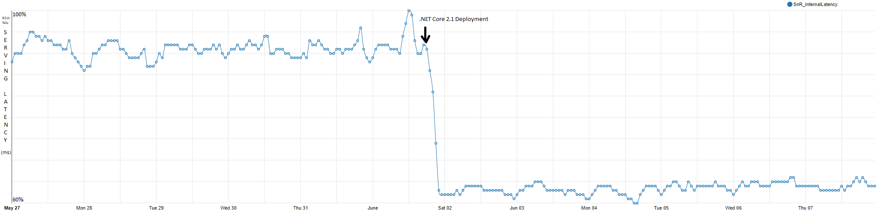
Bing.com on .NET Core 2.1
Notes:
The good new is that we are starting to get good data on that. Recently bing.com transitioned from running on the desktop framework to .NET Core. Latency is key to their success and they have really good measurements on it.
This graph demonstrates the latency improvements they found when they deployed 2.1 onto their existing infrastructure. The numbers are hard to see here but that represents a 34% drop in latency. The measurements behind this graph also tell us which fixes were most impactful to their scenarios. Turns out the single biggest contributor is the vectorization of string.equals and index.
As someone who did a lot of work on Span<T> it’s really satisifying to see this kind of impact in the real world. It continues to illustrate the value of making these small improvements at the bottom of the stack. They tend to have a ripple effect on the higher layers which implicitly depend on them.
Transition: now I’m going to step back and let Mei-Chin talk about where we’re going forward from here
https://blogs.msdn.microsoft.com/dotnet/2018/08/20/bing-com-runs-on-net-core-2-1/

Slide 28
Migration Wave
Bing front end SNR migration
PowerShell Core
Azure DevOps
Office Planner
Bing back end XAP start the migration
IoTEdge
Cosmos
More
Notes:
This gives us validation the work we did in .NET Core 2.0 was successful.

Slide 29






RayGun
"Using the same-size server, we were able to go from 1,000 requests per second per node with Node.js to 20,000 requests per second with .NET Core."
- John-Daniel Trask, CEO and Co-Founder
AstroReality, Quantum Technologies
"We think .NET Core is mature, very powerful, and a great choice for advanced modern apps."
- Zerlot Ma, Cofounder and CEO
Jet.com Inc.
"The event-driven, microservices paradigm eliminated a lot of the overhead that comes with a service-oriented architecture."
- Mike Hanrahan, CTO
Tencent
“The cross-platform capabilities of .NET Core were very important to us. Also, Microsoft designed .NET Core with a microservice architecture in mind, and that fits right in with our redesign plans.”
- Shanyou Zhang: Senior Software Architect
Age of Ascent, Illyriad Games
"Our game microservices are built using ASP.NET Core which gives us superior performance. ASP.NET is open source, that allows us to contribute back to it if we have any performance issues which Microsoft review and together we make a better product."
- Ben Adams, CTO and Co-founder
NetEase
".NET Core doesn't just help us get to market faster, it also enables our developers to focus on the core logic and what really matters, our players' experience. They don't have to deal with the communication gap and different ways of implementing the algorithm on the back and front end. They can just work on finding better ways to implement their ideas."
- Feng Zhou, Product Director
United Parcel Service (UPS)
"Xamarin allowed us to develop a single code base in C# and deploy the application to two completely different mobile phone ecosystems."
- Scott Hildebrand, Application Development Manager
GoDaddy
“Services can be developed more quickly, perform faster in production, and scale better if they’re written using .NET Core with C#.”
- Jeremiah Gowdy: Principal Software Architect
And many more: microsoft.com/net/customers
Notes:
Our customers have been embracing the productivity in our platform, languages and tools for 15+ years. We’re now gaining existing customers as well as new ones on our cloud-native, cross-platform, and device-native approaches with these new architectures. Here are just a few. There are many more (and their stories) on our website.

Slide 30
Where We're Going

Slide 31
Your platform for building anything
DESKTOP
WEB
CLOUD
MOBILE
GAMING
IoT
AI
.NET
Notes:
Remember when we started this talk? This is our mission and goal..

Slide 32
Tune CoreCLR for the future
Continue to delight our customers with productivity performance scalability reliability
Better cross language interop
More customizable
More configurable
Language/runtime innovation

Slide 33
Our mind set - always curious and experimenting
Arena allocator
CoreRT
UTF8String
WebAssembly
JIT optimization
More…
Notes:
Use data/evidence to support experiment ideas. Being a low level platform, we need to stay ahead o game or we will be obsolete. Use observation to form experimenting ideas. Observation from data, industry trend and more. Participating in emerging scenarios.
Experimenting turn into product – tiering jitting in addition to Span<T>/Memory<T>
Experimenting in our JIT optimization capability.
Many other managed heap experiments.

Slide 34
Experiment - Arena
Observing – transaction based work load
Hypothesis – when transaction is done, all transaction related data is no longer needed.

Slide 35
Arena API
Arena arena = new Arena();
using (arena.Activate())
{
// allocations now go into the arena
…
using (Arena.GCHeap.Activate())
{
// allocations go to GC Heap
}
// allocate from arena again
}
// allocate from GC heap again
arena.Dispose(); // delete the arena
Notes:
So, you can switch the current thread to allocate from an arena. Also, when allocating from an arena, you can temporarily switch back to allocating from the GC heap instead.
When Arena is being destroyed, the objects that survive Arena will be promoted.

Slide 36
Arena Status
Benchmark marking
A benchmark loads the same large XML file for over 1000 times as that many tasks.
1.6x faster
Validating with real world work loads
Validate customer/developer experience
Notes:
Arena Benchmarking– On HP Z240 workstation (Intel Core i7-7700 processor, 3.6 GHz), this runs in 34.6 secs with arenas and 55.3 secs without, for a perf gain of 1.6.
Loading the XML file causes about 100 MB of allocation. While the loading is going on, the GC can not cleanup much, but when it’s done, the whole data structure representing the contents of the XML goes away. The perf gain comes because the programmer can indicate when it’s a good time to clean up the memory.
Working with Bing’s back end to validate for real world work load. Will come to .NET Core as experiment. And will validate with more real world work load.
Challenge on Arena – pointers point into Arena that survive arena
Looking at P95 improvement

Slide 37
Experiment – CoreRT
An attempt to match C++ performance
Limited platform dependency
Ease of deployment
Small footprint on disk
Constraint execution environment
More at https://github.com/dotnet/corert
Notes:
It started as a dream to match C++ native code execution performance.
We want to know what is the smallest API surface areas that we need to depend on platform. The less that you depends on the platform, the more portable that a runtime is.
Single file to xcopy deployment.
Extremely small footprint where it might matter in IoT
Very suitable for Constraint execution environment such as Enclave and WebAssembly.
Very suitable for command line tools
It has been serving us as a technology brewing ground. We started with a stretch goal of matching C++ performance. This enables us to do a lot of learning. Having a simple runtime allows us to incubate ideas faster and fail faster. When concept is proven worthy, we will harvest it back to our mainline product. Small one like GC encoding, playing with codegen idea when there is no JIT. It is pushing ourselves out of comfort zone.
You are welcome to check out the repo and trying our your incubation ideas.

Slide 38
.NET Core
Mature runtime and framework
Cross platform
Open source
Customer choices
AppLocal vs side-by-side
Configurable
Customizable
Fast moving
It is the future .NET

Slide 39
Future is Bright.
.NET Growth Continues
Visual Studio
+1 million new monthly active .NET developers in last year
.NET Core
Over half a million .NET Core 2.0 developers
Notes:
If asked 3.6 for VS but only counting a few versions. Estimate there are > than 5.0 million total.
In the last year we have seen over half a million developers use .NET Core, the cross-platform, high-performance, implementation of .NET.

Slide 40
Questions?
Mei-Chin Tsai
meichint@microsoft.com
Github.com/MeiChin-Tsai
Jared Parsons
jaredpar@microsoft.com
twitter.com/jaredpar
Github.com/jaredpar
AMA –
.NET/.NET Core AMA
11/7 2:55pm
Ballroom C

