Slide 1
How to Build Production-Ready Microservices
Michael Kehoe
Staff Site Reliability Engineer

Slide 2
Today’s agenda
1 | Introductions
2 | Tenets of Readiness
3 | Creating Measurable guidelines
4 | Measuring readiness
5 | Key Learning’s
6 | Q&A

Slide 3
Introduction

Slide 4

Michael Kehoe
$ whoami
Staff Site Reliability Engineer @ LinkedIn
Production-SRE Team
Funny accent = Australian + 4 years American
Worked on:
Networks
Microservices
Traffic Engineering
Databases

Slide 5

Production-SRE Team @ LinkedIn
$ WHOAMI
Disaster Recovery - Planning & Automation
Incident Response – Process & Automation
Visibility Engineering – Making use of operational data
Reliability Principles – Defining best practice & automating it
Notes:
Michael
So we’re apart of a team at LinkedIn called Production-SRE
The key tenants of production-sre at LinkedIn is:
Assist in restoring stability during site-critical issues
Developing applications to reduce MTTD and MTTR
Provide direction and guidelines for site-troubleshooting
Build tools for efficient site-issue troubleshooting, issue detection and correlation
As this presentation goes on, you’ll notice how an Event Correlation system fits into these

Slide 6
What is a Production Ready Service?

Slide 7
Production-Ready Microservices
Susan J. Fowler
O’Reilly 2017

Slide 8
“A production-ready application or service is one that can be trusted to serve production traffic…”
SUSAN J. FOWLER

Slide 9
“… We trust it to behave reasonably, we trust it to perform reliably, we trust it to get the job done and to do its job well with very little downtime.”
SUSAN J. FOWLER

Slide 10
Tenets of readiness

Slide 11
Tenets of Readiness
1 | Stability & Reliability
2 | Scalability & Performance
3 | Fault Tolerance and DR
4 | Monitoring
5 | Documentation

Slide 12
Stability & Reliability

Slide 13

Tenets of Readiness
Stability
Stable development cycle
Stable deployment cycle
Notes:
In this context, stability is about having a consistent pre-production experience
Development
Continuous Integration with central code repo and code review
Reproducible builds
Unit/ Integration testing
Deployment
Simple repeatable deploys
Canary/ Dark Canary/ Staging
Canary testing

Slide 14

Tenets of Readiness
Reliability
Dependency Management
Onboarding + Deprecation procedures
Routing + Discovery
Notes:
Dependency management
Unreliability in microservices usually comes from either changes in inbound traffic or changes in behavior from downstream traffic
Knowing all of these and understanding impact matters
Onboarding/ Deprecation
Documented manner to start using API’s
Access Control
Best Practices
Deprecation
ACL/ Firewalls
Code Cleanup
Routing + Discovery
Is there a standard way to discover how to get to your service
Does your application have reliable health-checks
Does your load-balancer respect these
Circuit breakers/ Degraders

Slide 15
Scalability & Performance

Slide 16

Tenets of Readiness
scalability
Understanding growth-scales
Resource awareness
Dependency scaling
Notes:
Growth Scales:
How your service scales with the business goals/ metrics
How your application scales as it gets more traffic (how do you make it serve more traffic)
What resource “bounds” the application throughput
Resource Awareness:
What is your resource usage
What are your bottlenecks
Horizontal vs Vertical scaling (don’t do this)
Dependency Scaling:
Going back to reliability…how do your downstreams scale with your services growth

Slide 17

Tenets of Readiness
performance
Constant performance evaluation
Traffic management
Capacity Planning
Notes:
Performance
This is essential
Ideally should be done every time a change is made to the service (deployment/ AB flag)
Measure and report performance
Traffic Management
QoS
Scaling for bursts/ failover
Capacity:
This really ties everything together
Do you have the right numbers to know how many resources you’ll need in the future

Slide 18
Fault Tolerance & DR

Slide 19

Tenets of Readiness
Fault Tolerance
Avoiding Single Points of Failure (SPOF)
Resiliency Engineering
Notes:
SPOF:
In 2018, this really shouldn’t be a problem.
Hardware failures
Rack failures
Do the right thing early to avoid problems down the road
Resiliency Engineering
May be known as chaos engineering
Deliberately break your service to find weakpoints and look to make things fail more gracefully
Outages happen, be prepared for them

Slide 20

Tenets of Readiness
Disaster recovery
Understand failure scenario’s
Disaster Recovery Plans
Incident Management
Notes:
Failure Scenarios:
Understand what ways your service can break – resiliency engineering can help here if you’re ensure
Have plans to respond to these
Disaster Recovery:
For larger scale outages, what’s your plan
IM:
What’s the process to manage & respond to the outage
Gamedays are a great way to test this

Slide 21
Monitoring

Slide 22

Tenets of Readiness
monitoring
Dashboards + Alerting for:
Service
Resource Allocation
Infrastructure
All alerts are actionable and have pre-documented procedures.
Logging
Notes:
Dashboards:
Dashboards are for high-level system health
Not for regression validation
Monitor service/ resources/ infrastructure
All alerts should be actionable and have pre-planned responses
Anything other than this creates alert fatigue
Logging is an underrated aspect of software development. During resiliency testing, see what the logs say and if they’re helpful

Slide 23
Documentation

Slide 24

Tenets of Readiness
Documentation
Have one central landing-place for documentation for the service
Review of documentation from Engineer/ SRE/ Partners
Reviewed Regularly
Notes:
Documentation:
Possibly the hardest tenet to execute on
Should have one place for all documentation (wiki/ website etc)
Documentation should be peer-reviewed by Engineers/ SRE/ Partners
Everyone should be writing this documentation
All documentation should be reviewed every 3-6 months

Slide 25
Tenets of Readiness
Documentation
What should documentation include:
Key information (ports/ hostnames etc)
Description
Architecture Diagram
API description
Oncall information
Onboarding information

Slide 26
Creating Measurable Guidelines

Slide 27

Creating Measurable Guidelines
Not all guidelines directly translate into something measurable
You may need to look outcomes of specific guidance to create measurable guidelines
Notes:
Problem is general concepts of readiness is not something you can directly translate into something that’s True/ False and can be scored or measured

Slide 28
Creating Measurable Guidelines
Example
Stability:
Stable development cycle
Stable deployment process
Stable introduction and deprecation procedures
Notes:
Here is an example looking at the ‘Stability Tenet

Slide 29
Creating Measurable Guidelines
Example
Stable development cycle
Is the unit-test coverage above X %?
Has this code-base been built in the last week?
Is there a staging environment for the application?
Notes:
Here is some potential outcomes of implementing some of the stability concepts

Slide 30
Creating Measurable Guidelines
Example
Stable deployment process
Has the application been deployed recently?
What is the successful deployment percentage?

Slide 31
Measuring Readiness

Slide 32


Measuring Readiness
Why?
Standardization
Quality Assurance
Ensuring that services are built and operated in a standard manner
Ensuring that services are trustworthy
Notes:
So why measure readiness?
Readiness helps ensure two key outcomes
Standardization
One key concept Susan points out in the book is that services should be built in the same manner
QA
If we have built the service correctly, we should be able to trust that the service will be reliable in Production

Slide 33

Measuring Readiness
How?
Manual Checklists
Automated Scorecards
Create a manual checklist
Automate the discovery and measurement of readiness
Notes:
So how do we measure this.
Manual Checklists
This should work ok for a small number of services, but becomes very very difficult as you have increased agility and an increased number of services
Automated Scorecards
This is a great way to build a scalable, reliable set of checks that can be constantly updated and provide reporting

Slide 34

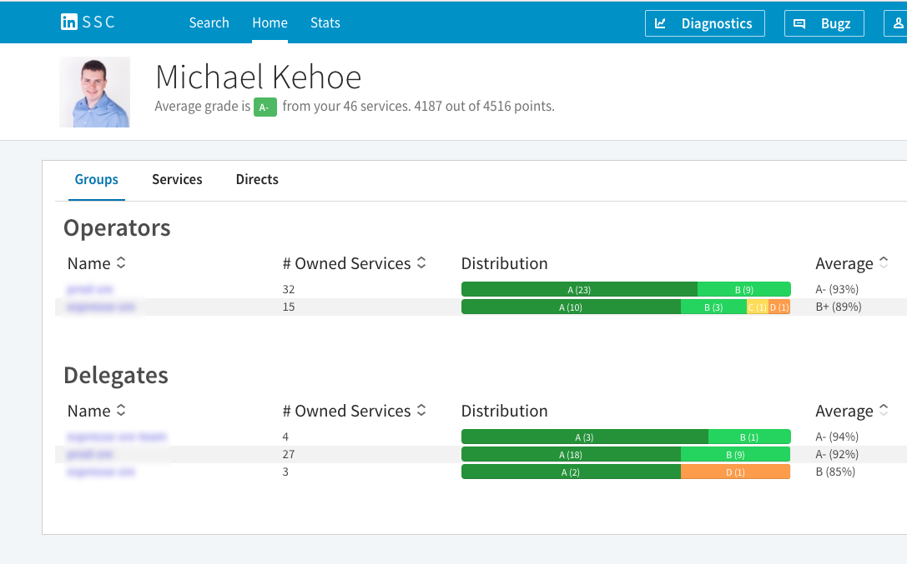
Automated Scorecards
Service Score Card
Automated Service Discovery
Breakdown of scores by team
Precise screen change for laptop: Select screen and go to inspector. Under the Arrange tab, note Size (10.81 x 16.03) and note Position (-0.6 , 2.23 – top left corner)
Make sure your new screen matches those numbers.

Slide 35
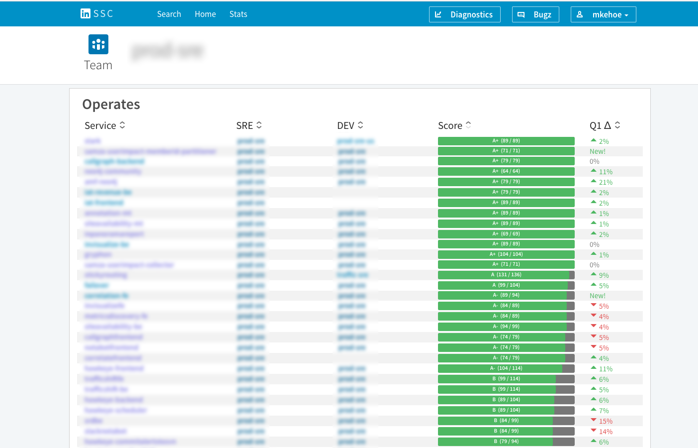
Automated Scorecards
Service Score Card
Team Overview
Precise screen change for laptop: Select screen and go to inspector. Under the Arrange tab, note Size (10.81 x 16.03) and note Position (-0.6 , 2.23 – top left corner)
Make sure your new screen matches those numbers.

Slide 36
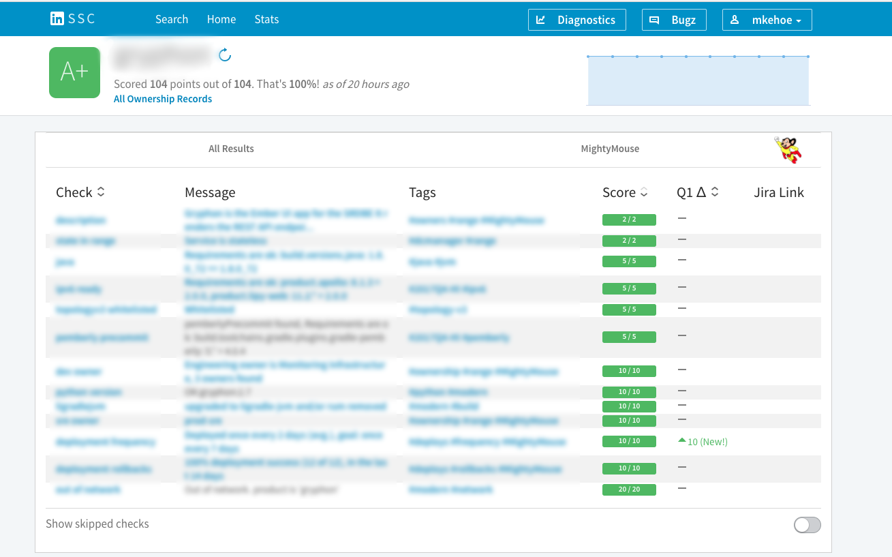
Automated Scorecards
Service Score Card
Breakdown of readiness results
Precise screen change for laptop: Select screen and go to inspector. Under the Arrange tab, note Size (10.81 x 16.03) and note Position (-0.6 , 2.23 – top left corner)
Make sure your new screen matches those numbers.

Slide 37
Key Learnings

Slide 38


Key Learnings
Create
Automate
Evangelize
A set of guidelines for what it means for your service to be ‘ready’
Automate the checking and scoring of these guidelines
Set the expectation between Engineering/ Product/ SRE that these guidelines have to be met
Notes:
Create:
First step is to agree on what your company defines as production ready
Automate:
I strongly suggest automating these checks
Evangelize:
Once you have everything in place, evangelize, set the expectation, make it apart of company culture

Slide 39
Q & A

Slide 40


