Slide 1
OMIS 652: Quick Bus - Online Bus Ticket Booking
Group: I
Yasaswani Gandi
Maneesha Avvaru
Chaitanya Swaroop Pokuri
Hemanth Tummala

Slide 2
Objectives
Abstract
Entities
Assumptions
Entity Relationship Diagram (ERD)
Database Diagram (Mapping)
Queries

Slide 3
Abstract
Online Bus booking system provides the facility to the passengers to book the tickets for buses that operate between cities Chicago, Rockford, Naperville etc. A passenger can book tickets by logging in with their username and password after which the booking information with such as Booking_Id , Bus number , Date of journey , Source and Destination , number of passengers travelling are displayed. Each booking has a payment mode which can be either a Credit or Debit card.
Each Bus has a unique bus number, rating, number of seats along with the driver details included . A bus can operate in multiple scheduled times having Departure and Arrival time information and each schedule for the bus is associated with specific route details such as Route_Id and fare. Every Route has different stops in each city. Every Stop is represented with Stop_Id , stop name in the cities Rosemont, Jackson, Naperville and Dekalb.
This system also provides the facility for passengers to talk to customer representative regarding any queries or complaints. Each representative has a unique Rep_Id working each under different departments such as Booking, Payment, Front desk, Cancellations and Feedback & Complaints.

Slide 4
Entities
Login
Login_Passenger
Passenger
BookingInfo
Payment
Bus_Info
Driver
Schedule
Route
Route_Stop
Stop
Rep_Passenger
Representative
Department

Slide 5
Assumptions
Each User Credentials belong to one and only one passenger.
A Passenger can have many login credentials.
A Representative belong to one Department and a department can have many representatives.
A passenger can book tickets any number of times.
Each Booking_Id has a unique payment information.
A Booking Info contains the details of one bus.
A Bus has a driver and a driver can ride one or many buses.
A Bus can have many schedules and a schedule belong to one bus.
A Route_stop can contain information of one route and a route can be included in zero or many Route_stop.

Slide 6
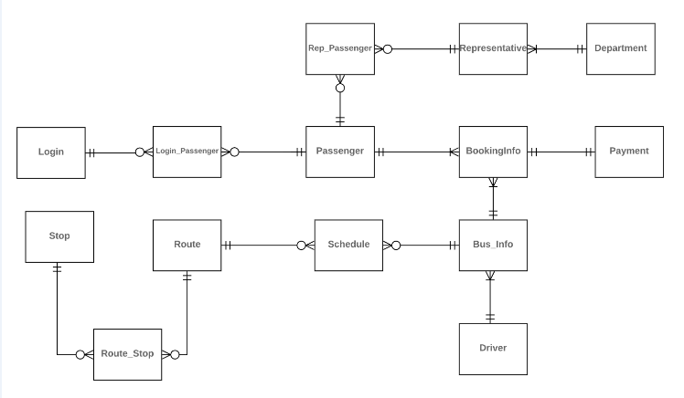
Entity Relationship Diagram

Slide 7
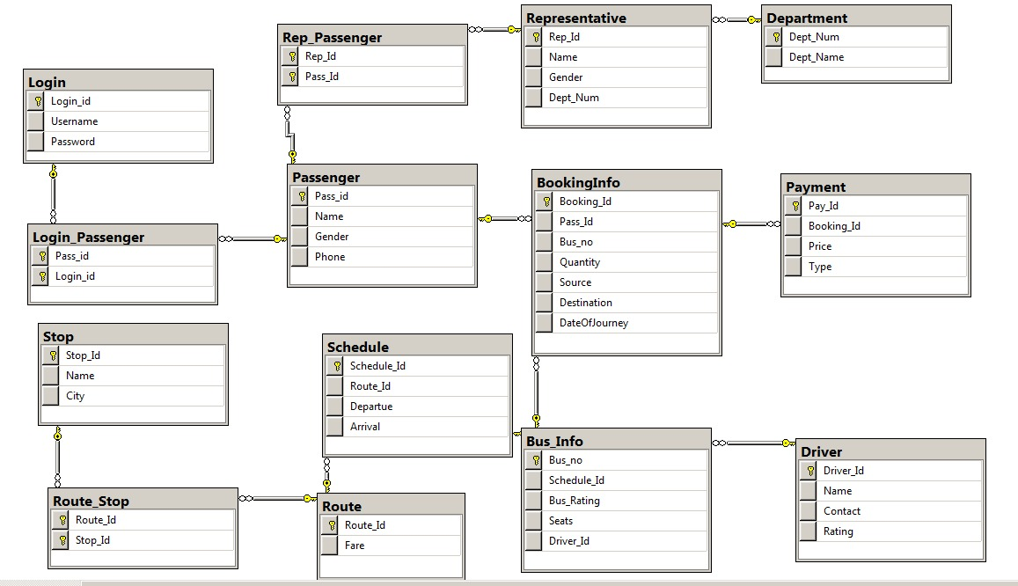
Database Diagram

Slide 8
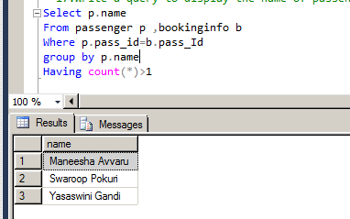
QUE#1: Write a query to display the name of passenger who made multiple booking

Slide 9
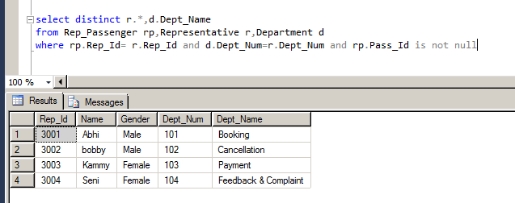
QUE #2: Write a query to display all the representative details (Rep_Id,Name,Gender and their Department Name) who are contacted by Passengers having non zero ids

Slide 10
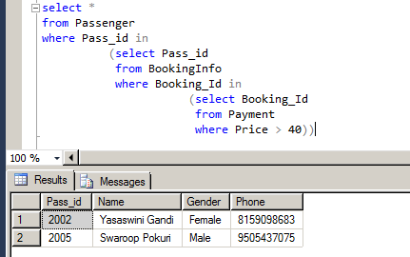
QUE #3:Display the passenger details who paid the price more than 40

Slide 11

QUESTIONS

Slide 12
THANK YOU

