Slide 1
OMIS 651 PROJECT NIU STUDENT EMPLOYMENT WEBSITE
Team Members:
Yasaswani Gandi (Z1852719)
Chaitanya Swaroop Pokuri (Z1853880)
Venkata Vijay Bhaskar Bommakanti (Z1869592)
Chizoba Ohalete (Z1856424)

Slide 2
CONTENTS
Introduction
Current System
Use Cases
UML Diagrams
User Interfaces
System Acquisition Strategy
Transition Strategy
Test Plan

Slide 3
INTRODUCTION
NIU Student employment portal
Provides variety of job opportunities for on-campus employment.
Accessed through https://jobs.niu.edu/ServiceAreas/StudentEmployment/JobSearch.cfm

Slide 4
CURRENT SYSTEM
CHALLENGES
No student consent before applying for a job.
Duplication of application.
No option to upload documents.
Tedious process to update student’s schedule.
No option to filter the jobs.

Slide 5
USE CASES

Slide 6
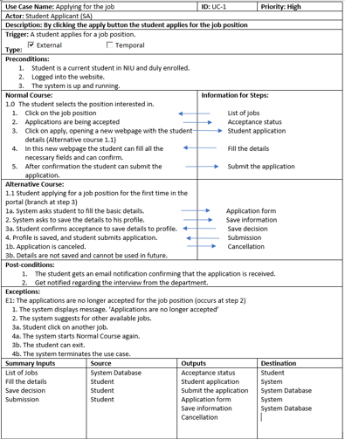
USE CASE – Apply for a new job

Slide 7
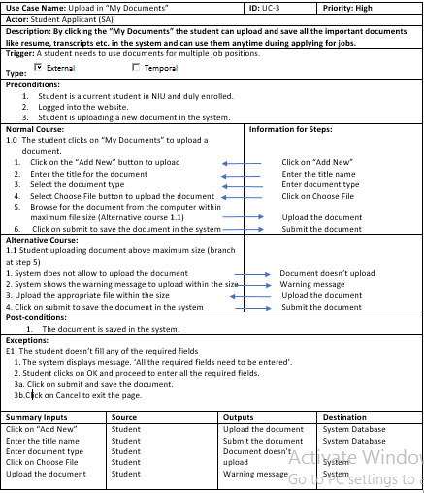
USE CASE – Upload documents

Slide 8
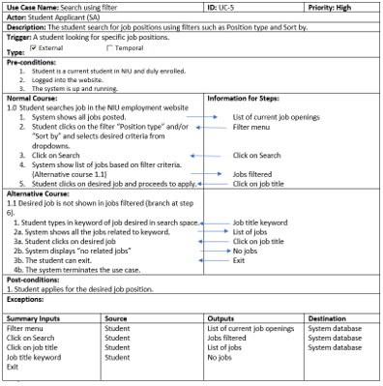
USE CASE – Search with filter

Slide 9
UML DIAGRAMS

Slide 10
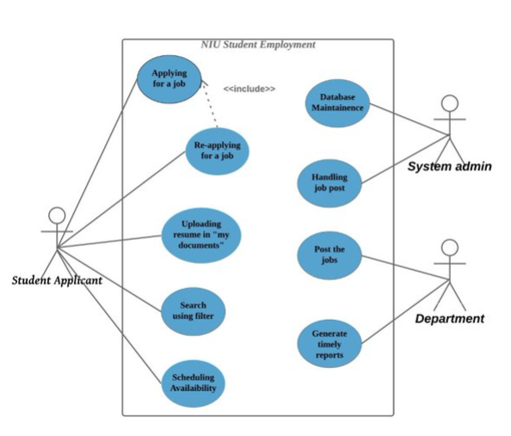
Use Case Diagram
Notes:
System admin- database management
website maintenance
handles a job post

Slide 11
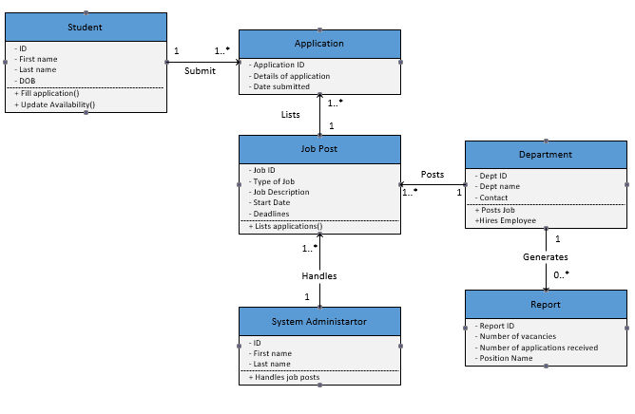
Class Diagram

Slide 12
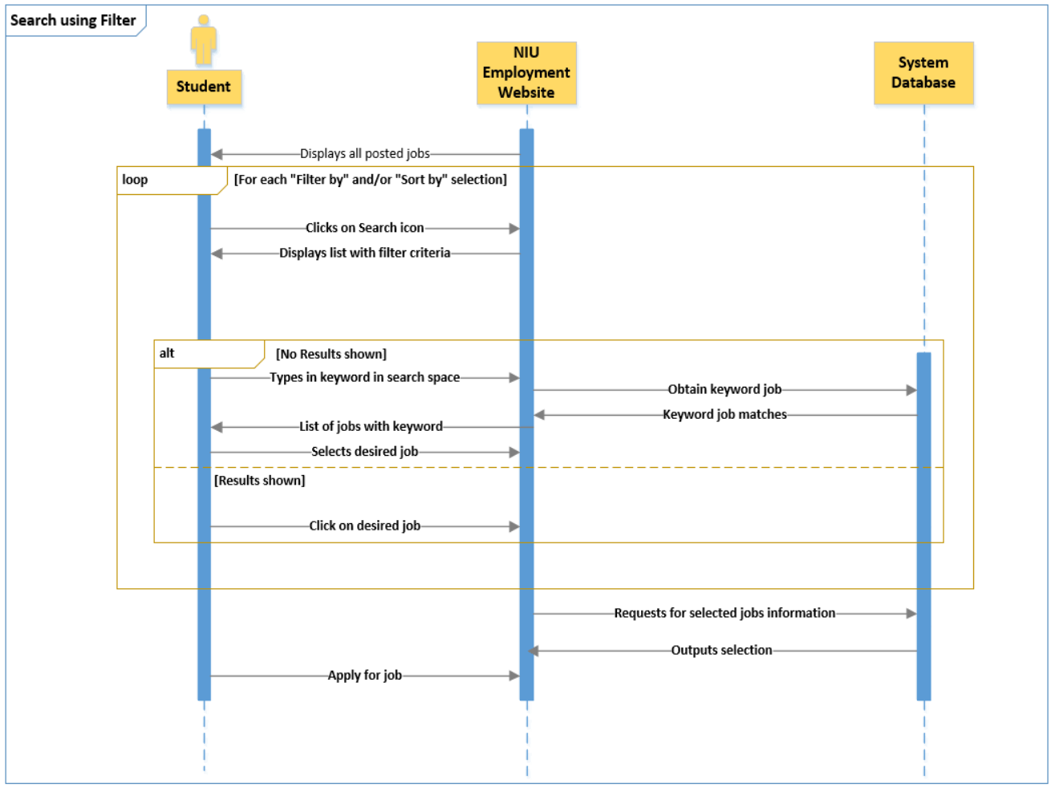
Sequence Diagram – Search using filter

Slide 13
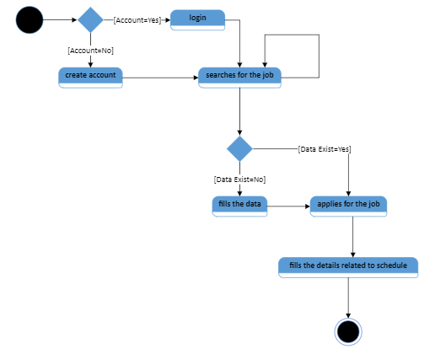
State Machine – Student Class

Slide 14
USER INTERFACES

Slide 15
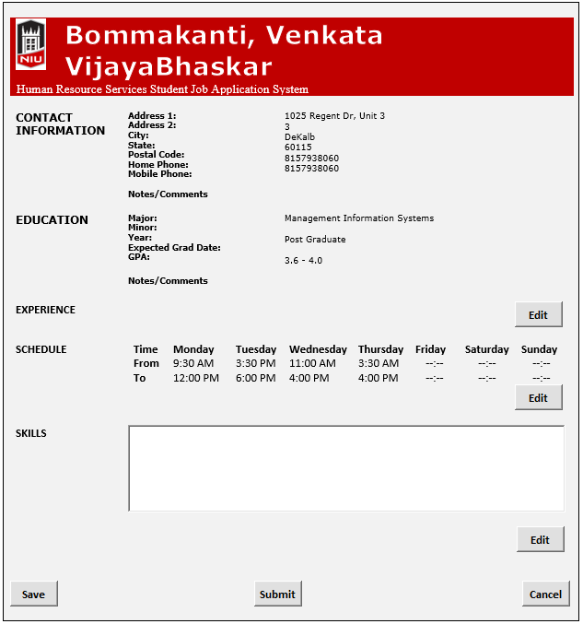
User Interface – Applying for a job

Slide 16
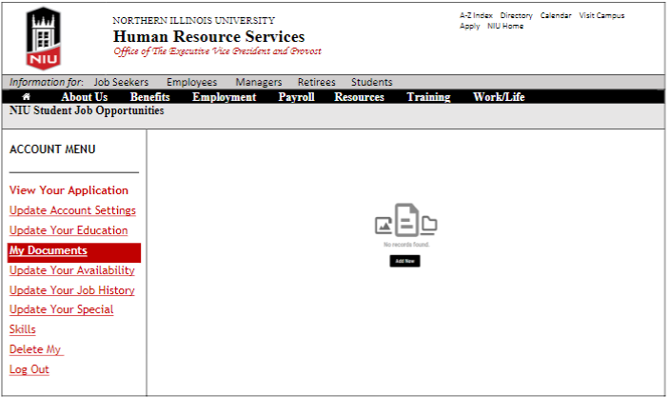
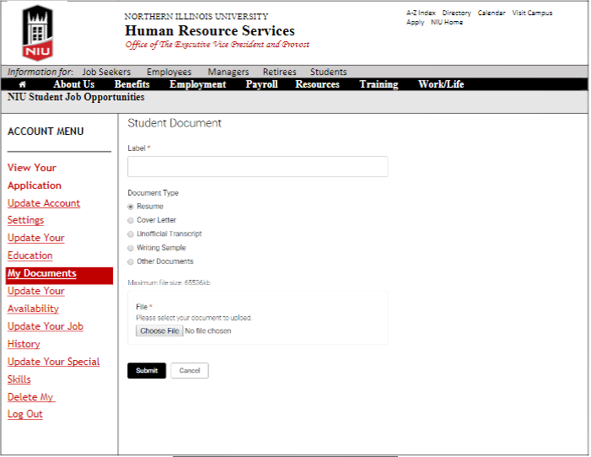
User Interface – Upload documents

Slide 17
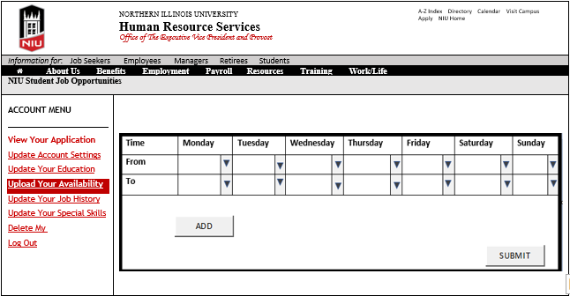
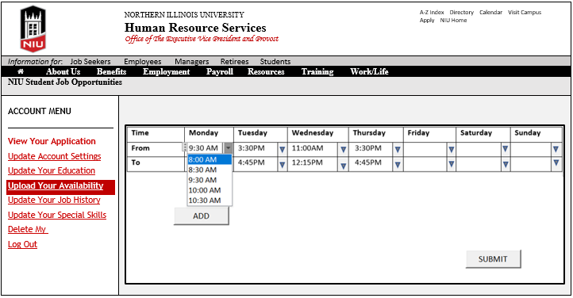
User Interface – Update Scheduling

Slide 18
System Acquisition Strategy
Custom in-house development
Business Strategy
Data privacy
Faster Communication
Cost and time management

Slide 19
Transition Strategy
Conversion Style
Direct
Low cost
Short time to migrate
Conversion Modules
Modular approach
One at a time
Low risk

Slide 20
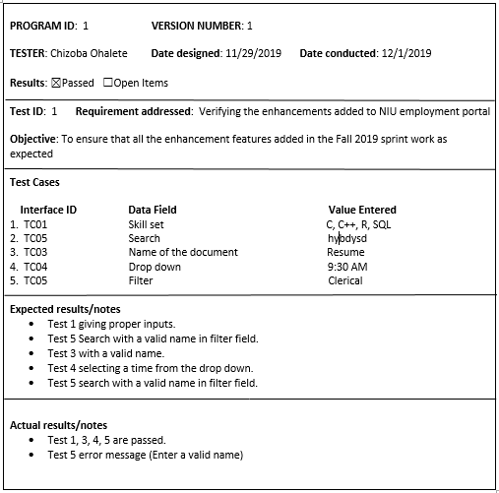
Test Plan

Slide 21
THANK YOU

