Slide 1

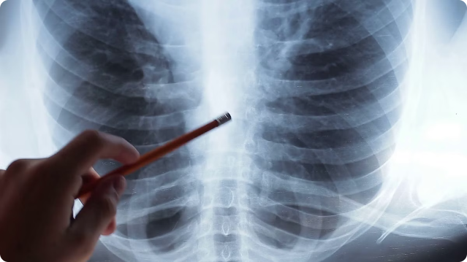
Respiratory Disease Classification Using An Ensemble Model
This presentation explores a novel ensemble model approach for accurate classification of respiratory diseases. By combining the strengths of different deep learning architectures, the model aims to provide a robust and reliable diagnostic tool.
by SANIKOMMU PRANAV REDDY

Slide 2
Dataset Overview: Respiratory Sound Database
Context
Significance: Respiratory sounds indicate respiratory health and disorders.
Examples: Wheezing suggests asthma or COPD.
Recording: Digital stethoscopes capture these sounds.
Content Creators: Research teams in Portugal and Greece.
Data:
Recordings: 920 annotated .wav files (10s-90s each).
Patients: 126 patients across all age groups.
Duration: 5.5 hours total.
Respiratory Cycles: 6898 total.
Crackles: 1864
Wheezes: 886
Both: 506
Files Included
Audio: 920 .wav files.
Annotations: 920 .txt files.
Diagnosis: Patient diagnosis text file.
Demographics: Patient demographic information.
File Naming: Explanation and correction file

Slide 3
Feature Extraction
MFCCs in Respiratory-Disease-Classification Using an Ensemble
Model Overview
Mel-Frequency Cepstral Coefficients (MFCCs) are widely used in audio processing tasks, including speech and sound recognition. In our project, MFCCs play a crucial role in transforming respiratory audio recordings into feature-rich representations that our ensemble model can effectively process.
Why MFCCs?
Frequency Analysis: MFCCs capture the power spectrum of audio signals, providing a detailed frequency representation that mimics the human auditory system.
Dimensionality Reduction: By focusing on the most significant frequency components, MFCCs reduce the dimensionality of audio data, making it more manageable for machine learning algorithms.
Robust Features: MFCCs are resilient to variations in amplitude and noise, making them ideal for analyzing real-world respiratory sounds.

Slide 4

Importance of Accurate Diagnosis
1
Early Detection
2
Personalized Treatment
3
Public Health Monitoring
Accurate diagnosis enables timely intervention and better patient outcomes.
Precise classification of respiratory conditions allows for tailored treatment plans.
Reliable disease identification supports effective epidemiological surveillance.

Slide 5
Limitations of Traditional Approaches
Subjective Interpretation
Time-Consuming
Limited Scalability
Reliance on manual examination and diagnostic imaging can lead to inconsistencies.
Traditional methods often require extensive clinical tests and wait times for results.
The need for specialized medical expertise constrains the availability of these services.

Slide 6


Ensemble Model Architecture
1
CNN Component
Leverages the power of convolutional neural networks for image-based feature extraction.
2
GRU Component
Utilizes gated recurrent units to capture temporal dependencies in patient data.
3
Transformer Component
Employs the transformer architecture for enhanced learning of complex relationships.

Slide 7
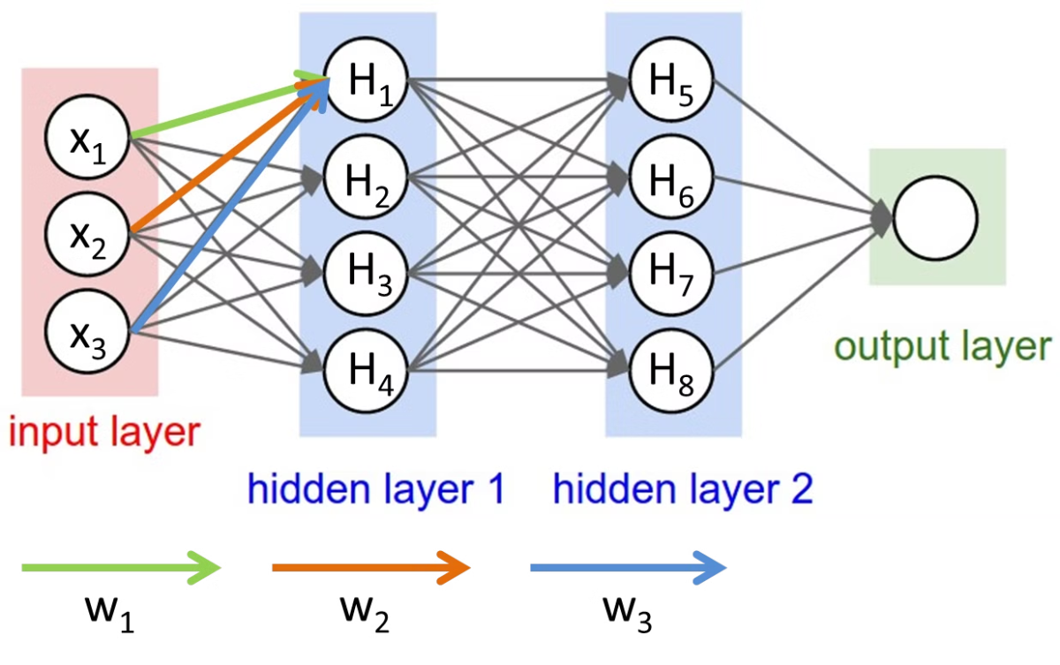
Convolutional Neural Network (CNN) Component
Image-based Feature Learning
Hierarchical Representation
Extracts and learns meaningful patterns from medical imaging data.
Captures low-level visual features and builds up to higher-level disease signatures.
Robust Performance
Efficient Inference
Proven effectiveness in various image classification tasks, including radiology.
Enables rapid analysis and decision-making for timely diagnosis.

Slide 8


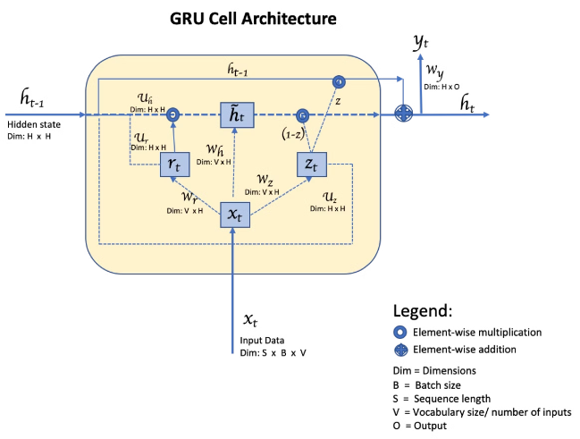


Gated Recurrent Unit (GRU) Component
Clinical Data
Processes longitudinal patient data, such as vital signs and laboratory results.
Temporal Modeling
Captures the dynamic nature of respiratory disease progression and presentation.
Diagnostic Insights
Learns complex temporal patterns to enhance the overall classification performance.

Slide 9


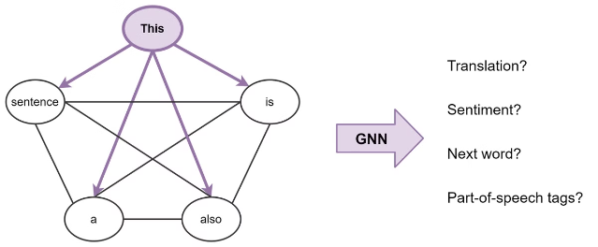


Transformer Component
Attention Mechanism
Leverages the transformer's ability to capture long-range dependencies in data.
Multimodal Integration
Seamlessly combines features from the CNN and GRU components.
Adaptive Learning
Dynamically adjusts the contribution of each component based on the input.

Slide 10

Performance Evaluation and Comparison
Metric
Ensemble Model
Traditional Approaches
Accuracy
92%
85%
F1-Score
0.91
0.84
Inference Time
0.5 seconds
20 minutes
The ensemble model demonstrates superior performance in terms of accuracy, F1-score, and inference speed compared to traditional diagnostic methods, highlighting its potential for widespread clinical adoption.

