Slide 1
Coursework 1 - Software Engineering Management & Development
Library Management System
Chaitanya Sharma
M00859748

Slide 2
Brief description of project
Using C++ programming, I created a library management system software for the project that will allow the librarian to maintain track of the books that the members have borrowed from the library.
This software can also keep track of multiple users' member IDs, names, email addresses, and other personal information. It can also keep track of which user has taken a book by combining their member ID and book ID. Additionally, this software has validations built in to determine whether or not a member ID already exists, whether a book request has already been fulfilled, and many other things.

Slide 3
Brief overview of presentation
This presentation includes UML diagrams that were used to create the software, as well as details on how I implemented logics and how the code sequence functions validations.
Furthermore, the method I employed to put this into practice is also included in this presentation. The way the design evolved into the functional software and the explanation of why version control was necessary for this project are also covered. I've also included screenshots from github that show commits and commit messages, along with my Catch2 testing methodology. Subsequently, it will cover software demonstrations, which illustrate the functionality and specifications of the software.
Lastly, there will be a conclusion that includes a succinct overview of the work, its shortcomings, and my future strategy for avoiding those shortcomings.

Slide 4
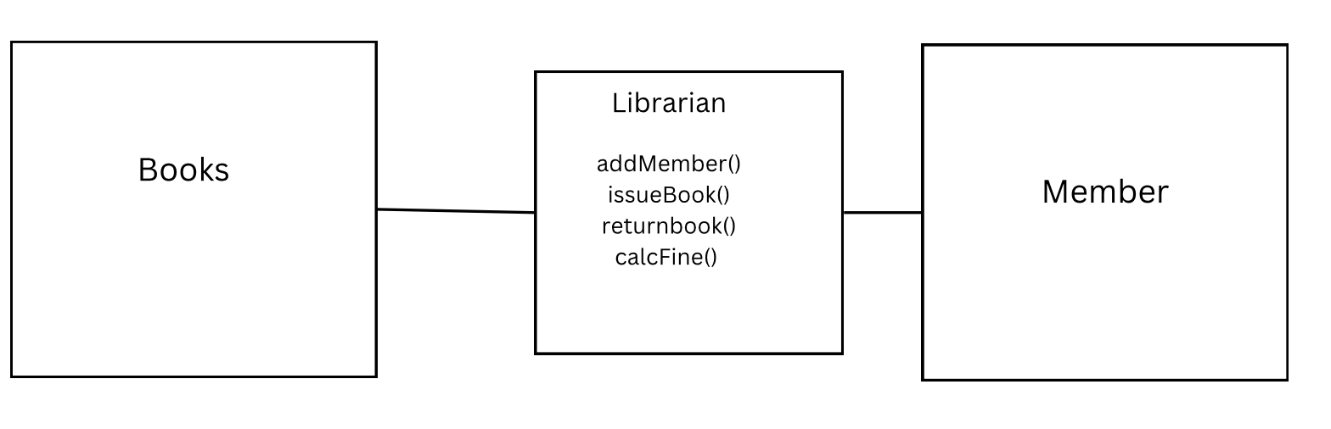
UML diagram 1
This UML diagram represents that the librarian has the control to issue book, return book add member and calculate the fine

Slide 5
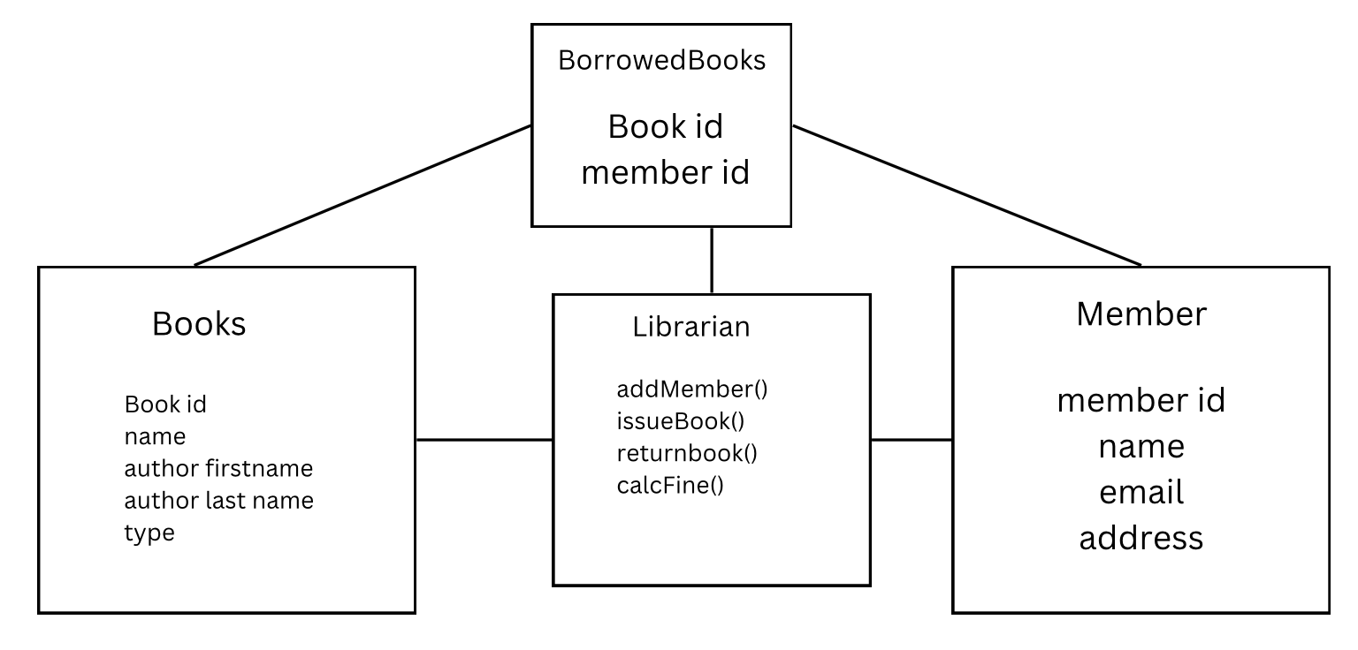
UML diagram 2
In the above UML diagram 2 there is one more class BorrowedBooks what this basically does is it store the data BookID and memberID when the librarian issues a book to a member. And when a book is returned it erases the particular data from the BorrowedBooks class

Slide 6
Approach in implementation
In this project the very first i have made the structure to store the variables i.e bookId, bookname, memberId, name, address as per UML given in the course work pdf. Therefore i have created CLASS in order to store these variables. And at this point the there was nothing in the int main() .
After this i have implemented code that reads the CSV file. Next i have bind the books variables with the data in the CSV file. Using function processCSVData.
Then i have started working on the functions: setStaffID, setSalary, issueBook() these functions were working at some extent meaning that there were some functionality needs to implemented. Moreover it was not equipped with the validations. The issueBook function works in the similar way as shown in the UML diagram 2 that stores bookid and member it to BooksBorrowed when a book is issued
After that, i have added validations for issueBook such as if a book does not exists in record this uses for loop iterates over them and check if exists in record (CSV file) it would display error message, if the book was issued to a member then it outputs book was already issued this works in a way by checking if the record exists in the borrowedBooks by iterating through it using a for loop.

Slide 7
If a member id does not exists makes a issue request then it would also be denied with an error message this checks Member data also uses for loop.
Then i have code to int main() that makes the program works in order by using while loop so that once a condition is satisfied the program would not stop until its given command EXIT
Subsequently, I updated the program to include the issuedate and due date in issuebook function. It essentially takes dates in their basic int format and converts them to strings. Additionally, it takes the day, month, and year out of the string, adds three days to the due date, and then converts it back to a string. and returns to the issuebook and display book that were successfully issued, along with the dates of issue and due.
Following that I updated the return book function to include the compute fine. If the book is returned after the due date, automatically compute the fine, which is one pound per day. It takes the due date from the BooksBorrowed class, extracts the string date in an easy-to-read format, determines how many days it is past due, and sets fine.
Furthermore, I have added membooksborrowed function that checks the books borrowed by an particular member by member id it uses for loop to find out from the class bookborrowed for the record and displays book id issued and with the issue and due date.

Slide 8
Then I have set the input to file name input and this would be the file that holds record for books .
Why Make file was used
The make file is used to build the program. The user can use make to build the program by navigating the directory and running make clean to clean up the generated files. In essence, this streamlines the compilation procedure. Keep an automatic eye on the dependencies. To put it succinctly, it improves the code and reduces the excess development work.

Slide 9
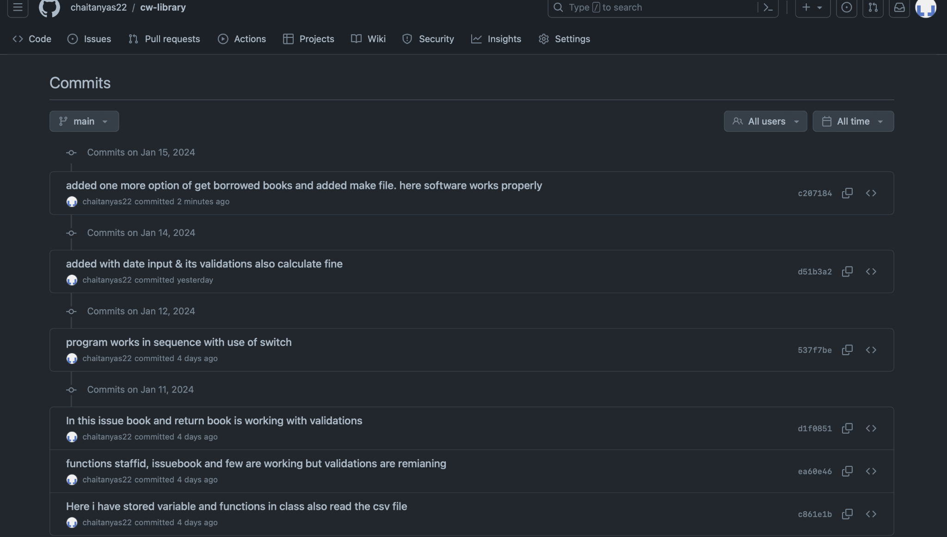
Screenshot of git repository

Slide 10
Software Demonstration
This software operates as follows:
In order to start this open terminal navigate to folder and use command make then use the execution name library_system
First, it asks for the file name, indicating that this is the file containing the book's ID, name, author's first and last names, page count, and type. Since this functionality is stored in the code's int main(), it operates when the program is first launched.
Subsequently, it proceeds to the initializations phase, prompting the setup of librarian particulars like staff ID, name, email, address, and salary. When it's finished, the library management software welcome screen appears.
Following that, the five options that displays are Issue book, Return Book, Add Member, Display Borrowed Books by Member, and Exit.
Beginning with the Add Member option, the program requests information such as the member's ID, name, address, and email. After receiving this, it stores the date in the Member class. The while loop that was added is the reason why, after the member is successfully added, the option screen appears again. This loop keeps going until the EXIT command (0), which breaks the loop when the condition is met.

Slide 11
When we select the Issue Book option, it first requests information such as the book ID (to be issued), the member ID (to whom it is to be issued), and the issue date. Following this, the provided information is validated. For example, if a book is present in the CSV file, an error message will be displayed; if a book id has already been issued to a member, a message stating that the member already has the book will be displayed; and if a member id is present or absent will be displayed. And whether or not the user enters the right date—for example, the number of days in a month cannot be less than one or greater than thirty-one, and the number of months in a year cannot be less than one or more than 12 once this is done it converts the date to a string for instance it takes input like DD then MM then YYYY so basically it converts it to string in format of DD-MM-YYYY. After this is done it sends it to the BooksBorrowed class and for the due date it extracts DD, MM and YYYY from the string and adds three days with proper validations and converts back to string and set as dueDate and sends back to the issuebook function. Hence it display books issued successfully to the member with issue date and due date.
Now coming to the return book option. The member ID, book ID, and return date are input into this function, which performs validations such as determining whether the book has been issued to a member through checking the BooksBorrowed records; if the records do not match, an error message is displayed. This function (returnbook) is also equipped with calculate fine and this works automatically if the book has been returned after the due date it issues fine that is £1 per. So for this it retrieves records (due date) from bookborrowed class and goes through an if else statements that is in returnbook() function. First it converts it extracts from string to a simple format and adds the number of days it has been overdue and sets up in the int (fine). Therefore, for example a book with due date of 12–03-2023 and returned on 14–03-2023 it would display a fine of £2.

Slide 12
The option Display Books borrowed my an member: this just takes input for member id and goes through the record of BooksBorrowed and shows all the books that has been borrowed by the particular member along with the issue date and due dates this function is memBorrowedBooks() this uses for loop and iterates in booksborrwed records and retrieves book id’s that has been issued to a particular member id.

Slide 13
Summary
I wrote the code for this project (a library management system) and put it in the main.cpp file.Additionally, created a makefile that is needed for program compilation. The completed program asks for the file name then links the variables, requests the librarian's information, and then displays a welcome screen with five options. This cycle of issuing books, returning books, displaying books that members have borrowed, and exiting continues until the condition is met (EXIT = 0). Along with the necessary validations, I have added functionality like issue books, add members, return books, show borrowed books, and calculate fines. I have added each development version to github using git commit along with the messages
Limitations:-
The first issue I ran into with this project was that, while the program could read the file, there were instances when it would miss a row, such as when a user tries to issue a book id of 20. It demonstrates its nonexistence.

Slide 14
How would I approach similar project in future to avoid limitation:-
For the reading of the file i will try to implement robust error handling for the reading file code that would check for the error during opening and reading lines in the file

