Slide 1
Typing Speed Tester
“CSE - D”
SPACE BAR

Slide 2
Our Team
Rohith
AP21110010219
Chaitanya AP21110010253
Bhargav
AP21110010204
Ritesh
AP21110010260
“CTRL”

Slide 3
01
02
Table of contents
Introduction
Modules Used
03
04
Interface
End User

Slide 4
01
Introduction
SPACE BAR

Slide 5
The history of the computer keyboard as we know it today may be traced back to the creation of the typewriter. The first functional modern typewriter was invented by Christopher Latham Sholes in 1868.
The Remington Company soon started selling the first typewriters in bulk, starting in 1877. The typewriter gradually transformed into the ordinary computer keyboard that your fingers are so accustomed to using today thanks to a number of technical advancements.

Slide 6
Typing Speed
We are going to make a simple Typing Speed Test with Python and its built-in UI Library Tkinter. The user has 60 seconds to type as many words as possible, and after that, we show how many words were written.
There will be a counter which tells the user how much time has gone by, and the part where he writes will be split in two.
On the left are the letters/words that already have been written, and on the right, we see the letters that will be written.
We always want the user to type the letter which is currently on the right of the grey letters so that letter moves over.

Slide 7
Modules Used
02
SPACE BAR

Slide 8
Modules used
labeltext()
stopTest()
restart()
add Second()
keyPress()
.
.
.
.
.

Slide 9
labeltext():
This function creates the widgets and launches the writing test.
We first define a list of potential texts in the function, and then we use the random.choice() function to pick one text at random from the list.
In the lines that follow, we do just that. We create a label for each side, save it to the variable with the proper name, and then position it in the window using put (). The widget is placed precisely, or at least more precisely than pack, using this method (). The elements will always be in the middle with respect to the window itself if the relx and depend parameters are set to 0.5.
If the test is still running, the writeable variable is True; if it's False, the test will be over. The keyPress() method, which we will discuss later, is then bound to each key event. It is supplied to the aforementioned label using the passedSeconds variable. Finally, we will configure our root to execute the addSecond() function after one second and the stopTest() function after 60 seconds. The after() method of our root is used for this:

Slide 10
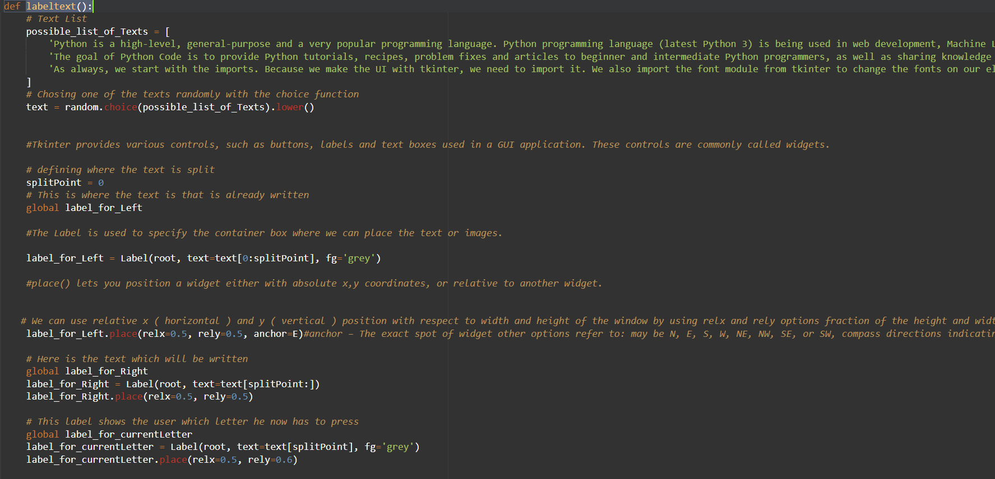
.

Slide 11
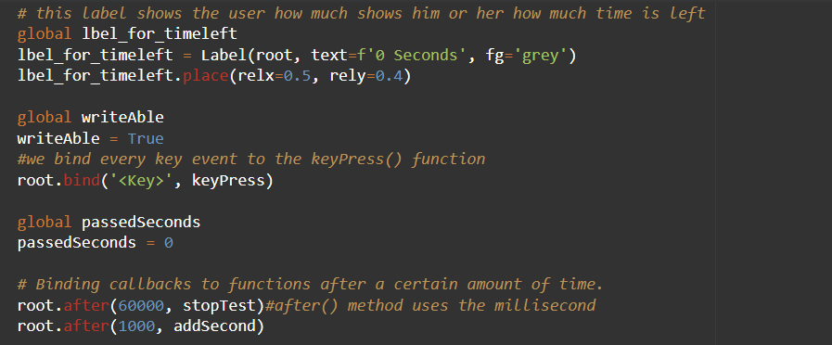

Slide 12
.
stopTest()
We will now examine the function that terminates the test. As we previously observed, the root will call this after 60 seconds. The writeAble variable will first be set to False. Next, we determine how many words the user has input. To accomplish this, we merely take the text from the left label, separate it by blank spaces, and then count the number of items in the list that results. The labels from the test are then destroyed using their destroy function as follows:

Slide 13
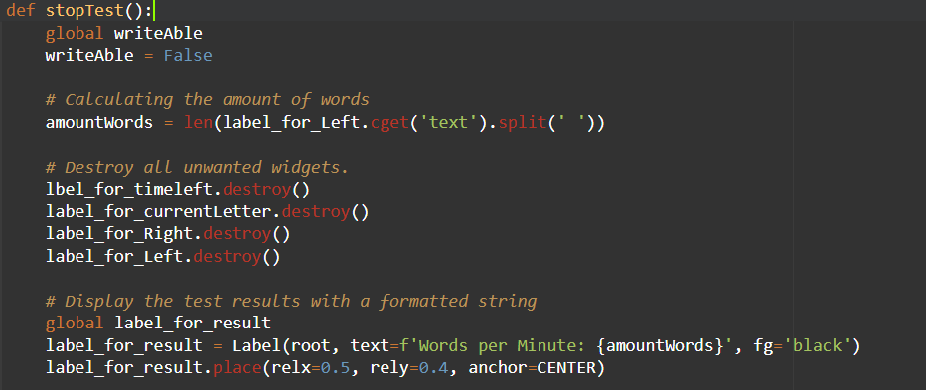
.

Slide 14
.
restart()
This function calls the resetWritingLabels() function, which starts the test, and then deletes the result label and restart button to restart the test:

Slide 15
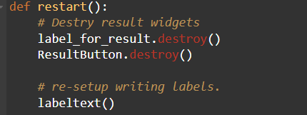
.

Slide 16
.
addSecond()
The information in the timeleftLabel will be updated by this function. If the test is still running, it will simply add one to passedSeconds, set the label's text appropriately, and then call itself once again a second later.

Slide 17
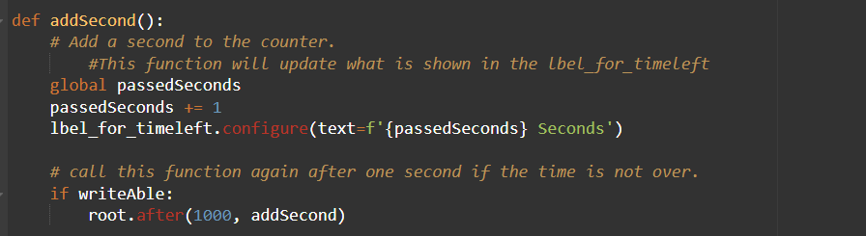
.

Slide 18
.
keyPress()
The keyPress function, which processes key presses, is the test's main structural component. As a result, it will always receive an event object that contains information about the keys that were pressed.
In order to make it appear as though the user is typing, we first determine whether the character of the event matches the next letter that must be pressed. If this evaluates to True, we delete the letter from the right side and put the same letter to the left label. The label for the current letter was also set to display the appropriate one.

Slide 19
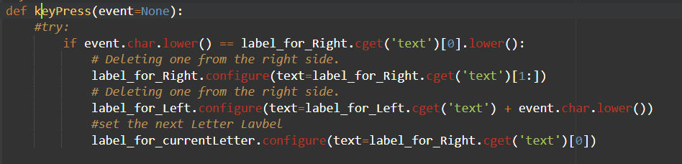

Slide 20
Interface
03
SPACE BAR

Slide 22
Future work
04
SPACE BAR

Slide 23
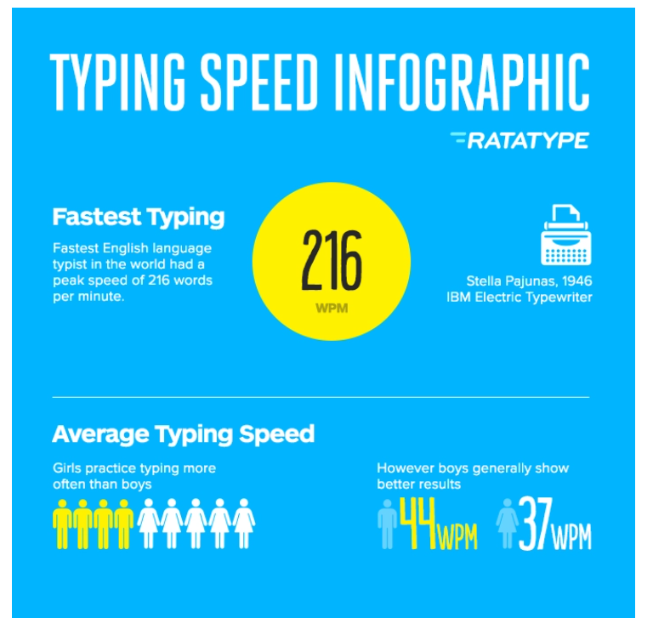
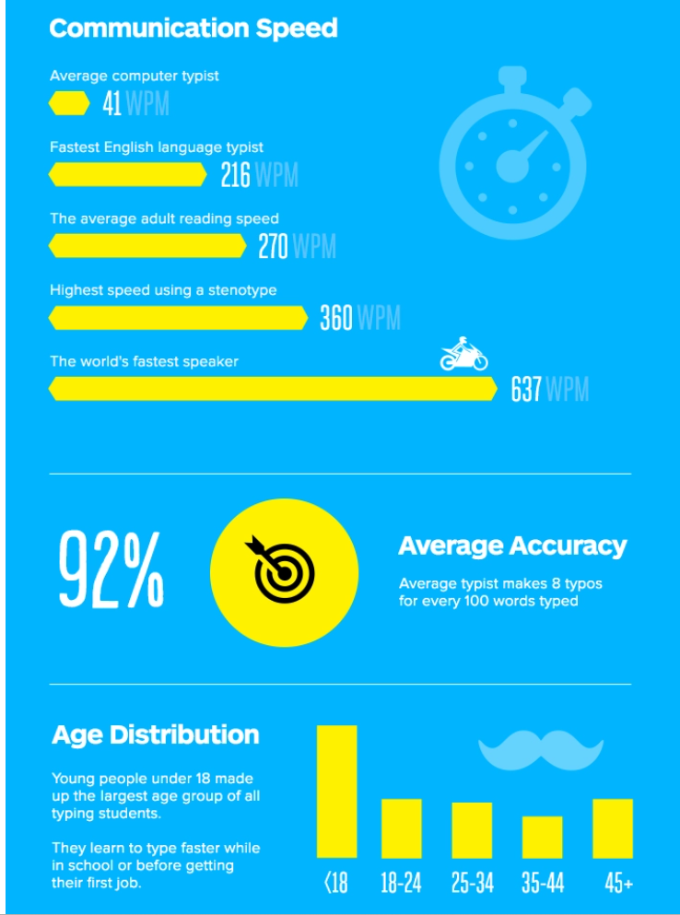
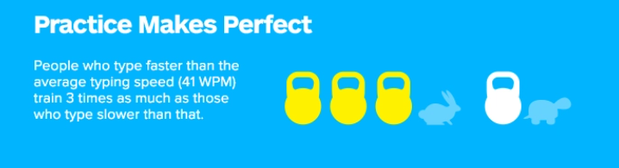
Currently using this technology:

Slide 24
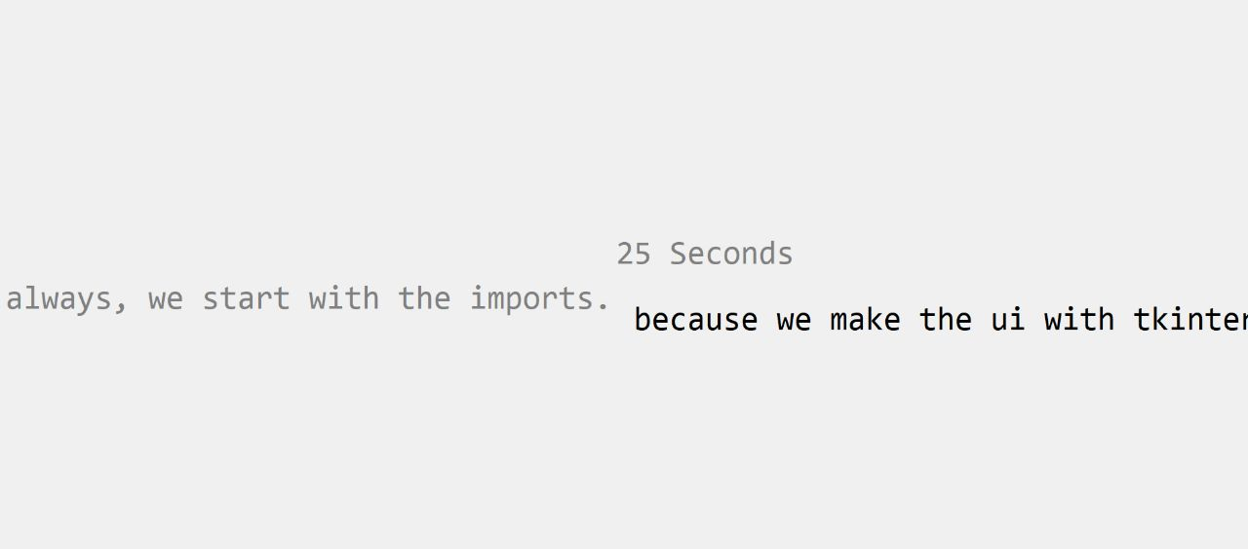
Mobile mockup
Tablet mockup
Desktop
mockup

Slide 25
Thank
you!
“CSE - D”
“CTRL”

