Slide 1


Slide 2
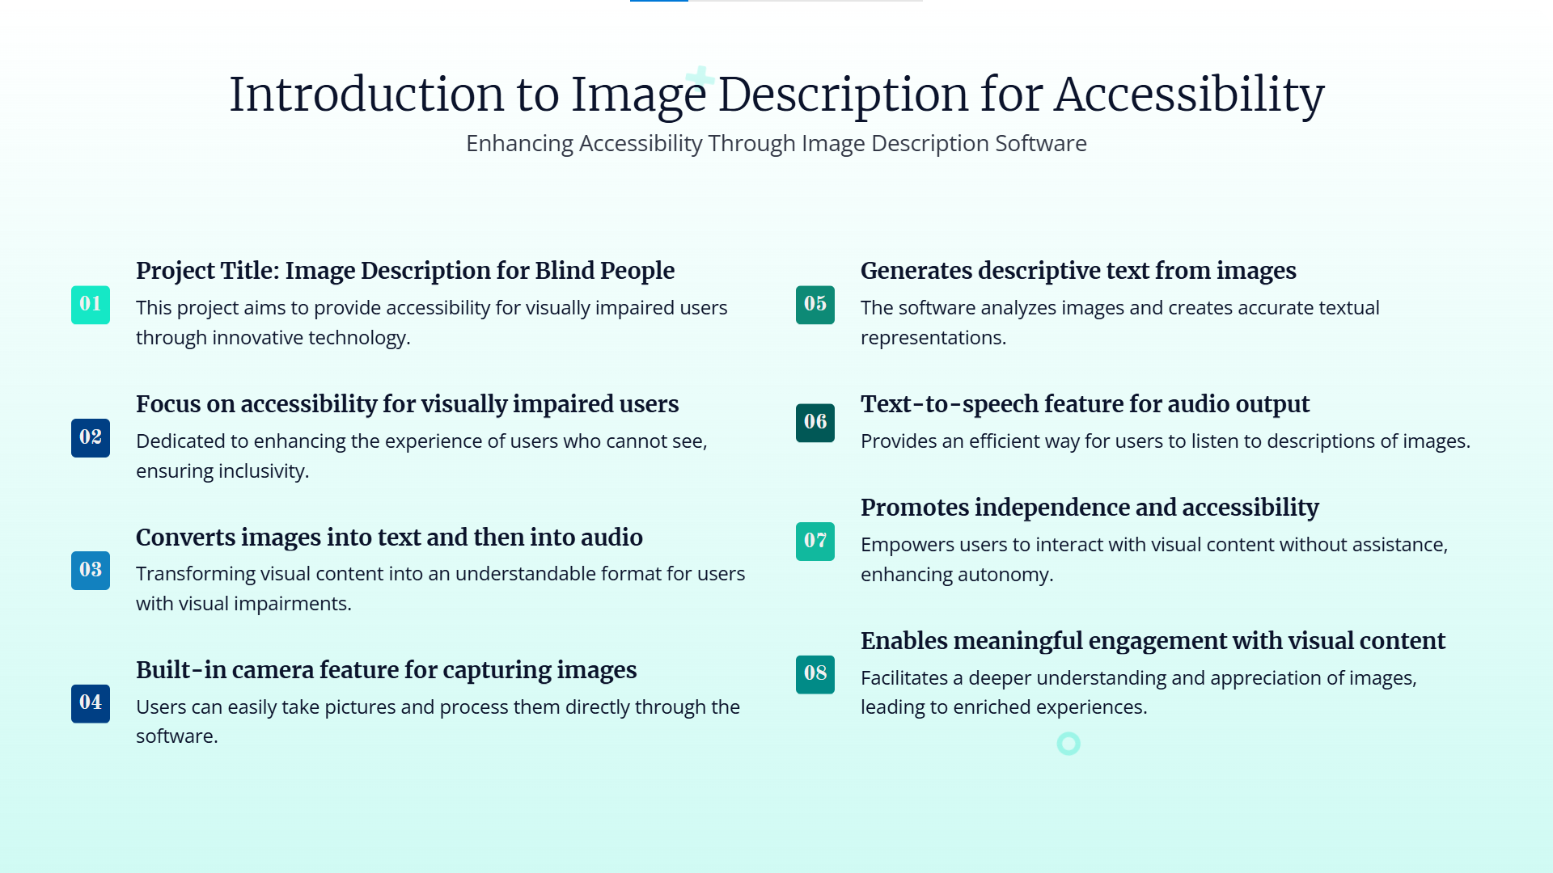

Slide 3


Slide 4


Slide 5
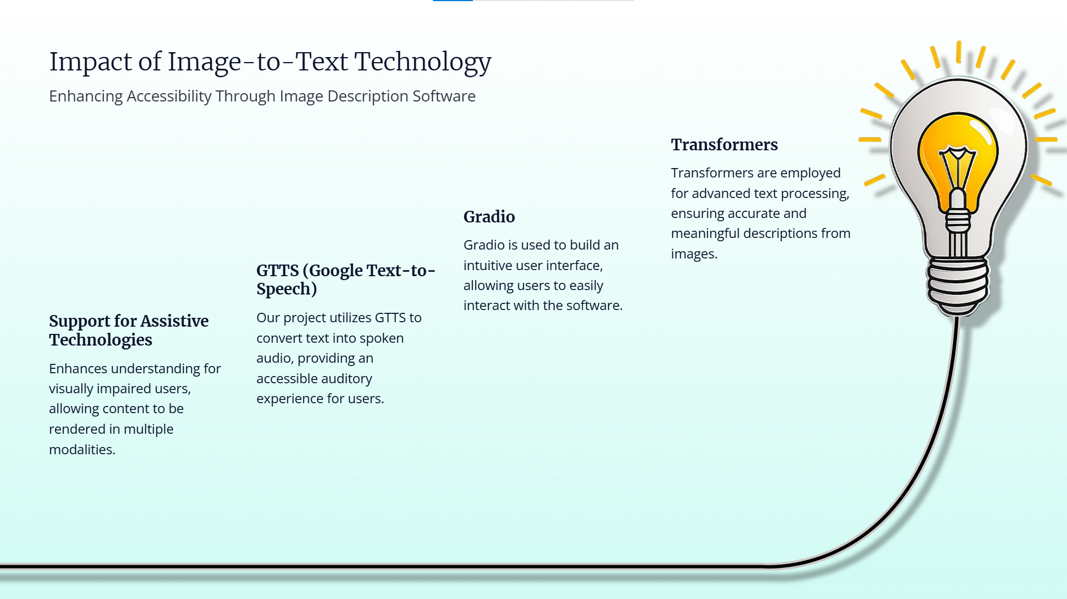

Slide 6


Slide 7


Slide 8


Slide 9
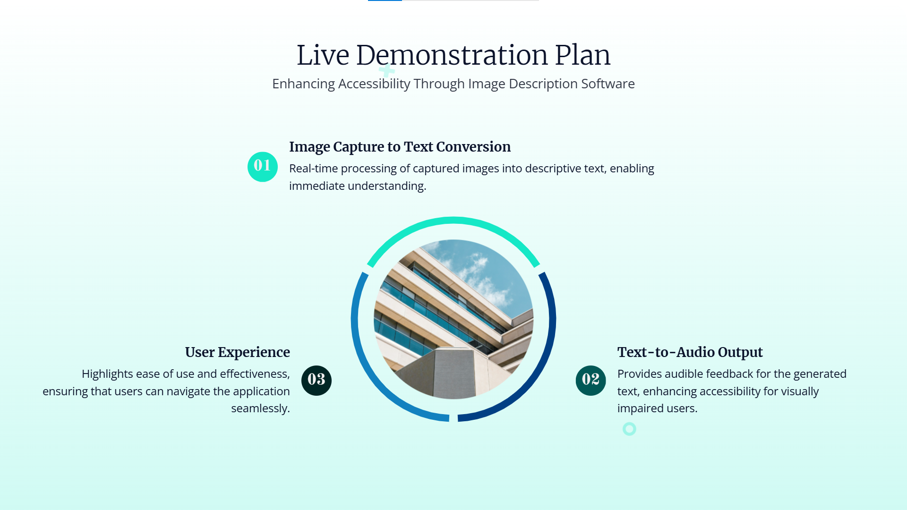

Slide 10


Slide 11


Slide 12
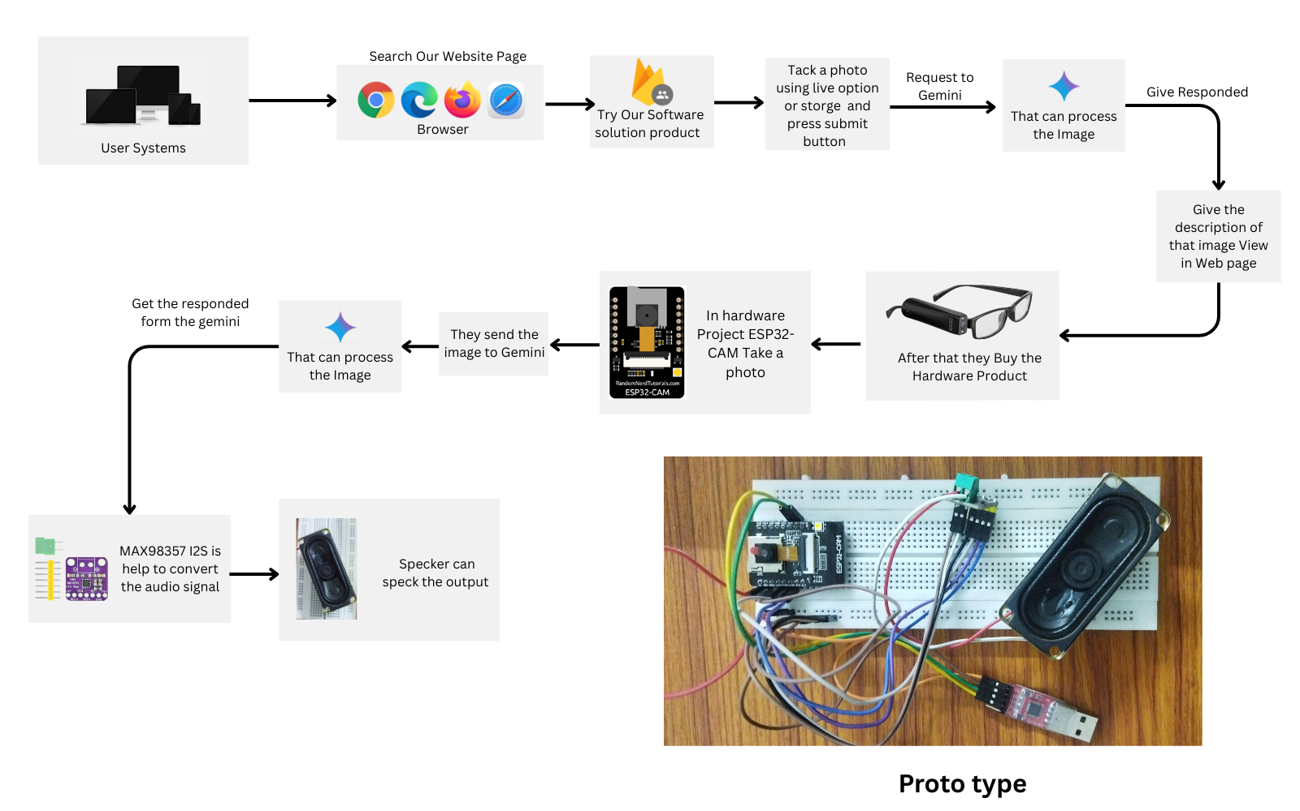

Slide 13
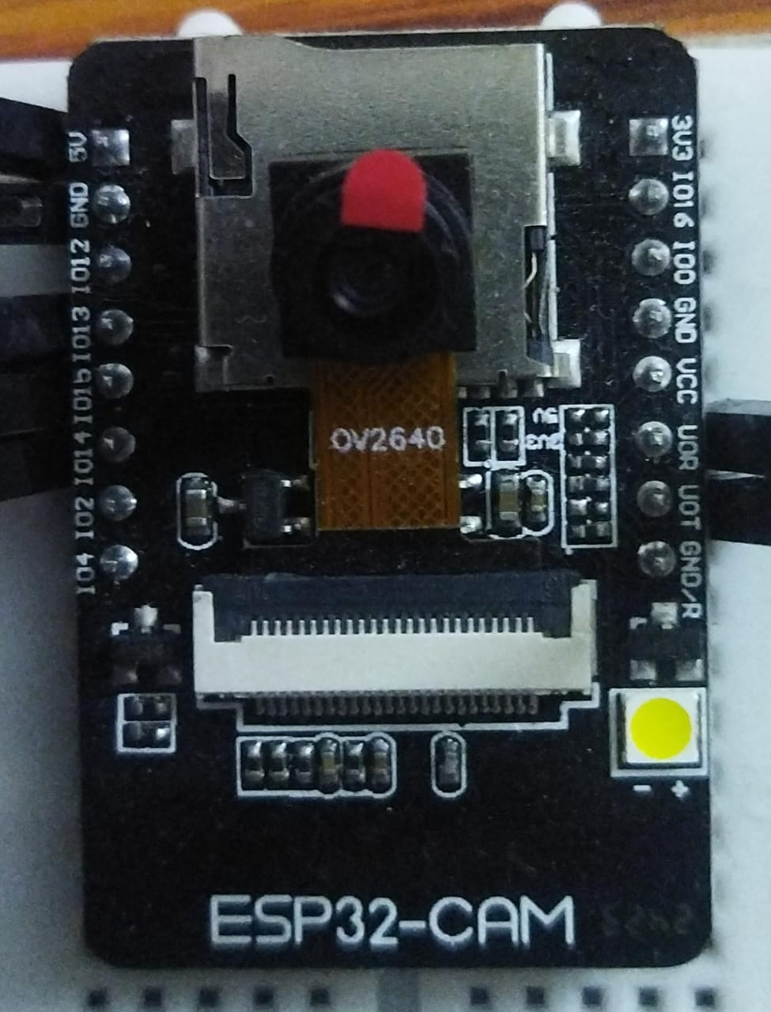
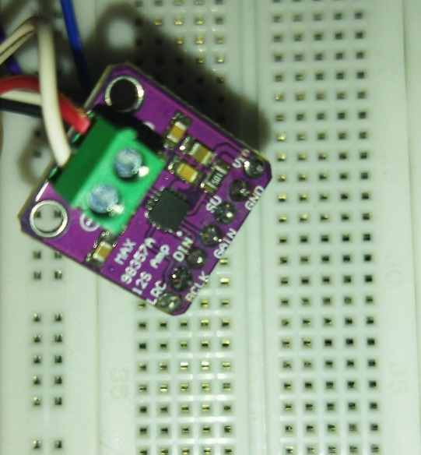
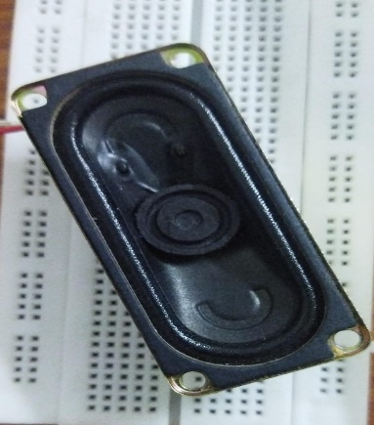
ESP32-CAM | MAX98357 I2S 3W | Rectangular Speaker - 2W / 8-ohm -70 x 30mm

Slide 14
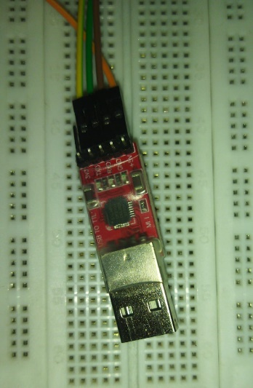
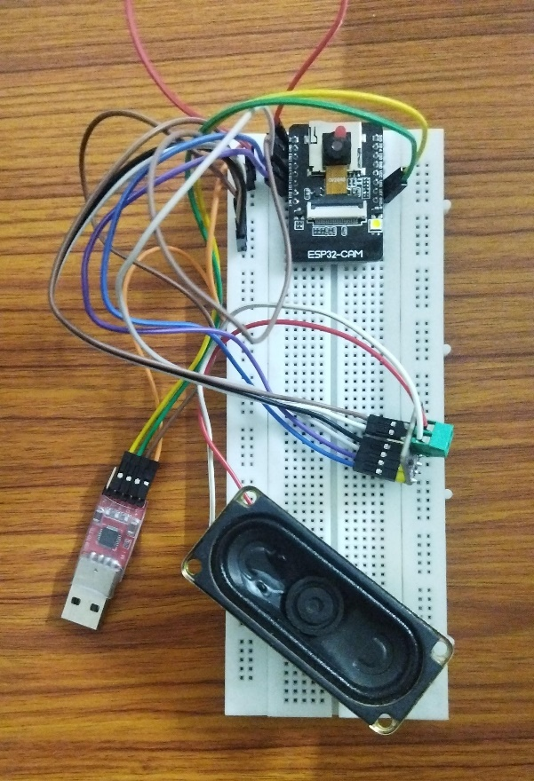
USB to TTL converter | FINAL CIRCUIT

