Slide 1

Designing Ecommerce site with mern
Tadikonda Chaitanya Sreenivas, 170031255, cse, Zinna Pattan Khan, Managing Partner, T. Aditya Rao.

Slide 2
Abstract
Electronic Commerce is process of doing business through computer networks. A person sitting on his chair in front of a computer can access all the facilities of the Internet to buy or sell the products.
Unlike traditional commerce that is carried out physically with effort of a person to go & get products, ecommerce has made it easier for human to reduce physical work and to save time.
E-Commerce which was started in early 1990’s has taken a great leap in the world of computers, but the fact that has hindered the growth of e-commerce is security.

Slide 3
Table
Fortnight duration | Work done | Remarks
1. 21/12/2020- 4/01/2021 | Learned the basics | 100%
2. 09/01/2021- 23/01/2021 | ReactJs concept | 100%
3. 23/01/2021- 06/02/2021 | Login Page | 100%
4. 07/02/2021- 20/02/2021 | Working on Front-end | 100%
5. 21/02/2021- 06/03/2021 | Working on Home Page | 100%
6. 07/03/2021- 20/03/2021 | Working on Dash board of Front-end | 100%

Slide 4
MERN
MERN stands for MongoDB, Express, React, Node, after the four key technologies that make up the stack.
M- MongoDB : document database
E- Express(.js) : Node.js web framework
R- React(.js) : a client-side JavaScript framework
N- Node(.js) : the premier JavaScript web server

Slide 5
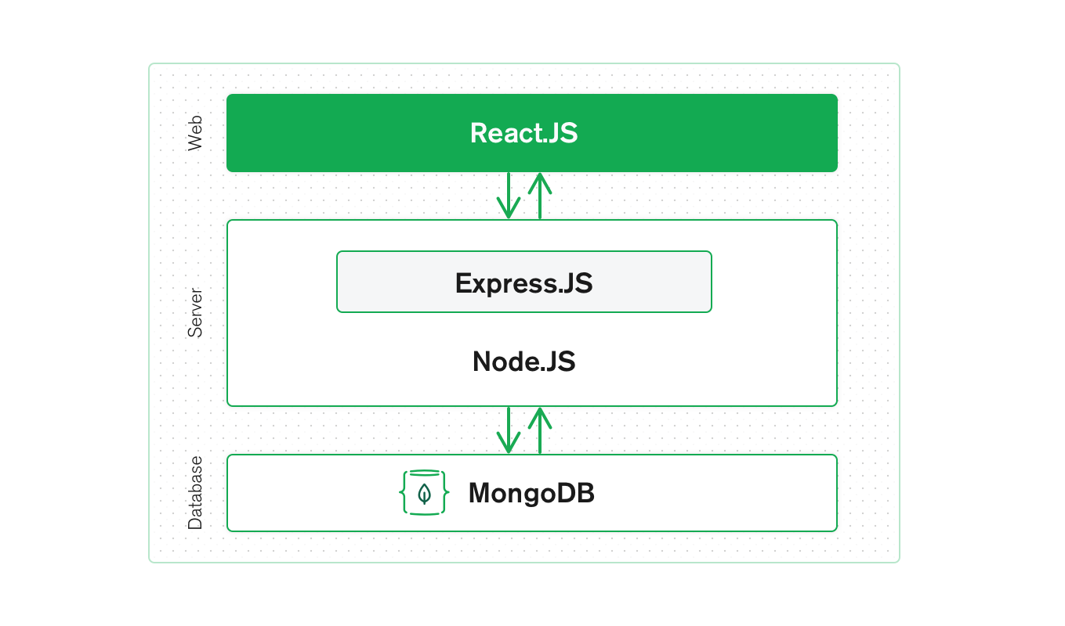
MERN

Slide 6
Ecommerce website
E-Commerce websites are online portals that facilitate online transactions of goods and services through means of the transfer of information and funds over the Internet. Now, with a single website, anything and everything that a transaction needs, can be executed online.

Slide 7
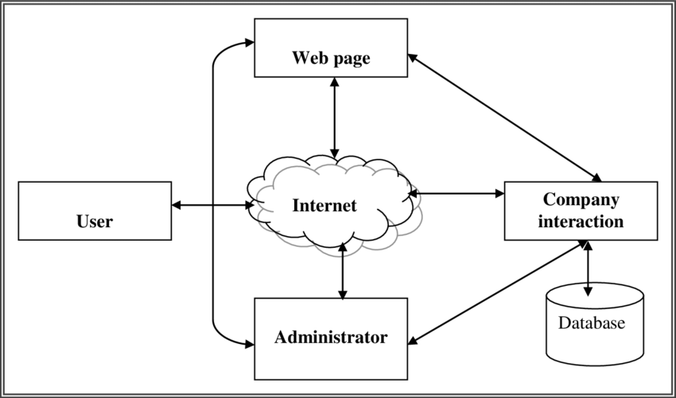
Architecture

Slide 8
Types of ecommerce businesses
There are four traditional types of ecommerce, including B2C (Business-to-Consumer), B2B (Business-to-Business), C2B (Consumer-to-Business) and C2C (Consumer-to-Consumer). There's also B2G (Business-to-Government), but it is often lumped in with B2B.

Slide 9
B2C Businesses
B2C eCommerce refers to the process of selling to individual customers directly. ... An example of a B2C transaction would be someone buying a pair of shoes online or booking a pet hotel for a dog.
B2C became immensely popular during the dotcom boom of the late 1990s when it was mainly used to refer to online retailers who sold products and services to consumers through the Internet.
As a business model, business-to-consumer differs significantly from the business-to-business model, which refers to commerce between two or more businesses

Slide 10
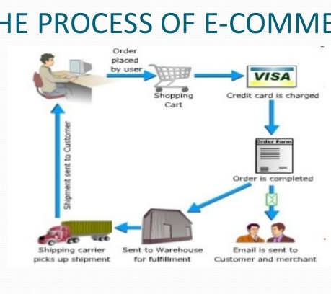
Flow chart of Ecommerce Website

Slide 11
Module
User:
Each built-in user role has a specific set of user permissions enabled. Creating the user module using which we can view existing user details. Also, we can delete an existing user.
The E-Commerce settings determine how a user can interact with the features required to set up the online store, manage your product list, or create order forms. To access these User Permissions, go to Admin > Users and click Edit Permissions next to the user you would like to modify.

Slide 12
1.Product
These permissions control the ability to view, add, edit & delete product records, as well as manage specific product functions.
Can view all records: This permission controls access to view individual product details.
Can edit all records: This permission controls the ability to change products once they've been created.
Can add: This permission controls the ability to enter new products.
Can search: This permission controls access to your product list.
Can delete: This permission controls the ability to delete a product record.

Slide 13
2. Order form
These permissions control the ability to view, add, edit & delete order forms. Order forms are used to sell a specific product or subscription program.
Can view all records: This permission controls access to view individual order forms.
Can edit all records: This permission controls the ability to edit an order form.
Can add: This permission controls the ability to create order forms.
Can search: This permission controls the ability to access order forms.
Can delete: This permission controls the ability to delete order forms.

Slide 14
Shopping Cart
a) Can manage shopping cart: This permission controls the ability to set up the Infusionsoft shopping cart.

Slide 15
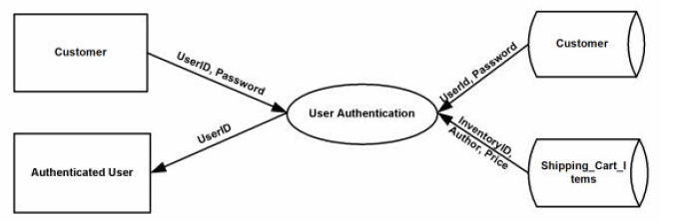
Flowchart

Slide 16
Languages Tools
HTML Visual Studio Code
CSS
MongoDB
Bootstrap
JavaScript

Slide 17
Benefits of ecommerce
The main advantage of an eCommerce business is that it allows you to conduct your business flexible and at the same time is very useful in reaching a full range of target audience within seconds.
Another significant benefit of an eCommerce business is that it helps you to identify the target audience very quickly and reach them easily too.
For example, if you are trying to sell some goods or products, you can easily make market research from the internet and identify your niche market.

Slide 18
Conclusion
E-Commerce is not an IT issue but a whole business undertaking. Companies that use it as a reason for completely re-designing their business processes are likely to reap the greatest benefits. Moreover, E-Commerce is a helpful technology that gives the consumer access to business and companies all over the world.

Slide 19
References
https://www.investopedia.com/terms/b/btoc.asp#:~:text=The%20term%20business%2Dto%2Dconsumer,referred%20to%20as%20B2C%20companies.
https://www.google.com/search?q=B2C+business+flow+chart&sxsrf=ALeKk016bDlqmYVbxRba-KEux_abGjd84A:1613812450782&source=lnms&tbm=isch&sa=X&ved=2ahUKEwi_mvPuj_juAhXDgeYKHaCLA3YQ_AUoAXoECAMQAw&biw=1093&bih=526&dpr=1.25#imgrc=zA6vaKGzxscFEM&imgdii=s1JoscgGe4FpZM
https://help.infusionsoft.com/help/user-permissions-ecommerce
https://support.bigcommerce.com/s/article/User-Permissions

Slide 20
Learning outcomes
From this project, I have learnt the concept of React JS and how it is useful in developing ecommerce website.
Importance of ecommerce website to the society and developed the simple website.

