Slide 1

Used Cars Data Team - 11
Used Car Market in the United States, Automobile Industry

Slide 2

Team Members
Chaitanya Swaroop Udata
Sai Kumar Mudhagoni
Pulugurtha Vinay Madhur

Slide 3
Contents
Introduction
Parameters included
list of goals
Conclusion

Slide 4

Introduction
From various market surveys, the consulting firm has compiled a large dataset of various makes and models of used cars.
Variables that influence the selling price of used cars are included in this data set.
Link To the Car Data:- CarsData

Slide 5

Parameters Included
The data we extracted include of following things:-
It consists of 18 columns.
It consists of 7906 rows.
It also consists of p.Sales as a parameter field which is used to calculate top 5, top 10 etc.
We also have calculated fields like miles driven which is computed from km driven and price in rupees is changed to price in dollars.

Slide 6

List Of Goals
1.
The objective is to find out vehicles sold in respective years in different states.
2.
The objective is to find the best milage providing cars based on different states in USA.
3.
The objective is to find out the comparison based on average mileage and average miles driven by different car companies in united states.
4.
The objective is to find the average milage given by different car companies.
5.
The objective is to find the relation between selling price and the ownership of cars.
6.
The objective is to find the Average selling price of different car companies in USA.
7.
The objective is to find out region wise sales of all the car brands in USA.

Slide 7
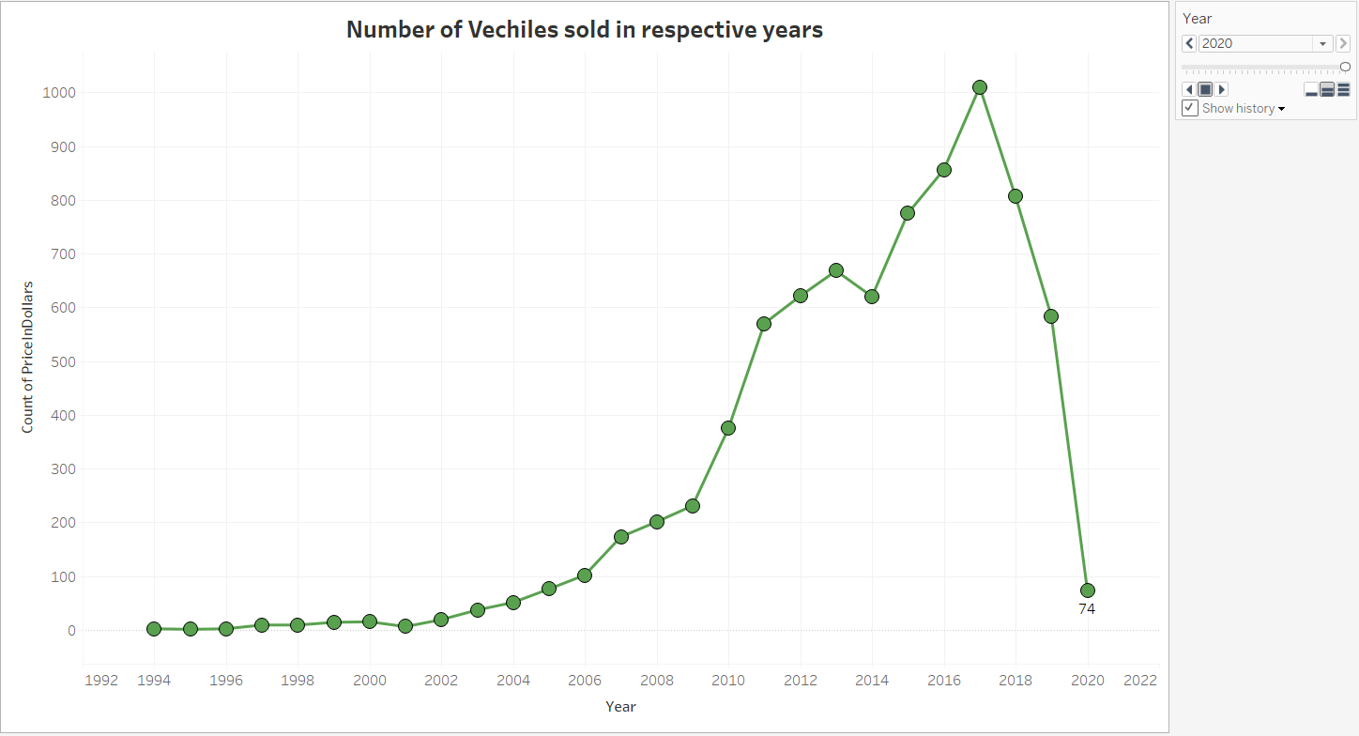
The objective is to find out vehicles sold in respective years in different states.
Story:- From the below bar chart we came to know the data of sales from 1994 to 2020, where maximum number of sales was given by 2017 which is $1,010 and minimum sales were recorded in the year 1995 as 1. The observation made by bar graph in the year 2020 which was recorded all time low since 2006 due to pandemic which is 74.

Slide 8
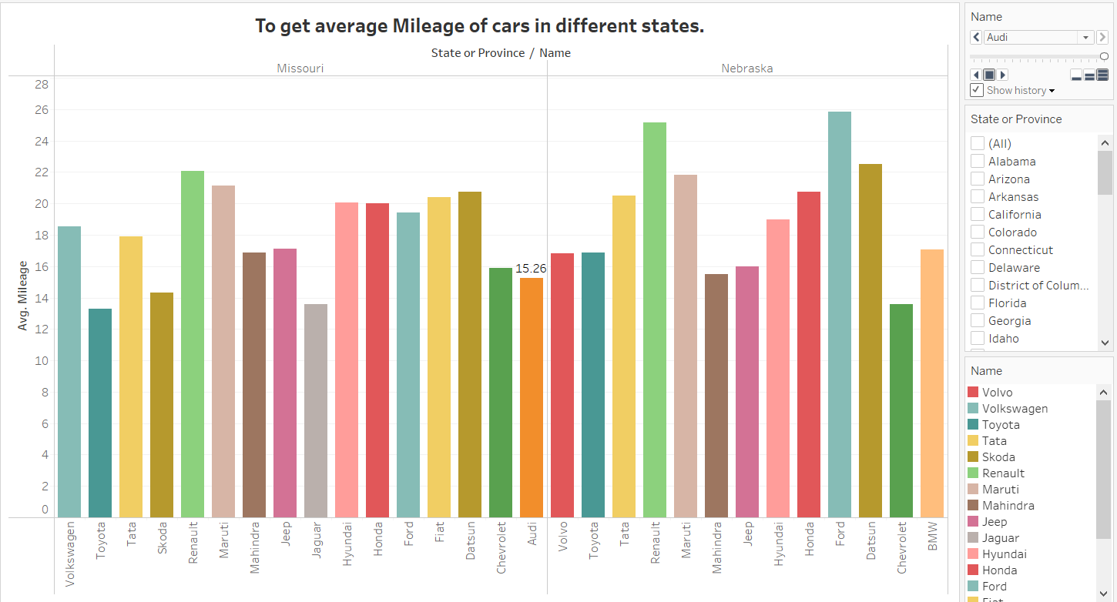
The objective is to find the best milage providing cars based on different states in USA.
Story:-The below multiple layer chart offers a side-by-side comparison of various car brands for different states as in here we are taking examples of Missouri and Nebraska states. When comparing both the below states highest milage was provided in Missouri was given by Renault as 22.08MPG and in Nebraska its Ford as 25.83MPG, closely followed by Renault at 25.17. Whereas lowest among both the states is given by Toyota at 13.30MPG in Missouri and Chevrolet at 13.58MPG in Nebraska.

Slide 9
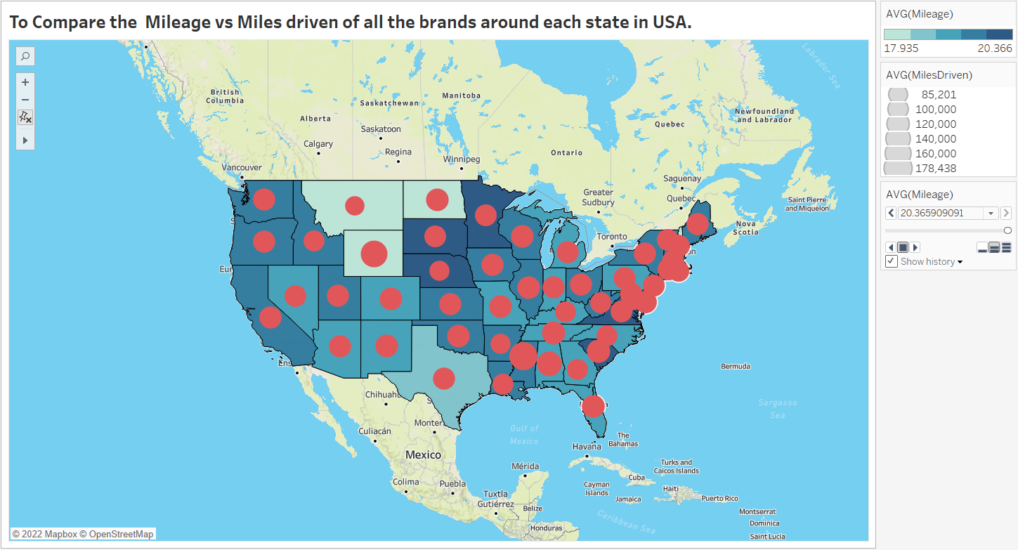
The objective is to find out the comparison based on average mileage and average miles driven by different car companies in united states.
Story:-In the below dual layer map the dark blue colored states are the highest ones giving average mileage across united states which are Virginia (20.028MPG), South Carolina(20.171MPG) and others and minimum was given by light blue color which includes states like-North Dakota(17.9MPG), followed by Wyoming & Montana .

Slide 10
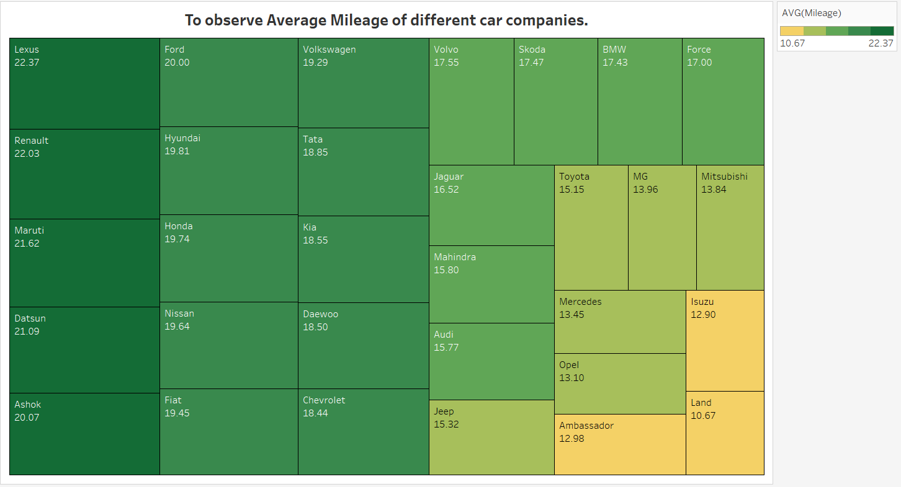
The objective is to find the average milage given by different car companies
Story:- Tree map represents the information on various car giants in today's automobile industries. So, the top 5 averages are given by first Lexus has 22.37 MPG, second by Renault 22.03 MPG, third by Maruti 21.62 MPG, fourth by Datsun 21.09 MPG and fifth was given by Ashok 20.07 MPG. The least car companies to give mileage as Land rover as 10.67 MPG followed by Isuzu, Ambassador, Opel, Mercedes.

Slide 11
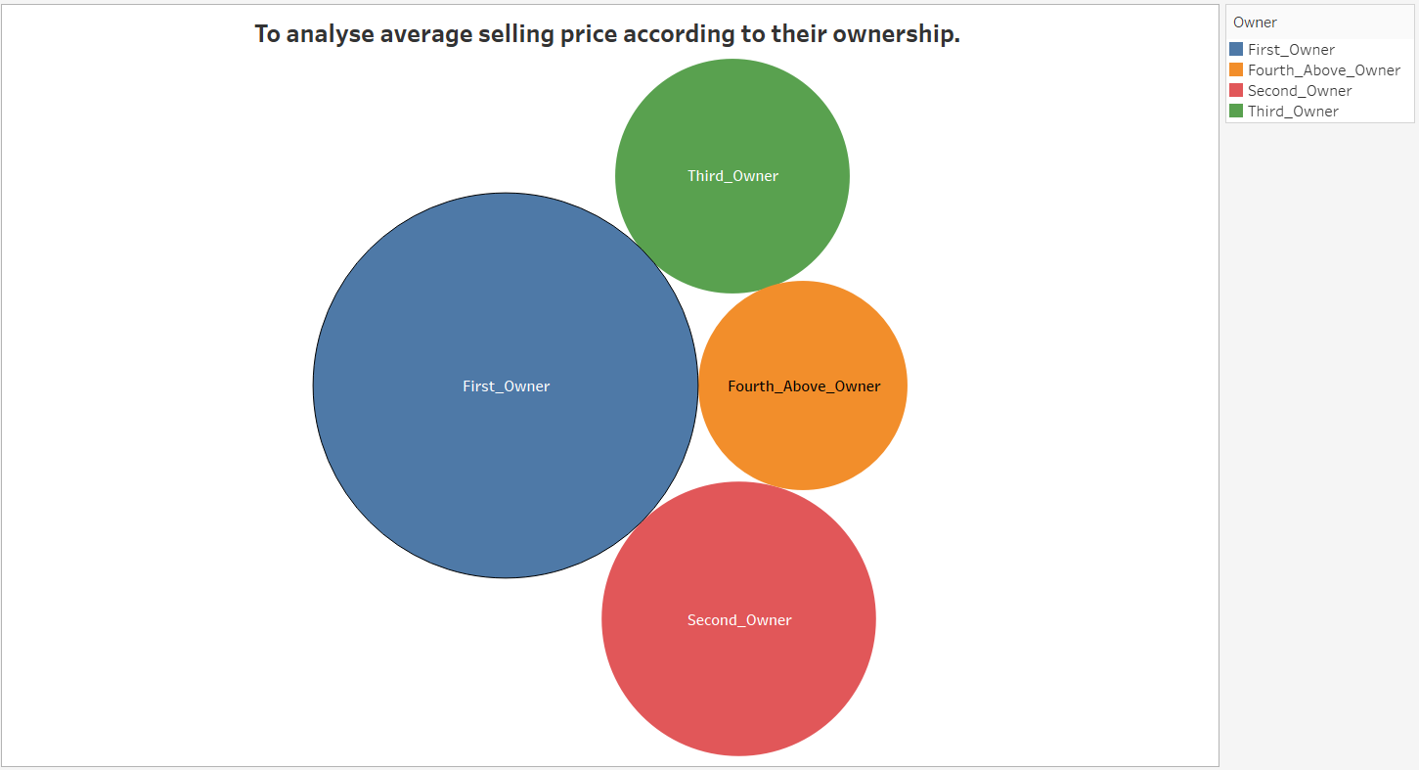
The objective is to find the relation between selling price and the ownership of cars.
Story:- The below bar chart is gathering the information on following data. The Selling price is directly related to ownership of the car used, so we have average selling price at which First_owner vehicle sold as 9,634 followed by Second as 4,893 then Third_Owners as 3,575 and Fourth_Above_Owner vehicle as 2,844.

Slide 12
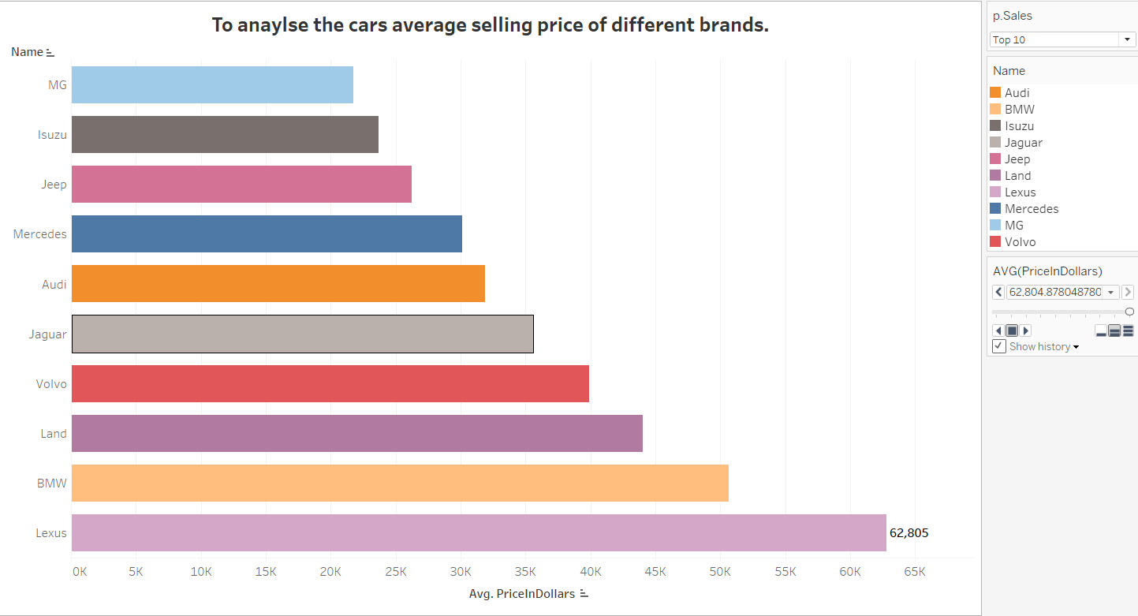
Goal:-To observe the average selling price of different car companies in United States Of America.
Story:- The below horizontal bar chart shows that the average selling price of top 10 car companies as Lexus being the highest at an average selling of his car brand at $62,805 and Then Followed by BMW at $50,656 and lowest selling car at an average price was MG at $21,748 and then by Isuzu at $23,683.

Slide 13
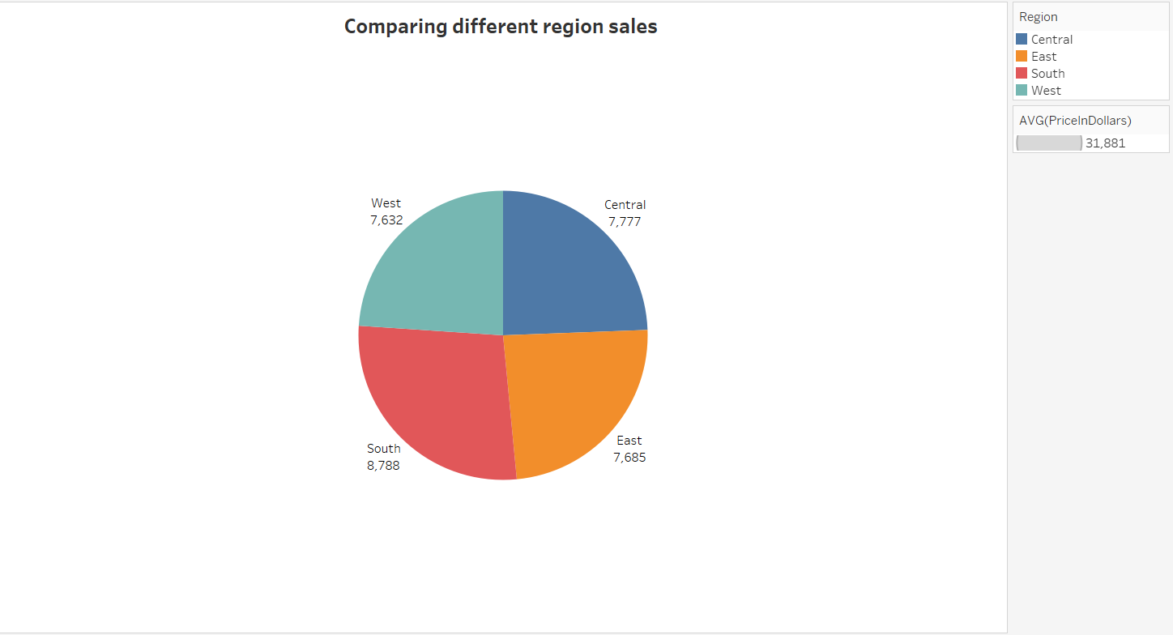
The objective is to find out region wise sales of all the car brands in USA.
Story:- Based on the pie chart shown below we have four different regions in which south region has the highest selling price 8,788$ then followed by central region as 7,777$ then by east region as 7,685 and the least was recorded by west region 7,632.

Slide 14

Conclusion
From 1994 to 2020, after the data had been examined and evaluated, objectives were established for them.
After Viewing the dashboards, it will be simple to examine the dataset on different aspects as Mileage, Miles driven across USA as in individual States

Slide 15

Thank You

