Slide 1
Design and Analysis of Algorithms
CS345
Lecture 10
A generic way to design Greedy Algorithms

Slide 2














Quiz 1
Question $3(b)$
Refuting the assertion “Least weight edge of a cycle belongs to the MST.”
Idea: Construct a cycle such that ($a,b$) is the heaviest edge of the cycle.
$$a$$
$$5$$
$$b$$
$$1$$
$$2$$
$$8$$
$$6$$
$$4$$
$$3$$
$$d$$
$$7$$
$$c$$

Slide 3
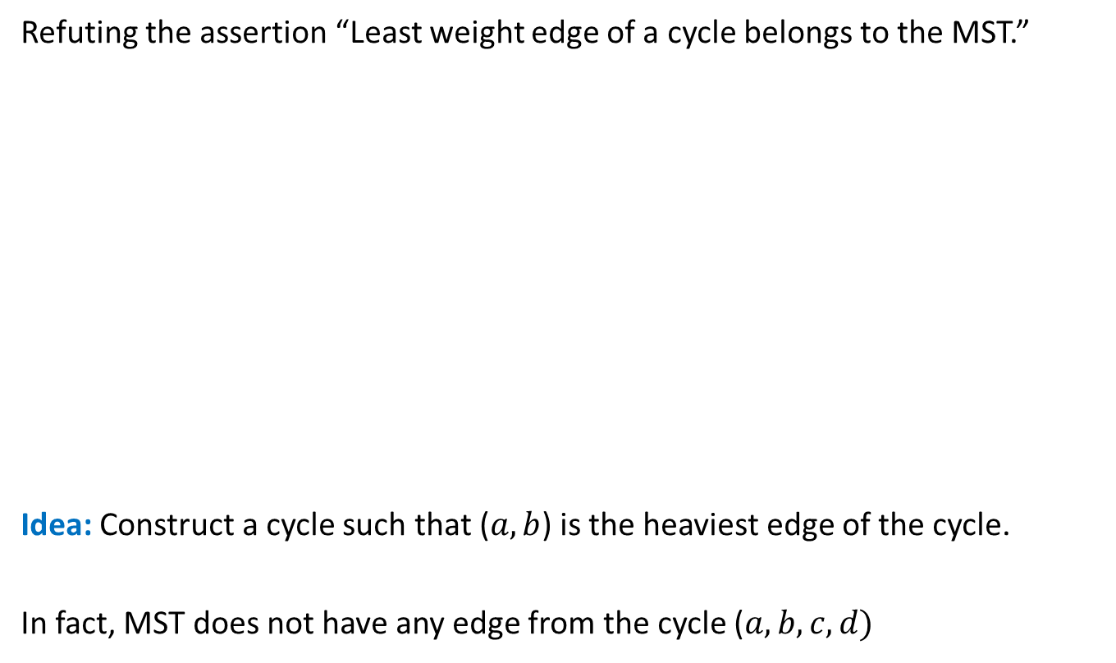
Quiz 1
Question $3(b)$
Refuting the assertion “Least weight edge of a cycle belongs to the MST.”
Idea: Construct a cycle such that ($a,b$) is the heaviest edge of the cycle.
In fact, MST does not have any edge from the cycle ($a,b,c,d)$
$$a$$
$$5$$
$$b$$
$$1$$
$$2$$
$$8$$
$$6$$
$$4$$
$$3$$
$$d$$
$$7$$
$$c$$

Slide 4

How to schedule more than 2 jobs ?
Lemma:(for 2 jobs)
Scheduling ``the earlier deadline job’’ ➔ an optimal solution
Consider any schedule
time
$$0$$

Slide 5

How to schedule more than 2 jobs ?
What if the original schedule was an optimal schedule ?
How do the jobs appear in the final schedule ?
Lemma:(for 2 jobs)
Scheduling ``the earlier deadline job’’ ➔ an optimal solution
Schedule the jobs in increasing order of their deadlines.
``jobs scheduled in the increasing order of deadline’’
is an optimal schedule
In increasing order of deadlines.
The final schedule is also an optimal schedule. ☺
Consider any schedule
time
$$0$$
Consider any pair of consecutive jobs.
If they are not scheduled in the increasing order of their deadlines,
swapping them will only minimize the maximum lateness of the schedule
By repeating this step for each pair of consecutive jobs,
we can transform the schedule into a schedule
whose maximum lateness is less than or equal to that of the original schedule.
Algorithm:
$O(n log⁡n)$ time

Slide 6
Finding the labeled binary tree for
Recap of last lecture
the optimal prefix codes

Slide 7



Optimal Prefix Coding
Algorithmic Problem: Given a set $A$of $n$alphabets and their frequencies,
compute coding $γ$ such that
$γ$ is prefix coding
$ABL\left(γ\right)$ is minimum.
Non-decreasing order of frequency
$${f(a}_{i})≤{f(a}_{i+1})$$
$a_{1}$ , $a_{2}$ , … , $a_{n}$

Slide 8


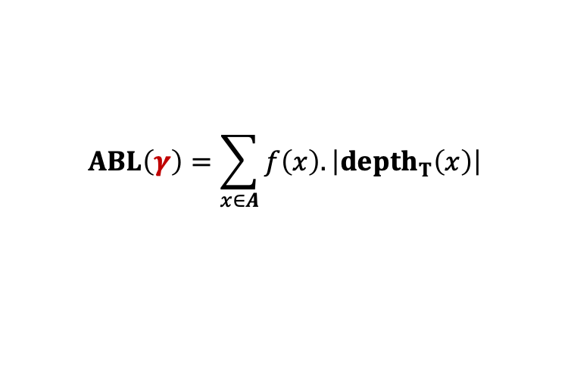

The binary tree of the optimal prefix code
0
1
0
1
0
1
. . .
1
0
1
Deepest level
$$a_{1}$$
$$a_{2}$$
Theorem: There exists an optimal prefix coding
in which $a_{1}$and $a_{2}$ appear as siblings
$$ABL\left(γ\right)=\sum_{x∈A}{f\left(x\right).\left|depth_{T}\left(x\right)\right|}$$

Slide 9
Problems solved using Greedy Paradigm
Maximum number of non-overlapping jobs
Scheduling jobs to minimize maximum lateness
Minimum Spanning tree
Adhoc solution for each problem

Slide 10



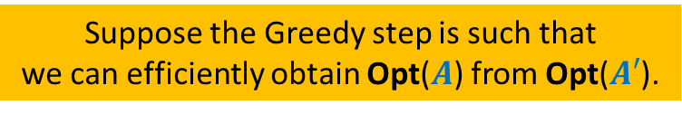

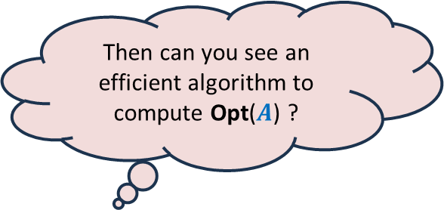




A generic way to design and analyse a greedy algorithm
Suppose the Greedy step is such that
we can efficiently obtain Opt($A$) from Opt($A′$).
P: a given optimization problem
So, all you need is to just design the Greedy step appropriately.
Opt($A$)
$$A$$
instance of size $n$of problem P
Then can you see an efficient algorithm to compute Opt($A$) ?
Greedy
step
?
Opt($A′$)
$$A′$$
instance of size $<n$of problem P
Ponder over this inference for some time.
Isn’t it amazing ?
Greedy
step
Yes, a simple recursive algorithm.☺
$$A′′$$
…
Opt($A′$)
Base case
Notes:
Let us illustrate its usefulness with the help of an example.

Slide 11
Example
Minimum spanning tree

Slide 12

instance $A$
170
54
33
63
35
50
70
31
41
81
64
78
53
42
52
80
49
54
42
60
44
43
50
30
49
57
29
102

Slide 13

instance $A$
Theorem 1 : There is an MST($A$) with edge (u,v)
170
54
33
63
35
50
70
31
41
81
64
78
53
42
52
80
49
54
42
60
44
43
50
30
49
57
u
29
102
v

Slide 14


instance $A′$
Theorem 1 : There is an MST($A$) with edge (u,v)
170
54
33
63
35
50
70
31
41
81
64
78
53
42
52
80
49
54
42
44
60
43
50
30
49
57
w
102

Slide 15
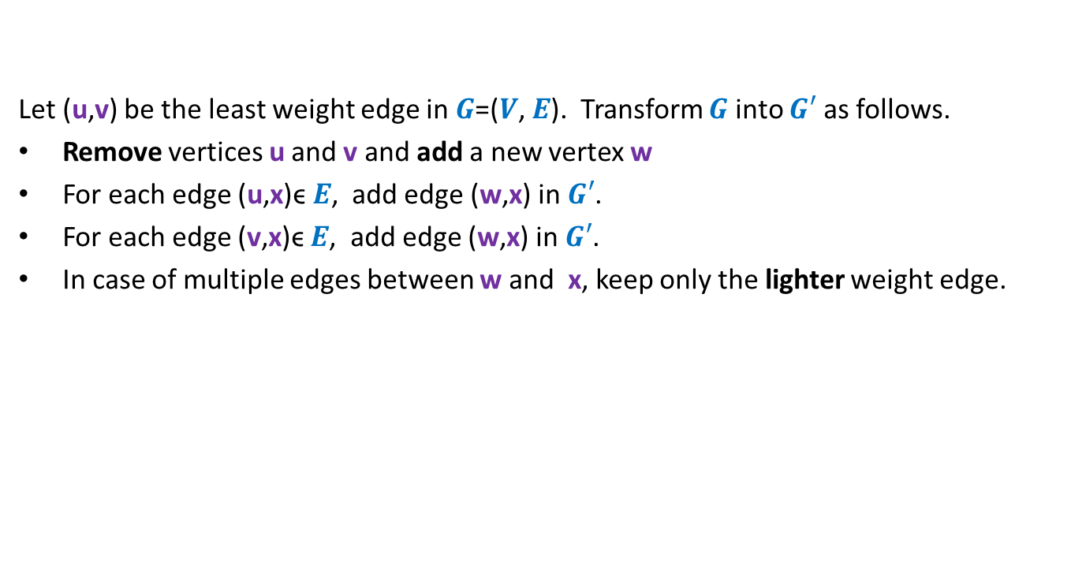

How to compute instance $A′$ ?
Let (u,v) be the least weight edge in $G$=($V$, $E$). Transform $G$ into $G′$ as follows.
Remove vertices u and v and add a new vertex w
For each edge (u,x)ϵ $E$, add edge (w,x) in $G′$.
For each edge (v,x)ϵ $E$, add edge (w,x) in $G′$.
In case of multiple edges between w and x, keep only the lighter weight edge.

Slide 16




Homework
Weight of MST($A$) $=$ Weight of MST($A′$) $+$w(u,v)
In the rest of the lecture, we shall discuss a technique which will also help you do this homework.
MST($A$)
$$A$$
Greedy
step
How ?
Using Theorem 1
MST($A′$)
$$A′$$

Slide 17
Finding the labeled binary tree for
the optimal prefix codes

Slide 18

The binary tree of the optimal prefix code
From this picture, can you design the greedy step that you will perform to compute the smaller instance ?
0
1
0
1
0
1
. . .
1
0
1
Deepest level
$$a_{1}$$
$$a_{2}$$
Theorem 2: There exists an optimal prefix coding
in which $a_{1}$and $a_{2}$ appear as siblings

Slide 19

The binary tree of the optimal prefix code
0
1
0
1
0
1
. . .
1
Deepest level
$a$’

Slide 20


The binary tree of the optimal prefix code
0
1
0
1
0
1
. . .
1
$a$’
Deepest level
$f\left(a\text{’}\right)=$ $f\left(a_{1}\right)+f\left(a_{2}\right)$

Slide 21
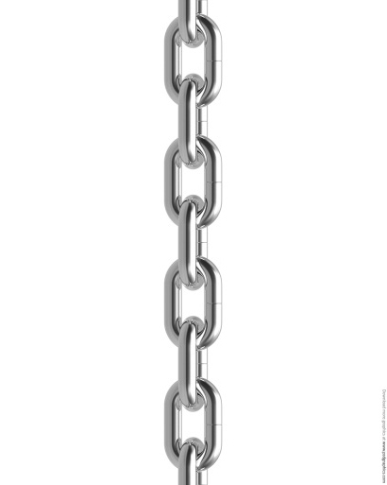



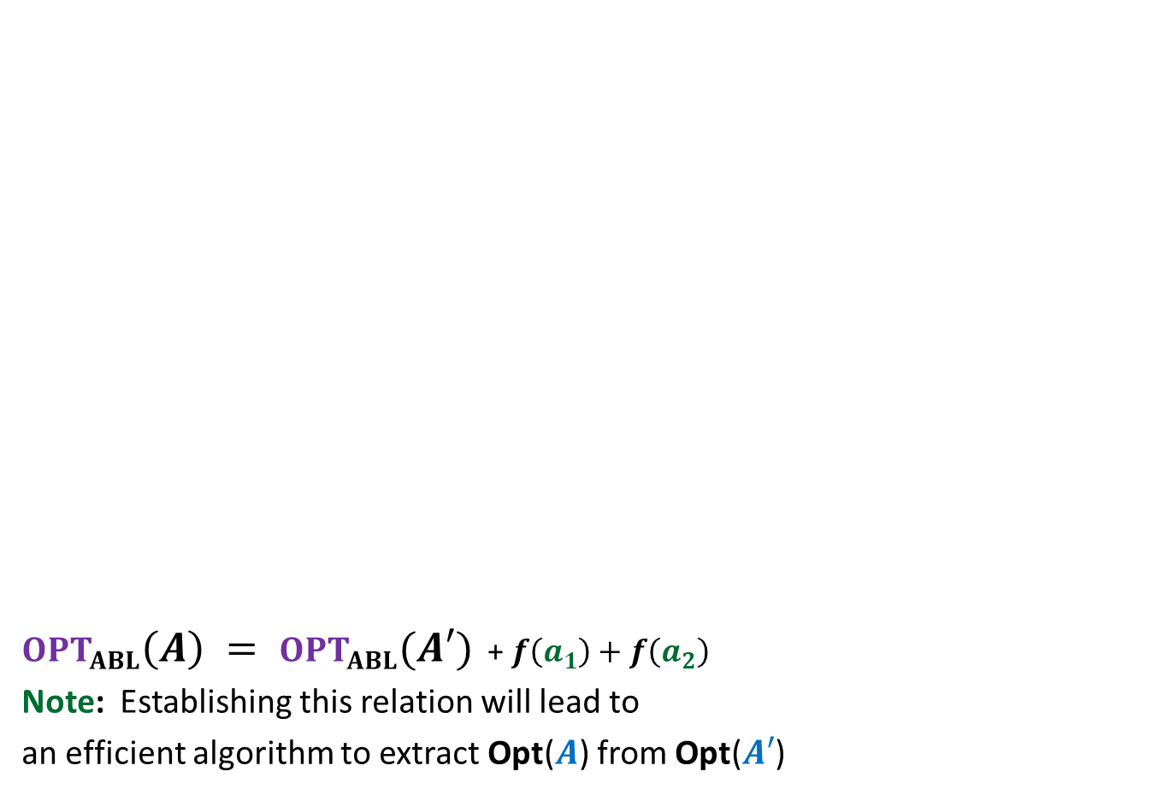





$OPT_{ABL}\left(A\right) = OPT_{ABL}(A′)$ + $f\left(a_{1}\right)+f\left(a_{2}\right)$
Note: Establishing this relation will lead to
an efficient algorithm to extract Opt($A$) from Opt($A′$)
Opt($A$)
$$A$$
$a_{1}$, $a_{2}$, $a_{3}$ , … … $a_{n}$
Greedy
step
Relation ?
Opt($A′$)
$$A′$$
$a_{3}$ , … … $a_{n}$
$$a′$$
$f\left(a\text{’}\right)=$ $f\left(a_{1}\right)+f\left(a_{2}\right)$
?

Slide 22
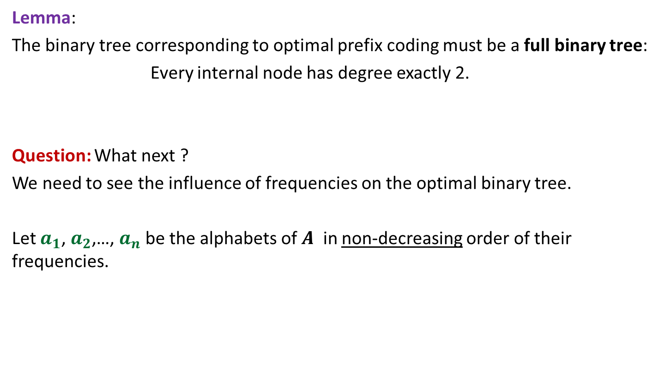
Proof for
$OPT_{ABL}\left(A\right)=OPT_{ABL}(A′)$ + $f\left(a_{1}\right)+f\left(a_{2}\right)$
Spend some time thinking about the proof
before moving ahead.
☺

Slide 23

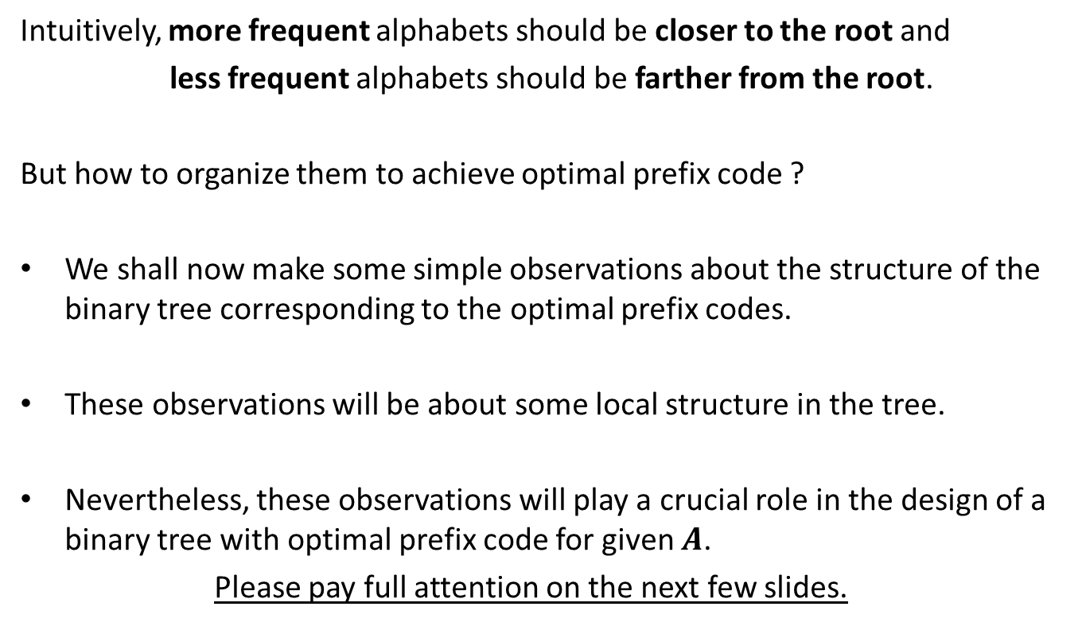
How to prove
$OPT_{ABL}\left(A\right)=OPT_{ABL}(A′)$ + $f\left(a_{1}\right)+f\left(a_{2}\right)$ ?
Question: Can we derive a prefix coding for $A$from $OPT(A′)$ ?
Question: Can we derive a prefix coding for $A′$from $OPT(A)$ ?

Slide 24


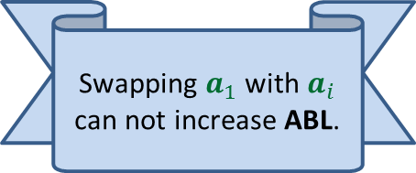

A prefix coding for $A$from $OPT\left(A^{′}\right)$
$T′$: the binary tree corresponding to $OPT_{ABL}(A′)$
0
1
0
1
0
1
$$T′$$
. . .
1
$a$’

Slide 25



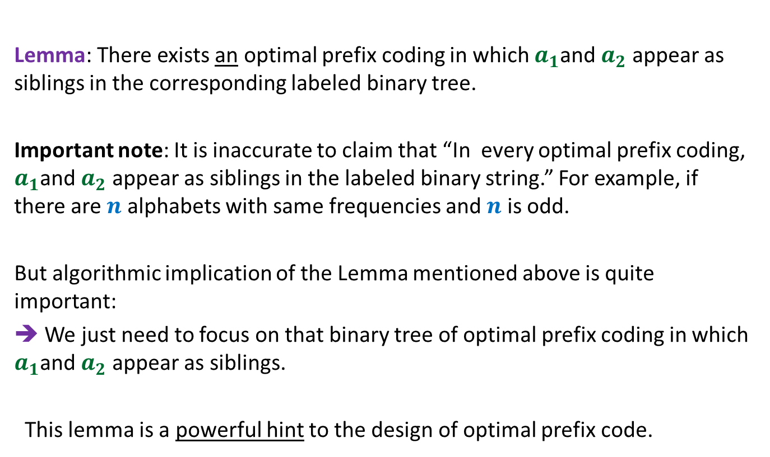


A prefix coding for $A$from $OPT\left(A^{′}\right)$
$T′$: the binary tree corresponding to $OPT_{ABL}(A′)$
This gives a prefix coding for $A$ with $ABL$ = ??
➔ $OPT_{ABL}\left(A\right)≤OPT_{ABL}(A′)$ + $f\left(a_{1}\right)+f\left(a_{2}\right)$
0
1
0
1
0
1
$$T′$$
. . .
1
0
1
$a$’
$$a_{1}$$
$$a_{2}$$
$OPT_{ABL}(A′)$ + $f\left(a_{1}\right)+f\left(a_{2}\right)$

Slide 26





A prefix coding for $A′$from $OPT(A)$
$T$: the binary tree corresponding to $OPT_{ABL}(A)$
0
1
Using Theorem 2
0
1
0
1
$$T$$
. . .
1
0
1
Deepest level
$$a_{1}$$
$$a_{2}$$

Slide 27

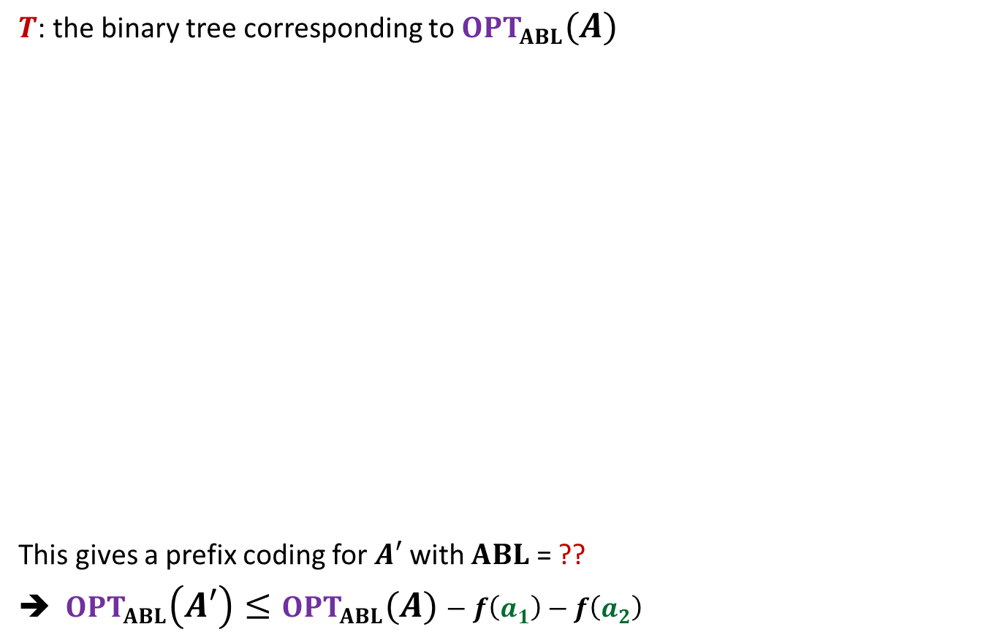

A prefix coding for $A′$from $OPT(A)$
$T$: the binary tree corresponding to $OPT_{ABL}(A)$
This gives a prefix coding for $A′$ with $ABL$ = ??
➔ $OPT_{ABL}\left(A′\right)≤OPT_{ABL}(A)−f\left(a_{1}\right)−f\left(a_{2}\right)$
0
1
Using Theorem 2
0
1
0
1
$$T$$
. . .
1
0
1
$a$’
Deepest level
$$a_{1}$$
$$a_{2}$$
$$OPT_{ABL}\left(A\right)−f\left(a_{1}\right)−f\left(a_{2}\right)$$

Slide 28
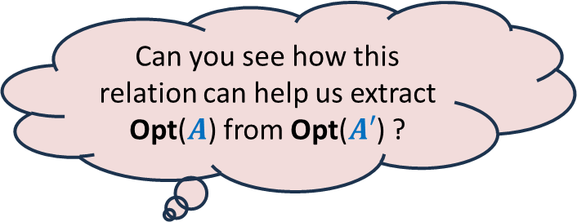
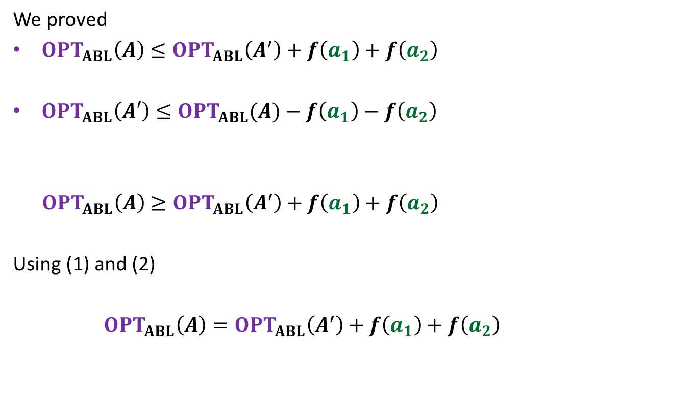
We proved
$OPT_{ABL}\left(A\right)≤OPT_{ABL}\left(A^{′}\right)+f\left(a_{1}\right)+f\left(a_{2}\right)$
$OPT_{ABL}\left(A′\right)≤OPT_{ABL}(A)−f\left(a_{1}\right)−f\left(a_{2}\right)$
$OPT_{ABL}\left(A\right)≥OPT_{ABL}\left(A^{′}\right)+f\left(a_{1}\right)+f\left(a_{2}\right)$
Using (1) and (2)
$OPT_{ABL}\left(A\right)=OPT_{ABL}\left(A^{′}\right)+f\left(a_{1}\right)+f\left(a_{2}\right)$
(1)
Can you see how this relation can help us extract Opt($A$) from Opt($A′$) ?
(2)

Slide 29

We have established
$$OPT_{ABL}\left(A\right)=OPT_{ABL}\left(A^{′}\right)+f\left(a_{1}\right)+f\left(a_{2}\right)$$
A prefix coding for $A$from $OPT\left(A^{′}\right)$
So
$T′$: the binary tree corresponding to $OPT_{ABL}(A′)$
This gives a prefix coding for $A$ with $ABL$ = ??
➔ $OPT_{ABL}\left(A\right)≤OPT_{ABL}(A′)$ + $f\left(a_{1}\right)+f\left(a_{2}\right)$
0
1
0
1
0
1
$$T′$$
. . .
1
0
1
$a$’
$$a_{1}$$
$$a_{2}$$
$OPT_{ABL}(A′)$ + $f\left(a_{1}\right)+f\left(a_{2}\right)$
$$=$$

Slide 30

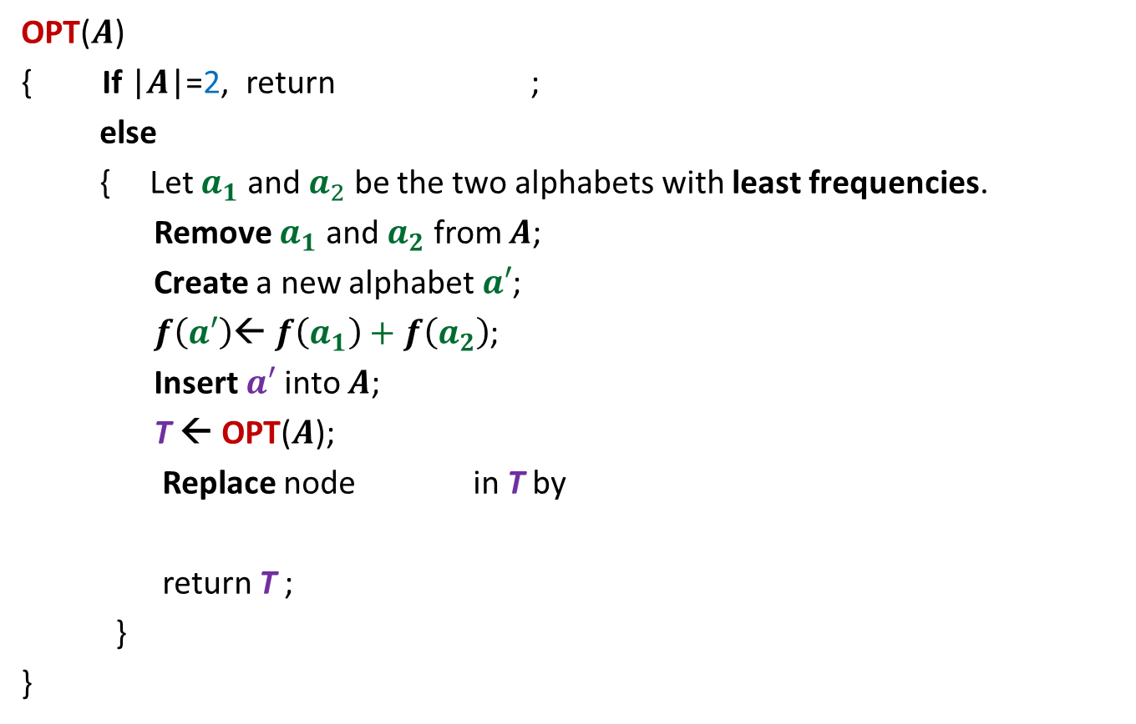







The algorithm based on
$OPT_{ABL}\left(A\right)=OPT_{ABL}(A′)$ + $f\left(a_{1}\right)+f\left(a_{2}\right)$
OPT($A$)
{ If |$A$|=2, return ;
else
{ Let $a_{1}$ and $a_{2}$ be the two alphabets with least frequencies.
Remove $a_{1}$ and $a_{2}$ from $A$;
Create a new alphabet $a′$;
$f\left(a′\right)$← $f\left(a_{1}\right)+f\left(a_{2}\right)$;
Insert $a′$into $A$;
T ← OPT($A$);
Replace node in T by
return T ;
}
}
0
1
$$a_{1}$$
$$a_{2}$$
$O(n^{2})$ time complexity
Homework:
Achieve $O(n log n)$ time complexity
0
1
$a$’
$$a_{1}$$
$$a_{2}$$

Slide 31






A generic way to design and analyse a greedy algorithm
P: a given optimization problem
1. Try to establish a relation between OPT($A$) and OPT($A′$);
2. Try to prove the relation formally by
deriving a solution of $A$ from OPT($A′$)
deriving a solution of $A′$ from OPT($A$)
If you succeed,
you have an algorithm
Opt($A$)
$$A$$
instance of size $n$of problem P
Greedy
step
based on a suitable Theorem about Opt($A$)
Opt($A′$)
$$A′$$
instance of size $<n$of problem P
from construction
use Theorem

Slide 32
More Homework

Slide 33

The 2 problems we discussed
Largest set of non-overlapping jobs
Scheduling jobs to minimize maximum lateness
$$0$$
time
Design and analyse a greed algorithm based on the generic technique.

