Slide 1
Design and Analysis of Algorithms
CS345
Lecture 11
Shortest paths in graphs with positive weights

Slide 2
Recap of last lecture

Slide 3
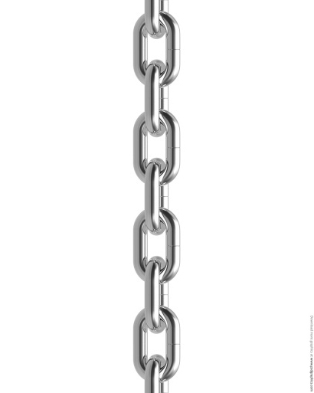
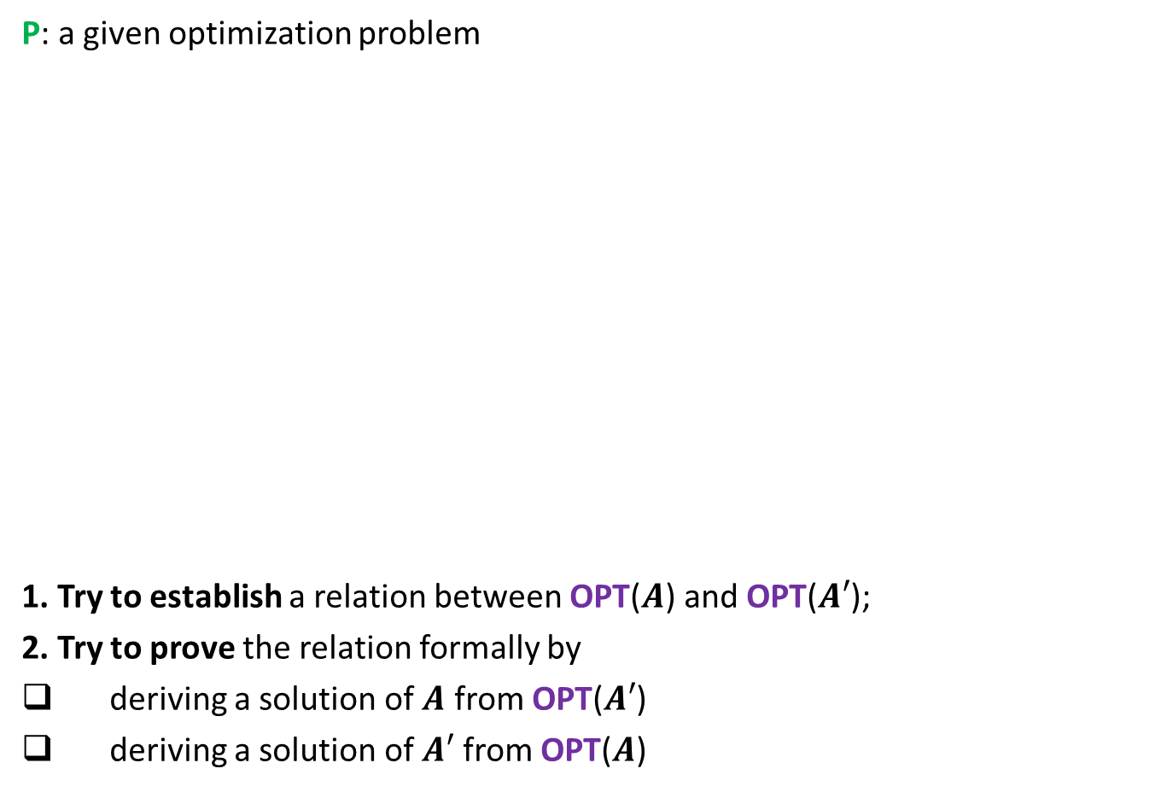






A generic way to design and analyse a greedy algorithm
P: a given optimization problem
1. Try to establish a relation between OPT($A$) and OPT($A′$);
2. Try to prove the relation formally by
deriving a solution of $A$ from OPT($A′$)
deriving a solution of $A′$ from OPT($A$)
If you succeed,
you have a recursive algorithm
Opt($A$)
$$A$$
instance of size $n$of problem P
Greedy
step
based on a suitable Theorem about Opt($A$)
Opt($A′$)
$$A′$$
instance of size $<n$of problem P
from construction
use Theorem

Slide 4
Single Source Shortest Paths
in
Graphs with non-negative weights
Internalizing an algorithm is different from just knowing an algorithm.
Go through these slides slowly, pondering over the observations,
and attempting questions posed there.
This is an opportunity for you to
(1) re-invent the algorithm and
(2) realize the proof of correctness.

Slide 5


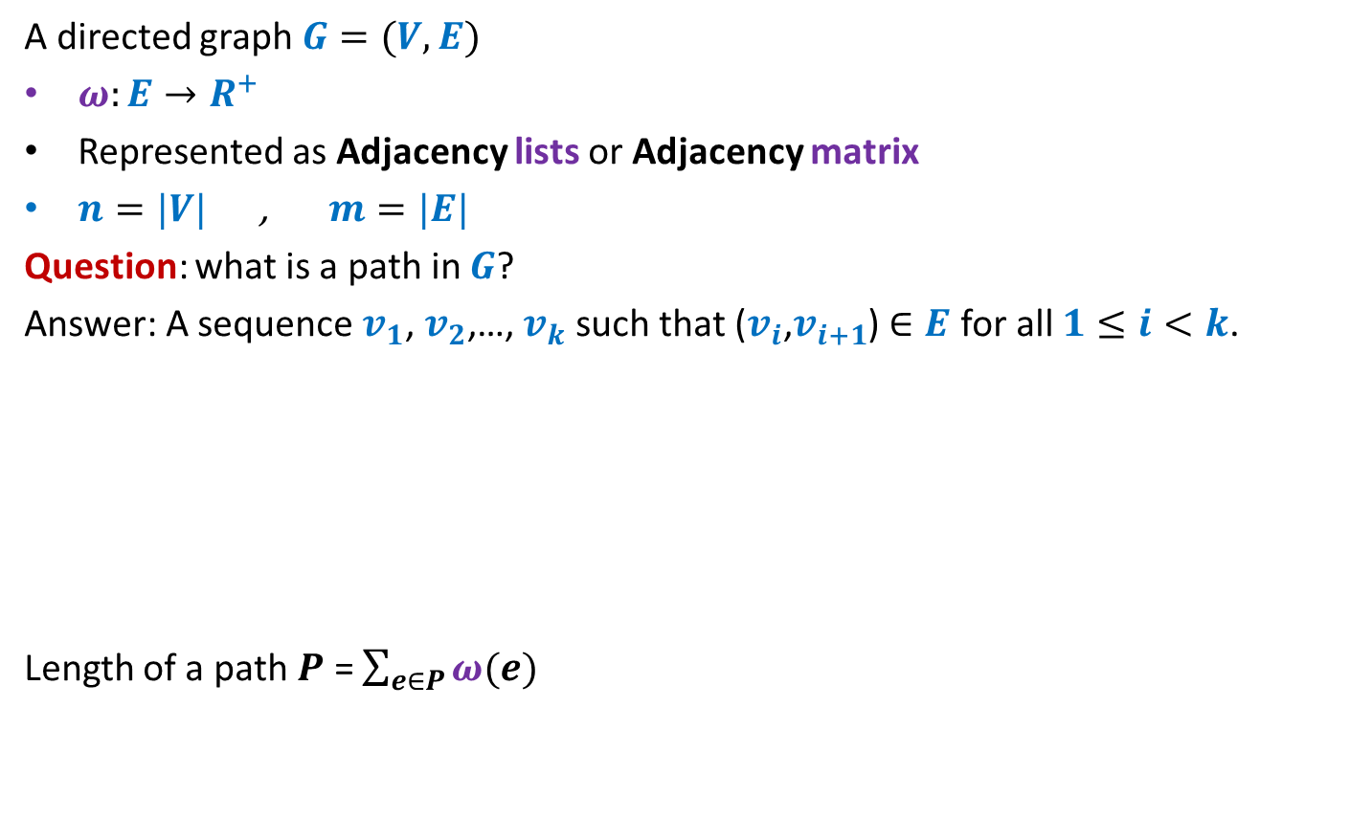



Notations and Terminologies
A directed graph $G=(V,E)$
$ω:E→R^{+}$
Represented as Adjacency lists or Adjacency matrix
$n=|V|$ , $m=|E|$
Question: what is a path in $G$?
Answer: A sequence $v_{1}$, $v_{2}$,…, $v_{k}$ such that ($v_{i}$,$v_{i+1}$) $∈E$ for all $1≤i<k$.
Length of a path $P$ = $\sum_{e∈P}{ω(e)}$
No vertex is repeated
12
3
…
29
$$v_{1}$$
$$v_{2}$$
$$v_{3}$$
$$v_{k−1}$$
$$v_{k}$$

Slide 6
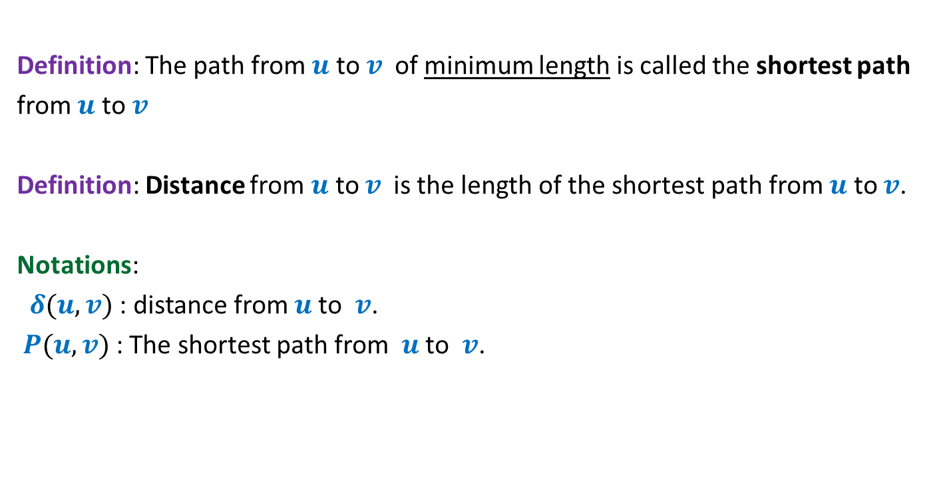
Notations and Terminologies
Definition: The path from $u$ to $v$of minimum length is called the shortest path
from $u$ to $v$
Definition: Distance from $u$ to $v$is the length of the shortest path from $u$ to $v$.
Notations:
$δ(u,v)$ : distance from $u$to $v$.
$P(u,v)$ : The shortest path from $u$to $v$.

Slide 7
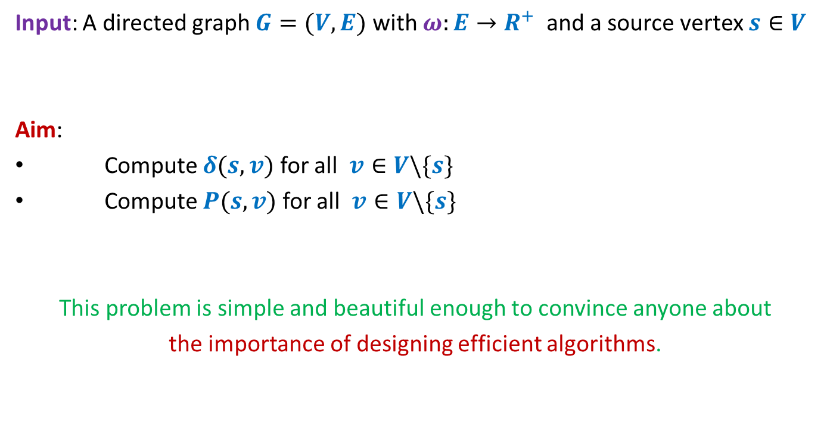
Problem Definition
Input: A directed graph $G=(V,E)$ with $ω:E→R^{+}$ and a source vertex $s∈V$
Aim:
Compute $δ(s,v)$ for all $v∈V\backslash \{s\}$
Compute $P(s,v)$ for all $v∈V\backslash \{s\}$
This problem is simple and beautiful enough to convince anyone about
the importance of designing efficient algorithms.

Slide 8


An example to get an insight into this problem
Inference:
The distance to any vertex depends upon global parameters.
$$q$$
5
7
6
12
G
$$s$$
16
4
9
11

Slide 9


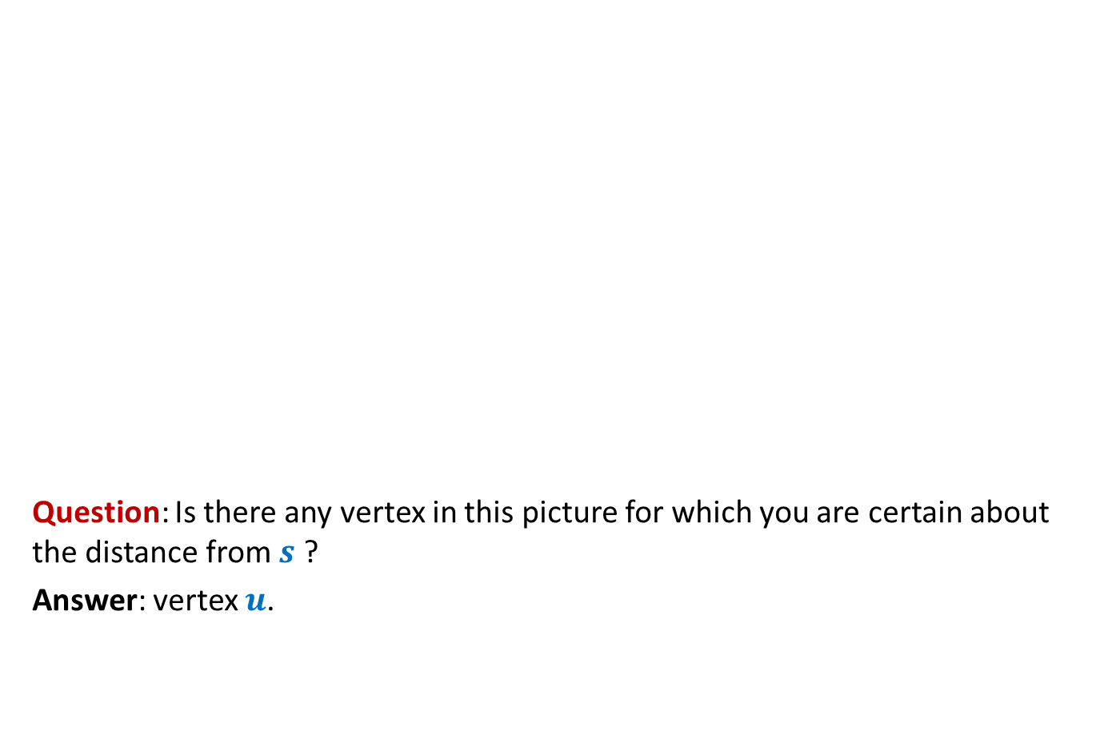



An example to get an insight into this problem
Question: Is there any vertex in this picture for which you are certain about the distance from $s$ ?
Answer: vertex $u$.
$$z$$
$$v$$
10
G
12
7
$$x$$
$$s$$
3
5
$$u$$
$$y$$
Give reasons.

Slide 10




An example to get an insight into this problem
➔ The shortest path to vertex $u$ is edge ($s$,$u$).
$$z$$
$$v$$
10
G
12
7
$$x$$
$$s$$
3
5
$$u$$
$$y$$
$$>0$$
The nearest vertex of $s$ must be $s$’s neighbor.

Slide 11







Designing a greedy algorithm for shortest paths
Using generic strategy
What should be the greedy step such that
“we can retrieve distance from $s$in $G$ using distance from $s$in $G′$ ” ?
Opt($G$)
$$G$$
instance of size $n$
Greedy
step
?
Opt($G′$)
$$G′$$
instance of size $<n$

Slide 12
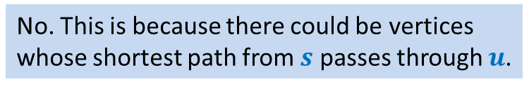
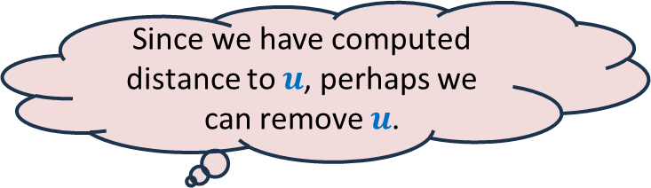



An example to get an insight into this problem
We know the distance to $u$.
Question: Can you remove vertex $u$ without affecting the distance from $s$ ?
$$z$$
$$v$$
10
G
12
7
2
$$x$$
$$s$$
21
$$t$$
3
5
$$u$$
3
8
$$y$$
$$r$$
Since we have computed distance to $u$, perhaps we can remove $u$.
No. This is because there could be vertices
whose shortest path from $s$ passes through $u$.

Slide 13

An example to get an insight into this problem
$$z$$
$$v$$
10
12
7
+3
G’
2
+3
$$x$$
21
$$t$$
$$s$$
5
+3
+3
8
3
$$y$$
$$r$$

Slide 14

An example to get an insight into this problem
Theorem: For each $v∈V\backslash \{s,u\}$,
$$δ_{G}\left(s,v\right)=δ_{G^{′}}\left(s,v\right)$$
$$z$$
$$v$$
10
G’
12
7
5
$$x$$
24
$$t$$
$$s$$
5
6
11
$$y$$
$$r$$

Slide 15
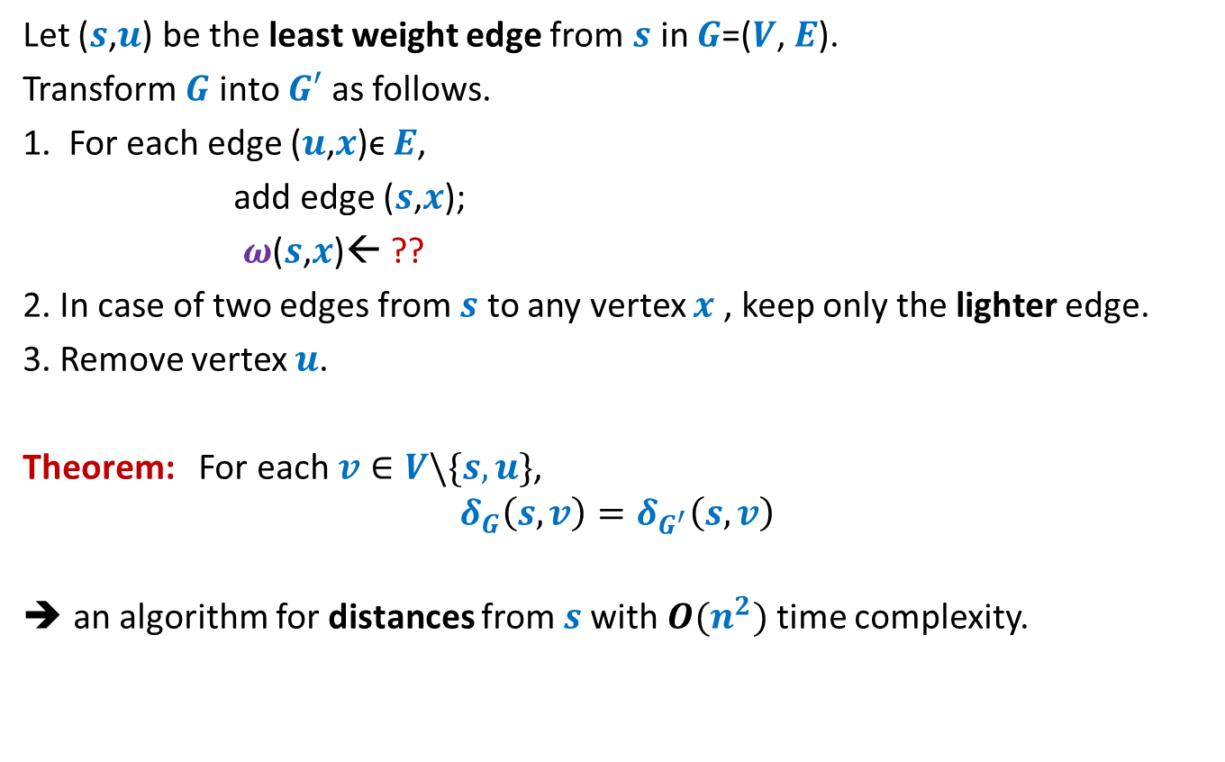


How to compute instance $G′$
Let ($s$,$u$) be the least weight edge from $s$ in $G$=($V$, $E$).
Transform $G$ into $G′$ as follows.
1. For each edge ($u$,$x$)ϵ $E$,
add edge ($s$,$x$);
$ω$($s$,$x$)← ??
2. In case of two edges from $s$ to any vertex $x$ , keep only the lighter edge.
3. Remove vertex $u$.
Theorem: For each $v∈V\backslash \{s,u\}$,
$$δ_{G}\left(s,v\right)=δ_{G^{′}}\left(s,v\right)$$
an algorithm for distances from $s$with $O(n^{2})$ time complexity.
$ω$($s$,$u$) + $ω$($u$,$x$);
Can you see some negative points of this algorithm ?

Slide 16
Shortcomings of the algorithm
No insight into the (beautiful) structure of shortest paths.
Just convinces that we can solve the shortest paths problem in polynomial time.
Very few options to improve the time complexity.
Silent about a compact data structure for storing all shortest paths from the source.
We shall now design a very insightful algorithm based on properties of shortest paths.

Slide 17
Properties of a shortest path

Slide 18






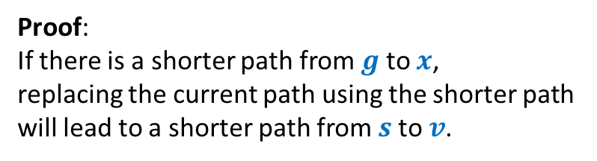


Optimal subpath property
Homework: Write a complete and formal proof for Lemma 1
Consider any shortest path $P(s,v)$.
$δ(s,v)$= 51
Lemma 1: Every subpath of a shortest path is also a shortest path.
Can you realize an assumption made by you in this proof ?
< 27
12
3
7
5
15
9
$$s$$
$$a$$
$$g$$
$$y$$
$$u$$
$$x$$
$v$
?
Proof:
If there is a shorter path from $g$ to $x$,
replacing the current path using the shorter path
will lead to a shorter path from $s$to $v$.

Slide 19



Exploiting the non-negative weight on edges
Consider once again a shortest path $P(s,v)$.
➔ $δ\left(s,a\right)≤δ\left(s,g\right)≤δ\left(s,y\right)≤δ\left(s,u\right)≤δ\left(s,x\right)≤δ(s,v)$
This leads to an alternate proof to the following assertion ☺:
The nearest vertex of $s$ must be $s$’s neighbor.
Can you realize this observation ?
$$≥0$$
$$≥0$$
$$≥0$$
$$≥0$$
$$≥0$$
$$≥0$$
$$s$$
$$a$$
$$g$$
$$y$$
$$u$$
$$x$$
$v$
(1)

Slide 20







More insights …
What can we say about $x$ ?
Let $s_{i}$ : $i$th nearest vertex from $s$.
$s_{0}$ = $s$.
Consider the shortest path $P\left(s,s_{i}\right)$.
Lemma 2: $P\left(s,s_{i}\right)$ must be of the form $s ⇝$ $s_{j} →s_{i}$ for some $j<i$.
$x$ must be $s_{j}$ for some $j<i$.
$$s$$
$$x$$
$s_{i}$
shortest
What picture captures all shortest paths from $s$?

Slide 21








Complete picture of all shortest paths ?
Shortest paths tree
$$s$$
$$s_{4}$$
$$s_{1}$$
$$s_{7}$$
$$s_{5}$$
$$s_{2}$$
$$s_{3}$$
$$s_{6}$$

Slide 22
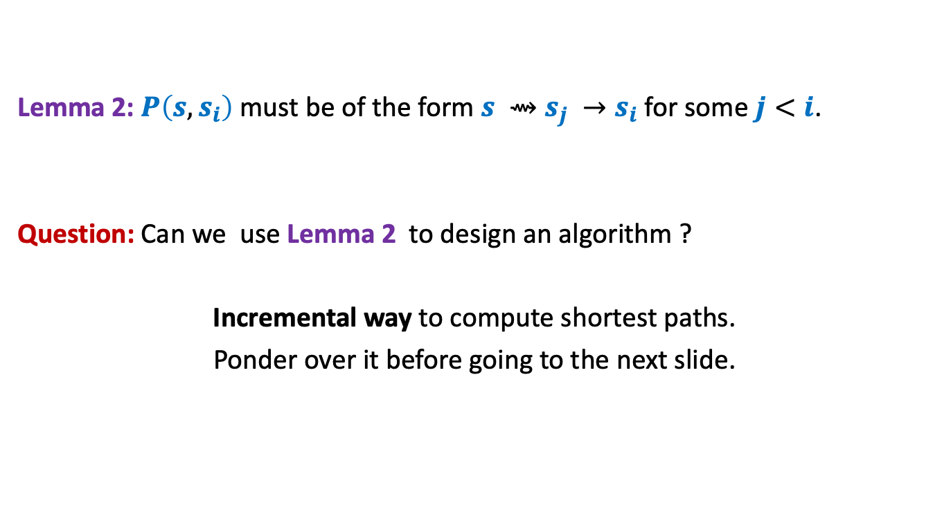
Designing the algorithm …
Lemma 2: $P\left(s,s_{i}\right)$ must be of the form $s ⇝$ $s_{j} →s_{i}$ for some $j<i$.
Question: Can we use Lemma 2 to design an algorithm ?
Incremental way to compute shortest paths.
Ponder over it before going to the next slide.
shortest

Slide 23



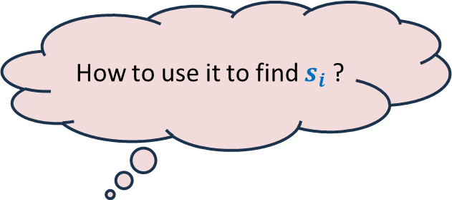

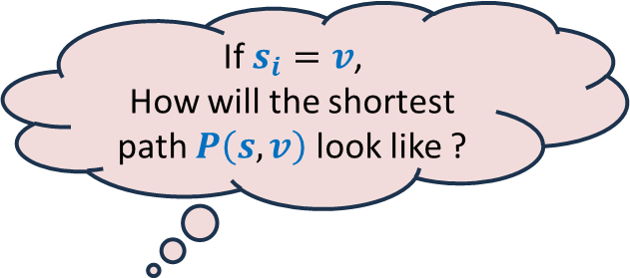
Suppose we have computed $s_{0}$, $s_{1}$,…, $s_{i−1}$.
How to find out $s_{i}$ ?
Using Lemma 2
Consider any $v∈V \backslash \{s_{0}\text{,} s_{1}\text{,…,} s_{i−1}\}$
Or
Or
$$s$$
G
$$s_{1}$$
$$s_{4}$$
$$v$$
$$s_{2}$$
$$s_{3}$$
If $s_{i}=v$,
How will the shortest path $P\left(s,v\right)$ look like ?
How to use it to find $s_{i}$ ?
Let us define a function $L\left(v\right)$
We need to just focus on
the edges incident on $v$ from $s_{0}$, $s_{1}$,…, $s_{i−1}$.
Isn’t it nice ☺ ?
Ponder over its usefulness before proceeding further.

Slide 24


Suppose we have computed $s_{1}$, $s_{2}$,…, $s_{i−1}$.
How to find out $s_{i}$ ?
For each $v∈V \backslash \{s_{1}\text{,} s_{2}\text{,…,} s_{i−1}\}$
$$L\left(v\right)=$$
$s_{i}$ is ??
Using Lemma 2
88
101
$$s$$
G
51
$$s_{1}$$
$$s_{4}$$
82
$$v$$
76
$$s_{2}$$
90
$$s_{3}$$
62
$$\left(δ\left(s,s_{j}\right)+ω\left(s_{j},v\right)\right)$$
$$\min_{\left({(s}_{j},v\right)∈E)}{ ? }$$
the vertex with minimum value of $L$.
Which vertex is $s_{i}$ ?

Slide 25



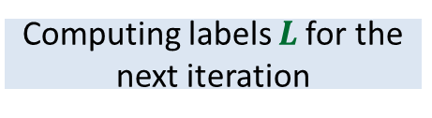
Dijkstra’s algorithm
Dijkstra-algo($s$,$G$)
$U$ ← $V$;
$L\left(s\right)$← $0$;
For $i$ = 0 to $n−1$ do
{ $y$← vertex from $U$ with minimum value of $L$;
$δ\left(s,y\right)\text{←}L\left(y\right)$;
move $y$ from $U$ to $S$;
For each $v∈U$ do
{ $L\left(v\right)$← $∞$;
For each $(x,v)∈E$ with $x∈S$do
$L\left(v\right) \text{←}$ min( $L\left(v\right)$, $δ\left(s,x\right)+ω\left(x,v\right)$ )
}
}
Only neighbors of $y$
$L\left(v\right)$← $∞$ for all $v∈U$ ;
Computing labels $L$for the next iteration
What are the vertices
whose $L$ value may change
in this iteration ?
a lot of re-computation

Slide 26

Dijkstra’s algorithm
Dijkstra-algo($s$,$G$)
$U$ ← $V$;
$L\left(s\right)$← $0$;
For $i$ = 0 to $n−1$ do
{ $y$← vertex from $U$ with minimum value of $L$;
$δ\left(s,y\right)\text{←}L\left(y\right)$;
move $y$ from $U$ to $S$;
For each $(y,v)∈E$ with $v∈U$do
{
$L\left(v\right) \text{←}$ min( $L\left(v\right)$, $δ\left(s,y\right)+ω\left(y,v\right)$ )
}
}
$L\left(v\right)$← $∞$ for all $v∈U$ ;
1 extract-min operation
deg($y$) Decrease-key operations

Slide 27
Homework
What data structure is to be used to efficiently implement the Dijkstra’s algorithm?
Write a neat pseudocode in terms of the data structure.
What is the time complexity of the implementation ?

