Slide 1
Design and Analysis of Algorithms
CS345
Lecture 12
Algorithms
for Directed Acyclic Graphs

Slide 2

















Question 4 from Quiz $1$
(Stable matching)
$$M_{1}$$
$$W_{1}$$
$$W_{1}$$
$$M_{1}$$
$$M_{2}$$
$$W_{2}$$
$$W_{2}$$
$$M_{2}$$
$$M_{3}$$
$$W_{4}$$
$$W_{3}$$
$$M_{3}$$
$$M_{4}$$
$$W_{3}$$
$$W_{4}$$
$$M_{4}$$
This solution was arrived at interactively in the class.

Slide 3
Recap of last lecture

Slide 4
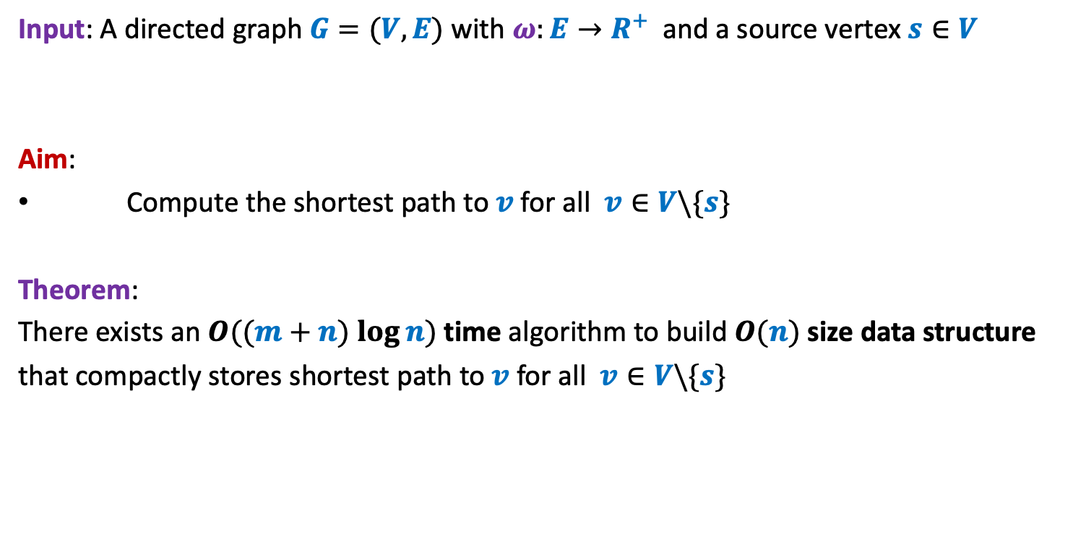
Problem Definition
Input: A directed graph $G=(V,E)$ with $ω:E→R^{+}$ and a source vertex $s∈V$
Aim:
Compute the shortest path to $v$for all $v∈V\backslash \{s\}$
Theorem:
There exists an $O((m+n) log⁡n)$ time algorithm to build $O(n)$ size data structure
that compactly stores shortest path to $v$for all $v∈V\backslash \{s\}$

Slide 5
Take a pause
Maximum Spanning Tree Minimum Spanning tree
Longest path to each vertex ?
No polynomial time algorithm till date !

Slide 6
Imagine there were no research in Algorithms. And you are asked to write a program to compute shortest paths from source s to every vertex. Your first attempt would have been to enumerate all paths from source and then report the path which is shortest. But the number of paths from source to any vertex can be exponential. So you would have felt the hardness of the shortest paths problem. May be, you would work hard with perseverance for weeks, and end up designing the algorithm which we call Dijkstra’s algorithm today.
But consider the situation now when the area of algorithm is quite developed (very active for more than 50 years). But the best algorithm the researchers have designed till date for the longest paths problem takes exponential time ! What would be your reaction to this reality ?
Frustration, feeling down ? (not good for a person with true scientific spirit)
Curiosity (natural)
There are hundreds of such algorithmic problems in computer science for which the fastest algorithm till date takes only exponential time.
Towards the end of this course, we shall discuss a theory of such a family of problems.
“Theory of NP complete problems”
With this note, we begin today’s lecture.

Slide 7
Directed Acyclic Graphs

Slide 8






Directed Acyclic Graphs
Question: what is a cycle in $G$?
Answer: A sequence $v_{1}$, $v_{2}$,…, $v_{k}$ such that ($v_{i}$,$v_{i+1}$) $∈E$ for all $1≤i<k$
and ($v_{k}$,$v_{1}$) $∈E$ .
…
$$v_{1}$$
$$v_{2}$$
$$v_{3}$$
$$v_{k−1}$$
$$v_{k}$$

Slide 9
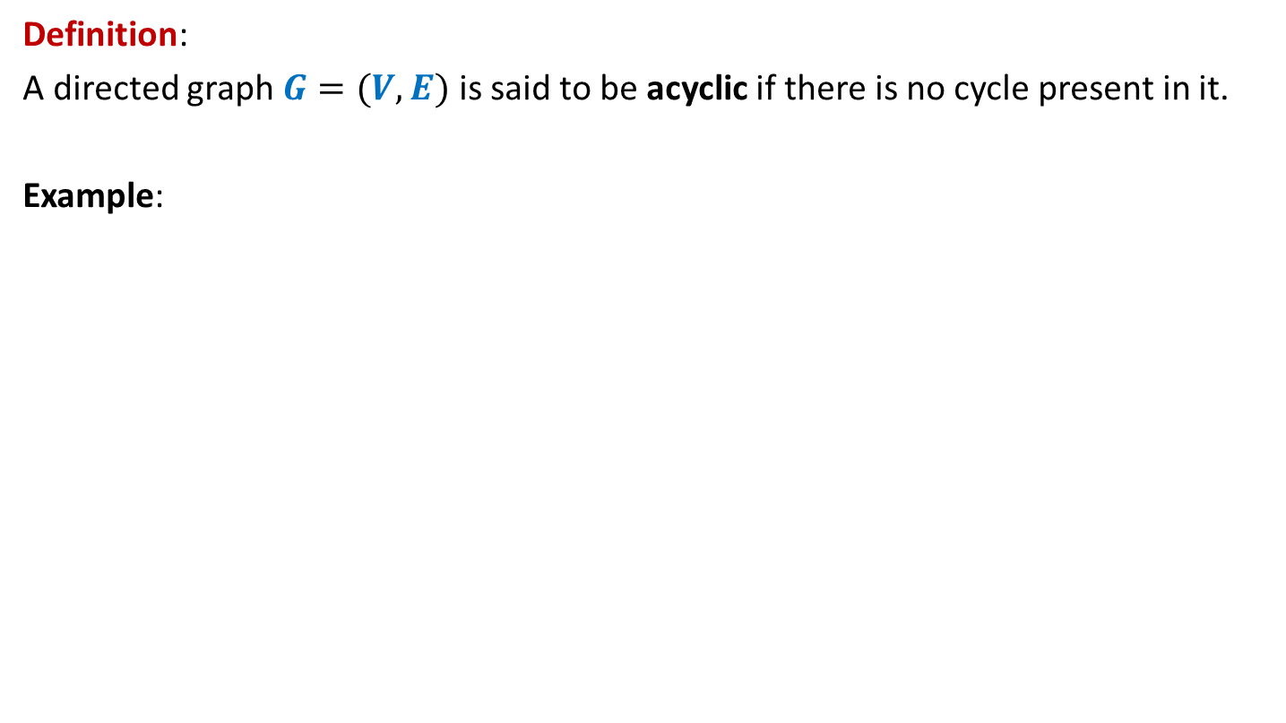
Directed Acyclic Graphs
Definition:
A directed graph $G=(V,E)$ is said to be acyclic if there is no cycle present in it.
Example:
u
DAG
z
b
v
y
x
w
a

Slide 10

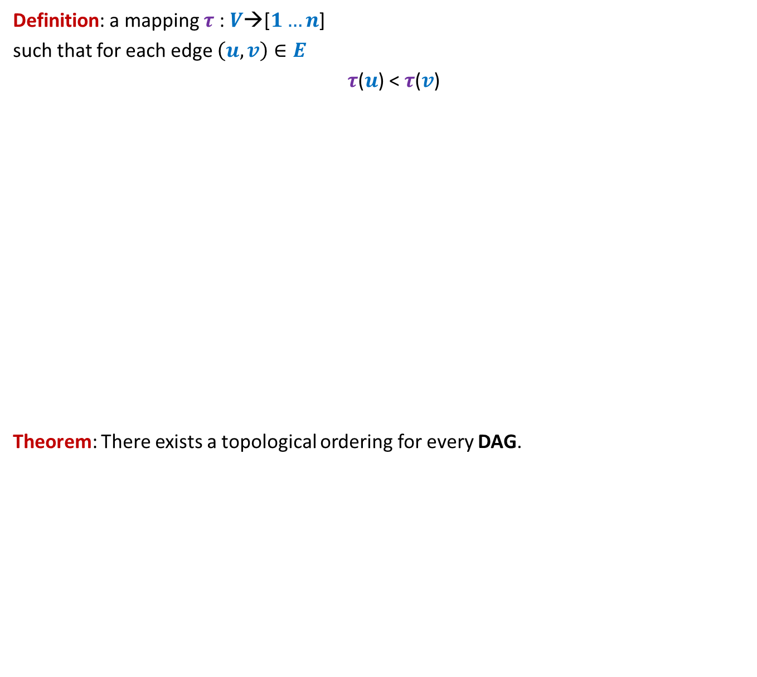
Topological ordering
Definition: a mapping $τ$ : $V$→[$1…n$]
such that for each edge $\left(u,v\right)∈E$
$τ$($u$) < $τ$($v$)
Theorem: There exists a topological ordering for every DAG.
1 2 3 4 5 6 7 8 9 10 11
Does there exist a topological ordering for every directed graph ?
Is it possible to arrange vertices in a line so that each edge goes from left to right ?
>
How to formalize it ?
<
<
<
<
<
<
Certainly No if there is any cycle

Slide 11

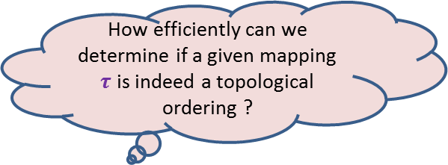
Topological ordering
Example:
This is indeed a valid topological ordering.
u
z
b
v
y
x
w
a
u
v
a
b
x
z
w
y
1 2 3 4 5 6 7 8
How efficiently can we determine if a given mapping $τ$ is indeed a topological ordering ?
O($m+n$) time

Slide 12
Topological ordering
Three questions
Question 1: Why does a topological ordering exist for every DAG ?
Question 2: How efficiently can we compute a topological ordering ?
Question 3: What is the use of topological ordering ?

Slide 13
applications of
Topological ordering
Question 3

Slide 14
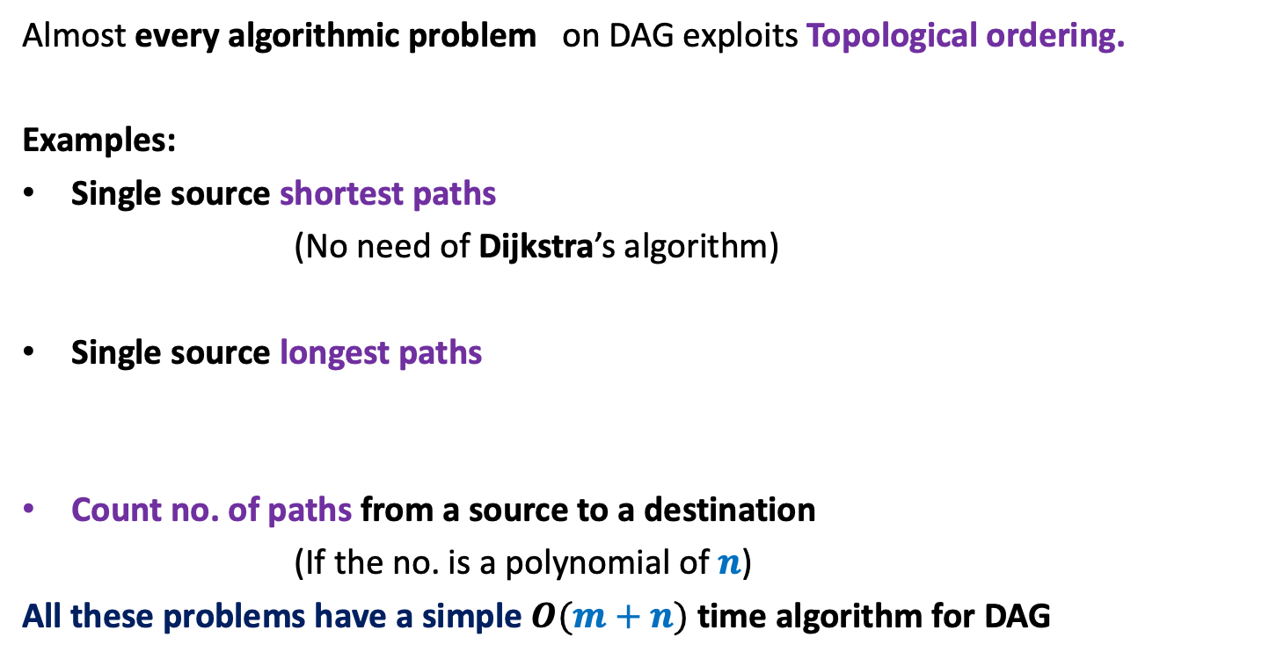
Applications of Topological ordering
Almost every algorithmic problem on DAG exploits Topological ordering.
Examples:
Single source shortest paths
(No need of Dijkstra’s algorithm)
Single source longest paths
Count no. of paths from a source to a destination
(If the no. is a polynomial of $n$)
All these problems have a simple $O(m+n)$ time algorithm for DAG

Slide 15
Why Does
Topological ordering exist for every DAG?
Question 1

Slide 16
Why does Topological ordering exist ?
Example:
u
z
b
v
y
x
w
a
What is the guarantee that such a vertex always exists in a DAG ?
Any vertex of indegree=0 can be given number 1 in a topological ordering.
Is there any vertex for which you can be sure of its place in the ordering?

Slide 17

Why does Topological ordering exist ?
Lemma 1: Every DAG has at least one vertex with in-degree = 0.
Proof:
(an algorithmic proof)
Pick any vertex $v$.
While in-degree$(v)$ $≠$ 0 do
{ Let $(u,v)$ be an edge
$v$← $u$;
}
return $v$;
Observation: This algorithm, if terminates, will output a vertex of indegree =0.
But what is the guarantee that it will terminate.?
The algorithm does indeed terminate.
In fact, no vertex will be processed twice in while loop.
…
c
b
y
x
c
a
cycle

Slide 18
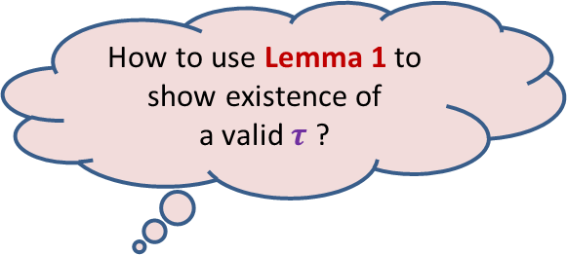
Why does Topological ordering exist ?
Lemma 1: Every DAG has at least one vertex with in-degree = 0.
u
z
b
v
y
x
w
a
How to use Lemma 1 to show existence of
a valid $τ$ ?

Slide 19
Why does Topological ordering exist ?
u
z
b
v
y
x
w
a
u
v
a
b
x
z
w
y
1
2
3
4
5
6
7
8

Slide 20

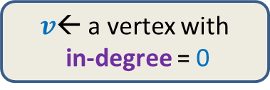
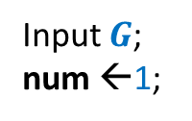
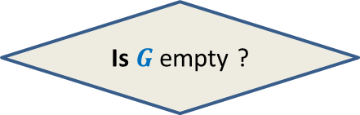
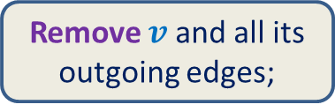

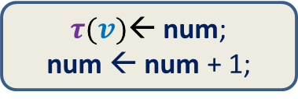

Why does Topological ordering exist ?
$O(m)$ time
Time complexity of the algorithm: ?
$O(mn)$
Input $G$;
num ←1;
$v$← a vertex with
in-degree = 0
$τ(v)$← num;
num ← num + 1;
Remove $v$ and all its outgoing edges;
Yes
NO
Is $G$ empty ?
A valid $τ$

Slide 21
How efficiently can we compute
Topological ordering ?

Slide 22
Important Questions
Aim:
To design a more efficient implementation of the algorithm.
Question:
What is the most time consuming step of the algorithm ?
Answer: Searching a vertex of in-degree = 0 ?
Question:
Do we need to compute from scratch the next vertex of in-degree 0 every time ?
Answer: Perhaps not !
Let us explore closely the algorithm to see
“how and when the vertices with in-degree=0 get created” ?

Slide 23
Revisiting the example
..but slowly this time…
The new vertices with indegree=0 are created during ?
u
z
b
v
y
x
w
a
u
v
a
b
x
z
w
y
1
2
3
4
5
6
7
8
the processing of the current vertex of indegree=0

Slide 24
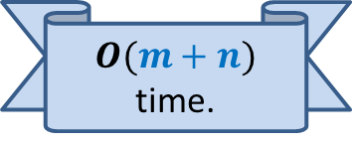
Algorithm for Topological ordering ?
Question:
How to design a more efficient implementation of the algorithm ?
Main step of the current algorithm:
Searching a vertex of in-degree = 0
Hints:
1. Maintain a set of vertices of In-degree=0
2. Keep an array In-degree[] that stores for each vertex the number of edges entering it at any stage during the algorithm.
$O(m+n)$ time.
Attempt as a Homework.

Slide 25
Applications of topological ordering ?

Slide 26
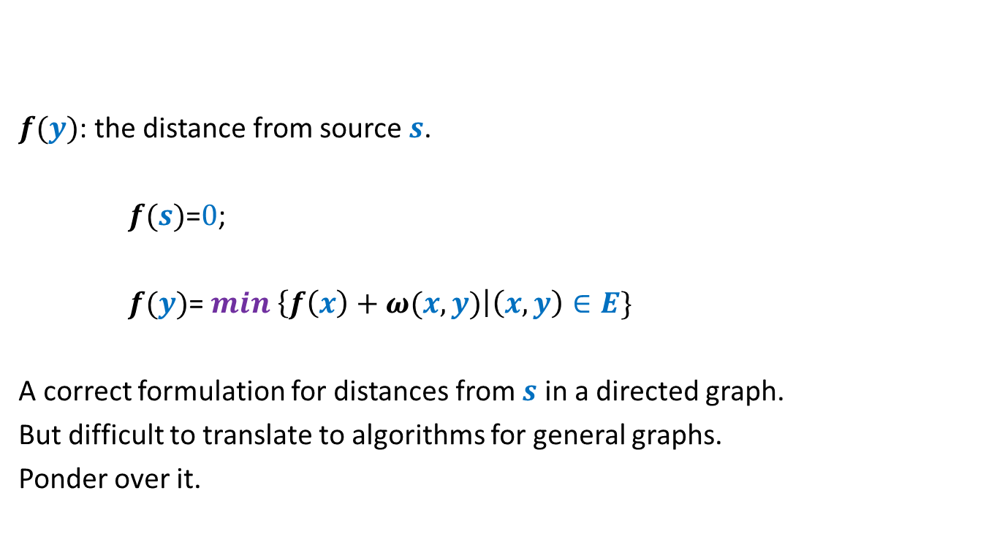
Example: Single source shortest paths
But, this formulation leads to a very simple and efficient algorithm for distance in DAGs.
$f(y)$: the distance from source $s$.
$f(s)$=$0$;
$f(y)$= $min$ $\left\{f\left(x\right)+ω(x,y)\right|\left(x,y\right)∈E\}$
A correct formulation for distances from $s$ in a directed graph.
But difficult to translate to algorithms for general graphs.
Ponder over it.
Now ponder over it.☺

Slide 27

Topological ordering
A mapping $τ$ : $V$→[$1…n$] such that
For each edge $\left(u,v\right)∈E$ , $τ$($u$) < $τ$($v$)
1 2 3 4 5 6 7 8 9 10 11

Slide 28


Applications of Topological ordering
I
A mapping $τ$ : $V$→[$1…n$] such that
For each edge $\left(u,v\right)∈E$ , $τ$($u$) < $τ$($v$)
Let $f$ be a function on $V$that we wish to compute
If $f(y)$ can be expressed in terms of ONLY $\left\{f\left(x\right) \right|\left(x,y\right)∈E\}$
➔We can compute $f$ by processing vertices in increasing order of $τ$.
1 2 3 4 5 6 7 8 9 10 11
$$y$$

Slide 29
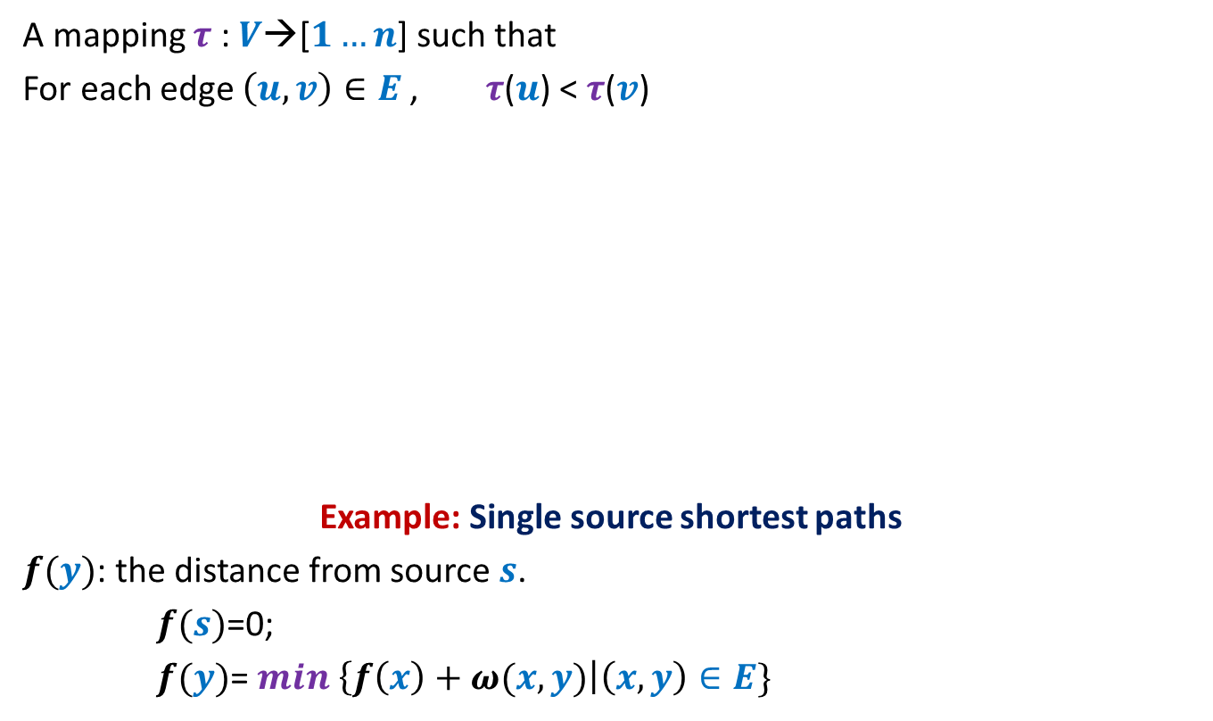

Applications of Topological ordering
I
A mapping $τ$ : $V$→[$1…n$] such that
For each edge $\left(u,v\right)∈E$ , $τ$($u$) < $τ$($v$)
Example: Single source shortest paths
$f(y)$: the distance from source $s$.
$f(s)$=0;
$f(y)$= $min$ $\left\{f\left(x\right)+ω(x,y)\right|\left(x,y\right)∈E\}$
1 2 3 4 5 6 7 8 9 10 11
$$y$$
$O(m+n)$ time algo

Slide 30

Applications of Topological ordering
II
A mapping $τ$ : $V$→[$1…n$] such that
For each edge $\left(u,v\right)∈E$ , $τ$($u$) < $τ$($v$)
Let $f$ be a function on $V$that we wish to compute
If $f(y)$ can be expressed in terms of ONLY $\left\{f\left(z\right) \right|\left(y,z\right)∈E\}$
➔We can compute $f$ by processing vertices in decreasing order of $τ$.
1 2 3 4 5 6 7 8 9 10 11
$$y$$

Slide 31
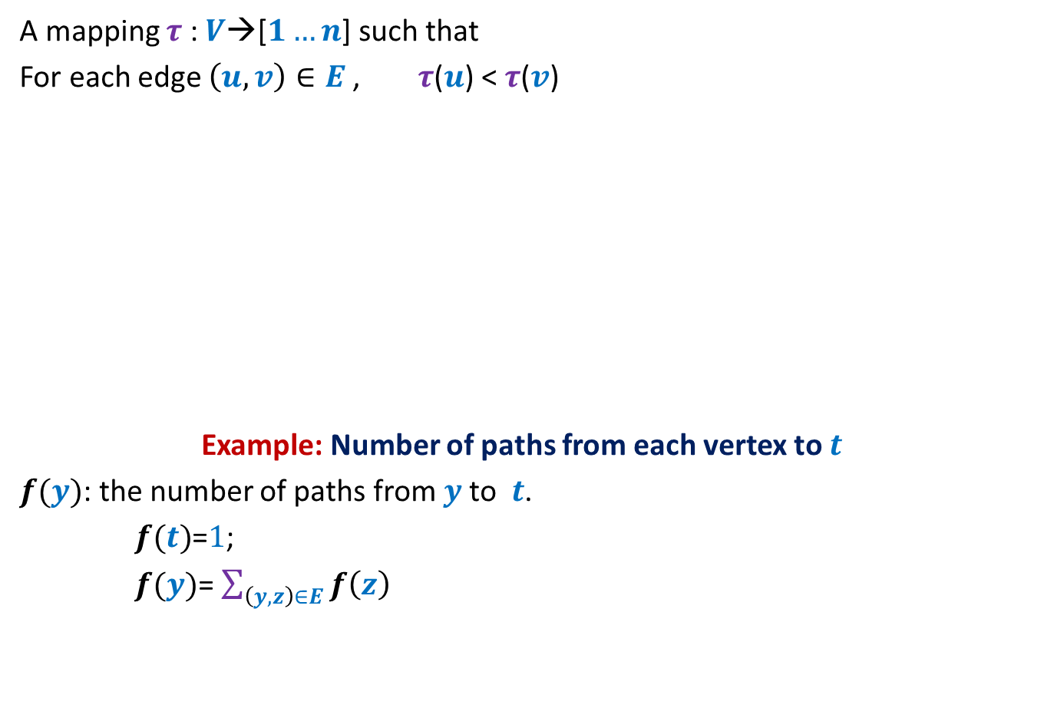
Applications of Topological ordering
II
A mapping $τ$ : $V$→[$1…n$] such that
For each edge $\left(u,v\right)∈E$ , $τ$($u$) < $τ$($v$)
Example: Number of paths from each vertex to $t$
$f(y)$: the number of paths from $y$to $t$.
$f(t)$=$1$;
$f(y)$= $\sum_{\left(y,z\right)∈E}{f\left(z\right)}$
1 2 3 4 5 6 7 8 9 10 11
$$y$$
$O(m+n)$ time algo

Slide 32
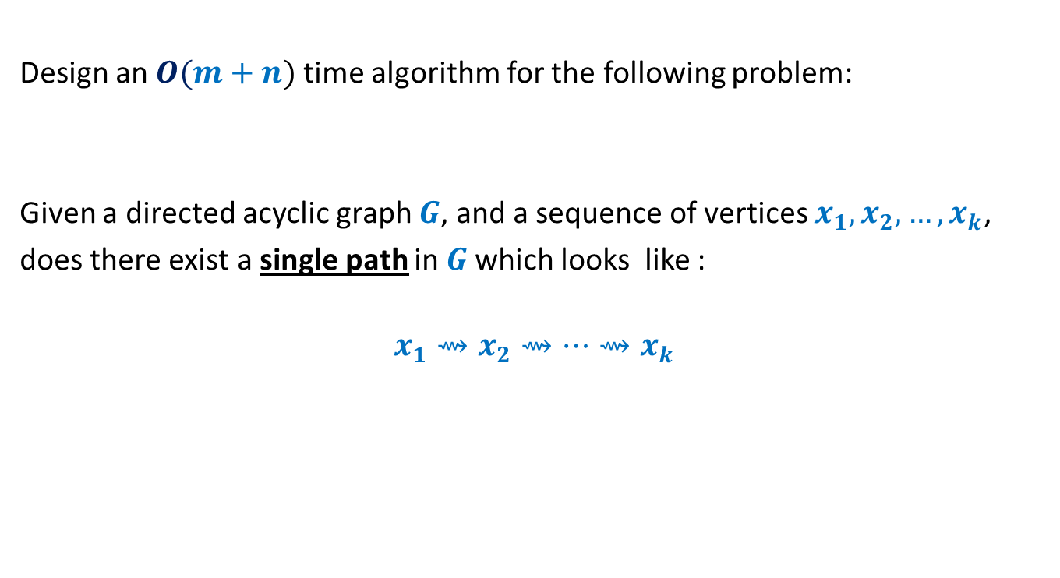
Homework
Design an $O(m+n)$ time algorithm for the following problem:
Given a directed acyclic graph $G$, and a sequence of vertices $x_{1},x_{2},…,x_{k}$,
does there exist a single path in $G$which looks like :
$$x_{1}⇝x_{2}⇝…{⇝x}_{k}$$

Slide 33
Moral of the story
Think of a problem on DAG
Think of topological ordering
☺

