Slide 1
Design and Analysis of Algorithms
CS345
Lecture 13
A powerful technique to
traverse a directed graph

Slide 2
Recap of last lecture

Slide 3

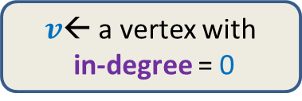
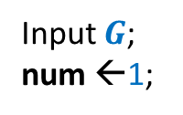
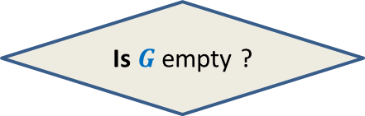


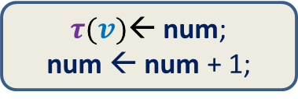

Algorithm for Topological ordering
$O(m)$ time
Time complexity of the algorithm: ?
$O(mn)$
Input $G$;
num ←1;
$v$← a vertex with
in-degree = 0
$τ(v)$← num;
num ← num + 1;
Remove $v$ and all its outgoing edges;
Yes
NO
Is $G$ empty ?
A valid $τ$

Slide 4
How to efficiently maintain
the set of vertices with in-degree=0?
Queue

Slide 5

Algorithm for Topological ordering
Topological-ordering($G$)
{ Create-queue($Q$);
For each $x∈V$ {
if (in-degree[$x$] = 0)
En-queue($x$,$Q$) }
num ← 1;
While( ? )
$v$← De-queue($Q$);
$τ$($v$) ← num;
num ← num + 1;
For each ($v,x$) $∈E$ do
in-degree[$x$] ← in-degree[$x$] – 1;
if (in-degree[$x$] = 0) En-queue($x$,$Q$);
not-empty($Q$)
{
O($deg(v)$) time
{
?
}
} return $τ$ ;
How to show that time complexity is $O(m+n)$?

Slide 6

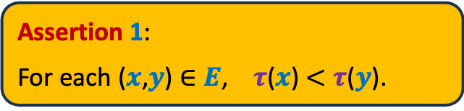
Algorithm for Topological ordering
Topological-ordering($G$)
{ Create-queue($Q$);
For each $x∈V$ {
if (in-degree[$x$] = 0)
En-queue($x$,$Q$) }
num ← 1;
While( ? )
$v$← De-queue($Q$);
$τ$($v$) ← num;
num ← num + 1;
For each ($v,x$) $∈E$ do
in-degree[$x$] ← in-degree[$x$] – 1;
if (in-degree[$x$] = 0) En-queue($x$,$Q$);
Assertion 1:
For each ($x$,$y$) $∈E$, $τ$($x$) $<τ$($y$).
Assertion 2:
For each $x∈V$, $τ$($x$) is assigned a
number.
not-empty($Q$)
{
{
What is the proof of correctness ?
}
} return $τ$ ;
Homework: make sincere attempts to prove these assertions. Just sincere attempts…
Proof will be discussed after a week in a lecture.

Slide 7
DEPTH FIRST SEARCH
Why is it worth re-visiting in this course ?

Slide 8

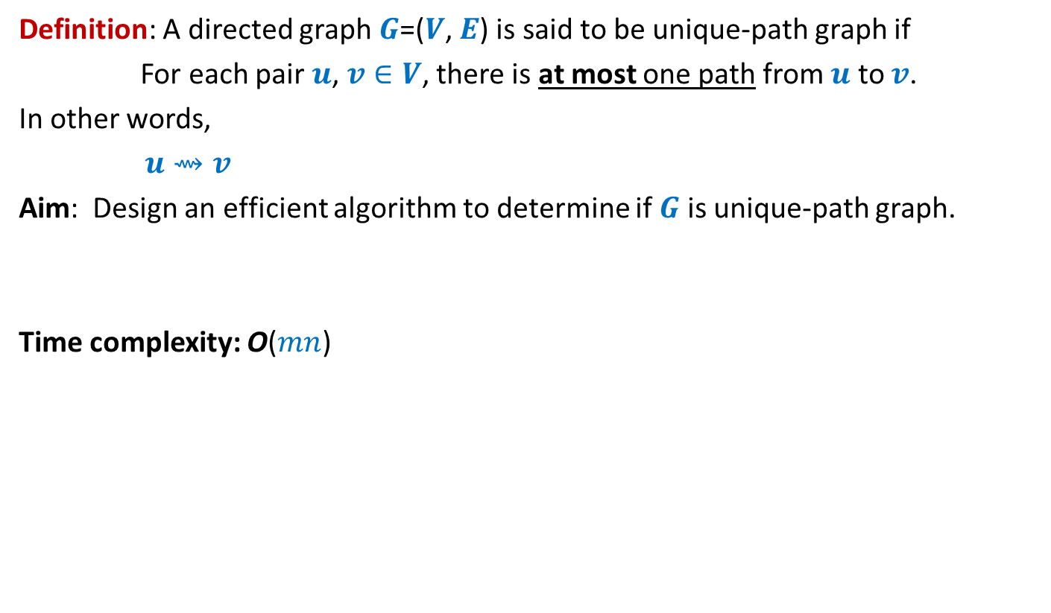

Unique-path graph
Definition: A directed graph $G$=($V$, $E$) is said to be unique-path graph if
For each pair $u$, $v∈V$, there is at most one path from $u$ to $v$.
In other words,
$u⇝v$
Aim: Design an efficient algorithm to determine if $G$ is unique-path graph.
Time complexity: O($mn$)
➔ there is only one path from $u$ to $v$
$$O(n^{2}\text{)}$$

Slide 9

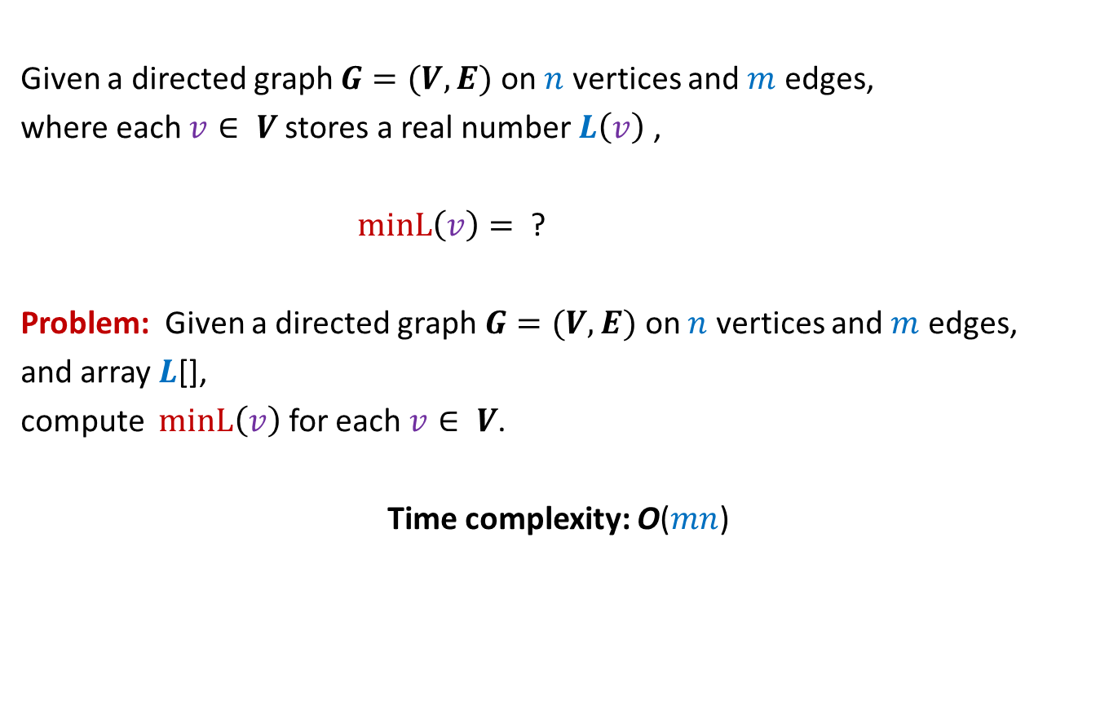

MIN-Label Problem
Given a directed graph $G=(V,E)$ on $n$ vertices and $m$ edges,
where each $v∈ V$stores a real number $L\left(v\right)$ ,
$minL\left(v\right)=$ ?
Problem: Given a directed graph $G=(V,E)$ on $n$ vertices and $m$ edges,
and array $L$[],
compute $minL\left(v\right)$ for each $v∈ V$.
Time complexity: O($mn$)
$$min\left\{L\left(x\right)\right| x \text{is} \text{reachable} \text{from} v\}$$
$$O(m+n\text{)}$$

Slide 10

DEPTH FIRST SEARCH
From a vertex $u$

Slide 11

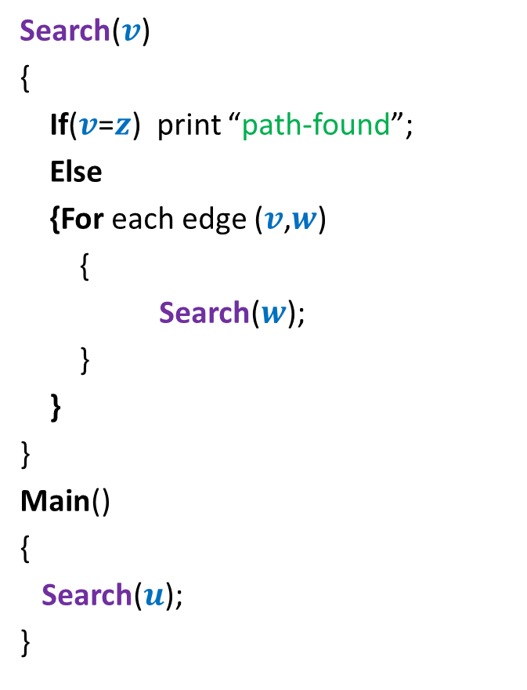




Searching path from $u$ to $z$
Search($v$)
{
If($v$=$z$) print “path-found”;
Else
{For each edge ($v$,$w$)
{
Search($w$);
}
}
}
Main()
{
Search($u$);
}
x
Visited[$v$] ← true;
y
u
s
q
If (Visited[$w$]=false)
w
j
r
p
z
t
For each $v$ $∈V$ Visited[$v$] ← false;
b
d
h
c

Slide 12



DFS from a vertex $u$
DFS($v$)
{
D[$v$]← count++ ;
…;
For each edge ($v$, $w$)
{
DFS($w$);
}
…;
}
Main()
{
count← 1;
DFS($u$);
}
x
Visited[$v$] ← true;
y
u
s
q
If (Visited[$w$]=false)
w
j
r
p
z
t
For each $v$ $∈$ $V$ Visited[$v$] ← false;
b
d
h
c

Slide 13
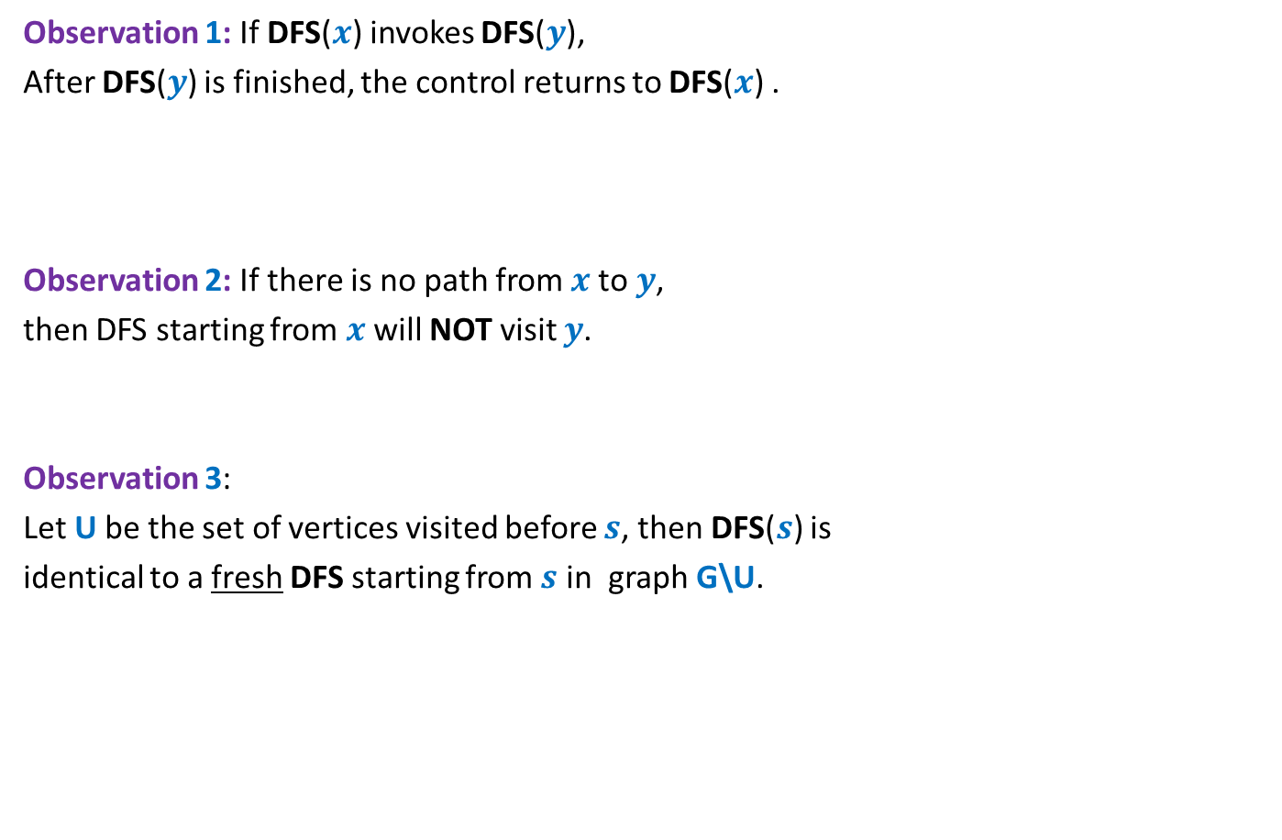
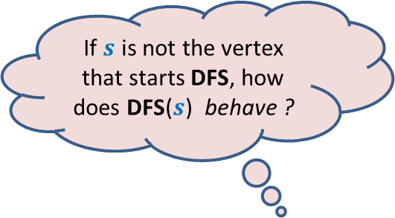
Relation among various DFS() calls
x
Observation 1: If DFS($x$) invokes DFS($y$),
After DFS($y$) is finished, the control returns to DFS($x$) .
Observation 2: If there is no path from $x$to $y$,
then DFS starting from $x$ will NOT visit $y$.
Observation 3:
Let U be the set of vertices visited before $s$, then DFS($s$) is
identical to a fresh DFS starting from $s$ in graph G\U.
y
u
s
q
w
j
r
p
z
t
If $s$ is not the vertex that starts DFS, how does DFS($s$) behave ?
b
d
h
c

Slide 14

DFS from a vertex $u$
Lemma 1: DFS($u$) visits all vertices reachable from $u$.
Proof:
We show that DFS($u$) visits $v$ if $u⇝v$
Focus on the first vertex visited after $u$.
Use three Observations
Induction on number of vertices in graph.
x
y
u
s
q
w
j
r
p
v
t
Homework: Attempt the proof with these hints.
The proof is given on the following slides appended after the lecture.

Slide 15
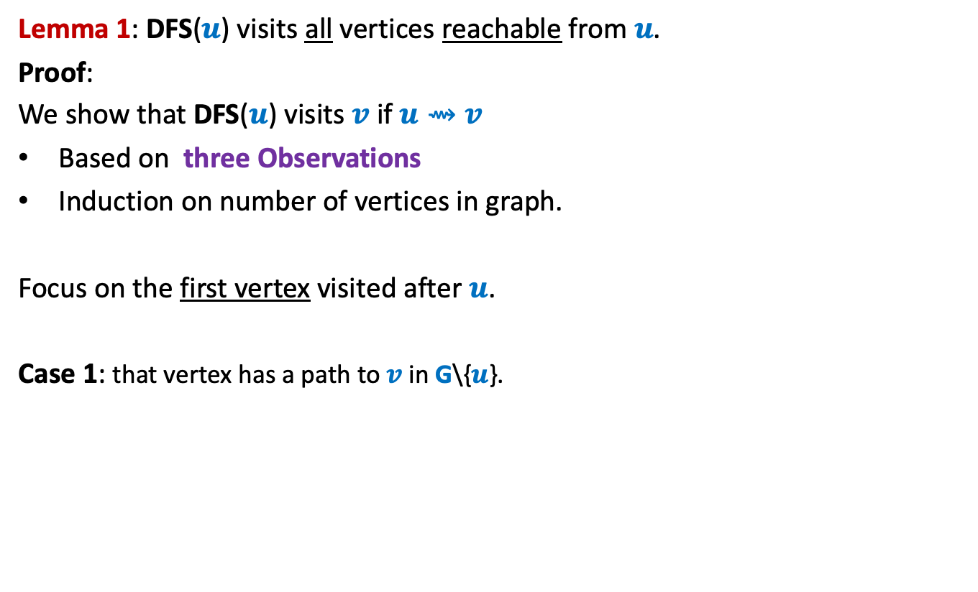
DFS from a vertex $u$
Lemma 1: DFS($u$) visits all vertices reachable from $u$.
Proof:
We show that DFS($u$) visits $v$ if $u⇝v$
Based on three Observations
Induction on number of vertices in graph.
Focus on the first vertex visited after $u$.
Case 1: that vertex has a path to $v$ in G\{$u$}.
x
y
u
s
q
w
j
r
p
v
t

Slide 16
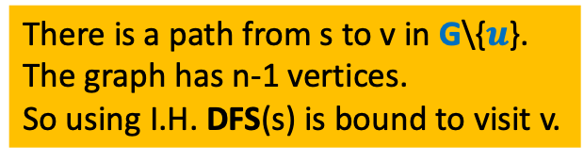
DFS from a vertex $u$
Lemma 1: DFS($u$) visits all vertices reachable from $u$.
Proof:
We show that DFS($u$) visits $v$ if $u⇝v$
Based on three Observations
Induction on number of vertices in graph.
Focus on the first vertex visited after $u$.
Case 1: that vertex has a path to $v$ in G\{$u$}.
x
y
u
s
q
w
j
(use Observation 3)
r
p
Case 2:
v
How can you show that v is visited in this case ?
t
There is a path from s to v in G\{$u$}.
The graph has n-1 vertices.
So using I.H. DFS(s) is bound to visit v.

Slide 17
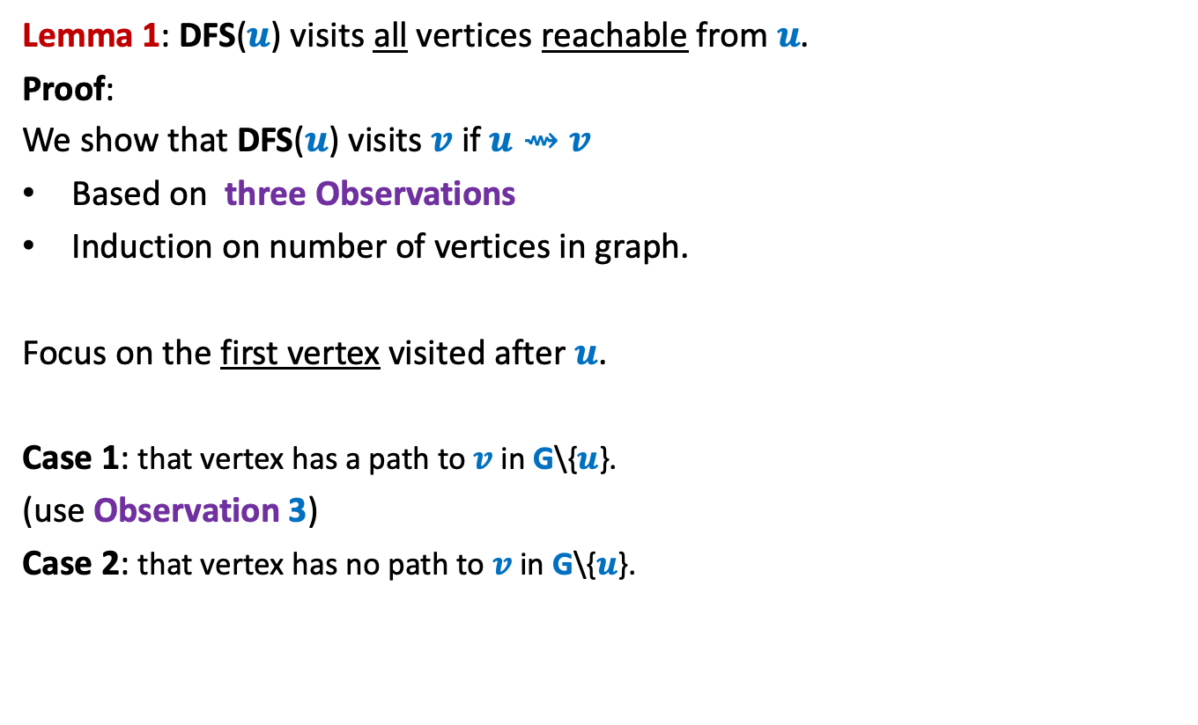
DFS from a vertex $u$
Lemma 1: DFS($u$) visits all vertices reachable from $u$.
Proof:
We show that DFS($u$) visits $v$ if $u⇝v$
Based on three Observations
Induction on number of vertices in graph.
Focus on the first vertex visited after $u$.
Case 1: that vertex has a path to $v$ in G\{$u$}.
(use Observation 3)
Case 2: that vertex has no path to $v$ in G\{$u$}.
x
y
u
s
q
w
j
r
p
v
t

Slide 18
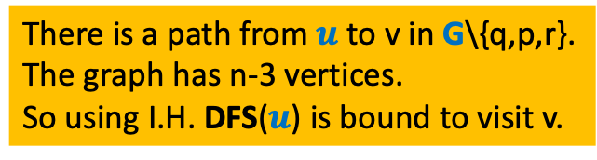
DFS from a vertex $u$
Lemma 1: DFS($u$) visits all vertices reachable from $u$.
Proof:
We show that DFS($u$) visits $v$ if $u⇝v$
Based on three Observations
Induction on number of vertices in graph.
Focus on the first vertex visited after $u$.
Case 1: that vertex has a path to $v$ in G\{$u$}.
(use Observation 3)
Case 2: that vertex has no path to $v$ in G\{$u$}.
x
y
u
s
q
w
j
r
p
(use Observation 1 ,2 and 3)
v
t
How can you show that v is visited in this case ?
There is a path from $u$ to v in G\{q,p,r}.
The graph has n-3 vertices.
So using I.H. DFS($u$) is bound to visit v.

Slide 19

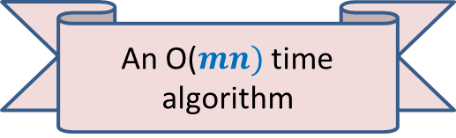
DFS from a vertex $u$
Lemma 1: DFS($u$) visits all vertices reachable from $u$.
Application 1:
Computing reachability from all vertices in graph
It suffices to execute fresh DFS($u$) from each $u∈V$.
An O($mn)$ time algorithm

Slide 20

More insights ABOUT DFS($u$)

Slide 21
DFS from a vertex $u$
x
y
u
s
q
w
j
r
p
v
t

Slide 22
DFS from a vertex $u$
x
y
u
s
q
w
j
r
p
v
t

Slide 23

DFS from a vertex $u$
Lemma 2: DFS($u$) computes a tree on all vertices reachable from $u$.
x
y
u
s
q
w
j
r
p
v
t

Slide 24

DFS from a vertex $u$
Lemma 2: DFS($u$) computes a tree on all vertices reachable from $u$.
Question: Is the DFS tree unique ?
Answer: No. But every tree is also not a DFS tree.
x
y
u
NOT a DFS tree. Can you explain it?
s
Another DFS tree
q
w
j
r
p
Is this a DFS tree ?
v
t

Slide 25

DEPTH FIRST SEARCH
For entire graph $G$

Slide 26
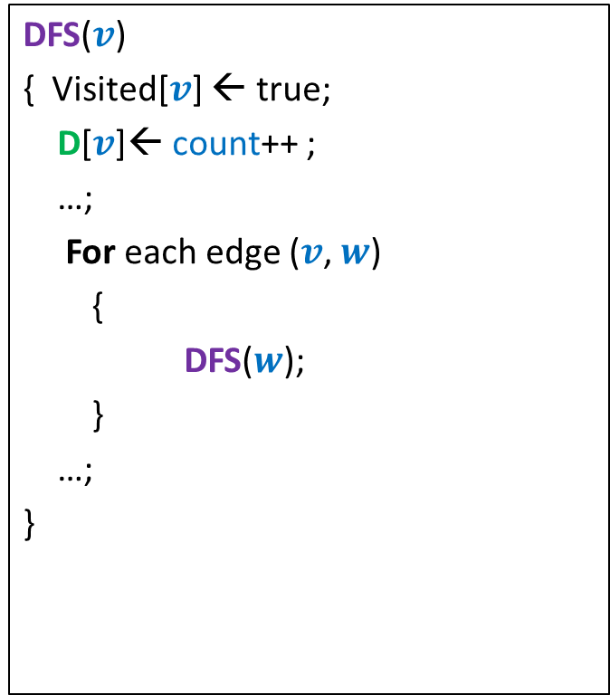
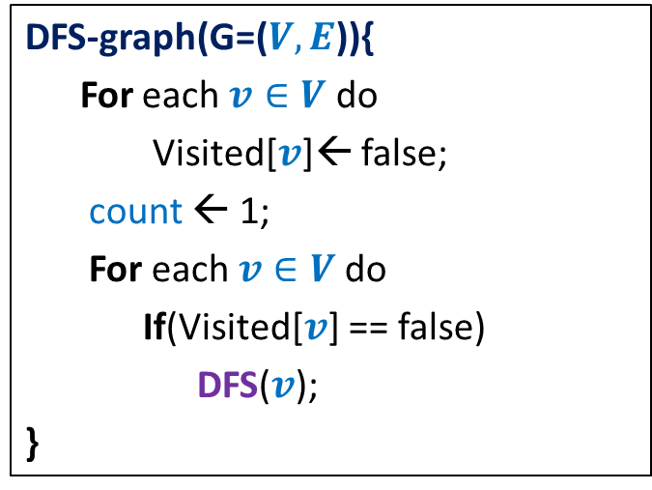
DFS on the graph
DFS($v$)
{ Visited[$v$] ← true;
D[$v$]← count++ ;
…;
For each edge ($v$, $w$)
{
DFS($w$);
}
…;
}
DFS-graph(G=($V,E$)){
For each $v∈V$ do
Visited[$v$]← false;
count ← 1;
For each $v∈V$do
If(Visited[$v$] == false)
DFS($v$);
}
Notes:
Interestingly, adding only a few statements in the code DFS(v) leads to efficient algorithms for a variety of problems.

Slide 27
x
x
y
y
u
u
Lemma 3: DFS partitions the graph into a forest of DFS trees.
v
q
v
q
w
j
w
j
r
p
r
p
k
t
k
t
b
b
d
d
h
h
c

Slide 28
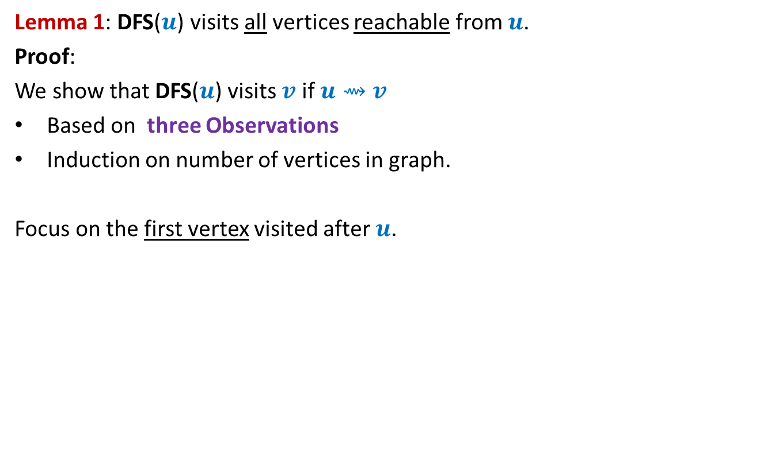
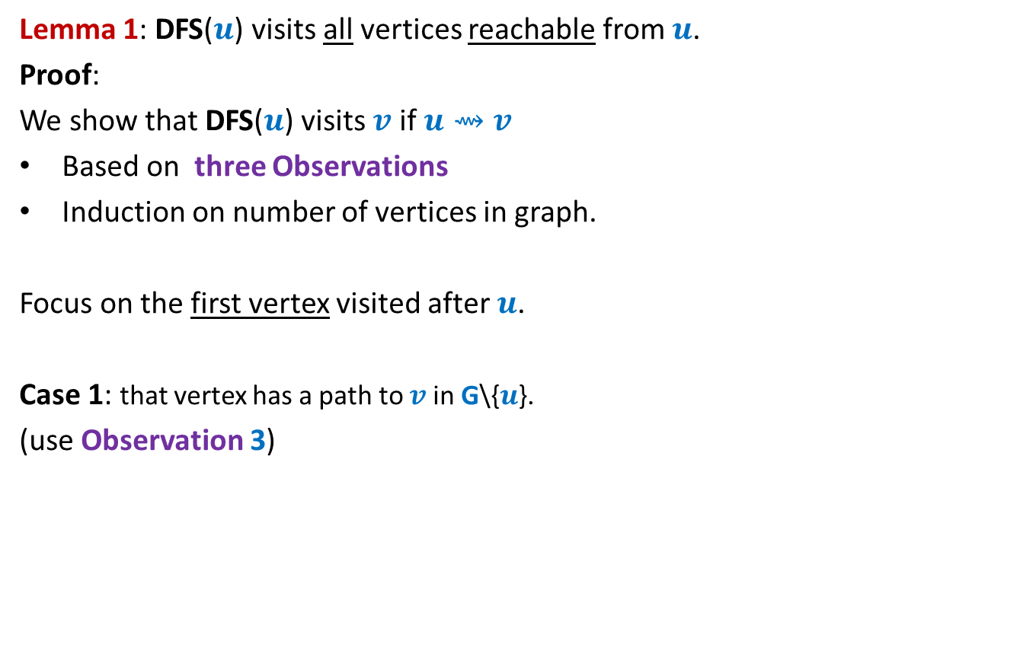
DFS on the graph
DFS($v$)
{ Visited[$v$] ← true;
D[$v$]← count++ ;
…;
For each edge ($v$, $w$)
{ If(Visited[$w$] = false)
DFS($w$);
….
}
…;
}
DFN number of v :
the time when DFS starts at v.
DFS-graph(G=($V,E$)){
For each $v∈V$ do
Visited[$v$]← false;
count ← 1;
For each $v∈V$do
If(Visited[$v$] == false)
DFS($v$);
}
F[$v$]← count++ ;
Finish number of v :
the time when DFS at v ends.
Notes:
Interestingly, adding only a few statements in the code DFS(v) leads to efficient algorithms for a variety of problems.

Slide 29
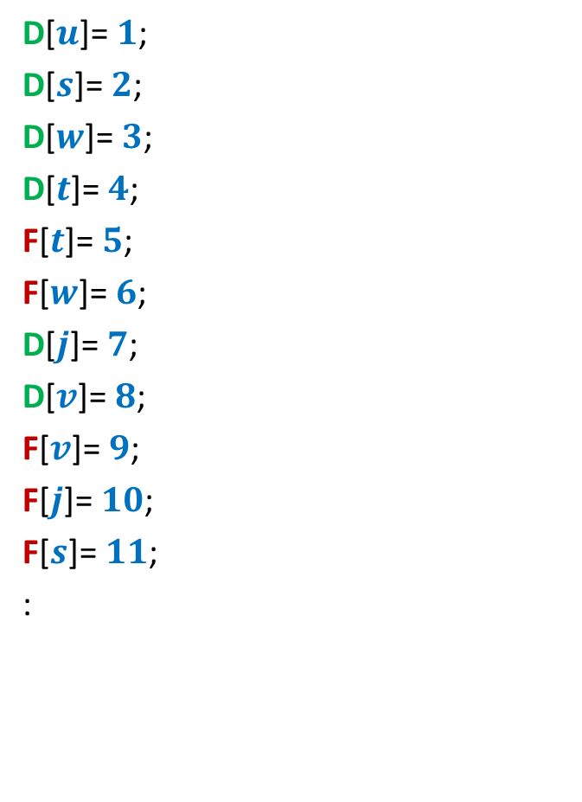
DFS on the graph
Is there any relation between D and F values of any pair of vertices ?
D[$u$]= $1$;
D[$s$]= $2$;
D[$w$]= $3$;
D[$t$]= $4$;
F[$t$]= $5$;
F[$w$]= $6$;
D[$j$]= $7$;
D[$v$]= $8$;
F[$v$]= $9$;
F[$j$]= $10$;
F[$s$]= $11$;
:
x
y
u
s
q
w
j
r
p
v
t

Slide 30
DFS on the graph
D[$u$]= $1$;
D[$s$]= $2$;
D[$w$]= $3$;
D[$t$]= $4$;
F[$t$]= $5$;
F[$w$]= $6$;
D[$j$]= $7$;
D[$v$]= $8$;
F[$v$]= $9$;
F[$j$]= $10$;
F[$s$]= $11$;
:
x
y
u
s
q
w
j
r
p
v
t

Slide 31





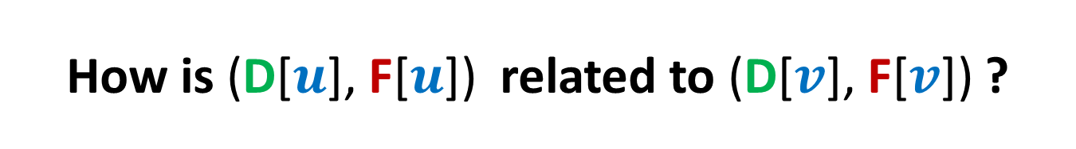








How is (D[$u$], F[$u$]) related to (D[$v$], F[$v$]) ?
Disjoint
One enclosing another
What about D[$u$] < D[$v$] <F[$u$] < F[$v$] ?
D[$u$]
F[$u$]
D[$v$]
F[$v$]
D[$u$]
F[$u$]
D[$v$]
F[$v$]
D[$u$]
F[$u$]
D[$v$]
F[$v$]
It follows from Observation 1.
(Recursive nature of DFS traversal)

Slide 32
Application - I
Alternate algorithm
for topological numbering of a DAG.

Slide 33


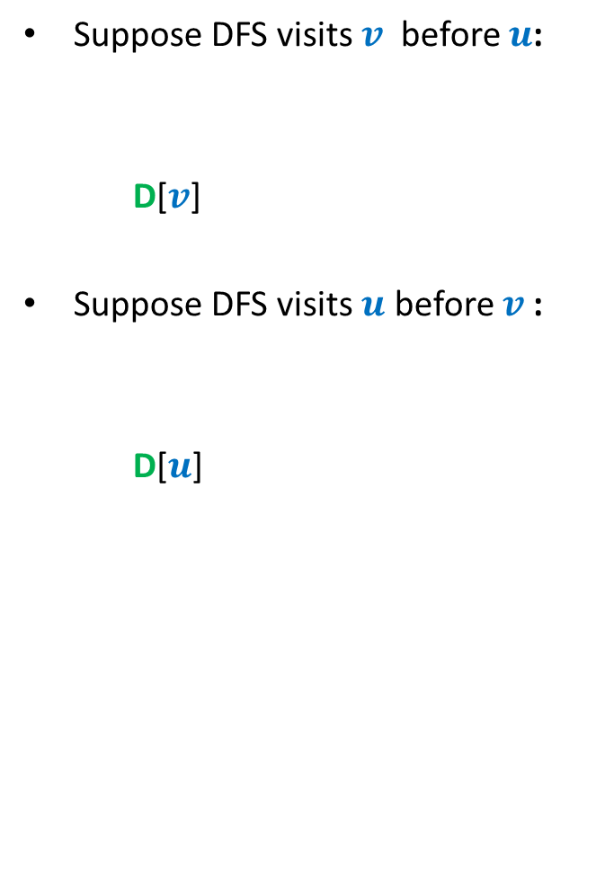



DFS on a DAG
Suppose DFS visits $v$ before $u$:
D[$v$]
Suppose DFS visits $u$ before $v$:
D[$u$]
< F[$v$]
< D[$u$] < F[$u$]
u
< D[$v$] < F[$v$]
< F[$u$]
v
F[$u$] > F[$v$] always !!

Slide 34
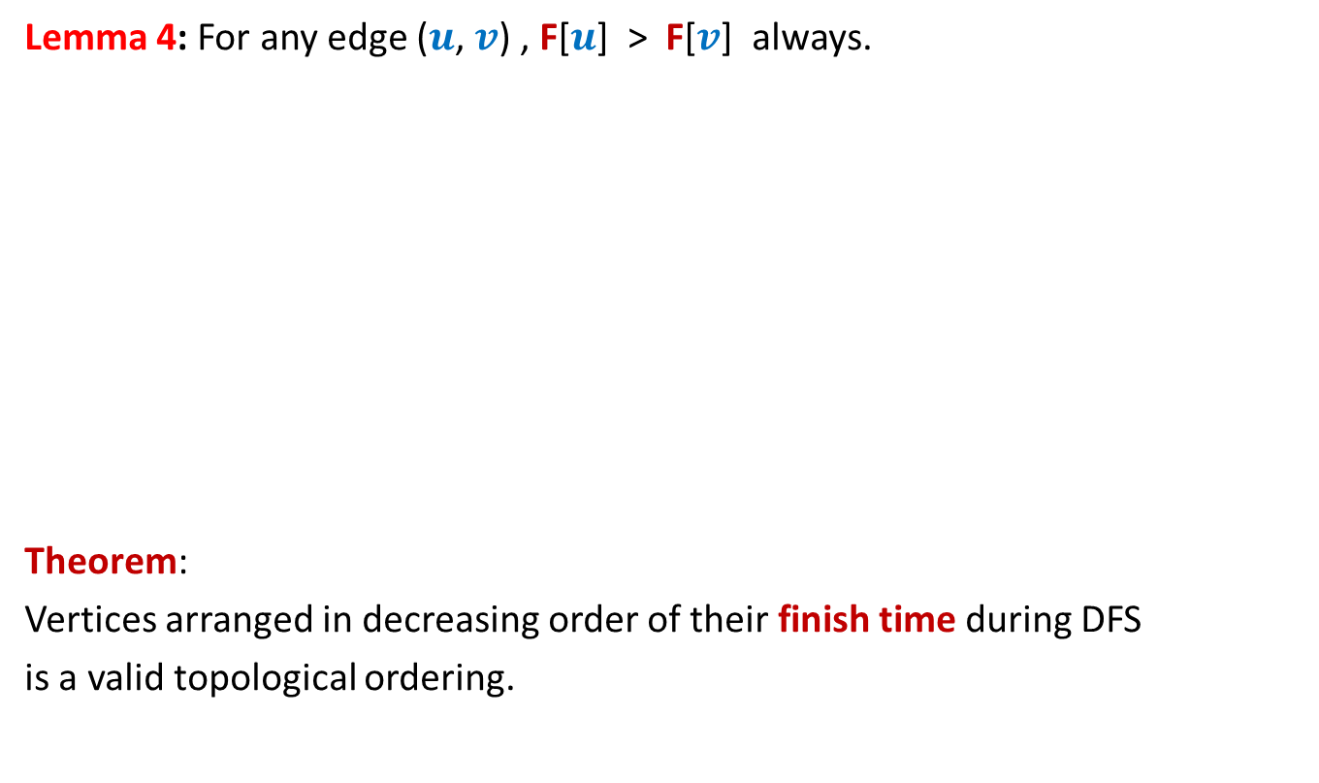
DFS on a DAG
Lemma 4: For any edge ($u$, $v$) , F[$u$] > F[$v$] always.
Theorem:
Vertices arranged in decreasing order of their finish time during DFS
is a valid topological ordering.
Decreasing order of F
1 2 3 4 5 6 7 8 9 10 11

Slide 35
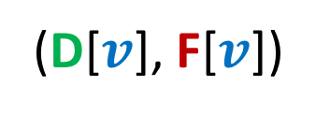
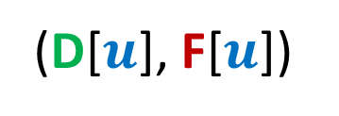
Classification of non-tree edges
using
(D[$u$], F[$u$])
and
(D[$v$], F[$v$])

Slide 36
Classification of non-tree edges
There seems to be many different types of non-tree edges.
x
y
u
s
q
Can we classify the non-tree edges ?
w
j
r
p
v
t
b
d
h
c

Slide 37







($u$,$v$) is Forward edge
$$u$$
$$s$$
$$w$$
$$v$$
D[$u$]
F[$u$]
D[$v$]
F[$v$]

Slide 38

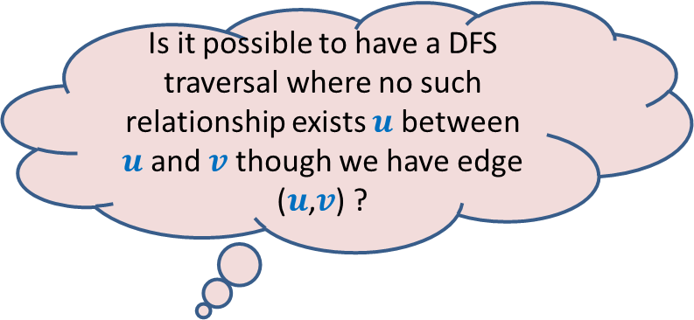









($u$,$v$) is Backward edge
Till now, we considered the situations in which either $u$ is ancestor of $v$ or vice versa.
$$v$$
$$s$$
Is it possible to have a DFS traversal where no such relationship exists $u$ between $u$and $v$ though we have edge ($u$,$v$) ?
$$w$$
Yes, indeed.
Think over it before coming to the next lecture.
$$u$$
D[$v$]
F[$v$]
D[$u$]
F[$u$]

Slide 39











($u$,$v$) is Cross edge
$$y$$
$$u$$
$$v$$
Are there any other type of non-tree edges ?
$$s$$
$$w$$
$$x$$
D[$v$]
F[$v$]
D[$u$]
F[$u$]
Homework: Prove rigorously that there are no other types of edges.
We shall discuss it in next class. ☺

