Slide 1
Design and Analysis of Algorithms
CS345
Lecture 14
Depth First Search in Directed Graph - II

Slide 2
Recap of the last lecture

Slide 3
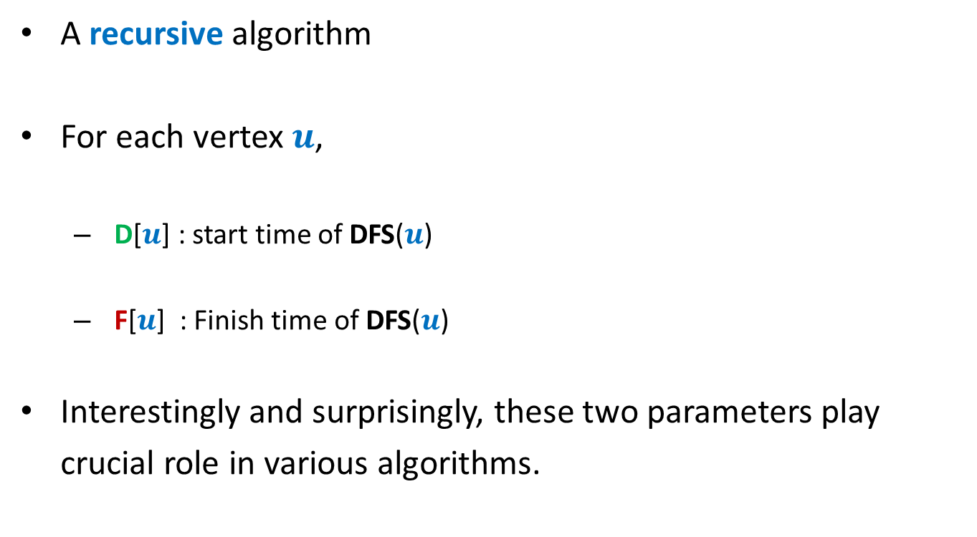
DFS traversal in directed graph
A recursive algorithm
For each vertex $u$,
  D[$u$] : start time of DFS($u$)
  F[$u$] : Finish time of DFS($u$)
Interestingly and surprisingly, these two parameters play
crucial role in various algorithms.

Slide 4





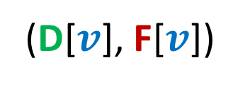
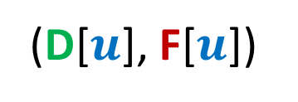








Relation between
(D[$u$], F[$u$])
and
(D[$v$], F[$v$])
Disjoint
One enclosing another
What about
D[$u$]
F[$u$]
D[$v$]
F[$v$]
D[$u$]
F[$u$]
D[$v$]
F[$v$]
D[$u$]
F[$u$]
D[$u$] < D[$v$] <F[$u$] < F[$v$] ?
D[$v$]
F[$v$]
This is because of recursive nature of DFS traversal.

Slide 5

There seem to be many different types of non-tree edges.
x
y
u
s
q
Can we classify the non-tree edges ?
w
j
r
p
v
t
b
d
h
c

Slide 6
Classification of non-tree edges
using
(D[$u$], F[$u$])
and
(D[$v$], F[$v$])

Slide 7









($u$,$v$) is Forward edge
$$u$$
$$s$$
$$w$$
$$v$$
D[$u$]
F[$u$]
D[$v$]
F[$v$]

Slide 8
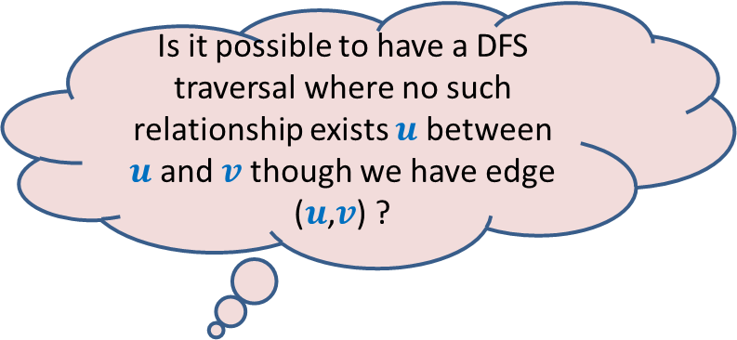








($u$,$v$) is Backward edge
Till now, we considered the cases in which either $u$ is ancestor of $v$ or vice versa.
$$v$$
$$s$$
Is it possible to have a DFS traversal where no such relationship exists $u$ between $u$and $v$ though we have edge ($u$,$v$) ?
$$w$$
$$u$$
Yes, indeed.
Think over it before moving to the next slide
D[$v$]
F[$v$]
D[$u$]
F[$u$]

Slide 9











($u$,$v$) is Cross edge
$$y$$
$$u$$
$$v$$
Is there any other type of non-tree edge ?
Think over it …
$$s$$
$$w$$
In the following slide, we shall show that these are the only possibilities of a non-tree edge.
$$x$$
D[$v$]
F[$v$]
D[$u$]
F[$u$]

Slide 10








Classification of non-tree edges
Consider an edge ($u$,$v$)
Case 1: $u$must be ancestor of $v$
Case 2: $u$must be descendant of $v$
Case 3:
Case 4:
➔ Tree edge or Forward edge
D[$u$]
F[$u$]
D[$v$]
F[$v$]
D[$v$]
F[$v$]
➔ Backward edge
D[$u$]
F[$u$]
Since (D[$u$], F[$u$]) and (D[$v$], F[$v$]) are
either disjoint or one of them encloses the other,
there are only $4$ possibilities.
Cross edge
D[$v$]
F[$v$]
D[$u$]
F[$u$]
D[$u$]
F[$u$]
D[$v$]
F[$v$]

Slide 11
Classification of non-tree edges
x
Forward edges
(u,w)
(b,c)
y
u
s
q
w
j
r
p
v
t
b
d
h
c

Slide 12
Classification of non-tree edges
x
Forward edges
(u,w)
(b,c)
Backward edges
(t,u)
(j,u)
(r,q)
(c,b)
y
u
s
q
w
j
r
p
v
t
b
d
h
c

Slide 13
Classification of non-tree edges
x
Forward edges
(u,w)
(b,c)
Backward edges
(t,u)
(j,u)
(r,q)
(c,b)
Cross edges
(x,u)
(j,t)
(y,u)
(y,q)
y
u
s
q
w
j
r
p
v
t
b
d
h
c

Slide 14
Application - I
unique-path graph problem

Slide 15


Unique-path graph
Definition: A directed graph $G$=($V$, $E$) is said to be unique-path graph if
For each pair $u$, $v∈V$, there is at most one path from $u$ to $v$.
In other words,
$u⇝v$
Aim: Design an efficient algorithm to determine if $G$ is unique-path graph.
➔ there is only one path from $u$ to $v$

Slide 16
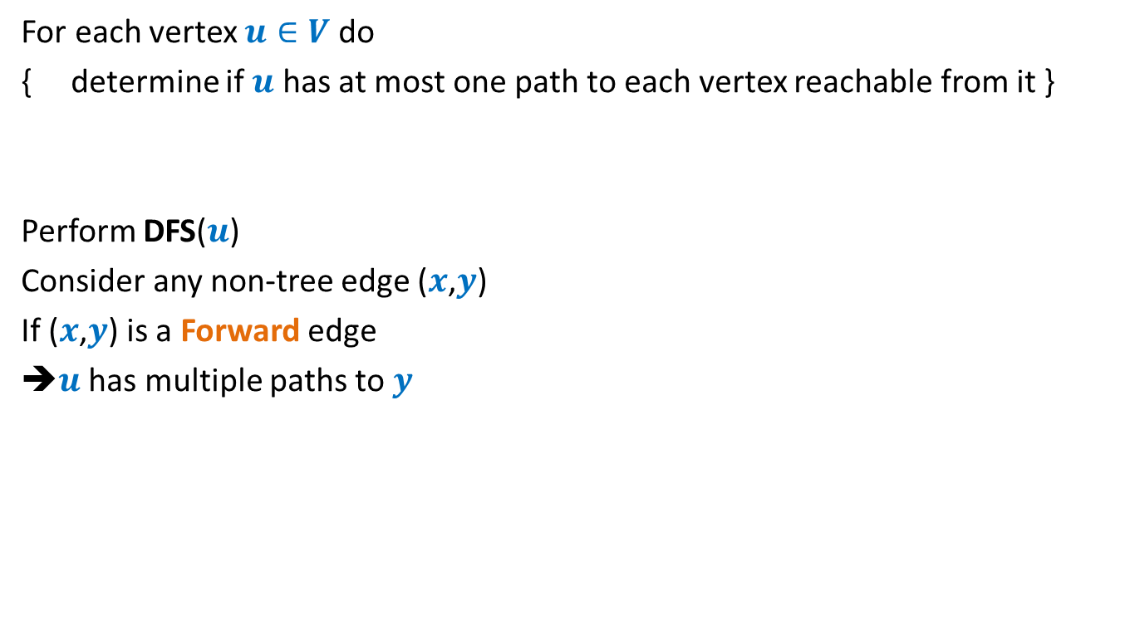

An O($mn$) time algorithm
For each vertex $u∈V$ do
{ determine if $u$ has at most one path to each vertex reachable from it }
Perform DFS($u$)
Consider any non-tree edge ($x$,$y$)
If ($x$,$y$) is a Forward edge
➔$u$ has multiple paths to $y$
a
b
u
s
q
w
j
r
p
v
t

Slide 17
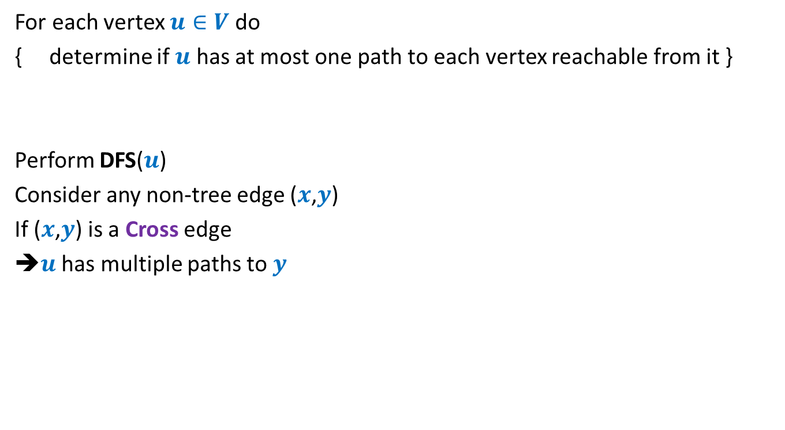
An O($mn$) time algorithm
For each vertex $u∈V$ do
{ determine if $u$ has at most one path to each vertex reachable from it }
Perform DFS($u$)
Consider any non-tree edge ($x$,$y$)
If ($x$,$y$) is a Cross edge
➔$u$ has multiple paths to $y$
u
s
q
w
j
r
p
v
t

Slide 18

An O($mn$) time algorithm
For each vertex $u∈V$ do
{ determine if $u$ has at most one path to each vertex reachable from it }
Perform DFS($u$)
Consider any non-tree edge ($x$,$y$)
If ($x$,$y$) is a Backward edge
u
s
q
w
j
r
p
v
t

Slide 19
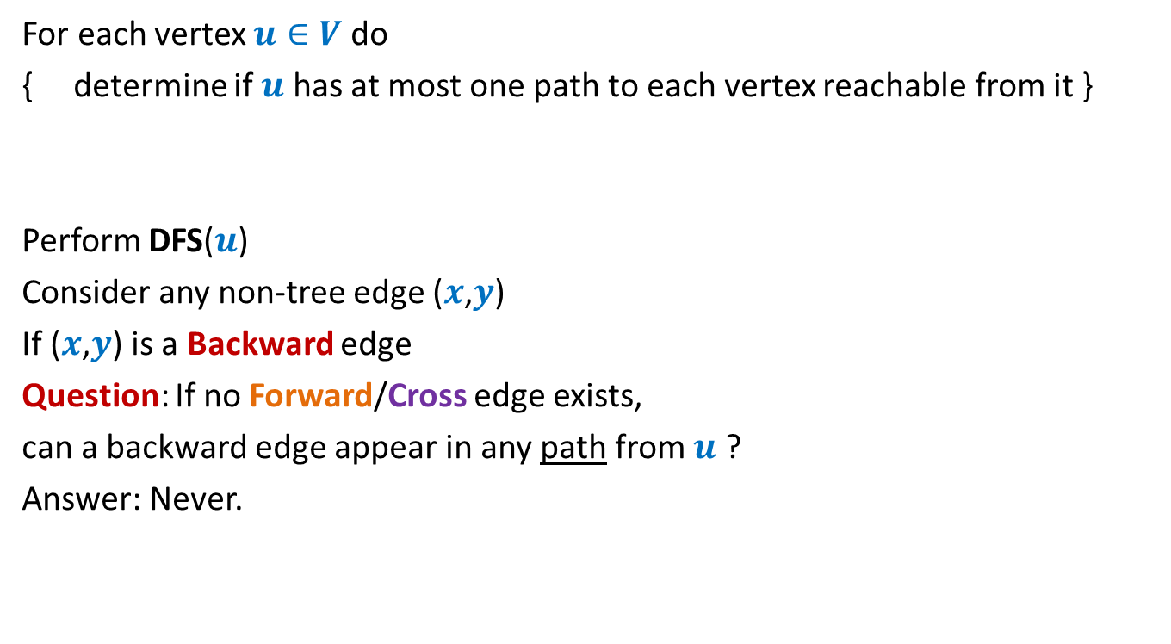
An O($mn$) time algorithm
For each vertex $u∈V$ do
{ determine if $u$ has at most one path to each vertex reachable from it }
Perform DFS($u$)
Consider any non-tree edge ($x$,$y$)
If ($x$,$y$) is a Backward edge
Question: If no Forward/Cross edge exists,
can a backward edge appear in any path from $u$ ?
Answer: Never.
u
s
q
w
j
r
p
v
t

Slide 20
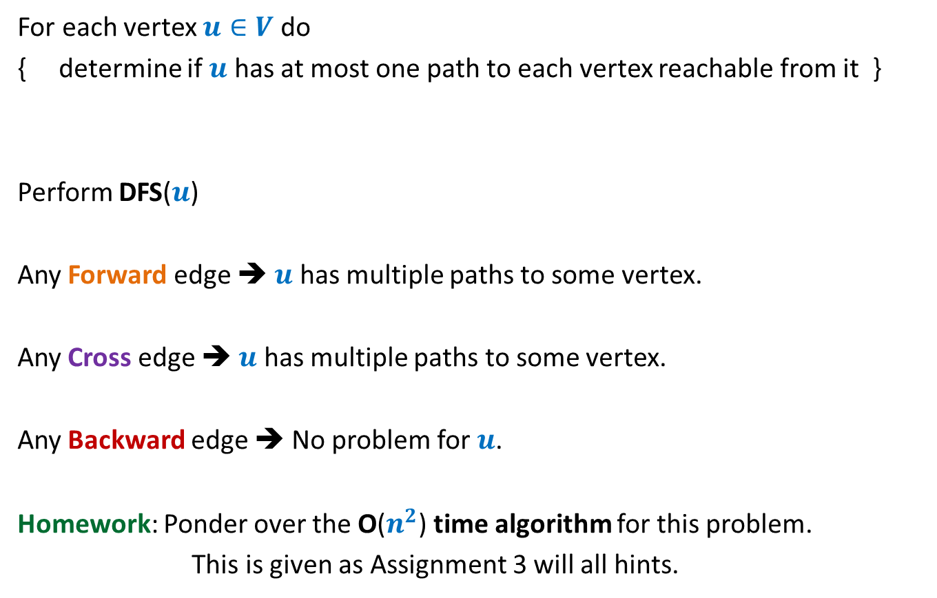
An O($mn$) time algorithm
For each vertex $u∈V$ do
{ determine if $u$ has at most one path to each vertex reachable from it }
Perform DFS($u$)
Any Forward edge ➔ $u$ has multiple paths to some vertex.
Any Cross edge ➔ $u$ has multiple paths to some vertex.
Any Backward edge ➔ No problem for $u$.
Homework: Ponder over the O($n^{2}$) time algorithm for this problem.
This is given as Assignment 3 will all hints.

Slide 21
Application - II
Computing Strongly connected components of a directed graph.

Slide 22


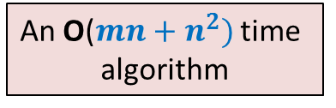
Strongly connected components
Definition: Two vertices $u$ and $v$ are said to be strongly connected if
$u$ is reachable from $v$
$v$ is reachable from $u$
A strongly connected component:
a maximal subset of “strongly connected vertices”
x
An O($m+n)$ time algorithm
An O($mn+n^{2})$ time
algorithm
y
u
v
q
b
d
w
j
r
p
h
c
t
k

Slide 23
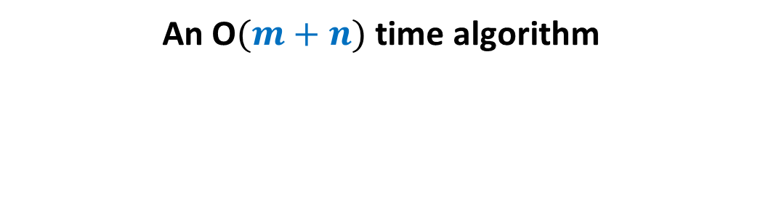
Computing SCCs efficiently
An O$(m+n)$ time algorithm

Slide 24


Observation 1
Consider any path from x to z in $G$.
Let y be any vertex on this path.
What can you infer about y?
There is a path from y to z in $G$.
Can you show existence of a path from z to y in $G$?
x
x
It could be like this.
Or
?
y
z
An SCC
z
There is surely a path from z to x
Just trace this path slowly to build a path from z to y.
since they are strongly connected.

Slide 25

Observation 1
Consider any path from x to z in $G$.
Let y be any vertex on this path.
What can you infer about y?
There is a path from y to z in $G$.
Hence y and z are strongly connected.
In fact,
x
x
It could be like this.
Or
?
y
It could be like this.
z
An SCC
z

Slide 26

Observation 1
Consider any path from x to z in $G$.
Let y be any vertex on this path.
What can you infer about y?
There is a path from y to z in $G$.
Hence y and z are strongly connected.
In fact, all vertices on the path are strongly connected.
x
x
y
z
An SCC
z

Slide 27
Inference of Observation 1
Notation (root of an SCC):
the vertex of the SCC
which is visited first during the DFS.
Inference:
At the moment r is visited,
Surely, no other vertex of the SCC is visited.
Moreover, using Observation 1,
every path from r to every other vertex of the SCC is intact
(it is present in the subgraph induced by unvisited vertices)
Can you use this inference to claim anything about the DFS trees and the SCCs ?
r
x
z
An SCC

Slide 28
Inference of Observation 1
Notation (root of an SCC):
the vertex of the SCC
which is visited first during the DFS.
r
r
An SCC

Slide 29
Inference of Observation 1
Notation (root of an SCC):
the vertex of the SCC
which is visited first during the DFS.
All vertices of the SCC will be descendants of r in the DFS tree.
There may be vertices from other SCCs that will be descendant of r.
But, the entire SCC appears contiguously in the subtree rooted at r.
r
r
An SCC

Slide 30
Try to spot the roots of SCC in the DFS forest.
x
x
y
y
u
u
v
q
v
q
w
j
w
j
r
p
r
p
Let us analyse the finish time.
Since it worked for topological ordering ☺
k
t
k
t
b
b
d
d
h
h
c
What should we do ?
Having seen nice structure of SCCs in the DFS forest, we feel motivated to design an efficient algorithm based on DFS.
But how should we start with ?
If we can find out the roots of SCCs, we can find respective SCCs.
But this appears to be as difficult as computing SCCs.

Slide 31
Study Finish time
u
u
There does not appear to be any order ☹.
v
v
q
q
w
j
w
j
r
p
r
p
t
k
t
k
t w k j v r p q u
Increasing order of F[]

Slide 32

Kosaraju’s Algorithm
DFS Traversal
A simple but very powerful idea
Mtech IIT KGP
PhD Uni. Pennsylvania
Faculty at John Hopkins University

Slide 33




A simple but very powerful idea
$G$ : the given directed graph
$G^{r}$: the graph $G$ after reversing edge directions;
Let us see whether you can use it in the next lecture ☺
SCCs of $G$
?
SCCs of $G^{r}$

Slide 34
Computing SCCs efficiently
An O$(m+n)$ time algorithm

Slide 35
Searching for an order using Finish time
It looks too complex !
SCC A
SCC D
SCC B
Have some perseverance, buddy !
SCC C
Increasing order of F[]
Where might be
the roots of each SCC ?
Let us analyse the finish time.
Of the roots of SCCs. May be there exists some order there !

Slide 36
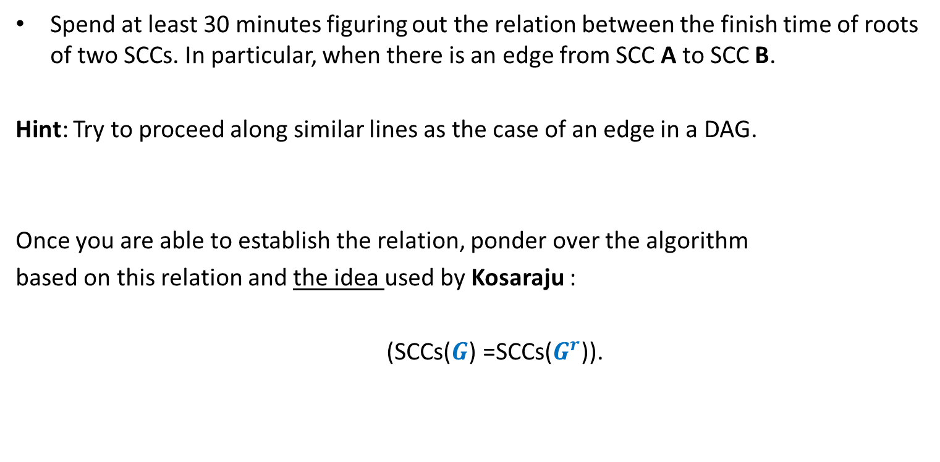
Homework
Spend at least 30 minutes figuring out the relation between the finish time of roots of two SCCs. In particular, when there is an edge from SCC A to SCC B.
Hint: Try to proceed along similar lines as the case of an edge in a DAG.
Once you are able to establish the relation, ponder over the algorithm
based on this relation and the idea used by Kosaraju :
(SCCs($G$) =SCCs($G^{r}$)).

