Slide 1
Design and Analysis of Algorithms
CS345
Lecture 17
Dynamic Programming - II

Slide 2
Recap of the last lecture

Slide 3
Overview of Dynamic Progrmming Paradigm.
From Longest common subsequence problem
Recursive Formulation
Recursive Algorithm
What is the most nontrivial step among these ?
Exponential time
Polynomial no. of
distinct subproblems
Cause of exponential time:
Overlap in subProblems
Bottom up approach
A Polynomial time algorithm

Slide 4

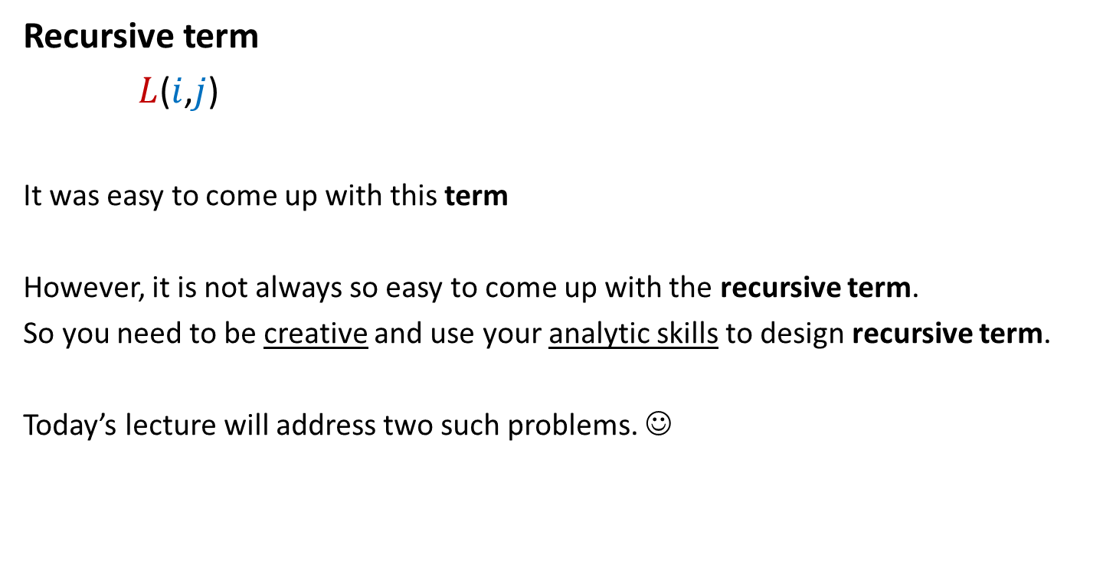
From Longest common subsequence problem
Recursive term
$L$($i$,$j$)
It was easy to come up with this term
However, it is not always so easy to come up with the recursive term.
So you need to be creative and use your analytic skills to design recursive term.
Today’s lecture will address two such problems. ☺
: The length of LCS of A[$1..i]$ and B[$1..j]$
because of linear structure of sequence.

Slide 5
OPTMAL Triangulation of a CONVEX POLYGON

Slide 6












Convex polygon
Representation: ?
How to store: ?
< $p_{i}$,…, $p_{j}$> : ?
< $p_{1}$,…, $p_{n}$>
Array
$$p_{i}$$
$$q$$
$$p_{n−2}$$
$$p_{3}$$
$$r$$
$$p_{2}$$
$$p_{n−1}$$
$$p_{n}$$
$$p_{1}$$
Polygon consisting of points $p_{i}$,…, $p_{j}$

Slide 7
Triangulation of a CONVEX POLYGON
Partitioning the polygon into disjoint triangles
$$p_{i}$$
$$p_{3}$$
$$p_{2}$$
$$p_{n−1}$$
$$p_{n}$$
$$p_{1}$$
, each defined by 3 points on the polygon

Slide 8
Triangulation of a CONVEX POLYGON
Partitioning the polygon into disjoint triangles
$$p_{i}$$
$$p_{3}$$
$$p_{2}$$
$$p_{n−1}$$
$$p_{n}$$
$$p_{1}$$
, each defined by 3 points on the polygon

Slide 9


Triangulation of a CONVEX POLYGON
Though there may be many triangulations,
but each has exactly
$n−2$ triangles.
Each side of the polygon
belongs to exactly $1$ triangle in a triangulation.
$$p_{i}$$
$$p_{3}$$
$$p_{2}$$
$$p_{n−1}$$
$$p_{n}$$
$$p_{1}$$

Slide 10
OPTMAL Triangulation of a CONVEX POLYGON

Slide 11


$ω$($i$,$j$,$k$) : weight of triangle formed by $p_{i}$, $p_{j}$, $p_{k}$.
Assumption: It takes O(1) time to compute $ω$($i$,$j$,$k$)
Cost of a triangulation : sum of the weight of $n−2$ triangles formed.
Aim: Compute triangulation of minimum cost.
$$p_{i}$$
$$p_{3}$$
$$p_{2}$$
$$p_{n−1}$$
$$p_{n}$$
$$p_{1}$$

Slide 12
Attempt 1
Let us count the number of all possible triangulations.
If it is polynomial,
we have a polynomial time algorithm
to compute optimal triangulation.

Slide 13







How many possible triangulations ?
Let us explore the triangles to which side ($p_{1}$, $p_{n}$) may belong in any triangulation.
$$p_{k}$$
$$p_{3}$$
$$p_{2}$$
$$p_{n−1}$$
$$p_{n}$$
$$p_{1}$$

Slide 14
How many possible triangulations ?
$$p_{k}$$
$$p_{3}$$
$$p_{2}$$
$$p_{n−1}$$
$$p_{n}$$
$$p_{1}$$

Slide 15
How many possible triangulations ?
$$p_{k}$$
$$p_{3}$$
$$p_{2}$$
$$p_{n−1}$$
$$p_{n}$$
$$p_{1}$$

Slide 16
How many possible triangulations ?
$$p_{k}$$
$$p_{3}$$
$$p_{2}$$
$$p_{n−1}$$
$$p_{n}$$
$$p_{1}$$

Slide 17
How many possible triangulations ?
$$p_{k}$$
$$p_{3}$$
$$p_{2}$$
$$p_{n−1}$$
$$p_{n}$$
$$p_{1}$$

Slide 18
How many possible triangulations ?
$$p_{k}$$
$$p_{3}$$
$$p_{2}$$
$$p_{n−1}$$
$$p_{n}$$
$$p_{1}$$

Slide 19

How many possible triangulations ?
$$p_{k}$$
$$p_{3}$$
$$p_{2}$$
$$p_{n−1}$$
$$p_{n}$$
$$p_{1}$$
Exactly $n−2$ triangles.

Slide 20
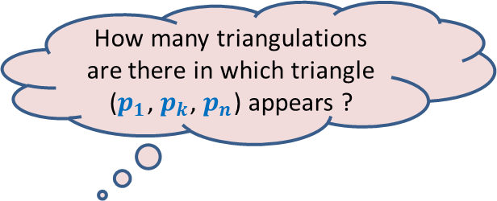


How many possible triangulations ?
$$F(n)$$
: The number of possible triangulations of polygon of $n$sides.
$$p_{k}$$
$$F\left(3\right)=1$$
$$p_{3}$$
$$p_{2}$$
$$p_{n−1}$$
How many triangulations are there in which triangle ($p_{1}$, $p_{k}$, $p_{n}$) appears ?
$$p_{n}$$
$$p_{1}$$
Exactly $n−2$ triangles.

Slide 21
How many possible triangulations ?
$$F(n)$$
: The number of possible triangulations of polygon of $n$sides.
$$p_{k}$$
$$F\left(3\right)=1$$
$$p_{3}$$
$$p_{2}$$
$$p_{n−1}$$
How many triangulations are there in which triangle ($p_{1}$, $p_{k}$, $p_{n}$) appears ?
$$p_{n}$$
$$p_{1}$$

Slide 22



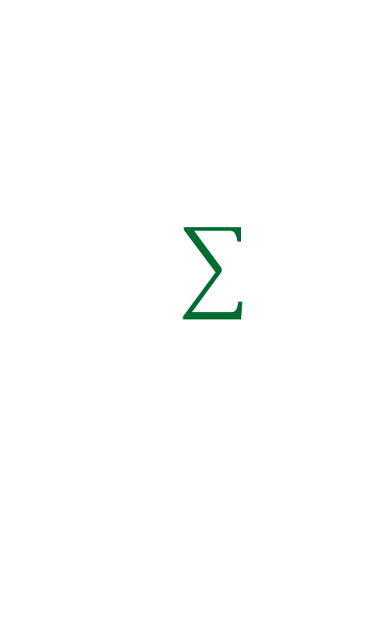








How many possible triangulations ?
$$F(n)$$
: The number of possible triangulations of polygon of $n$sides.
$$p_{k}$$
$$F\left(2\right)=1$$
$$F\left(3\right)=1$$
What about $F(n)$?
$$F(n−k+1)$$
$$F(k)$$
$$p_{3}$$
Exponential in $n$ ☹
$$p_{2}$$
$$p_{n−1}$$
Can you write a recurrence for this count ?
$$×$$
$$F(k)$$
$$F(n−k+1)$$
$$p_{n}$$
$$p_{1}$$
$$2≤k≤n−1$$
= # rooted binary trees on $n−2$ nodes
= ($n−2$)th Catalan number

Slide 23
There are exponential number of triangulations.
So we cannot afford to enumerate them to compute least cost triangulation.
But, ..
the insight we developed from the exercise of counting the no. of triangulations
will help us design the recursive formulation for the least cost triangulation.
Spend some time working on your own before proceeding further. ☺

Slide 24

How to compute optimal triangulation ?
Question: If the opt. triangulation has triangle ($p_{1}$, $p_{k}$, $p_{n}$), what can we infer ?
$$p_{k}$$
$$p_{3}$$
$$p_{2}$$
$$p_{n−1}$$
Can you give a recursive formulation for the problem ?
What will be the recursive term ?
How many parameters ?
$$p_{n}$$
$$p_{1}$$
Homework: Ponder over these questions before coming to next class …

Slide 25
Bitonic tour

Slide 26







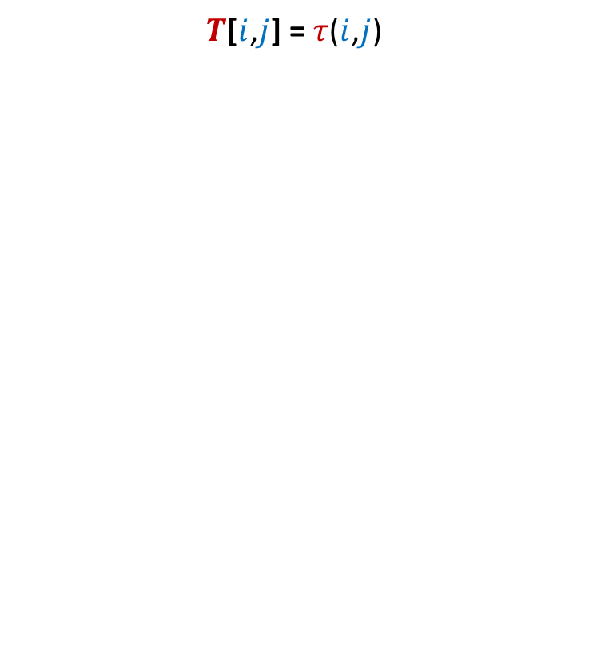

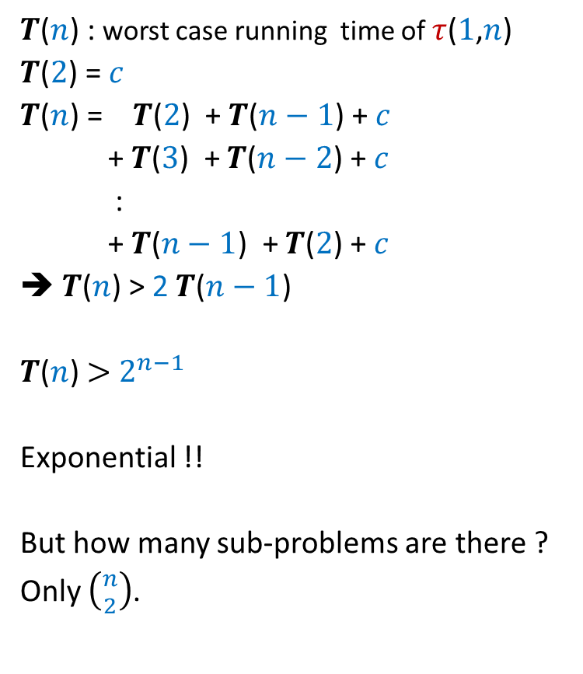

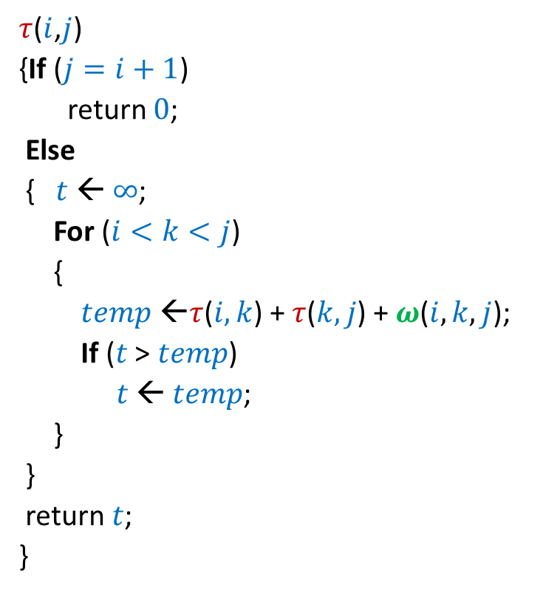
Bitonic tour
There are $n$ points in a plane.
$δ(p_{i},p_{j})$: distance between $p_{i}$ and $p_{j}$
Cost of a tour: Total distance traveled.
$$p_{6}$$
$$p_{2}$$
$$p_{4}$$
$$p_{7}$$
$$p_{10}$$
$$p_{1}$$
$$p_{9}$$
$$p_{11}$$
$$p_{3}$$
$$p_{5}$$
$$p_{8}$$

Slide 27

Bitonic tour
There are $n$ points in a plane.
$δ(p_{i},p_{j})$: distance between $p_{i}$ and $p_{j}$
Cost of a tour: Total distance traveled.
Not bitonic
$$p_{6}$$
$$p_{2}$$
$$p_{4}$$
$$p_{7}$$
$$p_{10}$$
$$p_{1}$$
$$p_{9}$$
$$p_{11}$$
$$p_{3}$$
$$p_{5}$$
$$p_{8}$$

Slide 28

Bitonic tour
There are $n$ points in a plane.
$δ(p_{i},p_{j})$: distance between $p_{i}$ and $p_{j}$
Cost of a tour: Total distance traveled.
Problem: Given $n$ points <$p_{1}$,$p_{2}$,…,$p_{n}$> in increasing $x$-coordinates,
compute their least cost Bitonic tour.
Bitonic
$$p_{6}$$
$$p_{2}$$
$$p_{4}$$
$$p_{7}$$
$$p_{10}$$
$$p_{1}$$
$$p_{9}$$
$$p_{11}$$
$$p_{3}$$
$$p_{5}$$
$$p_{8}$$

Slide 29

Bitonic tour
Can you give a recursive formulation for the problem ?
What will be the recursive term ?
How many parameters ?
Let us reformulate the problem to make it
uni-directional.
Spend some time pondering over these questions before moving on…
There are $n$ points in a plane.
$δ(p_{i},p_{j})$: distance between $p_{i}$ and $p_{j}$
Problem: Given $n$ points <$p_{1}$,…,$p_{n}$> in increasing $x$-coordinates,
We need to travel from $p_{n}$to $p_{1}$ twice, each time from right to left.
We need to ensure that each intermediate point is visited exactly once.
What is the least distance that needs to be traveled ?
$$p_{6}$$
$$p_{2}$$
$$p_{4}$$
$$p_{7}$$
$$p_{10}$$
$$p_{1}$$
$$p_{9}$$
$$p_{11}$$
$$p_{3}$$
$$p_{5}$$
$$p_{8}$$

Slide 30


Attempt 1
Try to relate
$T[n]$ and $T[n−1]$.
$T[i]$: The least cost of reaching $p_{1}$ by two paths from $p_{i}$
while traversing each intermediate point exclusively once.
Aim: To compute $T[n]$.
$$p_{6}$$
$$p_{2}$$
$$p_{4}$$
$$p_{7}$$
$$p_{10}$$
$$p_{1}$$
$$p_{9}$$
$$p_{11}$$
$$p_{3}$$
$$p_{5}$$
$$p_{8}$$
No obvious way !
Is there any way to have 2 paths from $p_{11}$ ?

Slide 31


New Idea:
Generalize the problem
$$p_{6}$$
$$p_{2}$$
$$p_{4}$$
$$p_{7}$$
$$p_{10}$$
$$p_{1}$$
$$p_{n}$$
$$p_{9}$$
$$p_{n+1}$$
$$p_{3}$$
$$p_{5}$$
$$p_{8}$$

Slide 32

New Idea:
Generalize the problem
$$p_{6}$$
$$p_{2}$$
$$p_{4}$$
$$p_{7}$$
$$p_{10}$$
$$p_{1}$$
$$p_{n}$$
$$p_{9}$$
$$p_{3}$$
$$p_{8}$$
$$p_{n+1}$$
$$p_{5}$$

Slide 33

New Idea:
Generalize the problem
Problem: Given $n+1$ points <$p_{1}$,…,$p_{n+1}$> in increasing $x$-coordinates,
We need to travel from $p_{n}$and $p_{n+1}$ to $p_{1}$
What is the least distance traveled ?
$$p_{6}$$
$$p_{2}$$
$$p_{4}$$
$$p_{7}$$
$$p_{10}$$
$$p_{1}$$
$$p_{n}$$
$$p_{9}$$
$$p_{3}$$
$$p_{8}$$
$$p_{n+1}$$
$$p_{5}$$
traversing each point exclusively once.
When $p_{n}$ and $p_{n+1}$ coincide, this becomes our the bitonic tour problem.

Slide 34
Homework
Make sincere attempts to design a recursive formulation of the generalized problem.
We shall discuss it in the next class.

Slide 35
Shortest pathS in a graph
In presence of negative edge weights

Slide 36
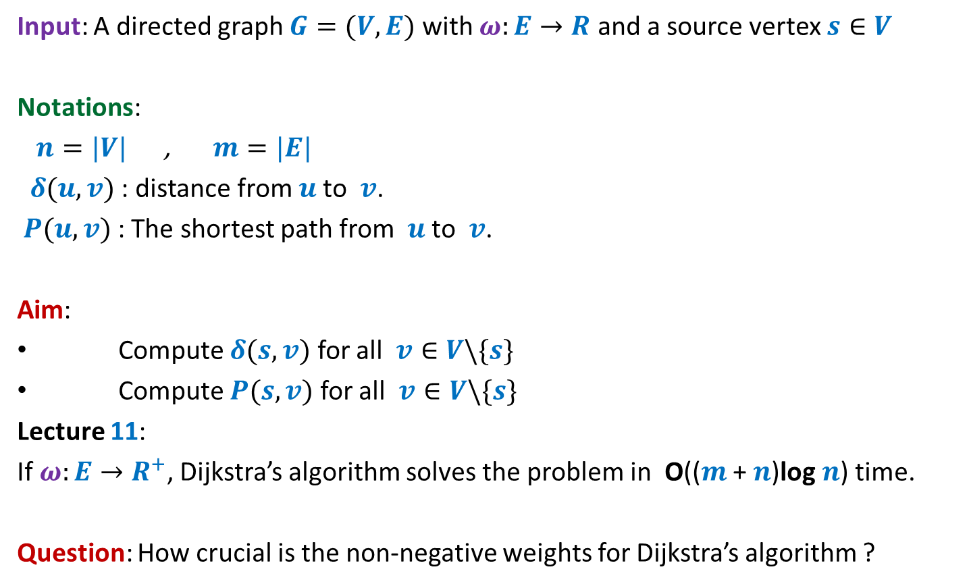
Problem Definition
Input: A directed graph $G=(V,E)$ with $ω:E→R$ and a source vertex $s∈V$
Notations:
$n=|V|$ , $m=|E|$
$δ(u,v)$ : distance from $u$to $v$.
$P(u,v)$ : The shortest path from $u$to $v$.
Aim:
Compute $δ(s,v)$ for all $v∈V\backslash \{s\}$
Compute $P(s,v)$ for all $v∈V\backslash \{s\}$
Lecture 11:
If $ω:E→R^{+}$, Dijkstra’s algorithm solves the problem in O(($m$ + $n$)log $n$) time.
Question: How crucial is the non-negative weights for Dijkstra’s algorithm ?

Slide 37
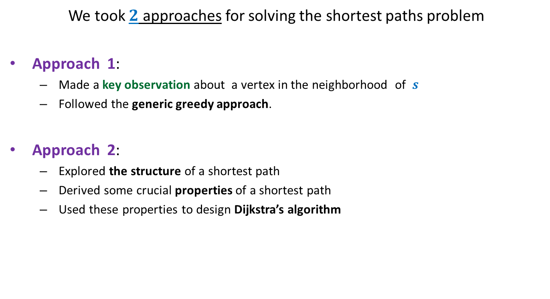
Revisiting Lecture 11
We took $2$ approaches for solving the shortest paths problem
Approach 1:
  Made a key observation about a vertex in the neighborhood of $s$
  Followed the generic greedy approach.
Approach 2:
  Explored the structure of a shortest path
  Derived some crucial properties of a shortest path
  Used these properties to design Dijkstra’s algorithm
Let us explore how crucial was the role of “non-negative edge weights” in these approaches.

Slide 38












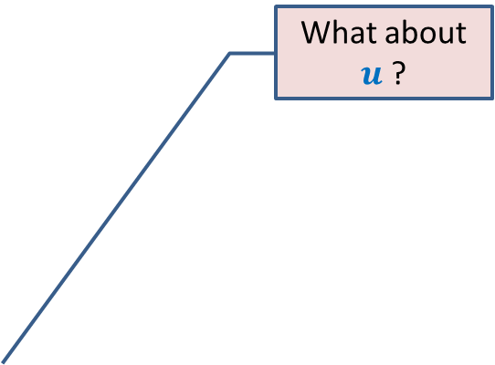
Approach 1
What about $u$ ?
Question: Can we be certain about the distance from $s$ to any vertex in this picture ?
Answer: NO.☹
$$z$$
$$10$$
$$v$$
G
$$12$$
$$7$$
$$x$$
$$s$$
$$−3$$
$$5$$
$$u$$
$$y$$

Slide 39

Approach 1
$$z$$
$$10$$
$$v$$
G
$$12$$
$$7$$
$$x$$
$$s$$
$$−3$$
$$5$$
$$u$$
$$y$$
$$−16$$
Approach 1 fails ☹

Slide 40
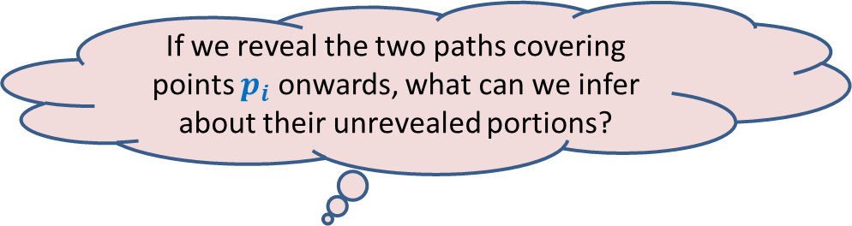


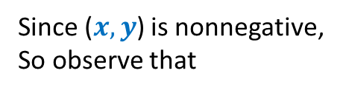




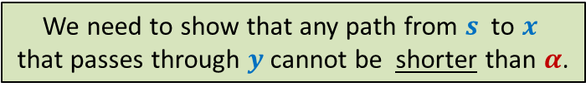
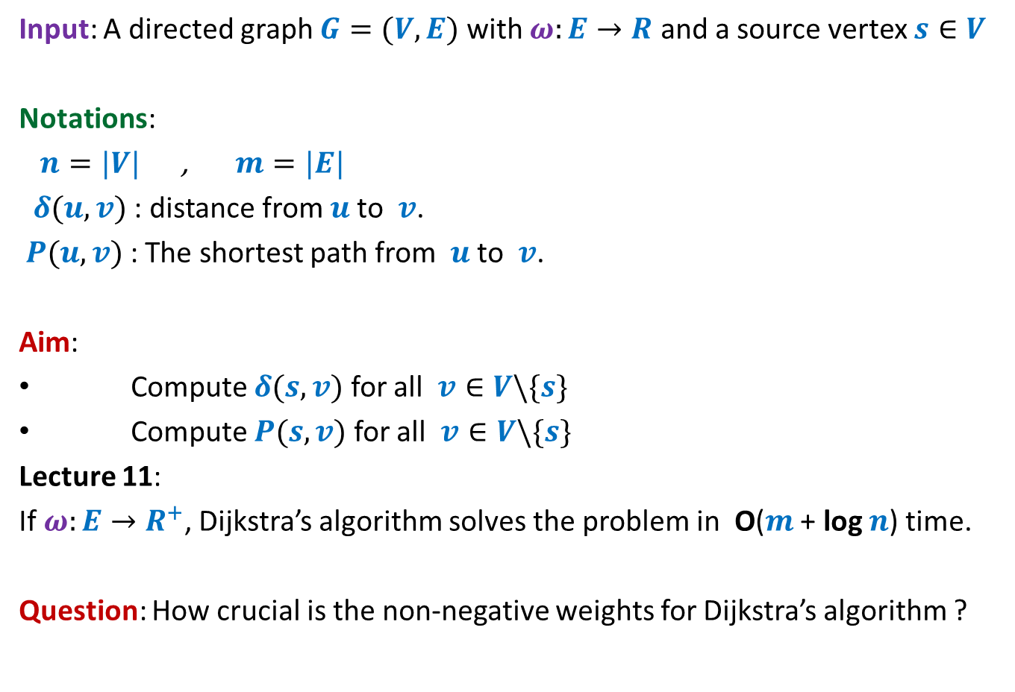



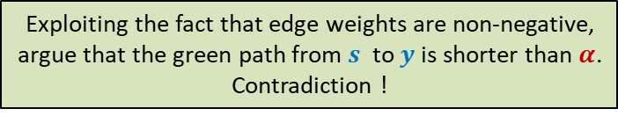
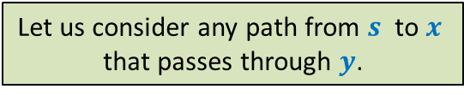
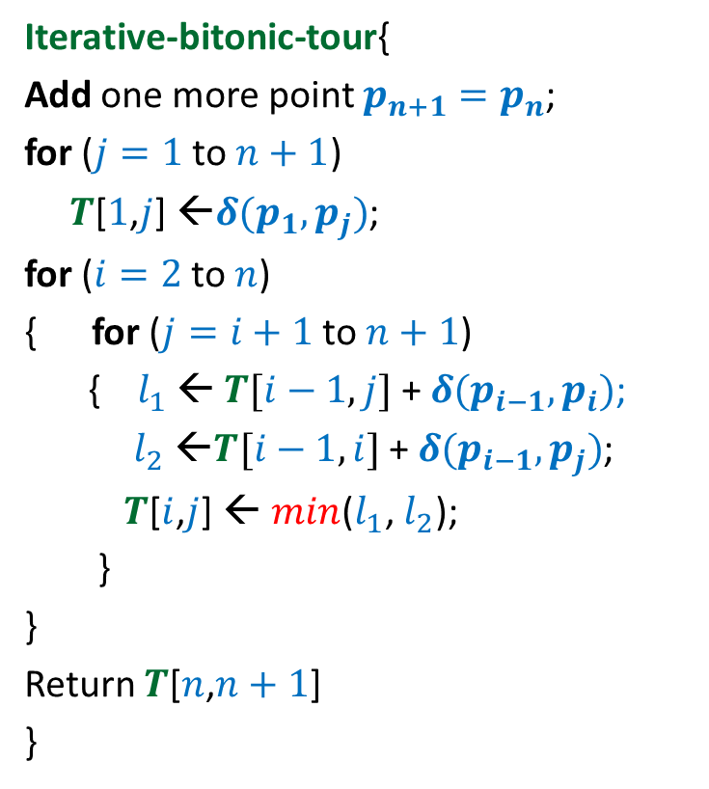

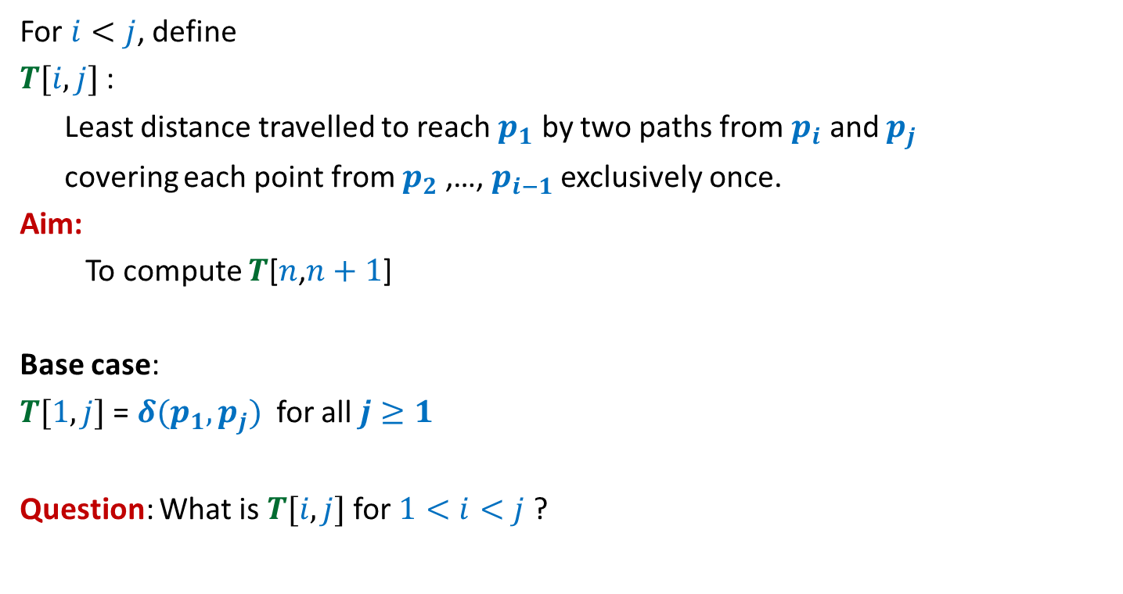

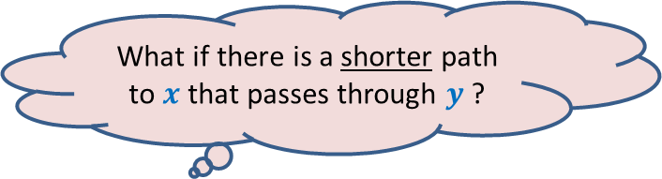

What properties does Dijkstra’s algorithm exploit ?
Approach 2
Property 1: Any subpath of $P(s,y)$ is also a shortest path.
Proof: If $Q$ is not shortest path to $x$,
replace it by a shorter path from $s$ to $x$.
This will give us a path to $y$, which is shorter than $P(s,y)$.
This contradicts that $P(s,y)$ is the shortest path to $y$.
If $P\left(s,y\right)=Q∷(x,y)$, then $Q$ is the shortest path from $s$ to $x$.
Suppose this path is shorter than $α$
$$<α$$
$$a$$
$$b$$
$$c$$
$$f$$
$$<α$$
Since ($x,y$) is nonnegative,
So observe that
We used 2 properties of a shortest path to design Dijkstra’s algorithm
$$P(s,y)$$
$$δ\left(s,y\right)≥α$$
$$s$$
$$u$$
$$v$$
$$x$$
$$y$$
$α$= Length of $Q$
$$Q$$
This proof is incomplete.
Can you spot that ?
What if there is a shorter path to $x$ that passes through $y$ ?
Let us consider any path from $s$ to $x$
that passes through $y$.
Exploiting the fact that edge weights are non-negative,
argue that the green path from $s$ to $y$is shorter than $α$.
Contradiction !
We need to show that any path from $s$ to $x$
that passes through $y$cannot be shorter than $α$.
The argument of the proof won’t work.
What to do ? ☹

Slide 41

What properties does Dijkstra’s algorithm exploit ?
?
Property 1: Any subpath of $P(s,y)$ is also a shortest path.
Property 2:
$δ\left(s,u\right)≤δ\left(s,v\right)≤δ(s,x)≤δ(s,y)$
If $P\left(s,y\right)=Q∷(x,y)$, then $Q$ is the shortest path from $s$ to $x$.
$$P(s,y)$$
$$s$$
70
$$u$$
-20
$$v$$
10
$$x$$
-55
$$y$$
Which of these properties will fail to hold if edge weights are allowed to be negative ?

Slide 42

Violating the Optimal subpath property
Property 1: Any subpath of $P(s,y)$ is also a shortest path.
$δ(s,y)$ = ?
$δ(s,x)$ = ?
To show the violation, we need to come up with
a path to $x$ of length < 60 that passes through $y$.
and still keeping $δ(s,y)$ = 5.
If $P\left(s,y\right)=Q∷(x,y)$, then $Q$ is the shortest path from $s$ to $x$.
5
2
-3
10
40
$$a$$
$$b$$
$$c$$
$$f$$
5
6
$$P(s,y)$$
$$s$$
70
$$u$$
-20
$$v$$
10
$$x$$
-55
$$y$$
60
< 30
10

Slide 43

Violating the Optimal subpath property
Property 1: Any subpath of $P(s,y)$ is also a shortest path.
$δ(s,y)$ = ?
$δ(s,x)$ = ?
If $P\left(s,y\right)=Q∷(x,y)$, then $Q$ is the shortest path from $s$ to $x$.
5
2
-3
10
40
$$a$$
$$b$$
$$c$$
$$f$$
5
6
$$P(s,y)$$
$$s$$
70
$$u$$
-20
$$v$$
10
$$x$$
-55
$$y$$
What to do ? ☹
10
This example illustrates that the optimal subpath property may get violated when the edge weights are negative.
Instead of working with these numbers (2,-3,10,…), consider a generic example where the property fails.
Start all over from scratch to solve the shortest paths problem in graph with –ve edge weights
But how ?
Let us investigate like a true researcher for the exact cause of the violation of the optimal subpath property.
Give up !

