Slide 1
Design and Analysis of Algorithms
CS345
Lecture 18
Dynamic Programming – III
Optimal triangulation of a polygon
Bitonic Tour
Shortest paths in the presence of negative edge weights

Slide 2
OPTMAL Triangulation of a CONVEX POLYGON

Slide 3







$ω$($i$,$j$,$k$) : weight of triangle formed by $p_{i}$, $p_{j}$, $p_{k}$.
Assumption: It takes O(1) time to compute $ω$($i$,$j$,$k$)
Cost of a triangulation : sum of the weight of $n−2$ triangles formed.
Aim: Compute triangulation of minimum cost.
$$p_{i}$$
$$p_{3}$$
$$p_{2}$$
$$p_{n−1}$$
$$p_{n}$$
$$p_{1}$$

Slide 4








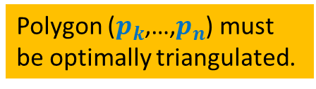

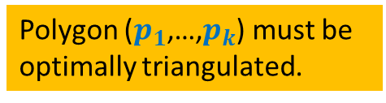
How to compute optimal triangulation ?
Question: If the opt. triangulation has triangle ($p_{1}$, $p_{k}$, $p_{n}$), what can we infer ?
$$p_{k}$$
$$p_{3}$$
Polygon ($p_{1}$,…,$p_{k}$) must be
optimally triangulated.
Polygon ($p_{k}$,…,$p_{n}$) must
be optimally triangulated.
$$p_{2}$$
$$p_{n−1}$$
Can you give a recursive formulation for the problem ?
What will be the recursive term ?
How many parameters ?
$$p_{n}$$
$$p_{1}$$
Otherwise, we can replace it with optimal triangulation of ($p_{1}$,…,$p_{k}$) to get a triangulation of ($p_{1}$,…,$p_{n}$) with cost less than the optimal.
A contradiction !
Otherwise, we can replace it with optimal triangulation of ($p_{k}$,…,$p_{n}$) to get a triangulation of ($p_{1}$,…,$p_{n}$) with cost less than the optimal.
A contradiction !
Spend some time pondering over these questions before moving on…

Slide 5
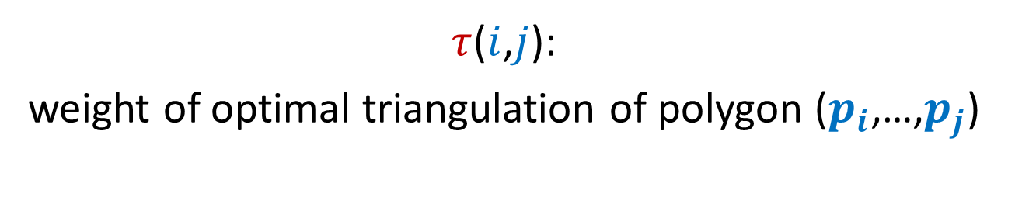
Recursive formulation of OPTMAL Triangulation
$τ$($i$,$j$):
weight of optimal triangulation of polygon ($p_{i}$,…,$p_{j}$)

Slide 6








Recursive formulation for $τ$($i$,$j$)
Base case:
$τ$($i$,$i+1$) = 0
For $j>i+1$
$τ$($i$,$j$) =
$$\min_{?}{? }$$
$$p_{k}$$
Generic case:
$$p_{j}$$
($τ$($i$,$k$) $+τ\text{(}k,j\text{)+}ω\text{(}i,k,j\text{)}$ )
$i$<$k$< $j$
$$p_{i+1}$$
$$p_{i}$$

Slide 7
Recursive ALGORITHM of OPTMAL Triangulation

Slide 8
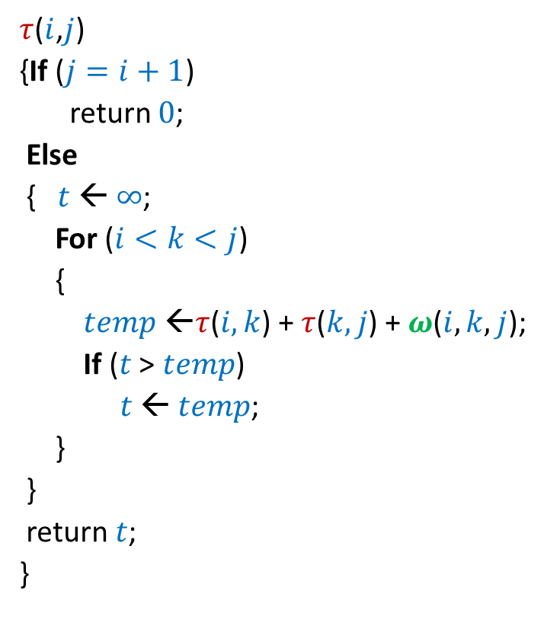

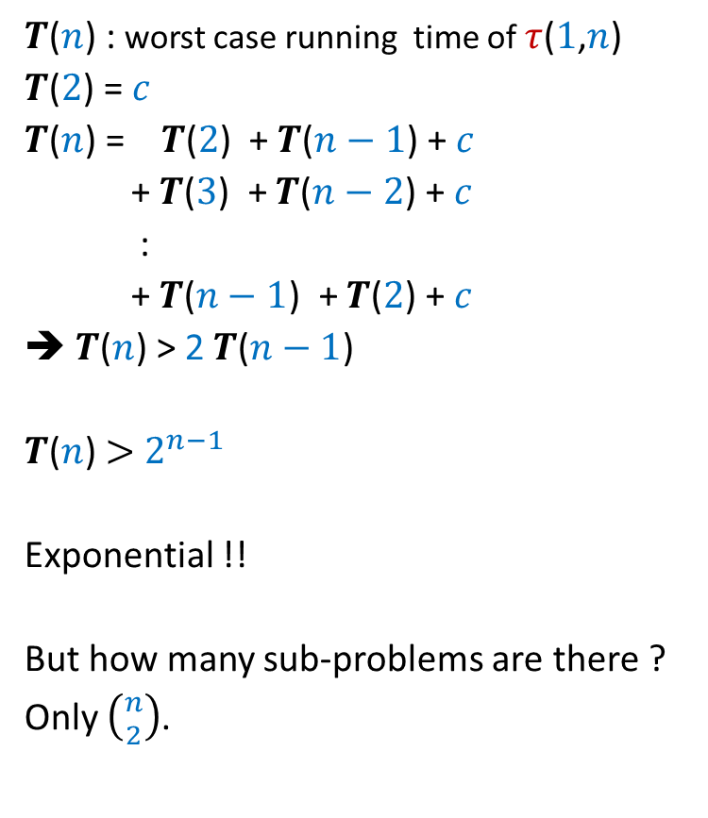
Recursive algorithm for $τ$($i$,$j$)
$τ$($i$,$j$)
{If ($j=i+1$)
return $0$;
Else
{$t$ ← $∞$;
For ($i<k<j$)
{
$temp$ ←$τ$($i,k$) + $τ$($k,j$) + $ω$($i,k,j$);
If ($t$ > $temp$)
$t$ ← $temp$;
}
}
return $t$;
}
$T$($n$) : worst case running time of $τ$($1$,$n$)
$T$($2$) = $c$
$T$($n$) = $T$($2$) + $T$($n−1$) + $c$
+ $T$($3$) + $T$($n−2$) + $c$
:
+ $T$($n−1$) + $T$($2$) + $c$
➔ $T$($n$) > 2 $T$($n−1$)
$T$($n$) $>$ $2^{n−1}$
Exponential !!
But how many sub-problems are there ?
Only $\left({n \atop 2}\right)$.

Slide 9






Recursive algorithm for $τ$($i$,$j$)
$T$[$i$,$j$] = $τ$($i$,$j$)
$τ$($i$,$j$)
{If ($j=i+1$)
return $0$;
Else
{$t$ ← $∞$;
For ($i<k<j$)
{
$temp$ ←$τ$($i,k$) + $τ$($k,j$) + $ω$($i,k,j$);
If ($t$ > $temp$)
$t$ ← $temp$;
}
}
return $t$;
}
$$n$$
0
0
0
0
0
0
0
0
0
$$i$$
0
…
0
2
0
1
0
1 2 ... $n$
$$j$$
$$T$$

Slide 10



Iterative algorithm for $τ$($i$,$j$)
$T$[$i$,$j$] = $τ$($i$,$j$)
$$n$$
0
0
0
0
0
0
0
0
0
$$i$$
0
…
0
2
0
$$Δ$$
1
0
$$Δ$$
1 2 ... $n$
$$j$$
$$T$$
Homework:
Write a neat and efficient iterative algorithm. The solution is given on the following slide.
Watch it only after making sincere attempts on your own.

Slide 11

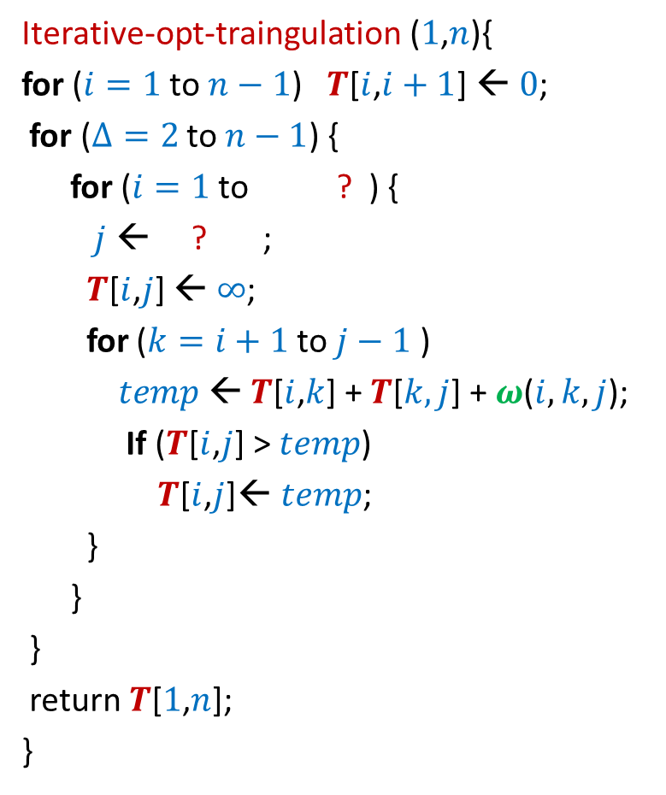


Iterative algorithm for $τ$($i$,$j$)
Iterative-opt-traingulation ($1$,$n$){
for ($i=1$ to $n−1$) $T$[$i$,$i+1$] ← $0$;
for ($Δ=2$ to $n−1$) {
for ($i=1$ to ? ) {
$j$ ← ? ;
$T$[$i$,$j$] ← $∞$;
for ($k=i+1$ to $j−1$ )
$temp$← $T$[$i$,$k$] + $T$[$k,j$] + $ω$($i,k,j$);
If ($T$[$i$,$j$] > $temp$)
$T$[$i$,$j$]← $temp$;
}
}
}
return $T$[$1$,$n$];
}
$T$[$i$,$j$] = $τ$($i$,$j$)
$$n$$
$$n−Δ$$
0
0
$$i+Δ$$
0
0
0
0
$$Δ$$
Polygons of sides $Δ$
0
{
0
0
$$i$$
0
…
0
2
0
1
0
$$Δ$$
1 2 ... $n$
$$j$$
$$T$$

Slide 12
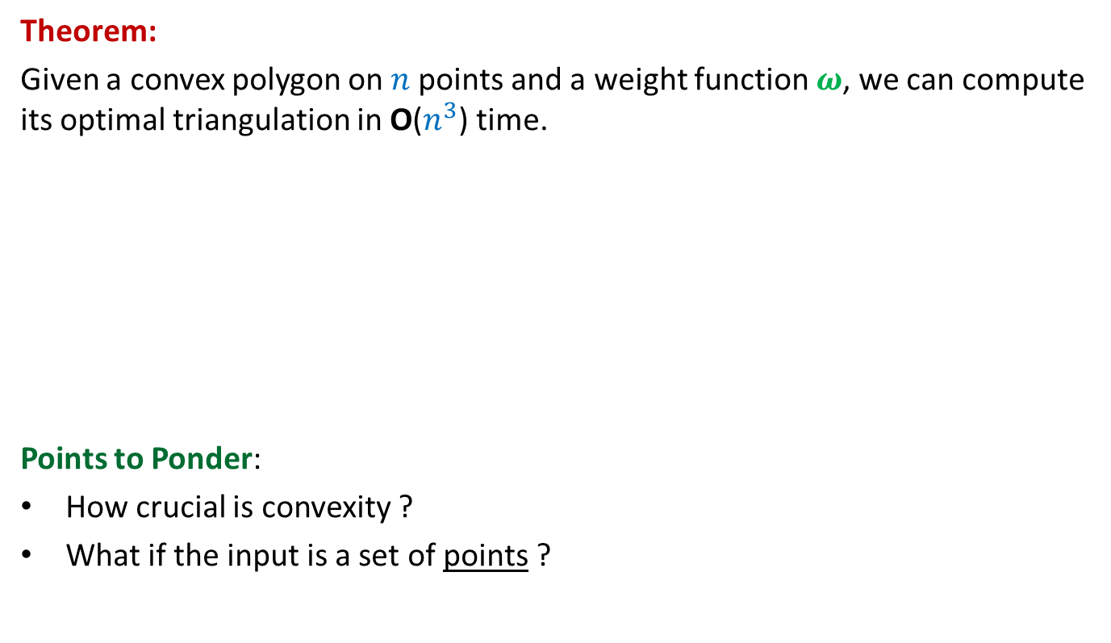
Iterative algorithm for $τ$($i$,$j$)
Theorem:
Given a convex polygon on $n$points and a weight function $ω$, we can compute its optimal triangulation in O($n^{3}$) time.
Points to Ponder:
How crucial is convexity ?
What if the input is a set of points ?
Not much.
No polynomial time algorithm till date ☹

Slide 13
Bitonic tour

Slide 14




Bitonic tour
Can you give a recursive formulation for the problem ?
What will be the recursive term ?
How many parameters ?
Let us reformulate the problem to make it
uni-directional.
Spend some time pondering over these questions before moving on…
There are $n$ points in a plane.
$δ(p_{i},p_{j})$: distance between $p_{i}$ and $p_{j}$
Problem: Given $n$ points <$p_{1}$,…,$p_{n}$> in increasing $x$-coordinates,
We need to travel from $p_{n}$to $p_{1}$ twice, each time from right to left.
We need to ensure that each intermediate point is visited exactly once.
What is the least distance that needs to be traveled ?
$$p_{6}$$
$$p_{2}$$
$$p_{4}$$
$$p_{7}$$
$$p_{10}$$
$$p_{1}$$
$$p_{9}$$
$$p_{11}$$
$$p_{3}$$
$$p_{5}$$
$$p_{8}$$

Slide 15


New Idea:
Generalize the problem
$$p_{6}$$
$$p_{2}$$
$$p_{4}$$
$$p_{7}$$
$$p_{10}$$
$$p_{1}$$
$$p_{n}$$
$$p_{9}$$
$$p_{n+1}$$
$$p_{3}$$
$$p_{5}$$
$$p_{8}$$

Slide 16

New Idea:
Generalize the problem
$$p_{6}$$
$$p_{2}$$
$$p_{4}$$
$$p_{7}$$
$$p_{10}$$
$$p_{1}$$
$$p_{n}$$
$$p_{9}$$
$$p_{3}$$
$$p_{8}$$
$$p_{n+1}$$
$$p_{5}$$

Slide 17
New Idea:
Generalize the problem
Problem: Given $n+1$ points <$p_{1}$,…,$p_{n+1}$> in increasing $x$-coordinates,
We need to travel from $p_{n}$and $p_{n+1}$ to $p_{1}$
What is the least distance traveled ?
$$p_{6}$$
$$p_{2}$$
$$p_{4}$$
$$p_{7}$$
$$p_{10}$$
$$p_{1}$$
$$p_{n}$$
$$p_{9}$$
$$p_{3}$$
$$p_{8}$$
$$p_{n+1}$$
$$p_{5}$$
traversing each point exclusively once.

Slide 18
What should be the Term for
One parameter or multiple parameters ?
Recursive formulation ?

Slide 19
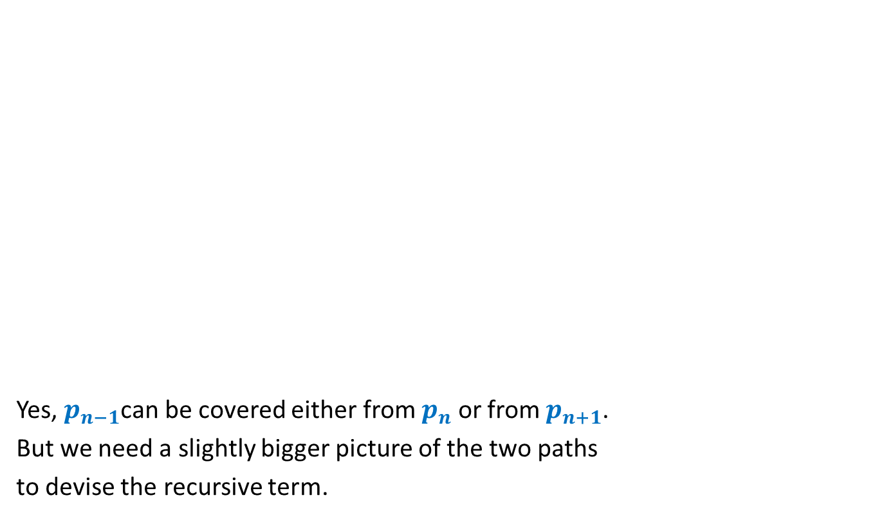


Term for Recursive formulation ?
Yes, $p_{n−1}$can be covered either from $p_{n}$ or from $p_{n+1}$.
But we need a slightly bigger picture of the two paths
to devise the recursive term.
$$p_{n}$$
$$p_{1}$$
$$p_{n+1}$$
$$p_{n−1}$$

Slide 20

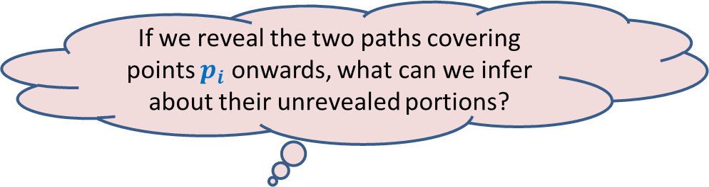





Term for Recursive formulation ?
If we reveal the two paths covering points $p_{i}$ onwards, what can we infer about their unrevealed portions?
Can you see the recursive term that we need ?
$$p_{i}$$
$$p_{n}$$
$$p_{1}$$
$$p_{i−1}$$
$$p_{j}$$
$$p_{n+1}$$
Least dist. travelled to reach $p_{1}$
by two paths from $p_{i}$ and $p_{j}$
covering $p_{2}$,…, $p_{i−1}$exclusively once.

Slide 21
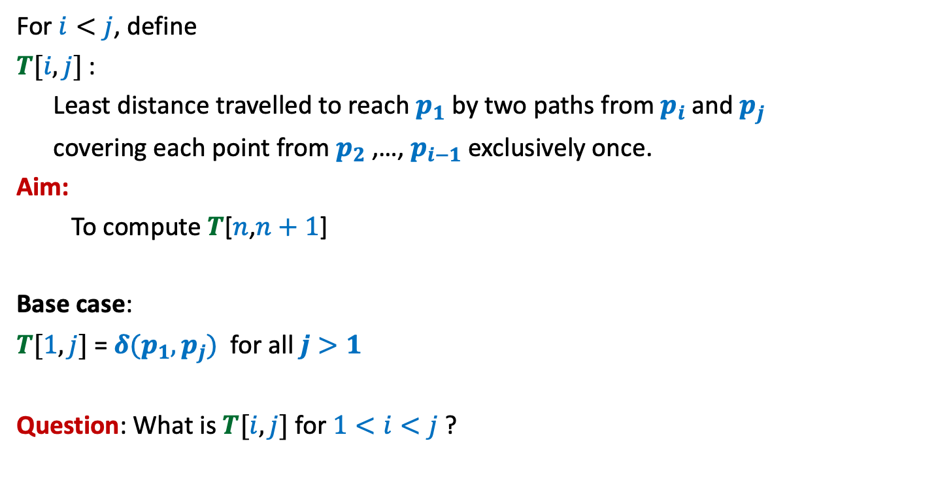
Term for Recursive formulation ?
For $i<j$, define
$T[i,j]$ :
Least distance travelled to reach $p_{1}$ by two paths from $p_{i}$ and $p_{j}$
covering each point from $p_{2}$,…, $p_{i−1}$ exclusively once.
Aim:
To compute $T$[$n$,$n+1$]
Base case:
$T[1,j]$ = $δ(p_{1},p_{j})$ for all $j>1$
Question: What is $T[i,j]$ for $1<i<j$ ?

Slide 22

Recursive formulation for
$$T[i,j]$$

Slide 23







Recursive formulation of $T[i,j]$
Two cases:
$p_{i−1}$ visited from $p_{i}$
$p_{i−1}$ visited from $p_{j}$
$T(i,j)$ = $min$($T(i−1,j)$ + $δ(p_{i−1},p_{i})$ , $T(i−1,i)$ + $δ(p_{i−1},p_{j})$)
➔ $T(i,j)$ = $T(i−1,j)$ + $δ(p_{i−1},p_{i})$
➔ $T$($i,j$)= $T(i−1,i)$ + $δ(p_{i−1},p_{j})$
$$p_{i}$$
$$p_{i−1}$$
$$p_{1}$$
$$p_{j}$$

Slide 24
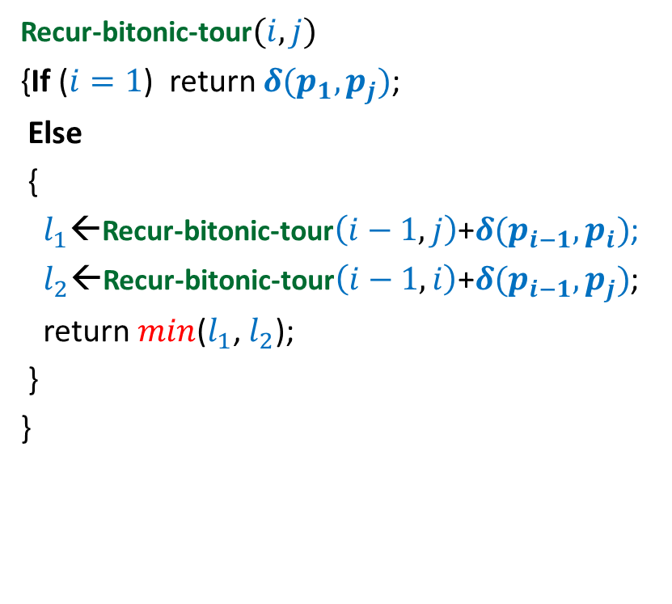

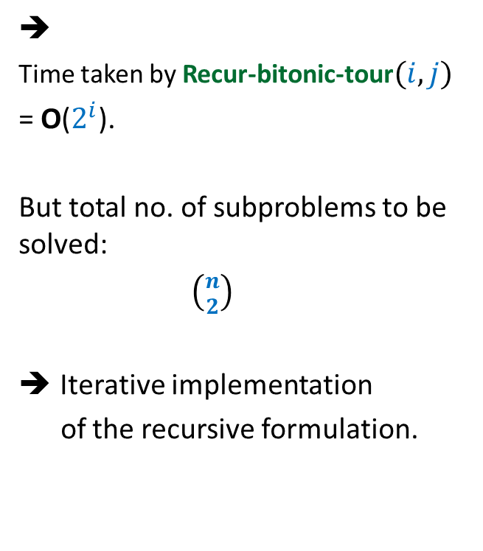
Recursive algorithm for $T(i,j)$
Recur-bitonic-tour$(i,j)$
{If ($i=1$) return $δ(p_{1},p_{j})$;
Else
{
$l_{1}$←Recur-bitonic-tour$\left(i−1,j\right)$+$δ(p_{i−1},p_{i})$;
$l_{2}$←Recur-bitonic-tour$\left(i−1,i\right)$+$δ(p_{i−1},p_{j})$;
return $min$($l_{1}$, $l_{2}$);
}
}
➔
Time taken by Recur-bitonic-tour$(i,j)$
= O($2^{i}$).
But total no. of subproblems to be solved:
$\left({n \atop 2}\right)$
Iterative implementation
of the recursive formulation.

Slide 25





Recursive algorithm for $T(i,j)$
Recur-bitonic-tour$(i,j)$
{If ($i=1$) return $δ(p_{1},p_{j})$;
Else
{
$l_{1}$←Recur-bitonic-tour$\left(i−1,j\right)$+$δ(p_{i−1},p_{i})$;
$l_{2}$←Recur-bitonic-tour$\left(i−1,i\right)$+$δ(p_{i−1},p_{j})$;
return $min$($l_{1}$, $l_{2}$);
}
}
$$n$$
$$i$$
…
2
1
$$i$$
$$j$$
1 2 ... $n+1$
$$T$$

Slide 26
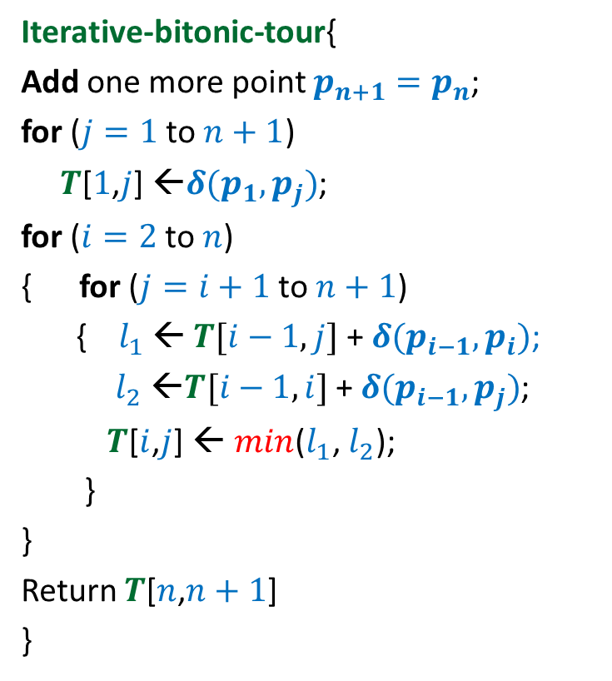


Iterative algorithm for Optimal Bitonic tour
Iterative-bitonic-tour{
Add one more point $p_{n+1}=p_{n}$;
for ($j=1$ to $n+1$)
$T$[$1$,$j$] ←$δ(p_{1},p_{j})$;
for ($i=2$ to $n$)
{ for ($j=i+1$ to $n+1$)
{ $l_{1}$ ← $T[i−1,j]$ + $δ(p_{i−1},p_{i})$;
$l_{2}$ ←$T[i−1,i]$ + $δ(p_{i−1},p_{j})$;
$T$[$i$,$j$] ← $min$($l_{1}$, $l_{2}$);
}
}
Return $T$[$n$,$n+1$]
}
$$n$$
$$i$$
…
2
1
1 2 ... $n+1$
$$j$$
Time complexity: O($n^{2}$)
$$T$$

Slide 27
Lessons learnt
There may be multiple parameter term
hidden in the recursive formulation.
Sometimes generalizaton helps !

Slide 28
Shortest pathS in a graph
In presence of negative edge weights

Slide 29
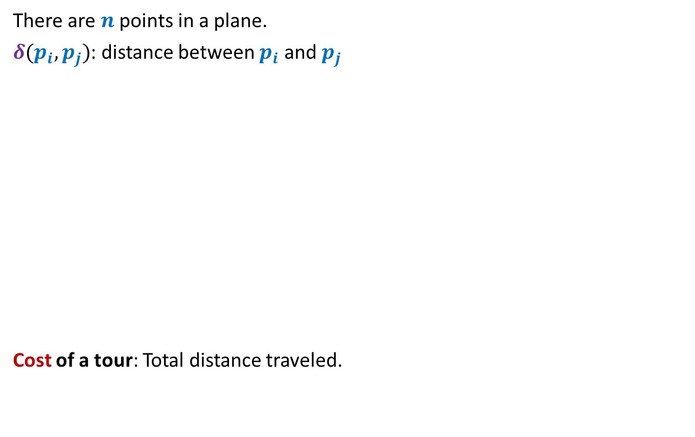



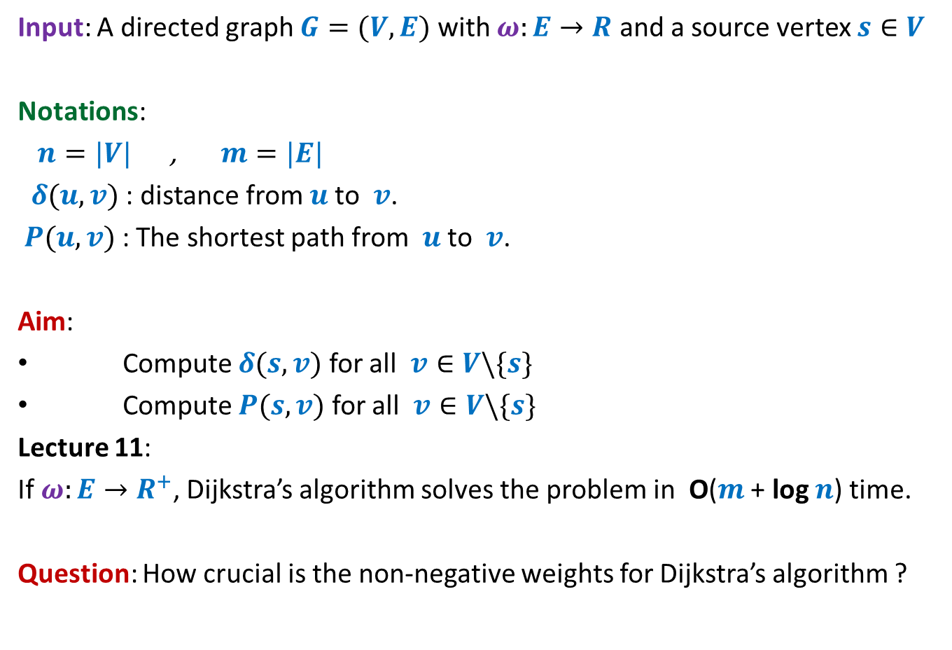
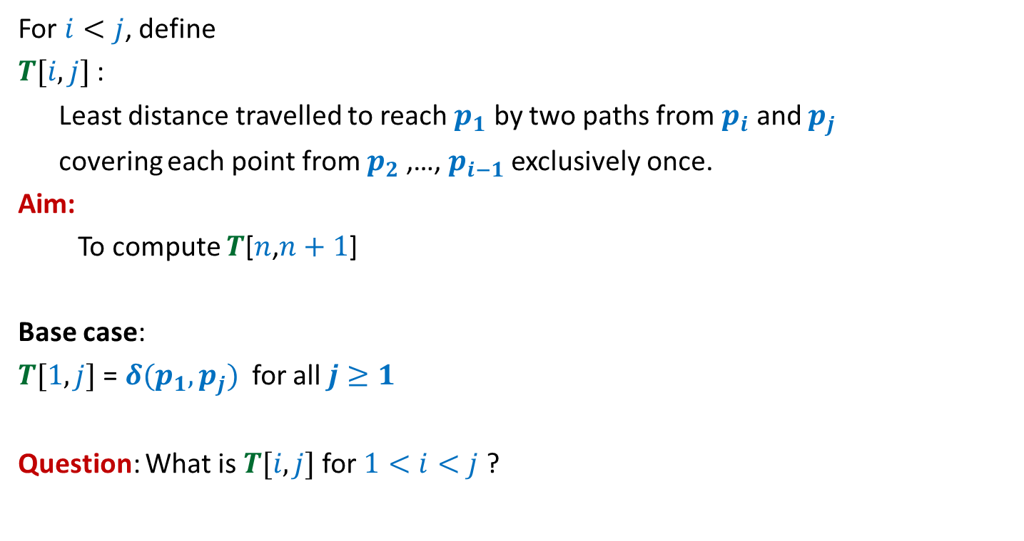
Violating the Optimal subpath property
Property 1: Any subpath of $P(s,y)$ is also a shortest path.
$δ(s,y)$ = ?
$δ(s,x)$ = ?
To show the violation, we need to come up with
a path to $x$ of length < 60 that passes through $y$.
and still keeping $δ(s,y)$ = 5.
If $P\left(s,y\right)=Q∷(x,y)$, then $Q$ is the shortest path from $s$ to $x$.
5
2
-3
10
40
$$a$$
$$b$$
$$c$$
$$f$$
5
6
$$P(s,y)$$
$$s$$
70
$$u$$
-20
$$v$$
10
$$x$$
-55
$$y$$
60
< 30
10

Slide 30

Violating the Optimal subpath property
Property 1: Any subpath of $P(s,y)$ is also a shortest path.
$δ(s,y)$ = ?
$δ(s,x)$ = ?
If $P\left(s,y\right)=Q∷(x,y)$, then $Q$ is the shortest path from $s$ to $x$.
5
2
-3
10
40
$$a$$
$$b$$
$$c$$
$$f$$
5
6
$$P(s,y)$$
$$s$$
70
$$u$$
-20
$$v$$
10
$$x$$
-55
$$y$$
10
What to do ? ☹
This example illustrates that the optimal subpath property may get violated when the edge weights are negative.
Instead of working with these numbers (2,-3,10,…), consider a generic example where the property fails.
Start all over from scratch to solve the shortest paths problem in graph with –ve edge weights
But how ?
Let us investigate like a true researcher for the exact cause of the violation of the optimal subpath property.
Give up !

Slide 31
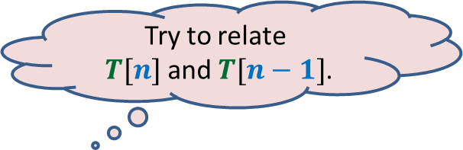

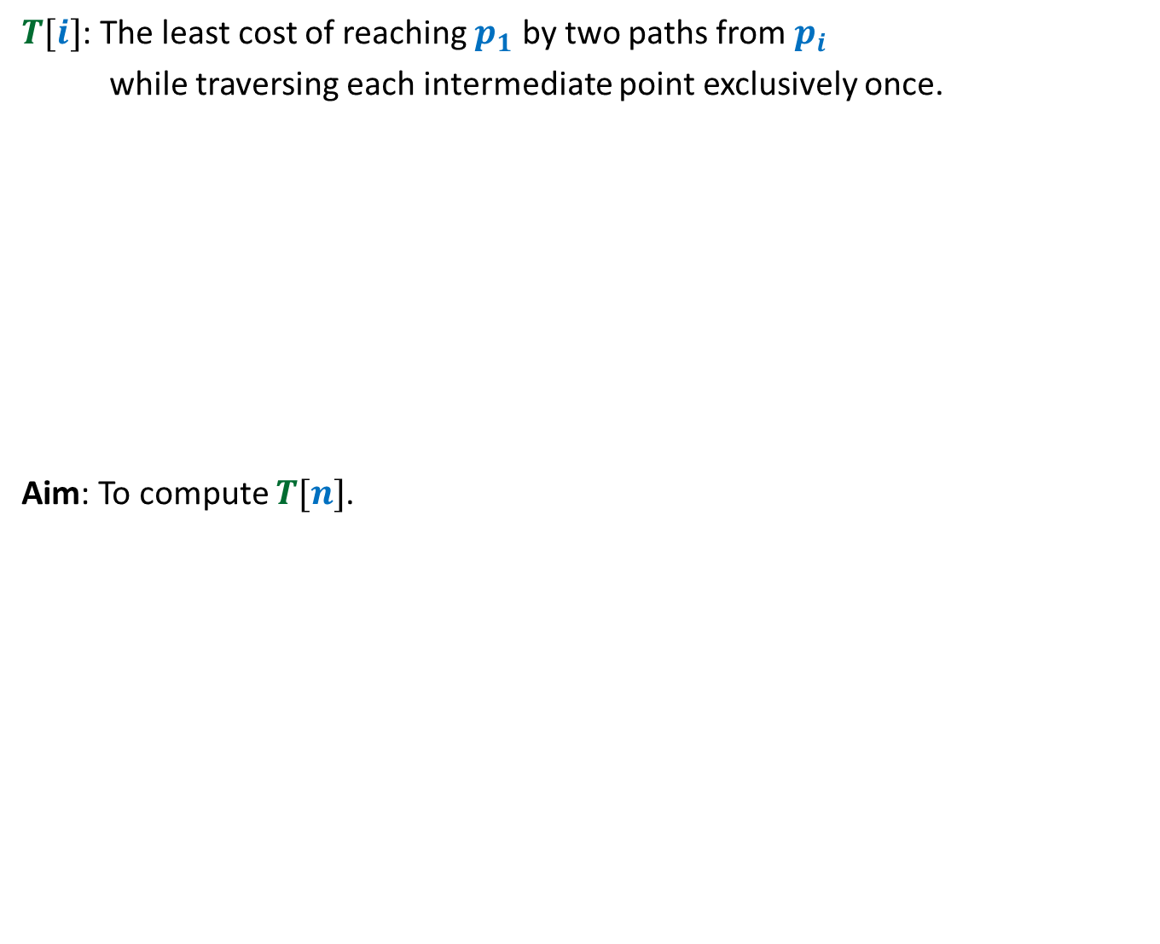



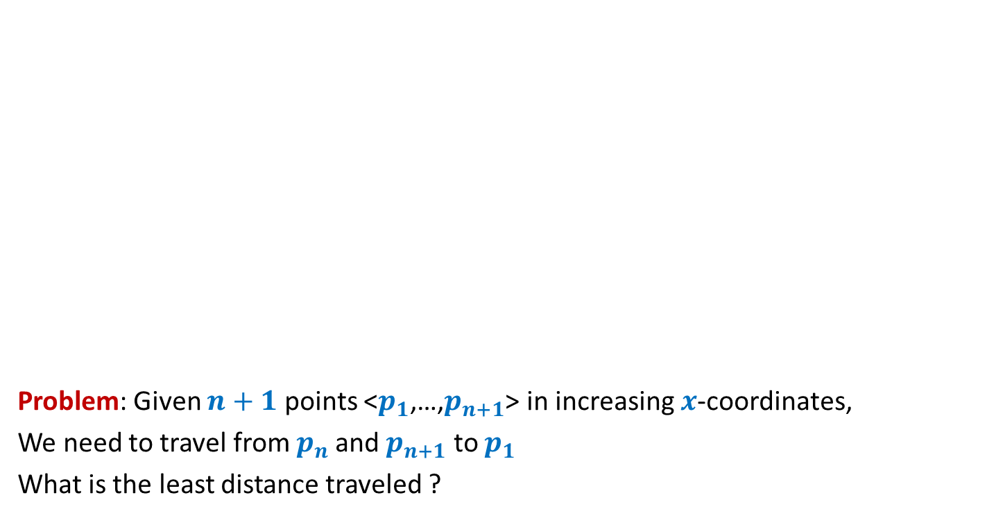
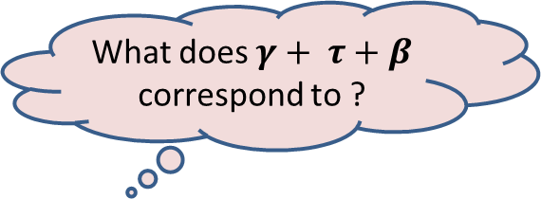
Violating the Optimal subpath property
What does $γ+ τ+β$ correspond to ?
$$C$$
Question: When can there be a shorter $s⇝x$ path that passes through $y$ ?
$C+τ+β<α+β$
$α+β+γ+τ+β<α+β$
$$P(s,y)$$
$$s$$
$$α$$
$$β$$
$$x$$
$$γ$$
$$y$$
$$τ$$
$$α+β+γ≤C$$
Because $P(s,y)$ is the shortest path
Since the green path to $x$ is shorter than the subpath of $P(s,y)$
➔ $γ+ τ+β<0$

Slide 32


Violating the Optimal subpath property
What does $γ+ τ+β$ correspond to ?
$$C$$
Question: When can there be a shorter $s⇝x$ path pass through $y$ ?
Answer: Weight of the cycle $C$ must be NEGATIVE.
$$P(s,y)$$
$$s$$
$$α$$
$$β$$
$$x$$
$$γ$$
$$y$$
Cycle $C$
$$τ$$
➔ $γ+ τ+β<0$

Slide 33




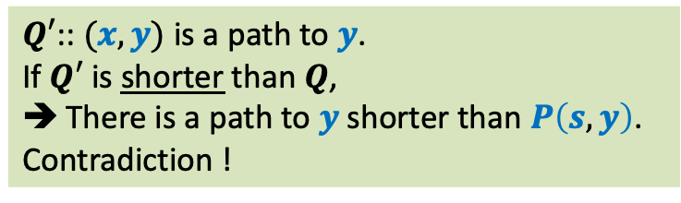
Inference
Lemma: Let $G$be a graph with no negative weight cycle and $P\left(s,y\right)=Q∷(x,y)$.
Any path to $x$that passes through $y$ cannot be shorter than $Q$.
Any path to $x$that doesn’t pass through $y$ cannot be shorter than $Q$.
$$Q′$$
$$s$$
$$u$$
$$v$$
$$x$$
$$y$$
$$Q$$
$Q′$:: $(x,y)$ is a path to $y$.
If $Q′$ is shorter than $Q$,
There is a path to $y$shorter than $P\left(s,y\right)$.
Contradiction !
What about any path to $x$
that does not pass through $y$?
Focus on the Lemma.
What does it convey ?

Slide 34

Inference
The Optimal Subpath Property
Lemma: Let $G$be a graph with no negative weight cycle and $P\left(s,y\right)=Q∷\left(x,y\right)$
$$Q=P\left(s,x\right)$$
$$s$$
$$u$$
$$v$$
$$x$$
$$y$$
$$Q$$

Slide 35









Exploiting the Optimal subpath property
Ponder over it. We shall discuss it in the next lecture.
Observation: If $P(s,v)$ has $i$ edges, $P(s,x)$ has $i−1$ edges.
It suggests that if we know the number of edges on the shortest paths to
each vertex, then we can compute the shortest path to each vertex.
$$P(s,v)$$
$$1$$
$$2$$
$$…$$
$$i$$
$$s$$
$$x$$
$v$
Try to realize the difficulty in exploiting this observation to design recursive formulation of the solution ?
How to get this information ? It is too much to ask for. ☹

