Slide 1
Design and Analysis of Algorithms
CS345
Lecture 19
Fast Matrix Multiplication
I
and its Applications

Slide 2
shortest paths in a graph
The Last Lecture before the mid-semester exam
Negative weights
BUT No negative cycle

Slide 3









Exploiting the Optimal subpath property
Observation: If $P(s,v)$ has $i$ edges, $P(s,x)$ has $i−1$ edges.
$$P(s,v)$$
$$1$$
$$2$$
$$…$$
$$i$$
$$s$$
$$x$$
$v$

Slide 4


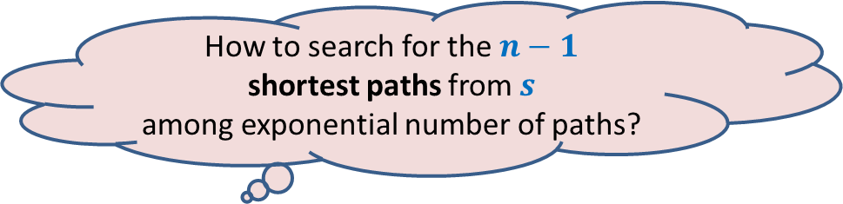
The brilliant idea of Bellman Ford
All paths from $s$
How to search for the $n−1$
shortest paths from $s$
among exponential number of paths?

Slide 5










The brilliant idea of Bellman Ford
Recursive Formulation for $L\left(v,i\right)$
Aim:
To compute $L(v,n−1)$ for all $v$
$$n−1$$
$P(v,i)$ : the shortest $s⇝v$ path having at most $i$ edges.
$L(v,i)$ : length of $P(v,i)$
$$n−2$$
$$i$$
$$i−1$$
$$1$$
Paths with edges $≤i$
All paths from $s$
Paths with edges$≤i−1$

Slide 6





The brilliant idea of Bellman Ford
Recursive Formulation for $L\left(v,i\right)$
Case 1: $P(v,i)$ has $<i$ edges $L(v,i)$ = $L(v, i−1)$
Case 2: $P(v,i)$ has exactly $i$ edges
There are $2$ cases for $P(v,i)$. Can you spot them ?
$$i$$
$$i−1$$
$$1$$
Paths with edges $≤i$
Paths with edges$≤i−1$
$$P(x,i−1)$$
?
$$1$$
$$2$$
$$…$$
$$i$$
$$s$$
$$x$$
$v$
Homework: Prove it and use this observation for the recursive formulation.

Slide 7
Algorithms for
Fast Matrix Multiplication

Slide 8

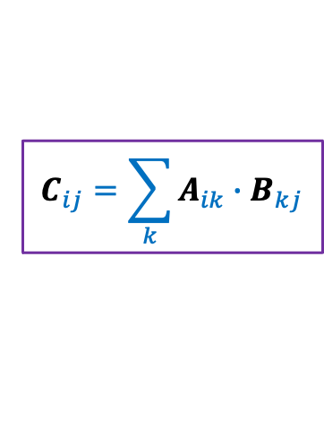
Multiplication of Matrices
2 | 3 | 0 | 3 | 7
8 | 0 | 9 | 7 | 1
0 | 0 | 4 | 0 | 0
0 | 8 | 0 | 1 | 0
5 | 3 | 0 | 5 | 0
6 | 0 | 7 | 0 | 0
0 | 9 | 8 | 0 | 7
3 | 2 | 9 | 1 | 0
6 | 1 | 8 | 9 | 0
1 | 0 | 4 | 6 | 0
A
B
C
$$C_{ij}=\sum_{k}{A_{ik}{∙B}_{kj}}$$
Time complexity: O$(n^{3})$ time .
But faster algorithms exist for more than 50 years.

Slide 9
Fast Matrix Multiplication
2 | 3 | 0 | 3 | 7
8 | 0 | 9 | 7 | 1
0 | 0 | 4 | 0 | 0
0 | 8 | 0 | 1 | 0
5 | 3 | 0 | 5 | 0
6 | 0 | 7 | 0 | 0
0 | 9 | 8 | 0 | 7
3 | 2 | 9 | 1 | 0
6 | 1 | 8 | 9 | 0
1 | 0 | 4 | 6 | 0
A
B
C
Can you recall a similar problem we discussed in this course ?

Slide 10
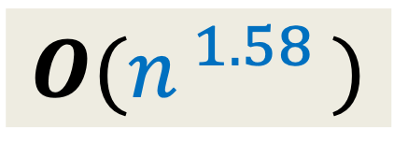
Fast Polynomial Multiplication
$$A\left(x\right)=A_{first}\left(x\right)+{ x}^{\frac{n}{2}} A_{second}\left(x\right)$$
$$B\left(x\right)=B_{first}\left(x\right)+{ x}^{\frac{n}{2}} B_{second}\left(x\right)$$
$A\left(x\right)×B\left(x\right)$ =
$$4 ×$$
Multiplication of $2$polynomials of degree $<n/2$
$T(n) = cn + 4 T(n/2)$
$$O(n^{ 1.58 })$$
$$3$$

Slide 11
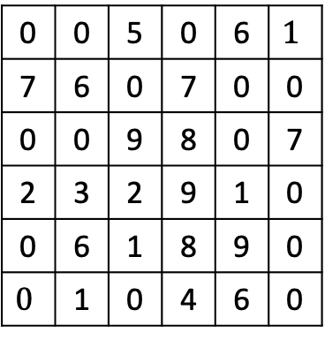
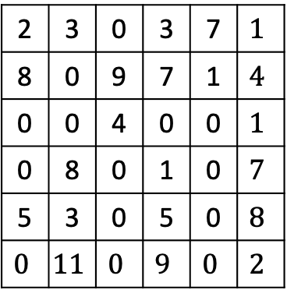

Fast Matrix Multiplication
Divide each matrix into four n/2 $×$ n/2 matrices
2 | 3 | 0 | 3 | 7 | $$1$$
8 | 0 | 9 | 7 | 1 | $$4$$
0 | 0 | 4 | 0 | 0 | $$1$$
0 | 8 | 0 | 1 | 0 | $$7$$
5 | 3 | 0 | 5 | 0 | $$8$$
$$0$$ | $$11$$ | $$0$$ | $$9$$ | $$0$$ | $$2$$
A11
A12
0 | 0 | 5 | 0 | 6 | $$1$$
7 | 6 | 0 | 7 | 0 | 0
0 | 0 | 9 | 8 | 0 | 7
2 | 3 | 2 | 9 | 1 | 0
0 | 6 | 1 | 8 | 9 | 0
$$0$$ | 1 | 0 | 4 | 6 | 0
B11
B12
C11
C12
A21
A22
B21
B22
C21
C22
A
B
C
How to divide the problem instance ?

Slide 12

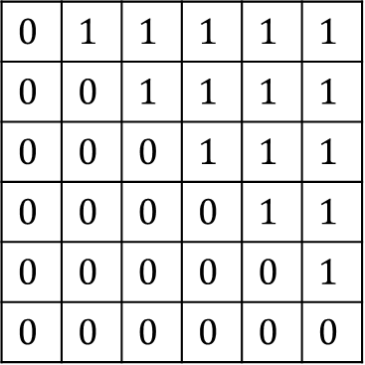


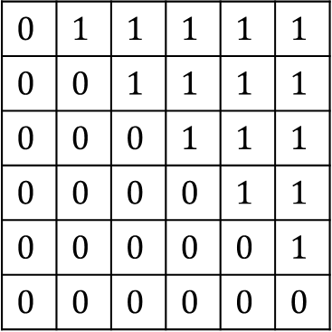

Fast Matrix Multiplication
Divide each matrix into four n/2 $×$ n/2 matrices
C11 = A11 $×$ B11 + A12 $×$ B21
C12 = A11 $×$ B12 + A12 $×$ B22
C21 = A21 $×$ B11 + A22 $×$ B21
C22 = A21 $×$ B12 + A22 $×$ B22
$$0$$ | $$1$$ | $$1$$ | $$1$$ | $$1$$ | $$1$$
$$0$$ | $$0$$ | $$1$$ | $$1$$ | $$1$$ | $$1$$
$$0$$ | $$0$$ | $$0$$ | $$1$$ | $$1$$ | $$1$$
$$0$$ | $$0$$ | $$0$$ | $$0$$ | $$1$$ | $$1$$
$$0$$ | $$0$$ | $$0$$ | $$0$$ | $$0$$ | $$1$$
$$0$$ | $$0$$ | $$0$$ | $$0$$ | $$0$$ | $$0$$
A11
A12
$$0$$ | $$1$$ | $$1$$ | $$1$$ | $$1$$ | $$1$$
$$0$$ | $$0$$ | $$1$$ | $$1$$ | $$1$$ | $$1$$
$$0$$ | $$0$$ | $$0$$ | $$1$$ | $$1$$ | $$1$$
$$0$$ | $$0$$ | $$0$$ | $$0$$ | $$1$$ | $$1$$
$$0$$ | $$0$$ | $$0$$ | $$0$$ | $$0$$ | $$1$$
$$0$$ | $$0$$ | $$0$$ | $$0$$ | $$0$$ | $$0$$
B11
B12
$$0$$ | $$1$$ | $$1$$ | $$1$$ | $$1$$ | $$1$$
$$0$$ | $$0$$ | $$1$$ | $$1$$ | $$1$$ | $$1$$
$$0$$ | $$0$$ | $$0$$ | $$1$$ | $$1$$ | $$1$$
$$0$$ | $$0$$ | $$0$$ | $$0$$ | $$1$$ | $$1$$
$$0$$ | $$0$$ | $$0$$ | $$0$$ | $$0$$ | $$1$$
$$0$$ | $$0$$ | $$0$$ | $$0$$ | $$0$$ | $$0$$
C11
C12
$$A_{i}$$
$$c_{ij}$$
$$B_{j}$$
A21
A22
B21
B22
C21
C22
A
B
C

Slide 13









Fast Matrix Multiplication
Divide each matrix into four n/2 $×$ n/2 matrices
C11 = A11 $×$ B11 + A12 $×$ B21
C12 = A11 $×$ B12 + A12 $×$ B22
C21 = A21 $×$ B11 + A22 $×$ B21
C22 = A21 $×$ B12 + A22 $×$ B22
$$T\left(n\right)= 8 T(n/2) + c n^{2}$$
$$0$$ | $$1$$ | $$1$$ | $$1$$ | $$1$$ | $$1$$
$$0$$ | $$0$$ | $$1$$ | $$1$$ | $$1$$ | $$1$$
$$0$$ | $$0$$ | $$0$$ | $$1$$ | $$1$$ | $$1$$
$$0$$ | $$0$$ | $$0$$ | $$0$$ | $$1$$ | $$1$$
$$0$$ | $$0$$ | $$0$$ | $$0$$ | $$0$$ | $$1$$
$$0$$ | $$0$$ | $$0$$ | $$0$$ | $$0$$ | $$0$$
A11
A12
$$0$$ | $$1$$ | $$1$$ | $$1$$ | $$1$$ | $$1$$
$$0$$ | $$0$$ | $$1$$ | $$1$$ | $$1$$ | $$1$$
$$0$$ | $$0$$ | $$0$$ | $$1$$ | $$1$$ | $$1$$
$$0$$ | $$0$$ | $$0$$ | $$0$$ | $$1$$ | $$1$$
$$0$$ | $$0$$ | $$0$$ | $$0$$ | $$0$$ | $$1$$
$$0$$ | $$0$$ | $$0$$ | $$0$$ | $$0$$ | $$0$$
B11
B12
$$0$$ | $$1$$ | $$1$$ | $$1$$ | $$1$$ | $$1$$
$$0$$ | $$0$$ | $$1$$ | $$1$$ | $$1$$ | $$1$$
$$0$$ | $$0$$ | $$0$$ | $$1$$ | $$1$$ | $$1$$
$$0$$ | $$0$$ | $$0$$ | $$0$$ | $$1$$ | $$1$$
$$0$$ | $$0$$ | $$0$$ | $$0$$ | $$0$$ | $$1$$
$$0$$ | $$0$$ | $$0$$ | $$0$$ | $$0$$ | $$0$$
C11
C12
A21
A22
B21
B22
C21
C22
A
B
C
$8$ multiplications & $4$ additions of $\frac{n}{2}×\frac{n}{2}$ matrices
Volker Strassen, 1969
$7$ multiplications
& $18$ additions/subtractions of $\frac{n}{2}×\frac{n}{2}$ matrices
$$7$$
$$=Θ(n^{\log_{2} 8})$$
$$=Θ(n^{3})$$
$$=Θ(n^{\log_{2} 7})$$
$$=Θ(n^{2.81})$$

Slide 14



Fast Matrix Multiplication
Volker Strassen, 1969
$$=Θ(n^{2.81})$$
Virginia Vassilevska Williams, 2020
$$=Θ(n^{2.37286})$$
$ω=2.37286$

Slide 15
Amazing Applications of
Fast Matrix Multiplication

Slide 16
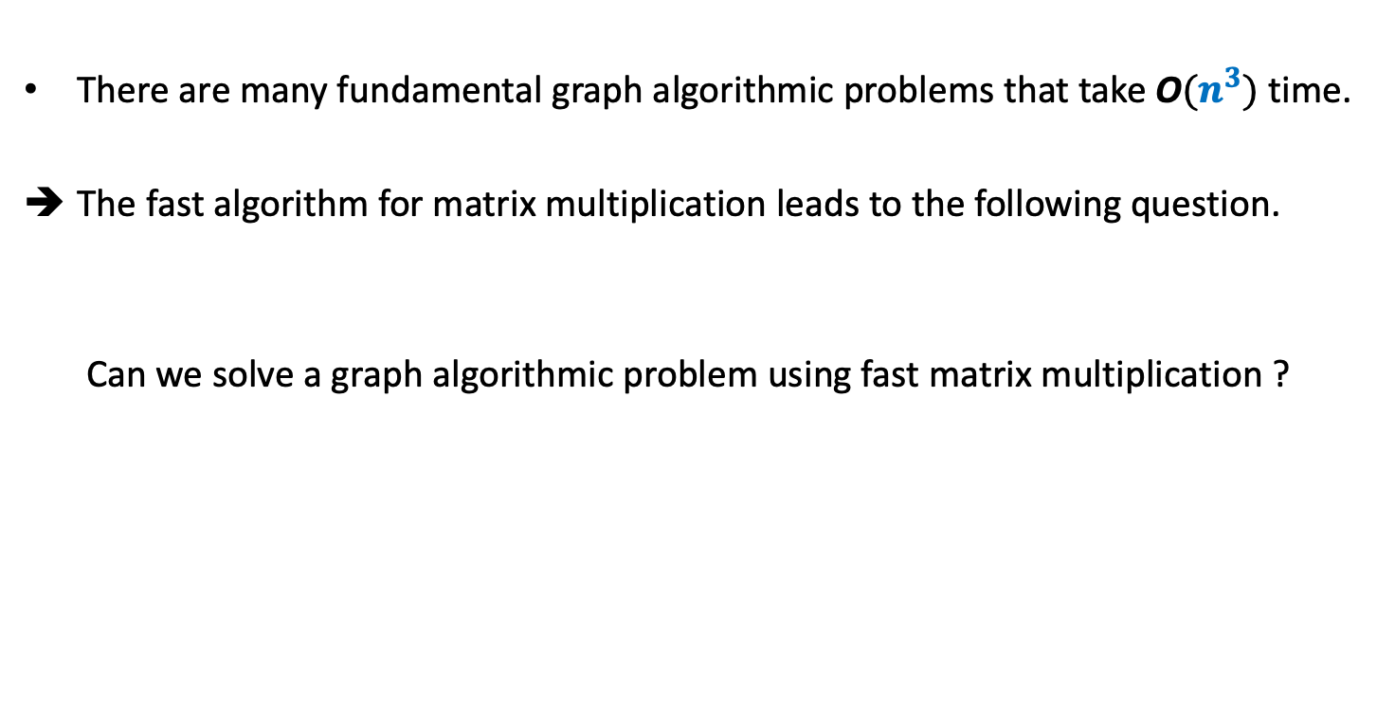
The main insight
There are many fundamental graph algorithmic problems that take O$(n^{3})$ time.
The fast algorithm for matrix multiplication leads to the following question.
Can we solve a graph algorithmic problem using fast matrix multiplication ?

Slide 17

All Pairs Reachability
BFS or DFS
➔ O$(n^{3})$ in the worst case.
Time complexity for APR: O$(n^{ω})$ time.

Slide 18

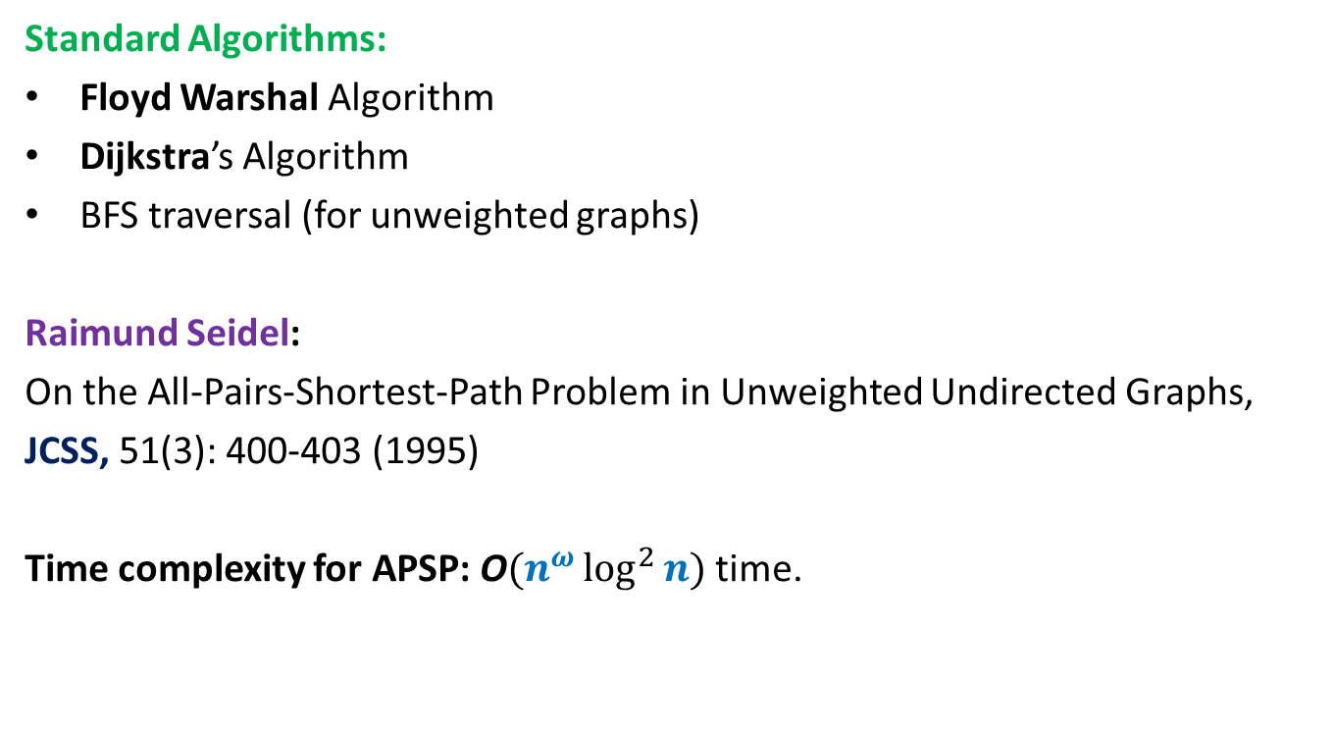
All Pairs Shortest Paths (APSP)
Matrix Multiplication
Standard Algorithms:
Floyd Warshal Algorithm
Dijkstra’s Algorithm
BFS traversal (for unweighted graphs)
Raimund Seidel:
On the All-Pairs-Shortest-Path Problem in Unweighted Undirected Graphs,
JCSS, 51(3): 400-403 (1995)
Time complexity for APSP: O$(n^{ω}\log^{2}{n})$ time.
O$(n^{3})$ time in the worst case

Slide 19
But why did anyone think of this approach ?
There must have been some obvious connection between graphs and matrices.
Indeed, there is such a connection.
Can you spot it ?
Answer:
Each graph is represented as an adjacency matrix.
But which matrices should be multiplied to solve a given graph problem ?
Ponder over it before going to the next slide.

Slide 20
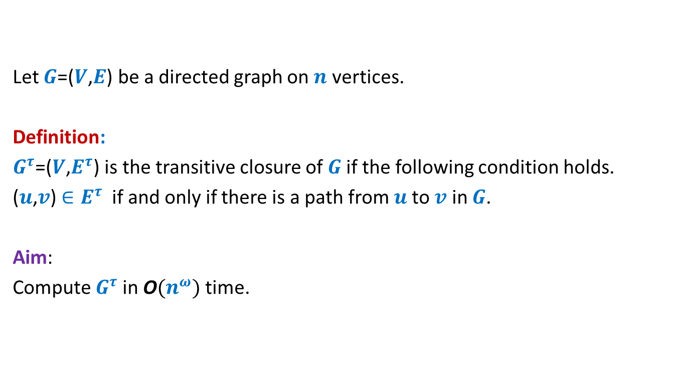
Transitive Closure of Graph
Let $G$=($V$,$E$) be a directed graph on $n$ vertices.
Definition:
$G^{τ}$=($V$,$E^{τ}$) is the transitive closure of $G$if the following condition holds.
($u$,$v$) $∈E^{τ}$ if and only if there is a path from $u$to $v$ in $G$.
Aim:
Compute $G^{τ}$in O$(n^{ω})$ time.

Slide 21






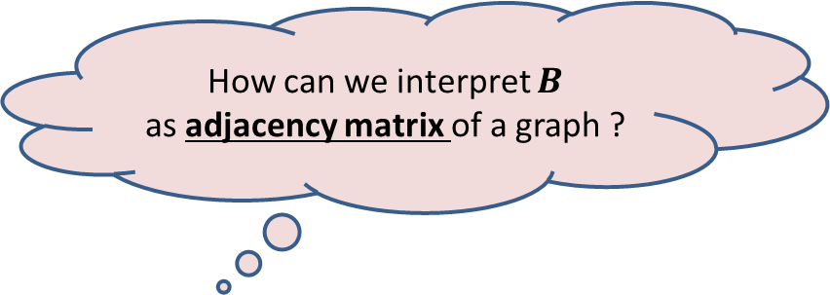
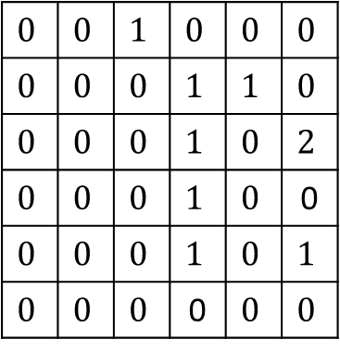
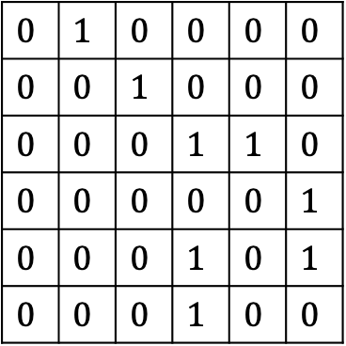


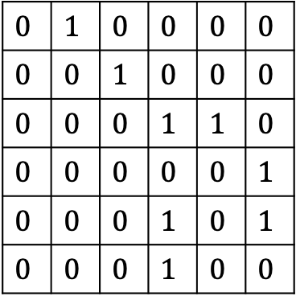







$$1$$ | $$2$$ | $$3$$ | $$4$$ | $$5$$ | $$6$$
$$1$$ | $$2$$ | $$3$$ | $$4$$ | $$5$$ | $$6$$
$$1$$
$$2$$
$$3$$
$$4$$
$$5$$
$$6$$
$$0$$ | $$1$$ | $$0$$ | $$0$$ | $$0$$ | $$0$$
$$0$$ | $$0$$ | $$1$$ | $$0$$ | $$0$$ | $$0$$
$$0$$ | $$0$$ | $$0$$ | $$1$$ | $$1$$ | $$0$$
$$0$$ | $$0$$ | $$0$$ | $$0$$ | $$0$$ | $$1$$
$$0$$ | $$0$$ | $$0$$ | $$1$$ | $$0$$ | $$1$$
$$0$$ | $$0$$ | $$0$$ | $$1$$ | $$0$$ | $$0$$
$$0$$ | $$1$$ | $$0$$ | $$0$$ | $$0$$ | $$0$$
$$0$$ | $$0$$ | $$1$$ | $$0$$ | $$0$$ | $$0$$
$$0$$ | $$0$$ | $$0$$ | $$1$$ | $$1$$ | $$0$$
$$0$$ | $$0$$ | $$0$$ | $$0$$ | $$0$$ | $$1$$
$$0$$ | $$0$$ | $$0$$ | $$1$$ | $$0$$ | $$1$$
$$0$$ | $$0$$ | $$0$$ | $$1$$ | $$0$$ | $$0$$
$$1$$
$$2$$
$$3$$
$$4$$
$$5$$
$$6$$
$$0$$ | $$0$$ | $$1$$ | $$0$$ | $$0$$ | $$0$$
$$0$$ | $$0$$ | $$0$$ | $$1$$ | $$1$$ | $$0$$
$$0$$ | $$0$$ | $$0$$ | $$1$$ | $$0$$ | $$2$$
$$0$$ | $$0$$ | $$0$$ | $$1$$ | $$0$$ | 0
$$0$$ | $$0$$ | $$0$$ | $$1$$ | $$0$$ | $$1$$
$$0$$ | $$0$$ | $$0$$ | 0 | $$0$$ | $$0$$
$$A$$
$$A$$
$$Z$$
𝒁 has some entries which are not 0-1.
$$4$$
How can we interpret $B$
as adjacency matrix of a graph ?
$$6$$
$$1$$
$$2$$
$$3$$
$$5$$
$$G$$

Slide 22

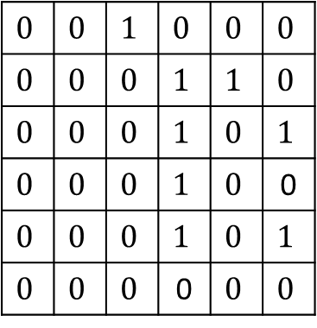
$$1$$ | $$2$$ | $$3$$ | $$4$$ | $$5$$ | $$6$$
$$1$$ | $$2$$ | $$3$$ | $$4$$ | $$5$$ | $$6$$
$$1$$
$$2$$
$$3$$
$$4$$
$$5$$
$$6$$
$$0$$ | $$1$$ | $$0$$ | $$0$$ | $$0$$ | $$0$$
$$0$$ | $$0$$ | $$1$$ | $$0$$ | $$0$$ | $$0$$
$$0$$ | $$0$$ | $$0$$ | $$1$$ | $$1$$ | $$0$$
$$0$$ | $$0$$ | $$0$$ | $$0$$ | $$0$$ | $$1$$
$$0$$ | $$0$$ | $$0$$ | $$1$$ | $$0$$ | $$1$$
$$0$$ | $$0$$ | $$0$$ | $$1$$ | $$0$$ | $$0$$
$$0$$ | $$1$$ | $$0$$ | $$0$$ | $$0$$ | $$0$$
$$0$$ | $$0$$ | $$1$$ | $$0$$ | $$0$$ | $$0$$
$$0$$ | $$0$$ | $$0$$ | $$1$$ | $$1$$ | $$0$$
$$0$$ | $$0$$ | $$0$$ | $$0$$ | $$0$$ | $$1$$
$$0$$ | $$0$$ | $$0$$ | $$1$$ | $$0$$ | $$1$$
$$0$$ | $$0$$ | $$0$$ | $$1$$ | $$0$$ | $$0$$
$$1$$
$$2$$
$$3$$
$$4$$
$$5$$
$$6$$
$$0$$ | $$0$$ | $$1$$ | $$0$$ | $$0$$ | $$0$$
$$0$$ | $$0$$ | $$0$$ | $$1$$ | $$1$$ | $$0$$
$$0$$ | $$0$$ | $$0$$ | $$1$$ | $$0$$ | $$1$$
$$0$$ | $$0$$ | $$0$$ | $$1$$ | $$0$$ | 0
$$0$$ | $$0$$ | $$0$$ | $$1$$ | $$0$$ | $$1$$
$$0$$ | $$0$$ | $$0$$ | 0 | $$0$$ | $$0$$
$$A$$
$$A$$
$$B$$
𝒁 has diagonal entries non-zero.
$$4$$
How can we interpret $B$
as adjacency matrix of a graph ?
$$6$$
$$1$$
$$2$$
$$3$$
$$5$$
$$G$$

Slide 23







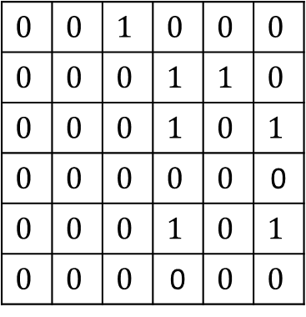





$$1$$ | $$2$$ | $$3$$ | $$4$$ | $$5$$ | $$6$$
$$1$$ | $$2$$ | $$3$$ | $$4$$ | $$5$$ | $$6$$
$$1$$
$$2$$
$$3$$
$$4$$
$$5$$
$$6$$
$$0$$ | $$1$$ | $$0$$ | $$0$$ | $$0$$ | $$0$$
$$0$$ | $$0$$ | $$1$$ | $$0$$ | $$0$$ | $$0$$
$$0$$ | $$0$$ | $$0$$ | $$1$$ | $$1$$ | $$0$$
$$0$$ | $$0$$ | $$0$$ | $$0$$ | $$0$$ | $$1$$
$$0$$ | $$0$$ | $$0$$ | $$1$$ | $$0$$ | $$1$$
$$0$$ | $$0$$ | $$0$$ | $$1$$ | $$0$$ | $$0$$
$$0$$ | $$1$$ | $$0$$ | $$0$$ | $$0$$ | $$0$$
$$0$$ | $$0$$ | $$1$$ | $$0$$ | $$0$$ | $$0$$
$$0$$ | $$0$$ | $$0$$ | $$1$$ | $$1$$ | $$0$$
$$0$$ | $$0$$ | $$0$$ | $$0$$ | $$0$$ | $$1$$
$$0$$ | $$0$$ | $$0$$ | $$1$$ | $$0$$ | $$1$$
$$0$$ | $$0$$ | $$0$$ | $$1$$ | $$0$$ | $$0$$
$$1$$
$$2$$
$$3$$
$$4$$
$$5$$
$$6$$
$$0$$ | $$0$$ | $$1$$ | $$0$$ | $$0$$ | $$0$$
$$0$$ | $$0$$ | $$0$$ | $$1$$ | $$1$$ | $$0$$
$$0$$ | $$0$$ | $$0$$ | $$1$$ | $$0$$ | $$1$$
$$0$$ | $$0$$ | $$0$$ | $$0$$ | $$0$$ | 0
$$0$$ | $$0$$ | $$0$$ | $$1$$ | $$0$$ | $$1$$
$$0$$ | $$0$$ | $$0$$ | 0 | $$0$$ | $$0$$
There is an edge ($i,j$) in the graph corresponding to $B$
if and only if there is a path of length 2 from $i$ to $j$ in $G$.
$$A$$
$$A$$
$$B$$
When do we have an edge in this graph ? Explore this question.
$$4$$
$$4$$
$$6$$
$$6$$
$$1$$
$$2$$
$$3$$
$$1$$
$$2$$
$$3$$
What if we add the missing edges from $G$ ?
Hint:
$$5$$
$$5$$
$$G$$
𝑩$\left[i,j\right]=1$ if
$∃k$ such that
$A\left[i,k\right]=1$and $A\left[k,j\right]=1$

Slide 24

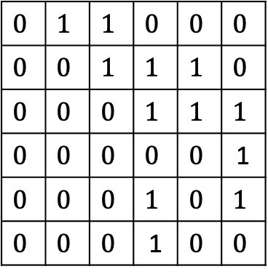


$$1$$ | $$2$$ | $$3$$ | $$4$$ | $$5$$ | $$6$$
$$1$$ | $$2$$ | $$3$$ | $$4$$ | $$5$$ | $$6$$
$$1$$
$$2$$
$$3$$
$$4$$
$$5$$
$$6$$
$$0$$ | $$1$$ | $$0$$ | $$0$$ | $$0$$ | $$0$$
$$0$$ | $$0$$ | $$1$$ | $$0$$ | $$0$$ | $$0$$
$$0$$ | $$0$$ | $$0$$ | $$1$$ | $$1$$ | $$0$$
$$0$$ | $$0$$ | $$0$$ | $$0$$ | $$0$$ | $$1$$
$$0$$ | $$0$$ | $$0$$ | $$1$$ | $$0$$ | $$1$$
$$0$$ | $$0$$ | $$0$$ | $$1$$ | $$0$$ | $$0$$
$$0$$ | $$1$$ | $$0$$ | $$0$$ | $$0$$ | $$0$$
$$0$$ | $$0$$ | $$1$$ | $$0$$ | $$0$$ | $$0$$
$$0$$ | $$0$$ | $$0$$ | $$1$$ | $$1$$ | $$0$$
$$0$$ | $$0$$ | $$0$$ | $$0$$ | $$0$$ | $$1$$
$$0$$ | $$0$$ | $$0$$ | $$1$$ | $$0$$ | $$1$$
$$0$$ | $$0$$ | $$0$$ | $$1$$ | $$0$$ | $$0$$
$$1$$
$$2$$
$$3$$
$$4$$
$$5$$
$$6$$
$$0$$ | $$1$$ | $$1$$ | $$0$$ | $$0$$ | $$0$$
$$0$$ | $$0$$ | $$1$$ | $$1$$ | $$1$$ | $$0$$
$$0$$ | $$0$$ | $$0$$ | $$1$$ | $$1$$ | $$1$$
$$0$$ | $$0$$ | $$0$$ | $$0$$ | $$0$$ | 1
$$0$$ | $$0$$ | $$0$$ | $$1$$ | $$0$$ | $$1$$
$$0$$ | $$0$$ | $$0$$ | 1 | $$0$$ | $$0$$
There is an edge ($i,j$) in the graph corresponding to $B$
if and only if there is a path of length 2 from $i$ to $j$ in $G$.
$$A$$
$$A$$
$$B$$
at most 2 from $i$ to $j$ in $G$.
$$4$$
$$4$$
$$6$$
$$6$$
$$1$$
$$2$$
$$3$$
$$1$$
$$2$$
$$3$$
$$5$$
$$5$$
$$G$$
$$G^{2}$$

Slide 25











$$1$$ | $$2$$ | $$3$$ | $$4$$ | $$5$$ | $$6$$
$$1$$ | $$2$$ | $$3$$ | $$4$$ | $$5$$ | $$6$$
$$1$$
$$2$$
$$3$$
$$4$$
$$5$$
$$6$$
$$0$$ | $$1$$ | $$0$$ | $$0$$ | $$0$$ | $$0$$
$$0$$ | $$0$$ | $$1$$ | $$0$$ | $$0$$ | $$0$$
$$0$$ | $$0$$ | $$0$$ | $$1$$ | $$1$$ | $$0$$
$$0$$ | $$0$$ | $$0$$ | $$0$$ | $$0$$ | $$1$$
$$0$$ | $$0$$ | $$0$$ | $$1$$ | $$0$$ | $$1$$
$$0$$ | $$0$$ | $$0$$ | $$1$$ | $$0$$ | $$0$$
$$0$$ | $$1$$ | $$0$$ | $$0$$ | $$0$$ | $$0$$
$$0$$ | $$0$$ | $$1$$ | $$0$$ | $$0$$ | $$0$$
$$0$$ | $$0$$ | $$0$$ | $$1$$ | $$1$$ | $$0$$
$$0$$ | $$0$$ | $$0$$ | $$0$$ | $$0$$ | $$1$$
$$0$$ | $$0$$ | $$0$$ | $$1$$ | $$0$$ | $$1$$
$$0$$ | $$0$$ | $$0$$ | $$1$$ | $$0$$ | $$0$$
$$1$$
$$2$$
$$3$$
$$4$$
$$5$$
$$6$$
$$0$$ | $$1$$ | $$1$$ | $$0$$ | $$0$$ | $$0$$
$$0$$ | $$0$$ | $$1$$ | $$1$$ | $$1$$ | $$0$$
$$0$$ | $$0$$ | $$0$$ | $$1$$ | $$1$$ | $$1$$
$$0$$ | $$0$$ | $$0$$ | $$0$$ | $$0$$ | 1
$$0$$ | $$0$$ | $$0$$ | $$1$$ | $$0$$ | $$1$$
$$0$$ | $$0$$ | $$0$$ | 1 | $$0$$ | $$0$$
Question:
How to compute $G^{3}$ ?
Question:
How to compute $G^{4}$ ?
Question:
How to compute Transitive Closure ?
$$A$$
$$A$$
$$B$$
Compute $A × B$
and take union with $B$
Let $B′$ be the Adjacency Matrix of $G^{3}$
Compute $B × B$
and take union with $B$
Compute $A × B′$
and take union with $B′$
Compute $G^{n−1}$
$n−1$ Matrix Multiplications ☹
Hint: Can we compute $G^{4}$ from $G^{2}$ in a single matrix multiplication than 2 multiplications ?

Slide 26





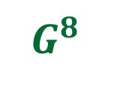
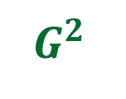
Theorem:
We can compute transitive closure of graph $G$ in O$(n^{ω} log n)$ time.
$$G$$
$\log{n}$ Matrix Multiplications ☺
$G^{2}$
$G^{4}$
$G^{8}$
…
$$G^{n−1}$$
How to eliminate the $log n$ factor ?
This will be the 4th worked out assignment, to be posted soon.
Homework: What if $n−1$is not power of 2. Write neat pseudocode for the general $n$.

Slide 27
All-Pairs Shortest Paths in undirected unweighted Graph

Slide 28











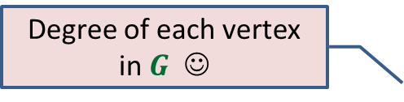
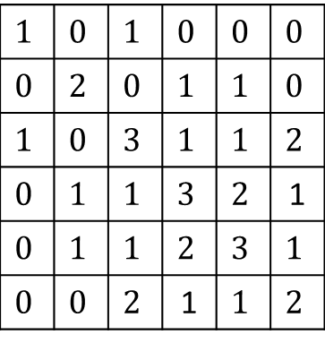




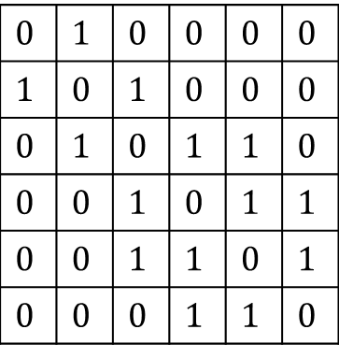


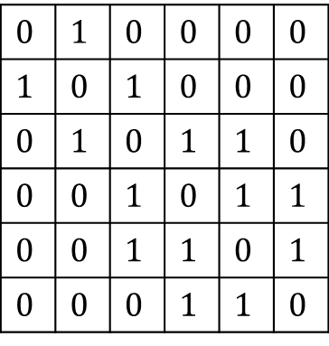



Degree of each vertex in $G$ ☺
$$1$$ | $$2$$ | $$3$$ | $$4$$ | $$5$$ | $$6$$
$$1$$
$$2$$
$$3$$
$$4$$
$$5$$
$$6$$
$$0$$ | $$1$$ | $$0$$ | $$0$$ | $$0$$ | $$0$$
$$1$$ | $$0$$ | $$1$$ | $$0$$ | $$0$$ | $$0$$
$$0$$ | $$1$$ | $$0$$ | $$1$$ | $$1$$ | $$0$$
$$0$$ | $$0$$ | $$1$$ | $$0$$ | $$1$$ | $$1$$
$$0$$ | $$0$$ | $$1$$ | $$1$$ | $$0$$ | $$1$$
$$0$$ | $$0$$ | $$0$$ | $$1$$ | $$1$$ | $$0$$
$$0$$ | $$1$$ | $$0$$ | $$0$$ | $$0$$ | $$0$$
$$1$$ | $$0$$ | $$1$$ | $$0$$ | $$0$$ | $$0$$
$$0$$ | $$1$$ | $$0$$ | $$1$$ | $$1$$ | $$0$$
$$0$$ | $$0$$ | $$1$$ | $$0$$ | $$1$$ | $$1$$
$$0$$ | $$0$$ | $$1$$ | $$1$$ | $$0$$ | $$1$$
$$0$$ | $$0$$ | $$0$$ | $$1$$ | $$1$$ | $$0$$
$$1$$ | $$0$$ | $$1$$ | $$0$$ | $$0$$ | $$0$$
$$0$$ | $$2$$ | $$0$$ | $$1$$ | $$1$$ | $$0$$
$$1$$ | $$0$$ | $$3$$ | $$1$$ | $$1$$ | $$2$$
$$0$$ | $$1$$ | $$1$$ | $$3$$ | $$2$$ | 1
$$0$$ | $$1$$ | $$1$$ | $$2$$ | $$3$$ | $$1$$
$$0$$ | $$0$$ | $$2$$ | 1 | $$1$$ | $$2$$
$$0$$
$$0$$
$$0$$
$$1$$
$$0$$
$$1$$
$$1$$
$$0$$
$$1$$
$$0$$
$$A$$
$$A$$
$$B$$
$$Z$$
$$B_{ij}=\left\{\begin{aligned}1 if Z_{ij}≠0 \\ 0 otherwise \end{aligned}\right.$$
$Z_{ii}$ : degree of$i$in $G$
$$4$$
Can you interpret $Z$for some parameter of the graph ?
$$6$$
$$1$$
$$2$$
$$3$$
Hint:
$$G$$
$$5$$
Z$\left[i,i\right]=$
Number of entries $k$ such that
$A\left[i,k\right]=1$and $A\left[k,i\right]=1$

Slide 29


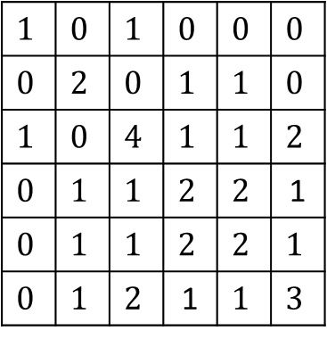






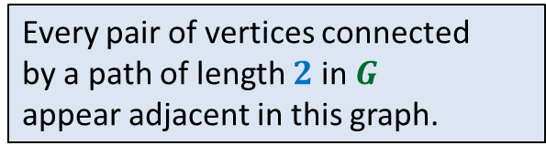
$$1$$ | $$2$$ | $$3$$ | $$4$$ | $$5$$ | $$6$$
$$1$$
$$2$$
$$3$$
$$4$$
$$5$$
$$6$$
$$0$$ | $$1$$ | $$0$$ | $$0$$ | $$0$$ | $$0$$
$$1$$ | $$0$$ | $$1$$ | $$0$$ | $$0$$ | $$0$$
$$0$$ | $$1$$ | $$0$$ | $$1$$ | $$1$$ | $$0$$
$$0$$ | $$0$$ | $$1$$ | $$0$$ | $$1$$ | $$1$$
$$0$$ | $$0$$ | $$1$$ | $$1$$ | $$0$$ | $$1$$
$$0$$ | $$0$$ | $$0$$ | $$1$$ | $$1$$ | $$0$$
$$0$$ | $$1$$ | $$0$$ | $$0$$ | $$0$$ | $$0$$
$$1$$ | $$0$$ | $$1$$ | $$0$$ | $$0$$ | $$0$$
$$0$$ | $$1$$ | $$0$$ | $$1$$ | $$1$$ | $$0$$
$$0$$ | $$0$$ | $$1$$ | $$0$$ | $$1$$ | $$1$$
$$0$$ | $$0$$ | $$1$$ | $$1$$ | $$0$$ | $$1$$
$$0$$ | $$0$$ | $$0$$ | $$1$$ | $$1$$ | $$0$$
$$1$$ | $$0$$ | $$1$$ | $$0$$ | $$0$$ | $$0$$
$$0$$ | $$2$$ | $$0$$ | $$1$$ | $$1$$ | $$0$$
$$1$$ | $$0$$ | $$4$$ | $$1$$ | $$1$$ | $$2$$
$$0$$ | $$1$$ | $$1$$ | $$2$$ | $$2$$ | 1
$$0$$ | $$1$$ | $$1$$ | $$2$$ | $$2$$ | $$1$$
$$0$$ | $$1$$ | $$2$$ | 1 | $$1$$ | $$3$$
$$0$$
$$0$$
$$0$$
$$1$$
$$0$$
$$1$$
$$1$$
$$0$$
$$1$$
$$0$$
$$A$$
$$A$$
$$B$$
$$B_{ij}=\left\{\begin{aligned}1 if Z_{ij}≠0 \\ 0 otherwise \end{aligned}\right.$$
or $A_{ij}=1$
$$4$$
$$4$$
$$6$$
$$6$$
$$1$$
$$2$$
$$3$$
$$1$$
$$2$$
$$3$$
How would you interpret this row ?
Every pair of vertices connected
by a path of length $2$ in $G$
appear adjacent in this graph.
Let us also add each edge of $G$as well to this graph if it is not already there
$$G$$
$$5$$
$$5$$
$$G^{2}$$

Slide 30


What is $G^{k}$ ?
There is an edge between $i$ and $j$ if
there is a path of length at most $i$ between them in $G$

Slide 31











$$1$$ | $$2$$ | $$3$$ | $$4$$ | $$5$$ | $$6$$
$$j$$
$$1$$
$$2$$
$$3$$
$$4$$
$$5$$
$$6$$
$$0$$ | $$1$$ | $$0$$ | $$0$$ | $$0$$ | $$0$$
$$1$$ | $$0$$ | $$1$$ | $$0$$ | $$0$$ | $$0$$
$$0$$ | $$1$$ | $$0$$ | $$1$$ | $$1$$ | $$0$$
$$0$$ | $$0$$ | $$1$$ | $$0$$ | $$1$$ | $$1$$
$$0$$ | $$0$$ | $$1$$ | $$1$$ | $$0$$ | $$1$$
$$0$$ | $$0$$ | $$0$$ | $$1$$ | $$1$$ | $$0$$
$$0$$ | $$1$$ | $$0$$ | $$0$$ | $$0$$ | $$0$$
$$1$$ | $$0$$ | $$1$$ | $$0$$ | $$0$$ | $$0$$
$$0$$ | $$1$$ | $$0$$ | $$1$$ | $$1$$ | $$0$$
$$0$$ | $$0$$ | $$1$$ | $$0$$ | $$1$$ | $$1$$
$$0$$ | $$0$$ | $$1$$ | $$1$$ | $$0$$ | $$1$$
$$0$$ | $$0$$ | $$0$$ | $$1$$ | $$1$$ | $$0$$
$$i$$
$B_{ij}$ = $1$ if and only if there is a path between $i$ and $j$ of length $≤k+ℓ$
$$A′$$
$$A"$$
$$Z$$
Adj. Matrix of $G^{k}$
Adj. Matrix of $G^{ℓ}$
$$B_{ij}=\left\{\begin{aligned}1 if Z_{ij}≠0 \\ 0 otherwise \end{aligned}\right.$$
or ${A′}_{ij}=1$
or ${A”}_{ij}=1$

Slide 32
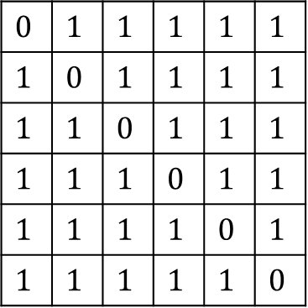
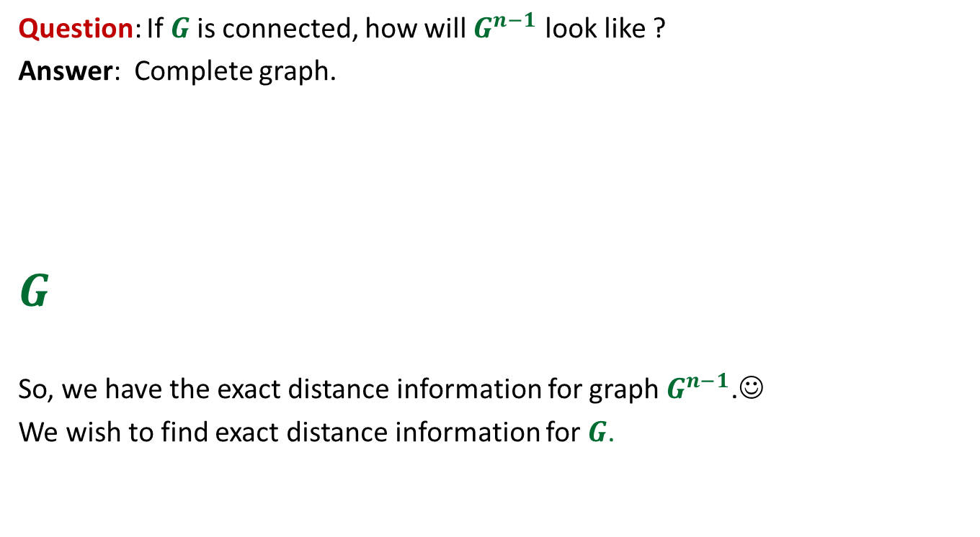
$$0$$ | $$1$$ | $$1$$ | $$1$$ | $$1$$ | $$1$$
$$1$$ | $$0$$ | $$1$$ | $$1$$ | $$1$$ | $$1$$
$$1$$ | $$1$$ | $$0$$ | $$1$$ | $$1$$ | $$1$$
$$1$$ | $$1$$ | $$1$$ | $$0$$ | $$1$$ | $$1$$
$$1$$ | $$1$$ | $$1$$ | $$1$$ | $$0$$ | $$1$$
$$1$$ | $$1$$ | $$1$$ | $$1$$ | $$1$$ | $$0$$
Question: If $G$is connected, how will $G^{n−1}$ look like ?
Answer: Complete graph.
$$G$$
So, we have the exact distance information for graph $G^{n−1}$.☺
We wish to find exact distance information for $G$.
?
$G^{2}$
$G^{4}$
$G^{8}$
…
$$G^{n−1}$$
How do we proceed ?

Slide 33
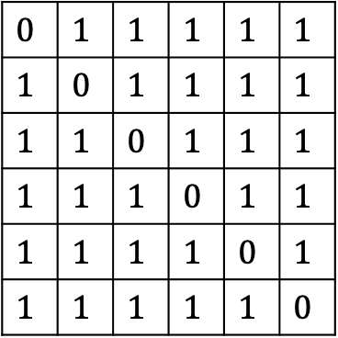

$$0$$ | $$1$$ | $$1$$ | $$1$$ | $$1$$ | $$1$$
$$1$$ | $$0$$ | $$1$$ | $$1$$ | $$1$$ | $$1$$
$$1$$ | $$1$$ | $$0$$ | $$1$$ | $$1$$ | $$1$$
$$1$$ | $$1$$ | $$1$$ | $$0$$ | $$1$$ | $$1$$
$$1$$ | $$1$$ | $$1$$ | $$1$$ | $$0$$ | $$1$$
$$1$$ | $$1$$ | $$1$$ | $$1$$ | $$1$$ | $$0$$
$$G$$
?
$G^{2}$
$G^{4}$
$G^{8}$
…
$$G^{n−1}$$

