Slide 1
Design and Analysis of Algorithms
CS345
Lecture 2
Divide and Conquer Paradigm – I
- Closest Pair of Points

Slide 2
Divide and Conquer paradigm

Slide 3
An Overview
Divide the problem instance into two or more instances of the same problem.
Solve each smaller instance recursively (base case suitably defined).
Combine the solutions of the smaller instances
to get the solution of the original instance.
Notes:
How do we solve any problem in this paradigm ?
The 3rd step (Combine step) is usually the main nontrivial step in the design of an algorithm using divide and conquer strategy

Slide 4

Example Problems
Merge Sort
Multiplication of two $n$-bit integers.
Counting the number of inversions in an array $A$.
Finding median of $n$numbers in linear time.

Slide 5
Divide and Conquer Paradigm
(Advanced Problems)
Geometric Problems:
  Closest Pair Distance
  Non-dominated Points
  Convex Hull
Number theoretic Problem
  Multiplication of 2 Polynomials

Slide 6





Distance between 2 points
$$(x_{j},y_{j})$$
O($1$) time
$$(x_{i},y_{i})$$
$$y$$
$$x$$

Slide 7

The Closest Pair Distance Problem
$$δ$$
$$y$$
$$x$$

Slide 8
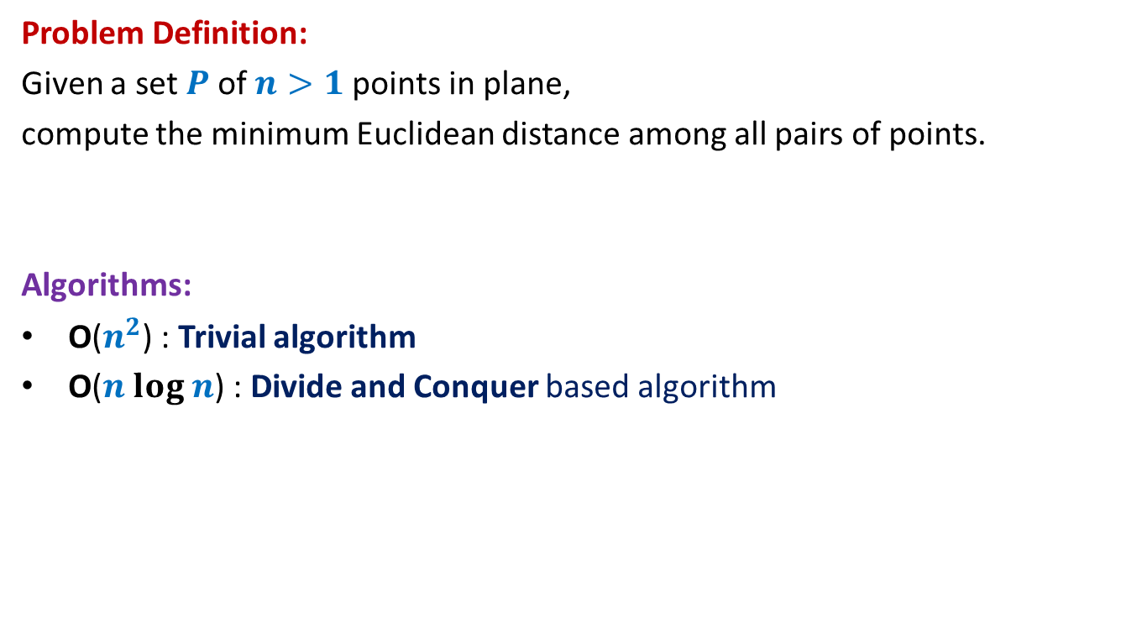
The Closest Pair Distance Problem
Problem Definition:
Given a set $P$of $n>1$points in plane,
compute the minimum Euclidean distance among all pairs of points.
Algorithms:
O($n^{2}$) : Trivial algorithm
O($n log n$) : Divide and Conquer based algorithm
We shall use 3 tools to design this algorithm. Please make sure you internalize them well.

Slide 9

Question 1
Tool 1
A fact from high school geometry
Fact :
Let $p=(x_{1},y_{1})$ and $q=(x_{2},y_{2})$ be any two points.
If $\left|x_{1}−x_{2}\right|>δ$, distance($p,q$) $>δ$
If $\left|y_{1}−y_{2}\right|>δ$, distance($p,q$) $>δ$

Slide 10
A discrete math exercise
Exercise:
What is the maximum number of points that can be placed in a unit square
such that each pair of them is separated by distance at least 1 ?
1
Notes:
If there are more than 4 points in the unit square,
at least one of the four small squares will have more than 1 points.

Slide 11
A discrete math exercise
Exercise:
What is the maximum number of points that can be placed in a unit square
such that each pair of them is separated by distance at least 1 ?
1
Notes:
If there are more than 4 points in the unit square,
at least one of the four small squares will have more than 1 points.

Slide 12




A discrete math exercise
Tool 2
Exercise:
What is the maximum number of points that can be placed in a unit square
such that each pair of them is separated by distance at least 1 ?
$$δ−$$
$$δ$$
Answer: 4.
$$\frac{1}{\sqrt{2}}$$
1
$$δ$$
Notes:
If there are more than 4 points in the unit square,
at least one of the four small squares will have more than 1 points.

Slide 13
Question 2
Tool 3
A fundamental question about data structure ?
Question:
While solving an algorithmic problem, when do we feel the need of an
efficient data structure ?
Answer:
when the algorithm involves “many” operations of same type on a given data.
Notes:
For example, it is worth sorting an array only if there are going to be many search queries on it.
Let us see if you can use this principle to solve this problem.

Slide 14
a Divide and Conquer algorithm for
Closest Pair Distance

Slide 15


The divide step
$$y$$
$$x$$

Slide 16



Solving the problem in 1-dimension
Median of $n$ points.
$$y$$
$$x$$
Left half set
$⌈\frac{n}{2}⌉$points
$⌊\frac{n}{2}⌋$points
Right half set

Slide 17




Solving the problem in 1-dimension
We can not afford to compute distance between each point of the left half set and each point of the right half set.
We need to consider only one point from the left half set
and one point from the right half set. Can you spot them ?
T($n$) = c $n$ + 2 T($n$/2)
$=O$($n\log{n}$)
What is the recurrence for the running time of the algorithm ?
$$δ_{L}$$
$$δ_{R}$$
$$x$$
Left half set
$⌈\frac{n}{2}⌉$points
$⌊\frac{n}{2}⌋$points
Right half set

Slide 18
How to extend to 2-dimensions
$$x$$

Slide 19
The divide step
Think simple and use inspiration from the 1-dimensional case.
$$y$$
$$x$$

Slide 20



Solving the 2 smaller instances
$$δ_{L}$$
$$δ_{R}$$
Left half set
$⌈\frac{n}{2}⌉$points
$δ$ ← min($δ_{L}{,δ}_{R}$)
$⌊\frac{n}{2}⌋$points
Right half set
Notes:
1. Compute the closest pair distance of the left half set
2. Let it be Delta_L.
3.Compute the closest pair distance of the right half set
4. Let it be Delta_R.

Slide 21



The combine step
Do we need to compute distance each point on left halfset and each point of the right halfset. ?
Tool 1
$$>δ$$
$$δ_{L}$$
$$δ_{R}$$
$$δ$$
$$δ$$
$δ$ ← min($δ_{L}{,δ}_{R}$)
Notes:
Which points do we need to focus on for the closest pairs ?
The total number of these pairs are Theta(n^2).
How to do it efficiently ?
Exploit the geometric aspect of the problem.
Time to use Hint 1.
For a point in the left half set, if its distance to any point in the right set is less than delta, can we infer anything about its x-coordinate.
: Its x-coordinate can not be less than the x-coordinate of the other point by more than delta.

Slide 22


The combine step
Potentially $Θ(n)$ points in each strip
$$δ_{L}$$
$$δ_{R}$$
$$δ$$
$$δ$$
$δ$ ← min($δ_{L}{,δ}_{R}$)
Notes:
But there may still be $Θ(n)$ points in each of these strips.
So what to do ?

Slide 23


The combine step
Do we need to compute distance from $p$
to each point of the red strip ?
Tool 1
$$δ_{L}$$
$$p$$
$$δ_{R}$$
$$δ$$
$$δ$$
$δ$ ← min($δ_{L}{,δ}_{R}$)
Notes:
1. Only the points lying in these 2 red squares are relevant as far as $p$ is concerned.
2. Time to use Hint 2
3. Surely not more than 8.
-----------------------------
1. How to find the points in these red square for point $p$?

Slide 24

The combine step
Tool 1
$$δ_{L}$$
$$δ$$
$$p$$
$$δ$$
$$δ_{R}$$
$$δ$$
$$δ$$
$δ$ ← min($δ_{L}{,δ}_{R}$)
Notes:
1. Only the points lying in these 2 red squares are relevant as far as $p$ is concerned.
2. Time to use Hint 2
3. Surely not more than 8.
-----------------------------
1. How to find the points in these red square for point $p$?

Slide 25

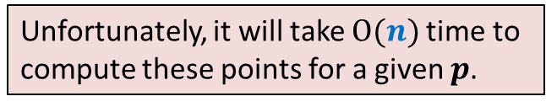
The combine step
But we need to do this task for each point of left strip.
How many points lie in these 2 squares ?
Tool 2
$$δ_{L}$$
Unfortunately, it will take $O(n)$time to
compute these points for a given $p$.
$O(1)$points only
$$δ$$
$$p$$
$$δ$$
$$δ_{R}$$
$$δ$$
$$δ$$
$δ$ ← min($δ_{L}{,δ}_{R}$)
Notes:
1. Only the points lying in these 2 red squares are relevant as far as $p$ is concerned.
2. Time to use Hint 2
3. Surely not more than 8.
-----------------------------
1. How to find the points in these red square for point $p$?

Slide 26
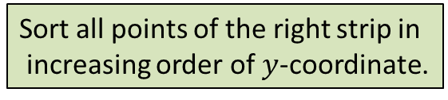







The combine step
But we need to do this task for each point of left strip.
What will be the suitable data structure storing all the points of the right strip ?
How can we find the points lying inside the 2 pink squares for $p$?
Tool 3
$$δ$$
$$δ$$
$$δ$$
$$δ$$
Sort all points of the right strip in
increasing order of $y$-coordinate.
$$δ_{L}$$
$$δ$$
$$δ$$
$$δ$$
$$(x^{′},y^{′})$$
Binary search for ($y^{′}+δ$)
$$p$$
$$δ$$
Binary search for ($y^{′}−δ$)
$$δ_{R}$$
$$δ$$
$$δ$$
$δ$ ← min($δ_{L}{,δ}_{R}$)

Slide 27
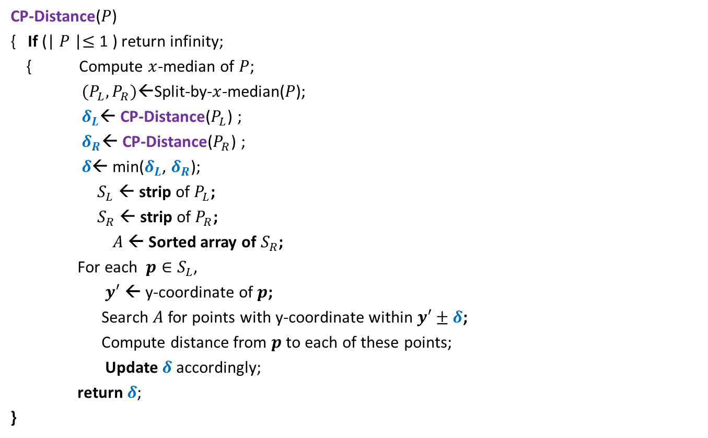


Divide and Conquer based algorithm
CP-Distance($P$)
{ If (| $P$|$≤$ 1 ) return infinity;
{ Compute $x$-median of $P$;
$(P_{L},P_{R})$←Split-by-$x$-median($P$);
$δ_{L}$← CP-Distance($P_{L}$) ;
$δ_{R}$← CP-Distance($P_{R}$) ;
$δ$← min($δ_{L}$, $δ_{R}$);
$S_{L}$ ← strip of $P_{L}$;
$S_{R}$ ← strip of $P_{R}$;
$A$← Sorted array of $S_{R}$;
For each $p∈S_{L}$,
$y′$ ← y-coordinate of $p$;
Search $A$for points with y-coordinate within $y′±δ$;
Compute distance from $p$to each of these points;
Update $δ$ accordingly;
return $δ$;
}
$O(\left|P\right|)$ + 2 T(|$P$|/2) time
Divide step
$O(\left|P\right| \log{|P|})$ time
Combine/conquer step

Slide 28


Running time of the algorithm
What is the recurrence for running time?
T($n$) = c $n$ log $n$ + 2 T($n$/2)
➔
T($n$) = O( $n$ $\log^{2}n$)
Theorem:
There exists an O( $n$ $\log^{2}n$) time algorithm to compute the closest pair distance of $n$points in plane.
c $n$

Slide 29
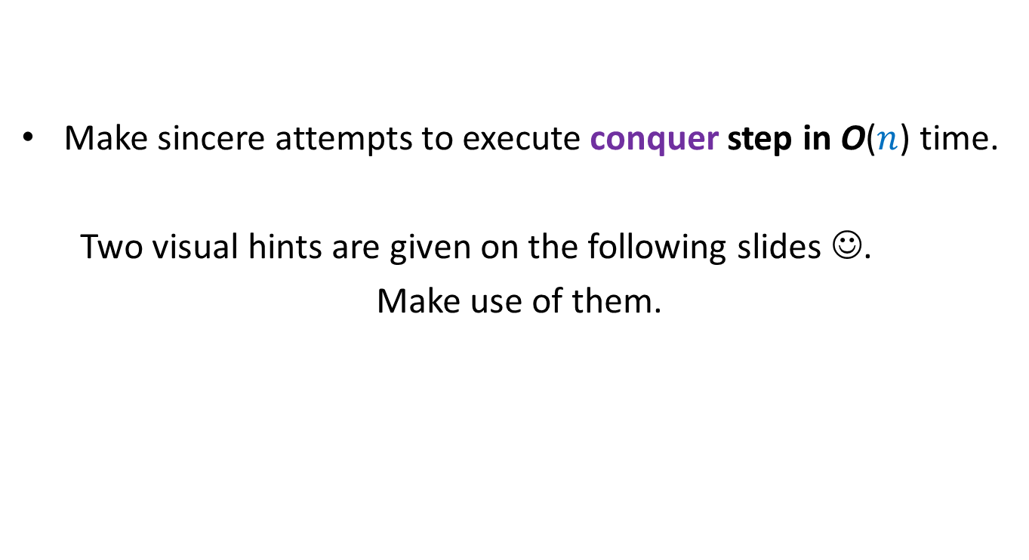
Homework 1
Make sincere attempts to execute conquer step in O($n$) time.
Two visual hints are given on the following slides ☺.
Make use of them.

Slide 30




The conquer step in O($n$) time
If the two strips are already sorted
$$δ_{L}$$
$$δ_{R}$$
$$δ$$
$$δ$$
$δ$ ← min($δ_{L}{,δ}_{R}$)

Slide 31
Inspiration from Merge sort
Merge
Notes:
In merge sort, the two recursive calls return sorted lists.
So creating the sorted list requires only merging them.

