Slide 1
Design and Analysis of Algorithms
CS345
Lecture 21
Detecting negative cycle during shortest paths computation &
Overview of the 2nd part of the course

Slide 2

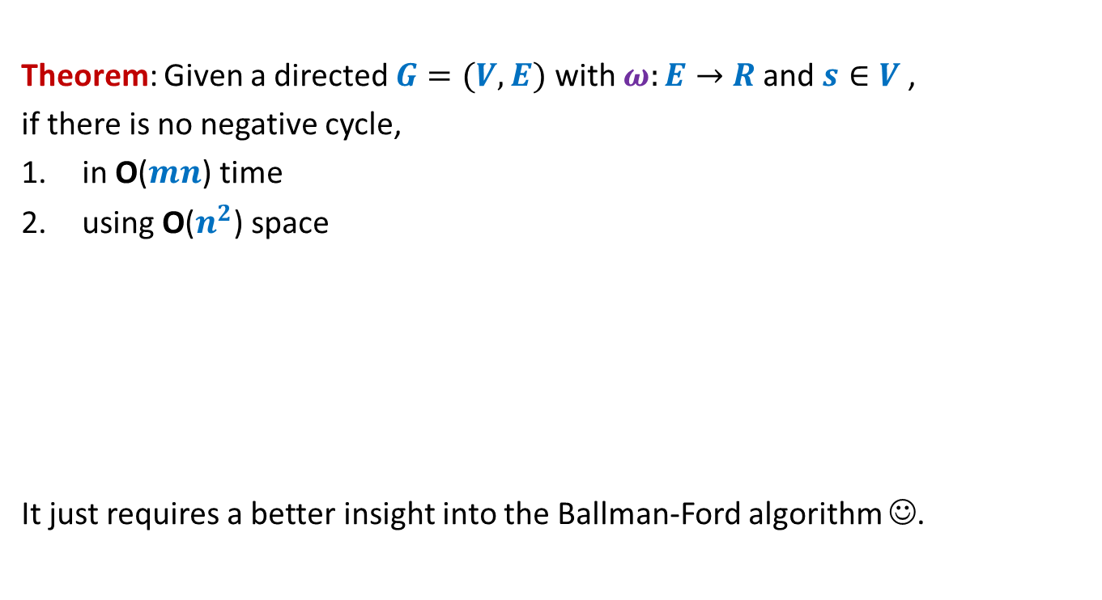
Bellman-Ford algorithm
Theorem: Given a directed $G=(V,E)$ with $ω:E→$ $R$ and $s∈V$,
if there is no negative cycle,
in O($mn$) time
using O($n^{2}$) space
It just requires a better insight into the Ballman-Ford algorithm ☺.
then we can compute shortest paths from $s$
How to get rid of the “if” condition?
How to detect a negative cycle, if present ?

Slide 3








Bellman-Ford algorithm
Bellman-Ford-algo($s$,$G$)
{
For each $v∈V\backslash \{s\}$ do
If $(s,v)∈E$ then $L[v,1]$← ?
else $L[v,1]$← ?
$L[s,1]$← ?
For $i$ = $2$ to $n−1$ do
{ For each $v∈V$ do
$L[v,i]$←$L[v,i−1]$;
For each $(x,v)∈E$ do
$L[v,i]\text{←}$ min( ? , ? )
}
}
$ω\left(s,v\right)$
$∞$;
Initializing $L[∗,1]$
$0$;
{
Computing$L[v,i]$
$$L[v,i]$$
$L[x,i−1]+ω\left(x,v\right)$
}
Lemma: $L[v,i]$ stores the shortest path from $s$to $v$ having at most $i$ edges.

Slide 4
Key Observations on
Bellman-Ford algorithm

Slide 5



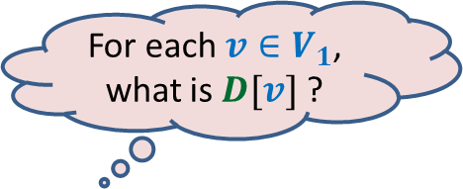


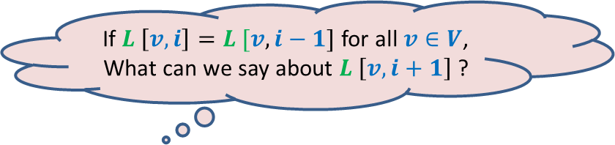
Observation 1
If $L \left[v,i\right]=L [v,i−1]$ for all $v∈V$,
What can we say about $L \left[v,i+1\right]$ ?
Bellman-Ford-algo($s$,$G$)
{
For each $v∈V\backslash \{s\}$ do
If $(s,v)∈E$ then $L[v,1]$← ?
else $L[v,1]$← ?
$L[s,1]$← ?
For $i$ = $2$ to $n−1$ do
{ For each $v∈V$ do
$L[v,i]$←$L[v,i−1]$;
For each $(x,v)∈E$ do
$L[v,i]\text{←}$ min($L[v,i]$, $L[x,i−1]+ω\left(x,v\right)$)
}
}
=
=
=
=
=
=
=
=
=
=
=
=
=
=
=
=
=
$ω\left(s,v\right)$
$∞$;
$0$;
$$L$$
$$V$$
{
$$i$$
}

Slide 6




Observation 1
Answer: $L \left[v,j\right]=L [v,i−1]$ for all $j>i−1$ , $v∈V$ ?
If $L \left[v,i\right]=L [v,i−1]$ for all $v∈V$,
What can we say about $L \left[v,i+1\right]$ ?
Bellman-Ford-algo($s$,$G$)
{
For each $v∈V\backslash \{s\}$ do
If $(s,v)∈E$ then $L[v,1]$← ?
else $L[v,1]$← ?
$L[s,1]$← ?
For $i$ = $2$ to $n−1$ do
{ For each $v∈V$ do
$L[v,i]$←$L[v,i−1]$;
For each $(x,v)∈E$ do
$L[v,i]\text{←}$ min($L[v,i]$, $L[x,i−1]+ω\left(x,v\right)$)
}
}
=
=
=
=
=
=
=
=
=
=
=
=
=
=
=
=
=
=
=
=
=
=
=
=
=
=
=
=
=
=
=
=
=
=
$ω\left(s,v\right)$
$∞$;
$0$;
$$L$$
$$V$$
{
$$\min_{\left((x,v\right)∈E)}\left(L\left(x, i\right)\text{+} ω\left(x,v\right)\right)$$
$L[v,i+1]\text{←}$ min( ? , )
$$L(v, i)$$
$$i$$
}
=
=
=
=
$$\min_{\left((x,v\right)∈E)}\left(L\left(x, i−1\right)\text{+} ω\left(x,v\right)\right)$$
$L[v,i]\text{←}$ min($L(v, i−1)$, ? )

Slide 7






Observations 2
Question: If there is no negative cycle,
then what happens if we execute Bellman-Ford algorithm for $n$ iteration?
Answer: $L\left[v,n\right]=L\left[v,n−1\right]$ for each $v$.
No negative cycle
Optimal Subpath property holds
$L[v,i]$ $=$
?
Length of shortest path to $v$with at most $i$ edges
$L[v,n−1]$ $=$
?
Length of the shortest path to $v$
$$=L[v,n]$$

Slide 8



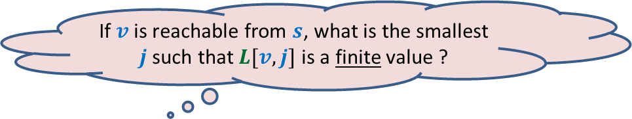



Observation 3
If $v$is reachable from $s$, what is the smallest
$j$such that $L[v,j]$ is a finite value ?
Bellman-Ford-algo($s$,$G$)
{
For each $v∈V\backslash \{s\}$ do
If $(s,v)∈E$ then $L[v,1]$← ?
else $L[v,1]$← ?
$L[s,1]$← ?
For $i$ = $2$ to $n−1$ do
{ For each $v∈V$ do
$L[v,i]$←$L[v,i−1]$;
For each $(x,v)∈E$ do
$L[v,i]\text{←}$ min($L[v,i]$, $L[x,i−1]+ω\left(x,v\right)$)
}
}
$ω\left(s,v\right)$
$$v$$
$$∞$$
$$∞$$
$∞$;
$$∞$$
$$c$$
$0$;
$$L$$
$$V$$
{
$$j$$
$$i$$
}

Slide 9

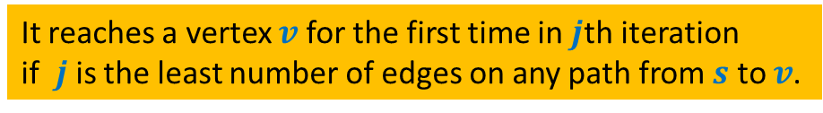







The execution of Bellman Ford algorithm
Like a wave …☺
$$n−1$$
$$n−2$$
$$i$$
$$i−1$$
$$1$$
Paths with edges $≤i$
All paths from $s$
Paths with edges$≤i−1$
It reaches a vertex $v$for the first time in $j$th iteration
if $j$is the least number of edges on any path from $s$ to $v$.

Slide 10

Detecting negative cycle in $G$

Slide 11

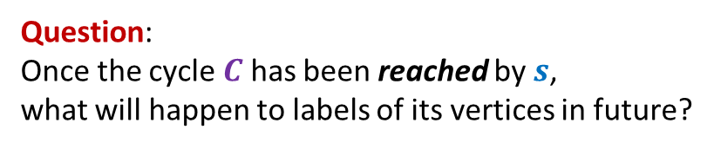




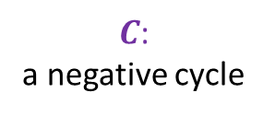

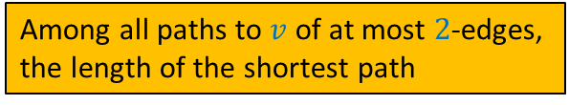

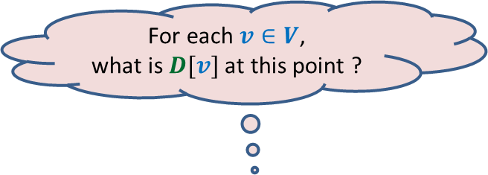
$$v_{1}$$
$$v_{k}$$
$$v_{2}$$
$C$:
a negative cycle
Question:
Once the cycle $C$ has been reached by $s$,
what will happen to labels of its vertices in future?
$$v_{3}$$
$$s$$
$$v_{4}$$
$$v_{6}$$
$$v_{5}$$
$i$th iteration

Slide 12


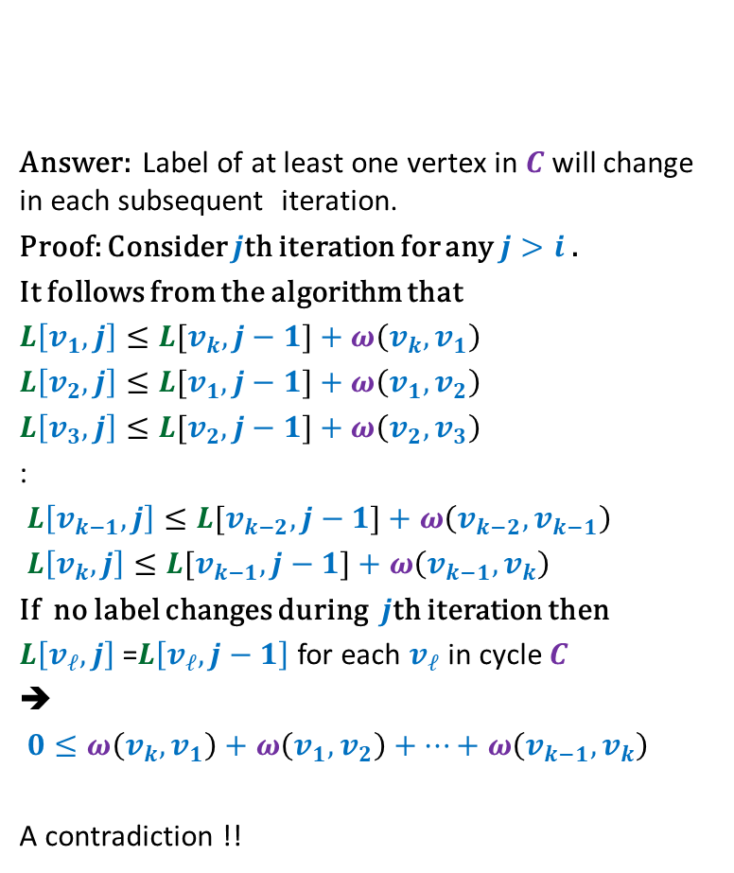

Question:
Once the cycle $C$ has been reached by $s$,
what will happen to labels of its vertices in future?
Answer: Label of at least one vertex in $C$will change in each subsequent iteration.
Proof: Consider $j$th iteration for any $j>i$.
It follows from the algorithm that
$L\left[v_{1},j\right]≤L[v_{k},j−1]+ω\left(v_{k},v_{1}\right)$
$L\left[v_{2},j\right]≤L[v_{1},j−1]+ω\left(v_{1},v_{2}\right)$
$L\left[v_{3},j\right]≤L[v_{2},j−1]+ω\left(v_{2},v_{3}\right)$
:
$L\left[v_{k−1},j\right]≤L[v_{k−2},j−1]+ω\left(v_{k−2},v_{k−1}\right)$
$L\left[v_{k},j\right]≤L[v_{k−1},j−1]+ω\left(v_{k−1},v_{k}\right)$
If no label changes during $j$th iteration then
$L\left[v_{ℓ},j\right]$ =$L\left[v_{ℓ},j−1\right]$ for each $v_{ℓ}$ in cycle $C$
➔
$0≤ω\left(v_{k},v_{1}\right)+ω\left(v_{1},v_{2}\right)+…+ω\left(v_{k−1},v_{k}\right)$
A contradiction !!
$$v_{1}$$
$$v_{k}$$
$$v_{2}$$
$C$:
a negative cycle
$$v_{3}$$
$$s$$
$$v_{4}$$
$$v_{6}$$
$$v_{5}$$
$i$th iteration
Weight of $C$

Slide 13
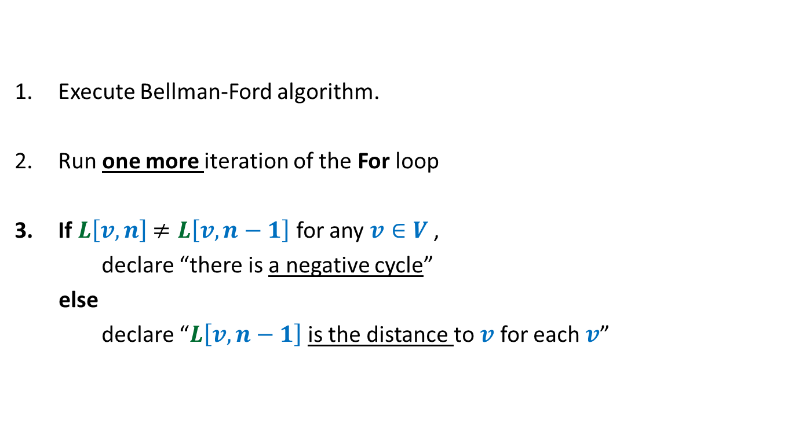
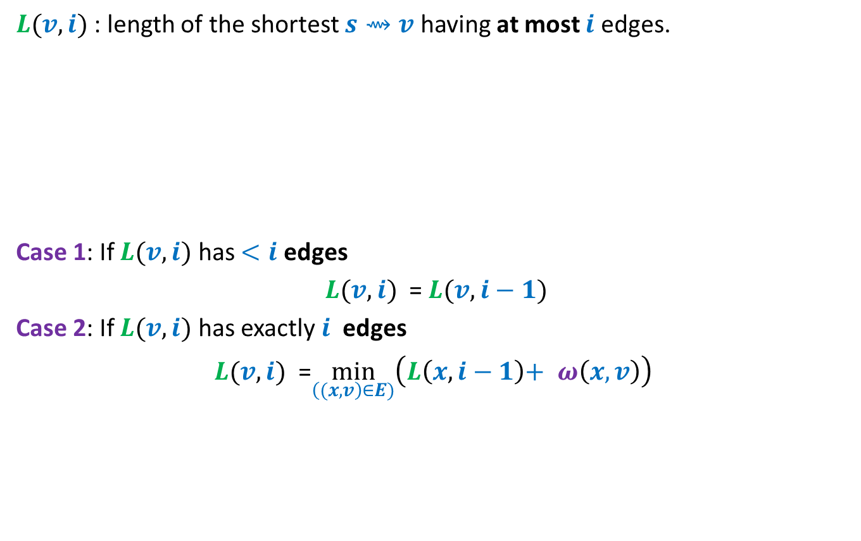
Detecting negative cycle in $G$
Execute Bellman-Ford algorithm.
Run one more iteration of the For loop
If $L\left[v,n\right]$ $≠L\left[v,n−1\right]$ for any $v∈V$ ,
declare “there is a negative cycle”
else
declare “$L\left[v,n−1\right]$is the distance to $v$ for each $v$”

Slide 14
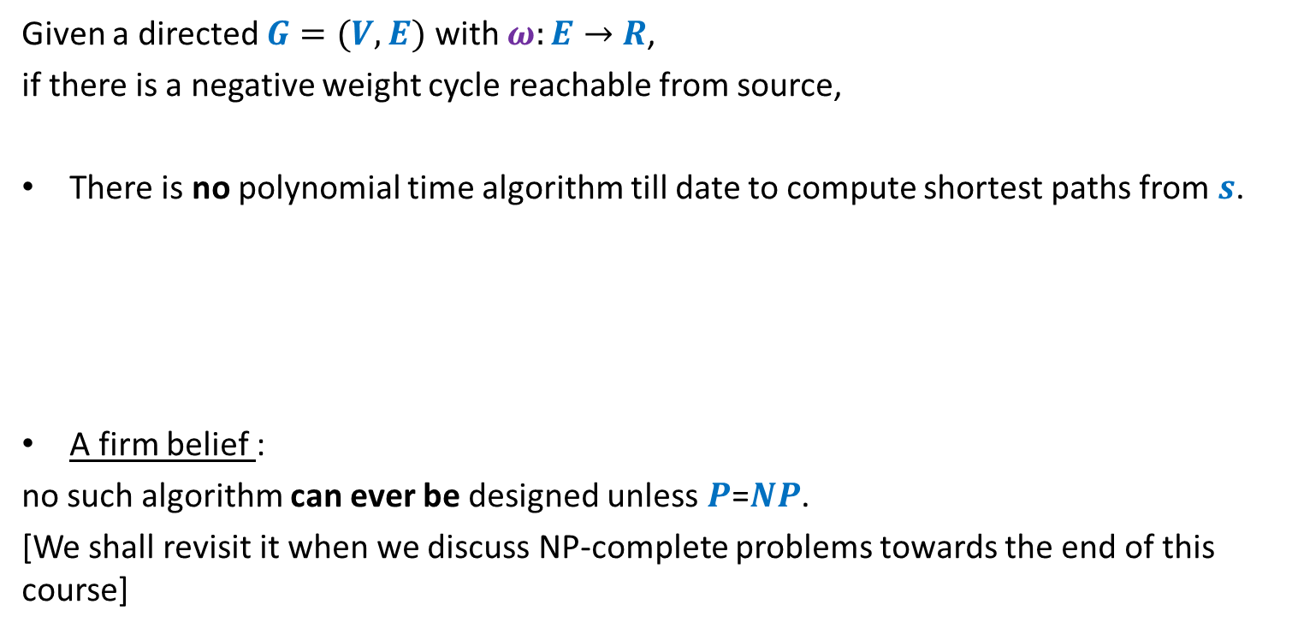
Shortest paths in presence of negative weight cycles
Given a directed $G=(V,E)$ with $ω:E→$ $R$,
if there is a negative weight cycle reachable from source,
There is no polynomial time algorithm till date to compute shortest paths from $s$.
A firm belief :
no such algorithm can ever be designed unless $P$=$NP$.
[We shall revisit it when we discuss NP-complete problems towards the end of this course]

Slide 15




The Journey
Journey So Far
Journey Ahead
$21$Lectures
$18$Lectures
$45\%$Marks
$55\%$Marks

Slide 16





The Journey
Journey Ahead
$$Amortized Analysis$$
$$Network Flows$$
$18$Lectures
$$NP−Completeness$$
$$Miscellaneous Problems$$

Slide 17


Binary Search Trees
$$Amortized Analysis$$
Examples:
AVL tree
Red-Black tree
Strength:
Achieve worst case O(log $n$) time for all operations.
Weakness:
Very difficult to implement.
Splay tree
Can we have a simpler BST ?

Slide 18
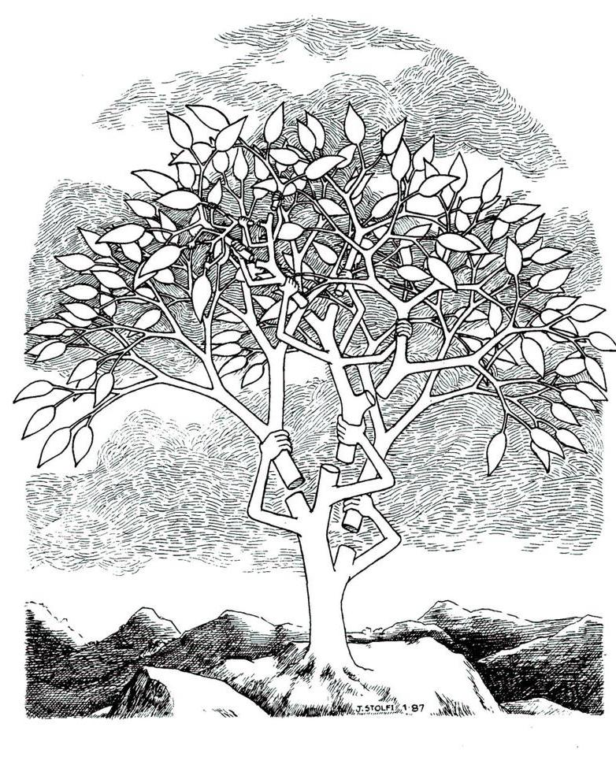

Splay tree:
A self organizing Binary search trees.
Daniel Sleator
&
Robert Tarjan
JACM $1985$

Slide 19
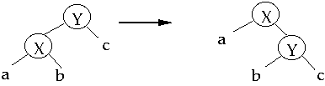
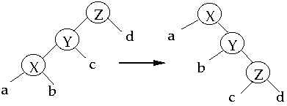
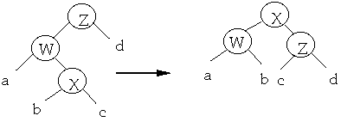
Splay operation
Splay(x)
Single rotation
Zig
Zig-zig
Double rotation
Zig-zag

Slide 20
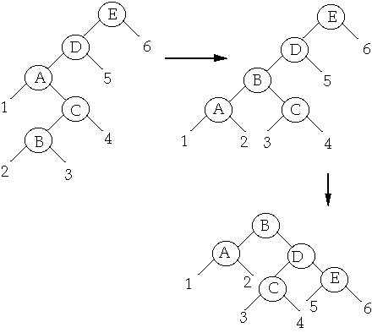
Splay operation
Splay(B)

Slide 21


Search($x$) on a Splay Tree
Perform ordinary search for $x$ on the BST.
Bring the element $x$ to the root by a sequence of splaying.

Slide 22




A magic
How to establish this bound? Ponder over it using your excellent analytical skills. You might still fail most likely.
The analysis uses …
Insertion ?
Deletion ?
Any arbitrary BST on $n$ keys
Any arbitrary $m$search operations
Time taken : ??????
O(($m+n$) log $(m+n)$).
O($m$ log $m$) if $m>n$
EQUALLY SIMPLE
Used in GCC compilers

Slide 23
Amortized Analysis
A powerful technique to analyse the time complexity of an algorithm.

Slide 24
Maximum Flow in a Network

Slide 25

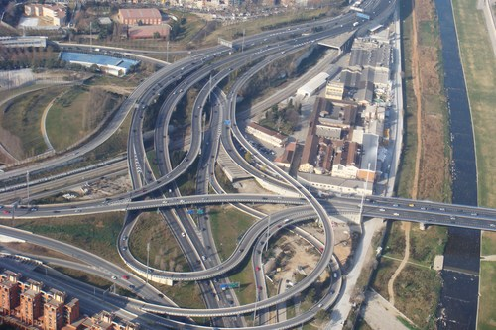
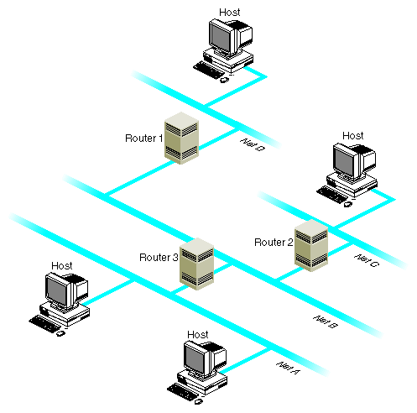
Network

Slide 26







Problem definition
(Informal)
2
Given a network, where each edge has a certain capacity,
there is a designated source vertex $s$and sink vertex $t$.
Compute the maximum flow that we can send from $s$to $t$.
$$v$$
$$x$$
5
6
15
8
$$t$$
$$s$$
6
7
14
7
17
$$u$$
4
$$y$$

Slide 27

Question: What is flow along an edge ?
Answer: The rate at which the commodity is being transported along the edge.
Question: What is capacity of an edge ?
Answer: The maximum rate at which the commodity can be transported
along the edge.
Example: 25 litre/sec
1 GB /sec
An edge

Slide 28





Are there any constraints for a flow ?
$$x$$
$≤$25
Capacity constraint :
Flow along an edge cannot exceed its capacity
Conservation constraint :
Flow entering node $u$ = Flow leaving node $u$.
25
$$u$$
5
$$u$$
25
20

Slide 29
Formal Description of Flow

Slide 30
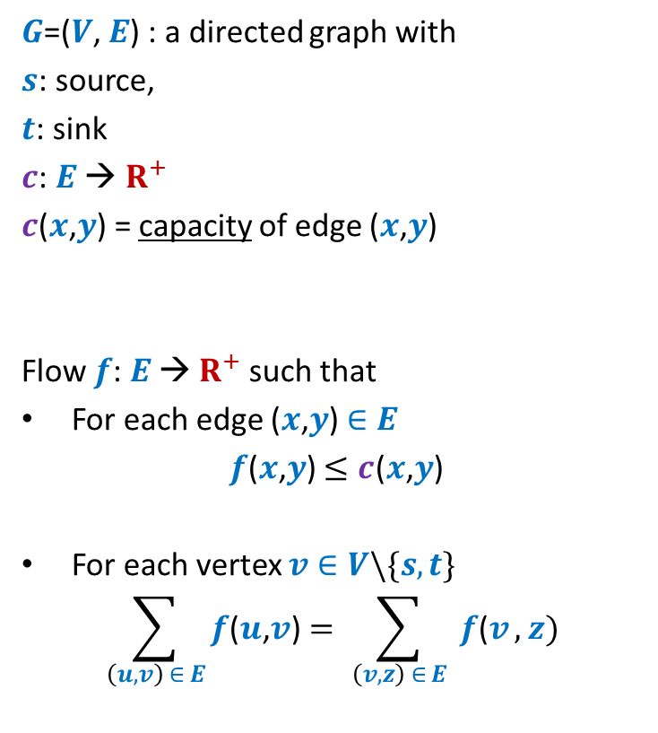
Formal Description of Flow
2
$G$=($V$, $E$) : a directed graph with
$s$: source,
$t$: sink
$c$: $E$ → $R^{+}$
$c$($x$,$y$) = capacity of edge ($x$,$y$)
Flow $f$: $E$ → $R^{+}$ such that
For each edge ($x$,$y$) $∈E$
$f$($x$,$y$) $≤c$($x$,$y$)
For each vertex $v∈V\backslash \{s,t\}$
$$\sum_{\left(u,v\right) ∈ E}{f\text{(}u\text{,}v\text{)}}=\sum_{ \left(v,z\right) ∈ E }{f\text{(}v},z)$$
$$v$$
$$x$$
5
6
15
8
$$t$$
$$s$$
6
7
14
7
17
$$u$$
4
$$y$$
Capacity constraint
Conservation constraint

Slide 31

Formal Description of Flow
2
$\text{value}\text{(}f\text{)=}$ flow leaving $s$
$$=\sum_{\left(s,v\right) ∈ E}{f\text{(}s\text{,}v\text{)}}$$
$G$=($V$, $E$) : a directed graph with
$s$: source,
$t$: sink
$c$: $E$ → $R^{+}$
$c$($x$,$y$) = capacity of edge ($x$,$y$)
Flow $f$: $E$ → $R^{+}$ such that
For each edge ($x$,$y$) $∈E$
$f$($x$,$y$) $≤c$($x$,$y$)
For each vertex $v∈V\backslash \{s,t\}$
$$\sum_{\left(u,v\right) ∈ E}{f\text{(}u\text{,}v\text{)}}=\sum_{ \left(v,z\right) ∈ E }{f\text{(}v},z)$$
$$v$$
$$x$$
4
5
5
11
6
1
15
8
$$t$$
$$s$$
6
7
1
7
7
14
7
17
$$u$$
4
$$y$$
It takes $O(m+n)$ time to verify if $f$ is a valid flow.

Slide 32
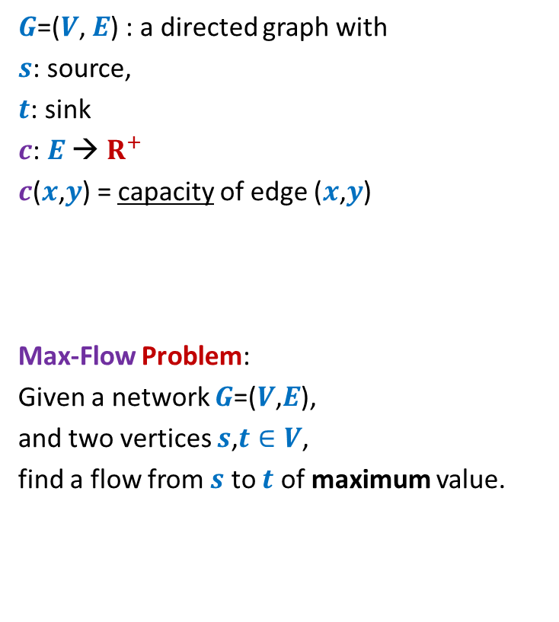
Formal Description of Flow
2
$\text{value}\text{(}f\text{)=}$ flow leaving $s$
$$=\sum_{\left(s,v\right) ∈ E}{f\text{(}s\text{,}v\text{)}}$$
$G$=($V$, $E$) : a directed graph with
$s$: source,
$t$: sink
$c$: $E$ → $R^{+}$
$c$($x$,$y$) = capacity of edge ($x$,$y$)
Max-Flow Problem:
Given a network $G$=($V$,$E$),
and two vertices $s$,$t∈V$,
find a flow from $s$ to $t$ of maximum value.
$$v$$
$$x$$
5
6
15
8
$$t$$
$$s$$
6
7
14
7
17
$$u$$
4
$$y$$

Slide 33

$$Network Flows$$
Elegance
Depth
A famous graph theorem
Wide Applications
Perhaps the most elegant, intuitive, and fresh
Much deeper analysis than Bellman Ford algorithm
MaxFlow-MinCut Theorem
Wider than MST, DFS, Dijkstra’s algorithm

Slide 34

An important advice
Do not miss any lecture from the next $6$lectures.

