Slide 1
Design and Analysis of Algorithms
CS345
Lecture 22
Maximum Flow - I

Slide 2
More motivation for
Maximum Flow
There are numerous problems which don’t seem to have anything to with maximum flow. But they have elegant solution based on maximum flow.
The following slide states one such problem.

Slide 3

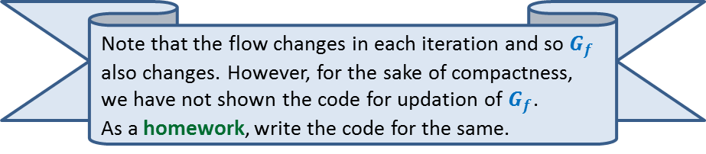
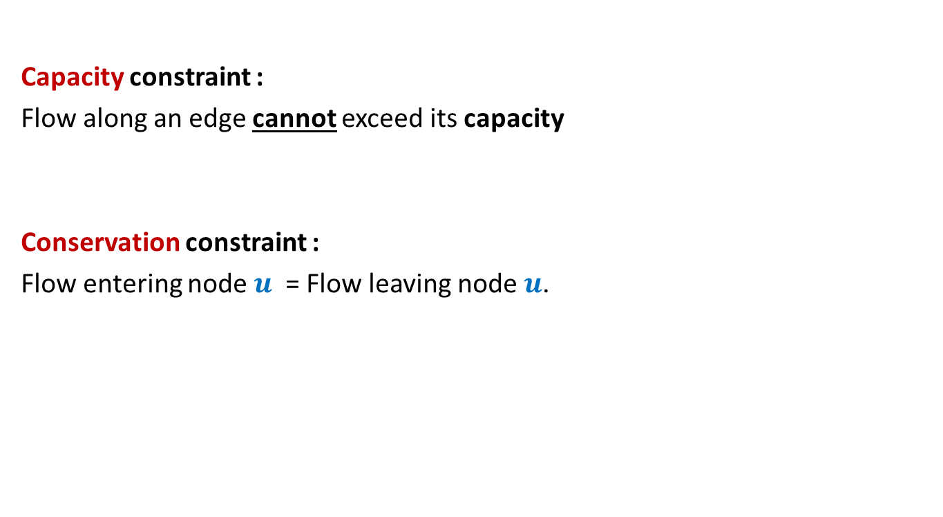


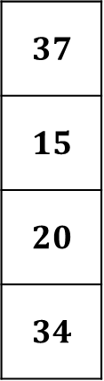
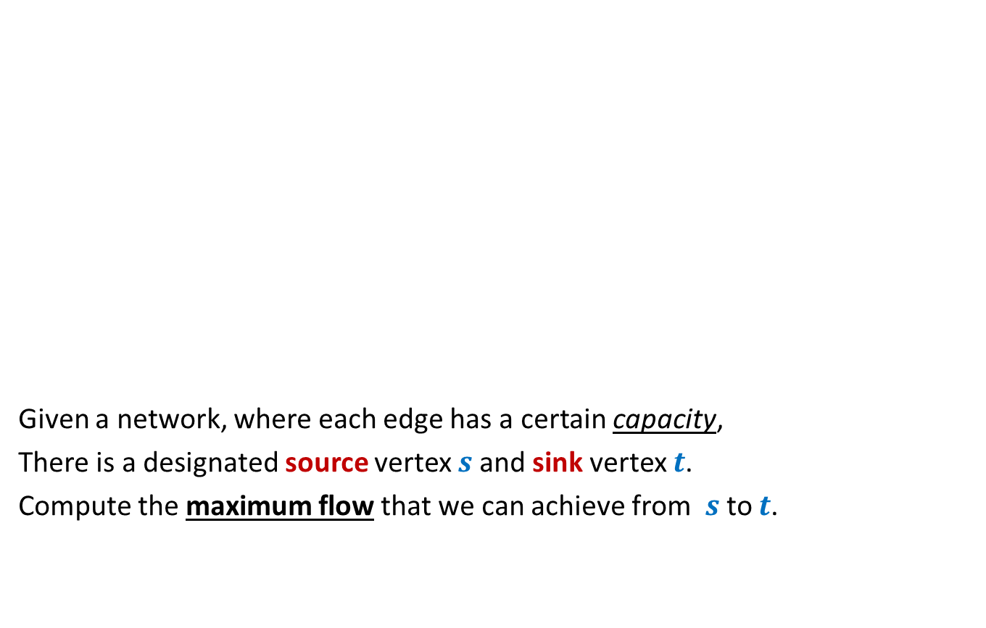
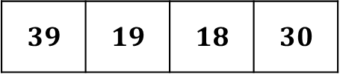


Rounding of a matrix
$$11$$
$$11.7$$
$$12$$
$$39$$ | $$19$$ | $$18$$ | $$30$$
$$39$$ | $$19$$ | $$18$$ | $$30$$
$$37$$
$$15$$
$$20$$
$$34$$
$$11.7$$ | $$2.4$$ | $$4.3$$ | $$18.6$$
$$5.2$$ | $$6.1$$ | $$1.0$$ | $$2.7$$
$$6.7$$ | $$3.6$$ | $$9.1$$ | $$0.6$$
$$15.4$$ | $$6.9$$ | $$3.6$$ | $$8.1$$
$$37$$
$$15$$
$$20$$
$$34$$
$$12$$ | $$2$$ | $$4$$ | $$19$$
$$5$$ | $$6$$ | $$1$$ | $$3$$
$$7$$ | $$4$$ | $$9$$ | $$0$$
$$15$$ | $$7$$ | $$4$$ | $$8$$
An amazing application of max flows.
Design an algorithm to round a $n×n$ matrix, if possible ?
Rounding always exists !
Rounding can be computed efficiently.
Using Max Flow ☺

Slide 4
Maximum Flow in a Network

Slide 5
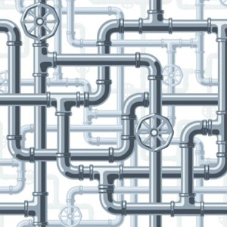
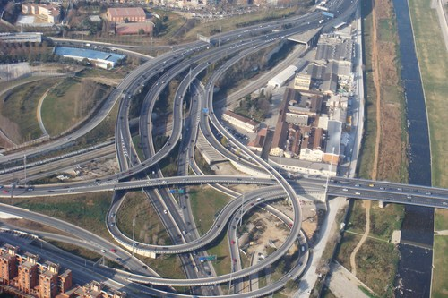
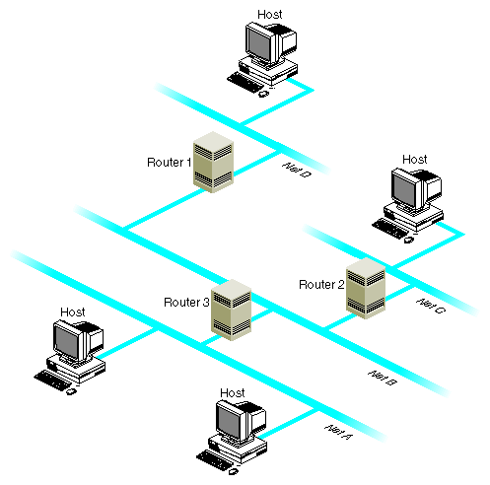
Network

Slide 6






Problem definition
(Informal)
2
Given a network, where each edge has a certain capacity,
there is a designated source vertex $s$and sink vertex $t$.
Compute the maximum flow that we can send from $s$to $t$.
$$v$$
$$x$$
5
6
15
8
$$t$$
$$s$$
6
7
14
7
17
$$u$$
4
$$y$$

Slide 7
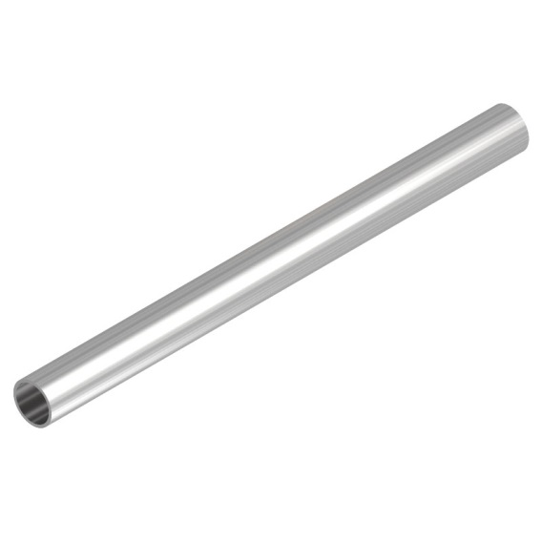
Question: What is flow along an edge ?
Answer: The rate at which the commodity is being transported along the edge.
Question: What is capacity of an edge ?
Answer: The maximum rate at which the commodity can be transported
along the edge.
Example: 25 litre/sec
1 GB /sec
An edge

Slide 8


Are there any constraints for a flow ?
$$x$$
$≤$25
Capacity constraint :
Flow along an edge cannot exceed its capacity
Conservation constraint :
Flow entering node $u$ = Flow leaving node $u$.
25
$$u$$
5
$$u$$
25
20

Slide 9
Formal Description of Flow

Slide 10
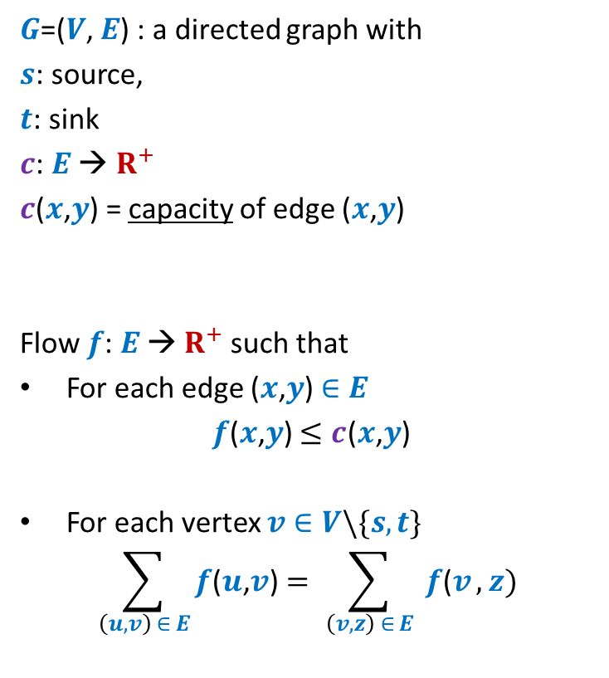
Formal Description of Flow
2
$G$=($V$, $E$) : a directed graph with
$s$: source,
$t$: sink
$c$: $E$ → $R^{+}$
$c$($x$,$y$) = capacity of edge ($x$,$y$)
Flow $f$: $E$ → $R^{+}$ such that
For each edge ($x$,$y$) $∈E$
$f$($x$,$y$) $≤c$($x$,$y$)
For each vertex $v∈V\backslash \{s,t\}$
$$\sum_{\left(u,v\right) ∈ E}{f\text{(}u\text{,}v\text{)}}=\sum_{ \left(v,z\right) ∈ E }{f\text{(}v},z)$$
$$v$$
$$x$$
5
6
15
8
$$t$$
$$s$$
6
7
14
7
17
$$u$$
4
$$y$$
Capacity constraint
Conservation constraint

Slide 11

Formal Description of Flow
2
$\text{value}\text{(}f\text{)=}$ flow leaving $s$
$$=\sum_{\left(s,v\right) ∈ E}{f\text{(}s\text{,}v\text{)}}$$
$G$=($V$, $E$) : a directed graph with
$s$: source,
$t$: sink
$c$: $E$ → $R^{+}$
$c$($x$,$y$) = capacity of edge ($x$,$y$)
Flow $f$: $E$ → $R^{+}$ such that
For each edge ($x$,$y$) $∈E$
$f$($x$,$y$) $≤c$($x$,$y$)
For each vertex $v∈V\backslash \{s,t\}$
$$\sum_{\left(u,v\right) ∈ E}{f\text{(}u\text{,}v\text{)}}=\sum_{ \left(v,z\right) ∈ E }{f\text{(}v},z)$$
$$v$$
$$x$$
4
5
5
11
6
1
15
8
$$t$$
$$s$$
6
7
1
7
7
14
7
17
$$u$$
4
$$y$$
It takes $O(m+n)$ time to verify if $f$ is a valid flow.

Slide 12
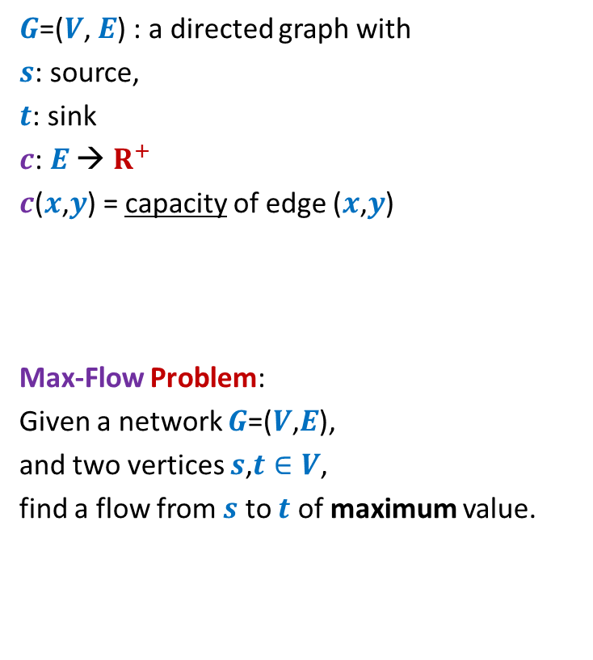
Formal Description of Flow
2
$\text{value}\text{(}f\text{)=}$ flow leaving $s$
$$=\sum_{\left(s,v\right) ∈ E}{f\text{(}s\text{,}v\text{)}}$$
$G$=($V$, $E$) : a directed graph with
$s$: source,
$t$: sink
$c$: $E$ → $R^{+}$
$c$($x$,$y$) = capacity of edge ($x$,$y$)
Max-Flow Problem:
Given a network $G$=($V$,$E$),
and two vertices $s$,$t∈V$,
find a flow from $s$ to $t$ of maximum value.
$$v$$
$$x$$
5
6
15
8
$$t$$
$$s$$
6
7
14
7
17
$$u$$
4
$$y$$

Slide 13





Towards designing max flow algorithm
2
$$v$$
$$x$$
5
6
15
Can we handle simpler graphs ?
8
$$t$$
$$s$$
6
7
14
7
17
$$u$$
4
$$y$$

Slide 14
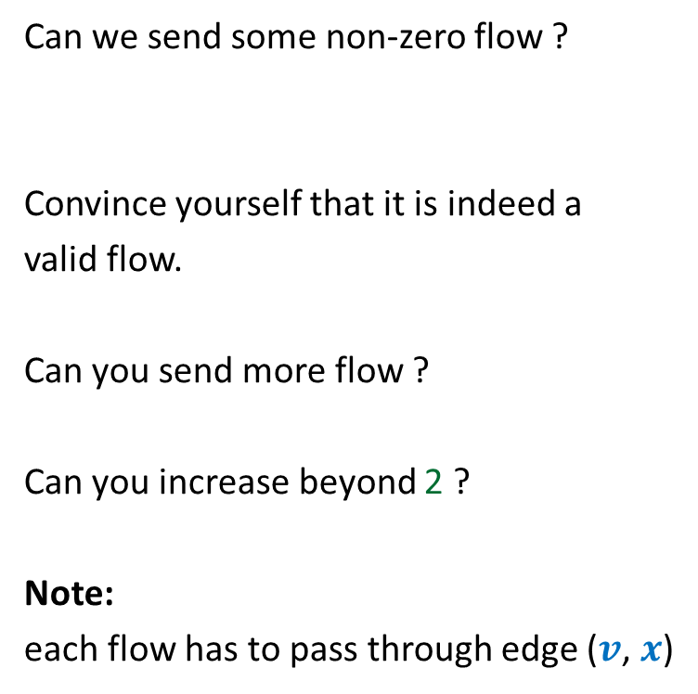


Towards designing max flow algorithm
Can we send some non-zero flow ?
Convince yourself that it is indeed a
valid flow.
Can you send more flow ?
Can you increase beyond 2 ?
Note:
each flow has to pass through edge ($v$, $x$)
$$v$$
$$x$$
6
5
15
$$t$$
$$s$$
1
2
1
1
2
2

Slide 15
Towards designing max flow algorithm
We can compute maximum flow in a path easily.
$$v$$
$$x$$
Let us see how we can use this knowledge for any directed graph?
6
5
15
$$t$$
$$s$$
5
5
5
Bottleneck edge

Slide 16
Towards designing max flow algorithm
2
$$v$$
$$x$$
5
6
15
What is the most natural approach to find the maximum flow ?
8
$$t$$
$$s$$
6
7
14
7
17
$$u$$
4
$$y$$
You will be shown some animation
A drop of water
or a bit originating at source.
to help you think about the natural approach.
Let us traverse its journey.
Watch it slowly with attentive mind ☺
Imagine the maximum flow in the network.

Slide 17
Towards designing max flow algorithm
2
$$v$$
$$x$$
5
6
15
8
$$t$$
$$s$$
6
7
14
7
17
$$u$$
4
$$y$$
Another drop of water
or a bit originating at source.

Slide 18
Towards designing max flow algorithm
2
$$v$$
$$x$$
5
Could you now get the most natural approach to compute maximum flow ?
6
15
8
$$t$$
$$s$$
6
7
14
7
17
$$u$$
4
$$y$$

Slide 19
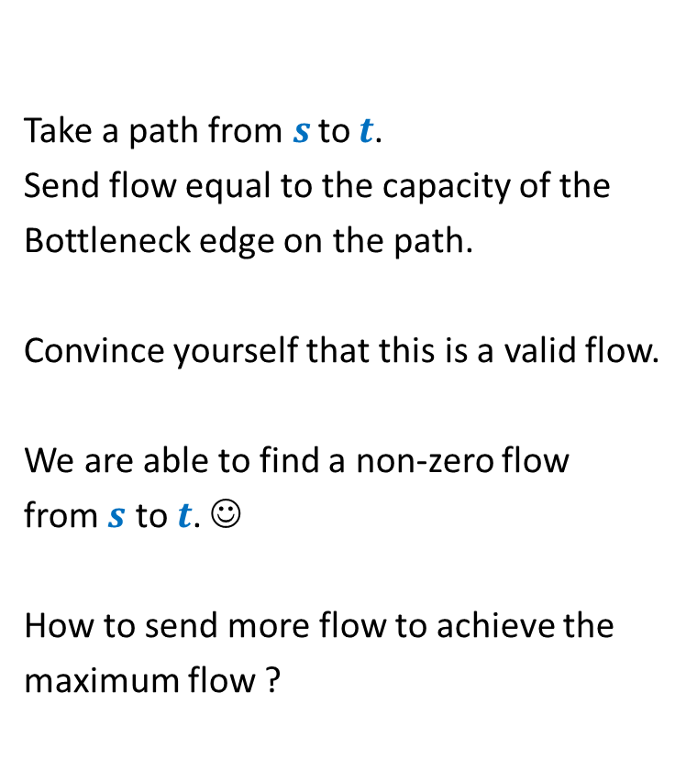
Towards designing max flow algorithm
2
Update the capacities of the edges.
And …
Find another path ☺
Take a path from $s$ to $t$.
Send flow equal to the capacity of the
Bottleneck edge on the path.
Convince yourself that this is a valid flow.
We are able to find a non-zero flow
from $s$ to $t$. ☺
How to send more flow to achieve the
maximum flow ?
$$v$$
5
$$x$$
5
5
0
5
6
10
1
15
8
$$t$$
$$s$$
6
7
14
7
17
$$u$$
4
$$y$$

Slide 20

Towards designing max flow algorithm
2
Update the capacities of the edges.
And …
Find another path ☺
$$v$$
5
$$x$$
5
0
$+$1
5
0
1
10
8
$$t$$
$$s$$
6
1
1
14
7
16
7
6
17
$$u$$
4
$$y$$

Slide 21

Towards designing max flow algorithm
2
Update the capacities of the edges.
And …
Find another path ☺
$$v$$
5
$$x$$
6
0
5
$+$7
0
3
10
8
$$t$$
$$s$$
6
7
1
1
7
7
7
14
6
16
0
$$u$$
4
$$y$$

Slide 22


Towards designing max flow algorithm
2
2
$$v$$
$$x$$
We are unable to find any path from $s$ to $t$ of non-zero capacity.
Let us bring the original network to see how far we have reached ☺
We can send flow at most $13$ from $s$ to $t$
$$v$$
5
$$x$$
5
5
6
0
6
12
12
15
0
3
6
$$t$$
8
6
$$t$$
8
6
$$s$$
$$s$$
7
7
1
1
1
1
7
7
7
14
7
17
0
7
6
16
4
$$u$$
4
$$y$$
$$u$$
$$y$$

Slide 23

Towards designing max flow algorithm
2
2
$$v$$
$$x$$
We can send flow at most $13$ from $s$ to $t$
$$v$$
5
$$x$$
5
5
6
0
6
12
12
15
0
3
6
$$t$$
8
6
$$t$$
8
6
$$s$$
$$s$$
7
1
1
7
1
1
7
7
7
14
7
17
0
7
6
16
4
$$u$$
4
$$y$$
$$u$$
$$y$$
We are sending flow of value $13$.
We found Maximum Flow in this network.

Slide 24
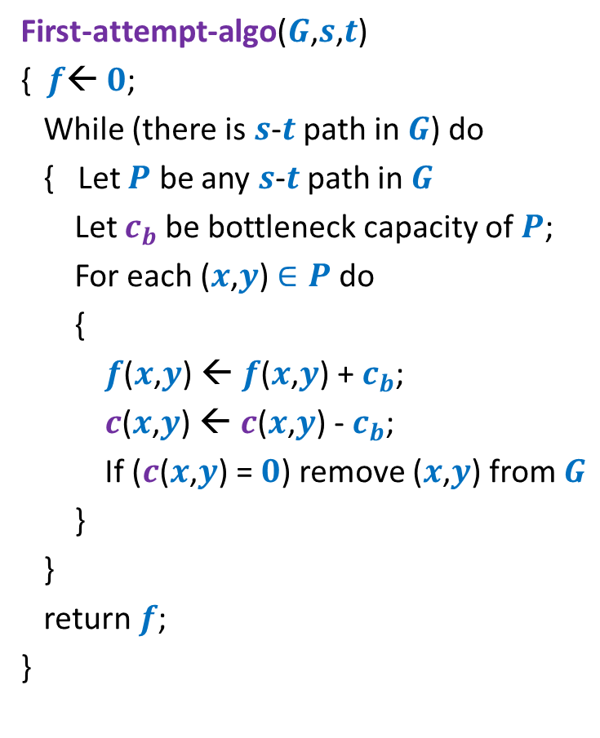
Towards designing max flow algorithm
First-attempt-algo($G$,$s$,$t$)
{ $f$← $0$;
While (there is $s$-$t$ path in $G$) do
{ Let $P$ be any $s$-$t$ path in $G$
Let $c_{b}$be bottleneck capacity of $P$;
For each ($x$,$y$) $∈P$ do
{
$f$($x$,$y$) ← $f$($x$,$y$) + $c_{b}$;
$c$($x$,$y$) ← $c$($x$,$y$) - $c_{b}$;
If ($c$($x$,$y$) = $0$) remove ($x$,$y$) from $G$
}
}
return $f$;
}
Correctness ?

Slide 25
A counterexample for
First-attempt-algo

Slide 26

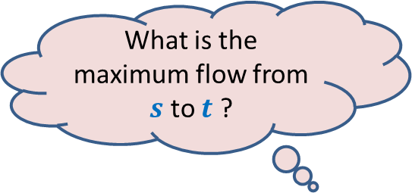


$$x$$
What is the maximum flow from $s$ to $t$ ?
20
10
20
10
$$s$$
10
50
$$t$$
30
10
20
10
20
$$y$$

Slide 27


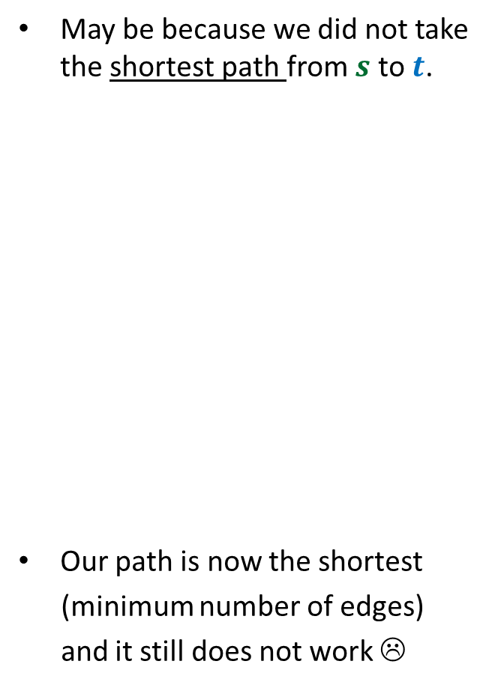


Executing our first attempt algorithm
May be because we did not take the shortest path from $s$ to$t$.
Our path is now the shortest
(minimum number of edges)
and it still does not work ☹
$$x$$
$$x$$
20
20
10
10
$$s$$
20
50
$$t$$
$$s$$
30
$$t$$
20
10
20
10
$$y$$
$$y$$
No $s−t$ path

Slide 28
We feel disappointed from this counterexample ☹.
Let us learn from this counterexample ☺.

Slide 29
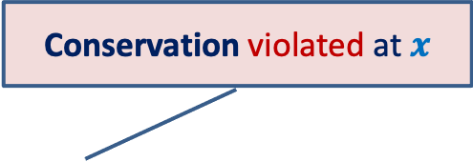

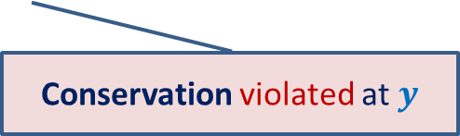
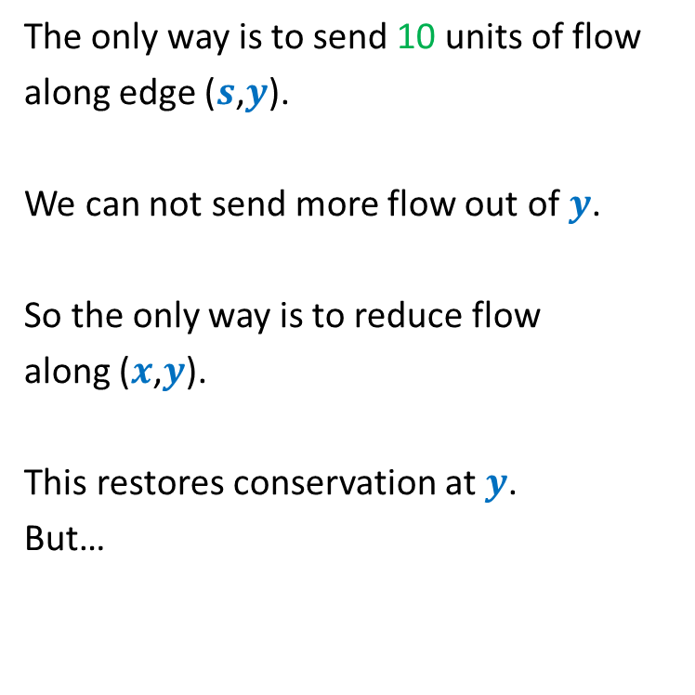

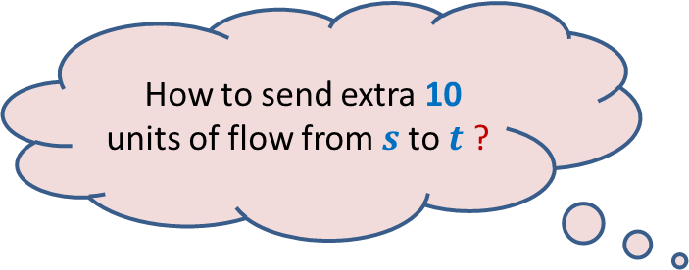
Finding a solution with scientific spirit
Conservation violated at $x$
The only way is to send 10 units of flow
along edge ($s$,$y$).
We can not send more flow out of $y$.
So the only way is to reduce flow
along ($x$,$y$).
This restores conservation at $y$.
But…
$$x$$
20
20
10
How to send extra 10 units of flow from $s$to $t$ ?
$$s$$
20
50
$$t$$
10
10
20
10
20
$$y$$
Conservation violated at $y$

Slide 30
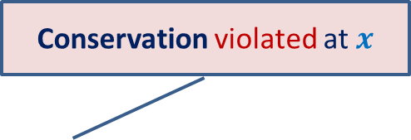

Finding a solution with scientific spirit
Conservation violated at $x$
$x$has excess incoming flow.
We can not reduce flow along ($s$,$x$).
But we can increase flow along ($x$,$t$) ☺.
$$x$$
20
10
20
10
$$s$$
10
50
$$t$$
10
20
10
20
$$y$$

Slide 31
Homework
Spend at least 1 hour today on the following task
Learn from the way we increases flow from 20 to 30.
Try to get the insight from this example.
Modify the existing algorithm so that it may compute the maximum flow…

