Slide 1
Design and Analysis of Algorithms
CS345
Lecture 3
Divide and Conquer Paradigm – II
- Closest Pair of Points (Final algorithm)
- Non-Dominated Points

Slide 2
Recap of the last lecture
a Divide and Conquer algorithm for
Closest Pair Distance

Slide 3






The combine step
Tool 1
$$δ_{L}$$
$$p$$
$$δ_{R}$$
$$δ$$
$$δ$$
$δ$ ← min($δ_{L}{,δ}_{R}$)
Notes:
1. Only the points lying in these 2 red squares are relevant as far as $p$ is concerned.
2. Time to use Hint 2
3. Surely not more than 8.
-----------------------------
1. How to find the points in these red square for point $p$?

Slide 4

The combine step
Tool 1
$$δ_{L}$$
$$δ$$
$$p$$
$$δ$$
$$δ_{R}$$
$$δ$$
$$δ$$
$δ$ ← min($δ_{L}{,δ}_{R}$)
Notes:
1. Only the points lying in these 2 red squares are relevant as far as $p$ is concerned.
2. Time to use Hint 2
3. Surely not more than 8.
-----------------------------
1. How to find the points in these red square for point $p$?

Slide 5
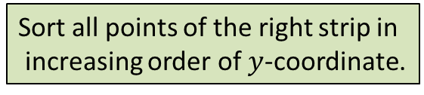







The combine step
$$δ$$
$$δ$$
$$δ$$
$$δ$$
Sort all points of the right strip in
increasing order of $y$-coordinate.
$$δ_{L}$$
$$δ$$
$$δ$$
$$δ$$
$$(x^{′},y^{′})$$
Binary search for ($y^{′}+δ$)
$$p$$
$$δ$$
Binary search for ($y^{′}−δ$)
$$δ_{R}$$
$$δ$$
$$δ$$
$δ$ ← min($δ_{L}{,δ}_{R}$)

Slide 6


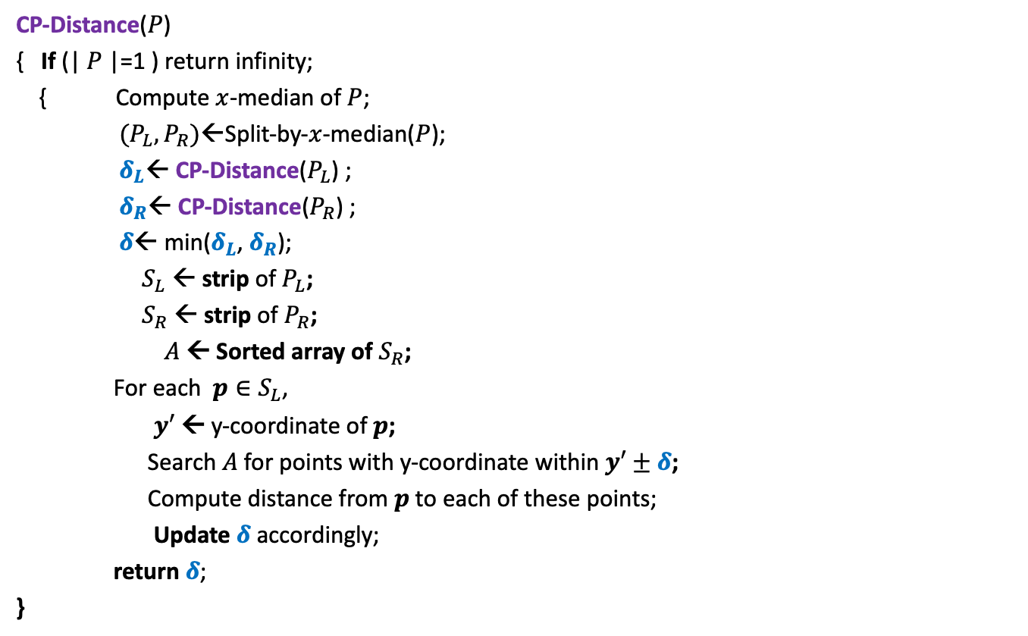
Divide and Conquer based algorithm
CP-Distance($P$)
{ If (| $P$|=1 ) return infinity;
{ Compute $x$-median of $P$;
$(P_{L},P_{R})$←Split-by-$x$-median($P$);
$δ_{L}$← CP-Distance($P_{L}$) ;
$δ_{R}$← CP-Distance($P_{R}$) ;
$δ$← min($δ_{L}$, $δ_{R}$);
$S_{L}$ ← strip of $P_{L}$;
$S_{R}$ ← strip of $P_{R}$;
$A$← Sorted array of $S_{R}$;
For each $p∈S_{L}$,
$y′$ ← y-coordinate of $p$;
Search $A$for points with y-coordinate within $y′±δ$;
Compute distance from $p$to each of these points;
Update $δ$ accordingly;
return $δ$;
}
$O(\left|P\right|)$ + 2 T(|$P$|/2) time
Divide step
$O(\left|P\right| \log{|P|})$ time
Combine/conquer step

Slide 7


Running time of the algorithm
What is the recurrence for running time?
T($n$) = c $n$ log $n$ + 2 T($n$/2)
➔
T($n$) = O( $n$ $\log^{2}n$)
Theorem:
There exists an O( $n$ $\log^{2}n$) time algorithm to compute the closest pair distance of $n$points in plane.
c $n$

Slide 8




The combine step in O($n$) time
If the two strips are already sorted
$$δ_{L}$$
$$δ_{R}$$
$$δ$$
$$δ$$
$δ$ ← min($δ_{L}{,δ}_{R}$)

Slide 9





The combine step in O($n$) time
If the two strips are already sorted
$$δ$$
$$p$$
$$δ_{L}$$
$δ$
$$q$$
$$δ_{R}$$
$$δ$$
$$δ$$
$δ$ ← min($δ_{L}{,δ}_{R}$)
Notes:
For each point in one strip, we need to find distance to points
in the upper red- square in the other strip.
2. How to do it efficiently using the fact that the strips are sorted ?

Slide 10





The combine step in O($n$) time
At most $4$ consecutive points need to be considered.
?
Tool 2
$$δ$$
$$<δ$$
$$p$$
$$δ$$
Homework:
Give precise and formal arguments we gave in the class
to prove the above claim.

Slide 11
The combine step in O($n$) time
If the two strips are already sorted
$$δ_{L}$$
$$δ_{R}$$
$$δ$$
$$δ$$
$δ$ ← min($δ_{L}{,δ}_{R}$)

Slide 12
The combine step in O($n$) time
If the two strips are already sorted
?
$$δ_{L}$$
$$δ_{R}$$
$$δ$$
$$δ$$
$δ$ ← min($δ_{L}{,δ}_{R}$)

Slide 13
Inspiration from Merge sort
Merge
Notes:
In merge sort, the two recursive calls return sorted lists.
So creating the sorted list requires only merging them.

Slide 14


The combine step in O($n$) time
$$δ_{L}$$
$$δ_{R}$$
$$δ_{L}$$
$$δ_{L}$$
Notes:
If $P_{L}$ and $P_{R}$ are sorted according to y-coordinate,
Getting the strips sorted according to y-coordinate
Getting $P$sorted by merging them
takes O($n$) time. ☺

Slide 15


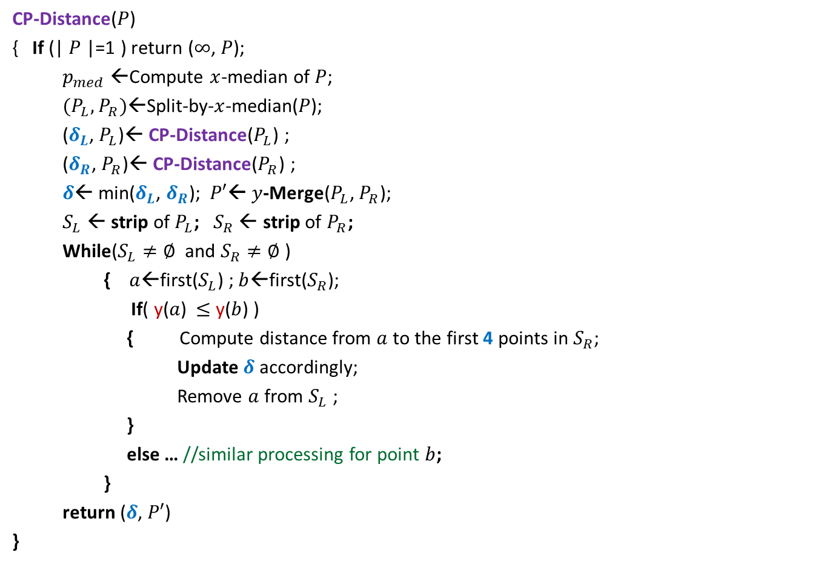
Divide and Conquer based algorithm
CP-Distance($P$)
{ If (| $P$|=1 ) return ($∞$, $P$);
$p_{med}$←Compute $x$-median of $P$;
$(P_{L},P_{R})$←Split-by-$x$-median($P$);
($δ_{L}$, $P_{L}$)← CP-Distance($P_{L}$) ;
($δ_{R}$, $P_{R}$)← CP-Distance($P_{R}$) ;
$δ$← min($δ_{L}$, $δ_{R}$); $P′$← $y$-Merge($P_{L}$, $P_{R}$);
$S_{L}$ ← strip of $P_{L}$; $S_{R}$ ← strip of $P_{R}$;
While($S_{L}≠∅$ and $S_{R}≠∅$ )
{ $a$←first($S_{L}$) ; $b$←first($S_{R}$);
If( y($a$) $≤$ y($b$) )
{ Compute distance from $a$to the first 4 points in $S_{R}$;
Update $δ$ accordingly;
Remove $a$ from $S_{L}$ ;
}
else … //similar processing for point $b$;
}
return ($δ$, $P′$)
}
$O(\left|P\right|)$ + 2 T(|$P$|/2) time
Divide step
$O(\left|P\right|)$ time
conquer step

Slide 16
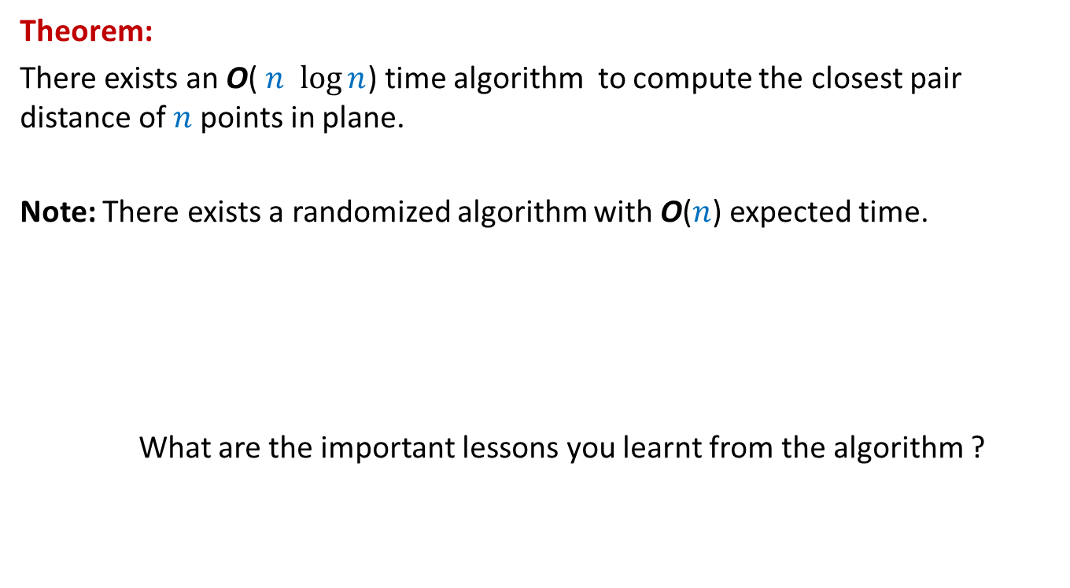
Conclusion
Theorem:
There exists an O( $n$ $\log{n}$) time algorithm to compute the closest pair distance of $n$points in plane.
Note: There exists a randomized algorithm with O($n$) expected time.
What are the important lessons you learnt from the algorithm ?

Slide 17
Lessons learnt
Data structures may play a crucial role in designing efficient algorithms.
Basic geometric facts may play an important role in designing an algorithm.
The final algorithm is arrived after many steps, each step requireing new insight.
Analysing the recurrences of time complexity of an algorithm may sometime help you make the algorithm more efficient.
Perseverance is the key in designing an efficient algorithm.

Slide 18
problem 2
Non-dominated Points

Slide 19





The Non-Dominated Points
y
Definition: point $p$ is said to dominate point $q$ if
x($p$) > x($q$)
and y($p$) > y($q$)
$$p$$
$$q$$
$$q$$
$$(0,0)$$
x

Slide 20
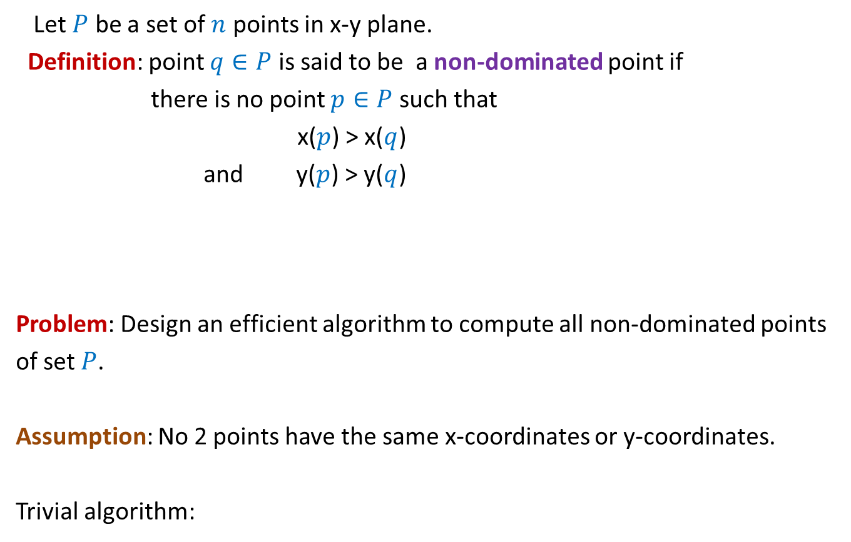

The Non-Dominated Points
Let $P$ be a set of $n$ points in x-y plane.
Definition: point $q∈P$ is said to be a non-dominated point if
there is no point $p∈P$ such that
x($p$) > x($q$)
and y($p$) > y($q$)
Problem: Design an efficient algorithm to compute all non-dominated points
of set $P$.
Assumption: No 2 points have the same x-coordinates or y-coordinates.
Trivial algorithm:
O($n^{2}$)

Slide 21


The Non-Dominated Points
y
Can you spot all non-dominated points
$$q$$
$$p$$
$$(0,0)$$
x

Slide 22
The Non-Dominated Points
y
What structure emerges ?
$$(0,0)$$
x

Slide 23
The Non-Dominated Points
y
$$p$$
$$(0,0)$$
x

Slide 24

The Non-Dominated Points
Let $P$ be a set of $n$ points in x-y plane.
A simpler problem:
Design an efficient algorithm to report any non-dominated point from $P$.

Slide 25

The Non-Dominated Points
y
O($n$) time
$$(0,0)$$
x

Slide 26
A simple algorithm for all non-dominated points

Slide 27
A Simple Algorithm
y
$$(0,0)$$
x

Slide 28



A Simple Algorithm
y
$h$ : no. of non-dominated points
Time complexity =
O($n^{2}$) ?
O($nh$)
$$(0,0)$$
x

Slide 29
A Divide and Conquer algorithm

Slide 30
A Divide and Conquer algorithm

Slide 31



The Divide step
y
O($n$) time
$$(0,0)$$
x
Left half set
$⌈\frac{n}{2}⌉$points
$⌊\frac{n}{2}⌋$points
Right half set

Slide 32

Solving the Subproblems recursively
y
2 T($\frac{n}{2}$) time
$$(0,0)$$
x
Left half set
$⌈\frac{n}{2}⌉$points
$⌊\frac{n}{2}⌋$points
Right half set

Slide 33


The conquer step
y
Each non-dominated point of the right half set
is a non-dominated point of the entire set.
What about the non-dominated points of the left half set ?
Think of an efficient way to perform conquer step ?
O($n$) time
$$p$$
$$(0,0)$$
x
Left half set
$⌈\frac{n}{2}⌉$points
$⌊\frac{n}{2}⌋$points
Right half set

Slide 34


The time complexity of the algorithm
y
T($n$) = c $n$ + 2 T($n$/2)
Time complexity =
O($n$ $\log{ n}$)
$$p$$
$$(0,0)$$
x
Left half set
$⌈\frac{n}{2}⌉$points
$⌊\frac{n}{2}⌋$points
Right half set

Slide 35
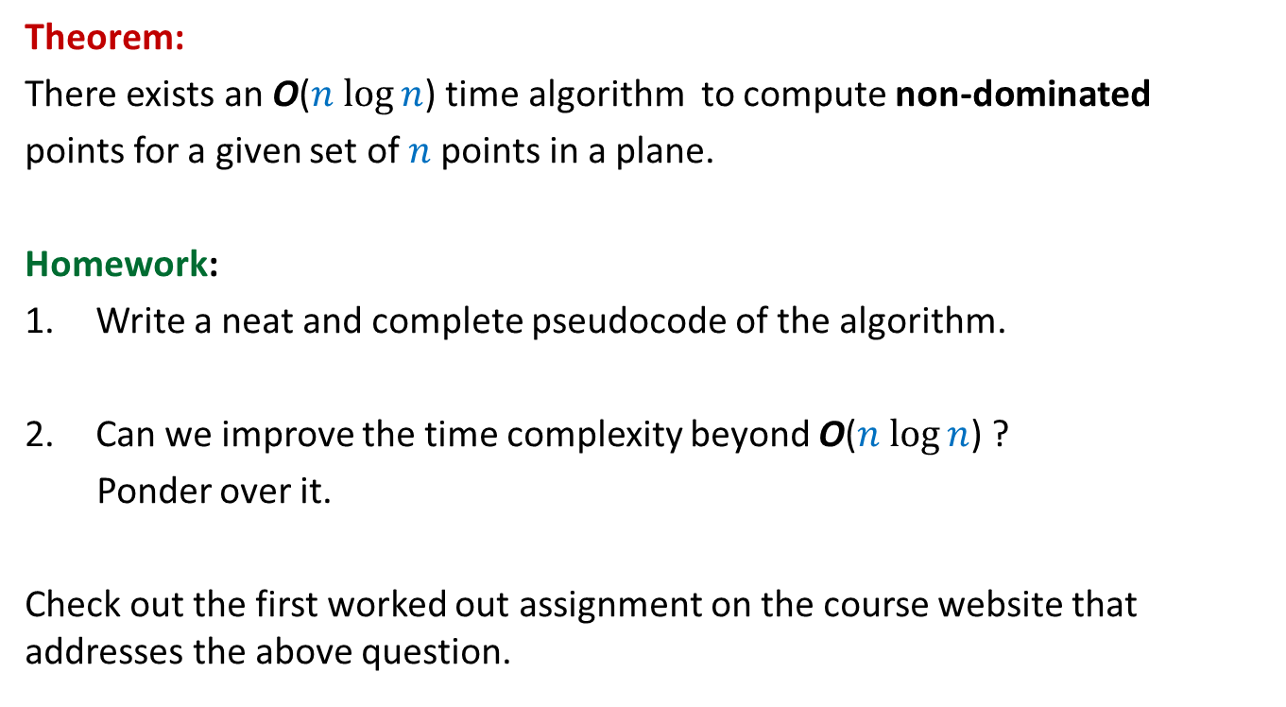
Theorem:
There exists an O($n$ $\log{n}$) time algorithm to compute non-dominated
points for a given set of $n$points in a plane.
Homework:
Write a neat and complete pseudocode of the algorithm.
Can we improve the time complexity beyond O($n$ $\log{n}$) ?
Ponder over it.
Check out the first worked out assignment on the course website that addresses the above question.

Slide 36
Homework from 1st class
The seat allocation algorithm for the single merit list.?
Can you now tackle the problem of multiple merit lists ?

Slide 37





Multiple Merit Lists
19 IITs
31 NITs
18 IIITs
33989 seats
1304127 candidates
18 OtherGFTIs

Slide 38
Fairness
Choice list of Mohan
p
q
p
Mohan
q
Ram
Merit list
of programme q
Ram
Mohan

Slide 39
How to tackle Multiple Merit Lists using “Single Merit list algorithm”

Slide 40

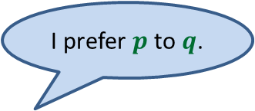







A common man’s algorithm
Allocation
IITs
Allocation
NITs
No
Should we remove from seat allocation in NITs for future rounds ?
$r$ →
Repeat
$q$ →
I prefer $p$to $q$.
$p$ or $q$ ?
$p$ →
$$p$$
$$r$$
$$q$$
Choice list for IITs
Choice list for NITs

Slide 41

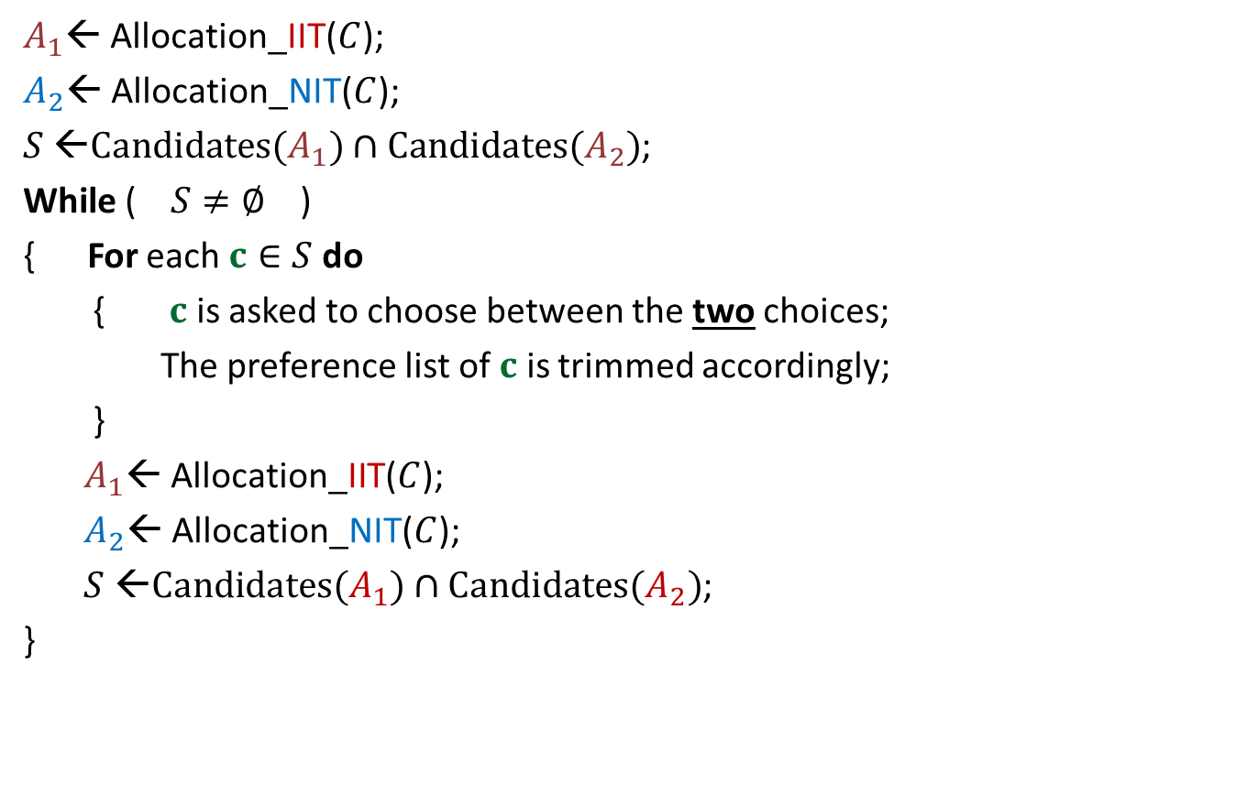


A common man’s algorithm
$A_{1}$← Allocation_IIT($C$);
$A_{2}$← Allocation_NIT($C$);
$S$ ←$Candidates(A_{1})∩Candidates(A_{2})$;
While ( $S≠∅$ )
{ For each $c∈S$ do
{ $c$ is asked to choose between the two choices;
The preference list of $c$ is trimmed accordingly;
}
$A_{1}$← Allocation_IIT($C$);
$A_{2}$← Allocation_NIT($C$);
$S$ ←$Candidates(A_{1})∩Candidates(A_{2})$;
}
Round ← $1$
and
Round $≤5$
)
Round ← Round + $1$
Homework (not for exam): Prove that the algorithm outputs a fair seat allocation.

Slide 42
Homework
Transform the common man’s algorithm to just 1 round ?

