Slide 1
Design and Analysis of Algorithms
CS345
Lecture 7
Greedy Paradigm - I

Slide 2
Homework from the last Lecture

Slide 3
Gayle Shapley Algorithm
Man-Proposing version
Proof of Man optimality

Slide 4
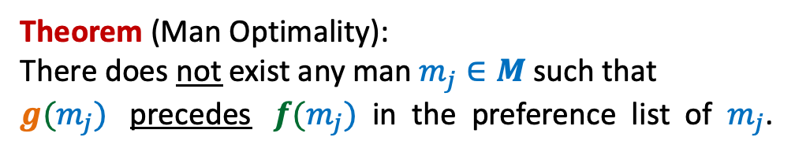

Let $f: M→W$be the matching produced by GS algorithm.
Let $g:M→W$ be any other stable matching.
Theorem (Man Optimality):
There does not exist any man $m_{j}∈M$such that
$g(m_{j})$ precedes $f(m_{j})$ in the preference list of $m_{j}$.

Slide 5
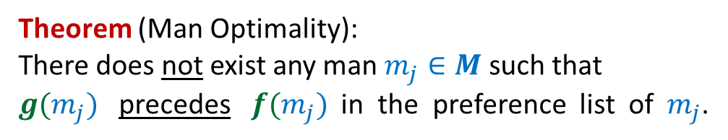

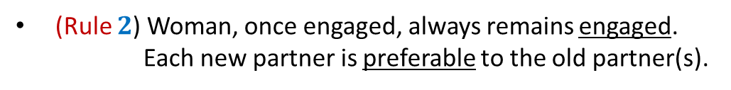
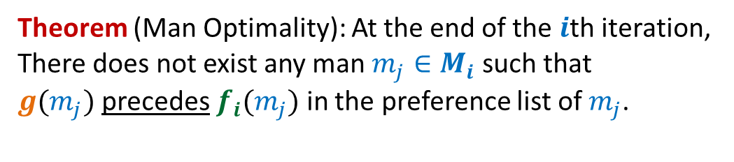
Theorem (Man Optimality):
There does not exist any man $m_{j}∈M$such that
$g(m_{j})$ precedes $f(m_{j})$ in the preference list of $m_{j}$.
At the end of the $i$th iteration,
$M_{i}:$ the set of men matched by GS algorithm.
$f_{i} :M_{i}→W$
Theorem (Man Optimality): At the end of the $i$th iteration,
There does not exist any man $m_{j}∈M_{i}$such that
$g(m_{j})$ precedes $f_{i}(m_{j})$ in the preference list of $m_{j}$.
Using these tools, we arrived at the proof interactively in the class.
The following slides show the steps. As a homework, fill in the proper arguments.
Tools used:
(Rule $1$) Each man propose in decreasing order of preference.
(Rule $2$) Woman, once engaged, always remains engaged.
Each new partner is preferable to the old partner(s).
The Induction Hypothesis

Slide 6
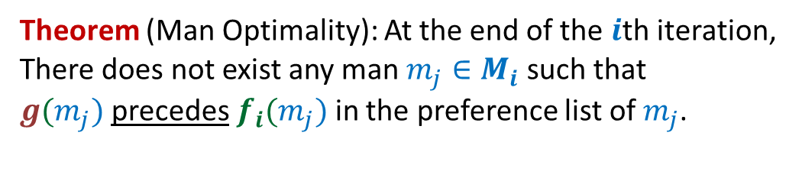


Theorem (Man Optimality): At the end of the $i$th iteration,
There does not exist any man $m_{j}∈M_{i}$such that
$g(m_{j})$ precedes $f_{i}(m_{j})$ in the preference list of $m_{j}$.
$$f_{i}$$
$$g$$

Slide 7

Theorem (Man Optimality): At the end of the $i$th iteration,
There does not exist any man $m_{j}∈M_{i}$such that
$g(m_{j})$ precedes $f_{i}(m_{j})$ in the preference list of $m_{j}$.
1st Iteration
$$f_{1}$$
$$g$$

Slide 8





Theorem (Man Optimality): At the end of the $i$th iteration,
There does not exist any man $m_{j}∈M_{i}$such that
$g(m_{j})$ precedes $f_{i}(m_{j})$ in the preference list of $m_{j}$.
$(i−1)$th iteration:
Execution of $i$th iteration:
$$f_{i−1}$$
$$m_{j}$$
$$g$$

Slide 9








Theorem (Man Optimality): At the end of the $i$th iteration,
There does not exist any man $m_{j}∈M_{i}$such that
$g(m_{j})$ precedes $f_{i}(m_{j})$ in the preference list of $m_{j}$.
Execution of $i$th iteration:
$$w_{j′}$$
$$m_{k}$$
$$w_{p}$$
$$m_{k}$$
$$w_{j}$$
$$m_{j}$$
$$f_{i}$$
$$w_{j′}$$
$$m_{j}$$
$g$ is not stable matching
$$g$$

Slide 10
Greedy Paradigm
Minimum Spanning Tree

Slide 11
Motivation:
A road or telecommunication network
Suppose there is a collection of possible links/roads that can be laid.
But laying down each possible link/road is costly.
Aim: To lay down least number of links/roads to ensure connectivity between each pair of nodes/cities.

Slide 12
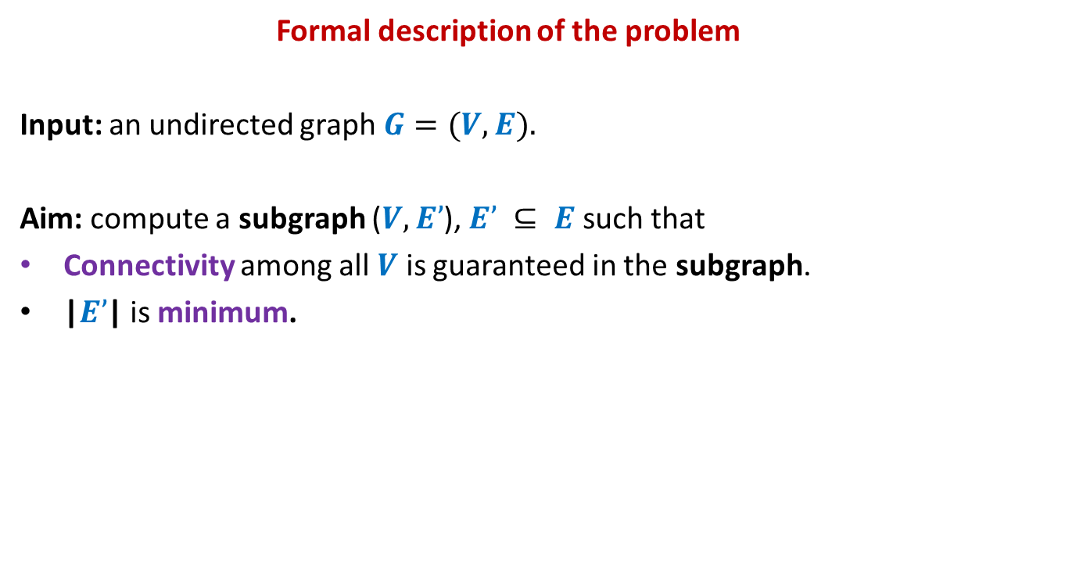
Formal description of the problem
Input: an undirected graph $G=(V,E).$
Aim: compute a subgraph ($V,E’$), $E’ ⊆ E$ such that
Connectivity among all $V$ is guaranteed in the subgraph.
|$E’$| is minimum.
How will such a subgraph look like ?

Slide 14
Is this subgraph meeting our requirement ?
No
Yes
No

Slide 15
A tree
The following definitions are equivalent.
An undirected graph which is connected but does not have any cycle.
An undirected graph where each pair of vertices has a unique path between them.
An undirected connected graph on $n$vertices and $n−1$edges.
An undirected graph on $n$vertices and $n−1$edges and without any cycle.

Slide 16

A Spanning tree
Definition: For an undirected graph ($V,E$),
A spanning tree is a subgraph ($V,E’$), $E’ ⊆ E$which is a tree.

Slide 17
Assign each edge a weight/cost.
170
54
33
63
35
50
70
31
41
81
64
78
53
52
80
49
54
42
60
44
50
30
49
57
29
102
Adding more reality to the problem

Slide 18

Problem Description
Input: an undirected graph $G=(V,E)$with w: $E → ℝ$,
Aim: compute a spanning tree ($V,E’$), $E’ ⊆ E$such that
$\sum_{eϵE’}{\text{w}(e)}$ is minimum.
Exponential number of spanning trees

Slide 19
A useful lesson for design of a graph algorithm
If you have a complicated algorithm for a graph problem, …
search for some graph theoretic property
to design simpler and more efficient algorithm

Slide 20
Two graph theoretic properties of MST
Cut property
Cycle property
Every algorithm till date is based on one of these properties!

Slide 21
Cut Property

Slide 22
Cut Property
Definition: For any subset $A$⊆ $V$, such that ∅≠ $A$ ≠ $V$,
cut($A$,$\overline{A}$) = { ($u$,$v$) ϵ $E$ | $u \text{ϵ} A$ and $v \text{ϵ} \overline{A}$ or $v \text{ϵ} A$ and $u \text{ϵ} \overline{A}$ }
Cut-property:
The least weight edge of a cut($A$,$\overline{A}$) must be in MST.
Pursuing greedy strategy to minimize weight of MST, what can we say about the edges of cut($A$, $\overline{A}$) ?
$$A$$
cut($A$,$\overline{A}$)
$$\overline{A}$$
48
67
37
v
13
u
23

Slide 23
Proof of cut-property
$$A$$
$$\overline{A}$$
48
67
37
v
13
u
23

Slide 24
Proof of cut-property
Let $T$ be the MST, and (u,v) $∉T$.
Question: What happens if we remove (x,y) from $T$, and add (u,v) to $T$.
$$\text{ϵ} \overline{A}$$
y
x
>13
$$\text{ϵ} A$$
$$\text{ϵ} A$$
v
13
$$\text{ϵ} \overline{A}$$
$$\text{ϵ} A$$
u
$$\text{ϵ} A$$

Slide 25
Proof of cut-property
Let $T$ be the MST, and (u,v) $∉T$.
Question: What happens if we remove (x,y) from $T$, and add (u,v) to $T$.
y
x
>13
v
13
u
We get a spanning tree $T′$ with weight < weight($T$)
A contradiction !

Slide 26
Cycle Property

Slide 27
Cycle Property
c
b
31
Let $C$ be any cycle in $G$.
Cycle-property:
Maximum weight edge of any cycle $C$can not be present in MST.
17
12
f
36
a
s
26
Pursuing greedy strategy to minimize weight of MST, what can we say about the edges of cycle $C$?
24
43
19
r
u
v
$$C$$

Slide 28
Proof of Cycle property
c
b
31
Let $T$ be the MST, and (u,v) $ϵ T$.
17
Some edge(s) of cycle $C$might already be present in $T$.
So how to pick an edge from $C$ to swap it with (u,v) to get another spanning tree.
f
We might like to replace (u,v) by some edge of cycle $C$? But how to find such an edge ?
12
36
a
s
26
24
43
19
r
u
v
$$C$$
43
u
v
$$T$$
b
c

Slide 29
Homework
Prove Cycle property of MST.

Slide 30
Algorithm based on cut Property

Slide 31
How to use cut property to compute a MST ?
There are exponential number of cuts. ☹
How to efficiently choose the cuts so that each cut gives us one edge of the MST ?
170
24
33
v
63
70
35
50
70
31
41
81
64
78
53
u
42
52
80
49
54
42
60
44
43
50
30
49
57
29
102

Slide 32
How to use cut property to compute a MST ?
170
w
24
33
v
63
70
35
50
70
31
41
81
64
78
53
u
42
52
80
49
54
42
60
44
43
50
30
49
57
29
102

Slide 33
How to use cut property to compute a MST ?
170
w
24
33
v
63
70
35
50
x
31
70
41
81
64
78
53
u
42
52
80
49
54
42
60
44
43
50
30
49
57
29
102

Slide 34
How to use cut property to compute a MST ?
170
w
24
33
v
63
70
35
50
x
31
70
41
81
64
78
53
u
y
42
52
80
49
54
42
60
44
43
50
30
49
57
29
102

Slide 35
How to use cut property to compute a MST ?
170
w
24
33
v
63
70
35
50
x
31
70
41
81
64
78
53
u
y
42
52
80
49
54
42
60
44
43
50
30
49
57
29
102

Slide 36
How to use cut property to compute a MST ?
170
w
24
33
v
63
70
35
50
x
31
70
41
81
64
78
53
u
y
42
52
80
49
54
42
60
44
43
50
30
49
57
29
102

Slide 37
An Algorithm based on cut property
Algorithm (Input: graph $G$=($V$,$E$) with weights on edges)
$T$← ∅;
$A$← {u};
While ( ?? ) do
{ Compute the least weight edge from cut($A$,$\overline{A}$);
Let this edge be (x,y), with xϵ $A$, yϵ $\overline{A}$;
$T$← $T∪${(x, y)};
$A$← $A$ $∪${y};
}
Return$T$;
Number of iterations of the While loop : ??
Time spent in one iteration of While loop: ??
Running time of the algorithm: O($mn$)
Homework:
How to improve the running time to O($m log n$)
$A<>$ $V$
$$n−1$$
$$\text{O}\text{(}m\text{)}$$

Slide 38
Algorithm based on cycle Property

Slide 39
An Algorithm based on cycle property
Description
Algorithm (Input: graph $G$=($V$,$E$) with weights on edges)
While ( ?? ) do
{
Compute any cycle $C$;
Let (u,v) be the maximum weight edge of the cycle $C$;
Remove (u,v) from $E$;
}
Return$E$;
Number of iterations of the While loop : ??
Time spent in one iteration of While loop: ??
➔ Running time of the algorithm: O($mn$)
$E$has any cycle
$$m−n+1$$
$$\text{O}\text{(}n\text{)}$$
BFS/DFS Traversal

Slide 40
Homework
Sort the edges in increasing order of weights.
$$e_{1}, e_{2},…e_{m}$$
$T$← ∅
For ( $i$= 1 to $m$) do
{
Let (u,v) be the endpoints of $e_{i}$
if … add $e_{i}$ to $T$;
}
Return$T$;
Fill in the blanks …

