Slide 1
Design and Analysis of Algorithms
CS345
Lecture 8
Greedy Paradigm - II
Job scheduling problems

Slide 2
Problem 1

Slide 3

Path to the solution of a problem
Examples
intuition/insight
Strategy
Have perseverance
Failure ☹
Better Insight ☺
No formula
But there is a systematic approach which usually works ☺
Success ☺

Slide 4
Today’s lecture will demonstrate this approach ☺
Problem : JOB Scheduling
Largest subset of non-overlapping job

Slide 5
A job scheduling problem
Formal Description
INPUT:
A set $J$of $n$ jobs {$j_{1}$, $j_{2}$,…, $j_{n}$}
job $j_{i}$ is specified by two real numbers
s($i$): start time of job $j_{i}$
f($i$): finish time of job $j_{i}$
A single server
Constraints:
Server can execute at most one job at any moment of time.
Job $j_{i}$, if scheduled, has to be scheduled during [s($i$), f($i$)] only.
Aim:
To select the largest subset of non-overlapping jobs.

Slide 6
Example
INPUT: ($1$, $2$), ($1.2$, $2.8$), ($1.8$, $4.6$), ($2.1$, $3$), ($3$, $5$), ($3.3$, $4.2$), ($3.9$, $4.4$), ($4.3$, $5.4$)
job $i$ is said to be non-overlapping with job $k$if [s($i$), f($i$)] ∩[s($k$), f($k$)] = ∅
0 1 2 3 4 5 6 7
It makes sense to work with pictures than these numbers☺
Try to find solution for the above example.

Slide 7
Example
INPUT: ($1$, $2$), ($1.2$, $2.8$), ($1.8$, $4.6$), ($2.1$, $3$), ($3$, $5$), ($3.3$, $4.2$), ($3.9$, $4.4$), ($4.3$, $5.4$)
job $i$ is said to be non-overlapping with job $k$if [s($i$), f($i$)] ∩[s($k$), f($k$)] = ∅
0 1 2 3 4 5 6 7
What strategy come to your mind?

Slide 8
Designing algorithm for any problem
Choose a strategy based on some intuition
Transform the strategy into an algorithm.
Try to prove
correctness
of the
algorithm
c
Try to design a
conterexample
c
Stop as soon as either of these goals is reached

Slide 9
Designing algorithm for the problem
Strategy 1: Select the earliest start time job
Intuition:
It might be better to assign jobs as early as possible so as to make optimum use of server.
0 1 2 3 4 5 6 7
When one fails to prove the correctness of this strategy, one should search for a counterexample. Can you transform the above example into a counterexample ?

Slide 10
Designing algorithm for the problem
Strategy 1: Select the earliest start time job
0 1 2 3 4 5 6 7

Slide 11
Designing algorithm for the problem
Strategy 1: Select the earliest start time job
0 1 2 3 4 5 6 7
Instead of getting disappointed, try to realize that this counterexample points towards some other strategy which might work.
counterexample. ☹

Slide 12
Designing algorithm for the problem
Strategy 2: Select the job with smallest duration
Intuition:
Such a job will make least use of the server
➔ this might lead to larger number of jobs to be executed
0 1 2 3 4 5 6 7
When one fails to prove the correctness of this strategy, one should search for a counterexample. Can you transform the above example into a counterexample ?

Slide 13
Designing algorithm for the problem
Strategy 2: Select the job with smallest duration
Intuition:
Such a job will make least use of the server
➔ this might lead to larger number of jobs to be executed
0 1 2 3 4 5 6 7
Instead of getting disappointed, try to realize that this counterexample points towards some other strategy which might work.
counterexample. ☹

Slide 14
Designing algorithm for the problem
Strategy 3: Select the job with smallest no. of overlaps
Intuition:
Selecting such a job will result in least number of other jobs to be discarded.
0 1 2 3 4 5 6 7

Slide 15

Designing algorithm for the problem
Strategy 3: Select the job with smallest no. of overlaps
Hint:
Add a few more jobs so that we pick only $3$ jobs with this strategy
although the optimal solution has $4$ jobs.
0 1 2 3 4 5 6 7
Give a counter example for this strategy.

Slide 16
Designing algorithm for the problem
Strategy 3: Select the job with smallest no. of overlaps
0 1 2 3 4 5 6 7
counterexample.

Slide 17
Designing algorithm for the problem
Strategy 4: Select the job with earliest finish time
Intuition:
Selecting such a job will free the server earliest
➔ hence more no. of jobs might get scheduled.
0 1 2 3 4 5 6 7

Slide 18
Designing algorithm for the problem
Strategy 4: Select the job with earliest finish time
Intuition:
Selecting such a job will free the server earliest
➔ hence more no. of jobs might get scheduled.
0 1 2 3 4 5 6 7
It is indeed a correct solution for this example. We should try to prove the correctness of the algorithm.☺But first we give a full description of the algorithm based on this strategy.

Slide 19
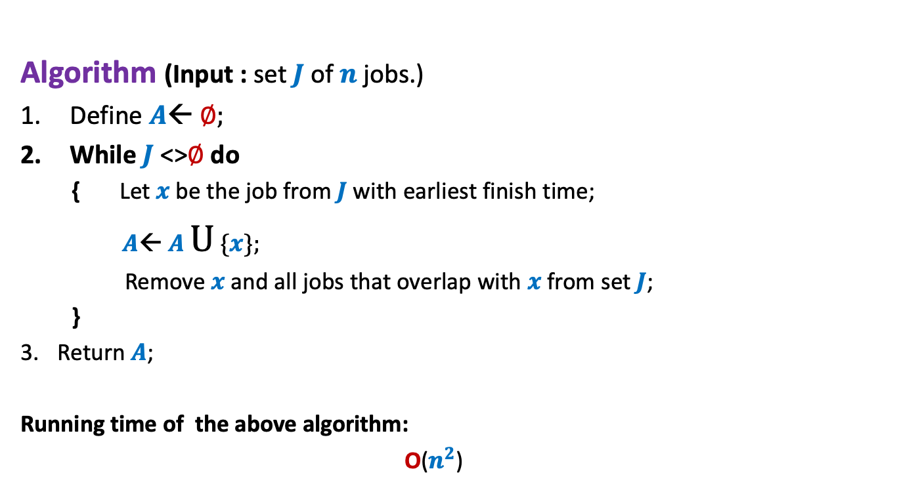
Algorithm “earliest finish time”
Description
Algorithm (Input : set $J$of $n$ jobs.)
Define $A$← ∅;
While $J$<>∅ do
{ Let $x$be the job from $J$with earliest finish time;
$A$← $A$ U {$x$};
Remove $x$and all jobs that overlap with $x$from set $J$;
}
Return $A$;
Running time of the above algorithm:
O($n^{2}$)

Slide 20

Algorithm “earliest finish time”
Correctness
Let $x$ be the job with earliest finish time.
Lemma1: $x$is present in the optimal solution for $J$.
Too strong a claim !
Wrong
0 1 2 3 4 5 6 7

Slide 21
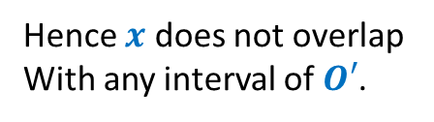






Algorithm “earliest finish time”
Correctness
Let $x$ be the job with earliest finish time.
Lemma1: There exists an optimal solution for $J$in which $x$is present.
Proof: Consider any optimal solution $O$ for $J$. Let us suppose $x$∉ $O$.
Let $y$ be the job from $O$ with earliest finish time.
Let $O′$← $O\backslash \{y\}$
So $O^{′}∪\{x\}$ is also an optimal solution.
Reason: $O^{′}∪\{x\}$ has no overlapping intervals and has the same cardinality as $O$.
➔f($x$) $≤$ f($y$)
➔f($y$) < s($z$) $∀$ $z∈$ $O′$
➔f($x$) < s($z$) $∀$ $z∈$ $O′$
$$x$$
Hence $x$ does not overlap
With any interval of $O′$.
$$y$$
0 1 2 3 4 5 6 7
Homework: Is the lemma sufficient for the correctness of the algorithm ? Ponder over it…

Slide 22

Homework
Design an O($n$log $n$) implementation of the algorithm.

Slide 23
Problem 2

Slide 24





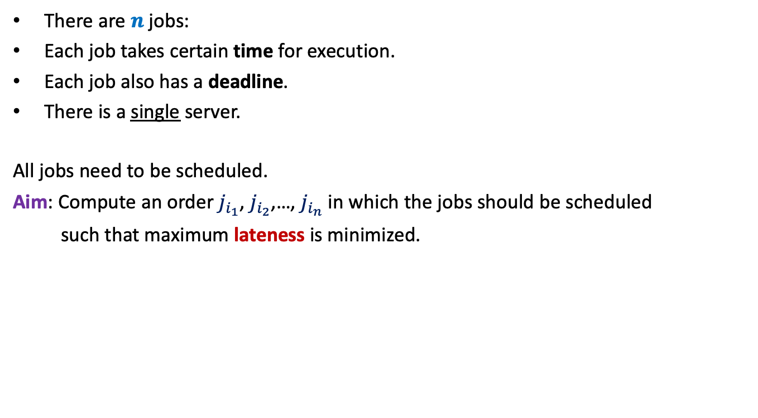








There are $n$ jobs:
Each job takes certain time for execution.
Each job also has a deadline.
There is a single server.
All jobs need to be scheduled.
Aim: Compute an order $j_{i_{1}}$, $j_{i_{2}}$,…, $j_{i_{n}}$ in which the jobs should be scheduled
such that maximum lateness is minimized.
$j_{1}$, $j_{2}$,…, $j_{n}$
Job $j_{i}$ takes $t_{i}$ time
Job $j_{i}$ has deadline $d_{i}$
$$f_{i_{k}}$$
$$d_{i_{k}}$$
$$d_{i_{k}}$$
Lateness of $j_{i_{k}}$
$$j_{i_{1}}$$
$$j_{i_{2}}$$
$$j_{i_{3}}$$
$$j_{i_{k}}$$
$$j_{i_{n}}$$
$$0$$
time

Slide 25





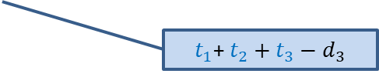



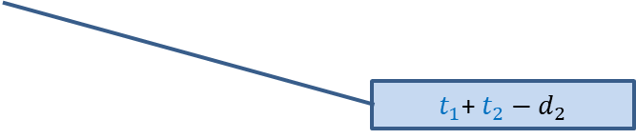




Example
$$t_{1}$$
$$j_{1}$$
$$d_{1}$$
$$t_{2}$$
$$j_{2}$$
$$d_{2}$$
$$t_{3}$$
$t_{1}$+ $t_{2}−d_{2}$
$$j_{3}$$
$$d_{3}$$
$t_{1}$+ $t_{2}+t_{3}−d_{3}$
$$j_{1}$$
$$j_{2}$$
$$j_{3}$$
time

Slide 26



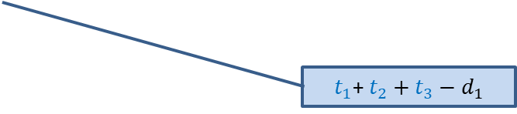
Example
$$t_{1}$$
$$j_{1}$$
$$d_{1}$$
$$t_{2}$$
$t_{1}$+ $t_{2}+t_{3}−d_{1}$
$$j_{2}$$
$$d_{2}$$
$$t_{3}$$
$$j_{3}$$
$$d_{3}$$
$$j_{2}$$
$$j_{3}$$
$$j_{1}$$
time

Slide 27

Towards designing an algorithm
Each job $j_{i}$ has two parameters
Time of execution $t_{i}$
Deadline $d_{i}$
Idea 1: Schedule the jobs in the increasing order of Time of execution.
Try to prove correctness
Try to come up with a counter example
Homework: Pursue this idea

Slide 28
Huffman Codes
A novel and quite inspiring application of greedy algorithms

Slide 29

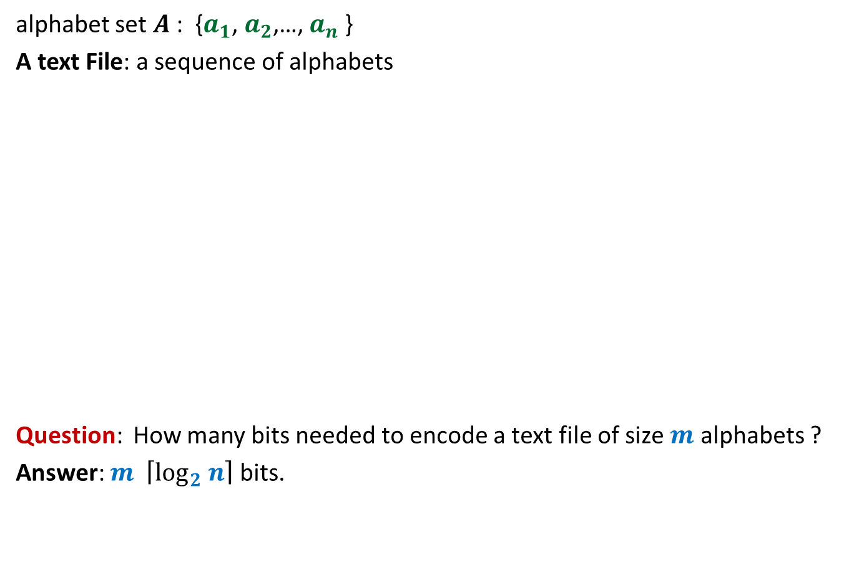
Binary coding
alphabet set $A$: {$a_{1}$, $a_{2}$,…, $a_{n}$ }
A text File: a sequence of alphabets
Question: How many bits needed to encode a text file of size $m$ alphabets ?
Answer: $m \left\lceil \log_{2} n\right\rceil$ bits.
once upon a time …………..
…………………………….
……………………………..
…………………
A text file F
Binary coding of F

Slide 30
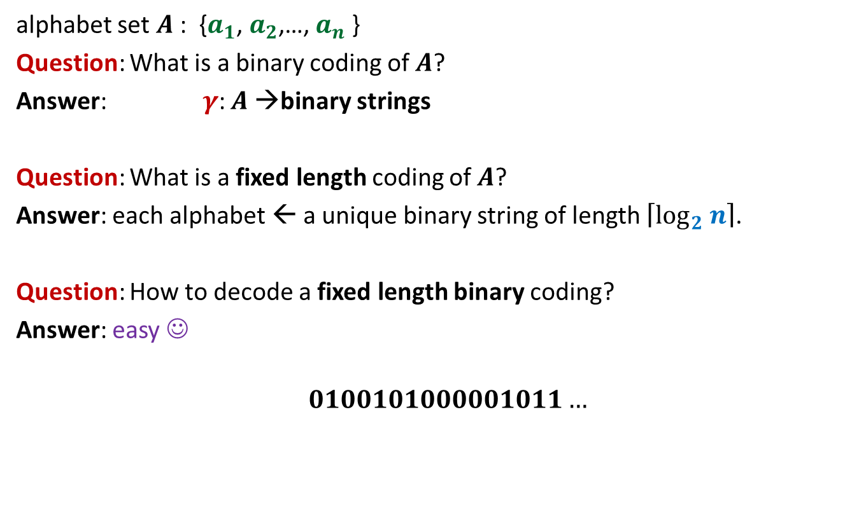
Fixed length coding
alphabet set $A$: {$a_{1}$, $a_{2}$,…, $a_{n}$ }
Question: What is a binary coding of $A$?
Answer: $γ$: $A$→binary strings
Question: What is a fixed length coding of $A$?
Answer: each alphabet ← a unique binary string of length $\left\lceil \log_{2} n\right\rceil$.
Question: How to decode a fixed length binary coding?
Answer: easy ☺
$$0100101000001011…$$

Slide 31
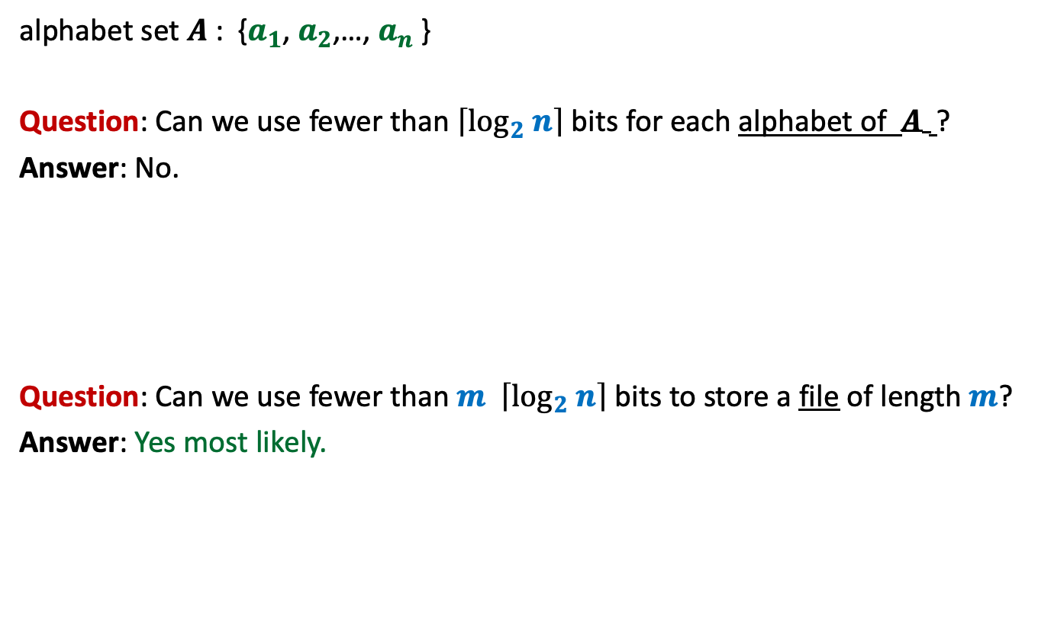
Fixed length coding
alphabet set $A$: {$a_{1}$, $a_{2}$,…, $a_{n}$ }
Question: Can we use fewer than $\left\lceil \log_{2} n\right\rceil$ bits for each alphabet of $A$ ?
Answer: No.
Question: Can we use fewer than $m \left\lceil \log_{2} n\right\rceil$ bits to store a file of length $m$?
Answer: Yes most likely.

Slide 32
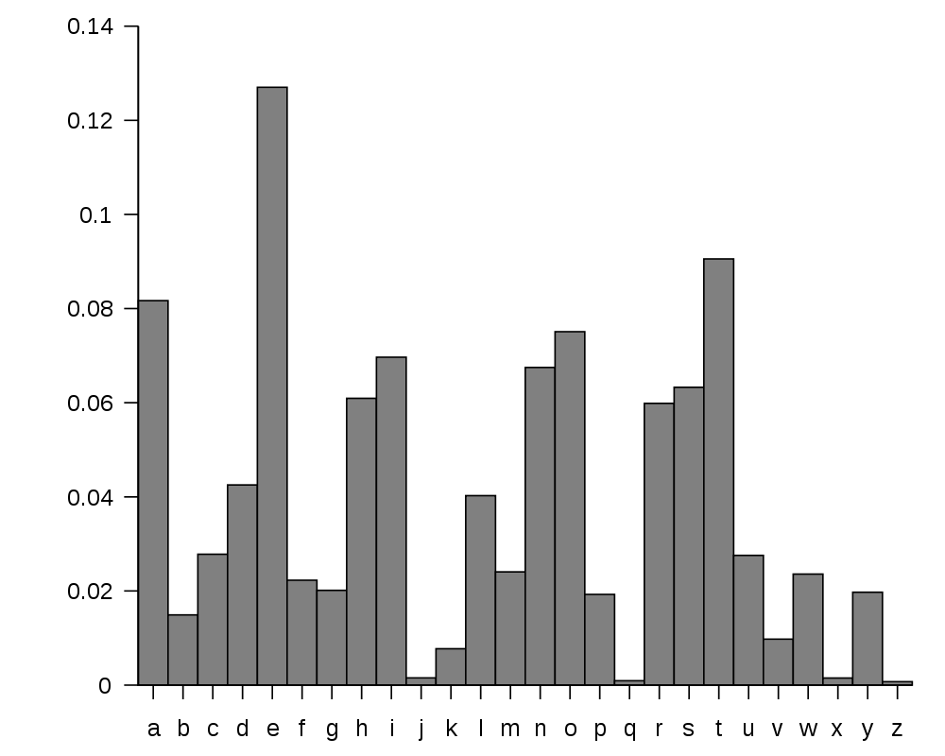
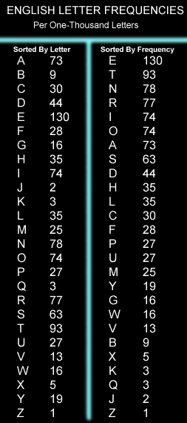
huge variation in the frequency of alphabets in a text.
http://en.wikipedia.org/wiki/Letter_frequency

Slide 33
huge variation in the frequency of alphabets in a text.
Question: How to exploit variation in the frequencies of alphabets ?
Answer:
More frequent alphabets ⬅ coding with shorter bit string
Less frequent alphabets ⬅ coding with longer bit string

Slide 34

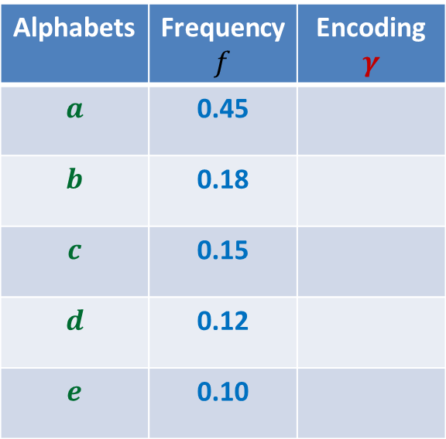

Variable length encoding
Let us think of some encoding exploiting
the variation in frequencies.
Average bit length per symbol using $γ$:
$$ABL\left(γ\right)=\sum_{x∈A}{f\left(x\right).\left|γ\left(x\right)\right|}$$
$=$ $0.45⨯1+0.18⨯2+(0.15+0.12+0.10)⨯3$
$=$ $1.92$
?
?
Alphabets | Frequency $f$ | Encoding $$γ$$
$$a$$ | 0.45
$$b$$ | 0.18
$$c$$ | 0.15
$$d$$ | 0.12
$$e$$ | 0.10
0
10
110
101
There is a serious problem with the $γ$encoding. Can you see?
111
Homework: Ponder over it.

