Slide 1
Design and Analysis of Algorithms
CS345
Lecture 9
Greedy Paradigm - III

Slide 2
Homework from the past
Prove Cycle property of MST.

Slide 3
Cycle Property
c
b
31
Let $C$ be any cycle in $G$.
Cycle-property:
Maximum weight edge of any cycle $C$can not be present in MST.
17
12
f
36
a
s
26
Pursuing greedy strategy to minimize weight of MST, what can we say about the edges of cycle $C$?
24
43
19
r
u
v
$$C$$

Slide 4
Proof of Cycle property
c
b
31
Let $T$ be the MST, and (u,v) $ϵ T$.
17
We might like to replace (u,v) by some edge of cycle $C$? But how to find such an edge ?
12
f
36
a
s
26
24
43
19
r
u
v
$$C$$
43
u
v
$$T$$

Slide 5
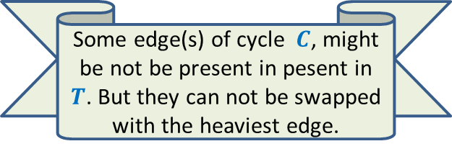
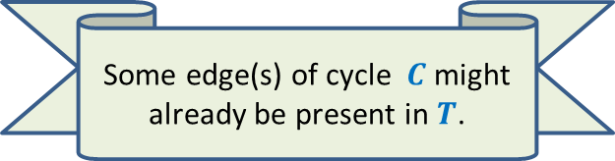
Proof of Cycle property
c
b
31
Let $T$ be the MST, and (u,v) $ϵ T$.
17
12
f
Some edge(s) of cycle $C$might already be present in $T$.
36
Some edge(s) of cycle $C$, might be not be present in pesent in $T$. But they can not be swapped with the heaviest edge.
a
s
26
24
43
19
r
u
v
$$C$$
43
u
v
$$T$$
b
c

Slide 6
Proof of Cycle property
c
b
31
Let $T$ be the MST, and (u,v) $ϵ T$.
17
How to find the edge that canbe swapped with the heaviest edge to get a spanning tree ?
12
f
Some edge(s) of cycle $C$, might be not be present in pesent in $T$. But they can not be swapped with the heaviest edge.
36
a
s
26
24
43
19
r
u
v
$$C$$
c
43
u
v
$$T$$
b
We shall use some graph theory to address this issue.

Slide 7
Fundamental Cycles
Definition: For an undirected graph (V,E),
A spanning tree is a subgraph (V,E’), E’ ⊆ E which is a tree.
$$T$$
$n−1$ tree edges
$m−n+1$ non-tree edges

Slide 8
Fundamental Cycles
Definition: For an undirected graph (V,E),
A spanning tree is a subgraph (V,E’), E’ ⊆ E which is a tree.
Each non tree edge and $T$ define a unique cycle. Can you spot them ?
These cycles are called fundamental cycles induced by $T$.
There are total $m−n+1$ such cycles.
y
x
$$T$$
x
y
y
x

Slide 9
Fundamental Cycles
Definition: For an undirected graph (V,E),
A spanning tree is a subgraph (V,E’), E’ ⊆ E which is a tree.
Observation: Let $e$ be any non-tree edge.
Let $C$ be the fundamental cycle defined by $e$ with respect to $T$.
Swapping $e$ with any other edge of $C$ gives us another spanning tree.
y
x
$$T$$

Slide 10
Fundamental Cycles
Definition: For an undirected graph (V,E),
A spanning tree is a subgraph (V,E’), E’ ⊆ E which is a tree.
Observation: Let $e$ be any non-tree edge.
Let $C$ be the fundamental cycle defined by $e$ with respect to $T$.
Swapping $e$ with any other edge of $C$ gives us another spanning tree.
Can you use this Observation to prove Cycle Property ? Make attempts …☺
y
x
$$T$$

Slide 11
Proof of Cycle property
c
b
31
Let $T$ be the MST, and (u,v) $ϵ T$.
17
12
f
For non-tree edge (f, s), tree edge (u, v) lies in the fundamental cycle.
So we can swap them. ☺_
36
There must exist an edge from $C$ that goes to the other side of the blue dotted line cutting (u, v).
Let us traverse the cycle from u. Watch carefully how its vertices appear in $T$.
a
s
26
24
43
19
r
u
v
$$C$$
a
24
43
u
v
12
$$T$$
s
17
c
b
31
f
36

Slide 12
Proof of Cycle property
c
b
31
Let $T$ be the MST, and (u,v) $ϵ T$.
17
12
f
We get another spanning tree of weight less than that of MST. – A contradiction. ☺
36
a
s
26
24
43
19
r
u
v
$$C$$
43
u
v
$$T$$
s
f
36

Slide 13
Recap of the last lecture

Slide 14





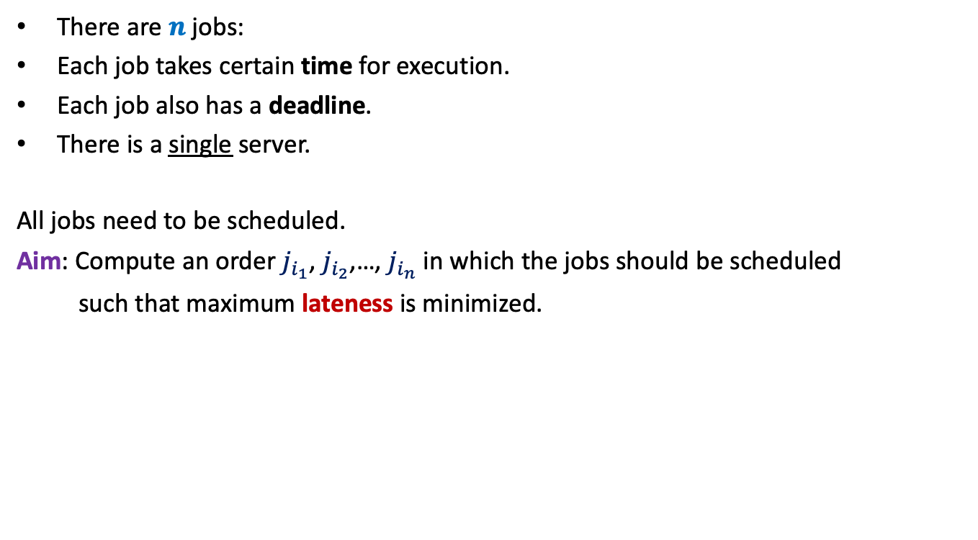








There are $n$ jobs:
Each job takes certain time for execution.
Each job also has a deadline.
There is a single server.
All jobs need to be scheduled.
Aim: Compute an order $j_{i_{1}}$, $j_{i_{2}}$,…, $j_{i_{n}}$ in which the jobs should be scheduled
such that maximum lateness is minimized.
$j_{1}$, $j_{2}$,…, $j_{n}$
Job $j_{i}$ takes $t_{i}$ time
Job $j_{i}$ has deadline $d_{i}$
$$f_{i_{k}}$$
$$d_{i_{k}}$$
$$d_{i_{k}}$$
Lateness of $j_{i_{k}}$
$$j_{i_{1}}$$
$$j_{i_{2}}$$
$$j_{i_{3}}$$
$$j_{i_{k}}$$
$$j_{i_{n}}$$
$$0$$
time

Slide 15





















Example
$$3$$
$$j_{1}$$
Lateness of $j_{1}$=
$$0$$
$$d_{1}=11$$
Lateness of $j_{2}$=
$$1.5$$
$$4.5$$
Lateness of $j_{3}$=
$$3$$
$$j_{2}$$
$$d_{2}=6$$
Maximum lateness = 3
$$5.5$$
$$j_{3}$$
$$d_{3}=10$$
$$3$$
$$7.5$$
$$13$$
$$j_{1}$$
$$j_{2}$$
$$j_{3}$$
$$0$$
time

Slide 16

Towards designing an algorithm
Each job $j_{i}$ has two parameters
Time of execution $t_{i}$
Deadline $d_{i}$
Idea 1: Schedule the jobs in the increasing order of Time of execution.
Try to prove correctness
Try to come up with a counter example

Slide 17





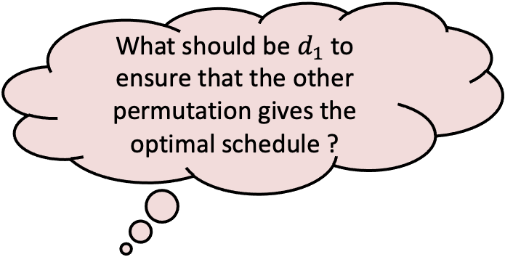


Towards designing a counterexample
Let us consider only 2 jobs.
What should be $d_{1}$ to ensure that the other permutation gives the optimal schedule ?
$$t_{1}$$
$$j_{1}$$
$$t_{2}$$
$$j_{2}$$
$$d_{2}$$
$$j_{1}$$
$$j_{2}$$
time

Slide 18

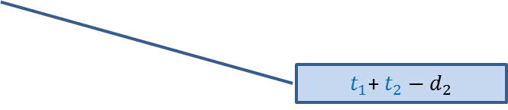

Towards designing a counterexample
Towards designing an algorithm
The job with farther deadline should be scheduled later.
the job with earlier deadline should be scheduled first.
$$t_{1}$$
This counterexample hints at a very important point as well.
$$j_{1}$$
?
$$d_{1}$$
$$t_{2}$$
$t_{1}$+ $t_{2}−d_{1}$
$$j_{2}$$
?
$$d_{2}$$
$t_{1}$+ $t_{2}−d_{2}$
$$j_{1}$$
$$j_{2}$$
time

Slide 19
How to schedule more than 2 jobs ?
time
$$0$$

Slide 20
How to schedule more than 2 jobs ?
All other jobs remain unaffected.
The maximum lateness for these 2 jobs
Can only reduce.
What happens if we just swap these 2 jobs only.
Homework:
Write a neat pseudocode of an efficient algorithm for this problem.
Write a formal proof of correctness of the algorithm.
time
$$0$$

Slide 21
Huffman Codes
A novel and quite inspiring application of greedy algorithms

Slide 22
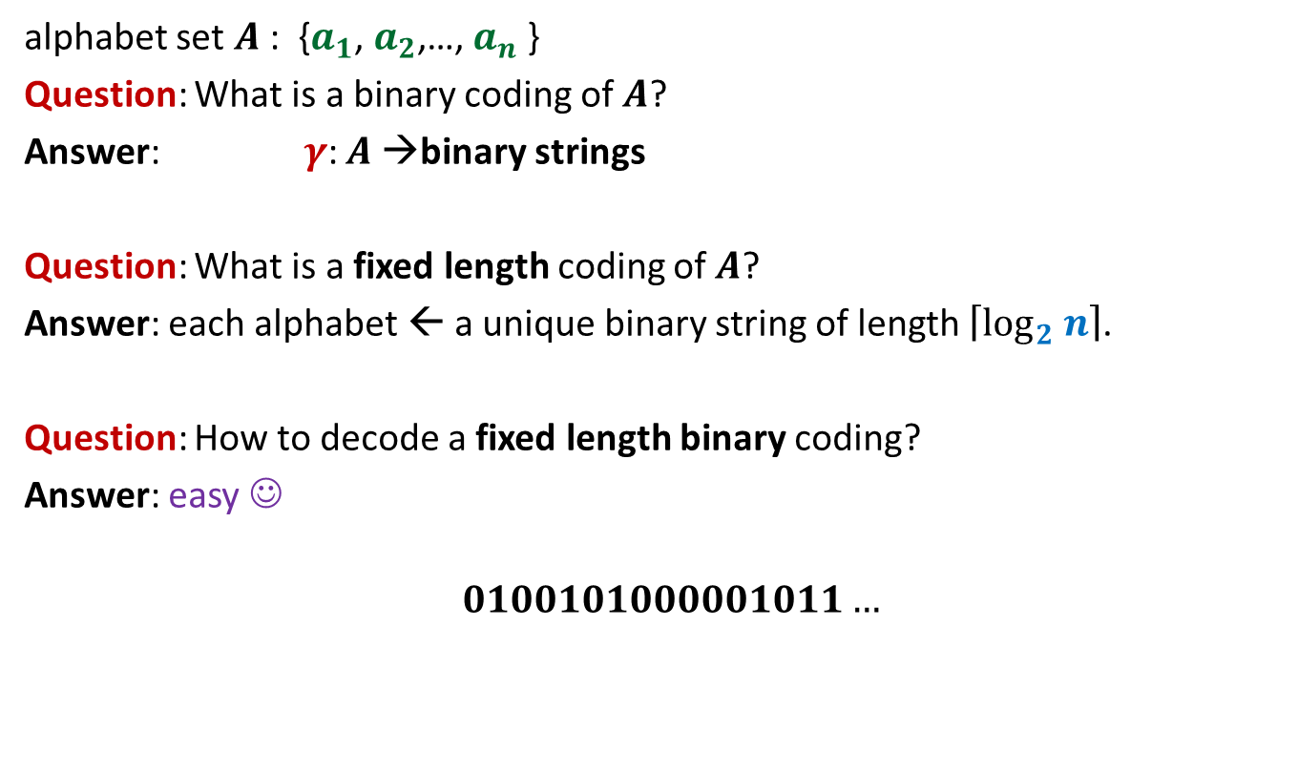
Fixed length coding
alphabet set $A$: {$a_{1}$, $a_{2}$,…, $a_{n}$ }
Question: What is a binary coding of $A$?
Answer: $γ$: $A$→binary strings
Question: What is a fixed length coding of $A$?
Answer: each alphabet ← a unique binary string of length $\left\lceil \log_{2} n\right\rceil$.
Question: How to decode a fixed length binary coding?
Answer: easy ☺
$$0100101000001011…$$

Slide 23
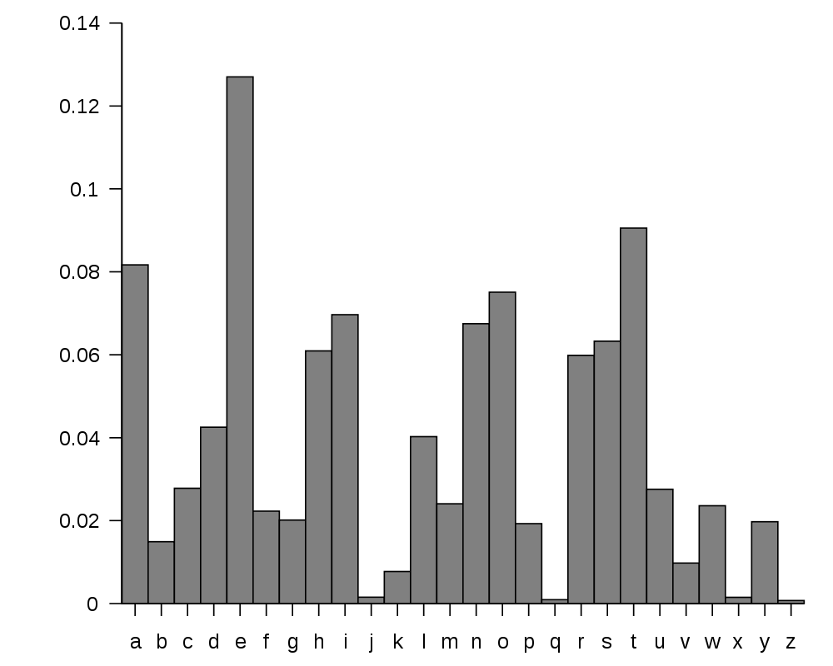
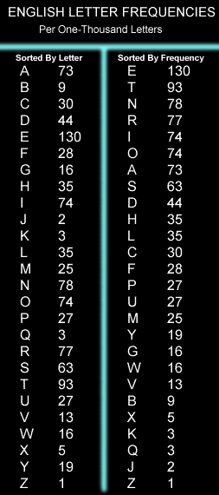
huge variation in the frequency of alphabets in a text.
http://en.wikipedia.org/wiki/Letter_frequency

Slide 24
huge variation in the frequency of alphabets in a text.
Question: How to exploit variation in the frequencies of alphabets ?
Answer:
More frequent alphabets ⬅ coding with shorter bit string
Less frequent alphabets ⬅ coding with longer bit string

Slide 25

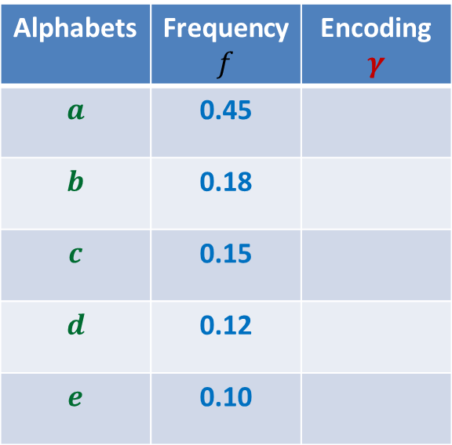
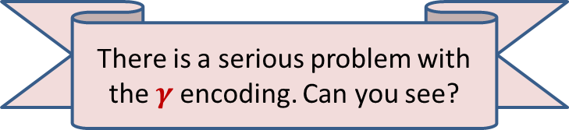
Variable length encoding
Let us think of some encoding exploiting
the variation in frequencies.
Average bit length per symbol using $γ$:
$$ABL\left(γ\right)=\sum_{x∈A}{f\left(x\right).\left|γ\left(x\right)\right|}$$
$=$ $0.45⨯1+0.18⨯2+(0.15+0.12+0.10)⨯3$
$=$ $1.92$
Question: How will you decode 01010111 ?
Answer: $abbe$ or $adae$
Question: What is the source of this ambiguity ?
Answer: $γ\left(b\right)$ is a prefix of $γ\left(d\right)$.
?
?
Alphabets | Frequency $f$ | Encoding $$γ$$
$$a$$ | 0.45
$$b$$ | 0.18
$$c$$ | 0.15
$$d$$ | 0.12
$$e$$ | 0.10
0
10
110
101
111
There is a serious problem with the $γ$encoding. Can you see?
Can we fix it ?

Slide 26

Variable length encoding
Average bit length per alphabet using $γ$:
$$ABL\left(γ\right)=\sum_{x∈A}{f\left(x\right).\left|γ\left(x\right)\right|}$$
$=$ $0.45⨯1+0.18⨯3+(0.15+0.12+0.10)⨯3$
$=$ $2.1$
Alphabets | Frequency $f$ | Encoding $$γ$$
$$a$$ | 0.45
$$b$$ | 0.18
$$c$$ | 0.15
$$d$$ | 0.12
$$e$$ | 0.10
0
100
110
101
111

Slide 27
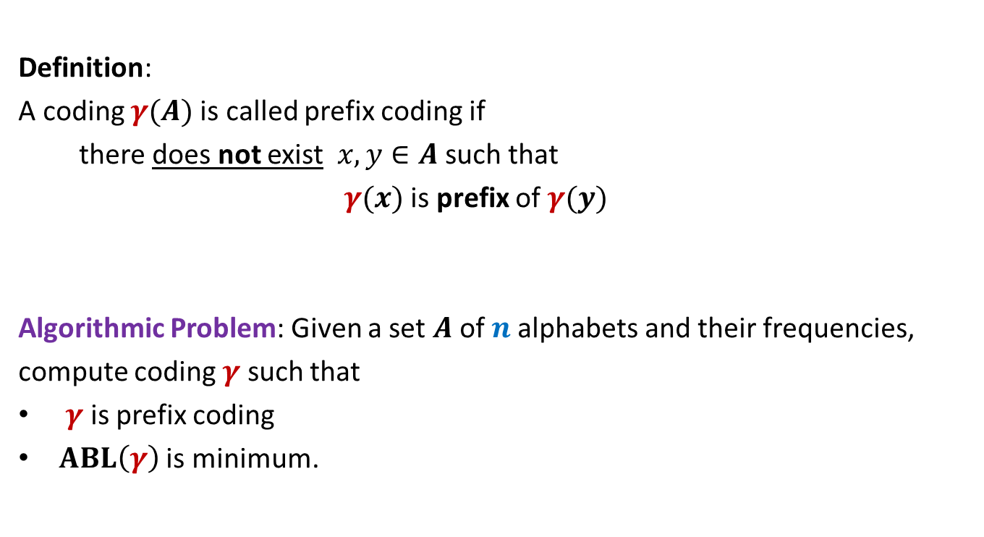
Prefix Coding
Definition:
A coding $γ(A)$is called prefix coding if
there does not exist $x,y∈A$ such that
$γ(x)$ is prefix of $γ(y)$
Algorithmic Problem: Given a set $A$of $n$alphabets and their frequencies,
compute coding $γ$ such that
$γ$ is prefix coding
$ABL\left(γ\right)$ is minimum.

Slide 28

The challenge of the problem
Among all possible binary coding of $A$, how to find the optimal prefix coding ?
It looks too complex ☹ because …
it is too difficult to see any structure underlying the set of binary strings

Slide 29
The novel idea of Huffman
?
0
1
Each encoding
0
1
0
1
Labeled
Binary tree

Slide 30
A labeled binary tree
How can a labeled binary tree be interpreted as a encoding of a set of alphabets ?
nodes → ?
Code of an alphabet = ?
0
1
0,
00,
001
01,
1,
10,
100,
101
0
1
0
1
0
1
alphabets
Label of path from root

Slide 31
prefix codes and labeled Binary tree

Slide 32
A labeled binary tree
Consider a prefix code 101
0
1
1
0
Visualize a binary tree for the prefix coding ?
0
1
Some nodes are forbidden to represent any alphabet. Can you spot them ?

Slide 33
A labeled binary tree
0
1
0
1
1
0
0
1
0
1
0
1
0
1
So how can a labeled tree represent a prefix coding ?

Slide 34
A labeled binary tree
leaf nodes → alphabets
Code of an alphabet =
0
1
01,
001,
0000,
11,
100,
10110,
10111
0
1
1
0
0
1
0
1
0
1
0
1
Label of path from root

Slide 35
Homework
Design an algorithm that given a prefix coding for a set of alphabets, builds the corresponding labeled binary tree.
The algorithm is sketched on the following slide.

Slide 36

Prefix Coding
Question:
How to build the labeled tree for a prefix code ?
Alphabets | Frequency $f$ | Encoding $$γ$$
$$a$$ | 0.45
$$b$$ | 0.18
$$c$$ | 0.15
$$d$$ | 0.12
$$e$$ | 0.10
0
{0, 100, 101, 110, 111}
0
1
100
110
{00,01,10,11}
$$a$$
101
111

Slide 37
Prefix Coding
Question:
How to build the labeled tree for a prefix code ?
Alphabets | Frequency $f$ | Encoding $$γ$$
$$a$$ | 0.45
$$b$$ | 0.18
$$c$$ | 0.15
$$d$$ | 0.12
$$e$$ | 0.10
0
0
1
100
110
0
1
$$a$$
101
{0,1}
{0,1}
111

Slide 38




Prefix Coding
Question:
How to build the labeled tree for a prefix code ?
Alphabets | Frequency $f$ | Encoding $$γ$$
$$a$$ | 0.45
$$b$$ | 0.18
$$c$$ | 0.15
$$d$$ | 0.12
$$e$$ | 0.10
0
0
1
100
110
0
1
$$a$$
101
0
1
0
1
111
$$b$$
$$d$$
$$c$$
$$e$$

Slide 39
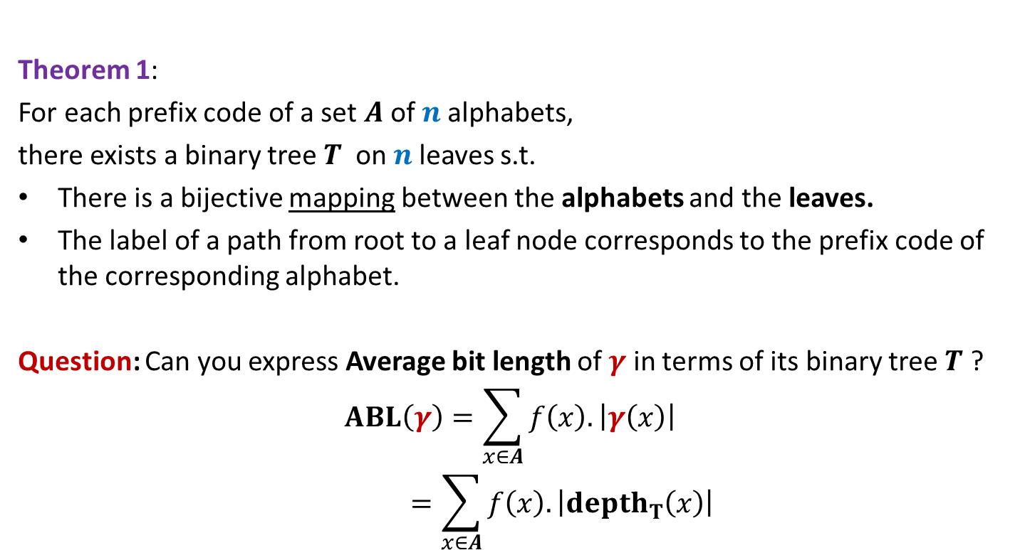
Theorem 1:
For each prefix code of a set $A$of $n$alphabets,
there exists a binary tree$T$ on $n$leaves s.t.
There is a bijective mapping between the alphabets and the leaves.
The label of a path from root to a leaf node corresponds to the prefix code of the corresponding alphabet.
Question: Can you express Average bit length of $γ$ in terms of its binary tree $T$ ?
$$ABL\left(γ\right)=\sum_{x∈A}{f\left(x\right).\left|γ\left(x\right)\right|}$$
$$=\sum_{x∈A}{f\left(x\right).\left|depth_{T}\left(x\right)\right|}$$

Slide 40
Finding the labeled binary tree for
the optimal prefix codes

Slide 41
Is the following prefix coding optimal ?
full binary tree
0
1
0
1
1
0
0
1
0
1
0
1
0
1

Slide 42


Observations on the binary tree of the optimal prefix code
Lemma:
The binary tree corresponding to optimal prefix coding must be a full binary tree:
Every internal node has degree exactly 2.
Question: What next ?
We need to see the influence of frequencies on the optimal binary tree.
Non-decreasing order of frequency
$${f(a}_{i})≤{f(a}_{i+1})$$
$a_{1}$ , $a_{2}$ , … , $a_{n}$

Slide 43
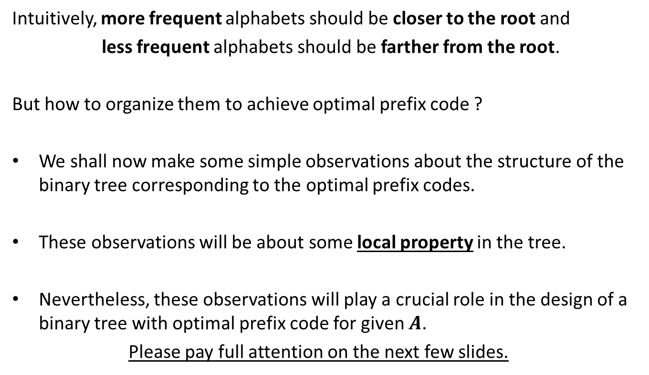
Observations on the binary tree of the optimal prefix code
Intuitively, more frequent alphabets should be closer to the root and
less frequent alphabets should be farther from the root.
But how to organize them to achieve optimal prefix code ?
We shall now make some simple observations about the structure of the binary tree corresponding to the optimal prefix codes.
These observations will be about some local property in the tree.
Nevertheless, these observations will play a crucial role in the design of a binary tree with optimal prefix code for given $A$.
Please pay full attention on the next few slides.

Slide 44

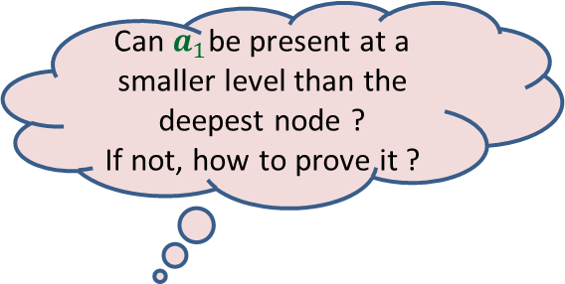

More Observations
Can $a_{1}$be present at a smaller level than the deepest node ?
If not, how to prove it ?
0
1
0
1
0
1
. . .
0
1
0
$$a_{1}$$
Deepest level
$$a_{i}$$

Slide 45


More Observations
0
1
1
Swapping $a_{1}$ with $a_{i}$ can not increase ABL.
0
1
0
. . .
0
1
0
$$a_{1}$$
Deepest level
$$a_{i}$$

Slide 46

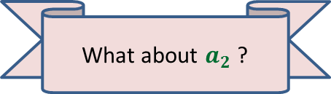

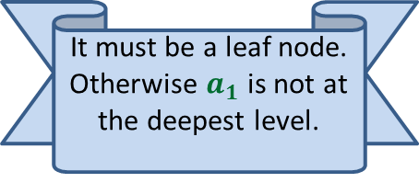


More Observations
0
1
Since the tree is full binary, $a_{1}$ must have a sibling. What can we say about it ?
1
Swapping $a_{2}$ with $a_{i}$ can not increase ABL.
0
1
0
It must be a leaf node. Otherwise $a_{1}$ is not at the deepest level.
. . .
What about $a_{2}$ ?
0
1
$$a_{2}$$
0
1
Deepest level
$$a_{1}$$
$$a_{i}$$

Slide 47

More Observations
0
1
1
Swapping $a_{2}$ with $a_{i}$ can not increase ABL.
0
1
0
. . .
0
1
$$a_{2}$$
0
1
Deepest level
$$a_{1}$$
$$a_{i}$$

Slide 48
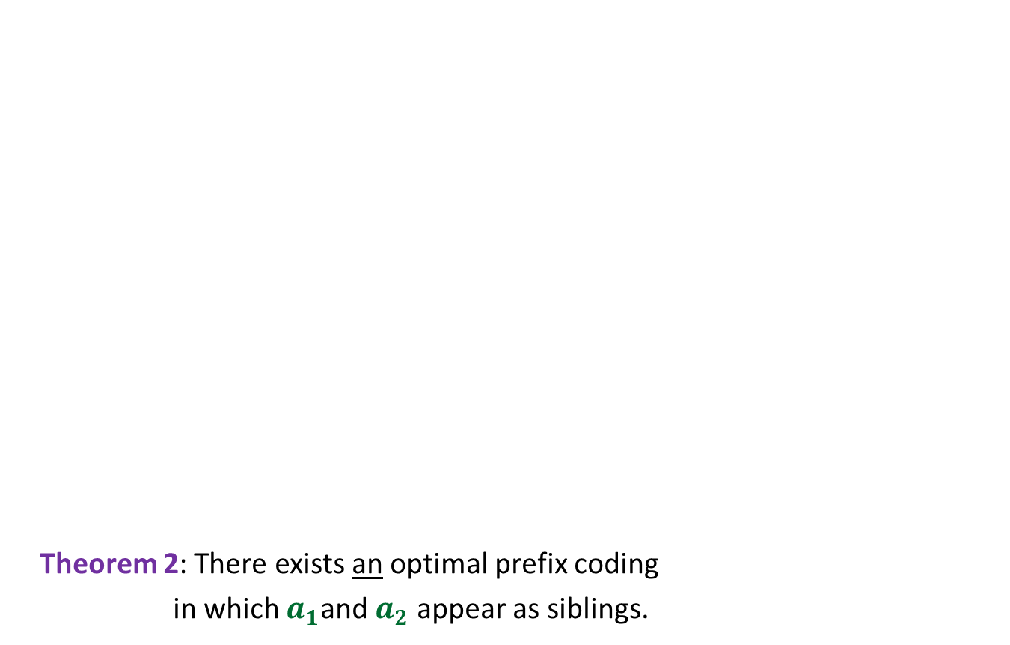

More Observations
0
1
Theorem 2: There exists an optimal prefix coding
in which $a_{1}$and $a_{2}$ appear as siblings.
0
1
0
1
. . .
1
0
1
Deepest level
$$a_{1}$$
$$a_{2}$$

Slide 49
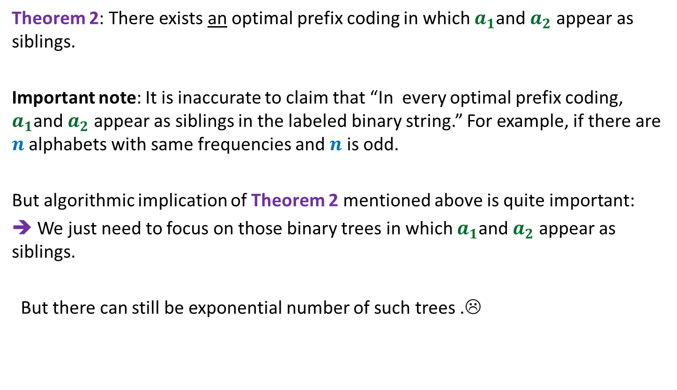
The important observation
Theorem 2: There exists an optimal prefix coding in which $a_{1}$and $a_{2}$ appear as siblings.
Important note: It is inaccurate to claim that “In every optimal prefix coding, $a_{1}$and $a_{2}$ appear as siblings in the labeled binary string.” For example, if there are $n$ alphabets with same frequencies and $n$ is odd.
But algorithmic implication of Theorem 2 mentioned above is quite important:
➔ We just need to focus on those binary trees in which $a_{1}$and $a_{2}$ appear as siblings.
But there can still be exponential number of such trees .☹

Slide 50
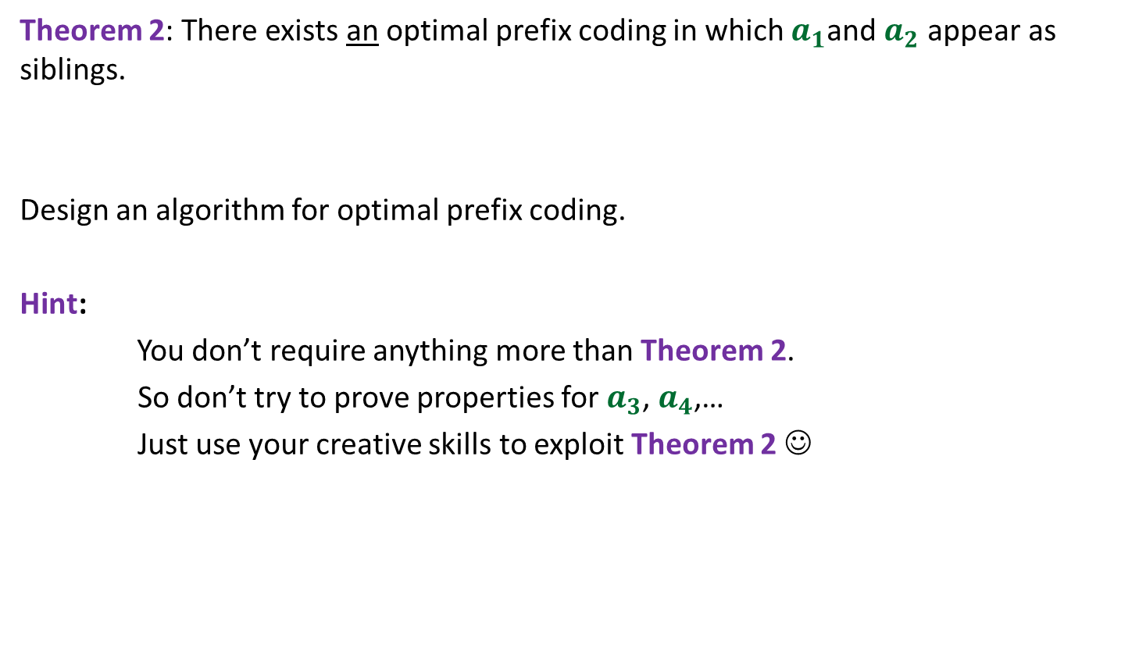
Homework
Theorem 2: There exists an optimal prefix coding in which $a_{1}$and $a_{2}$ appear as siblings.
Design an algorithm for optimal prefix coding.
Hint:
You don’t require anything more than Theorem 2.
So don’t try to prove properties for $a_{3}$, $a_{4}$,…
Just use your creative skills to exploit Theorem 2 ☺

