Slide 2
Unit 3
Public policy for fairness and efficiency

Slide 3
Outline

Slide 4
Outline
Introduction
Evaluating Allocations
Efficiency: The Pareto Criterion
Fairness and Inequality
Public Policies, Unintended Consequences

Slide 5
Evaluating Allocations
SECTION B

Slide 6
Public policy objectives
Allocation = outcome of an economic interaction
Two policy objectives: Efficiency and fairness
Example: Tragedy of the Commons (Unit 2)
Without intervention, too many cows on the shared pasture, so it becomes overgrazed.
Possible policy interventions:
Make cows common property – but who takes care of the cows?
Give only one herder access to the pasture – efficient but unfair

Slide 7
Example: The ultimatum game
A sequential game where players choose how to divide up a cash prize
Proposer has $100 to split
After observing the offer, the Responder accepts or rejects it
  If the offer is rejected, both individuals get nothing.
  If it is accepted, the split is implemented.
  = Take-it-or-leave-it offer
A game tree

Slide 8
Social preferences in the ultimatum game
A Responder who cares only about own payoffs would accept any positive offer, because something is better than nothing.
A Responder who thinks that the Proposer’s offer has violated a social norm of fairness, or that the offer is insultingly low for some other reason, might be willing to sacrifice the payoff to punish the Proposer.
Evaluating outcomes:
If Responder rejects, the outcome – throwing away money!– cannot be efficient.
Dictator game where Responder cannot reject offer eliminates this inefficiency, but is hardly fair!
➔ There may be trade-offs between efficiency and fairness

Slide 9
Playing the ultimatum game
Efficiency: The Responder should accept any offer from the Proposer (anything is better than nothing)
Fairness: The Responder might reject offers he/she considers to be unfair
Experimental evidence that people value fairness – nobody was willing to accept an offer of zero.

Slide 10
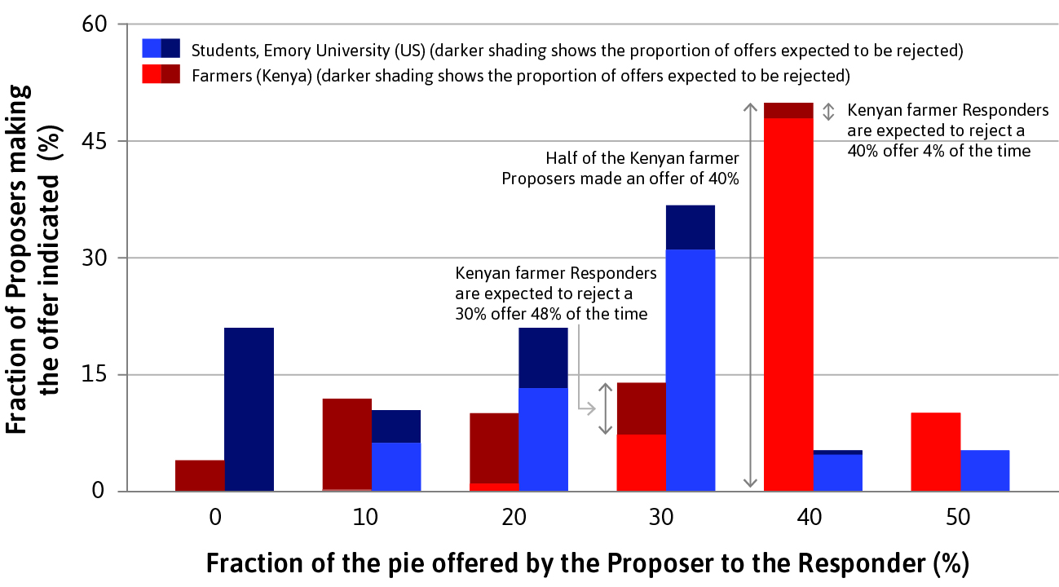
Playing the ultimatum game
Offers are consistent with social preferences, but also with expected payoff maximisation

Slide 11
Efficiency: The Pareto Criterion
SECTION C

Slide 12
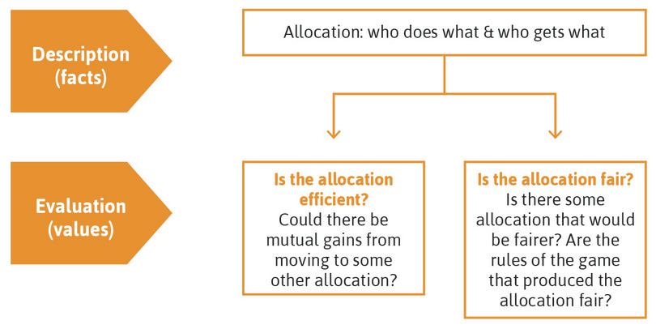
Evaluating economic outcomes
How can public policies improve observed outcomes?

Slide 13
Evaluating economic outcomes
(Pareto) Efficiency = There is no alternative technically feasible allocation in which at least one person would be better off, and nobody worse off.
Fairness = Evaluation based on one’s conception of justice
Many other values we might care about, such as:
Individual dignity and freedom
Diversity
Conformity to perceptions of one’s religion or other beliefs

Slide 14
Pareto efficiency
Pareto criterion = A desirable attribute of an allocation is that it be Pareto efficient
May not be very helpful in comparing allocations (change in status quo is almost never a Pareto improvement).
E.g. the pest control game (Unit 2) has 3 Pareto efficient allocations.

Slide 15
Pareto efficiency with compensation
Could introduce a second stage where players are compensated for their loss in the first stage, leaving everyone better off than in the status quo
E.g. Move from (T, T) to (T, I) with Anil paying Bala 1.5.
Both receive 2.5, which is better for each than (T, T).
Public policies often use this principle.

Slide 16
Fairness and Inequality
SECTION D

Slide 17
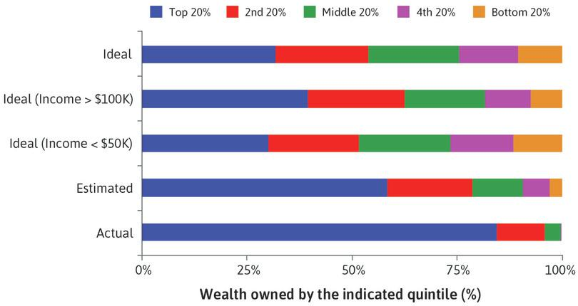
Too much inequality?
Americans’ ideal, estimated, and actual distribution of wealth
The actual distribution is much more unequal than the public’s estimate – and contrats sharply with the even lower inequality they would find ideal.

Slide 18
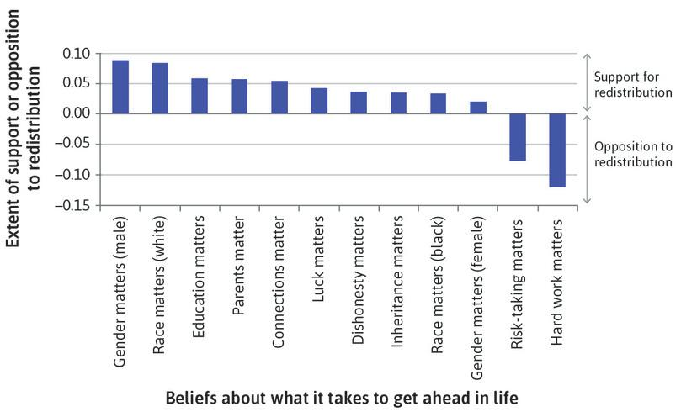
Too much inequality?
Not all economic inequalities are considered unfair
A person who thinks that hard work and risk-taking are essential to economic success is much less likely to support pro-poor redistribution.

Slide 19
Defining fairness
Allocations can be judged unfair because of:
How unequal they are: In terms of income, for example, or subjective wellbeing or the distribution of wealth. These are substantive judgements of fairness, which are based on the characteristics of the allocation itself.
How the inequalities came about: For example, by force or racial discrimination, by competition on a level playing field, or by hard work. These are procedural judgements of fairness.

Slide 20
Procedural judgments of fairness
Evaluate rules of the game according to aspects such as:
Voluntary exchange of private property acquired by legitimate means: Were the actions resulting in the allocation the result of free choices by the individuals involved?
Equal opportunity for economic advantage: Or were they subjected to some kind of discrimination because of their race, sexual preference, gender, or who their parents were?
Deservingness: Did the rules take account of the extent to which individuals need, or deserve, the amounts they get?

Slide 21
Questions of value in economics
No science can eliminate disagreements about questions of value. But economics can clarify:
How the dimensions of unfairness may be connected
The trade-offs between fairness and efficiency - Are some kinds of unfairness essential for achieving efficient outcomes?
Public policies to address concerns about unfairness - How can governments or other entities reduce unfairness?
The effects of the introduction of new policies - will the intended outcomes of a government policy result once we take account of government actions and the reactions of private actors?

Slide 22
Public Policies, Unintended Consequences
SECTION E

Slide 23
Implementing public policies
Outcome of a public policy is the result of an interaction between the government’s actions and the privately chosen actions of those affected
Policies can change economic outcomes by influencing what actions people decide to take. This is done through some combination of:
  Prohibitions and directives e.g. mandatory education
  Incentives: A policy changes the benefits or costs of alternative courses of action open to the individual.
  The information available: People can use this information when they make decisions about which actions to take.

Slide 24
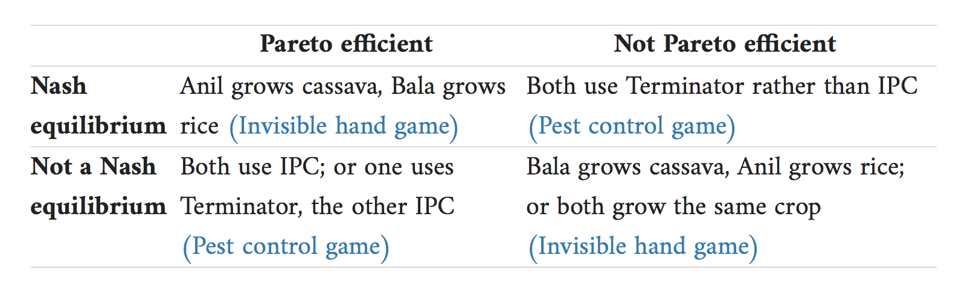
Pareto efficiency and Nash equilibrium
Remember: Nash equilibrium and Pareto efficiency refer to completely different aspects of a social interaction.
A Nash equilibrium may not be Pareto efficient, and vice versa.

Slide 25
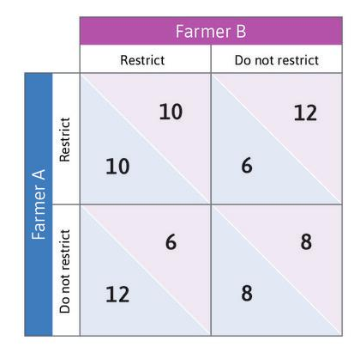
Example #1: The tragedy of the commons
A prisoners’ dilemma in which overgrazing is the dominant strategy
Overgrazing is the Nash equilibrium but restricting would support higher payoffs for both.
An effective government policy might alter this situation by changing the Nash equilibrium.

Slide 26
A tax on overgrazing the commons
Impose a tax of 0.4 for any cow beyond 10.
Reduces the payoffs for ‘Do not restrict’
(Restrict, Restrict) is new Nash equilibrium
Features of the overgrazing tax:
It treats both herders equally.
Each herder must take account of the cost that their overgrazing imposes on the other.
Better herders find it more valuable to put their cows on the pasture: Those less skilled will not find it worth paying the tax.

Slide 27
Example #2: Tax avoidance game
Change in the tax regime may cause firms to change their strategies e.g. hire lawyers to exploit tax loopholes.
Tax avoidance game:
Government either levies moderate taxes or high taxes on the Firm owner’s profits.
Firm can either pay taxes at the statutory rate or hire tax lawyers to minimize tax obligations.

Slide 28
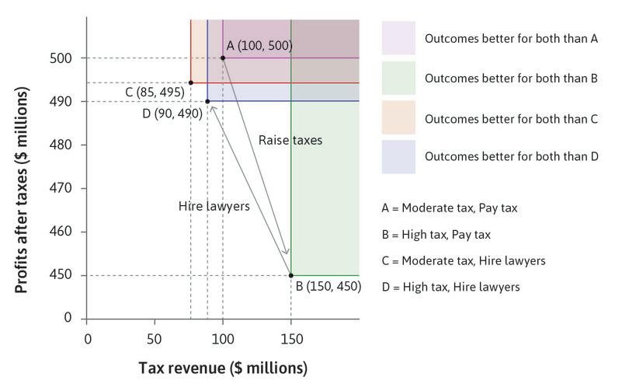
Unintended consequences
Tax rise will result in allocation D, which is Pareto-dominated by the initial situation at A.
Allocation at B (intended by government) is not a Nash equilibrium.
A successful policy must therefore be a Nash equilibrium

Slide 29
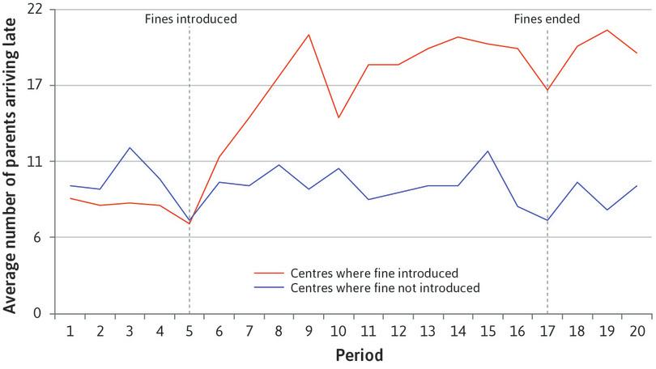
Policies can affect preferences
Example: Introduction of ‘fine for lateness’ in daycare centres (about $3)
The use of a market-based incentive (price of lateness) provided a new frame for the decision.
Economic incentives have crowded out social preferences.

Slide 30
What have these two examples shown?
In order to avoid unintended consequences, a policymaker must make sure that:
The policy does not change people’s preferences in unintended ways: A change in preferences might mean that behaviour changes too, which may mean the policy fails to hit its target.
The intended outcome is a Nash equilibrium: Under the new policy, people must be motivated to act in ways that are consistent with the objective of the policymaker.

Slide 31
Policy evaluation
To evaluate a policy’s likely effect, economists face the difficult problem of identifying causes rather than simply finding correlations.
Sugar tax: Because detailed data on patterns of consumption is available, it is possible to design a well-targeted tax that would lead to a fall in obesity.
Intellectual property rights: Modern governments can use natural experiments in history to find out whether patents and copyright encourage innovation, and how best to design these policies.

Slide 32
Summary
Rules of the game and social preferences are key determinants of allocations. Evaluating outcomes involves looking at:
Pareto efficiency
Substantive and procedural fairness
Public policies can influence people’s behaviour by changing incentives and available information, but:
Market-based incentives may adversely affect (social) preferences
Intended outcome must be a Nash equilibrium
Establishing causal links is not always straightforward

Slide 33
In the next unit
How do people make choices?
Develop an economic model of
  Optimal decision-making under scarcity
  The impact of technological change
Consumption externalities can cause social dilemmas
Use these concepts to explain differences in working hours across countries and over time

