Slide 1
Design and Analysis of Algorithms
CS345
Lecture 16
Dynamic Programming – III
Bitonic Tour
Shortest Paths in graphs
with negative edge weights.

Slide 2
Bitonic tour

Slide 3





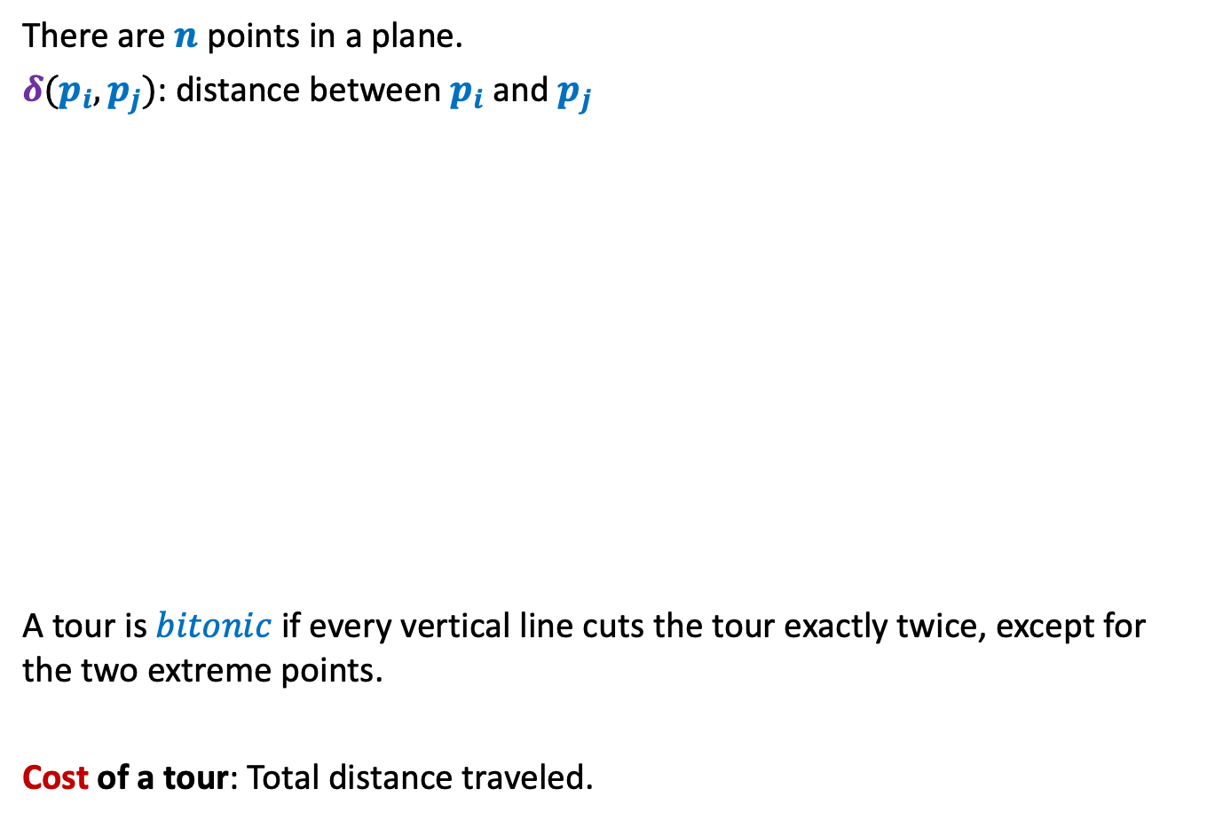

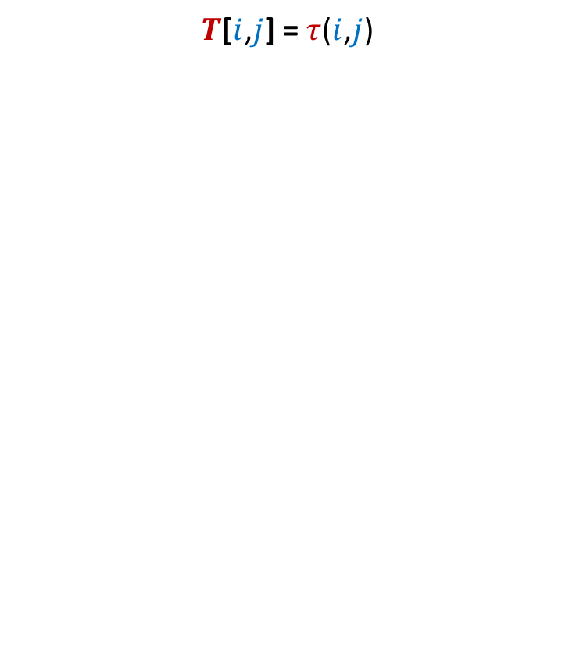

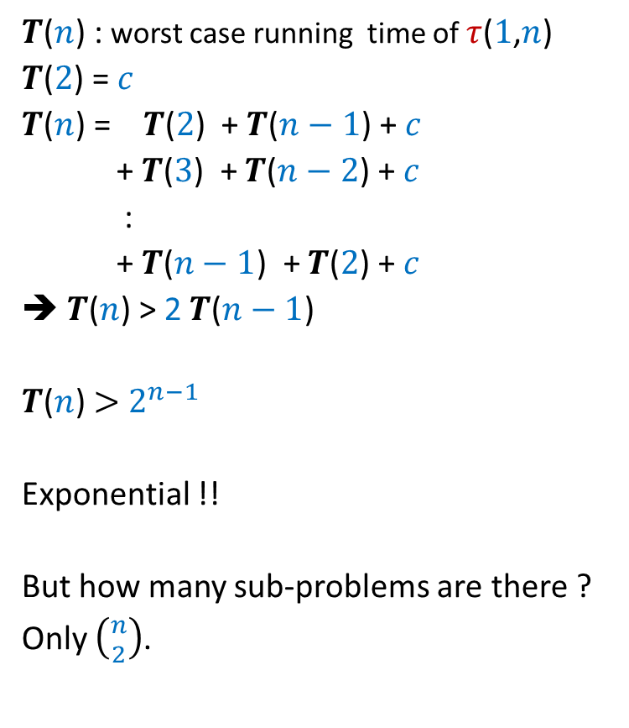

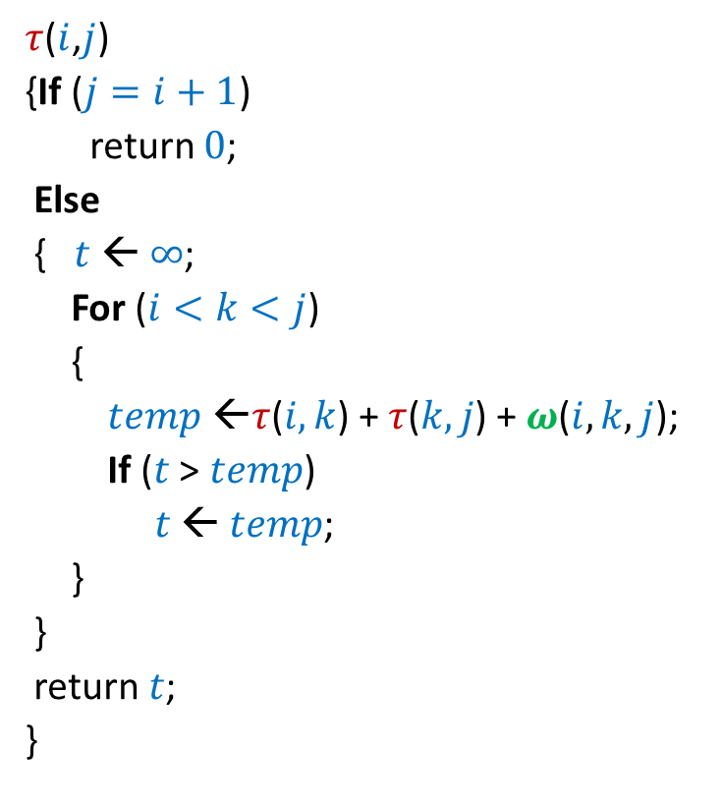
Bitonic tour
There are $n$ points in a plane.
$δ(p_{i},p_{j})$: distance between $p_{i}$ and $p_{j}$
A tour is $bitonic$ if every vertical line cuts the tour exactly twice, except for the two extreme points.
Cost of a tour: Total distance traveled.
$$p_{6}$$
$$p_{2}$$
$$p_{4}$$
$$p_{7}$$
$$p_{10}$$
$$p_{1}$$
$$p_{9}$$
$$p_{11}$$
$$p_{3}$$
$$p_{5}$$
$$p_{8}$$

Slide 4

Bitonic tour
There are $n$ points in a plane.
$δ(p_{i},p_{j})$: distance between $p_{i}$ and $p_{j}$
Cost of a tour: Total distance traveled.
Not bitonic
$$p_{6}$$
$$p_{2}$$
$$p_{4}$$
$$p_{7}$$
$$p_{10}$$
$$p_{1}$$
$$p_{9}$$
$$p_{11}$$
$$p_{3}$$
$$p_{5}$$
$$p_{8}$$

Slide 5

Bitonic tour
There are $n$ points in a plane.
$δ(p_{i},p_{j})$: distance between $p_{i}$ and $p_{j}$
Cost of a tour: Total distance traveled.
Problem: Given $n$ points <$p_{1}$,$p_{2}$,…,$p_{n}$> in increasing $x$-coordinates,
compute the least cost Bitonic tour.
Bitonic
$$p_{6}$$
$$p_{2}$$
$$p_{4}$$
$$p_{7}$$
$$p_{10}$$
$$p_{1}$$
$$p_{9}$$
$$p_{11}$$
$$p_{3}$$
$$p_{5}$$
$$p_{8}$$

Slide 6

Bitonic tour
Equivalent View
There are $n$ points in a plane.
$δ(p_{i},p_{j})$: distance between $p_{i}$ and $p_{j}$
Cost of a tour: Total distance traveled.
Problem: Given $n$ points <$p_{1}$,$p_{2}$,…,$p_{n}$> in increasing $x$-coordinates,
compute the least cost of reaching $p_{1}$ by two paths from $p_{n}$
while traversing each intermediate point exclusively once.
$$p_{6}$$
$$p_{2}$$
$$p_{4}$$
$$p_{7}$$
$$p_{10}$$
$$p_{1}$$
$$p_{9}$$
$$p_{11}$$
$$p_{3}$$
$$p_{5}$$
$$p_{8}$$

Slide 7

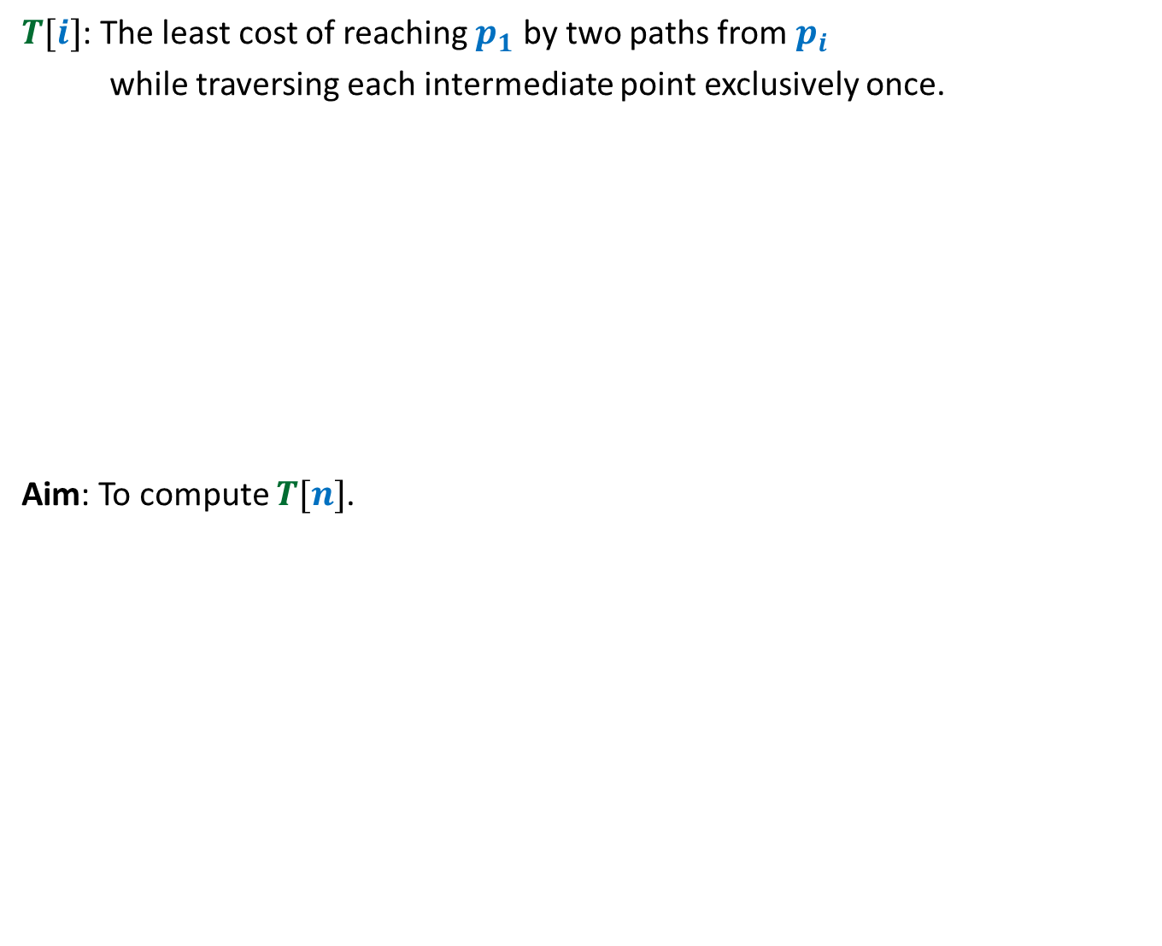
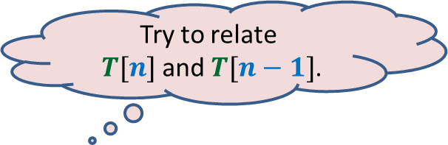
Attempt 1
Try to relate
$T[n]$ and $T[n−1]$.
$T[i]$: The least cost of reaching $p_{1}$ by two paths from $p_{i}$
while traversing each intermediate point exclusively once.
Aim: To compute $T[n]$.
$$p_{6}$$
$$p_{2}$$
$$p_{4}$$
$$p_{7}$$
$$p_{10}$$
$$p_{1}$$
$$p_{9}$$
$$p_{11}$$
$$p_{3}$$
$$p_{5}$$
$$p_{8}$$
No obvious way !

Slide 8


New Idea: Split the tour
$$p_{6}$$
$$p_{2}$$
$$p_{4}$$
$$p_{7}$$
$$p_{10}$$
$$p_{1}$$
$$p_{n}$$
$$p_{9}$$
$$p_{n+1}$$
$$p_{3}$$
$$p_{5}$$
$$p_{8}$$

Slide 9

New Idea: Split the tour
Problem: Given $n+1$ points <$p_{1}$,…,$p_{n+1}$> in increasing $x$-coordinates,
We need to travel from $p_{n}$and $p_{n+1}$ to $p_{1}$
What is the least distance traveled ?
$$p_{6}$$
$$p_{2}$$
$$p_{4}$$
$$p_{7}$$
$$p_{10}$$
$$p_{1}$$
$$p_{n}$$
$$p_{9}$$
$$p_{3}$$
$$p_{8}$$
$$p_{n+1}$$
$$p_{5}$$
traversing each point exclusively once.

Slide 10
What should be the Term for
Recursive formulation ?

Slide 11
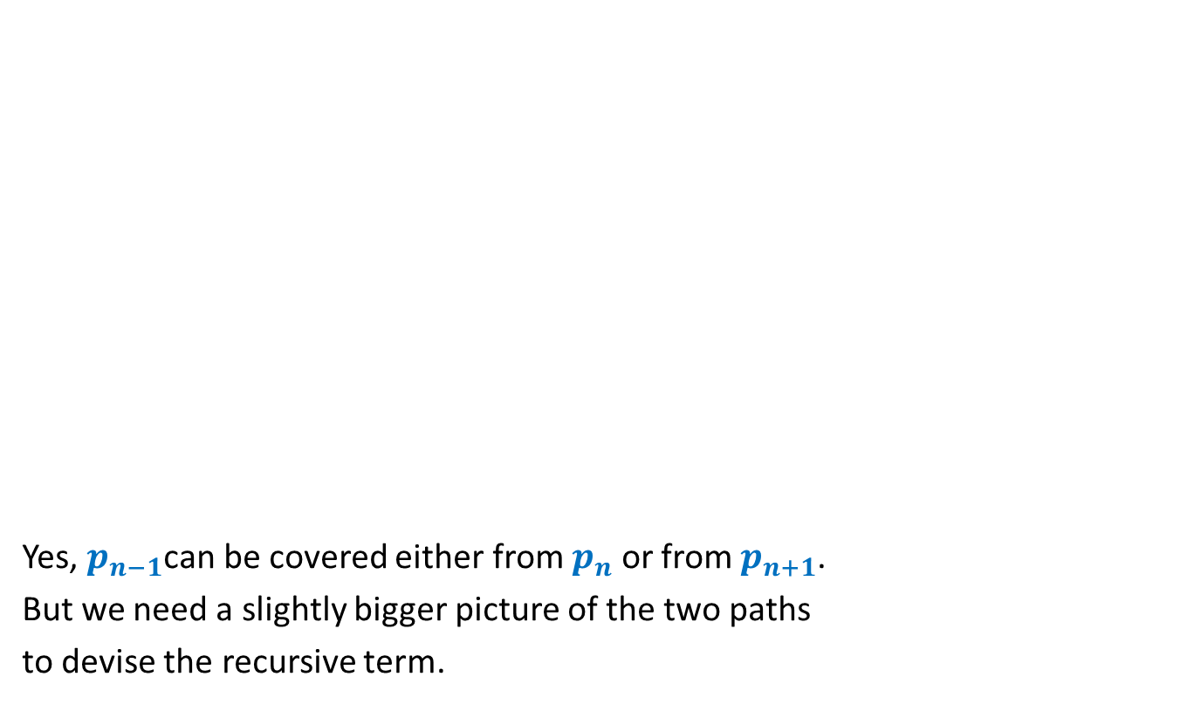


Term for Recursive formulation ?
Yes, $p_{n−1}$can be covered either from $p_{n}$ or from $p_{n+1}$.
But we need a slightly bigger picture of the two paths
to devise the recursive term.
$$p_{n}$$
$$p_{1}$$
$$p_{n+1}$$
$$p_{n−1}$$

Slide 12
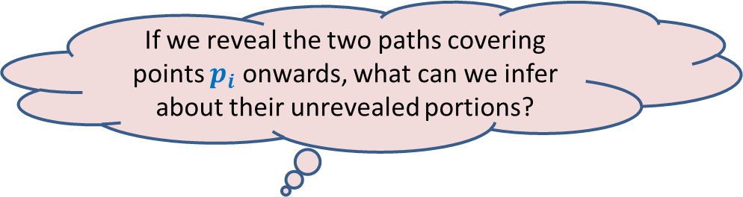



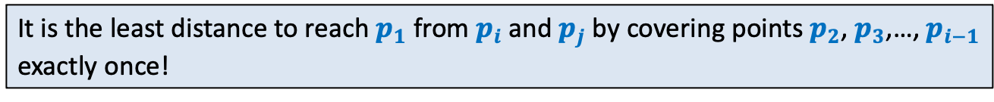
Term for Recursive formulation ?
If we reveal the two paths covering points $p_{i}$ onwards, what can we infer about their unrevealed portions?
$$p_{i}$$
$$p_{n}$$
$$p_{1}$$
$$p_{i−1}$$
$$p_{j}$$
$$p_{n+1}$$
It is the least distance to reach $p_{1}$ from $p_{i}$ and $p_{j}$ by covering points $p_{2}$, $p_{3}$,…, $p_{i−1}$ exactly once!

Slide 13
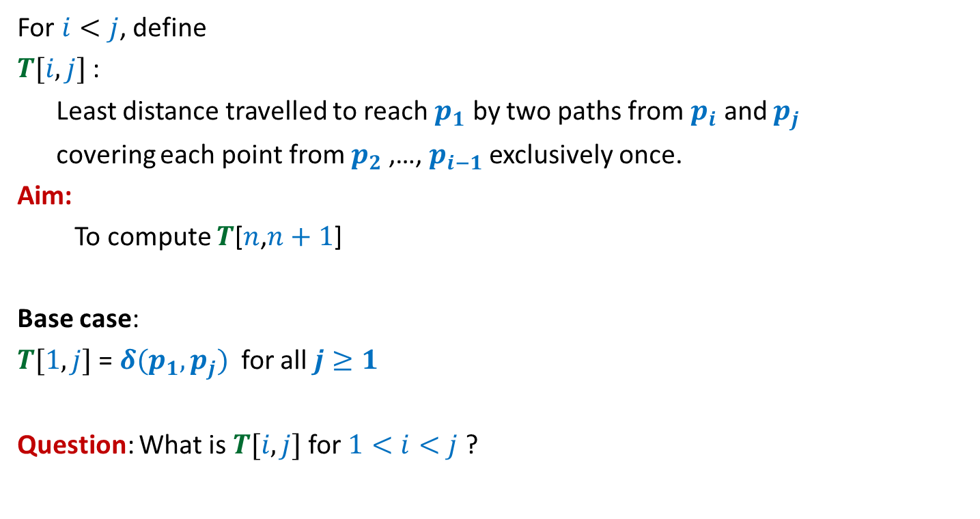
Term for Recursive formulation ?
For $i<j$, define
$T[i,j]$ :
Least distance travelled to reach $p_{1}$ by two paths from $p_{i}$ and $p_{j}$
covering each point from $p_{2}$,…, $p_{i−1}$ exclusively once.
Aim:
To compute $T$[$n$,$n+1$]
Base case:
$T[1,j]$ = $δ(p_{1},p_{j})$ for all $j≥1$
Question: What is $T[i,j]$ for $1<i<j$ ?

Slide 14

Recursive formulation for
$$T[i,j]$$

Slide 15







Recursive formulation of $T[i,j]$
Two cases:
$p_{i−1}$ visited from $p_{i}$
$p_{i−1}$ visited from $p_{j}$
$T(i,j)$ = $min$($T(i−1,j)$ + $δ(p_{i−1},p_{i})$ , $T(i−1,i)$ + $δ(p_{i−1},p_{j})$)
➔ $T(i,j)$ = $T(i−1,j)$ + $δ(p_{i−1},p_{i})$
➔ $T$($i,j$)= $T(i−1,i)$ + $δ(p_{i−1},p_{j})$
$$p_{i}$$
$$p_{i−1}$$
$$p_{1}$$
$$p_{j}$$

Slide 16
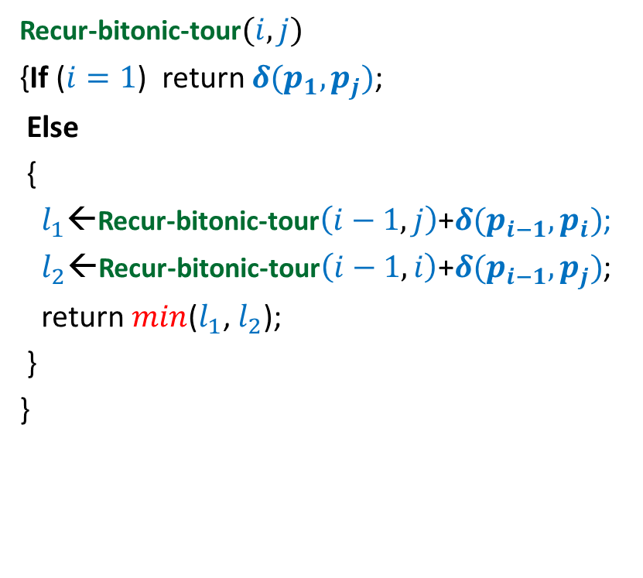

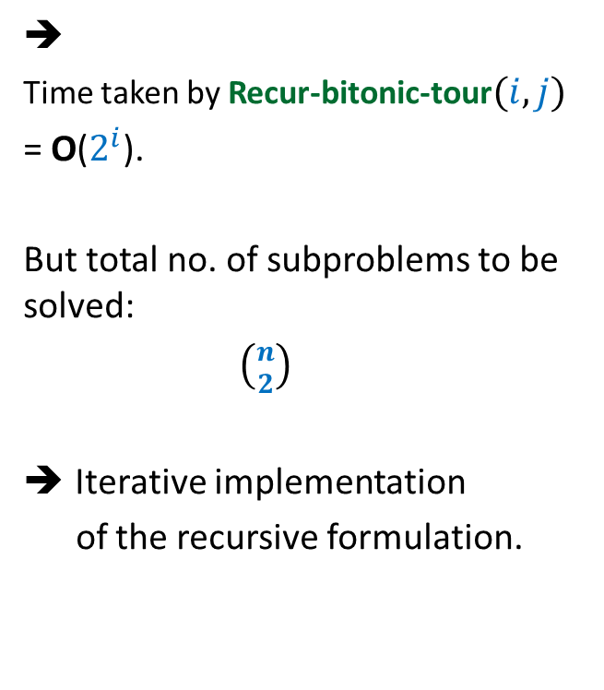
Recursive algorithm for $T(i,j)$
Recur-bitonic-tour$(i,j)$
{If ($i=1$) return $δ(p_{1},p_{j})$;
Else
{
$l_{1}$←Recur-bitonic-tour$\left(i−1,j\right)$+$δ(p_{i−1},p_{i})$;
$l_{2}$←Recur-bitonic-tour$\left(i−1,i\right)$+$δ(p_{i−1},p_{j})$;
return $min$($l_{1}$, $l_{2}$);
}
}
➔
Time taken by Recur-bitonic-tour$(i,j)$
= O($2^{i}$).
But total no. of subproblems to be solved:
$\left({n \atop 2}\right)$
Iterative implementation
of the recursive formulation.

Slide 17






Recursive algorithm for $T(i,j)$
Recur-bitonic-tour$(i,j)$
{If ($i=1$) return $δ(p_{1},p_{j})$;
Else
{
$l_{1}$←Recur-bitonic-tour$\left(i−1,j\right)$+$δ(p_{i−1},p_{i})$;
$l_{2}$←Recur-bitonic-tour$\left(i−1,i\right)$+$δ(p_{i−1},p_{j})$;
return $min$($l_{1}$, $l_{2}$);
}
}
$$n$$
$$i$$
…
2
1
$$i$$
$$j$$
1 2 ... $n+1$
$$T$$

Slide 18
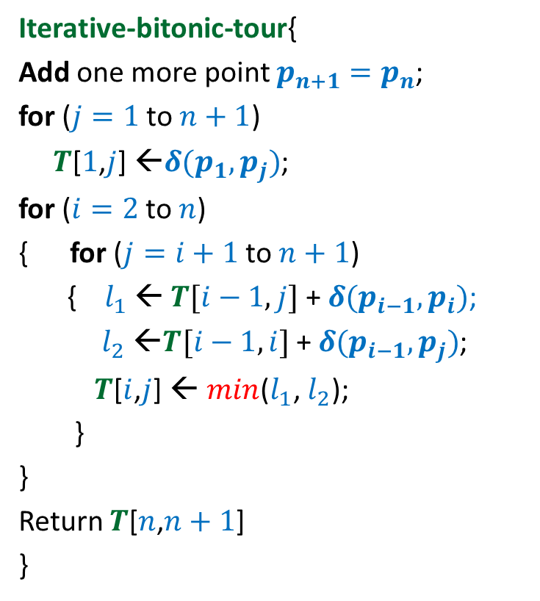


Iterative algorithm for Optimal Bitonic tour
Iterative-bitonic-tour{
Add one more point $p_{n+1}=p_{n}$;
for ($j=1$ to $n+1$)
$T$[$1$,$j$] ←$δ(p_{1},p_{j})$;
for ($i=2$ to $n$)
{ for ($j=i+1$ to $n+1$)
{ $l_{1}$ ← $T[i−1,j]$ + $δ(p_{i−1},p_{i})$;
$l_{2}$ ←$T[i−1,i]$ + $δ(p_{i−1},p_{j})$;
$T$[$i$,$j$] ← $min$($l_{1}$, $l_{2}$);
}
}
Return $T$[$n$,$n+1$]
}
$$n$$
$$i$$
…
2
1
1 2 ... $n+1$
$$j$$
Time complexity: O($n^{2}$)
$$T$$

Slide 19
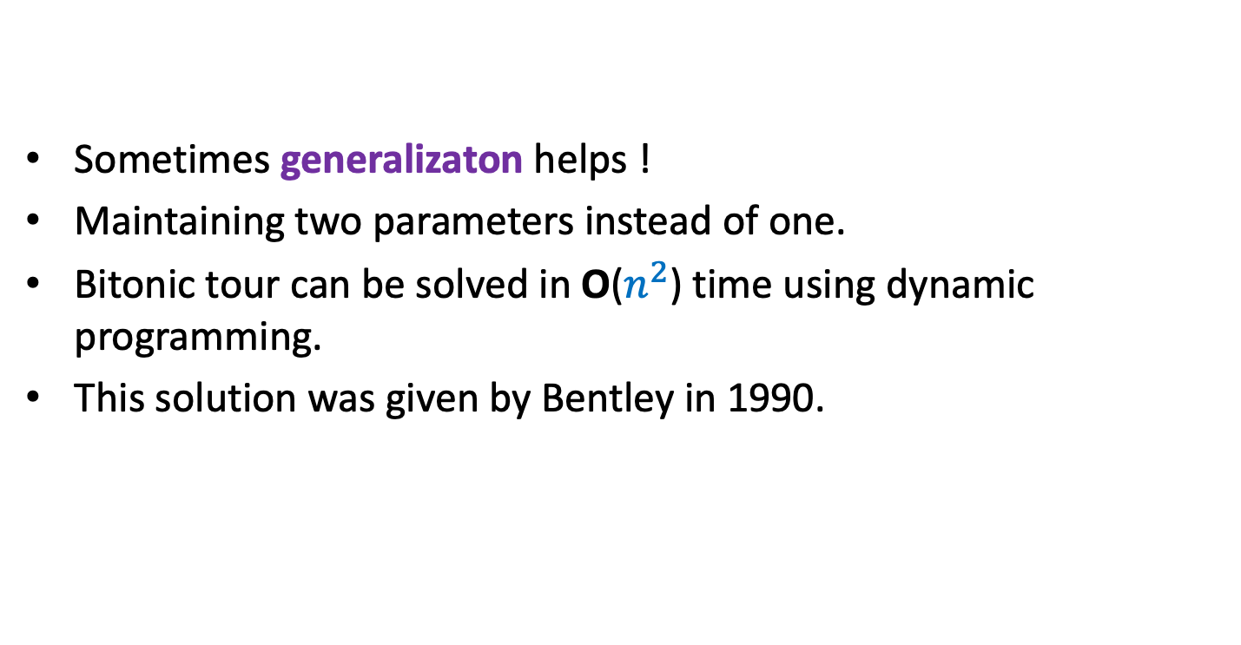
Summary
Sometimes generalizaton helps !
Maintaining two parameters instead of one.
Bitonic tour can be solved in O($n^{2}$) time using dynamic programming.
This solution was given by Bentley in 1990.

Slide 20
Shortest pathS in a graph
In presence of negative edge weights

Slide 21
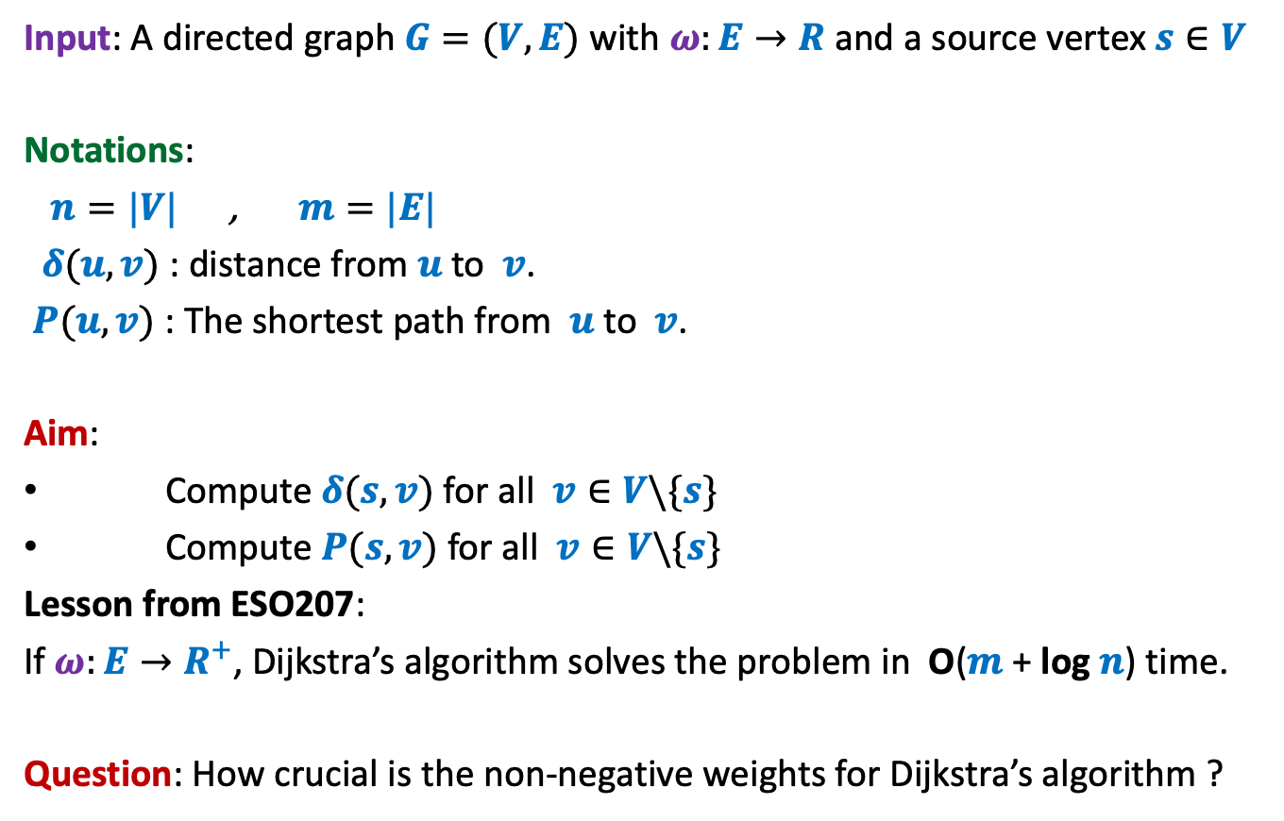
Problem Definition
Input: A directed graph $G=(V,E)$ with $ω:E→R$ and a source vertex $s∈V$
Notations:
$n=|V|$ , $m=|E|$
$δ(u,v)$ : distance from $u$to $v$.
$P(u,v)$ : The shortest path from $u$to $v$.
Aim:
Compute $δ(s,v)$ for all $v∈V\backslash \{s\}$
Compute $P(s,v)$ for all $v∈V\backslash \{s\}$
Lesson from ESO207:
If $ω:E→R^{+}$, Dijkstra’s algorithm solves the problem in O($m$ + log $n$) time.
Question: How crucial is the non-negative weights for Dijkstra’s algorithm ?

Slide 22
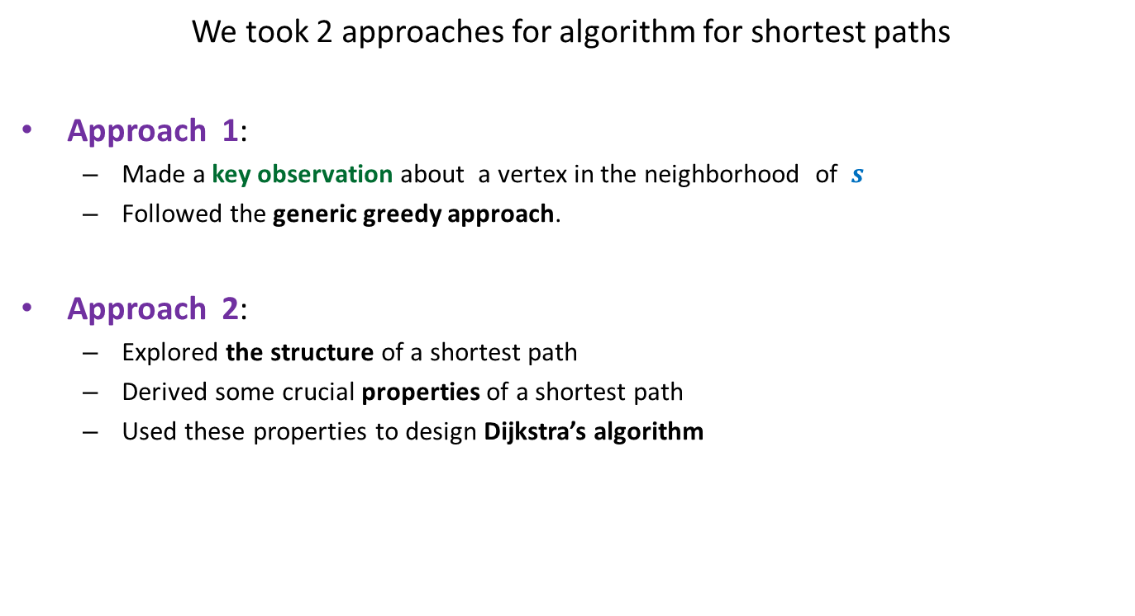
Revisiting Dijkstra’s Algorithm
We took 2 approaches for algorithm for shortest paths
Approach 1:
  Made a key observation about a vertex in the neighborhood of $s$
  Followed the generic greedy approach.
Approach 2:
  Explored the structure of a shortest path
  Derived some crucial properties of a shortest path
  Used these properties to design Dijkstra’s algorithm
Let us explore how crucial was the role of “positive edge weights” in these approaches.

Slide 23











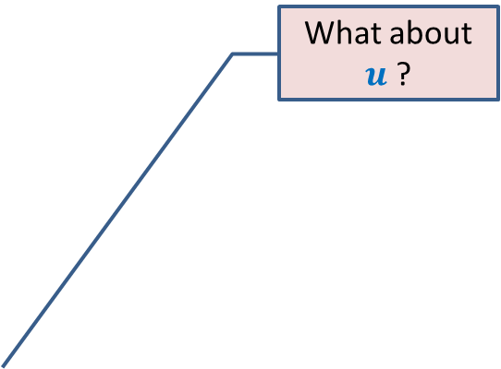
Approach 1
What about $u$ ?
Question: Can we be certain about the distance from $s$ to any vertex in this picture ?
Answer: NO.☹
$$z$$
$$10$$
$$v$$
G
$$12$$
$$7$$
$$x$$
$$s$$
$$−3$$
$$5$$
$$u$$
$$y$$

Slide 24

Approach 1
$$z$$
$$10$$
$$v$$
G
$$12$$
$$7$$
$$x$$
$$s$$
$$−3$$
$$5$$
$$u$$
$$y$$
$$−16$$

Slide 25

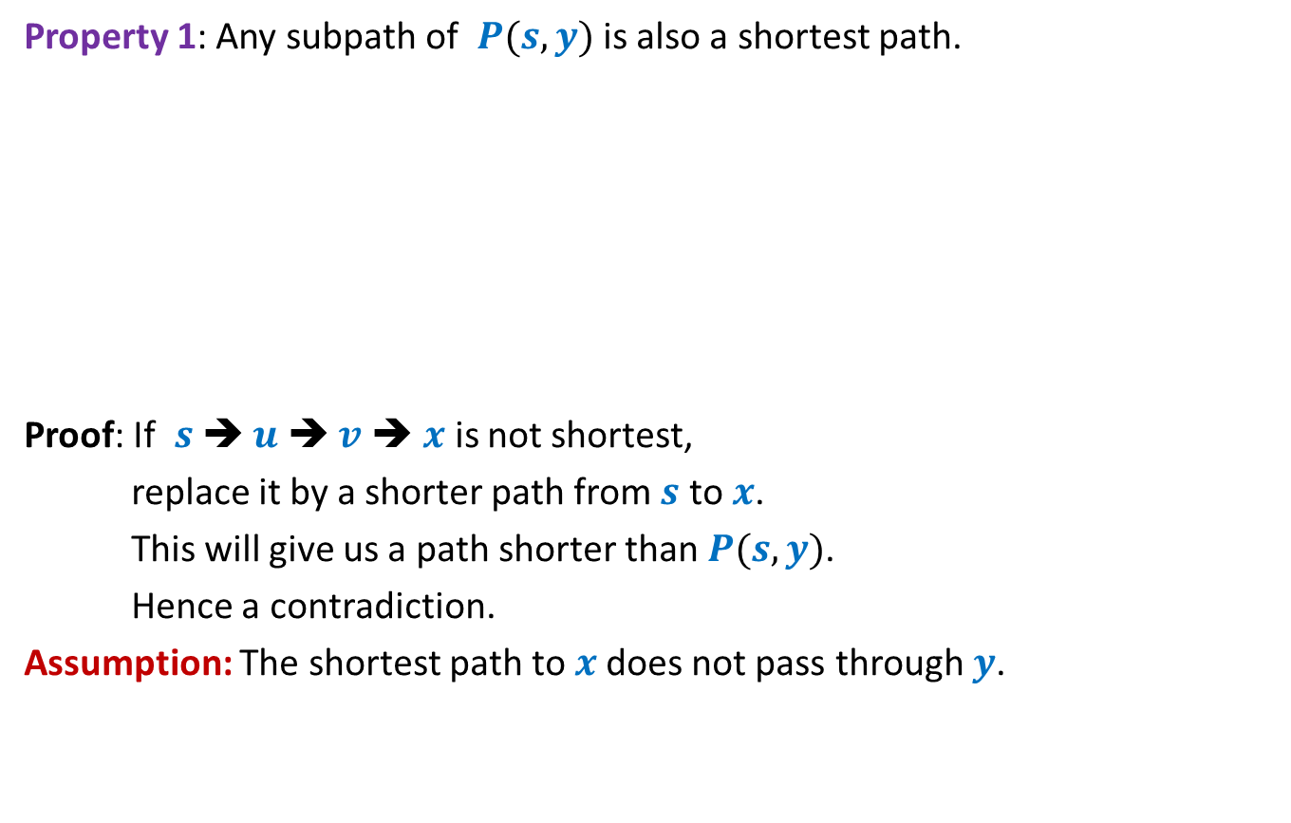
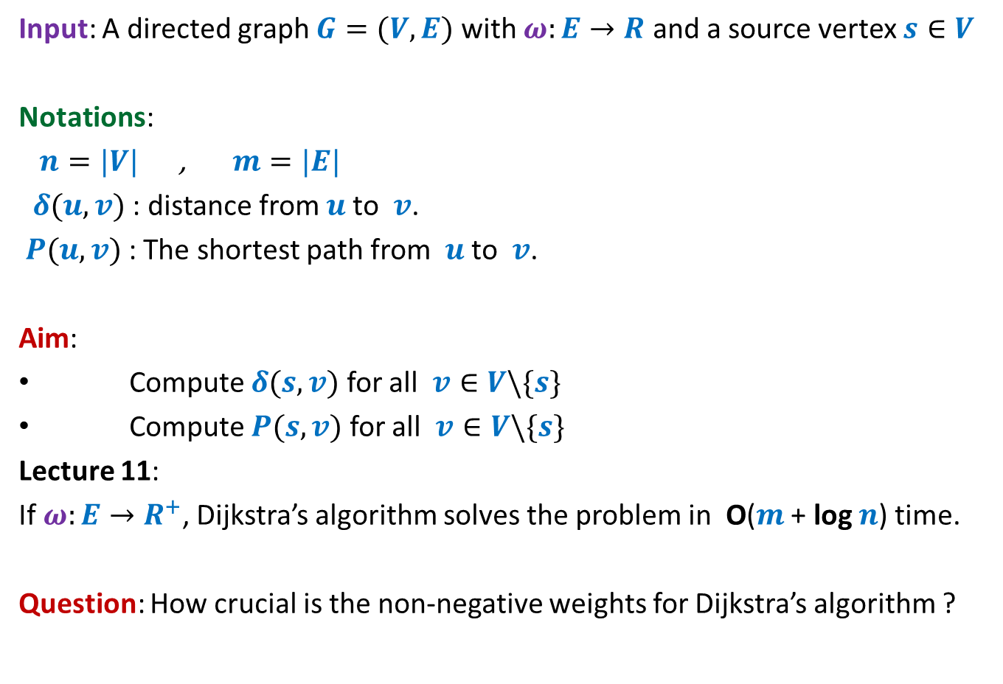




What properties does Dijkstra’s algorithm exploit ?
Approach 2
Property 1: Any subpath of $P(s,y)$ is also a shortest path.
Proof: If $s$➔ $u$ ➔ $v$ ➔ $x$ is not shortest,
replace it by a shorter path from $s$ to $x$.
This will give us a path shorter than $P(s,y)$.
Hence a contradiction.
Assumption: The shortest path to $x$does not pass through $y$.
If $P\left(s,y\right)=Q∷(x,y)$, then $Q$ is the shortest path from $s$ to $x$.
$$a$$
$$b$$
$$c$$
$$f$$
We used 2 properties of a shortest path to design Dijkstra’s algorithm
$$P(s,y)$$
$$s$$
$$u$$
$$v$$
$$x$$
$$y$$
Exploiting the fact that
edge weights are non-negative,
argue that the green path from $s$ to $y$
is shorter than $P(s,y)$.
Contradiction !
This proof is based on an assumption.
Can you spot that ?
Can you see that this assumption exploits the fact that edge weights are non-negative ?

Slide 26

What properties does Dijkstra’s algorithm exploit ?
?
Property 1: Any subpath of $P(s,y)$ is also a shortest path.
Property 2:
$δ\left(s,u\right)≤δ\left(s,v\right)≤δ(s,x)≤δ(s,y)$
If $P\left(s,y\right)=Q∷(x,y)$, then $Q$ is the shortest path from $s$ to $x$.
$$P(s,y)$$
$$s$$
70
$$u$$
-20
$$v$$
10
$$x$$
-55
$$y$$
Which of these properties will fail to hold if edge weights are allowed to be negative ?

Slide 27

Violating the Optimal subpath property
Property 1: Any subpath of $P(s,y)$ is also a shortest path.
$δ(s,y)$ = ?
$δ(s,x)$ = ?
To show the violation, we need to come up with
a path to $x$ of length < 60 that intersects $P\left(s,y\right)$
and still keeping $δ(s,y)$ = 5.
If $P\left(s,y\right)=Q∷(x,y)$, then $Q$ is the shortest path from $s$ to $x$.
5
2
-3
10
40
$$a$$
$$b$$
$$c$$
$$f$$
5
6
$$P(s,y)$$
$$s$$
70
$$u$$
-20
$$v$$
10
$$x$$
-55
$$y$$
60
10
What to do ? ☹
This example illustrates that the optimal subpath property may get violated when the edge weights are negative.
Instead of working with these numbers (2,-3,10,…), consider a generic example where the property fails.
Start all over from scratch to solve the shortest paths problem in graph with –ve edge weights
But how ?
Let us investigate like a true researcher for the exact cause of the violation of the optimal subpath property.
Give up !

Slide 28






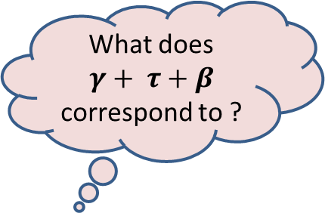
Violating the Optimal subpath property
What does $γ+ τ+β$ correspond to ?
$$ρ$$
Question: When can the shortest $s⇝x$ path pass through $y$ ?
$ρ+τ+β<α+β$
$α+β+γ+τ+β<α+β$
$$P(s,y)$$
$$s$$
$$α$$
$$β$$
$$x$$
$$γ$$
$$y$$
$$τ$$
$$α+β+γ≤ρ$$
Because $P(s,y)$ is the shortest path
Since the green path to $x$ is shorter than the subpath of $P(s,y)$
➔ $γ+ τ+β<0$

Slide 29



Violating the Optimal subpath property
What does $γ+ τ+β$ correspond to ?
$$ρ$$
Question: When can the shortest $s⇝x$ path pass through $y$ ?
Answer: Weight of the cycle $C$ must be NEGATIVE.
$$P(s,y)$$
$$s$$
$$α$$
$$β$$
$$x$$
$$γ$$
$$y$$
Cycle $C$
$$τ$$
➔ $γ+ τ+β<0$

Slide 30

Theorem: Given a directed $G=(V,E)$ with $ω:E→$ $R$,
if there are no negative cycles,
all shortest paths in $G$possess optimal substructure property
The spirit of a researcher proved to be very right.

Slide 31
shortest paths in a graph
Negative weights
BUT No negative cycle
Ponder over it before coming to the next class ☺
All we are allowed to use is the optimal subpath property.

