Slide 1
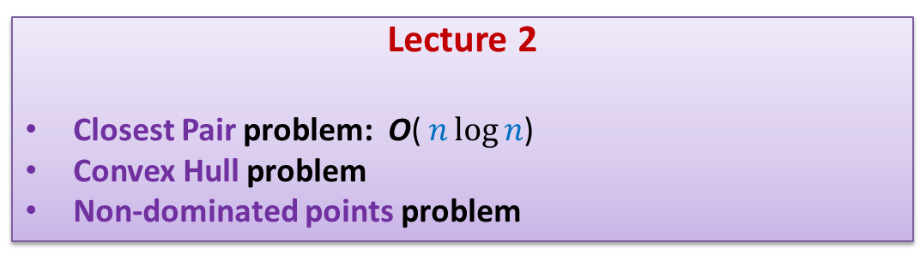
Design and Analysis of Algorithms
CS345
Lecture 2
Closest Pair problem: O( $n\log{n}$)
Convex Hull problem
Non-dominated points problem

Slide 2
Recap from Lecture 1

Slide 3
The Closest Pair Problem

Slide 4



The divide and conquer
$$δ_{L}$$
$$δ_{R}$$
$\frac{n}{2}$points
$\frac{n}{2}$points

Slide 5





The divide and conquer
$$δ_{L}$$
$$δ_{L}$$
$$δ_{L}$$
$$δ_{L}$$
$$δ_{L}$$
$$δ_{L}$$
$$p$$
$$δ_{L}$$
$$δ_{R}$$
$$δ_{L}$$
$$δ_{L}$$

Slide 6



Divide and Conquer based algorithm
CP-Distance($P$)
{ If (| $P$|=1 ) return infinity;
{ $p_{med}$← Compute $x$-median of $P$;
$(P_{L},P_{R})$←Split-by-$x$-median($P$, $p_{med}$);
$δ_{L}$← CP-Distance($P_{L}$) ;
$δ_{R}$← CP-Distance($P_{R}$) ;
$δ$← min($δ_{L}$, $δ_{R}$);
$S_{L}$ ← strip of $P_{L}$;
$S_{R}$ ← strip of $P_{R}$;
$A$← Sorted-array of $S_{R}$;
For each $p∈S_{L}$ do
$y$ ← y-coordinate of $p$;
Binary Search $A$for points with y-coordinate within $y±δ$;
Compute distance from $p$to each of these points;
Update $δ$ accordingly;
return $δ$;
}
$O(\left|P\right|)$ + 2 T(|$P$|/2) time
Divide step
$O(\left|P\right| \log{P})$ time
Combine/conquer step

Slide 7


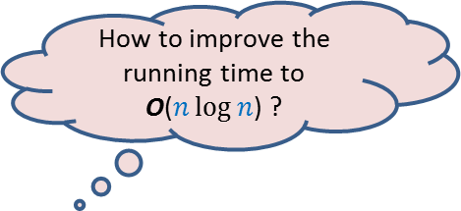
Running time of the algorithm
What is the recurrence for running time?
T($n$) = c $n$ log $n$ + 2 T($n$/2)
➔
T($n$) = O( $n$ $\log^{2}n$)
Theorem:
There exists an O( $n$ $\log^{2}n$) time algorithm to compute closest pair of $n$points in plane.
How to improve the running time to
O($n\log{n}$) ?
c $n$

Slide 8



The conquer step in O($n$) time
If the two strips are already sorted
$$δ_{L}$$
$$δ_{R}$$
$$δ_{L}$$
$$δ_{L}$$

Slide 9

The conquer step in O($n$) time
If the two strips are already sorted
For each point in one strip, we need to find distance to points in
the upper red- square in the other strip.
$δ_{L}$
$$δ_{L}$$
How to do it efficiently using the fact that the strips are sorted ?
$δ_{L}$
$$δ_{R}$$
$$δ_{L}$$
$$δ_{L}$$
$$δ_{L}$$

Slide 10
The conquer step in O($n$) time
If the two strips are already sorted
$$δ_{L}$$
$$δ_{R}$$
$$δ_{L}$$
$$δ_{L}$$

Slide 11
The conquer step in O($n$) time
If the two strips are already sorted
$$δ_{L}$$
$$δ_{R}$$
$$δ_{L}$$
$$δ_{L}$$

Slide 12

The conquer step in O($n$) time
If the two strips are already sorted
$$δ_{L}$$
This is very much like merging two strips.
We can indeed conquer in O($n$) time.
How to justify that the two strips are sorted without any overhead of time ?
Think over it …
$$δ_{R}$$
$$δ_{L}$$
$$δ_{L}$$

Slide 13
Inspiration from Merge sort
In merge sort, the two recursive calls return sorted lists.
So creating the sorted list requires only merging them.
Doesn’t it provide an answer to the question of the previous slide ?

Slide 14
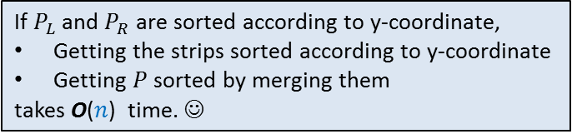
The conquer step in O($n$) time
If $P_{L}$ and $P_{R}$ are sorted according to y-coordinate,
Getting the strips sorted according to y-coordinate
Getting $P$sorted by merging them
takes O($n$) time. ☺
$$δ_{L}$$
$$δ_{R}$$
$$δ_{L}$$
$$δ_{L}$$

Slide 15

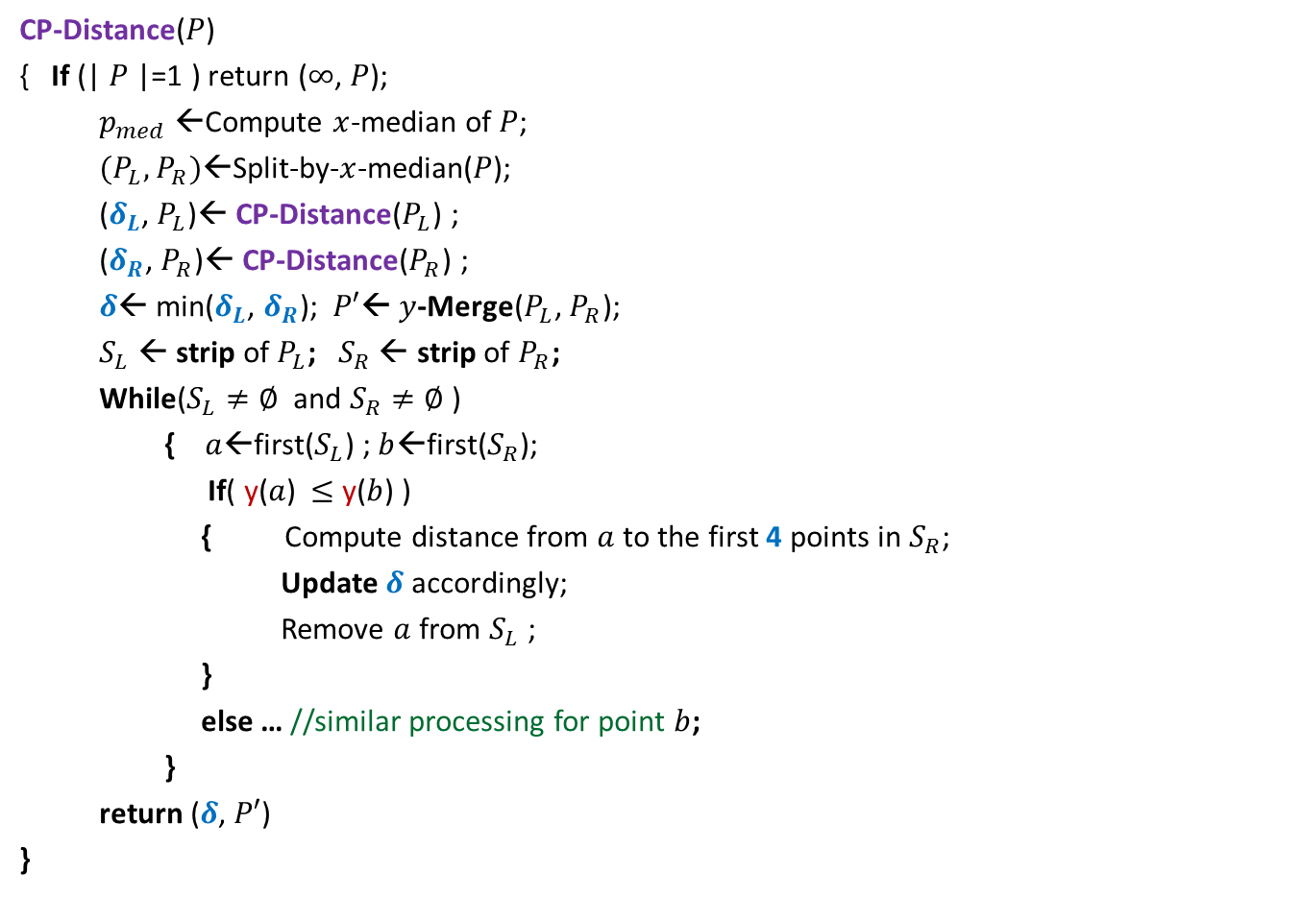

Divide and Conquer based algorithm
CP-Distance($P$)
{ If (| $P$|=1 ) return ($∞$, $P$);
$p_{med}$←Compute $x$-median of $P$;
$(P_{L},P_{R})$←Split-by-$x$-median($P$);
($δ_{L}$, $P_{L}$)← CP-Distance($P_{L}$) ;
($δ_{R}$, $P_{R}$)← CP-Distance($P_{R}$) ;
$δ$← min($δ_{L}$, $δ_{R}$); $P′$← $y$-Merge($P_{L}$, $P_{R}$);
$S_{L}$ ← strip of $P_{L}$; $S_{R}$ ← strip of $P_{R}$;
While($S_{L}≠∅$ and $S_{R}≠∅$ )
{ $a$←first($S_{L}$) ; $b$←first($S_{R}$);
If( y($a$) $≤$ y($b$) )
{ Compute distance from $a$to the first 4 points in $S_{R}$;
Update $δ$ accordingly;
Remove $a$ from $S_{L}$ ;
}
else … //similar processing for point $b$;
}
return ($δ$, $P′$)
}
$O(\left|P\right|)$ + 2 T(|$P$|/2) time
Divide step
$O(\left|P\right|)$ time
conquer step

Slide 16
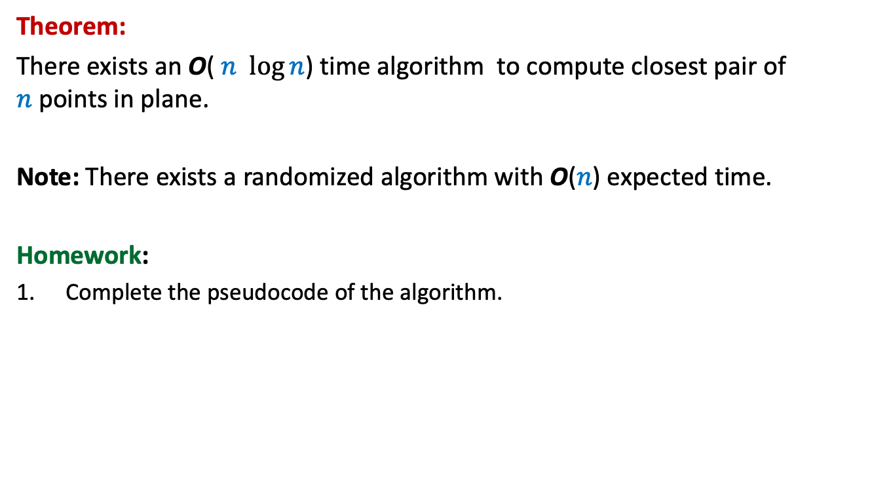
Theorem:
There exists an O( $n$ $\log{n}$) time algorithm to compute closest pair of $n$points in plane.
Note: There exists a randomized algorithm with O($n$) expected time.
Homework:
Complete the pseudocode of the algorithm.

Slide 17
Convex Hull

Slide 18

The Convex hull Problem
Definition: Convex polygon of smallest area enclosing a set $P$ of points.

Slide 19





A simple exercise
Given a line $L$ and a point $p$, how to determine if $p$ lies above/below $L$ ?
$$(a_{1},b_{1})$$
$$y=mx+c$$
$$(a_{2},b_{2})$$
$O(1)$ time ☺

Slide 20
Divide and Conquer algorithm
$\frac{n}{2}$points
$\frac{n}{2}$points

Slide 21
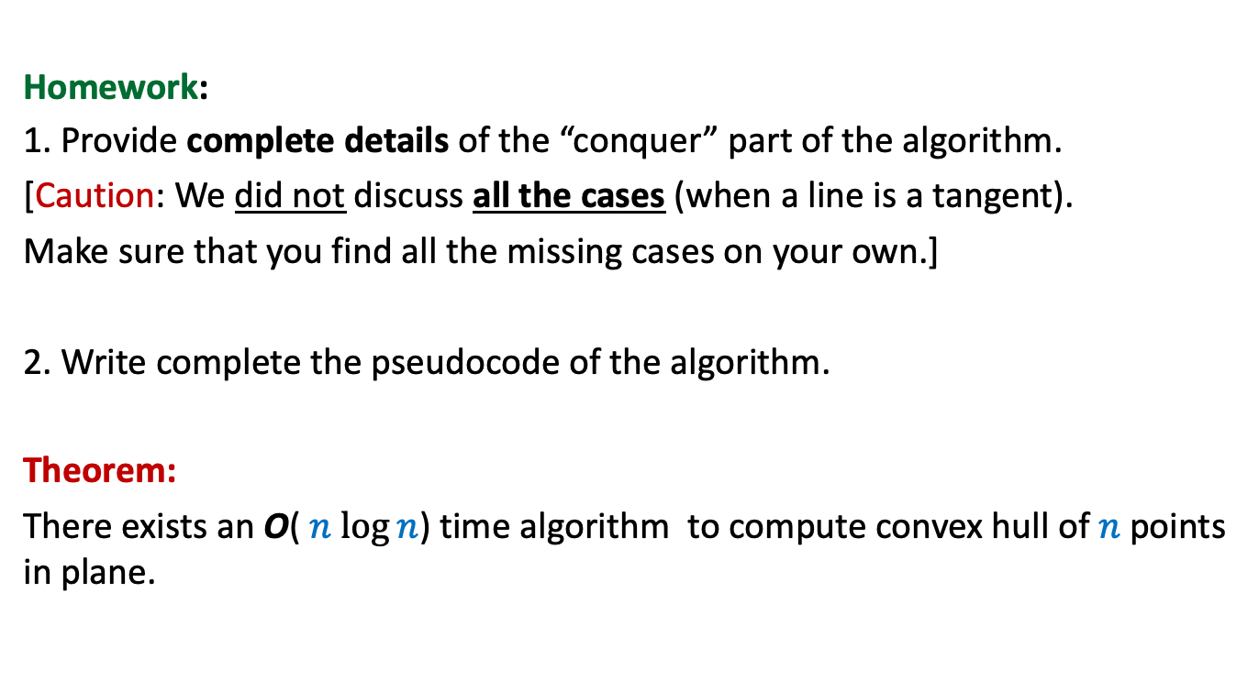
Homework:
1. Provide complete details of the “conquer” part of the algorithm.
[Caution: We did not discuss all the cases (when a line is a tangent).
Make sure that you find all the missing cases on your own.]
2. Write complete the pseudocode of the algorithm.
Theorem:
There exists an O( $n$ $\log{n}$) time algorithm to compute convex hull of $n$points in plane.

Slide 22
Non-dominated Points

Slide 23


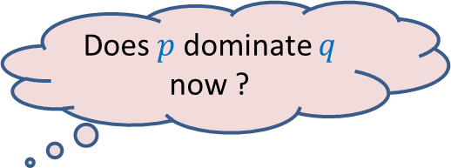


The Non Dominated Points
Given a set $P$ of $n$ points
Definition: point $p$ is said to dominate point $q$ if
x($p$) > x($q$)
and y($p$) > y($q$)
Does $p$dominate $q$ now ?
$$p$$
$$q$$
NO
$$q$$

Slide 24

The Non Dominated Points
Given a set $P$ of $n$ points
Definition: point $q∈P$ is said to be non-dominated point if
there is no point $p∈P$ such that
x($p$) > x($q$)
and y($p$) > y($q$)
$$p$$
$$q$$

Slide 25
The Non Dominated Points
How does the structure formed by all the non-dominated points look like ?
A staircase structure ☺
Prove it. (Exercise)

Slide 26
A simple algorithm
Based on the fact:
The point with maximum x-coordinate is surely a non-dominated point

Slide 27


A Simple Algorithm
$h$ : no. of non-dominated points
O($nh$) time algorithm

Slide 28
A Divide and Conquer algorithm

Slide 29

A Divide and conquer algorithm
$\frac{n}{2}$points
$\frac{n}{2}$points

Slide 30




A Divide and conquer algorithm
O($n$ $\log{ n}$)
O($n$ $\log{ h}$)
O($n h$)
$\frac{n}{2}$points
$\frac{n}{2}$points

Slide 31
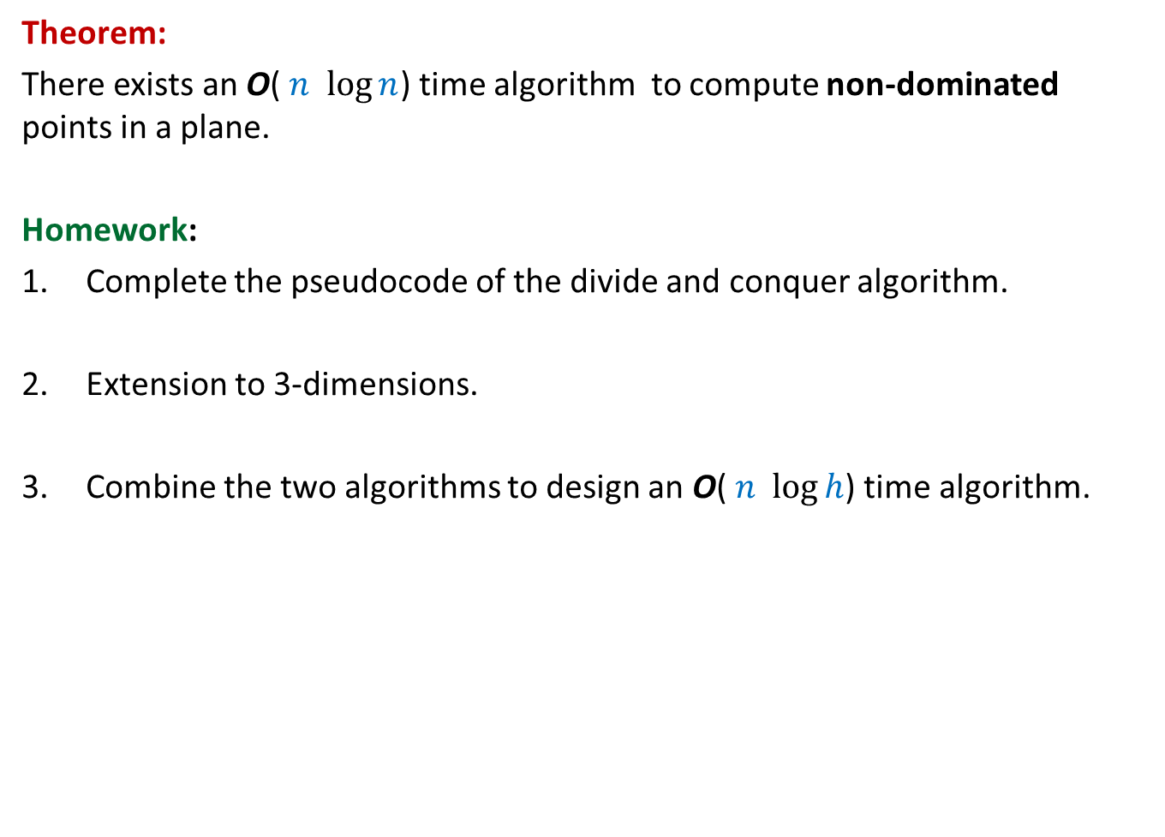
Theorem:
There exists an O( $n$ $\log{n}$) time algorithm to compute non-dominated points in a plane.
Homework:
Complete the pseudocode of the divide and conquer algorithm.
Extension to 3-dimensions.
Combine the two algorithms to design an O( $n$ $\log{h}$) time algorithm.

