Slide 1
Design and Analysis of Algorithms
CS345
Lecture 4
Data Structures :
The power of Binary Search Tree

Slide 2
Revisiting
Binary Search Tree

Slide 3

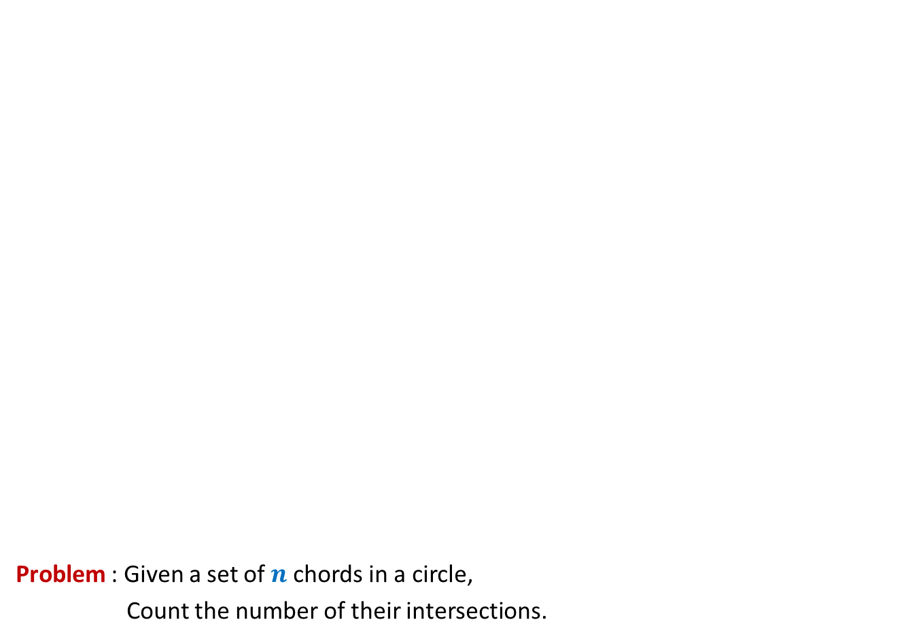
Problem : Given a set of $n$chords in a circle,
Count the number of their intersections.
O($n$ log $n$)

Slide 4
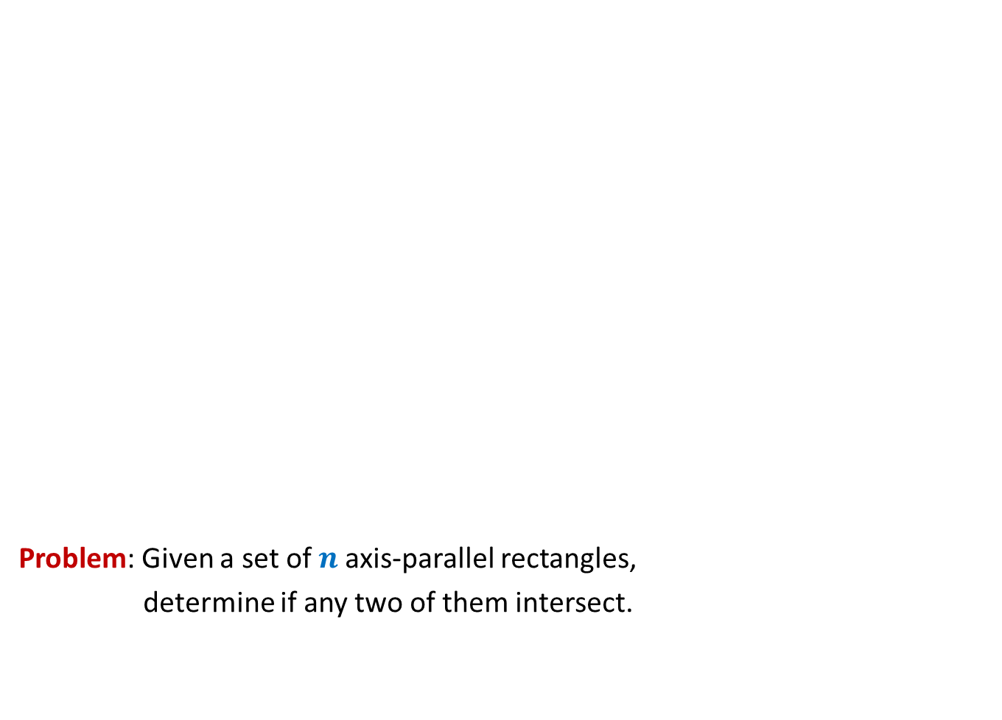
Surprising applications of data structures
Problem: Given a set of $n$axis-parallel rectangles,
determine if any two of them intersect.
O($n$ log $n$)

Slide 5
Red Black tree
(Height Balanced BST)
Operations you already know
Search(T,x)
Insert(T,x)
Delete(T,x)
Min(T)
Max(T)
Predecessor(T,x)
Successor(T,x)
A NOTATION
T < T’ :
every element of T is smaller than every
element of T’.
8. SpecialUnion(T, T’):
Given T and T’ such that T < T’,
compute T*=TUT’.
NOTE: T and T’ don’t exist after the union.
9. Split(T, x):
Split T into T’ and T’’ such that T’ < x < T’’.
Every operation in O(log n) time.

Slide 6
Red-Black Tree
How well have you understood it ?

Slide 7
Insertion in a red-black tree
Can you handle color-imbalance
in general as well ?
T
46
Yes
28
67
5
35
49
83
2
25
31
41
54
44
Color imbalance

Slide 8
SpecialUnion(T,T’)
Remember:
every element of T is smaller than every element of T’

Slide 9
SpecialUnion(T,T’)

Slide 10
A trivial algorithm that does not work
Time complexity: O(log n)
Height balance lost
<
T
T’

Slide 11
Towards an O(log n) time for SpecialUnion(T,T’) …
Can we solve some simple cases easily ?
Simplifying the problem
Solving the simpler version efficiently
Extending the solution to generic version

Slide 12
Simplifying the problem
Simplified problem:
Given two trees T, T’ of same black height
and a key x, such that T<x<T’,
transform them into a tree T*=TU{x}UT’
x
<
<
T
T’

Slide 13
Solving the simplified problem
Simplified problem:
Given two trees T, T’ of same black height
and a key x, such that T<x<T’,
transform them into a tree T*=TU{x}UT’
x
O (1) time
<
<
T
T’

Slide 14
Extending the algorithm to the generic problem
T
T’

Slide 15
Extending the algorithm to the generic problem
x
<
<
T
T’

Slide 16
Extending the algorithm to the generic problem
x
T
T’

Slide 17
Extending the algorithm to the generic problem
x
T
T’

Slide 18
Extending the algorithm to the generic problem
v
x
T
T’’

Slide 19
Extending the algorithm to the generic problem
v
x
T
T’’

Slide 20

Extending the algorithm to the generic problem
Algorithm for SpecialUnion(T,T’):
Let x be the node storing smallest element of T’.
Delete the node x from T’.
Let black height of T ≤ black height of T’
Keep following left pointer of T’ until we reach a node v such that
  left(v) is black
  The subtree T” rooted at Left(v) has black height same as that of T
left(x)← T;
right(x) ← T”;
Color(x)← red;
left(v)← x;
parent(x)← v;
If color(v) is red, remove the color imbalance
(like in the usual procedure of insertion in a red-black tree)
Total time : O(log $n$)

Slide 21
Split(T,x)

Slide 22

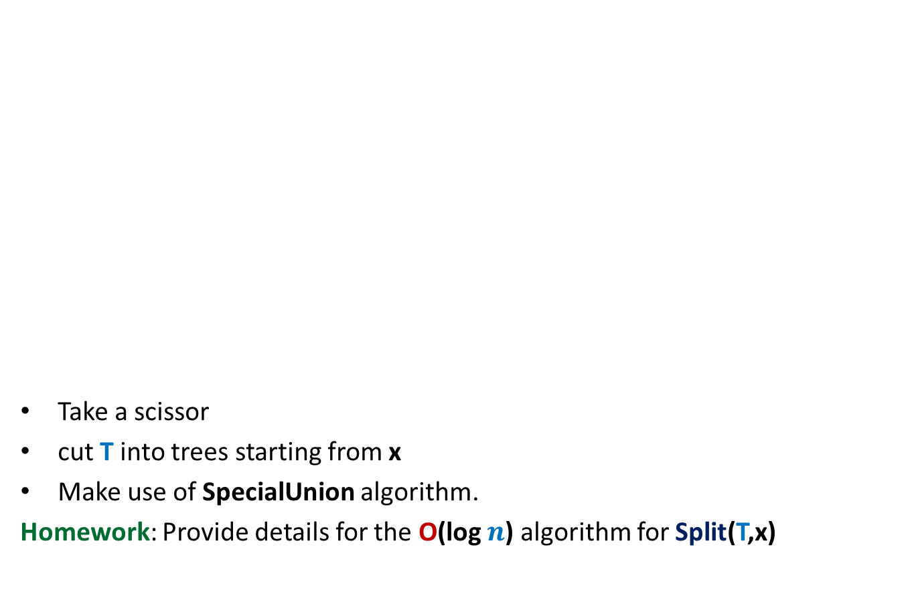

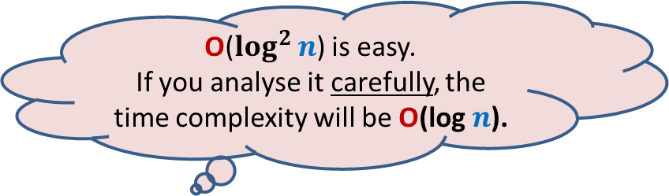
Achieving O(log $n$) time for Split(T,x)
O($\log^{2}{n}$) is easy.
If you analyse it carefully, the time complexity will be O(log $n$).
Take a scissor
cut T into trees starting from x
Make use of SpecialUnion algorithm.
Homework: Provide details for the O(log $n$) algorithm for Split(T,x)
x
T

Slide 23
Height Balanced BST
(Red-black tree, AVL tree)
Operations you already know
New operation
Search(T,x)
Insert(T,x)
Delete(T,x)
Min(T)
Max(T)
Predecessor(T,x)
Successor(T,x)
SpecialMerge(T, T’)
Split(T,x)
10. FindRank(T, x):
return the no. of elements in T that are smaller
than x.
Every operation in O(log n) time.

Slide 24
Find-rank(T,x)

Slide 25

A trivial algorithm for Find-rank(T,x)
T
Repeatedly find predecessors of x and stop when you reach the min element.
Time complexity: O ($k$ log $n$) (where $k$ is rank of x in T)
Homework: Show that all predecessors can be computed in O($k$+ log $n$) time.
46
28
67
5
35
49
2
25
31
41
48
53

Slide 26
Achieving O(log n) time for FindRank(T,x)
Assume without loss of generality that x belongs to T.
View the entire tree T from perspective of the path from x to the root.
How will T look like ?
x
T

Slide 27
Achieving O(log n) time for FindRank(T,x)
Can you identify the elements that contribute to Rank of x in this picture ?
Elements that are present in the subtrees lying to the left of this path.
And some elements on this path.
x
T

Slide 28
An elegant solution
Fields associated with a node v in T:
Value(v)
Left(v)
right (v)
parent(v)
Keep one more field
Size(v): The number of nodes stored in the subtree rooted at v.

Slide 29
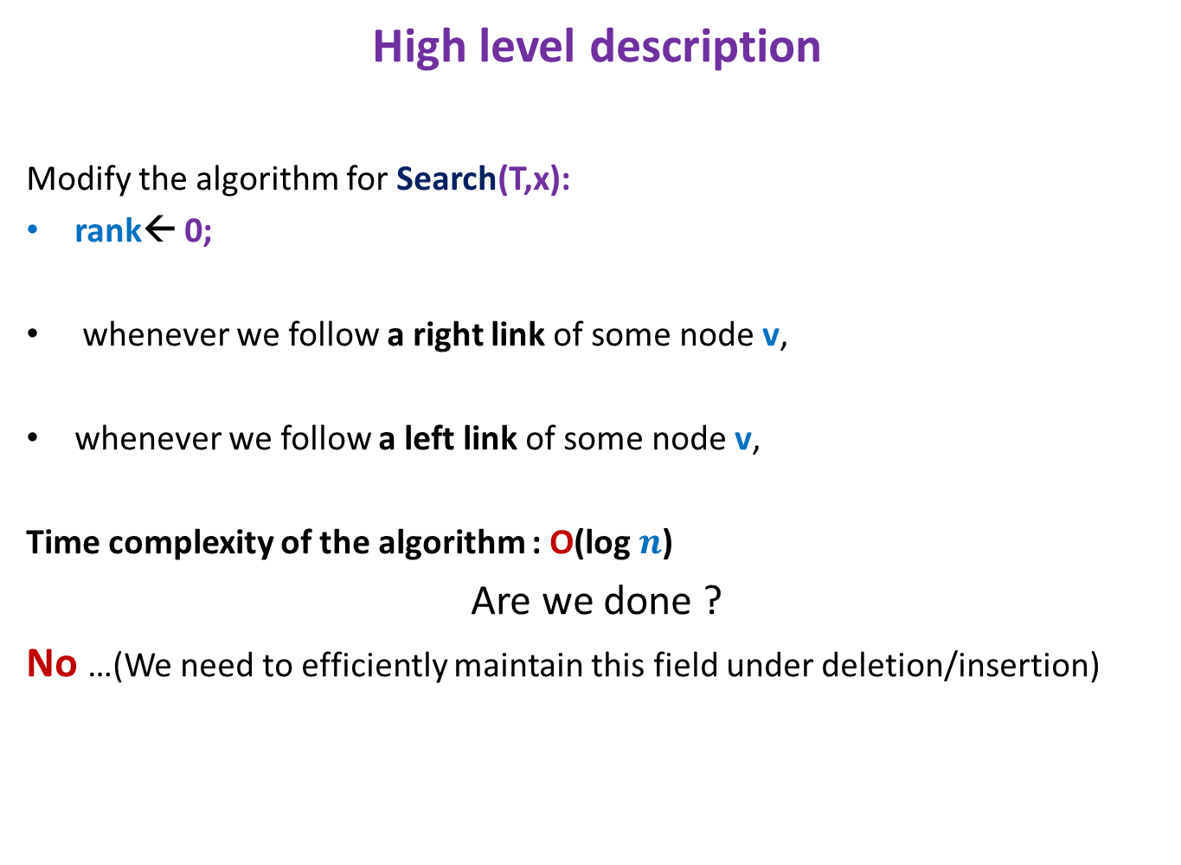
Algorithm for FindRank(T,x)
High level description
Modify the algorithm for Search(T,x):
rank← 0;
whenever we follow a right link of some node v,
whenever we follow a left link of some node v,
Time complexity of the algorithm : O(log $n$)
Are we done ?
No …(We need to efficiently maintain this field under deletion/insertion)
rank← rank + size(left(v)) + 1
Do nothing

Slide 30
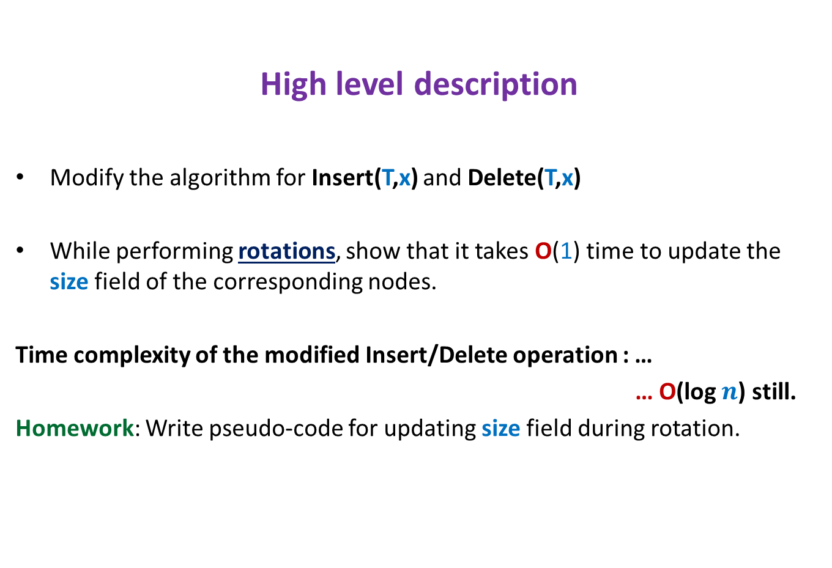
Maintaining size field T under insertion/deletion
High level description
Modify the algorithm for Insert(T,x) and Delete(T,x)
While performing rotations, show that it takes O(1) time to update the size field of the corresponding nodes.
Time complexity of the modified Insert/Delete operation : …
… O(log $n$) still.
Homework: Write pseudo-code for updating size field during rotation.

