Slide 1
Design and Analysis of Algorithms
CS345
Lecture 5
Data structures for
  Orthogonal Range Searching
  Dynamic sequences

Slide 2





Orthogonal Range searching
RangeSearch(T, $x_{1}$, $x_{2}$, $y_{1}$, $y_{2}$):
Report all points in the rectangle defined by ($x_{1}$, $x_{2}$, $y_{1}$, $y_{2}$)
$$y_{2}$$
$$y_{1}$$
Rectangle
$$x_{1}$$
$$x_{2}$$

Slide 3
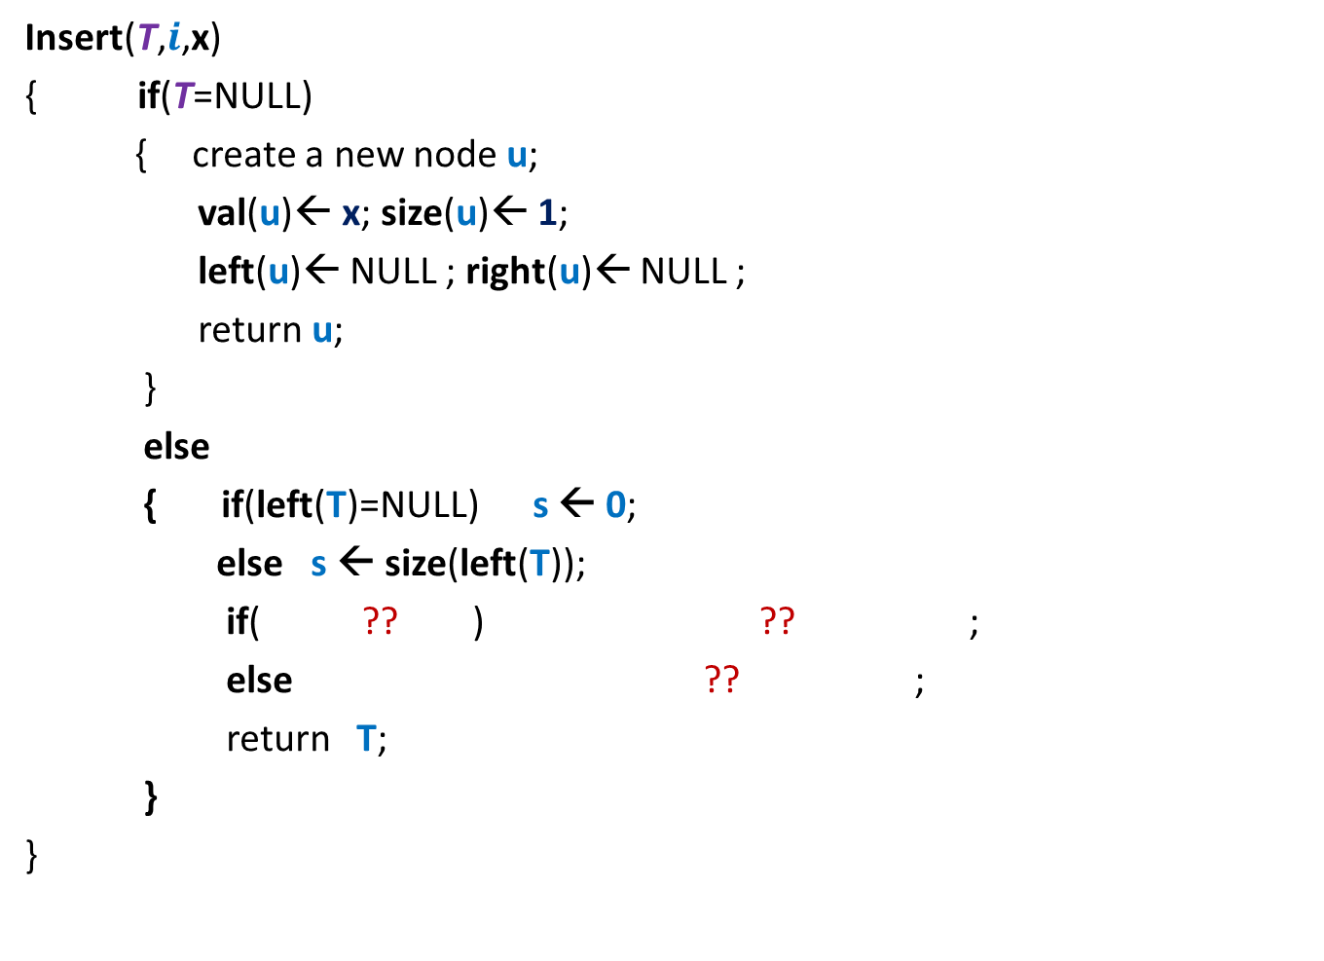
Orthogonal Range searching
Data structure: Size = O($n log n$),
Query = O($k+ \log^{2} n$),
Preprocessing time = O($n log n$)
Rectangle
No. of points in query rectangle

Slide 4
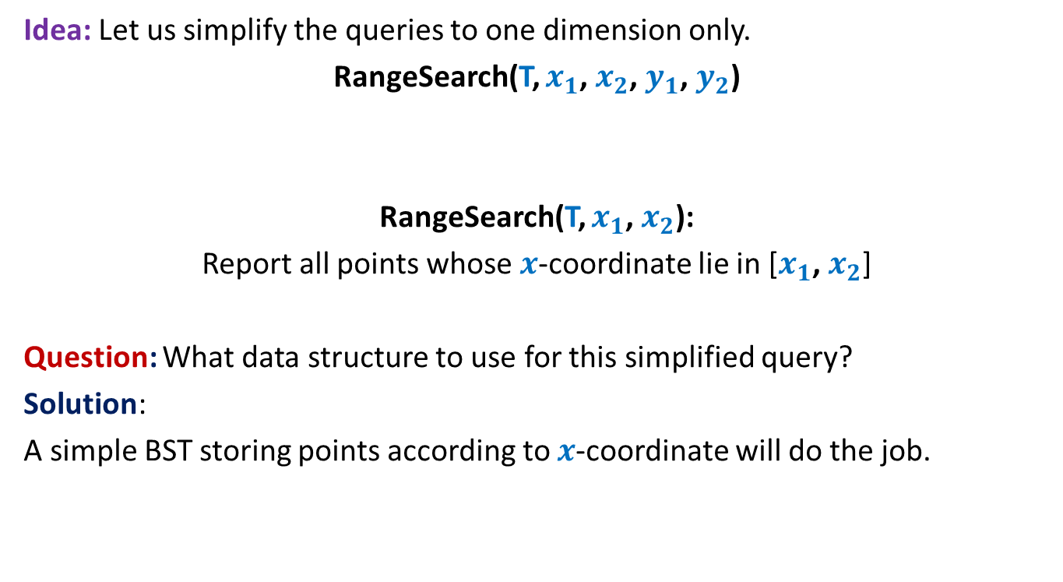
Orthogonal Range searching
Idea: Let us simplify the queries to one dimension only.
RangeSearch(T, $x_{1}$, $x_{2}$, $y_{1}$, $y_{2}$)
RangeSearch(T, $x_{1}$, $x_{2}$):
Report all points whose $x$-coordinate lie in [$x_{1}$, $x_{2}$]
Question: What data structure to use for this simplified query?
Solution:
A simple BST storing points according to $x$-coordinate will do the job.

Slide 5





RangeSearch(T, $x_{1}$, $x_{2}$):
Binary search tree on $x$-coordinates
View the entire tree T from perspective of the paths from $x_{1}$ and $x_{2}$ to the root.
How will T look like ?
LCA
$x_{2}$
$x_{1}$
T

Slide 6
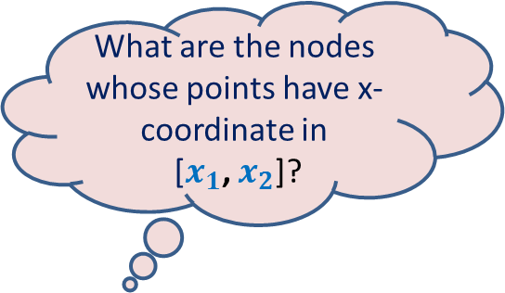

RangeSearch(T, $x_{1}$, $x_{2}$):
Binary search tree on x-coordinates
What are the nodes whose points have x-coordinate in
[$x_{1}$, $x_{2}$]?
LCA
$x_{2}$
$x_{1}$
T

Slide 7
RangeSearch(T, $x_{1}$, $x_{2}$):
Binary search tree on x-coordinates
LCA
$x_{2}$
$x_{1}$
T

Slide 8
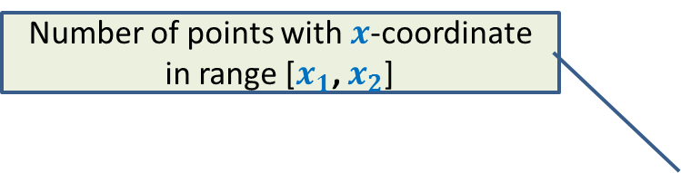

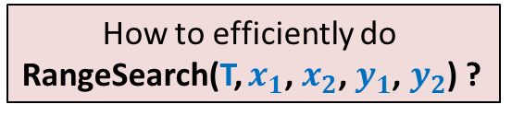
RangeSearch(T, $x_{1}$, $x_{2}$):
Number of points with $x$-coordinate in range [$x_{1}$, $x_{2}$]
Binary search tree on x-coordinates
How to efficiently do
RangeSearch(T, $x_{1}$, $x_{2}$, $y_{1}$, $y_{2}$) ?
Query time = O($k+log n$),
LCA
$x_{2}$
$x_{1}$
T

Slide 9
How should we augment each node?
Augment each node v with a pointer to another BST storing all points of T(v) according to y-coordinates.
value
Color-bit
Y-tree
left
v
right
BST storing T(v) according to y-coordinate
T(v)
v

Slide 10

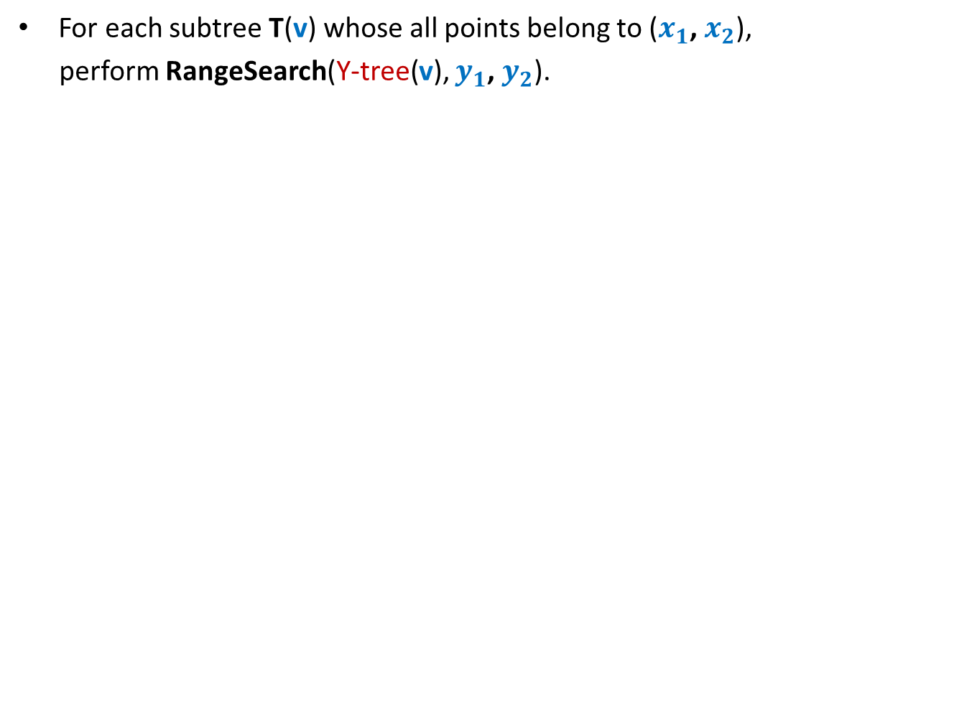

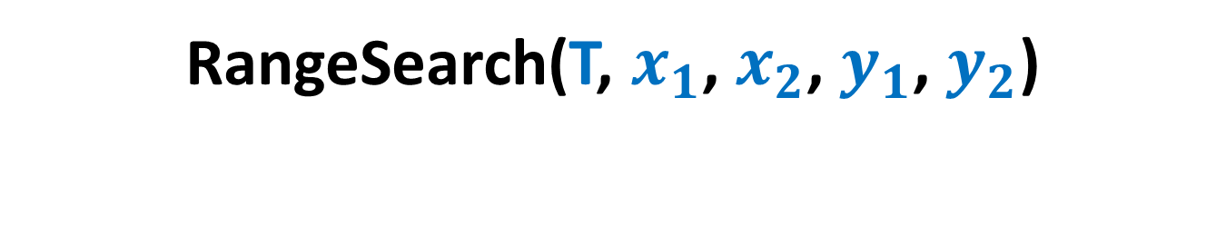
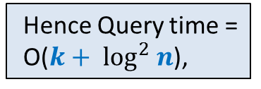
RangeSearch(T, $x_{1}$, $x_{2}$, $y_{1}$, $y_{2}$)
For each subtree T(v) whose all points belong to ($x_{1}$, $x_{2}$),
perform RangeSearch(Y-tree(v), $y_{1}$, $y_{2}$).
For each such subtree, time complexity will be O($k′+log n$), where $k′$are the points present in that subtree that belong to rectangle($x_{1}$, $x_{2}$, $y_{1}$, $y_{2}$).
LCA
There are O($log n$) such subtrees.
Hence Query time =
O($k+ \log^{2} n$),
$x_{2}$
$x_{1}$
T

Slide 11



Space of the data structure
Consider all the nodes at level $i$.
1
2
3
4
. . .
. . .
$$i$$
. . .
. . .
T
O(Log $n$)
BST before augmentation

Slide 12














Space of the data structure
$n_{1}$+ $n_{2}+$ $n_{3}$ + …+ $n_{j}$ < $n$
Total space due to the y-trees at level $i$ :
= $n_{1}$+ $n_{2}+$ $n_{3}$ + …+ $n_{j}$
= O($n$).
$$1$$
$$2$$
$$3$$
. . .
$$j$$
$$i$$
$$n_{1}$$
$$n_{2}$$
$$n_{3}$$
$$n_{j}$$
Total Space = O($n log n$),
. . .
$$n_{1}$$
$$n_{2}$$
T
$$n_{3}$$
$$n_{j}$$
BST before augmentation

Slide 13
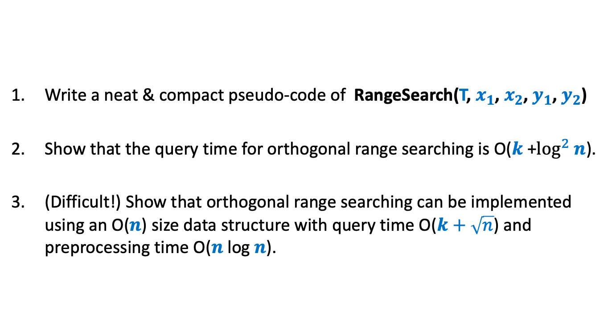
Homework
Write a neat & compact pseudo-code of RangeSearch(T, $x_{1}$, $x_{2}$, $y_{1}$, $y_{2}$)
Show that the query time for orthogonal range searching is O($k$+$\log^{2} n$).
(Difficult!) Show that orthogonal range searching can be implemented using an O($n$) size data structure with query time O($k+\sqrt{n}$) and preprocessing time O($n$log $n$).

Slide 14
Data Structure
For Dynamic Sequences

Slide 15



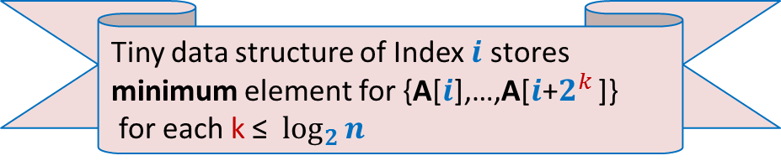

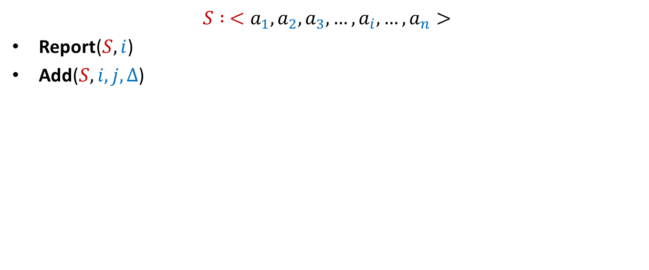




Dynamic Sequences
$$S : <a_{1}, a_{2},a_{3},…,a_{i}, …,a_{n}>$$
Report($S,i$)
Add($S,i,j,Δ$)
Add($S,3,8,6$)
Report($S,5$)
$$S$$
$$5$$
$$3$$
$$1$$
$$701$$
$$23$$
$$19$$
$$41$$
$$83$$
$$8$$
$$5$$

Slide 16




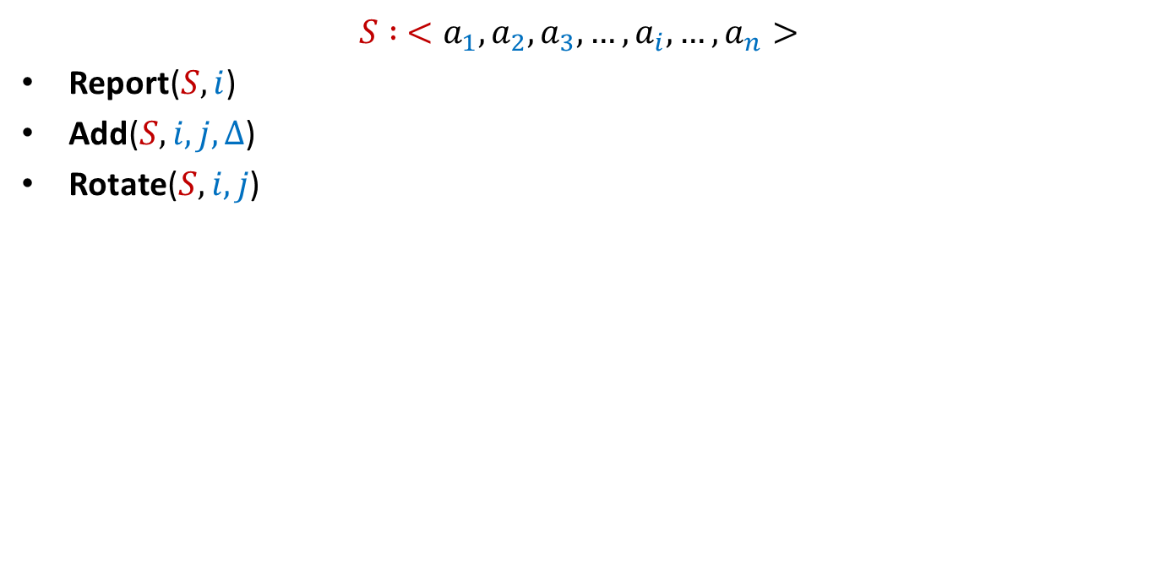


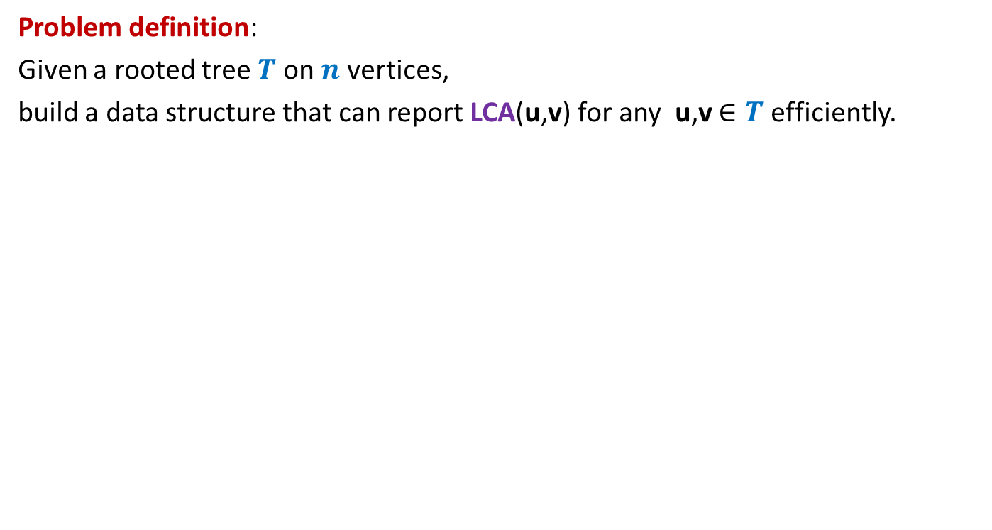






Dynamic Sequences
$$S : <a_{1}, a_{2},a_{3},…,a_{i}, …,a_{n}>$$
Report($S,i$)
Add($S,i,j,Δ$)
Rotate($S,i,j$)
$≈$ log $n$
Rotate($S,4,8$)
$$S$$
$$5$$
$$89$$
$$707$$
$$3$$
$$68$$
$$7$$
$$707$$
$$29$$
$$89$$
$$47$$
$$25$$
$$25$$
$$47$$
$$29$$
$$8$$
$$5$$

Slide 17
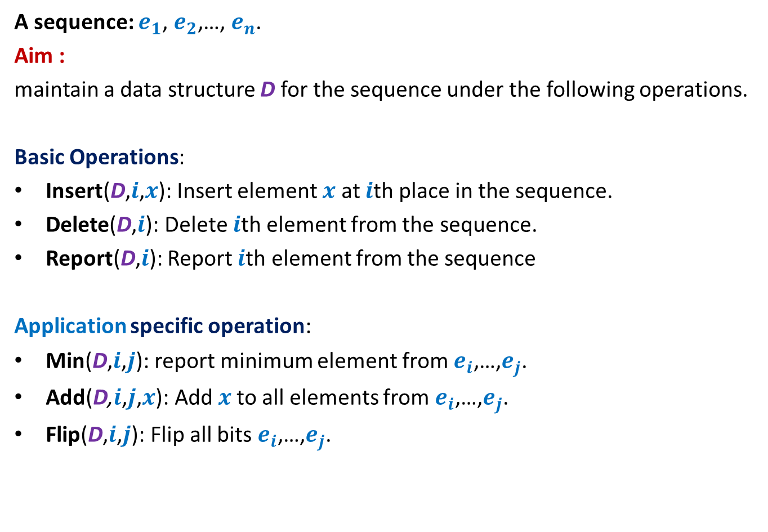
Dynamic Sequence
A sequence: $e_{1}$, $e_{2}$,…, $e_{n}$.
Aim :
maintain a data structure D for the sequence under the following operations.
Basic Operations:
Insert(D,$i$,$x$): Insert element $x$ at $i$th place in the sequence.
Delete(D,$i$): Delete $i$th element from the sequence.
Report(D,$i$): Report $i$th element from the sequence
Application specific operation:
Min(D,$i$,$j$): report minimum element from $e_{i}$,…,$e_{j}$.
Add(D,$i$,$j$,$x$): Add $x$to all elements from $e_{i}$,…,$e_{j}$.
Flip(D,$i$,$j$): Flip all bits $e_{i}$,…,$e_{j}$.
OR
OR

Slide 18



Representing sequence using a BST
A sequence: $e_{1}$, $e_{2}$,…, $e_{n}$.
Example: $6$, $0$, $5$, $13$, $2$, $14$, $1$, $32$.
“Inorder traversal produces the sequence.”
How can we represent a sequence using BST ?
$$2$$
$$0$$
$$1$$
$$6$$
$$5$$
$$14$$
$$32$$
$$13$$

