Slide 1
Computer Networks II
TCP Congestion Control
TCP Tahoe and TCP Reno
Amitangshu Pal
Computer Science and Engineering
IIT Kanpur

Slide 2

Network Congestion
Routers have input/output queue
  These queues get filled up → leads to congestion
Host A
Switch
fabric
Host B

Slide 3
Effects of Congestion
R/2
Host A
All link capacity = R
Host B
Retransmitting undelivered packets: Packets can be lost, dropped at router due to full buffers
Retransmitting timeout packets: Sender timers can time out prematurely, sending two copies, both of which are delivered
  Decrease maximum achievable goodput

Slide 4
Effects of Congestion
R/2
Host A
All link capacity = R
Host B
We want to operate just before the onset of congestion
  Avoid congestion
  Most capacity is used
  Needs to be fair across competitive flows

Slide 5
Challenges of Congestion Control
How the senders will know whether there is a congestion or not?
No explicit feedback from network
  Congestion inferred from observed loss, delay
Host A
Host B

Slide 6
Challenges of Congestion Control
The senders need to adapt/tune the sending rates to match the available bandwidth of the bottleneck link
  Sending rate= function (available bandwidth of the bottleneck link)
Which link has the lowest available bandwidth?
  Sender does not have the global picture
Available bandwidth varies with time
  Number of flows and their offered load is dynamic
  Bottleneck link can also vary
Capacity
Bandwidth
Time

Slide 7
Challenges of Congestion Control
The senders need to adapt/tune the sending rates to match the available bandwidth of the bottleneck link
  Sending rate= function (available bandwidth of the bottleneck link)
Which link has the lowest available bandwidth?
  Sender does not have the global picture
Available bandwidth varies with time
  Number of flows and their offered load is dynamic
  Bottleneck link can also vary

Slide 8
Challenges of Congestion Control
The senders need to adapt/tune the sending rates to match the available bandwidth of the bottleneck link
  Sending rate= function (available bandwidth of the bottleneck link)
Which link has the lowest available bandwidth?
  Sender does not have the global picture
Available bandwidth varies with time
  Number of flows and their offered load is dynamic
  Bottleneck link can also vary

Slide 9
TCP Congestion Control
Senders need to adapt/tune the sending rate
  How many bytes are inside the network → called congestion window or cwnd
TCP sender limits transmission:
sender sequence number space
LastByteSent - LastByteAcked ≤ cwnd
cwnd
TCP sending behavior : send cwnd bytes, wait RTT for ACKS, then send more bytes
last byte
ACKed
TCP rate
cwnd
sent, but not-yet ACKed
(“in-flight”)
available but not used
~
bytes/sec
~
RTT
last byte sent
cwnd is dynamically adjusted in response to observed network congestion → Implementing TCP congestion control

Slide 10
TCP Congestion Control: AIMD
Approach: Senders can increase sending rate until packet loss (congestion) occurs, then decrease sending rate on loss event
Additive Increase
Multiplicative Decrease
  Additively increase rate until network is not congested
  Multiplicatively decrease rate when congestion occurs
AIMD sawtooth
behavior: probing
for bandwidth
TCP sender Sending rate
Time

Slide 11
TCP Tahoe

Slide 12
TCP slow start
Host A
Host B
Slow start (cwnd = 1 MSS)
Assumption: 1 MSS = 1 Byte
CW = 1
1 2 3 4 5 6 7 8
B1
Host A
Host B
A2
CW = CW + 1 = 2
1 2 3 4 5 6 7 8
one segment
B2
RTT
B3
two segments
RTT
A3
CW = CW + 1 = 3
1 2 3 4 5 6 7 8
A4
four segments
B4
B5
CW = CW + 1 = 4
1 2 3 4 5 6 7 8
B6
CW is doubling in every RTT → exponential increase of CW
B7

Slide 13
TCP Slow Start
When connection begins, increase rate exponentially until first loss event:
  Initially cwnd = 1 MSS
  Double cwnd every RTT
  Done by incrementing cwnd for every ACK received
Host A
Host B
one segment
RTT
two segments
four segments
Summary: Initial rate is slow, but ramps up exponentially fast
time

Slide 14
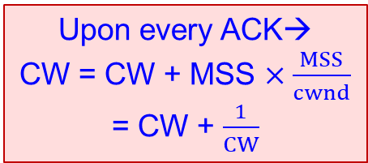
TCP Congestion Avoidance
Host A
Host B
Upon every ACK→
CW = CW + MSS $×\frac{MSS}{cwnd}$
= CW + $\frac{1}{CW}$
After ssthresh, reduce the rate of CW increase
Host A
Host B
A4
B4
CW = 1
1 2 3 4 5 6 7 8
B1
B5
CW = CW + 1 = 4
1 2 3 4 5 6 7 8
A5
B6
A2
B7
CW = 4 + 1/4
1 2 3 4 5 6 7 8 9 10 11 12 13
A6
CW = CW + 1 = 2
1 2 3 4 5 6 7 8
B8
B2
CW = 4 + 2/4
1 2 3 4 5 6 7 8 9 10 11 12 13
A7
B3
B9
CW = 4 + 3/4
1 2 3 4 5 6 7 8 9 10 11 12 13
A8
A3
B10
CW = 4 + 4/4 = 5
1 2 3 4 5 6 7 8 9 10 11 12 13
CW = CW + 1 = 3
1 2 3 4 5 6 7 8
A4
B11
B4
B12
B5

Slide 15
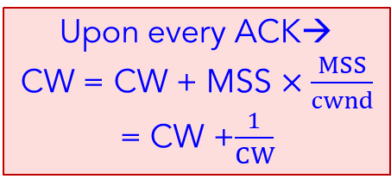
TCP Congestion Avoidance
Host A
Host B
Upon every ACK→
CW = CW + MSS $×\frac{MSS}{cwnd}$
= CW +$\frac{1}{CW}$
After ssthresh, reduce the rate of CW increase
Host A
Host B
A4
B4
B5
CW = 1
one segment
CW = CW + 1 = 4
1 2 3 4 5 6 7 8
RTT
B6
CW = 2
B7
two segments
CW = 4 + 1/4
1 2 3 4 5 6 7 8 9 10 11 12 13
A6
RTT
B8
CW = 4 + 2/4
1 2 3 4 5 6 7 8 9 10 11 12 13
A7
CW = 4
four segments
B9
CW = 4 + 3/4
1 2 3 4 5 6 7 8 9 10 11 12 13
A8
RTT
CW = 5
B10
CW = 4 + 4/4 = 5
1 2 3 4 5 6 7 8 9 10 11 12 13
B11
After 1 RTT, the CW is approx. increasing by 1 MSS → Congestion avoidance
B12

Slide 16
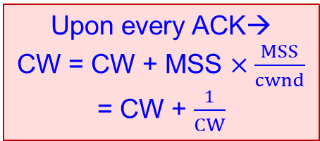
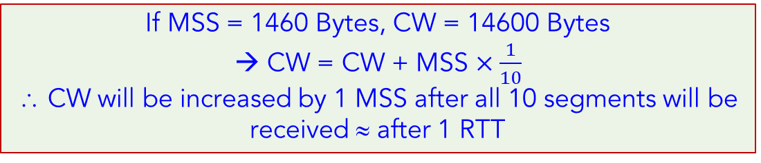
TCP Congestion Avoidance
Upon every ACK→
CW = CW + MSS $×\frac{MSS}{cwnd}$
= CW + $\frac{1}{CW}$
After ssthresh, reduce the rate of CW increase
Host A
Host B
CW = 1
one segment
RTT
If MSS = 1460 Bytes, CW = 14600 Bytes
→ CW = CW + MSS $×\frac{1}{10}$
∴ CW will be increased by 1 MSS after all 10 segments will be received ≈ after 1 RTT
CW = 2
two segments
RTT
CW = 4
four segments
RTT
CW = 5
After 1 RTT, the CW is approx. increasing by 1 MSS → Congestion avoidance

Slide 17
TCP Congestion Avoidance
After ssthresh, reduce the rate of CW increase
Host A
Host B
CW = 1
one segment
RTT
CW = 2
two segments
RTT
CW = 4
four segments
RTT
CW = 5
After 1 RTT, the CW is approx. increasing by 1 MSS → Congestion avoidance

Slide 18
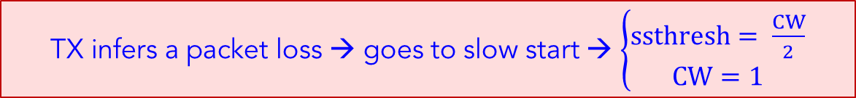
Packet/ACK Drop
Host A
Host B
Host A
Host B
Host A
Host B
CW = 2
B1
B2
B1
B1
X
timeout
A2
X
timeout
timeout
A3
A2
X
CW = 4
TX infers a packet loss → goes to slow start → $\left\{\begin{aligned}ssthresh= \frac{CW}{2} \\ CW=1\end{aligned}\right.$

Slide 19
TCP Fast Retransmit
Host A
Host B
If sender receives 3 duplicate ACKs:
  Likely that unACKed segment lost, so don’t wait for timeout
  Resend unACKed segment with smallest seq #
A5
B5
X
B6
B7
B8
timeout
A5
A5
A5
B5
Notes:
Let’s wrap up our study of TCP reliability by discussing an optimization to the original TCP known as TCP fast retransmit,
Take a look at this example on the right where 5 segments are transmitted and the second segment is lost. In this case the TCP receiver sends an ACK 100 acknowledging the first received segment.
When the third segment arrives at the receiver, the TCP receiver sends another ACK 100 since the second segment has not arrived. And similarly for the 4th and 5th segments to arrive.
Now what does the sender see? The sender receives the first ACK 100 it has been hoping for, but then three additional duplicate ACK100s arrive. The sender knows that somethings’ wrong – it knows the first segment arrived at the receiver but three later arriving segments at the receiver – the ones that generated the three duplicate ACKs – we received correctly but were not in order. That is, that there was a missing segment at the receiver when each of the three duplicate ACK were generated.
With fast retransmit, the arrival of three duplicate ACK causes the sender to retransmit its oldest unACKed segment, without waiting for a timeout event. This allows TCP to recover more quickly from what is very likely a loss event
specifically that the second segment has been lost, since three higher -numbered segments were received

Slide 20

TCP Tahoe: Slow start followed by additive increase
X

Slide 21
TCP Tahoe
.
new ACK
new ACK
cwnd = cwnd + MSS (MSS/cwnd)
transmit new segment(s), as allowed
cwnd = cwnd+MSS
transmit new segment(s), as allowed
L
cwnd = 1 MSS
ssthresh = 64 KB
Slow
start
cwnd > ssthresh
L
Congestion
avoidance
Timeout or 3 Duplicate ACK
timeout
ssthresh = cwnd/2
cwnd = 1 MSS
retransmit missing segment
ssthresh = cwnd/2
cwnd = 1 MSS
retransmit missing segment

Slide 22
TCP Reno

Slide 23
Fast Recovery
Host A
Host B
3 DupACks
Trigger Fast Retransmit
1. Ssthresh = CW/2
2. Transmit missing segment that is definitely causing DupAcks
3. CW = ssthresh + 3
4. Transmit new segments of CW allows
5. More DupAcks:
CW = CW + 1
Transmit new segments if CW allows
6. Normal ACK:
CW = ssthresh
Start congestion avoidance
Host A
Host B
A5
A5
A5
B5
A5
B6
B5
B7
B8
B9
timeout
A5
A5
A10
A5
B11
B12

Slide 24
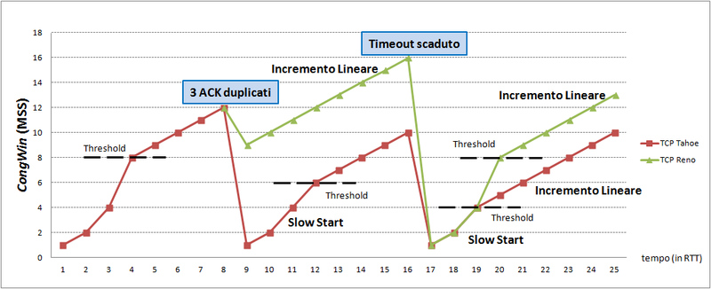
TCP Reno vs TCP Tahoe
Src: https://commons.wikimedia.org/wiki/File:CongWin_in_TCP_Tahoe_e_Reno.png

Slide 25
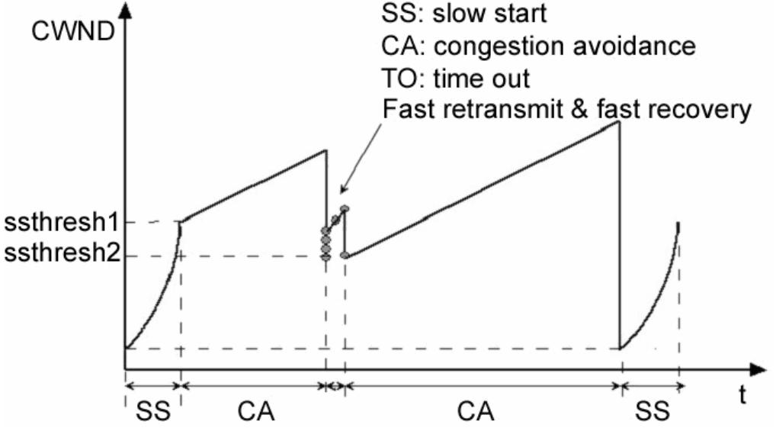
TCP Reno vs TCP Tahoe
Src: https://www.sfu.ca/~ljilja/papers/WM-195.PacketControl_edited.pdf

Slide 26
TCP Reno: TCP Tahoe + Fast recovery
.
duplicate ACK
new ACK
dupACKcount++
new ACK
cwnd = cwnd + MSS × (MSS/cwnd)
dupACKcount = 0
transmit new segment(s), as allowed
L
cwnd = cwnd+MSS
dupACKcount = 0
transmit new segment(s), as allowed
cwnd = 1 MSS
ssthresh = 64 KB
dupACKcount = 0
Slow
start
cwnd > ssthresh
Congestion
avoidance
L
timeout
ssthresh = cwnd/2
cwnd = 1 MSS
dupACKcount = 0
retransmit missing segment
duplicate ACK
timeout
dupACKcount++
ssthresh = cwnd/2
cwnd = 1 MSS
dupACKcount = 0
retransmit missing segment
timeout
ssthresh = cwnd/2
cwnd = 1
dupACKcount = 0
retransmit missing segment
New ACK
dupACKcount == 3
cwnd = ssthresh
dupACKcount = 0
dupACKcount == 3
ssthresh= cwnd/2
cwnd = ssthresh + 3
retransmit missing segment
ssthresh= cwnd/2
cwnd = ssthresh + 3
retransmit missing segment
Fast
recovery
duplicate ACK
cwnd = cwnd + MSS
transmit new segment(s), as allowed

Slide 27
TCP Throughput
Avg. TCP throughput as function of window size, RTT?
  Ignore slow start, assume always data to send
W: window size (measured in bytes) where loss occurs
  Avg. window size (# in-flight bytes) is ¾ W
  Avg. throughput is 3/4W per RTT
W
W/2
3
W
Avg TCP throughput =
RTT
bytes/sec
4

Slide 28
Summary
Network congestion control:
  Challenges of congestion
  TCP congestion control
    TCP Tahoe and TCP Reno

