Slide 1



Body Worn Video Audit (BWA) EXL’s Intelligence Platform
09th April 2026

Slide 2
PoC Initial understanding, Assumptions and Expectations
Body‑worn camera video recordings are available on the client side, currently, Marston uses the Video Lens application to review recordings and associated metadata.
Video data is required to be securely transferred from the client environment into the EXL environment for processing.
Assumed ingestion approach for POC:
Client requests upload access → system returns pre‑signed S3 URL → client uploads videos (multipart).
UI‑based uploads and direct object‑store sync are out of scope for the initial POC.
Recording format assumptions:
Container formats: MP4, MKV
Video codecs: H.264, H.265
Resolution: 720p / 1080p
Variable bitrate, depending on recording conditions and device configuration.
Input videos length is average 45-60 Min long
Platform expected to process 1,000 - 3,000 videos per day in batch mode.
AI core should auto‑scale horizontally to handle varying ingestion volumes.
GPU resources to be used efficiently and cost‑optimally.
Media will be normalized into AI‑ready formats for consistent inference.
Preprocess design and implementation success criteria:
Stable batch processing
Efficient GPU utilization and optimized cost usage
Accurate AI outputs suitable for QC and compliance analysis

Slide 3










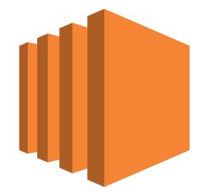

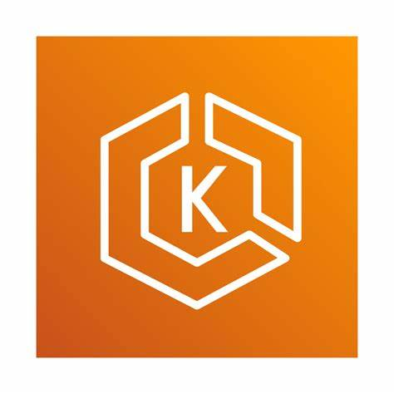


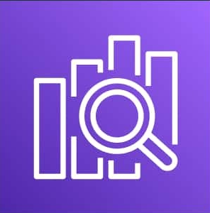




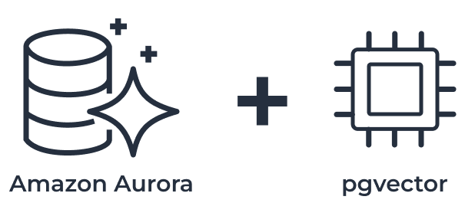

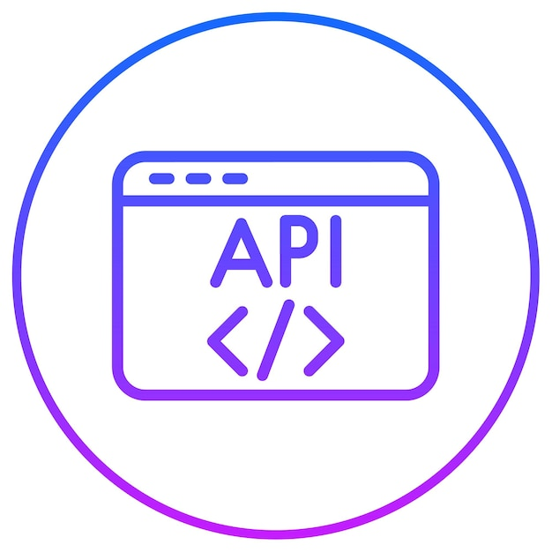
Body Worn Video Audit Intelligence Platform - Infrastructure Architecture
BWC-001-v1.0 · Marston Holdings · PoC · eu-west-2 London · Proprietary & Confidential
AWS Account · eu-west-2 London
VPC · Private Subnets · VPC Endpoints (S3, Lambda, SQS) · all traffic stays on AWS backbone
Video Metadata
INGESTION
1
NVR
BWC / Body Lens
Lambda
Presigned URL
S3 Object Lock
DynamoDB
AWS CloudFront
AWS WAF
footage vault
Metadata
PRE- PROCESS . AI CORE
NVIDIA NGC
ECS EC2 g6.2.xlarge · NVIDIA AI Core
One-time pull
to ECR on setup
2
SOP Config · Routing
DS
Q1 · Q2 · Q3 Risk Scoring
Orchestration FFMPEG
DeepStream
3
ECS
ECR
TRT
NRM
NLP
GRD
EFS
DynamoDB
Extract WAV 16Khz mono
Lambda
Lambda
SOP config · case data
Amazon SQS
ECR
Triton
ASR
Normalization
NIM + NLP
NeMo Guardrails
EFS /models
RESULTS & RETENTION
Riva
4
Development
Cloud Watch
CloudTrail
Aurora SLv2
Lambda
Presigned URL
S3 Object Lock
Records metric
Records action
results · transcripts
footage vault
EC 2 G5.2xlarge
Github Enterprise
EKS
AWS Bedrock
Sagemaker
Open Search Service
DASHBOARD
VSS
TAO
S3
VSS Blueprint
Hugging face
NVIDIA NIM
TAO Toolkit
Open AI
Aurora + Pgvector
Internet User / Supervisor
AWS WAF
Cognito
REST API GW
Agent portal
SOP admin / ECB

Slide 4
End-to-End Architecture Overview
Ingestion
Body‑worn camera videos and metadata are ingested from the client VMS (Body‑Lens)
CloudFront + WAF secure ingress traffic, while a Lambda acts as the control plane to validate requests and generate pre‑signed S3 URLs.
Raw video and metadata are uploaded directly to Amazon S3 (UK region) with Object Lock enabled, ensuring immutability and legal defensibility.
Ingestion metadata and processing state are captured in DynamoDB for orchestration.
Pre Process AI Core
Ingestion events trigger event‑driven orchestration using Lambda and Amazon SQS
Media normalization is performed using FFmpeg converting audio into Riva‑compatible PCM/WAV and stored
GPU‑enabled ECS (EC2 launch type) runs the AI core on GPU instances managed by Auto Scaling Groups (ASG), enabling elastic horizontal scaling
AI components run as containerized services and include: :
NVIDIA DeepStream for vision processing (person detection, facial expression, camera readiness, proximity)
NVIDIA Vision Models with YOLO‑class / CV models executed within DeepStream pipelines
NVIDIA Riva for Automatic Speech Recognition (ASR)
NLP / reasoning models + LLM for intent, SOP phrase detection, and escalation cues
NVIDIA Triton Inference Server for centralized inference execution
AI containers are sourced from NVIDIA NGC, customized, stored in Amazon ECR, and executed by ECS.

Slide 5
End-to-End Architecture Overview
AI models, TensorRT engines, and configuration files are stored in Amazon EFS to provide a shared runtime repository across containers.
Outputs generated by upstream AI components (DeepStream, Riva, NLP) are consolidated and normalized into a interaction object to ensure consistency for downstream QC processing.
Guardrails are applied to outputs to enforce policy constraints, flag biased/unsafe interpretations and prevent sensitive information from propagating further.
Result & Retention
A serverless post‑AI Lambda layer evaluates AI outputs against configurable SOP rules and create classification (Low / Medium / High)
Final QC results, explanations, and audit metadata are stored in structured backend data stores in the UK region.
Audit logging and data encryption are enforced to comply with regulatory and retention requirements.
Dashboard
QC outcomes and audit insights are exposed through secured APIs.
A web‑based dashboard allows supervisors and compliance teams to review:
SOP compliance metrics
Risk classification trends
Escalation details
Evidence‑linked explanations
Video playback is enabled using time-limited pre-signed S3 Url’s, allowing direct secure access to immutable evidence
User access is controlled through authentication and authorization mechanisms.
Dashboards provide full drill‑down capability while maintaining traceability.

Slide 6
Region:-
AWS eu‑west‑2 (London)
EC2:-
G6.2Xlarge
g4dn.xlarge
g6e.2xlarge
Sudo access
SSH access
Internet Access
Lambda:-
Receive trigger request
Create pre-signed URL
Send jobs to queue
Update DB status
Perform rule-based check
Sagemaker Studio
GPU instance access for Sagemaker studio for experimentation
Jupyter Lab Notebooks access
Code editor access
AWS Bedrock :-
NVIDIA Nemotron Nano 9B v2

Slide 7
External Access & URL Whitelisting:-
nvcr.io
api.ngc.nvidia.com
registry.ngc.nvidia.com
huggingface.co
cdn-lfs.huggingface.co
github.com
raw.githubusercontent.com
objects.githubusercontent.com
openai.com
data.mendeley.com
zenodo.org
archive.org
datasets.kaggle.com
storage.googleapis.com
youtube.com
www.youtube.com
youtube.googleapis.com
googlevideo.com
cloudflare.com
pypi.org

