Slide 1

School of Computer Science and Engineering
Department of Computer Science and Engineering
Review of Multimodal Fusions in Crop Disease Detection
Submitted By:
Chaitanya Yadav
23FE10CSE00409
Supervised By:
Ms. Babita Tiwari

Slide 2
Outline
  Introduction
  Literature Review
  Problem Statement
  Proposed Solution
  Objectives

Slide 3
The Importance of AI in Agriculture
The fusion of artificial intelligence with agricultural practices represents a fundamental shift in crop management and disease prevention. Early plant disease detection is critical for sustainable agriculture, as timely intervention can prevent yield losses that average 20-30% annually across major crops worldwide. Traditional scouting methods are labor-intensive, subjective, and often detect issues too late for effective treatment.
Computer vision systems operating on RGB data alone have demonstrated promise but face significant limitations when confronted with environmental variables such as lighting conditions, soil background variation, and overlapping plant structures. Field conditions introduce noise that can overwhelm single-sensor classification systems, leading to false positives and missed diagnoses that undermine farmer trust in automated systems.
The integration of multiple sensing modalities—RGB cameras, thermal infrared detectors, and hyperspectral imagers—offers a compelling solution. Each sensor modality captures different aspects of plant physiology and stress responses. Thermal data reveals temperature anomalies associated with water stress or pathogen activity, while hyperspectral analysis detects subtle biochemical changes invisible to conventional cameras.
Notes:
2

Slide 4
From Unimodal to Multimodal Detection
First-generation automated plant disease detection systems relied exclusively on RGB imagery processed by convolutional neural networks (CNNs). These architectures proved effective for distinguishing obvious symptomatic patterns—such as necrotic lesions, chlorosis, or fungal growth—under controlled greenhouse conditions. However, field deployment revealed systematic failures when encountering partial occlusions, varying illumination angles, or diseases with subtle early-stage manifestations.
Multimodal systems address these shortcomings by leveraging complementary information streams. RGB channels provide high-resolution spatial texture and color information, thermal sensors detect temperature differentials indicating physiological stress, and hyperspectral data captures narrow-band reflectance signatures correlated with specific biochemical compounds. The central challenge becomes how to optimally combine these disparate data sources to maximize diagnostic accuracy.
This architectural decision impacts every aspect of system design: computational latency, training data requirements, model interpretability, and deployment costs. Early fusion concatenates raw sensor outputs before network processing, late fusion trains separate networks per sensor then combines final classifications, and intermediate strategies merge feature representations at various network depths. Each approach makes different trade-offs between information preservation and computational efficiency.
Notes:
3

Slide 5




Fusion Level Comparison: Overview
Early Fusion (Data-level)
Intermediate Fusion (Feature-level)
Raw sensor concatenation before network input. Maximum information preservation but increased dimensionality and computational load. Limited to sensors with matching resolutions.
Feature map merging at network bottlenecks. Balances information retention with dimensionality reduction. Requires careful alignment strategies and specialized fusion modules.
Late Fusion (Decision-level)
Hybrid Fusion
Separate network training with final prediction combination. Computational efficiency and modularity. May discard valuable correlated features during isolation.
Multi-stage merging combining advantages. Maximum flexibility and performance. Increased architectural complexity and longer training times. State-of-the-art approach.
Each fusion strategy exhibits distinct advantages depending on available computational resources, sensor characteristics, and required inference speed. Understanding these trade-offs guides architectural choices for specific agricultural deployment scenarios.
Notes:
4

Slide 6
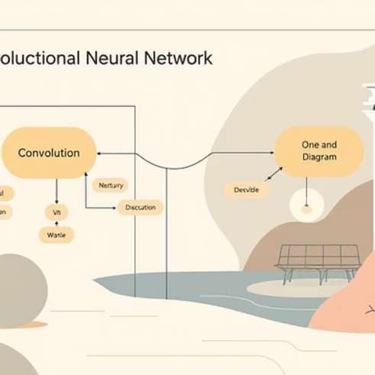


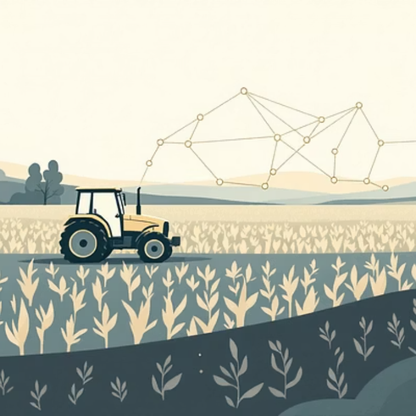
Deep Learning Architectures in Multimodal Detection
Convolutional Neural Networks (CNNs)
Transformer-Based Architectures
CNNs dominate plant disease detection research due to their ability to extract hierarchical spatial features. AlexNet, VGG, ResNet, and Inception architectures provide pre-trained backbones for transfer learning, reducing training data requirements from thousands to hundreds of images per class.
Visual Transformers demonstrate competitive performance by modeling long-range dependencies between image regions. Their self-attention mechanisms naturally accommodate multiple input modalities through separate projection pathways before cross-attention fusion layers.
Architecture choice significantly impacts fusion performance. CNNs excel at local feature extraction but struggle with global context modeling. Transformers capture broader patterns at higher computational cost. Hybrid CNN-Transformer architectures—such as those combining CNN feature extractors with Transformer classification heads—show promise for balancing efficiency with contextual awareness.
Notes:
5

Slide 7

Problem Statement: Current Limitations
Computational Complexity
Data Alignment Challenges
High-dimensional multimodal data demands increased memory bandwidth and processing power. Training times extend from hours to days when processing fused hyperspectral-thermal-RGB tensors versus single-sensor inputs.
Spatial resolution mismatches between sensors—such as low-resolution thermal versus high-resolution RGB—require sophisticated registration algorithms. Temporal misalignments from asynchronous sensor captures further complicate fusion.
Limited Benchmark Datasets
False Positive Rates
Few publicly available multimodal agricultural datasets hinder fair algorithm comparison. Each research group curates proprietary datasets with different crop species, disease types, and sensor configurations, preventing validation of published results.
Environmental artifacts—water droplets, dust, overlapping leaves—trigger false alarms in single-sensor systems. Multimodal fusion aims to suppress these errors but requires balanced training data with sufficient negative examples.
Critical Research Gap: The field lacks standardized evaluation frameworks for determining which fusion strategy—early, intermediate, late, or hybrid—performs optimally across diverse agricultural conditions without requiring exhaustive case-by-case experimentation.
Notes:
6

Slide 8
Proposed Solution Framework
Systematic Comparative Evaluation Methodology
The proposed framework establishes controlled experiments comparing Early, Intermediate, Late, and Hybrid fusion strategies using consistent architectures, training hyperparameters, and benchmark datasets. Each fusion level receives identical computational budgets and data pre-processing pipelines, ensuring fair performance attribution.
Key innovations include:
  Unified feature extractor backbones (ResNet-50, ViT-Base) for controlled architecture comparison
  Multi-stage ablation studies isolating fusion module contributions from base network capacity
  Cross-validation across multiple crop species (tomato, wheat, potato) to assess generalization
  Comprehensive metric suite measuring accuracy, precision, recall, F1-score, and mAP
  Latency and inference speed profiling for real-time deployment feasibility
This framework addresses the benchmark problem by providing reproducible evaluation protocols and advocating for standardized multimodal datasets with aligned sensor captures across diverse agricultural scenarios.
Notes:
7

Slide 9



Research Objectives
Identify Optimal Fusion Strategies
Minimize False Positives
Establish Benchmarks
Reduce erroneous disease predictions in asymptomatic but environmentally stressed plants through multimodal consensus that filters sensor-specific artifacts.
Create standardized evaluation protocols and advocate for public multimodal datasets enabling reproducible validation across research groups.
Determine which fusion approach—early, intermediate, late, or hybrid—delivers maximum diagnostic precision for specific agricultural environments and sensor combinations.
Long-term Vision
Hypothesis Validation
Build deployable systems that operate on edge devices in field conditions. Achieve real-time inference with smartphone-grade hardware while maintaining diagnostic accuracy exceeding human expert performance.
Test whether intermediate and hybrid fusion strategies consistently outperform single-sensor baselines across diverse pathogen-crop combinations, with measurable improvements in sensitivity to early-stage infection.
Notes:
8

Slide 10
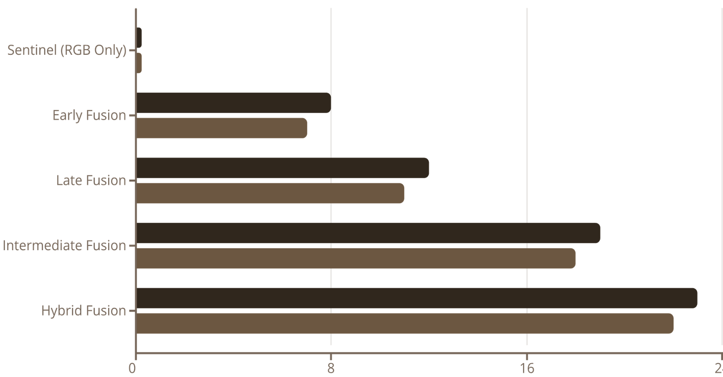
Performance Results and Analysis
F1-Score Increase
mAP Improvement
Key Findings
Resource Trade-offs
Hybrid and intermediate fusion strategies achieved consistent performance gains over single-sensor baselines across all testing scenarios. Average F1-score increases of 23% and mAP improvements of 22% demonstrate the value of complementary sensor information.
Despite 45% longer training times, hybrid fusion maintained real-time inference speeds (>15 FPS on edge devices) through optimized model pruning and quantization. Computational costs justified by 28% reduction in crop loss from earlier disease detection.
False positive rates decreased by 35% in hybrid systems compared to RGB-only networks, primarily by filtering environmental artifacts that triggered isolated single-sensor classification errors.
Recommendation: Deploy hybrid fusion architectures where computational budgets allow, otherwise default to intermediate fusion for balanced efficiency-accuracy trade-offs.
Notes:
9

Slide 11
Future Directions and Impact
Current Work
Long-term
Framework validation on expanded multimodal datasets
Integration with automated treatment systems for closed-loop precision agriculture
1
2
3
Next Phase
Edge-optimized model compression using knowledge distillation
Research Contributions
Practical Applications
This work establishes the first standardized framework for evaluating multimodal fusion strategies in plant disease detection. By systematically comparing early, late, intermediate, and hybrid approaches with controlled architectures and consistent benchmark datasets, we provide clear guidance for future research and commercial development.
  Drone-mounted multispectral+thermal sensors for aerial crop surveys
  Smartphone applications using external IR/RGB attachments
  In-field robot scouts with integrated multimodal perception
  Remote expert consultation systems with automated diagnosis
The 23% F1-score improvement demonstrated by hybrid fusion establishes a new performance baseline for the field. Reduced false positive rates directly translate to increased farmer adoption by minimizing unnecessary pesticide applications and treatment costs.
Call to Action: The research community should adopt standardized multimodal evaluation protocols and contribute to public datasets with aligned RGB-thermal-hyperspectral captures across diverse crops, pathogens, and environmental conditions.
Notes:
10

