Slide 1


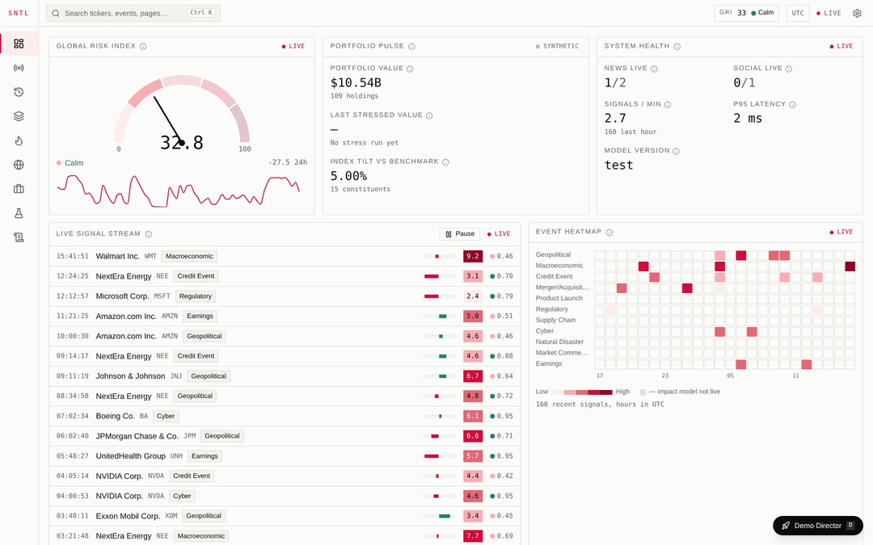
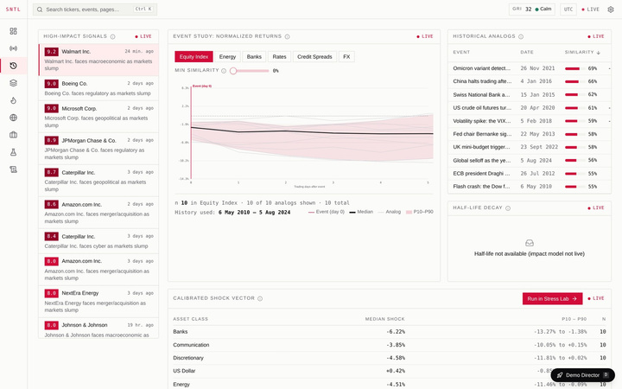
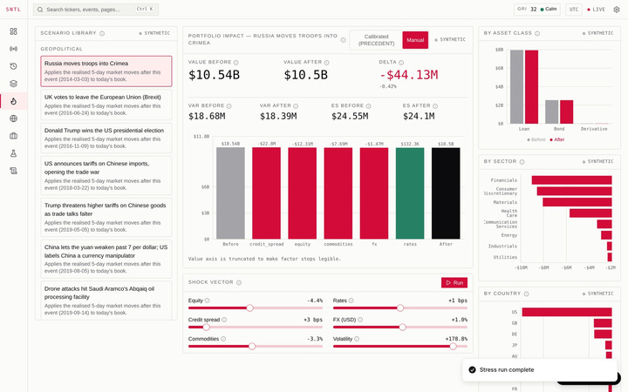
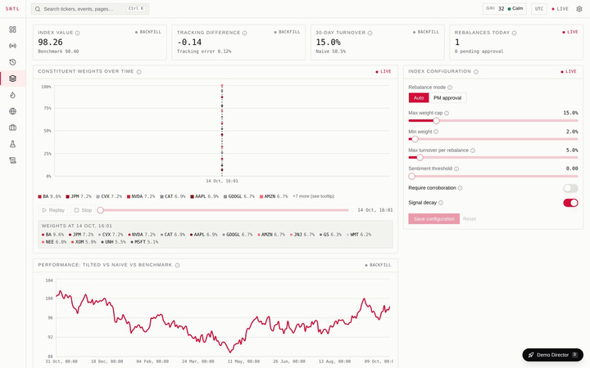
S&P GLOBAL & CRISIL CAMPUS HACKATHON 2026
sentinel / overview
SENTINEL
Risk intelligence with a memory.
Turns breaking financial headlines into quantified, auditable portfolio actions, by remembering what happened the last time.
139
10
100%
automated tests pass
live terminal views
public + synthetic data
Chaitenya Chand
Indira Gandhi Delhi Technical University for Women (IGDTUW)
chaitenya013mca25@igdtuw.ac.in · Individual submission
PRECEDENT analogs
Stress Lab
Adaptive Index
Real captures from the running app on seeded demo data
Notes:
Opening (30 s): SENTINEL is a risk-intelligence terminal that remembers. It reads public headlines, finds the closest past events, quantifies what that would do to a portfolio, and records every action in a tamper-evident ledger. Everything you will see runs on public or synthetic data, in an app I built end to end. Screenshots are real captures from the running system on seeded demo data.
1

Slide 2







01 · PROBLEM & APPROACH
Headlines move portfolios, but analysts get noise without memory
THE GAP TODAY
ONE LOOP, FOUR VERBS
Noise overwhelms signal
Only 29 of 150 hand-labelled headlines (19%) were risk-relevant. Analysts triage five items for every one that matters.
Detect
Remember
Quantify
Act
Relevance gate, event type, FinBERT sentiment and an integrity score turn raw headlines into scored signals.
›
PRECEDENT finds point-in-time analog events and shows what markets did over the next 20 days.
›
Calibrated shocks revalue the whole book: VaR/ES, Shapley attribution, reverse stress.
›
Adaptive Index tilts weights within caps; a PM approves; every step is hash-chained.
Alerts have no memory
Sentiment tools say how today's headline feels, not what markets did the last time something similar hit.
NLP pipeline
PRECEDENT
Stress Lab
Index + Audit
Typical workflow | SENTINEL
Keyword alerts | Learned + rule hybrid gate (AUC 0.78 vs 0.56 rules-only)
Today's sentiment only | Sentiment plus analog outcomes, with a low-n warning
Spreadsheet what-ifs | Full revaluation of 109 holdings in about 0.2 s, with attribution
Rebalance by hand (58.5% turnover*) | Constrained tilt, optional PM approval (15.0% turnover*)
Insight stops at the dashboard
Nothing links an event to portfolio loss, to a rule that fires, and to a decision someone can audit.
*30-day backfill on synthetic demo data. AUC from the held-out set of 150 labelled headlines.
SENTINEL · Chaitenya Chand · IGDTUW · S&P Global & Crisil Campus Hackathon 2026
2
Notes:
Problem (60 s): three gaps. One, noise: in my hand-labelled held-out set only 29 of 150 headlines were risk-relevant, so analysts triage five items for every one that matters. Two, alerts have no memory: sentiment tools describe today's headline but not what happened the last time. Three, insight stops at the dashboard: nothing connects an event to portfolio loss, to a rule, and to an auditable decision. Approach: four verbs in one loop. Detect, Remember, Quantify, Act. The strip at the bottom compares a typical workflow with SENTINEL. The 58.5 vs 15 percent turnover figure is from a backfill on synthetic demo data.
2

Slide 3
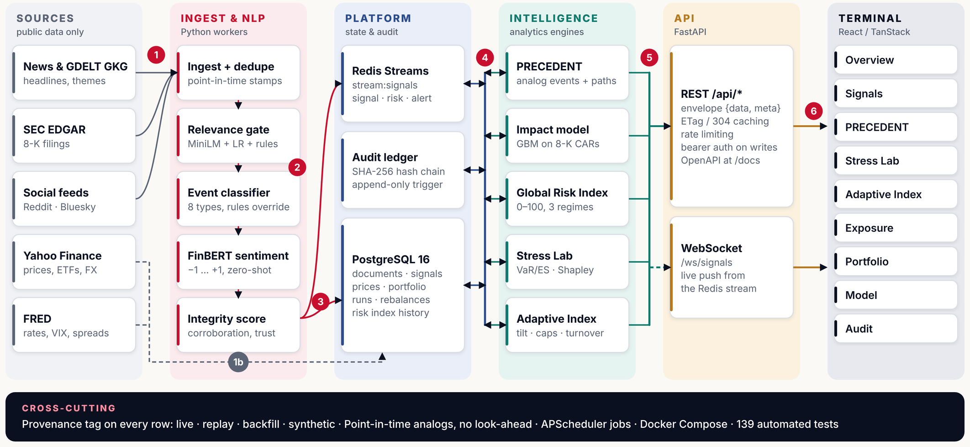
02 · SYSTEM DESIGN
One event stream feeds five engines in one auditable platform
1
Public sources ingested, deduped, time-stamped
2
NLP chain scores relevance, type, sentiment, integrity
3
Signal saved to Postgres, published on Redis Streams
4
Engines read and write state via the platform
5
REST and WebSocket serve the terminal
6
Terminal renders 9 views from real API data
SENTINEL · Chaitenya Chand · IGDTUW · S&P Global & Crisil Campus Hackathon 2026
3
Notes:
Architecture (75 s). Read left to right. One: public sources only, GDELT, SEC 8-Ks, social, Yahoo and FRED market data. Two: the NLP chain, ingest and dedupe, relevance gate, event classifier, FinBERT sentiment, integrity score. Three: each scored signal is persisted to PostgreSQL and announced on a Redis stream. Four: five engines, PRECEDENT, the 8-K impact model, the Global Risk Index, Stress Lab and the Adaptive Index, read and write state through that platform; the audit ledger is a SHA-256 hash chain with an append-only trigger. Five: FastAPI serves REST and a WebSocket. Six: the React terminal renders nine views. Every row carries a provenance tag: live, replay, backfill or synthetic, and analogs are point-in-time so there is no look-ahead.
3

Slide 4
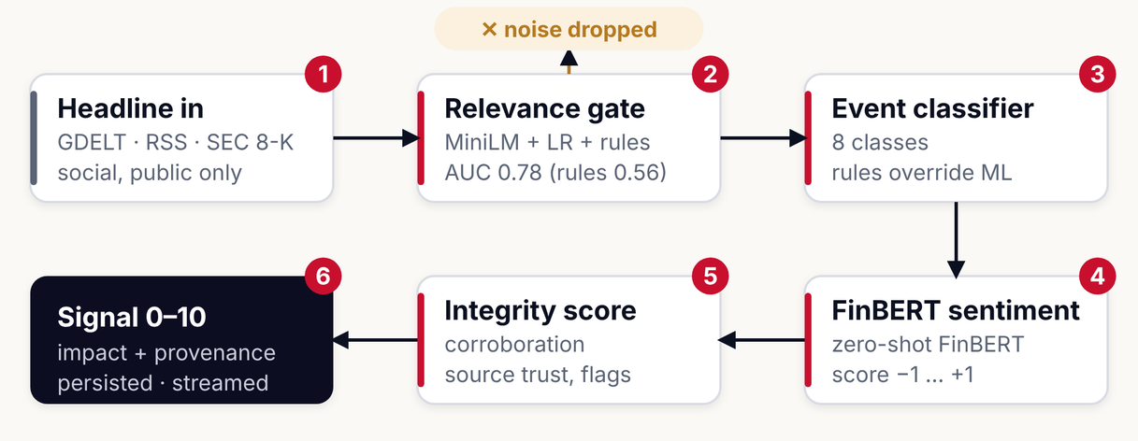
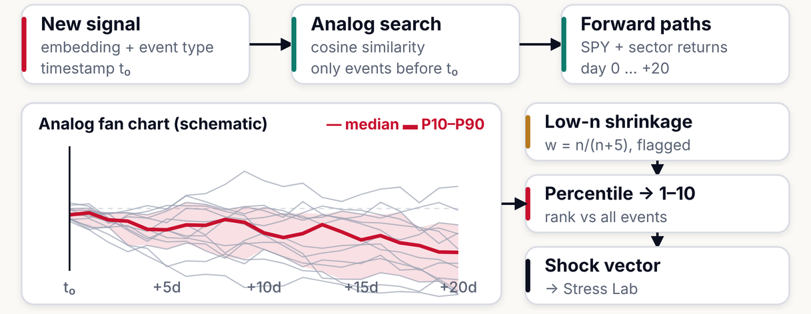
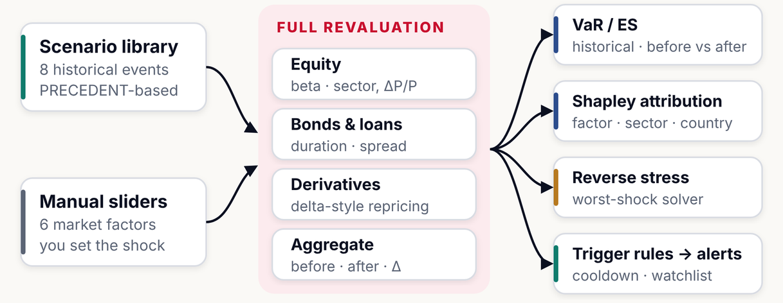
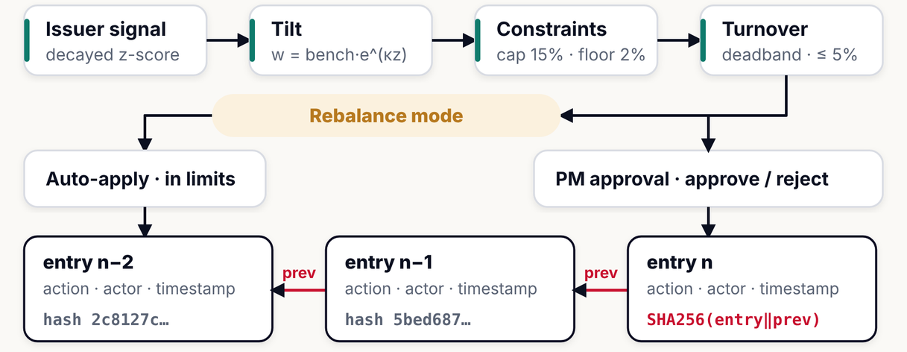
03 · IMPLEMENTATION HIGHLIGHTS
Four engines, each built to be inspected, tested and explained
1
NLP signal pipeline
MiniLM + FinBERT · 8 event types · hybrid gate
2
PRECEDENT analog engine
point-in-time · shrinkage w = n/(n+5)
3
Stress Lab
full revaluation · Shapley · reverse stress
4
Adaptive Index + audit ledger
caps · deadband · SHA-256 hash chain
SENTINEL · Chaitenya Chand · IGDTUW · S&P Global & Crisil Campus Hackathon 2026
4
Notes:
Implementation (90 s). Top left, the NLP pipeline: a relevance gate that blends MiniLM embeddings with rule features, an eight-class event classifier where rules keep the final say, zero-shot FinBERT sentiment, and an integrity score from corroboration and source trust. Top right, PRECEDENT: cosine search over the event library using only events before the signal time, forward paths for SPY and sector returns over 20 days, a low-n shrinkage weight n over n plus 5 with a warning flag, then a percentile mapped to a 1 to 10 impact and a calibrated shock vector. The fan chart is a schematic. Bottom left, Stress Lab: scenario or manual shocks go into full revaluation of equities, bonds and loans and derivatives, producing VaR and expected shortfall, Shapley attribution, reverse stress with a gradient-based worst-shock solver, and trigger rules. Bottom right, the Adaptive Index tilts weights as benchmark times exp of kappa z, applies a 15 percent cap and 2 percent floor, a deadband and a 5 percent turnover limit, then either auto-applies or waits for PM approval. Every action is appended to a SHA-256 hash chain.
4

Slide 5
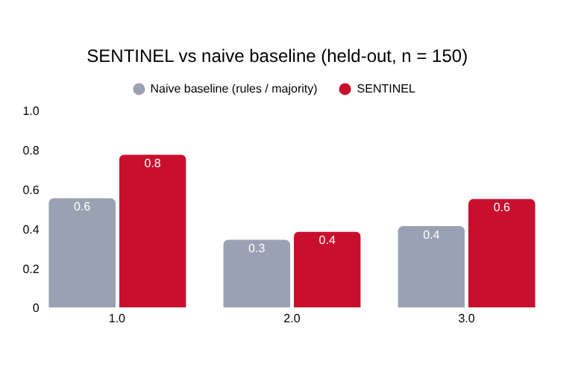
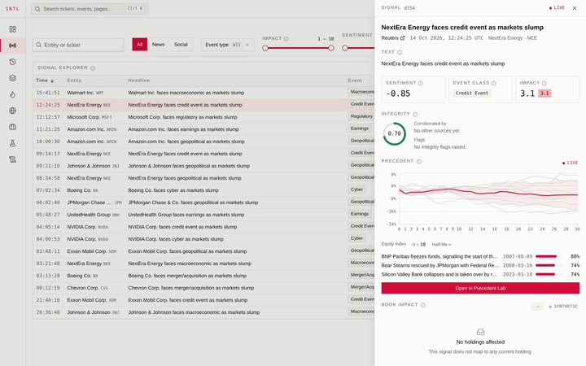
04 · KEY RESULTS
Measured, not claimed: beats naive baselines, with honest error bars
0.78
55%
Relevance AUC
Sentiment accuracy
naive rules-only: 0.56
majority-class baseline: 41%
15%
0.2 s
Index turnover
Full stress run
naive rebalance: 58.5%*
109 holdings, VaR/ES + Shapley
PRECEDENT: analog events, fan chart, calibrated shocks
Stress Lab: Crimea scenario, about −$44M on a $10.5B book
Adaptive Index: weights, 15.0% turnover vs 58.5% naive
Signals: drawer with integrity, analogs, book impact
Screenshots are the running app on seeded synthetic demo data (portfolio, prices, signals). The build sandbox had no live-feed access; replay mode uses archived GDELT episodes.
Held-out set: 29 relevant of 150, F1 95% CI 0.22–0.54. Impact model (5,825 8-K events): MAE 0.0187 vs 0.0195 baseline, Spearman 0.33. *30-day backfill, synthetic prices.
SENTINEL · Chaitenya Chand · IGDTUW · S&P Global & Crisil Campus Hackathon 2026
5
Notes:
Results (90 s). Left, four real screenshots of the running app: PRECEDENT with its analog fan chart and calibrated shock vector; Stress Lab running the Crimea 2014 scenario on the synthetic 10.5 billion dollar book, a loss of about 44 million dollars; the Adaptive Index with weights and turnover; and the Signals view with a drawer showing integrity, analogs and book impact. Right, the metrics. On the held-out set of 150 headlines, the learned relevance gate has AUC 0.78 against 0.56 for rules-only; sentiment accuracy is 55 percent against 41 percent for always predicting the majority class. Index turnover over a 30-day backfill is 15 percent against 58.5 percent for a naive rebalance, on synthetic prices. A full stress run on 109 holdings takes about 0.2 seconds in my sandbox. I want to be upfront that the held-out set is small, 29 relevant items, so the F1 confidence interval is wide, 0.22 to 0.54. The impact model, trained on 5,825 8-K events, improves MAE from 0.0195 to 0.0187.
5

Slide 6



05 · DOMAIN IMPACT
From headline to defensible decision, for ratings, index and risk teams
Credit & ratings surveillance analyst
WHERE IT PLUGS IN
Today Scans feeds and judges severity from memory.
With SENTINEL Relevance-gated signals ranked 1–10, with historical analogs and an integrity score.
Credit ratings surveillance
Index methodology
early warning on issuers and sectors
adaptive tilt with caps and approval
Earlier, evidence-backed watchlist calls
Index and portfolio manager
Today Rebalances by hand after events.
With SENTINEL Signal-tilted weights inside caps, optional PM approval. Demo: 15% vs 58.5% naive turnover.
SENTINEL
event memory
+ stress + audit
Lower turnover, same discipline
Risk & compliance officer
Today Runs what-ifs in spreadsheets; hard to prove who changed what.
With SENTINEL Stress runs with VaR/ES and Shapley attribution; audit chain verifies 362 entries in about 17 ms.
Counterparty exposure
Regulatory & audit
wholesale book stressed by sector and country
hash-chained, replayable decisions
Audit-ready by design
Illustrative mapping of capabilities to workflows; not a statement about any company's internal systems.
SENTINEL · Chaitenya Chand · IGDTUW · S&P Global & Crisil Campus Hackathon 2026
6
Notes:
Domain impact (60 s). Three users. A credit or ratings surveillance analyst gets relevance-gated, ranked signals with historical analogs and an integrity score, so watchlist calls are earlier and evidence-backed. An index or portfolio manager gets signal-tilted weights inside caps and optional approval; in the demo backfill that cut turnover from 58.5 to 15 percent. A risk and compliance officer gets stress runs with attribution and an audit chain that verifies 362 entries in about 17 milliseconds. On the right is where it plugs in: surveillance, index methodology, counterparty exposure and audit. This is an illustrative mapping of capabilities to workflows, not a statement about S&P Global or Crisil internal systems.
6

Slide 7
06 · LIMITATIONS & NEXT STEPS
Honest limits today, a clear path to production tomorrow
WHAT IS NOT SOLVED YET
NEXT 90 DAYS
Small gold-label set
Month 1
150 held-out headlines (29 relevant): relevance F1 95% CI 0.22–0.54. Directional, not definitive.
Label 1,000+ headlines; recalibrate relevance and event models.
Learned event classifier trails rules
Macro-F1 0.32 vs 0.47 held-out, so rule overrides stay in the decision.
Month 2
Verify live feeds; run the PSI drift monitor with alerts.
Modest impact-model lift
MAE 0.0187 vs 0.0195 baseline, Spearman 0.33; 8-K events skew to “Other”.
Month 3
Synthetic book, illustrative migration matrix
Real rating-transition data; SciPy SLSQP worst-shock solver.
The wholesale portfolio is synthetic and rating migration is a documented assumption.
Live connectors not exercised in the build
Beyond
Yahoo, FRED, SEC and GDELT code paths exist; the demo runs on replay and synthetic data.
Grounded LLM analyst narrative with a citation guard; multi-tenant auth.
Responsible use Outputs are risk analytics for demonstration, not investment advice. Built with AI assistance (Claude); data choices, validation and claims are the author's. Public and synthetic data only.
SENTINEL · Chaitenya Chand · IGDTUW · S&P Global & Crisil Campus Hackathon 2026
7
Notes:
Limitations and next steps (45 s). I would rather you hear the limits from me. The gold-label set is small, so confidence intervals are wide. The learned event classifier currently trails the rules, macro-F1 0.32 against 0.47, which is why rule overrides remain. The impact model gives a modest lift. The wholesale portfolio is synthetic and the rating-migration matrix is an illustrative assumption. Live Yahoo, FRED, SEC and GDELT paths are written but I could not exercise them in my build sandbox, so the demo uses replay and synthetic data. Next ninety days: grow labels to a thousand and calibrate; verify live feeds and put drift alerts on; bring in real transition data and an SLSQP solver; then a grounded LLM narrative with a citation guard. AI disclosure: this project was built with AI assistance; data choices, validation and every claim here are mine to defend.
7

