Slide 1
Undo and Redo Feature Simulation using Stack in C
TEAM DETAILS :
Team members: MADALA MANOHAR. (24kb1A3055) VALIPI KARTHIK CHAITHANYA. ( 24kb1A30c3) ISWANTH KOPPALA. (24kb1A3051) BANDILI BHARATH CHANDRA. (24kb1A3010) NBKRIST BTECH 1ST YEAR AI&DS-B,2024-2025

Slide 2
Subtitle: “Rewinding Actions with the Power of Stack – A Real-Time Text Editor Simulation in C”
1. Abstract :
This project demonstrates the implementation of Undo and Redo functionality using two stacks.
It mimics real-world text editor behaviour by storing user inputs (words) in a stack and allowing the user to undo and redo changes.
The project is developed using the C language and helps in understanding the LIFO (Last In First Out) concept practically.
It offers hands-on experience with stack operations and simulates how text editing apps like Notepad, Google Docs, and WhatsApp manage undo/redo internally.

Slide 3
Objective of the project
2. Objective : To simulate Undo and Redo features in a text environment. To use Stack data structure for managing editing history. To enhance understanding of stack operations and their real-life use cases.
1. Implement core editing features
2. Enhance text manipulation
3. Enable file handling operations
4. Provide analysis tools
5. Introduce formatting
6. Support page-based editing
7. Improve usability

Slide 4

Operations: Type Word → Push into Undo Stack Undo → Pop from Undo Stack, Push into Redo Stack Redo → Pop from Redo Stack, Push into Undo Stack Display → Show current contents of the Undo Stack
Features: Menu-driven program Typing and managing word history Undo/redo last operations Error-handling: Underflow of stacks Displaying current text

Slide 5
TOOLS AND WORKING PRINCIPLE
3. Tools and Technologies Used :
Language: C Compiler: GCC or Turbo C Platform: Code::Blocks / Linux Terminal / OnlineGDB Data Structure: Stack (implemented using arrays)
4. Working Principle:
Undo Stack (Main History): Stores typed words. Redo Stack (Temporary History): Stores words undone temporarily.

Slide 6
Flow of Execution
Flow of Execution:
Give step-by-step explanation: User types words → Goes into undo stack On Undo → Last word moved to redo stack On Redo → Word moved back to undo stack Add a simple flowchart or diagram for clarity.
Features:
Typing multiple words Undo last typed words Redo last undone words Handles stack overflow/underflow Real-time simulation

Slide 7
Real-time applications:
Applications:
Real-time usage examples: MS Word (Ctrl + Z / Ctrl + Y) WhatsApp (undo a deleted message) Paint/Photoshop (reverting brush strokes) Google Docs or Figma(undo/redo changes)

Slide 8
EXPLANATION OF WORKING
HOW IT WORKS :
Typing Words:
When a user types a word, it is pushed onto the undoStack. The redo stack is cleared.
Undo: The last word typed is removed from the undoStack and pushed to the redoStack.
3. Redo: The most recent word from the redoStack is pushed back onto the undoStack.
4. Text Operations: Word Counting: Counts the total number of words in the current text. Find and Replace: Finds specific words and replaces them with new words. Word Frequency Count: Displays how many times each word appears in the text. Highlighting:
Highlights a specific word by displaying it in a special format (e.g., ***word***). Word Statistics: Finds the longest and shortest word in the text.
5. Switching Pages: Users can switch between pages, and the notepad's content will reset when switching pages.
6. File Operations:
Saving: Save the current notepad content into a file. Loading: Load content from a file into the notepad.

Slide 9
“UNDO CURRENT REDO”_WHAT IF MEANS
"Undo Current Redo" – What It Means Conceptually: The phrase “Undo current redo” typically refers to reverting a redo operation, meaning you perform a redo, then undo it — effectively returning to the state before the redo. 1. Normal Flow: Let’s consider the flow of actions: 1. Initial State: "A" 2. User types "B" → state becomes "AB" 3. User Undo → state becomes "A" (undo stack has "AB", redo stack has "A") 4. User Redo → state becomes "AB" (undo stack has "A", redo stack empt
Undoing a Redo: Now, if the user redoes, and then presses undo again, it will simply reverse the redo. This works automatically in the stack-based model: After Redo, the current state "AB" is pushed to undo stack, and "A" is popped from redo stack. Now, pressing Undo again: Pushes "AB" to redo stack. Pops "A" from undo stack — bringing you back to the state before redo

Slide 10
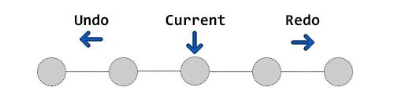
UNDO –CURRENT – REDO
1. Undo Stack stores previous states; Redo Stack stores undone states.
2. When an action is performed, push the current state to the Undo Stack and clear the Redo Stack.
3. On Undo, push the current state to Redo Stack and pop from Undo Stack to revert.
4. On Redo, push the current state to Undo Stack and pop from Redo Stack to reapply.
5. To undo a redo, just press Undo again — it reverses the last Redo action.

Slide 11
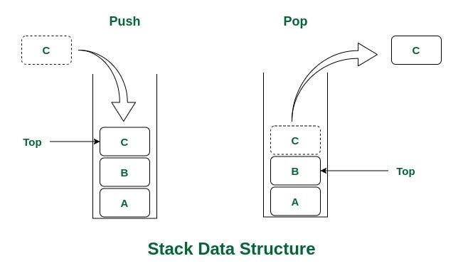
UNDO AND REDO BY USING STACK DATA STRUCTURES
1. Typing Words: When a user types a word, it is pushed onto the undoStack. The redo stack is cleared. 2. Undo: The last word typed is removed from the undoStack and pushed to the redoStack. 3. Redo: The most recent word from the redoStack is pushed back onto the undoStack. 4. Text Operations: Word Counting: Counts the total number of words in the current text. Find and Replace: Finds specific words and replaces them with new words. Word Frequency Count: Displays how many times each word appears in the text. Highlighting: Highlights a specific word by displaying it in a special format (e.g., ***word***).

Slide 12
LIMITATIONS AND FUTURE ENHANCEMENTS :
Limitations: *Word-based only (not full sentence editing) *Static array size for stacks *No file saving/loading feature
Future Enhancements: *Use linked list for dynamic memory *Support multi-line editing *Add GUI version *Enable file storage and restore *Add keyboard shortcuts simulation

Slide 13
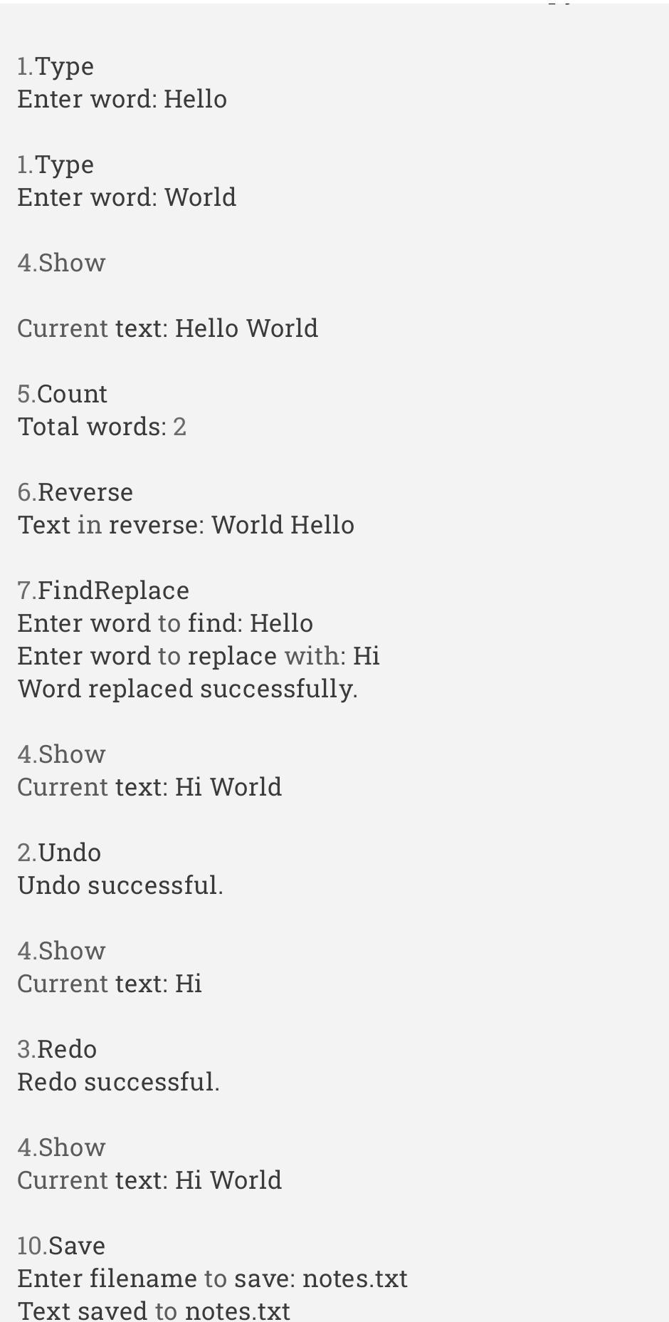
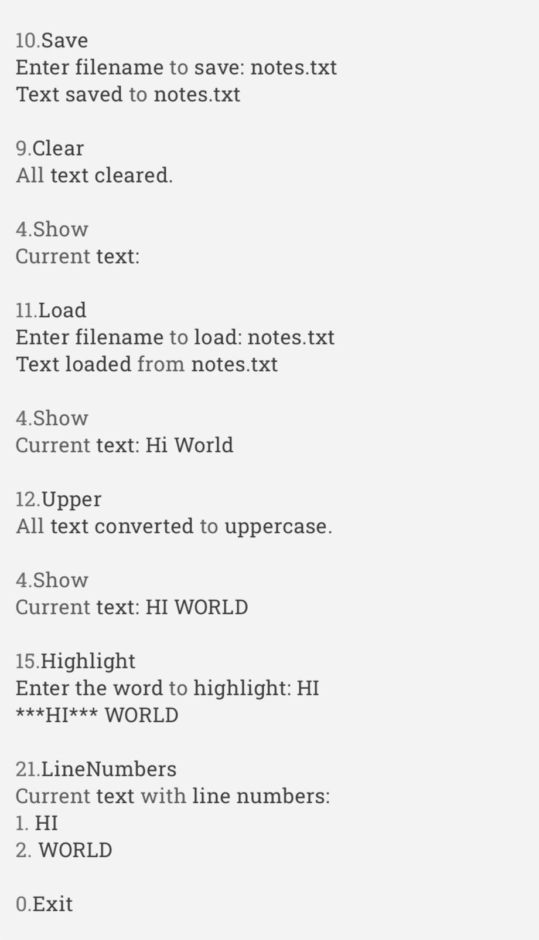
Sample Input and output

Slide 14
CONCLUSION FOR THIS PROJECT :
CONCLUSION :
This mini project successfully demonstrates the core concept of the Stack data structure through a real-time application—Undo and Redo functionality.
By implementing two stacks (Undo Stack and Redo Stack), the project simulates how modern text editors manage user input history. It strengthens the understanding of the LIFO principle and provides a practical approach to coding in C.
Additionally, this project builds foundational skills in algorithm development, modular programming, and debugging. It also opens up ideas for expanding features in the future, making it a meaningful and interactive learning experience for beginners in data structures.

Slide 15
Thank you
LOGIC LOOPERS,
AI&DS-B,
24KB1A30C3
24KB1A3010
24kb1A3055
24kb1A3051

