Slide 1

DATA ANALYSIS ESSENTIALS CORNERSTONE PROJECT
WEB SCRAPING AND PRODUCT
PRICE ANALYSIS SYSTEM
Review 2 | Project Implementation & Lines of Code (LOC)
Presented by
K. Shalini (25B11CS477)
Musindo Lloyed (25B11CSA69)
G. Sarath Sai Chaithanya (26B21CS027)
Department of Computer Science and Engineering
1

Slide 2
IMPLEMENTATION OVERVIEW
Current modules, source files and the PriceLens data flow
#
Module
Source file
What it implements
1
Access & fetching
scraper/fetcher.py
Validate public URLs, check robots.txt and bound HTTP requests.
2
Product extraction
scraper/scraper.py
Detect sources, paginate listings and normalize product records.
3
Generic parsing
scraper/parsers/generic.py
Parse Product and ItemList JSON-LD, with common HTML fallbacks.
4
Data cleaning
analysis/price_analysis.py
Normalize prices and ratings; remove duplicate or invalid-price rows.
5
Price insights
analysis/price_analysis.py
Calculate min, max, mean, median, range and product-level insights.
6
Web app & auth
web/app.py · web/auth/
Flask pages and APIs, SQLite accounts, analysis history and charts.
Public URL → Access checks → Product extraction → Cleaning → Price analysis → Charts and SQLite history → Flask dashboard
DATA ANALYSIS ESSENTIALS | REVIEW 2 | IMPLEMENTATION & LOC
2

Slide 3
MODULE 1: PRODUCT DATA COLLECTION
Source files: scraper/scraper.py, analysis/price_analysis.py and the CLI CSV outputs
Product collection
Structured fields
Two entry points
Fetch public product or listing pages and normalize extracted records.
Keep names, prices, currencies, ratings, stock, category and product links.
The CLI writes CSV files; the Flask app analyzes pages and saves history in SQLite.
products = scrape_products(url, pages=pages)
df = clean_product_data(products)
save_data(df, "data/processed/products.csv")
Product fields
product_name • price • currency • website_name
category • rating • availability • product_link
discount • last_updated
DATA ANALYSIS ESSENTIALS | REVIEW 2 | IMPLEMENTATION & LOC
3

Slide 4
MODULE 1: WEB SCRAPING
Source files: scraper/fetcher.py and scraper/scraper.py
1. Check public URL
2. Fetch politely
3. Extract product data
Reject private targets and check robots.txt before fetching each page.
Use per-host pacing, redirect checks and bounded connect/read timeouts.
Prefer Product/ItemList JSON-LD; use same-site detail pages when useful.
from scraper.fetcher import fetch_page
from scraper.parsers.generic import parse_products
html = fetch_page(product_url) # robots.txt + bounded fetch
products = parse_products(html, base_url=product_url)
Important limitation
Stop when robots.txt, rate limits, login or CAPTCHA block access. JavaScript-only pages may not expose product details.
DATA ANALYSIS ESSENTIALS | REVIEW 2 | IMPLEMENTATION & LOC
4

Slide 5
MODULE 2: DATA CLEANING & PREPROCESSING
Source file: analysis/price_analysis.py
Missing values
Duplicates
Price conversion
Keep optional ratings and discounts missing when the page omits them.
Remove duplicates using product_link and product_name.
Normalize common price formats and coerce unparseable values to missing.
df["price"] = pd.to_numeric(
df["price"].astype("string")
.str.replace(r"[^0-9,.-]", "", regex=True)
.str.replace(",", "", regex=False),
errors="coerce"
)
df = df.drop_duplicates(subset=["product_link", "product_name"])
df = df.dropna(subset=["price"])
Preprocessing outcome
Keep missing prices out of analysis. A product without a valid price is not assigned a zero value.
DATA ANALYSIS ESSENTIALS | REVIEW 2 | IMPLEMENTATION & LOC
5

Slide 6
MODULE 2: DATA VALIDATION & STORAGE
CLI: CSV exports • Web: account-scoped SQLite history
df = clean_product_data(products)
save_data(df, "data/processed/products.csv")
# The Flask API saves successful results
# and product records in SQLite history.
Quality checks
Clean numeric prices and ratings; remove duplicates and invalid-price rows.
Storage
The CLI exports raw and cleaned CSVs; the web app saves successful analyses to SQLite.
Mixed or missing currencies suppress combined price metrics to avoid misleading totals.
DATA ANALYSIS ESSENTIALS | REVIEW 2 | IMPLEMENTATION & LOC
6

Slide 7
MODULE 3: PRICE ANALYSIS
Source file: analysis/price_analysis.py
Minimum price
Maximum price
Average & difference
min() identifies the lowest valid price.
max() identifies the highest valid price.
mean() calculates average; median() finds the midpoint; max − min is the range.
statistics = calculate_price_statistics(df)
insights = get_product_insights(df)
# min, max, mean, median, and range
# are returned for one currency set.
Product insights
Identify the lowest-priced, highest-rated and most expensive products in the analyzed result set.
DATA ANALYSIS ESSENTIALS | REVIEW 2 | IMPLEMENTATION & LOC
7

Slide 8
MODULE 4: DESCRIPTIVE STATISTICS & INSIGHTS
Source file: analysis/price_analysis.py
statistics = calculate_price_statistics(df)
insights = get_product_insights(df)
# Price statistics are withheld
# when currencies cannot be compared.
Price summary
Product count, minimum, maximum, average, median and range.
Product insights
Select the lowest price, highest listed rating and highest price.
The dashboard has no price forecast; trend analysis needs dated history across multiple runs.
Analysis limits
Descriptive summaries only; mixed currencies are never combined into one total.
DATA ANALYSIS ESSENTIALS | REVIEW 2 | IMPLEMENTATION & LOC
8

Slide 9
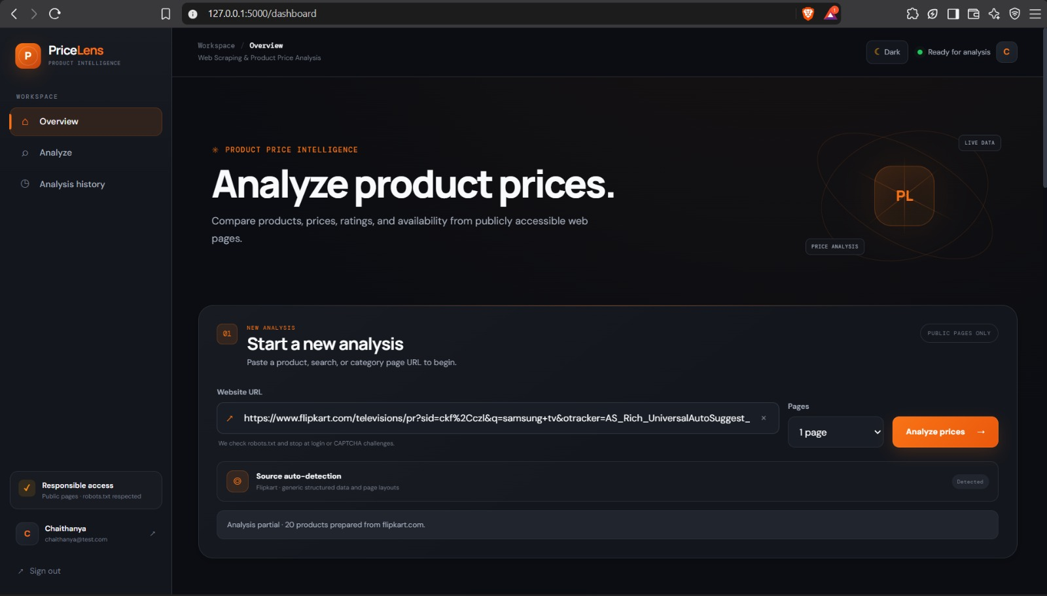
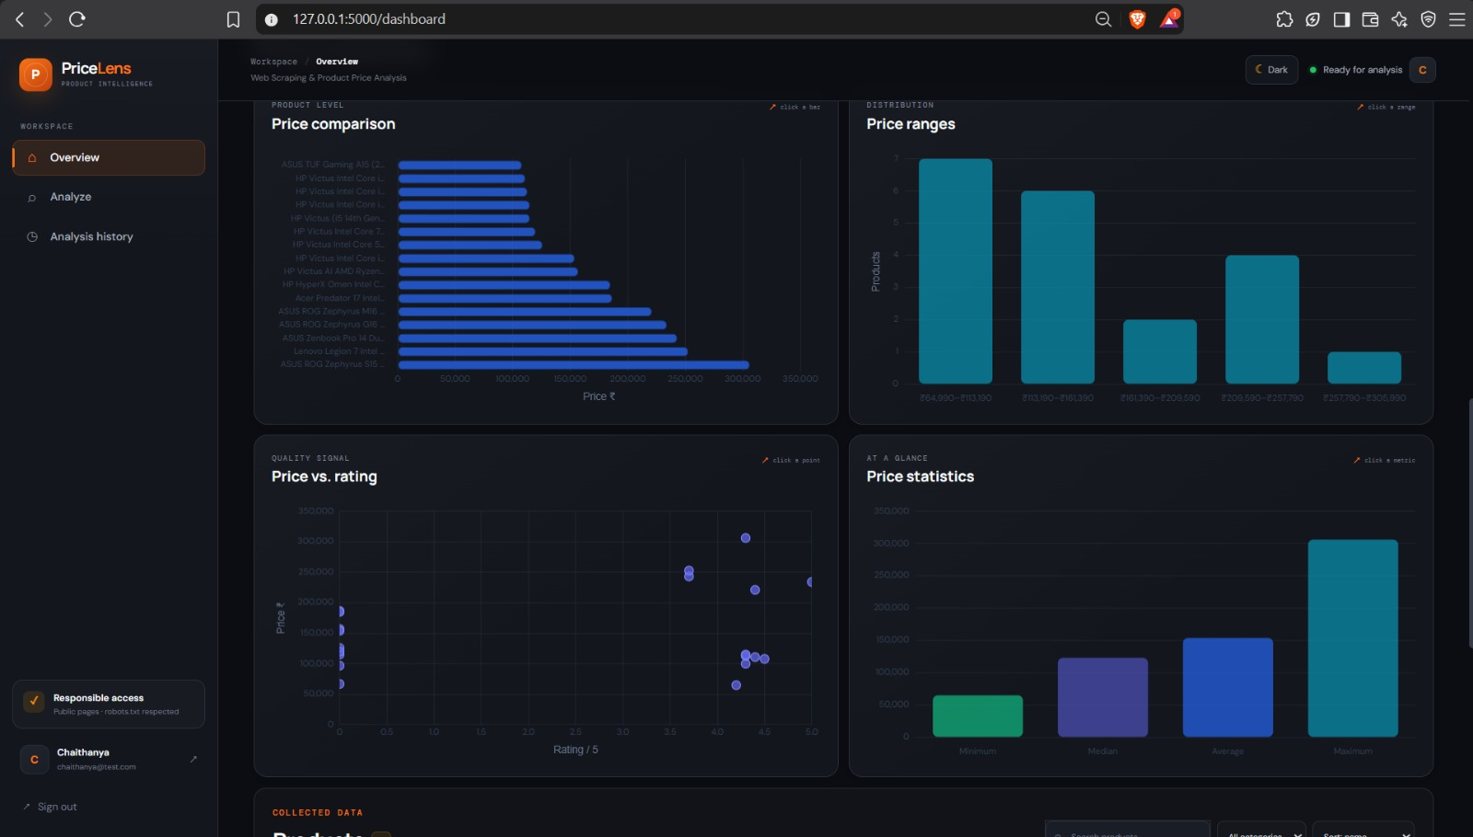
MODULE 5: DATA VISUALIZATION
Charts generated from the cleaned product dataset
The CLI exports price comparison, price distribution and rating-versus-price charts. The Flask dashboard adds four interactive charts with product and price-range drill-downs.
DATA ANALYSIS ESSENTIALS | REVIEW 2 | IMPLEMENTATION & LOC
9

Slide 10
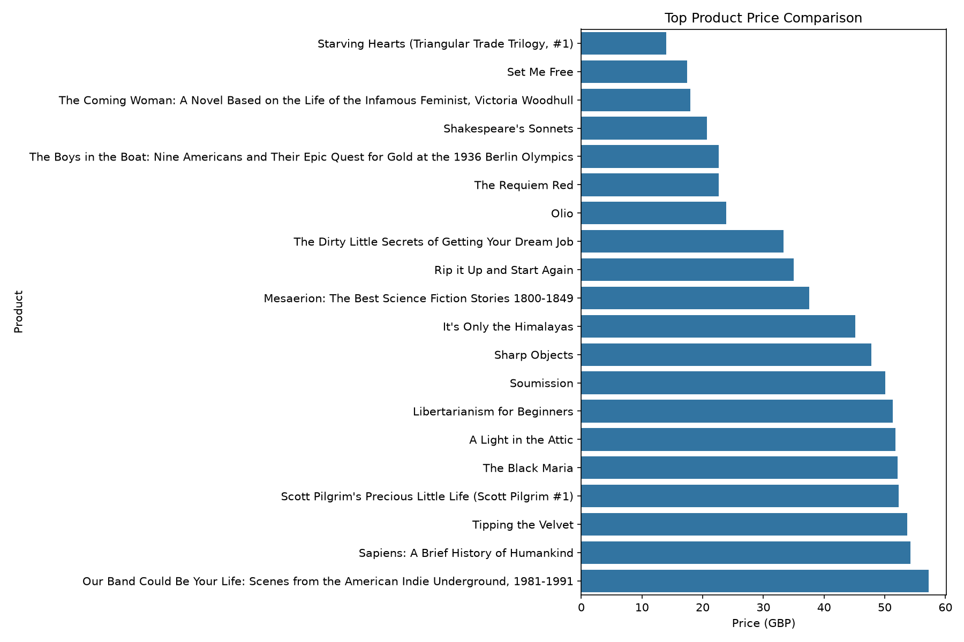
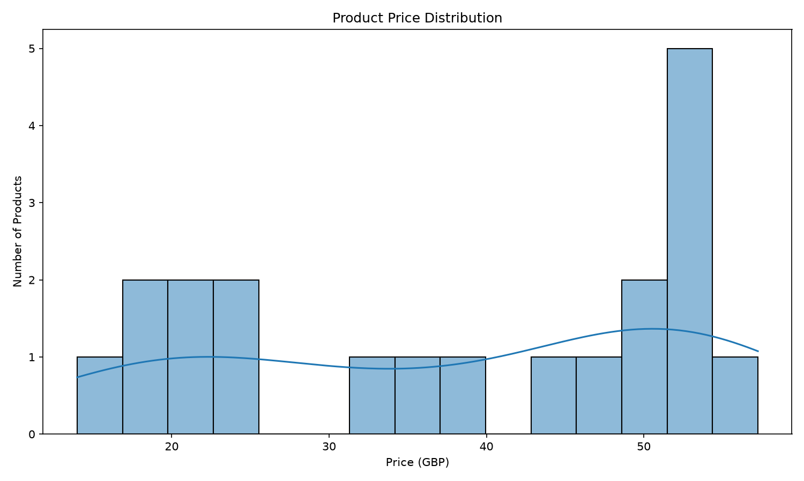
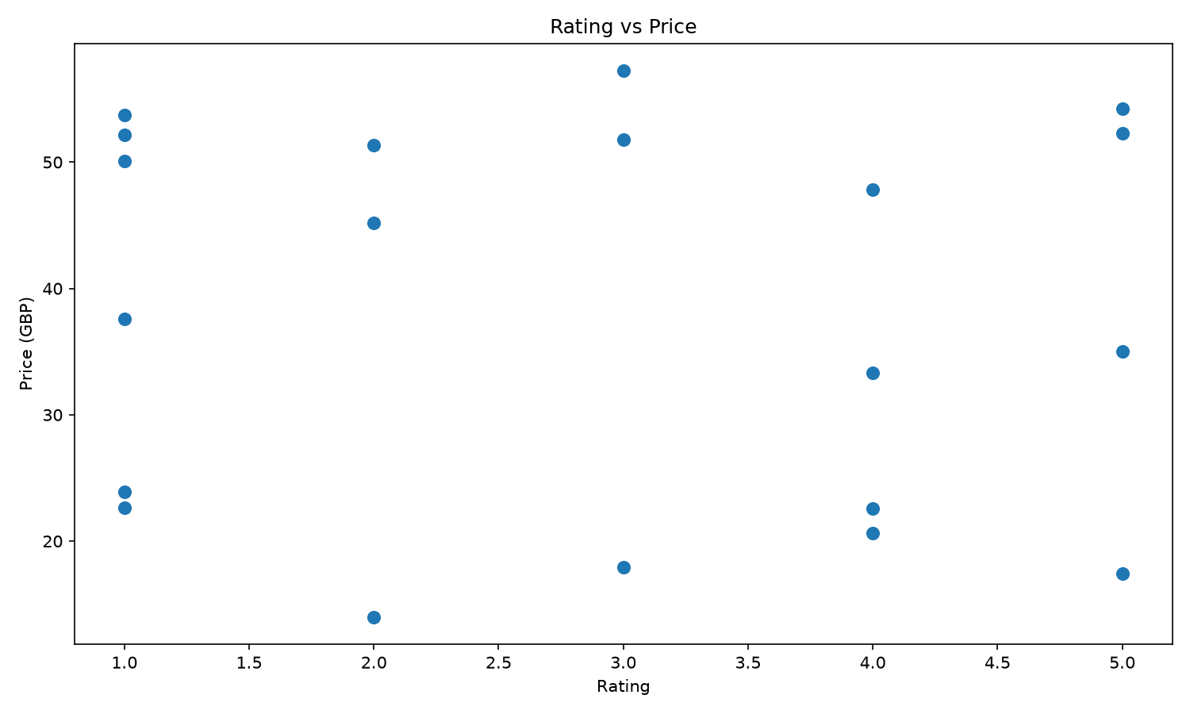
MODULE 5: VERIFIED CHART OUTPUTS
Matplotlib exports from the Books to Scrape sample in data/processed/products.csv
Price comparison
Price distribution
Rating vs. price
Compare product prices in the current analysis result.
Group products into price ranges; dashboard users can select a range to inspect its products.
Show observed prices against ratings when both fields are available.
Price statistics
Interactive drill-down
CLI chart files
Dashboard marks show count, minimum, maximum and mean for the current analysis.
Chart selections open a product detail or filtered price-range list.
The CLI saves three PNG charts: comparison, distribution and rating versus price.
DATA ANALYSIS ESSENTIALS | REVIEW 2 | IMPLEMENTATION & LOC
10

Slide 11
IMPLEMENTATION MODULES & VERIFIED CODE SIZE
Selected Python source counts • nonblank, noncomment lines • checked 9 Oct 2026
scraper/fetcher.py · 213 LOC
Validate public URLs; enforce robots.txt, per-host pacing and bounded HTTP requests.
scraper/scraper.py · 226 LOC
Detect sources, paginate listings and normalize extracted product records.
scraper/parsers/generic.py · 244 LOC
Parse Product and ItemList JSON-LD, plus common HTML product-page fallbacks.
analysis/price_analysis.py · 126 LOC
Clean product data; calculate price metrics and product-level insights.
visualization/charts.py + main.py · 208 LOC
Run the CLI workflow and export comparison, distribution and rating-price charts.
web/ + web/auth/ · 1,027 LOC
Flask pages and APIs, SQLite account/history storage and password-reset routes.
DATA ANALYSIS ESSENTIALS | REVIEW 2 | IMPLEMENTATION & LOC
11

Slide 12
MODULE 6: FLASK PRICELENS WEB APPLICATION
Source files: web/app.py, web/templates/ and web/static/
Analysis
Product details
Metrics & insights
Submit product, search or category URLs; review detected source and access status.
Review name, price, currency, rating, stock, category, link and scrape time.
Show count, min, max, average, median and range; surface product insights.
Interactive charts
History & profile
Accounts & recovery
Explore comparison, price ranges, rating versus price and price statistics.
Reopen account-scoped analysis history and manage profile details.
Werkzeug password hashes, session versioning and email OTP via environment-based SMTP.
@app.route("/api/analyze", methods=["POST"])
products = scrape_products(url, pages=pages)
df = clean_product_data(products)
DATA ANALYSIS ESSENTIALS | REVIEW 2 | IMPLEMENTATION & LOC
12

Slide 13
DEMO OUTPUT: BOOKS TO SCRAPE (20 PRODUCTS)
Minimum
Maximum
Average
Difference
£13.99
£57.25
£38.05
£43.26
Selected book prices (GBP)
Selected product records
Product
Price (GBP)
Rating
Availability
£57.25
Starving Hearts
13.99
2.0 / 5
In stock
Set Me Free
17.46
5.0 / 5
In stock
£17.46
£20.66
Shakespeare’s Sonnets
20.66
4.0 / 5
In stock
£13.99
Our Band Could Be…
57.25
3.0 / 5
In stock
Starving Hearts
Set Me Free
Shakespeare’s Sonnets
Our Band Could Be…
DATA ANALYSIS ESSENTIALS | REVIEW 2 | IMPLEMENTATION & LOC
13

Slide 14
REVIEW 2: CODE EXECUTION CHECKLIST
Walkthrough of the tested PriceLens workflow
1. Install and run
Install requirements.txt; run the CLI or Flask app.
2. Collect products
Use Books to Scrape or another public page permitted by robots.txt.
3. Clean records
Inspect normalized prices, missing fields and duplicate removal.
4. Analyze prices
Review product count, min, max, average, median, range and insights.
5. Explore charts
Generate three CLI charts and inspect four interactive web charts.
6. Review saved results
Open product details and history; verify profile and sign-out.
DATA ANALYSIS ESSENTIALS | REVIEW 2 | IMPLEMENTATION & LOC
14

Slide 15
CONCLUSION
Current product-analysis workflow and limits
Public URL → Access checks → Extraction → Cleaning → Price metrics → Charts and SQLite history → Flask dashboard
Data cleaning
Price insights
Web reporting
Pandas normalizes product prices and ratings; invalid prices and duplicate records are removed.
Minimum, maximum, average, median and range summarize one comparable currency set.
Four interactive charts, product details and account-scoped analysis history.
• Sample figures on slide 13 come from the saved 20-product Books to Scrape dataset.
• Price history across runs is not charted as a trend.
• Respect robots.txt; stop at blocks, login pages and CAPTCHAs.
DATA ANALYSIS ESSENTIALS | REVIEW 2 | IMPLEMENTATION & LOC
15

Slide 16
THANK YOU
Web Scraping and Product Price Analysis System
16

