Slide 1


AI JOB MARKET ANALYSIS

Slide 2

CONTENTS
ABSTRACT
IntrODUCTION
SYSTEM REQUIREMENTS
ARCHITECTURE
USES OF DATA ANALYSIS LIBRARY
ADVANTAGES
CONCLUSION

Slide 3
ABSTRACT
This project, titled " AI Job Market Analysis ", aims to explore the current and future job opportunities in Artificial Intelligence (AI) and Machine Learning (ML) for the year 2025.
The main objective is to analyze which field—AI or ML—offers better career prospects, what skills are most important to get hired, and how salaries vary across countries and job roles. Data was collected from global job portals, industry reports, and salary databases.
Using Python, along with libraries such as Pandas, Matplotlib, and Seaborn, the project performs data cleaning, visualization, and trend analysis. The results highlight that skills like LLMs (Large Language Models), MLOps, Deep Learning, and NLP are in high demand. ML Engineers and AI Specialists are among the highest-paid professionals, particularly in the United States, with rapidly growing opportunities in India and the UAE.
This study provides clear insights for students, professionals, and job seekers to focus on the right skill sets and prepare for the evolving AI/ML job market in 2025. The project can be extended in the future to forecast job and salary trends beyond 2025 using predictive models.

Slide 4

INTRODUCTION
With AI roles expanding globally, salary benchmarking and skills assessment become essential.
This study focuses on:
Identifying top-paying job roles and industries
Skill demand across sectors
Salary variation by experience, employment type, and remote work
Geographical impact on compensation

Slide 5


system requirements
HARDWARE
SOFTWARE
Windows /Mac/Linux OS
Standard PC with sufficient RAM and
disk space
Python 3.x
Pandas: pip install pandas
Matplotlib: pip install matplotlib
Seaborn: pip install seaborn
Jupyter Notebook / VSCode

Slide 6
PROJECT ARCHITECTURE
The architecture of the “AI JOB MARKET ANALYSIS “ using Python, Matplotlib, and Pandas involves several key steps that form a cohesive workflow.
The process typically includes data acquisition, data preprocessing, data visualization.
Let's explore the architecture in more detail:
IMPORTING DATASET
DATA EXPLORATION
DATA CLEANING
DATA GROUPING
DATA VISUALISATION

Slide 7
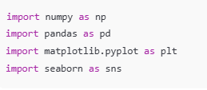

IMPORTING DATASET
The project begins with data collection, where the AI Job Dataset is sourced from reliable repositories or research platforms.
The dataset is then loaded into the Python environment using the Pandas library, forming a structured DataFrame for efficient analysis.
Importing libraries

Slide 8
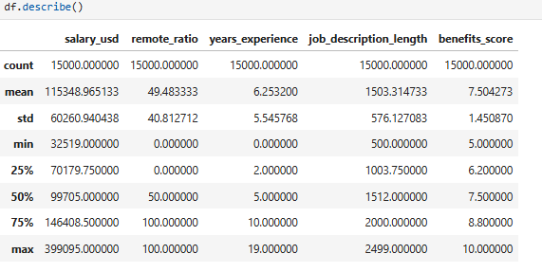

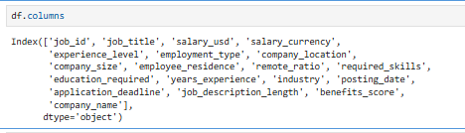
DATA EXPLORATION
The data exploration phase involves examining the dataset's basic structure, using Pandas functions
like head(), info(), and describe() to gain initial insights

Slide 9
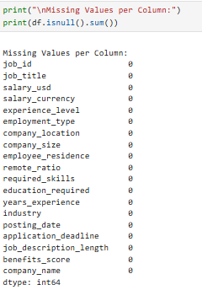
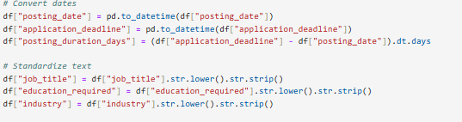
DATA CLEANING
Before analysis, it’s essential to ensure the dataset is clean and reliable.
This stage involves addressing missing values, removing duplicates, and formatting data correctly to maintain consistency and accuracy throughout the analysis.

Slide 10

DATA GROUPING
After cleaning the dataset, grouping is used to uncover key patterns and salary trends across different job characteristics.
What We Grouped By:
Job Title – to find highest-paying roles
Industry – to compare average salaries across sectors
Experience Level – to track how salary grows with experience

Slide 11
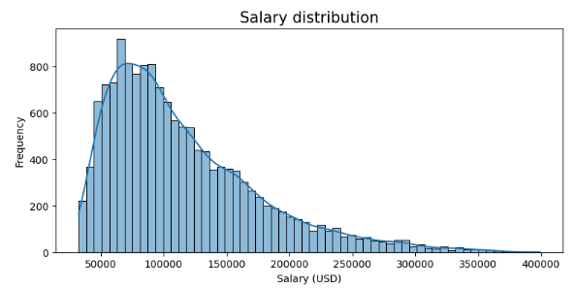
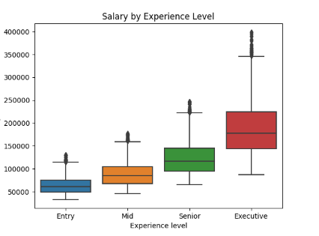
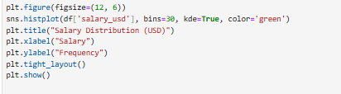
DATA VISUALIZATION

Slide 12
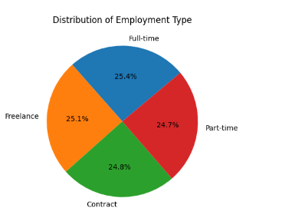
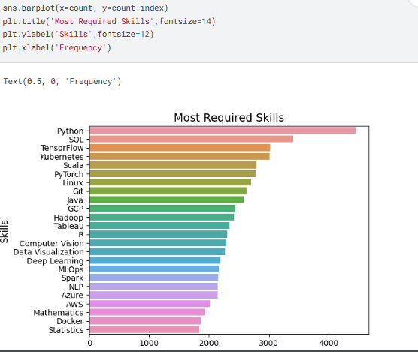
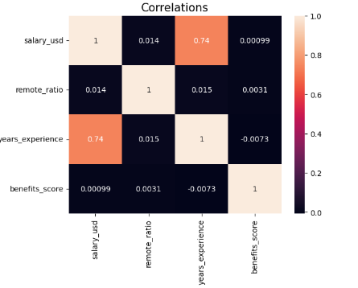

Slide 13




usage of libraries
1
2
3
PANDAS
MATPLOTLIB
SEABORN
Used for data loading, cleaning, transformation, and grouping.
Used to create custom plots like bar charts and line graphs.
Used for advanced and attractive statistical visualizations like box plots and heatmaps

Slide 14


ADVANTAGES
1
Reveals top-paying AI roles and industries
2
Identifies most in-demand job skills
3
Highlights salary trends by experience
4
Uses visualizations for easy understanding
5
Enables data-driven career and hiring decision

Slide 15
CONCLUSION
The analysis uncovered key trends in AI job salaries, skills, and employment types.
Salary varies significantly by role, experience, and location.
High-paying jobs demand specific skill sets, especially in AI/ML.
Visual insights help job seekers and recruiters make informed decisions.
The project demonstrates the power of Python in real-world data analysis.

Slide 16


SHAIK IMRAN (s201150)
GARA SURENDRA KUMAR (s200878)
BAYYE VINOD BABU (s200898)
SHAIK JAVEED (s200845)
NATUKULA CHAITHANYA KUMAR (s200712)
OUR TEAM

Slide 17



Thank You

