Slide 1

Green Building
Leadership in Energy and Environmental Design (LEED)

Slide 2
Quote
"A hundred years after we are gone and forgotten, those who never heard of us will be living with the results of our actions.”
Oliver Wendell Homes

Slide 3
Objectives
The student will be able to construct a table of materials, decide which are and are not environmentally friendly, and explain how they would make them better.
The student will be able to compare and contrast the different ways their own school is environmentally sustainable.
The student will be able to distinguish ways in which green building help save the environment.

Slide 4
Leadership in Energy and Environmental Design (LEED)
What is LEED?
  A Rating system that was developed by the U.S. Green Building Council (USGBC) to provide a recognized standard for the construction industry to assess the environmental sustainability of building designs.
  Promotes integrated, whole-building design practices
  Defined as a voluntary, consensus-based national standard for developing high performance, sustainable buildings

Slide 5
Why was LEED Created?
The program was created to….
define "green building" by establishing a common standard of measurement
promote integrated, whole-building design practices
recognize environmental leadership in the building industry
raise consumer awareness of green building benefits
transform the building market

Slide 6

LEED Strategies
Site Development
Water efficiency
Materials Efficiency
Energy Efficiency
Indoor Environmental Quality

Slide 7
Provides Framework
Helps to assess building performance
Helps meet sustainability goals
Recognizes achievements and promotes expertise in green building
Offers project certification, professional accreditation, training and practical resources

Slide 8
Six areas of LEED Programs
LEED for New Construction
LEED for Existing Buildings
LEED Rating System for Commercial Interiors
LEED Rating System for Core & Shell
LEED Rating System for Homes
LEED for Neighborhood Developments

Slide 9

LEED Building Rating System
Quantitative Measure
Project Registration
Documentation and Application
Building Certification
Professional Accreditation

Slide 10

LEED Building Rating System
Ratings (69 points)
Certified 26-32 points
Silver 33-38 points
Gold 39-51 points
Platinum 52 + points

Slide 11

LEED Credit Categories
Sustainable Sites - 22%
Water Efficiency - 8%
Energy & Atmosphere - 27%
Materials & Resources - 20%
Indoor Environmental Quality - 23%

Slide 12
Sustainable Sites – 14 Points
Site Selection:
Urban Redevelopment
Brownfield Redevelopment
Alternative Transportation
Reduce Site Disturbance
Stormwater Management
Landscape and Exterior
Light Pollution Reduction

Slide 13

Water Efficiency – 5 Points
Water Efficient Landscaping
Innovative Wastewater Technologies
Water Use Reduction

Slide 14

Energy & Atmosphere
17 Points
Building Systems Commissioning -Required
Minimum Energy Performance- Required
CFC Reduction in HVAC Equipment - Required
Optimize Energy Performance - 2-10 points *
Renewable Energy - 1-3 points
Additional Commissioning - 1 point
Elimination of HCFC’s and Halons - 1 point
Measurement and Verification - 1 point
Green Power - 1 point

Slide 15
Optimize Energy Performance
LEED Credit 1-10 Points
Intent : achieve increasing levels of energy performance above the prerequisite standard to reduce excessive energy use.

Slide 16

Optimize Energy Performance
For sustainable building projects, the ideal architectural glass is one that permits the greatest amount of natural light to enter a building while limiting, to the furthest extent possible, the thermal effects of infrared energy and solar heat gain.

Slide 17
Optimize Energy Performance
Related Pittsburgh Plate Glass (PPG) Solutions:
Oceans of Color Spectrally Selective Tinted Glass
Sungate 100 Low-E Glass
Sungate 500 Low-E Glass
Solarban 60 Solar Control Low-E Glass
Solarban 80 Solar Control Low-E Glass

Slide 18
Optimize Energy Performance
Architectural glass selection can significantly influence awarding of points by reducing demand on energy systems as well as the need for interior lighting
Credit will depend on several factors, including the whole building design and placement

Slide 19
Materials & Resources
13 Points
Storage & Collection of Recyclables - Required
Building Reuse - 1-3 points
Construction Waste Management - 1-2 points
Resource Reuse - 1-2 points
Recycled Content - 1-2 points *
Local / Regional Materials - 1-2 points *
Rapidly Renewable Materials - 1 point
Certified Wood - 1 point

Slide 20

Recycled Content
Credit 4.1: Recycled content 5% (post-consumer + ½ post-industrial)
Credit 4.2: Recycled content 10% (post-consumer + ½ post –industrial)
Intent: Increase demand for building products that incorporate recycled content materials, therefore reducing impacts resulting from extraction and processing of new virgin materials

Slide 21

Recycled Content
Requirements : Use materials with recycled content such that the sum of post-consumer recycled content plus one-half of the post-industrial content constitutes at least 5% / 10% of the total value of the materials in the project

Slide 22
Recycled Content
Related PPG Solution : All PPG glass contains a minimum of 20% post-industrial recycled content
Credit determined calculating the percent of recycled content (both post-consumer and post-industrial) and comparing to the total value of materials used
If glass is a large portion of building material value it has a potential to contribute towards credit

Slide 23
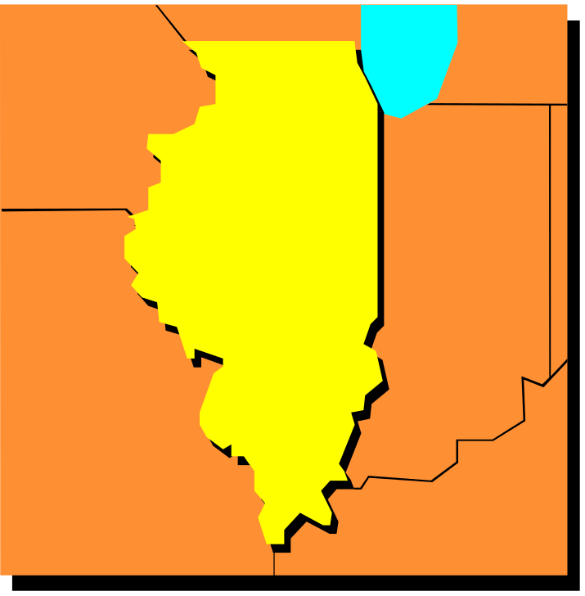
Regional Materials
Credit 5.1: 20% manufactured
regionally
Credit 5.2: 50% Manufactured
regionally
LEED Credit: 1 Point (per credit)
Intent: Increase the demand for building materials and products that are manufactured within region, thereby supporting regional economy and reducing environmental impact resulting from transportation

Slide 24
Regional Materials
Requirements: Use a minimum of 20% / 50% of building materials and products that are manufactured regionally within a radius of 500 miles
Related PPG Solution: purchasing glass from a local supplier provides highest possible level of quality & performance and claim credit depending on the percent of glass used in project

Slide 25

Indoor Environmental Quality
(IEC) 15 Points
Minimum indoor air quality - Required
Tobacco smoke control - Required
Carbon dioxide monitoring - 1 point
Increase ventilation effectiveness - 1 point
Construction IAQ Management plan - 1-2
Low-emitting materials - 1-4 points
Indoor chemical pollutant source control - 1
Controllability of systems - 1-2 points
Thermal comfort - 1-2 points
Daylight and views - 1-2 points *

Slide 26
Daylight and Views
Credit 8.1 : Daylight 75% of Spaces
Credit 8.2 : Daylight 90 % of Spaces
LEED Credit : 1 point (per credit)
Intent: Provide for the building occupants a connection between indoor spaces and the outdoors through the introduction of daylight and views into the regular occupied areas of the building

Slide 27

Daylight and Views
Requirements: Achieve a minimum daylight factor of 2% (excluding all direct sunlight penetration) in 75% / 90% off all spaces occupied for critical visual tasks.
Related PPG Solutions: This credit is awarded when 75% / 90% of occupied building space receives direct line of sight to vision glazing
Several factors must be taken into account such as building design, type of glass used and glazing

Slide 28
Pre-Design & Innovation Credits
LEED Innovation credit - 1-4 points
LEED Accredited Professional - 1point
www.usgbc.org (LEED)

