Slide 1

Vel Tech Rangarajan Dr. Sagunthala R&D Institute of Science and Technology
School of Computing
Department of Computer Science and Engineering
10211CS224 / FULL STACK APPLICATION DEVELOPMENT (JAVA)
MILESTONE PROJECT REVIEW 2
Date: 22-04-2026
JOB PORTAL MANAGEMENT SYSTEM
SDG: 9 - Industry, Innovation and Infrastructure
Presented By:
B. Chaithanya lakshmi-VTU24881-23UECS0682
Courses Handling Faculty:
Dr. S. Hemamalini Assistant professor-M.E.,P.HD

Slide 2
INTRODUCTION
A Job Portal Management System is a web-based application connecting job seekers and employers.
It allows users to search and apply for jobs from anywhere.
Employers can post job vacancies and manage applicants efficiently.
The system enables users to upload resumes and create profiles.
It reduces manual effort in recruitment processes.
Provides real-time notifications and updates.
Ensures secure login with authentication features.
Improves communication between users and employers.
1
2
3
4
5
6
7
8
9

Slide 3
PROBLEM STATEMENT
1
Existing recruitment systems are manual and time-consuming.
Job seekers must visit multiple platforms to find jobs.
No proper system to track application status.
Employers face difficulty managing large applicant data.
Lack of centralized data leads to inefficiency.
Difficult to filter candidates based on skills.
Poor communication between employers and candidates.
Risk of duplicate or missing application records.
2
3
4
5
6
7
8
9

Slide 4
OBJECTIVE(S)
1
To develop a web-based job portal connecting job seekers and employers.
To automate job application and recruitment process.
To implement secure login with OTP verification.
2
3
4
5
6
7
8
9

Slide 5
PROPOSED SYSTEM
1
Provides secure user registration and login.
Implements OTP verification through email.
Allows users to upload resumes.
Enables job search and application features.
Automatically filters candidates based on resume.
Sends email notifications to shortlisted candidates.
Maintains centralized database for all data.
Reduces manual work and improves efficiency.
2
3
4
5
6
7
8
9

Slide 6
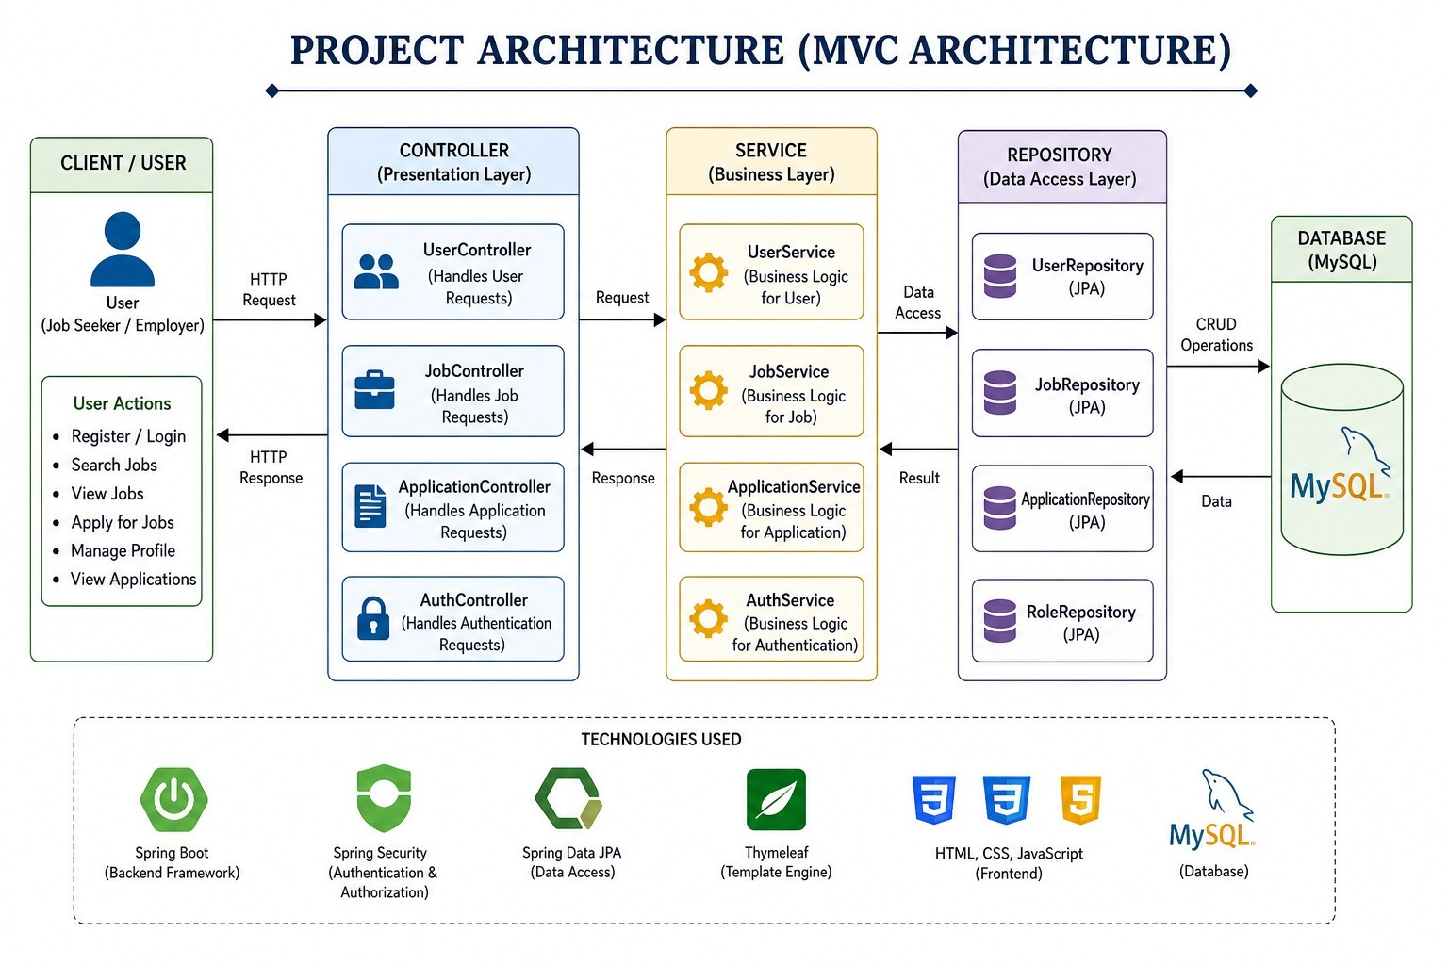
PROPOSED SYSTEM ARCHITECTURE
1
2
3
4
5
6
7
8
9
Input: User details, login credentials, resume, job applications
Processing: OTP verification, resume filtering, job matching
Database: Stores users, jobs, applications, resumes
Output: Job listings, status updates, email notifications

Slide 7
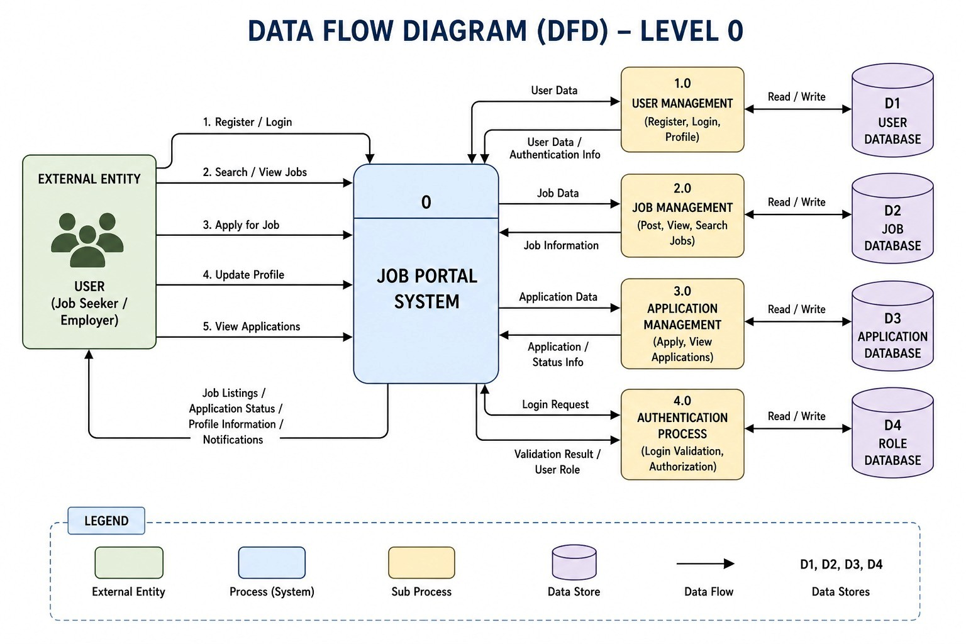
WORKFLOW
1
2
3
4
5
6
7
8
9

Slide 8
TECHNOLOGIES USED
Frontend: HTML, CSS, Thymeleaf
Backend: Java, Spring Boot, Spring MVC
Database: MySQL
Third-Party API: Java Mail API (for OTP & email)
Tools: VS Code, MySQL Workbench, Spring Initializer
Hardware/Software Requirements:
Minimum 4GB RAM
JDK 8+
Web Browser (Chrome)
1
2
3
4
5
6
7
8
9

Slide 9
MODULE DESCRIPTION
Module 1: User Management
Handles user registration, login, OTP verification, and profile management.
Module 2: Job Management
Manages job posting, updating, searching, and filtering.
Module 3: Application Management
Handles job applications, tracking, and status updates.
Module 4: Innovative Module
Implements OTP verification and email notification system.
Module 5: Database Management
Stores user data, job details, applications, and resumes.
1
2
3
4
5
6
7
8
9

Slide 10
IMPLEMENTATION SCREENSHOTS
(Add screenshots of:
Home page
Login page
Main module
Output page)
Explain each in 1–2 lines.
1
2
3
4
5
6
7
8
9

Slide 11
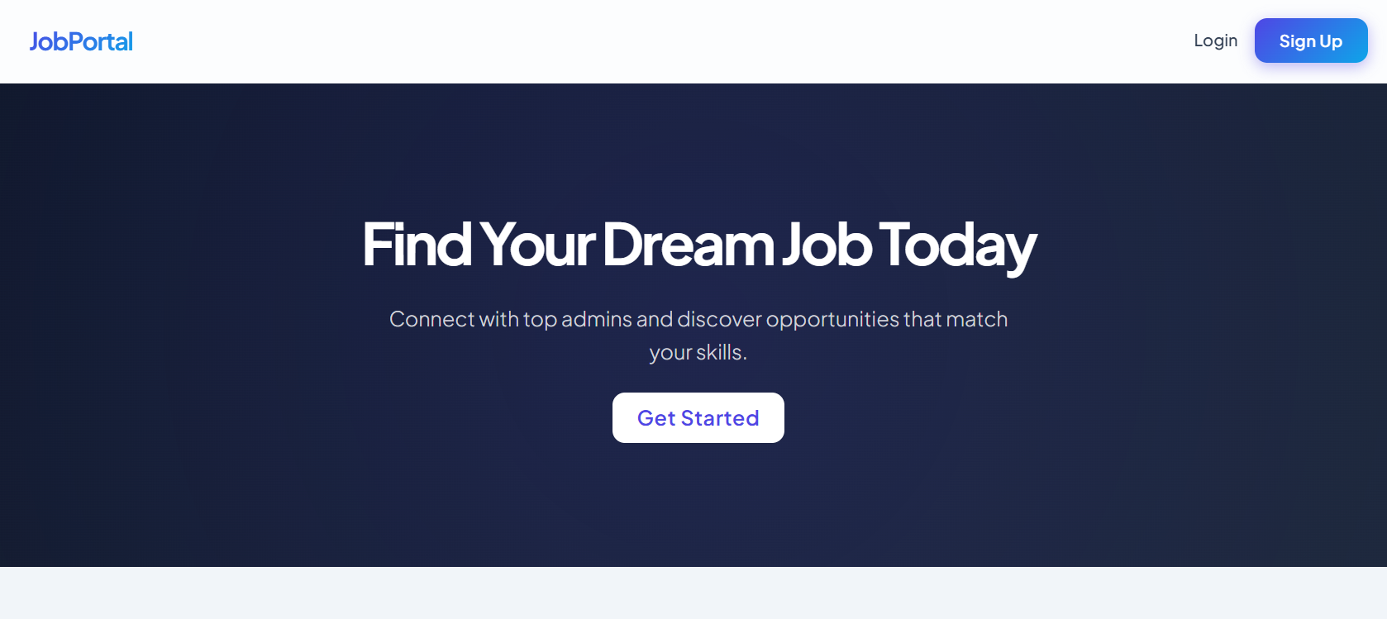
IMPLEMENTATION SCREENSHOTS
HOME PAGE
1
2
3
4
5
6
7
8(A)
The home page provides a user-friendly interface for job seekers to explore career opportunities and connect with recruiters easily. It includes navigation options for login and registration, along with a visually appealing banner that encourages users to start their job search journey.
9

Slide 12
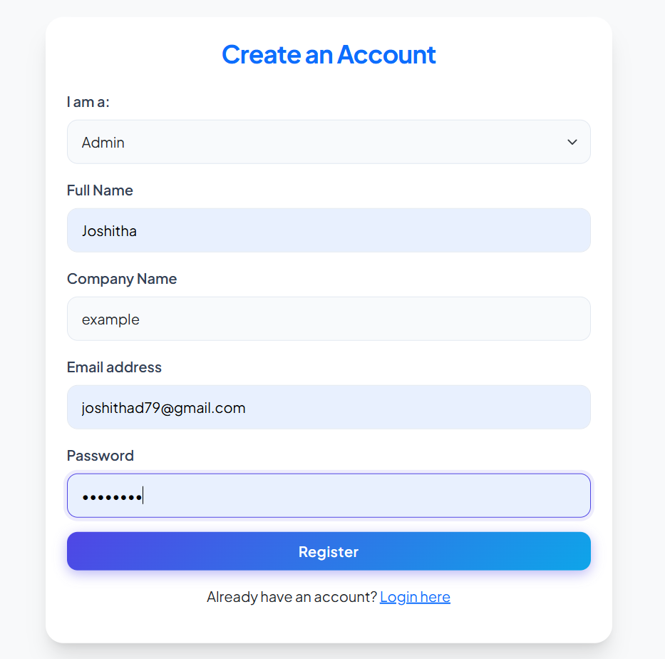
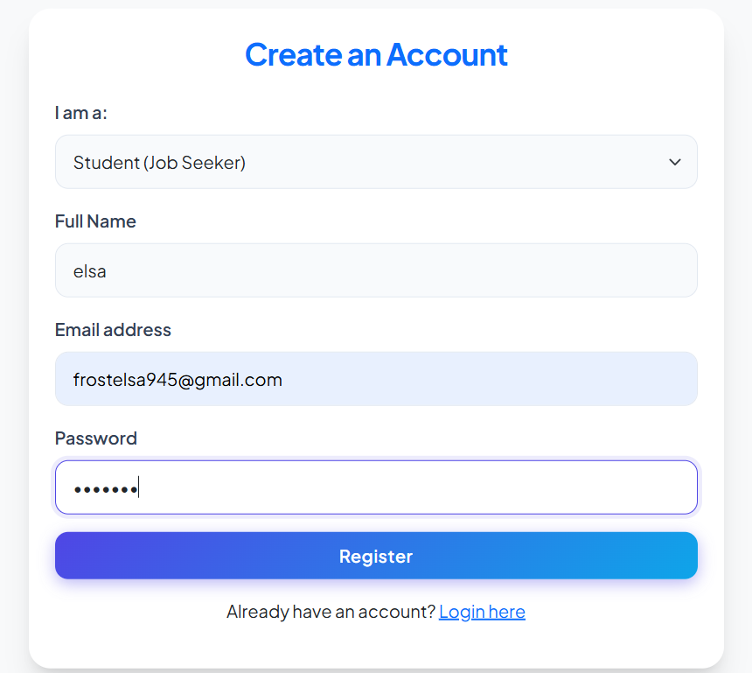
IMPLEMENTATION SCREENSHOTS
Admin Login Page
User Login Page
1
2
3
4
5
6
7
8(B)
9

Slide 13
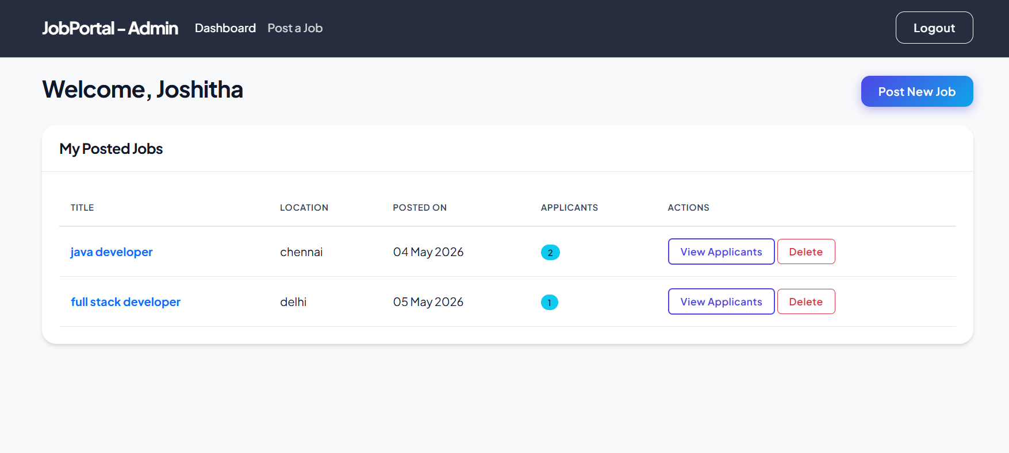
IMPLEMENTATION SCREENSHOTS
MODULE-1
1
2
3
4
5
6
7
8(C)
The admin dashboard allows recruiters to manage posted job vacancies and monitor applicant details efficiently. It provides options to post new jobs, view applicants for each job, and delete job postings through a simple and organized interface.
9

Slide 14
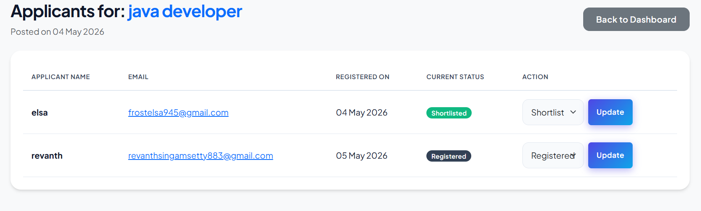
IMPLEMENTATION SCREENSHOTS
MODULE-2
1
2
3
4
5
6
7
8(C)
The applicants management page enables the admin to view details of candidates who applied for a specific job role. It allows updating applicant status such as registered or shortlisted, helping recruiters manage the hiring process effectively.
9

Slide 15
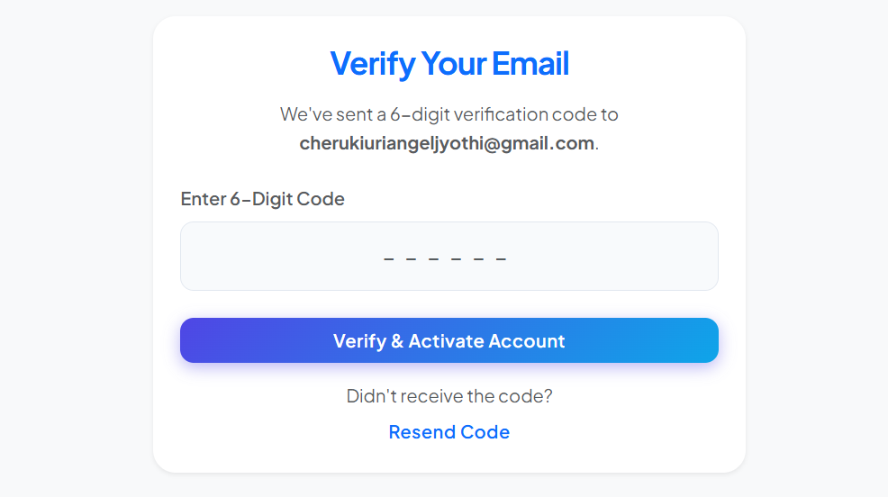
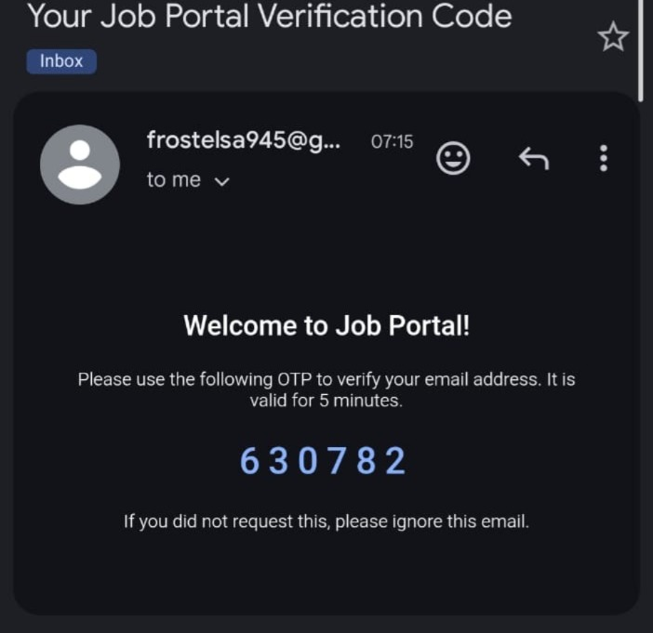
IMPLEMENTATION SCREENSHOTS
Innovative Module
1
2
3
4
5
6
7
8(C)
9
The innovative OTP verification module enhances security by validating the user’s email address during account registration. A unique 6-digit verification code is sent to the registered email, ensuring authenticated and secure user access to the job portal system.

Slide 16
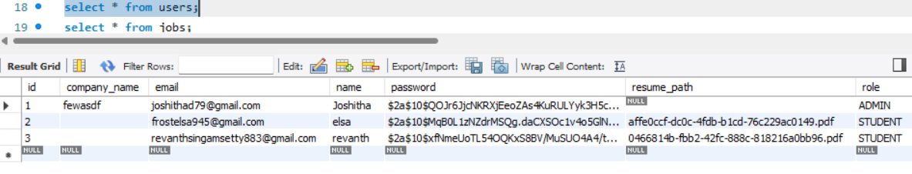
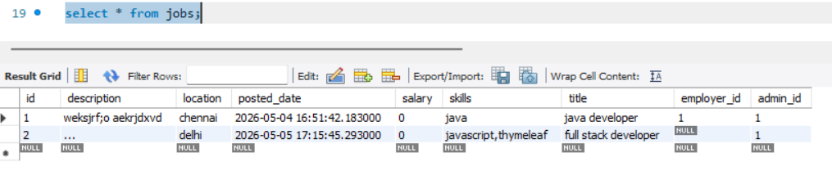
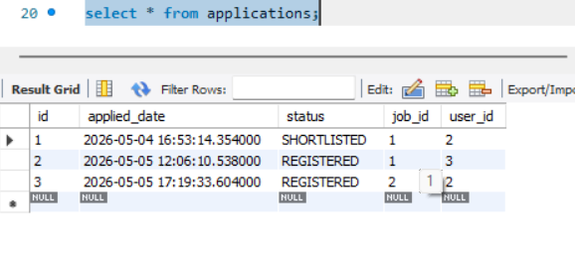
IMPLEMENTATION SCREENSHOTS
USER table
1
2
3
4
JOBS table
5
6
7
APPLICATIONS table:
8(C)
9

Slide 17
ADVANTAGES & LIMITATIONS
1
Advantages:
Reduces manual work
Easy job application process
Secure OTP authentication
Efficient candidate filtering
Real-time notifications
Limitations:
Requires internet connection
Basic security features
Depends on server performance
2
3
4
5
6
7
8
9

Slide 18
Thank you

