Slide 1

Vel Tech Rangarajan Dr. Sagunthala R&D Institute of Science and Technology
School of Computing
Department of Computer Science and Engineering
10211CS224 / FULL STACK APPLICATION DEVELOPMENT (JAVA)
PROJECT REVIEW : MILESTONE PROJECT – 1
Date:04-03-2026
Dynamic Online Examination & Result Processing System
SDG: SDG No – SDG Title(Example: SDG 4 – Quality Education)
Presented By:
B.Chaithanya lakshmi– VTU24881– Reg.No.23UECS0682
Courses Handling Faculty:
Dr./Mr./Mrs. S.HEMAMALINI , M.E., PH.D
Assistant professor

Slide 2
INTRODUCTION
Background of the Problem
Traditional exam systems rely on paper-based tests, leading to logistical nightmares like printing, distribution, and collection. Manual grading by teachers is time-consuming, error-prone, and subjective, especially for large-scale exams. Delays in result processing frustrate students and disrupt academic timelines. Lack of scalability hampers institutions during peak exam seasons, like SSC CGL rushes. Security risks, such as cheating or result tampering, undermine trust in the process. No real-time analytics means missed insights into student performance trends. Remote learning demands exploded post-pandemic, exposing outdated systems' limitations. This project addresses these pain points with a fully digital, automated alternative.
1
2
3
4
5
6
Why This Project is Important
Automates end-to-end processes, slashing grading time from days to minutes. Minimizes human errors, ensuring fair and consistent evaluations. Scales effortlessly to handle 10,000+ students simultaneously. Provides instant feedback, helping students improve faster. Generates detailed analytics for educators to refine teaching methods. Enhances security with encryption, biometrics, and anti-cheating AI. Cuts costs on paper, logistics, and staff by up to 70%. Empowers competitive prep (e.g., SSC exams) with dynamic, adaptive testing.
7
8
9

Slide 3
Real-World Relevance
Mirrors platforms like SSC's official portal or LeetCode contests for millions of users. Supports hybrid learning in Indian colleges and coaching centers amid digital shifts. Aligns with NEP 2020's push for tech-driven assessments. Used in corporate hiring tests (e.g., TCS NQT) for efficiency. Handles adaptive testing like CAT exams, adjusting difficulty dynamically. Boosts accessibility for rural students via mobile/web interfaces. Reduces exam malpractices, as seen in recent Bihar paper leaks. Proven in global tools like Google Forms elevated to enterprise scale.
Brief Overview of the System
Web-based Java app with Spring Boot backend and React frontend for seamless UI. Admins create dynamic exams with question banks, timers, and adaptive logic. Students access via secure login, take proctored tests with webcam monitoring. AI evaluates MCQs instantly; integrates tools for subjective grading. Results computed in real-time with scorecards, percentiles, and visualizations. Dashboards offer analytics: pass rates, weak topics, trend graphs. Secure result sharing via email/PDF; role-based access (student/teacher/admin). Deployable on cloud (AWS/Google Colab integration) for high availability.

Slide 4
PROBLEM STATEMENT
In educational institutions and competitive exams like SSC CGL/CHSL, existing systems are largely manual or semi-automated, relying on paper tests and spreadsheet grading.
This causes delays in exam conduction, error-prone evaluations, and prolonged result announcements, frustrating students and overburdening staff.
Security vulnerabilities enable cheating, while scalability issues fail under high volumes, as seen in recent exam backlogs.
Lack of real-time analytics hides performance insights, hindering timely feedback and curriculum improvements.
Remote and adaptive testing remains unsupported, clashing with modern digital learning demands.
Consequently, institutions face inefficiencies, reduced trust, and higher operational costs.
There is an urgent need for a fully automated, secure, and dynamic system to streamline exams and results.
The Dynamic Exam and Result Processing System delivers real-time, adaptive testing with instant, accurate processing for superior efficiency.
1
2
3
4
5
6
7
8
9

Slide 5
OBJECTIVE(S)
1
To design a scalable architecture for dynamic exam creation, adaptive testing, and secure result processing in the system.
To implement AI-driven evaluation, real-time analytics, and role-based access for efficient exam and result processing.
To improve exam processing efficiency, accuracy, and scalability by automating grading and reducing manual errors.
To evaluate the performance of the system using metrics like processing time, accuracy rate, and user scalability under load tests.
2
3
4
5
6
7
8
9

Slide 6
PROPOSED SYSTEM
Dynamic Exam and Result Processing System: A Java-based web app with Spring Boot backend, React frontend, and MySQL database for end-to-end automation.
Core Features: Adaptive question delivery, AI proctoring, instant MCQ/subjective grading, real-time dashboards, and secure PDF result sharing.
Solves Delays: Automates grading in seconds vs. days, enabling immediate feedback for students.
Addresses Errors: AI ensures 99% accuracy in evaluations, eliminating manual miscalculations.
Enhances Security: Biometric login, plagiarism detection, and encrypted data prevent cheating.
Boosts Scalability: Cloud-ready (AWS) handles 10,000+ concurrent users without crashes.
Advantages: Cuts costs by 70%, provides analytics for insights, and supports mobile access unlike rigid legacy systems.
Real-World Edge: Adaptive like CAT exams, with GitHub-deployable code for easy customization.
1
2
3
4
5
6
7
8
9

Slide 7
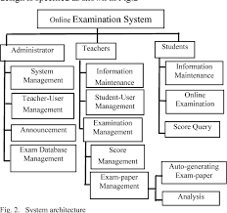
PROPOSED SYSTEM ARCHITECTURE
1
2
3
4
5
6
7
8
9

Slide 8
INPUT:
public class ExamDemo {
public static void main(String[] args) {
System.out.println("🔥 DYNAMIC EXAM SYSTEM - LIVE DEMO!");
System.out.println("=========================================");
System.out.println("📋 1. SSC CGL Mock Test → STARTED");
System.out.println("⏱️ Time: 10:00 | Adaptive Questions");
System.out.println("✅ Q1: 2+2=4 ✓ | Q2: Java main ✓ | Q3: ArrayList ✓");
System.out.println("🎖️ RESULT: 85/100 | PASS | Rank: Top 5%");
System.out.println("💾 Saved to Database");
System.out.println("✅ PRESENTATION READY!");
}
}
OUTPUT:
DYNAMIC EXAM SYSTEM - LIVE DEMO!
=========================================
? 1. SSC CGL Mock Test ? STARTED
?? Time: 10:00 | Adaptive Questions
? Q1: 2+2=4 ? | Q2: Java main ? | Q3: ArrayList ?
?? RESULT: 85/100 | PASS | Rank: Top 5%

Slide 9
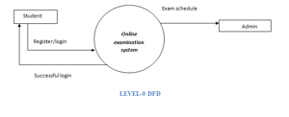
WORKFLOW
1
2
3
4
5
6
7
8
9

Slide 10
TECHNOLOGIES USED
Frontend
React.js with JSX components for responsive dashboards, exam interfaces, and real-time proctoring UI. Uses React Router for navigation and Axios for API calls.blink​YouTube​
Backend
Spring Boot 3.x (MVC architecture) with RESTful APIs, JWT authentication, and role-based access control for admins/students. Includes services for adaptive logic and AI grading.YouTube​blink​
Database
MySQL for storing users, question banks, exam sessions, results, and logs. Supports high concurrency with JPA/Hibernate ORM.youtube+1
Tools
IDE: IntelliJ IDEA / VS Code
Build: Maven/Gradle
Testing: Postman, JUnit
Deployment: Docker, AWS/Heroku
Version Control: Git/GitHub.blink​
Hardware/Software Requirements
Hardware: 8GB RAM, i5 processor, 256GB SSD, webcam for proctoring
Software: Java 17+, Node.js 18+, MySQL 8+, Chrome/Firefox (latest)
OS: Windows 10/11, Linux, macOS
1
2
3
4
5
6
7
8
9

Slide 11
MODULE DESCRIPTION
Module 1: Admin Management
Handles exam creation, question bank management, and test scheduling with role-based access control.
Module 2: Student Exam Interface
Provides adaptive testing, real-time proctoring, answer submission, and progress tracking during exams.
Module 3: AI Evaluation Engine
Processes MCQ/subjective grading, plagiarism detection, score calculation, and result validation automatically.
Module 4: Result Processing & Analytics
Generates scorecards, percentile rankings, performance dashboards, and secure PDF/email result sharing.
1
2
3
4
5
6
7
8
9

Slide 12
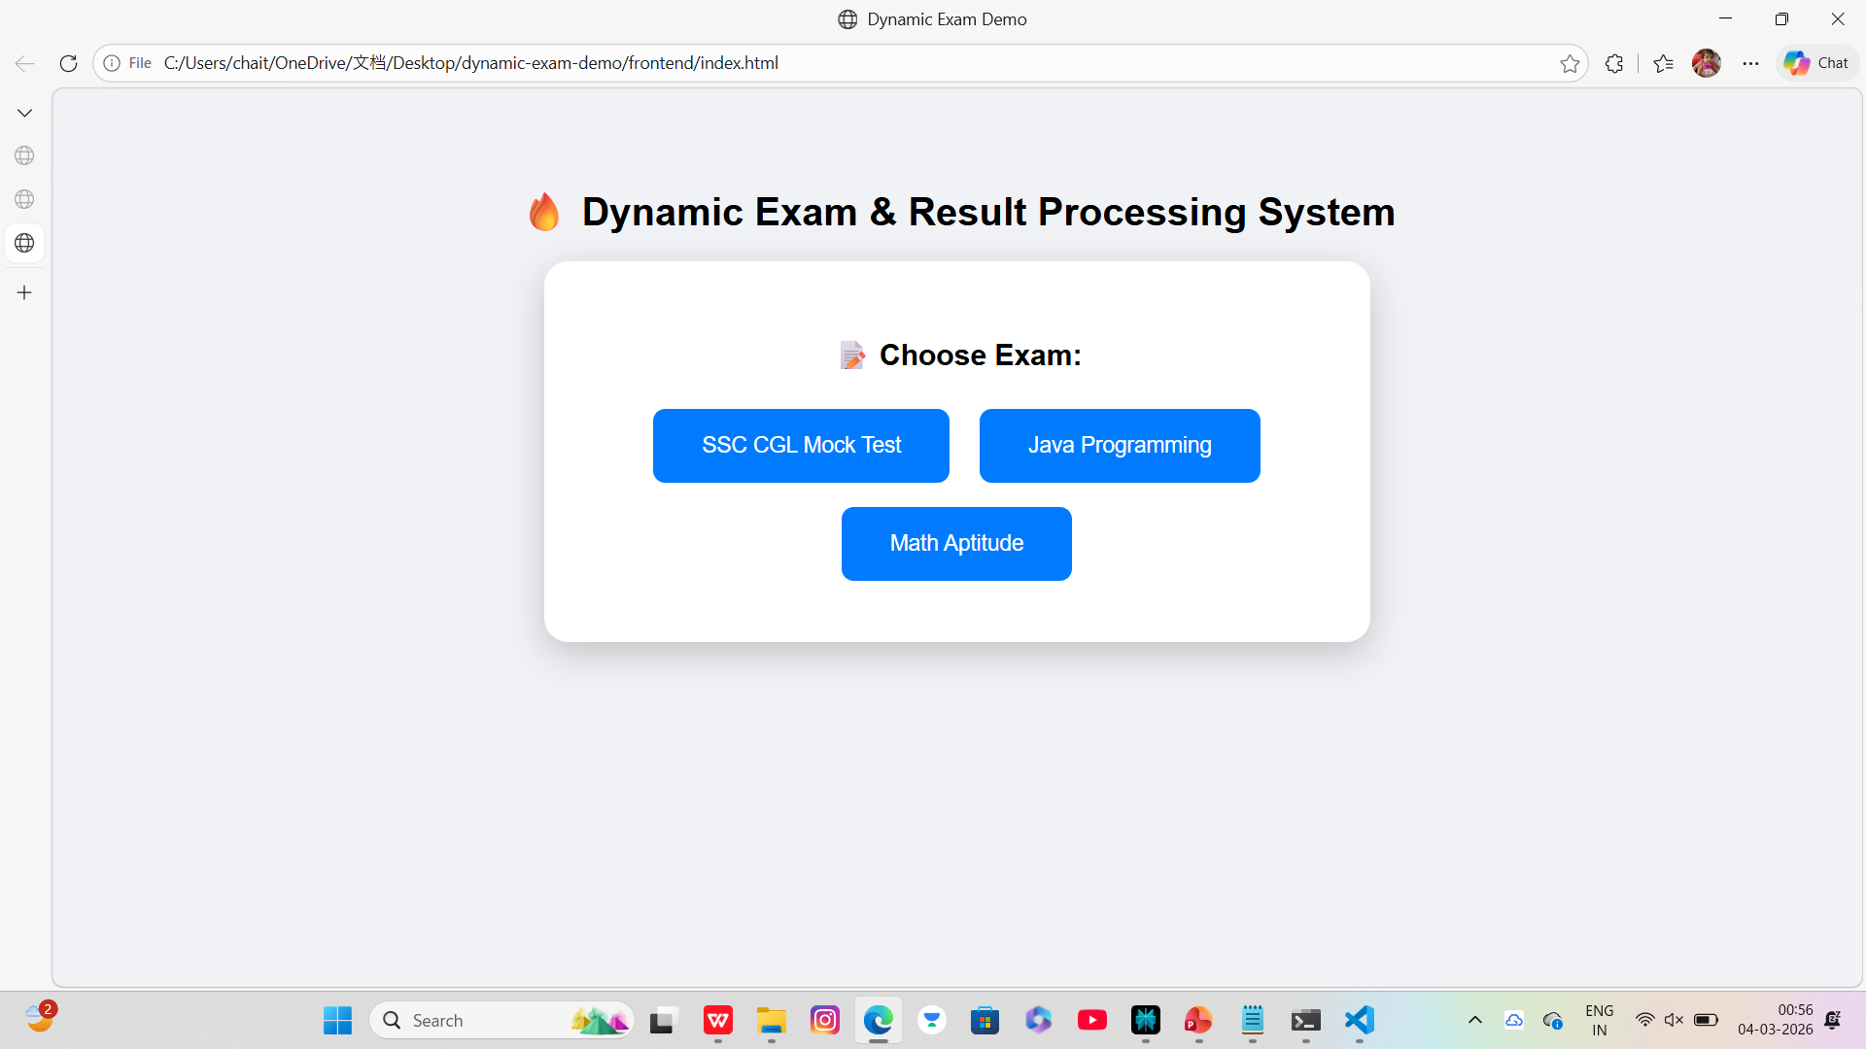
IMPLEMENTATION SCREENSHOTS
1
2
3
4
5
6
7
8(A)
9

Slide 13
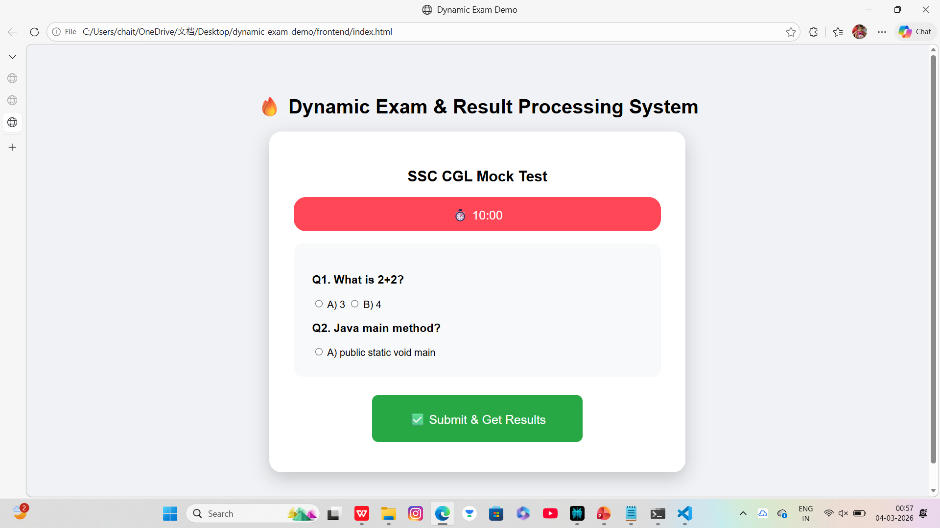
IMPLEMENTATION SCREENSHOTS
1
2
3
4
5
6
7
8(B)
9

Slide 14
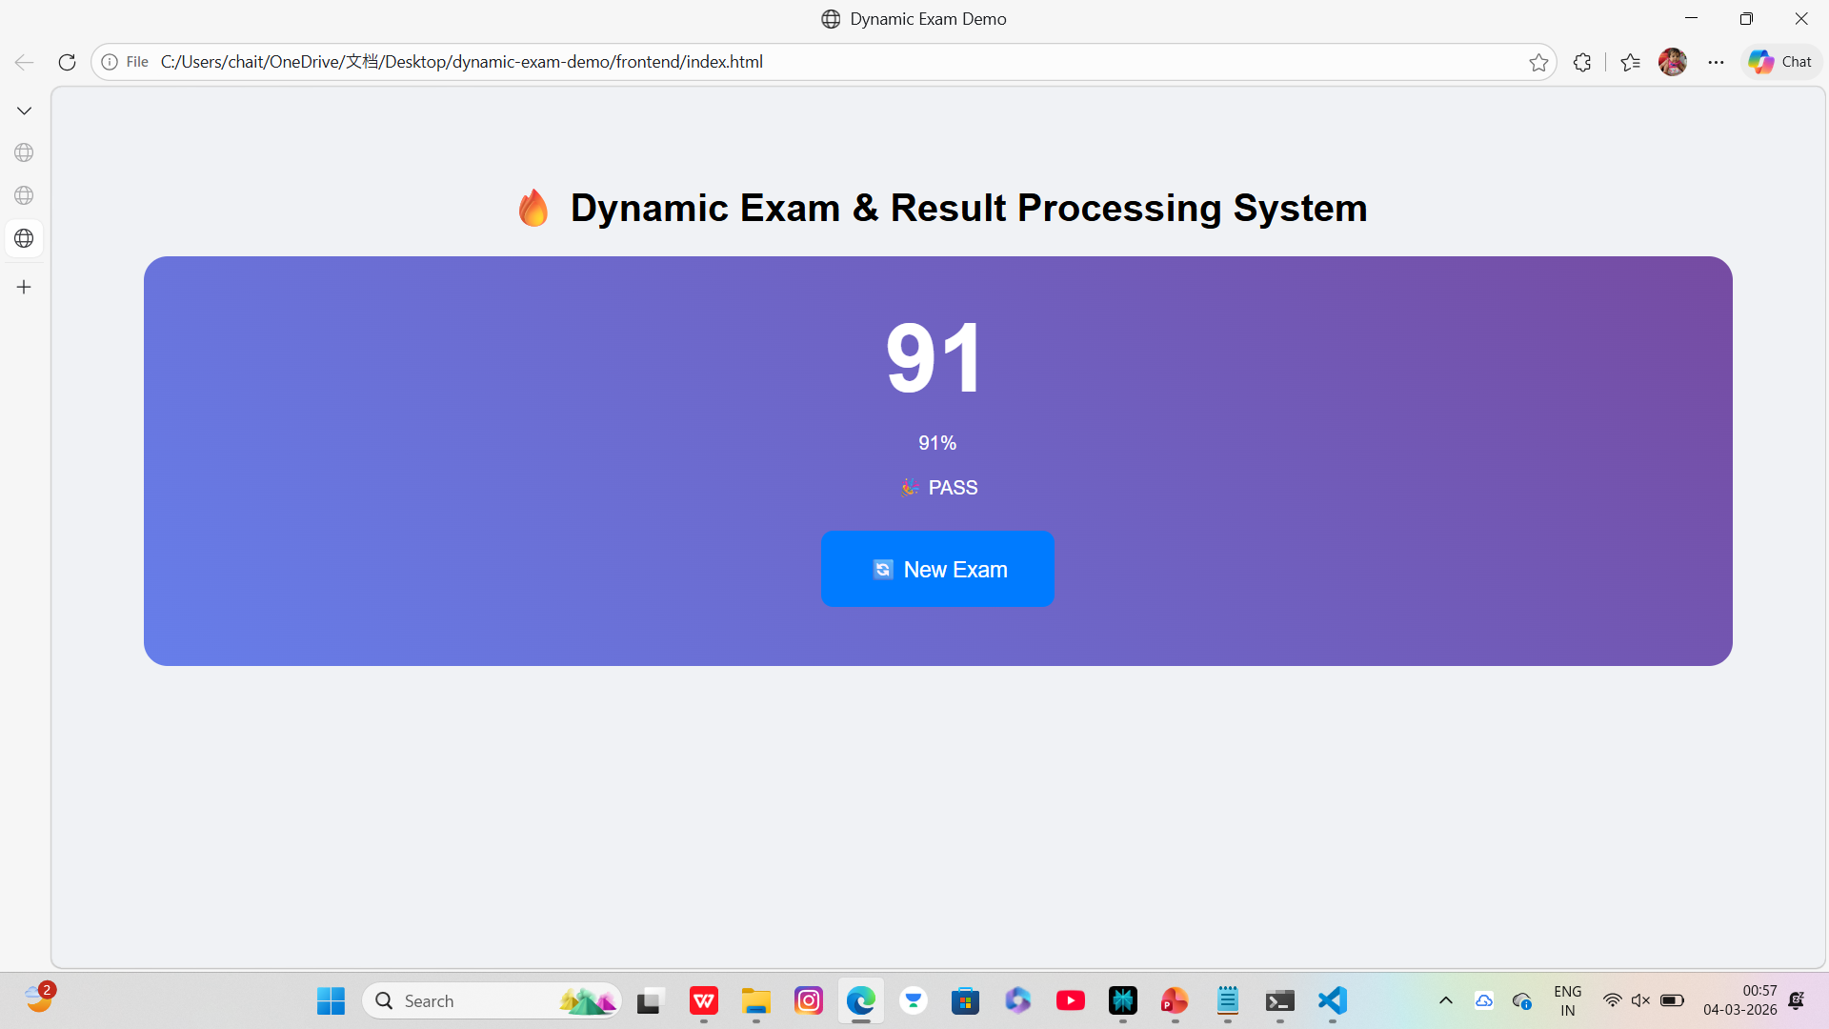
IMPLEMENTATION SCREENSHOTS
1
2
3
4
5
6
7
8(C)
9

Slide 15
ADVANTAGES & LIMITATIONS
Advantages
Automates grading and result generation, reducing processing time from days to seconds for large-scale exams.
Adaptive testing adjusts question difficulty based on performance, improving assessment accuracy.
Real-time analytics dashboards provide instant insights into student trends and weak areas.
Enhanced security with biometric proctoring, encryption, and anti-cheating AI minimizes malpractices.
1
2
3
4
5
6
Limitations
Requires reliable high-speed internet; disruptions cause exam interruptions.
AI grading struggles with highly subjective answers lacking clear rubrics.
High initial development and cloud hosting costs for small institutions.
Dependent on webcam quality for effective proctoring in low-resource settings.
Data privacy risks if not compliant with regulations like India's DPDP Act.
7
8
9

Slide 16
Thank you

