Slide 1
Airbnb Market Analysis
Chicago and New Orleans
- Kanaka Chaithanya

Slide 2
Key Metrics Summary
- Total Price: $4.84M
- Total Availability: 3M nights
- Average Reviews per Month: 1.64
- Total Reviews: 968K
- Listings Count: 16,590
- Host Count: 7,367

Slide 3
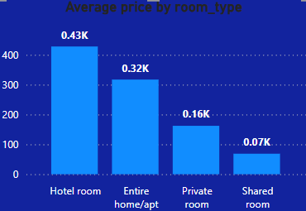
Average Price by Room Type
- Hotel room: $430
- Entire home/apt: $320
- Private room: $160
- Shared room: $70

Slide 4
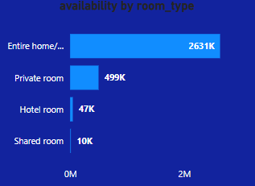
Availability by Room Type
- Entire home/apt: 2.63M nights
- Private room: 499K nights
- Hotel room: 47K nights
- Shared room: 10K nights

Slide 5
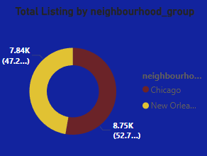
Listings by Neighbourhood Group
- Chicago: 8.75K listings (52.7%)
- New Orleans: 7.84K listings (47.2%)

Slide 6
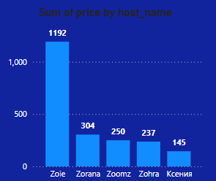
Top Hosts by Price
- Zoie: $1192K
- Zorana: $304K
- Zoomz: $250K
- Zohra: $237K
- Ксения: $145K

Slide 7
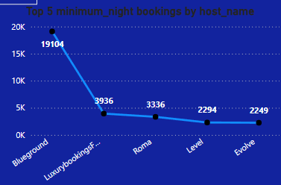
Top 5 Minimum Night Bookings by Host
- Blueground: 19,104 nights
- Luxurybookings-: 9,936 nights
- Roma: 3,336 nights
- Level: 2,294 nights
- Evolve: 2,249 nights

Slide 8
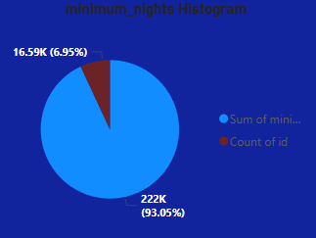
Minimum Nights Histogram
- 1 night: 93.05%
- 2-3 nights: 6.95%

Slide 9
Conclusion & Recommendations
- Hotel rooms command highest average prices.
- Entire home/apts have highest availability.
- Chicago slightly leads in listings volume.
- Most bookings are for short stays (1 night).
- Focus marketing efforts on Entire home/apts in Chicago.

