Slide 1


Department of Information Science and Engineering
Hotel Room Searching App
Student Names and USN:
Chaithanya M– 1NT22IS039
Ananya H – 1NT22IS015
Dhruthi S L– 1NT22IS049
B.Swathi -1NT22IS034

Slide 2
Tech Stack Used
Flutter – Framework for building the cross-platform mobile UI.
Dart – Programming language used with Flutter. Material Design – For UI components and styling.
Image.network – To load and display hotel images from URLs.
Stateful Widgets – Used for managing user input, filters, and dynamic content. Form & Validation – Booking form built using Form, TextFormField, and input validation logic.

Slide 3
Hotel Room Searching
Overview: A cross-platform mobile application developed using Flutter and Dart.
Allows users to search for hotels, apply filters, view detailed descriptions, and fill a booking form.
User Interface: Built using Material Design components for a modern and consistent look.
Uses stateful widgets for interactive UI updates. Implements GridView for displaying hotel cards in a responsive layout.
Search and Filter Features: Real-time search using a TextField that filters hotels by name. Filter by: Minimum rating using a DropdownButton.

Slide 4
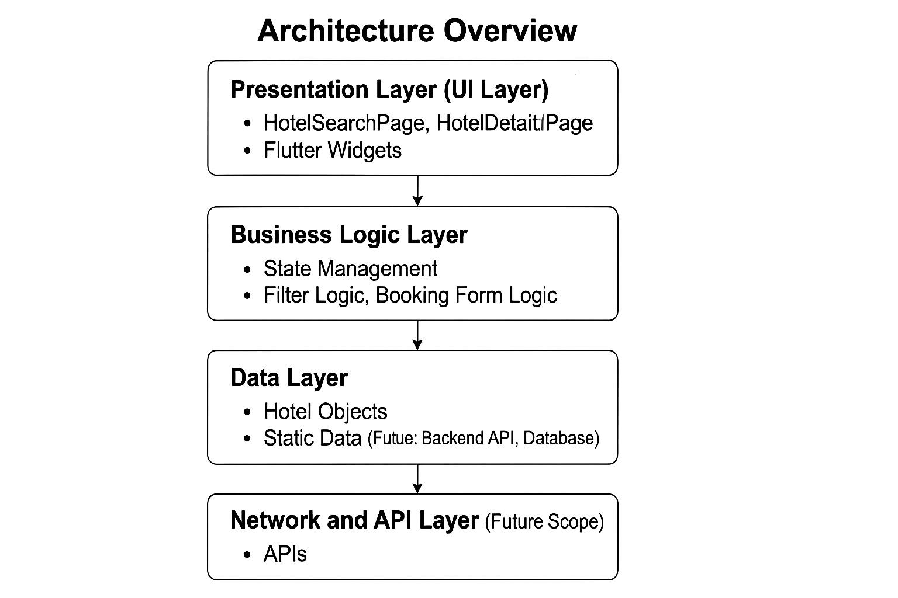
Architecture Overview
Presentation Layer: Manages UI and user interactions using Flutter widgets.Business
Logic Layer: Handles search, filtering, and booking form logic.
Data Layer: Stores static hotel data (can be replaced by backend).
Network/API Layer: For dynamic hotel listings, bookings, and real-time updates via APIs.

Slide 5
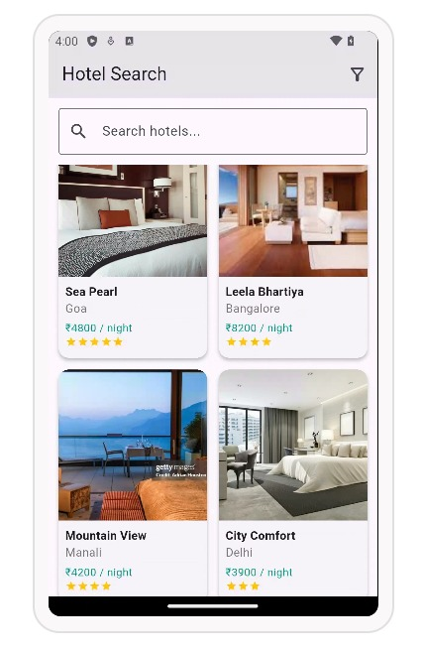
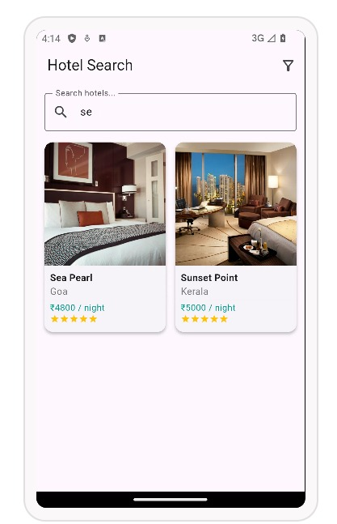
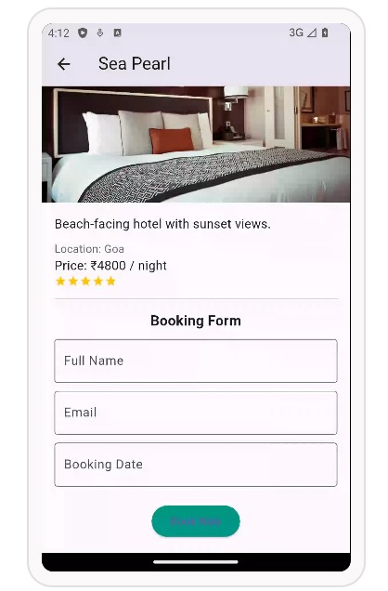
OUTPUT

Slide 6
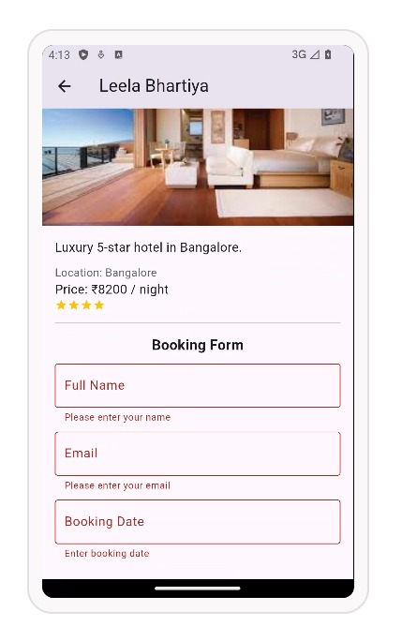
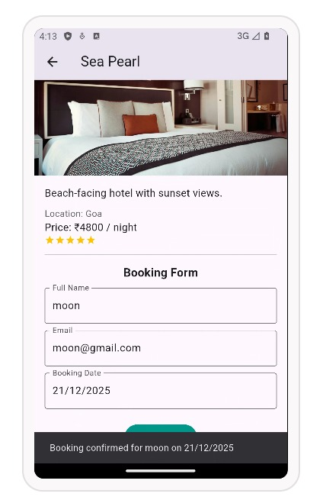
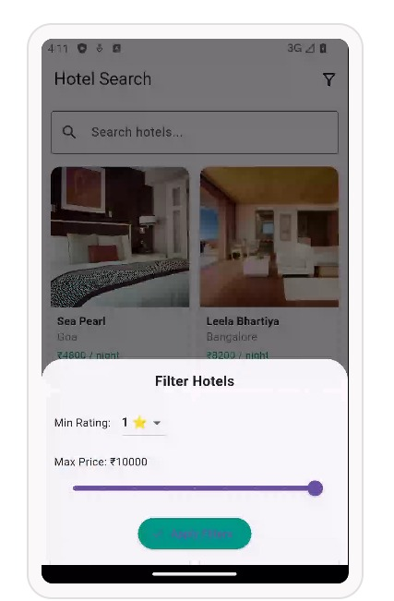
OUTPUT

Slide 7
Explanation
Explanation
A Flutter-based mobile app for browsing and booking hotels.
Users can search, filter by rating and price, and view hotel details.
Includes a booking form with validation for name, email, and date.
Uses hardcoded hotel data for demonstration purposes.
Follows a modular architecture with clear separation of UI, logic, and data.
Provides a foundation for future API integration and real-time bookings.
Demonstrates key Flutter concepts like state management, navigation, and form handling.

Slide 8
Future Scope
User Authentication: Implement login/signup functionality using Firebase or Oauth. Location-Based Suggestions: Suggest hotels based on user’s current location using GPS.
Chat Support: Provide in-app chat support for customer queries. Payment Gateway: Integrate Razorpay, Stripe, or UPI for online booking payments. Dark Mode Support: Enhance UI/UX with theme switching.
Multi-language Support: Add localization for wider accessibility.

Slide 9
Conclusion
The project demonstrates a functional hotel booking app using Flutter. Features include search, filter, detail view, and booking form. Uses clean architecture with separation of UI, logic, and data. Provides a solid foundation for future enhancements like API integration and authentication. Highlights Flutter development skills, UI design, and state handling. A strong base for scaling into a full-featured, real-world hotel booking solution.

Slide 10
Thank You

