Slide 1
PORTFOLIO WEBSITE • CASE STUDY
My Portfolio
A multi-page personal website built with HTML — telling the story of my
journey from Electronics & Communication to Full Stack Development.
Bommideni Chaithanya Priya
Aspiring Java Full Stack Developer
🌐 Live Site: https://chaithanyapriya08.github.io/HTML_Portfolio/
💻 github.com/chaithanyapriya08
🔗 linkedin.com/in/chaithanya-priya

Slide 2
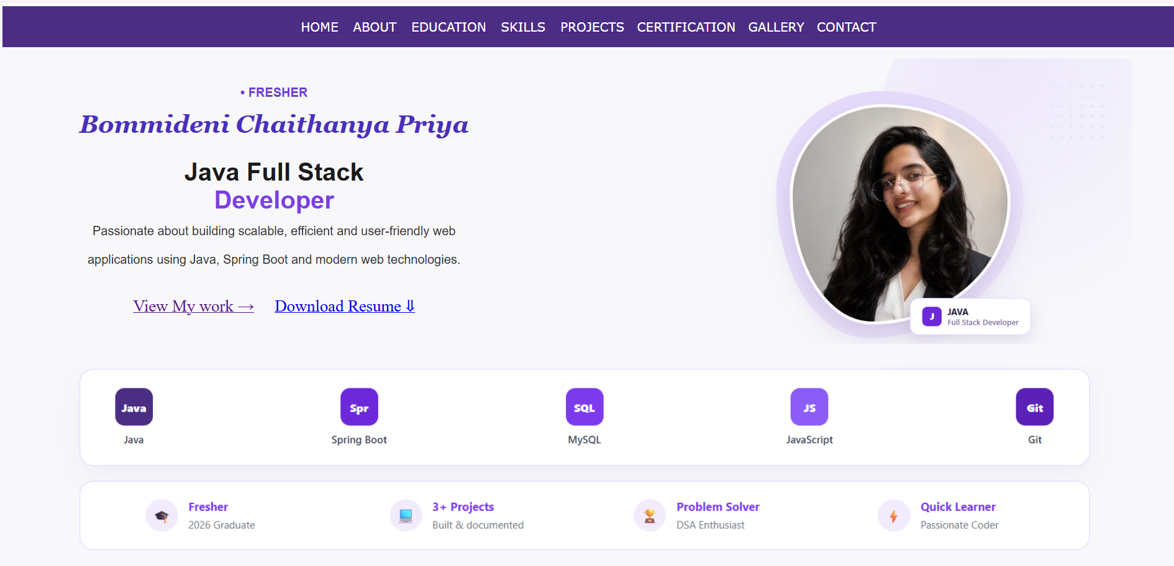
Project Overview
Purpose
A personal portfolio designed to present my academic background, projects, and skills to recruiters — built while preparing for Full Stack Developer roles.
Structure
8 interconnected HTML pages, each sharing a consistent purple-and-lavender navigation bar and footer for a unified experience.
Approach
Built ground-up with semantic HTML tables for layout, inline styling for rapid iteration, and embedded media for a richer showcase.
chaithanyapriya.dev • Portfolio Website Project
2

Slide 3
Site Structure — 8 Pages
🏠
Home
Landing hero, quick highlights & featured projects
🙋
About
Bio, career objective, interests & my journey
🎓
Education
Academic timeline, coursework & scores
🛠️
Skills
Proficiency bars across languages & web tech
💼
Projects
Deep-dive case studies of 2 major builds
📜
Certifications
Earned certificates with skills covered
🖼️
Gallery
Photos & embedded project demo videos
✉️
Contact
Contact forms, map & social links
chaithanyapriya.dev • Portfolio Website Project
3

Slide 4
Design System
Color Palette
Lavender White
Background
#F5F3FF
Royal Purple
Navbar
#6D28D9
Violet
Headings
#7C3AED
Medium Purple
Buttons
#8B5CF6
White
Cards
#FFFFFF
Slate Gray
Text
#374151
Light Lavender
Borders
#DDD6FE
Soft Lavender
Inputs
#C4B5FD
Deep Purple
Footer
#5B21B6
Light Purple
Hover
#E9D5FF
Typography Verdana for navigation & labels · Georgia / Arial for hero & section headings · a consistent purple-lavender theme carried across all 8 pages.
chaithanyapriya.dev • Portfolio Website Project
4

Slide 5
Key Features
🧭
Responsive Navigation
Identical nav bar & footer wired across every page
📄
Downloadable Resume
One-click resume PDF download from the homepage
📊
Animated Skill Bars
Visual proficiency indicators by skill category
📍
Embedded Google Map
Live location embed on the contact page
📝
Dual Contact Forms
Quick-message form plus a detailed inquiry form
🎬
Video Gallery
Embedded project demo videos with custom posters
🏅
Certification Showcase
Certificate images paired with skills covered
🔖
Anchor Navigation
In-page jump links for quick section access
chaithanyapriya.dev • Portfolio Website Project
5

Slide 6
Built With
HTML5
Semantic Tables
HTML Forms
iFrame Embeds
Media & Marquee Elements
Git & GitHub
VS Code
How it's built A hand-coded, framework-free HTML site — tables handle layout, native elements (forms, iframes, video, marquee) power the interactivity, all version-controlled on GitHub.
chaithanyapriya.dev • Portfolio Website Project
6

Slide 7
Project Highlights
8
2
5
50+
Pages Built
Major Projects Featured
Certifications Showcased
DSA Problems Solved (LeetCode)
From an ECE background to a self-built full stack portfolio — every page reflects a step in that journey.
chaithanyapriya.dev • Portfolio Website Project
7

Slide 8
Let's Connect
Explore the live site, check out the code, or reach out directly — I'm open to internship
and full-time opportunities as a Full Stack Developer.
🌐
💻
🔗
✉️
Live Site
GitHub Repo
LinkedIn
Email
www.linkedin.com/in/chaithanya-priya
https://github.com/chaithanyapriya08/HTML_Portfolio
linkedin.com/in/chaithanya-priya
chaithanyapriya08@gmail.com
Bommideni Chaithanya Priya
Aspiring Java Full Stack Developer • Hyderabad, Telangana • +91 8688494606
Thank you for viewing!

