Slide 1
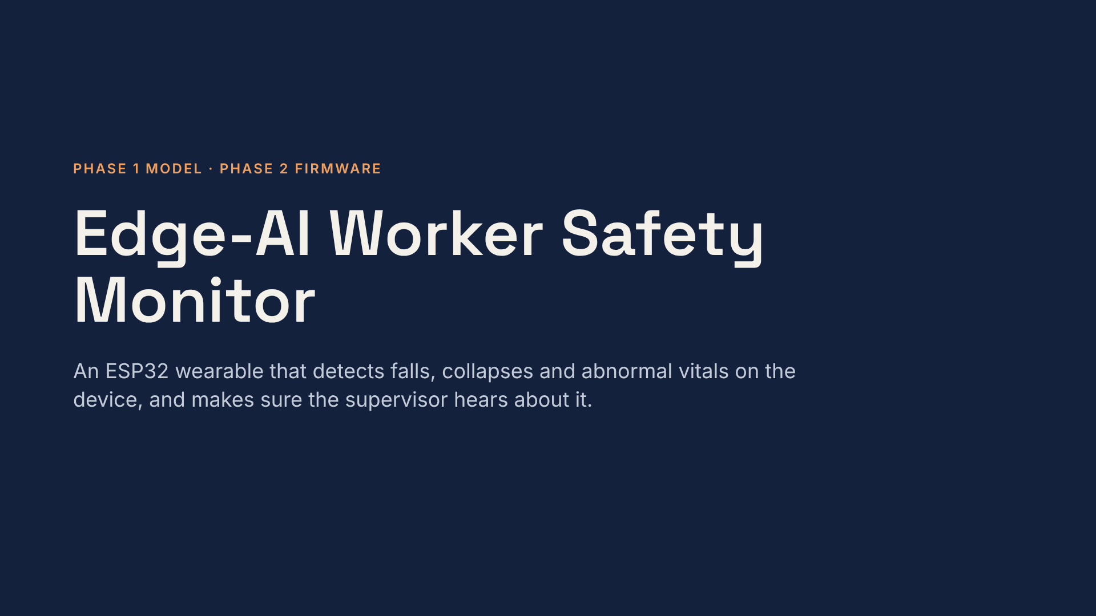
[Your name] · [Guide / course] · November 2026
Notes:
Thirty-second version: a waist-worn ESP32 runs an 18.6 kB neural network that detects falls on the device. On six people it never saw in training, it caught all 441 falls with one false alarm, about 0.8 seconds after impact. Phase 2 added firmware with man-down, vitals and reliable alerting, all tested in an ESP32 emulator. It has not run on a real board yet.

Slide 2
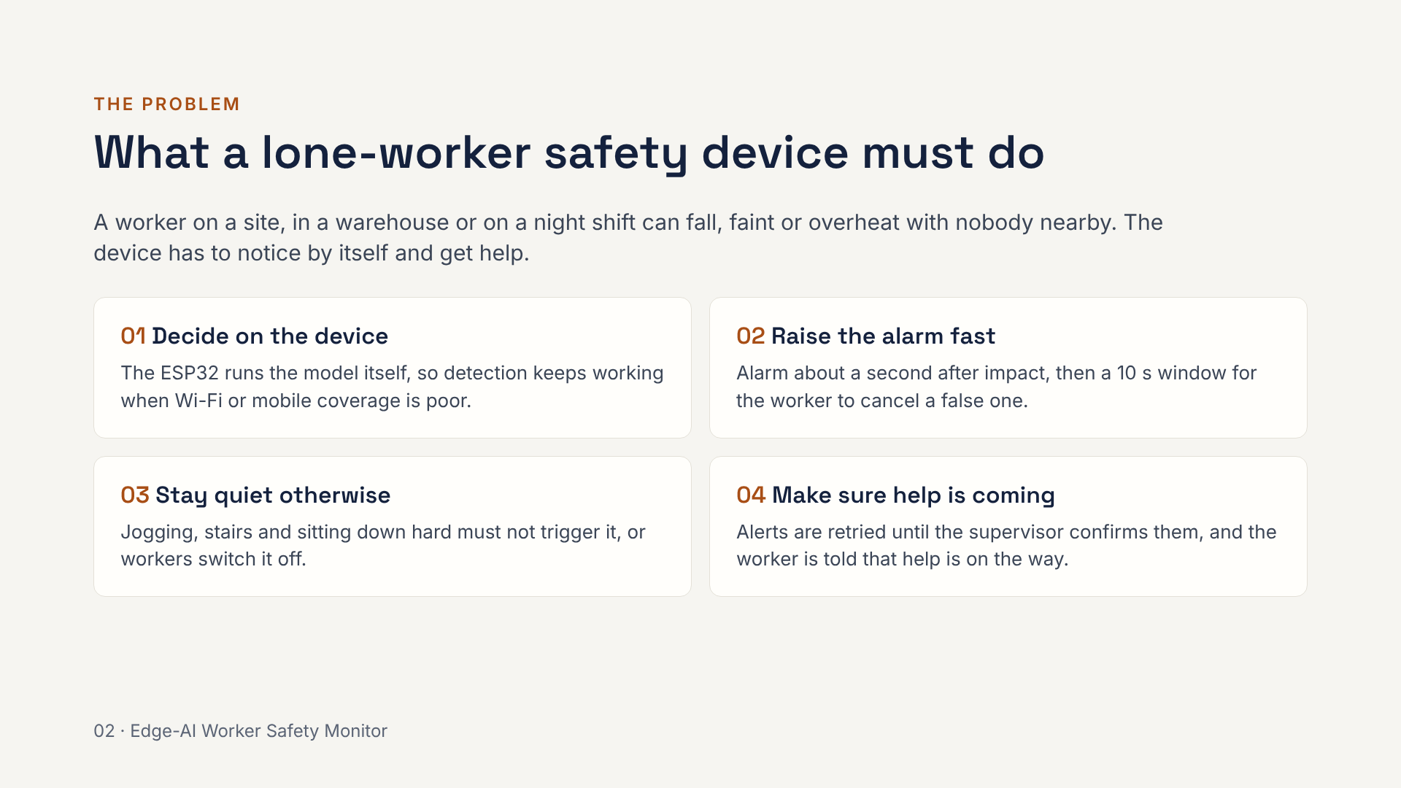
Notes:
These four requirements drive every design choice in the rest of the talk. On-device decisions mean no dependence on coverage. Speed and the cancel window balance each other. False alarms matter as much as missed falls, because a device that cries wolf gets switched off. And an alert is not finished until the supervisor has confirmed it.

Slide 3
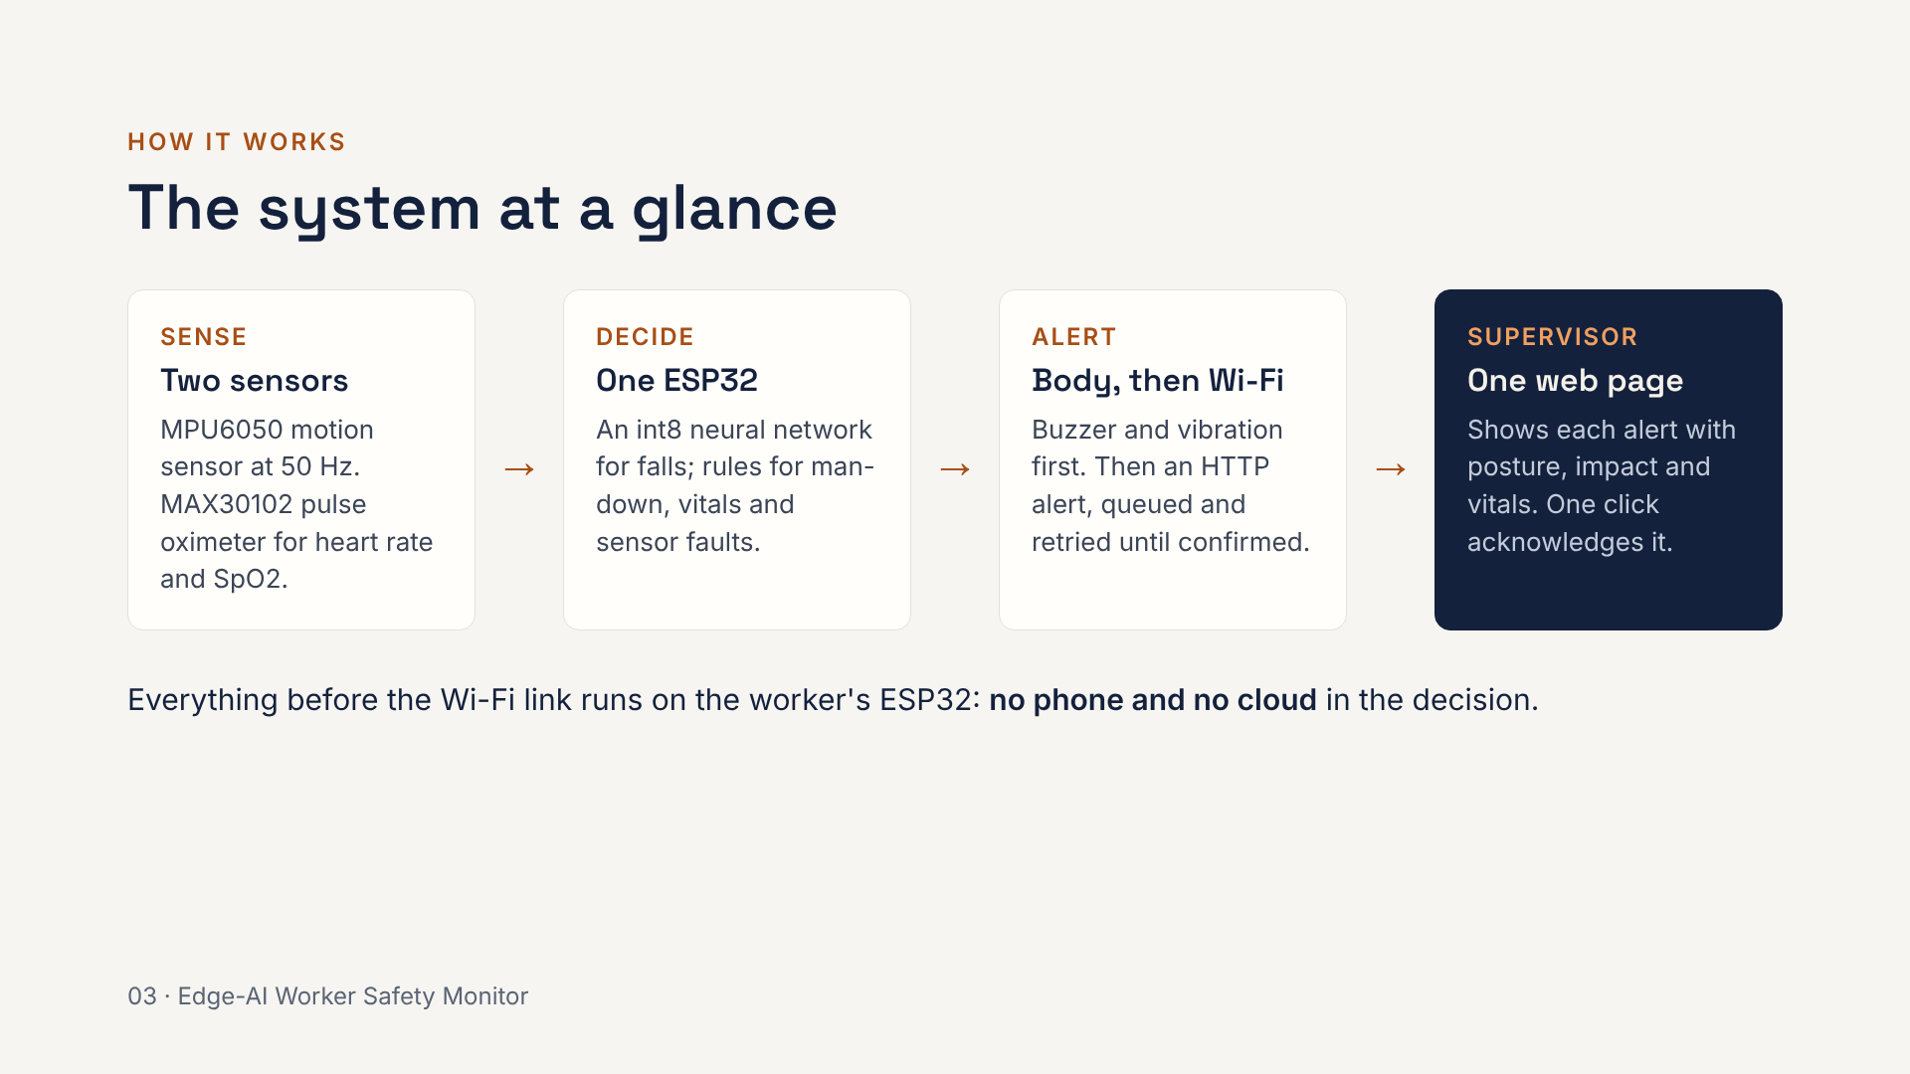
Notes:
Walk left to right. The motion sensor feeds the fall model and the man-down rule; the pulse oximeter feeds the vitals check. The ESP32 decides, warns the worker with buzzer and vibration, and only then sends an alert over Wi-Fi. The supervisor is a small Python web server, supervisor.py, which shows the alert and sends the acknowledgement back to the device.

Slide 4
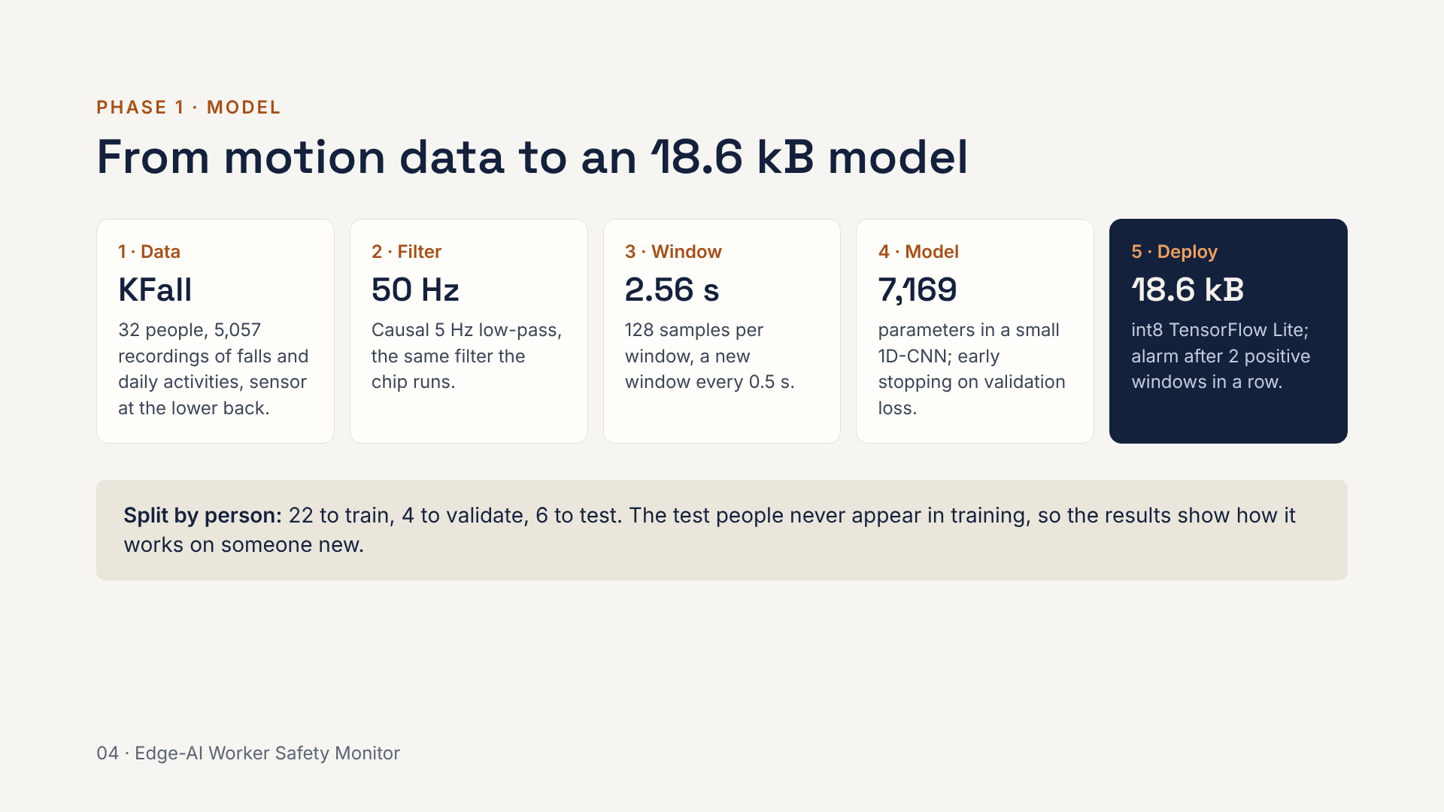
Notes:
The pipeline is phase1_pipeline.py. Each step is mirrored exactly in the firmware's C code, including the filter, so the chip sees the same numbers the model was trained on. The split by person is the important design choice: splitting by recording would let the model memorise people and inflate the scores.

Slide 5
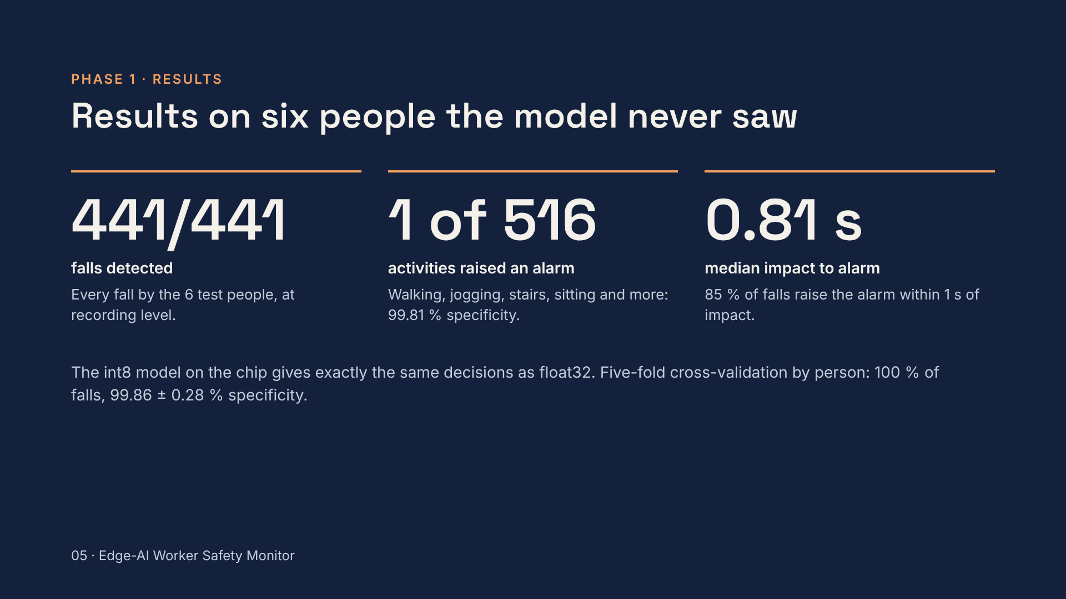
Notes:
Numbers are per recording, which is what matters on the device: did this fall raise an alarm, did this activity raise a false one. The test set is 441 falls and 516 activity recordings from six people held out from training. Window-level F1 is 99.77 %. Cross-validation repeats the whole split five times so the result does not depend on which six people were picked. The one false alarm comes from KFall task T05.

Slide 6
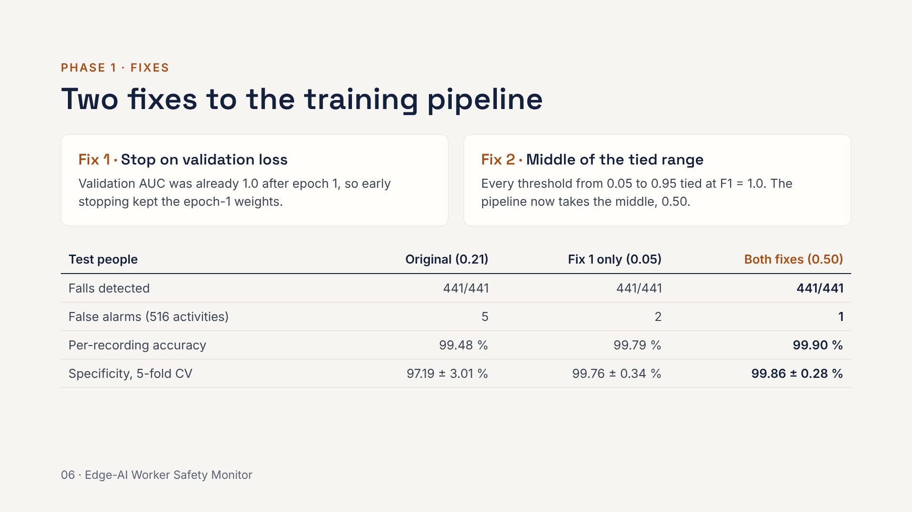
Notes:
Both fixes are small code changes with a measurable effect. Fix 1: the original monitored validation AUC, which hit 1.0 on the first epoch, so restore-best-weights returned an almost untrained model. Monitoring validation loss lets training continue. Fix 2: with a perfect tie, the old rule took the lowest threshold, which is the most alarm-happy choice. The middle of the tie is furthest from both failure modes. False alarms drop from 5 to 1 and cross-validation becomes much more stable, with no falls lost.

Slide 7
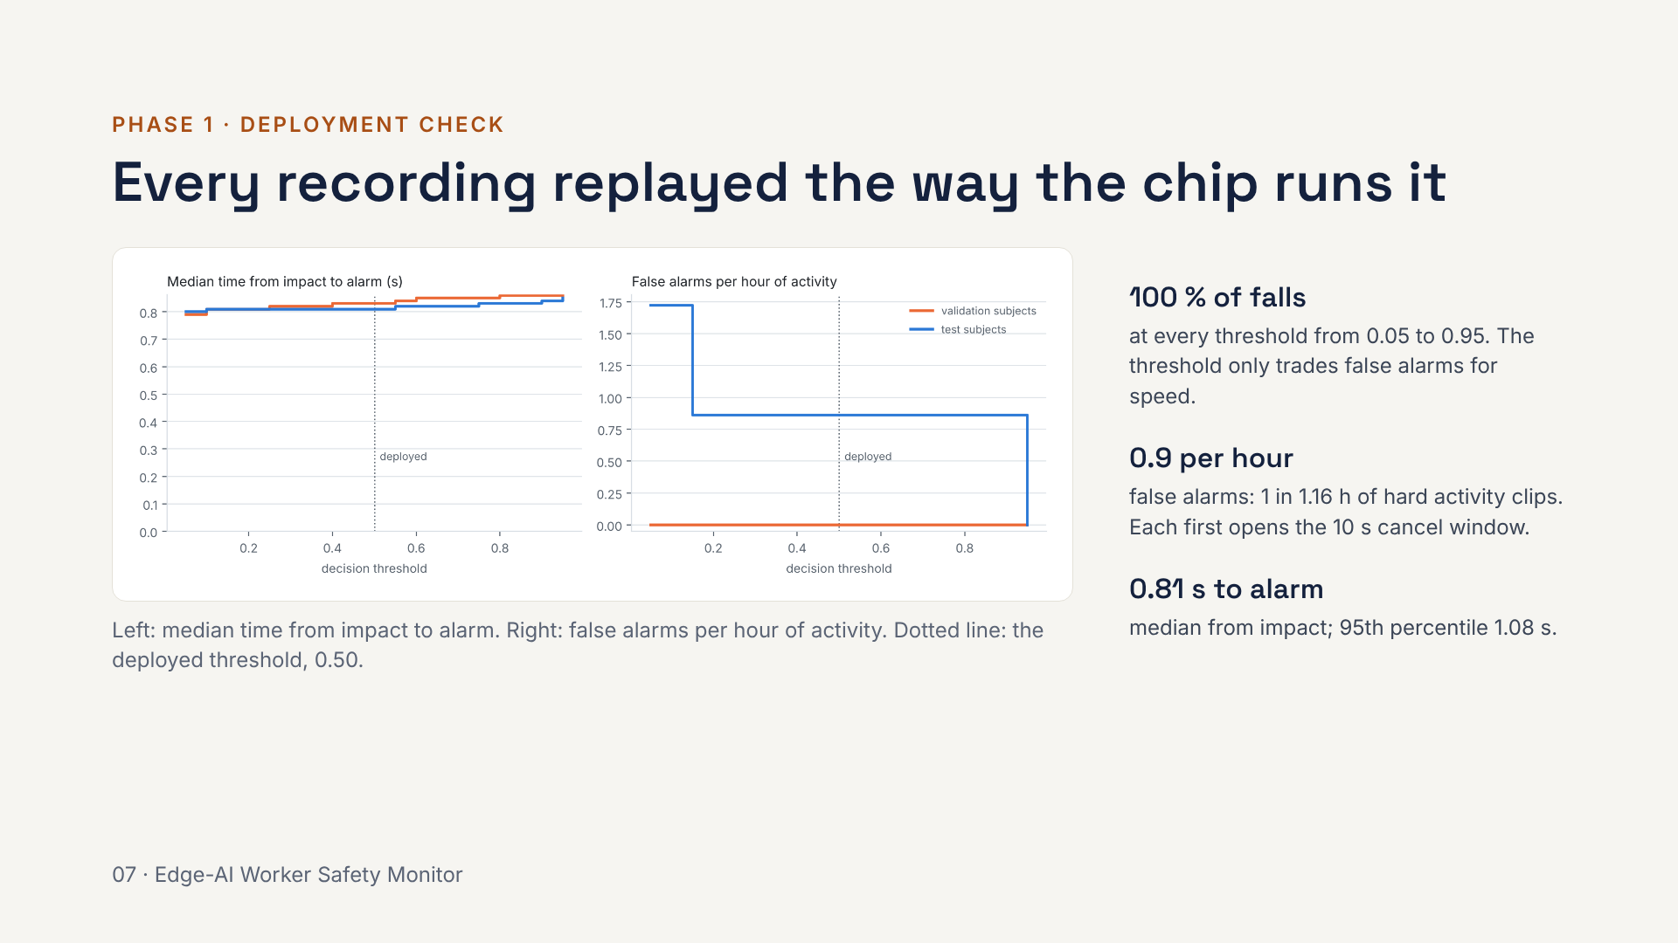
Notes:
evaluate_deployment.py replays every validation and test recording through the exact device rule: a 2.56 s window every 0.5 s and an alarm after two positive windows. The 95 % confidence interval on false alarms is 0 to 4.8 per hour, wide because there are so few events. KFall clips are short and full of hard movements, so this is a pessimistic figure for a normal shift. The threshold is chosen only from the validation people; choosing it from the test curve would over-fit.

Slide 8
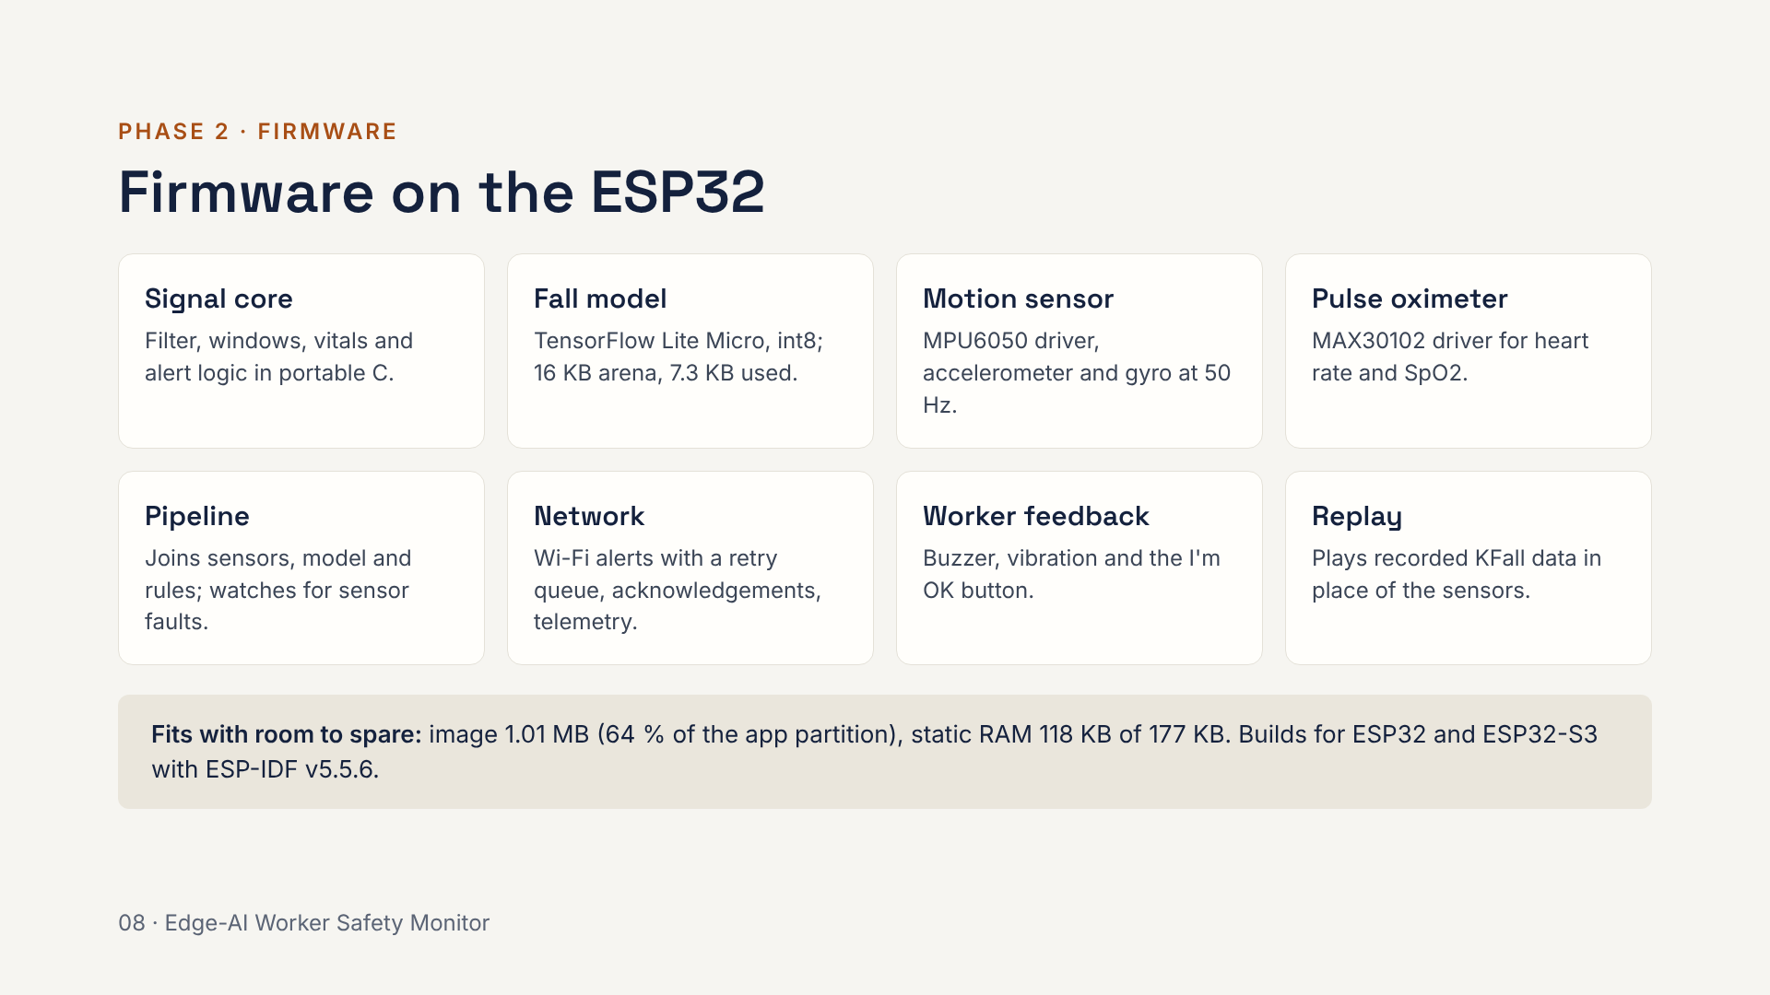
Notes:
The firmware is ordinary ESP-IDF C plus one C++ file for TensorFlow Lite Micro. The key design choice is the signal core: the filter, windowing, vitals and state machine are plain C with no ESP-IDF dependency, so the same code is compiled on a laptop and tested against the Python reference. The replay module lets the real firmware run on recorded data in the emulator, which is how everything is tested without a board.

Slide 9
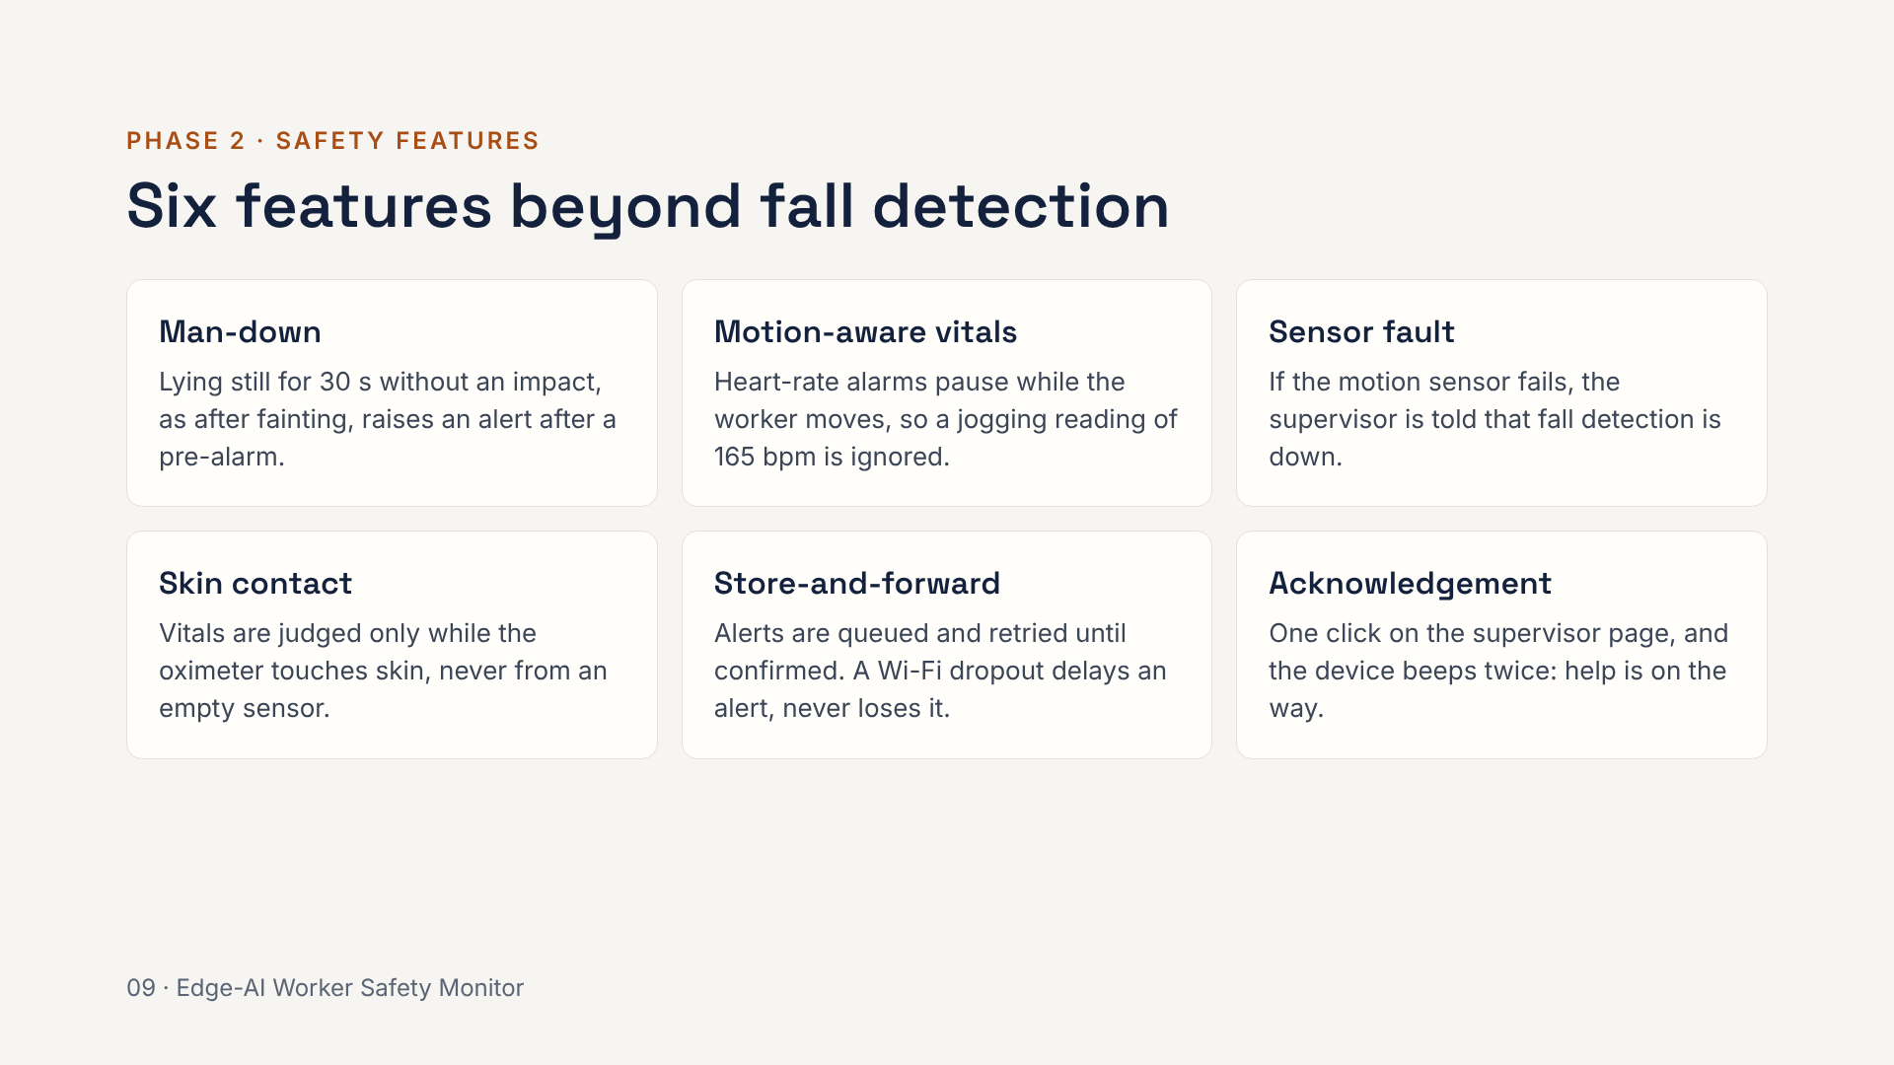
Notes:
Each feature answers a gap in plain fall detection. Man-down catches collapses with no impact, which the fall model cannot see. Motion-aware vitals stop false heart-rate alarms during exertion. Sensor fault and skin contact make sure the device never silently stops protecting the worker. Store-and-forward and acknowledgement close the loop with the supervisor. Every fall alert also carries posture and impact force, for example lying, 5.6 g. All thresholds are settings in menuconfig under Alert rules.

Slide 10
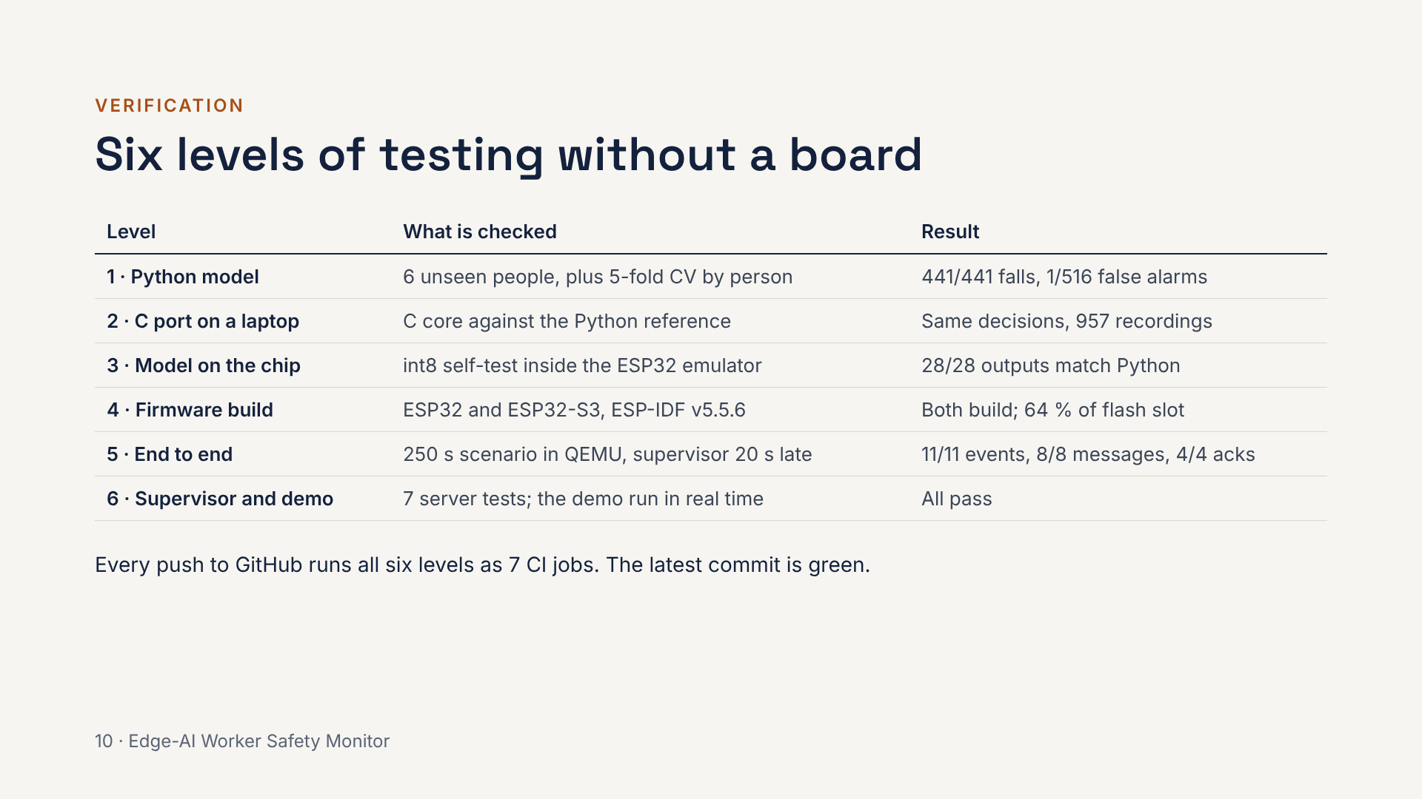
Notes:
Without a board, the risk is that the C code or the chip behaves differently from Python. Each level closes one gap. Level 2 compiles the firmware's C core on a laptop and feeds it the same inputs as Python, across all 957 test recordings: same decisions. Level 3 runs the real int8 model inside the emulated ESP32 and compares 28 outputs with Python bit for bit. Level 5 starts the supervisor 20 seconds late on purpose: the alerts wait in the device's queue and then arrive in order, all acknowledged.

Slide 11
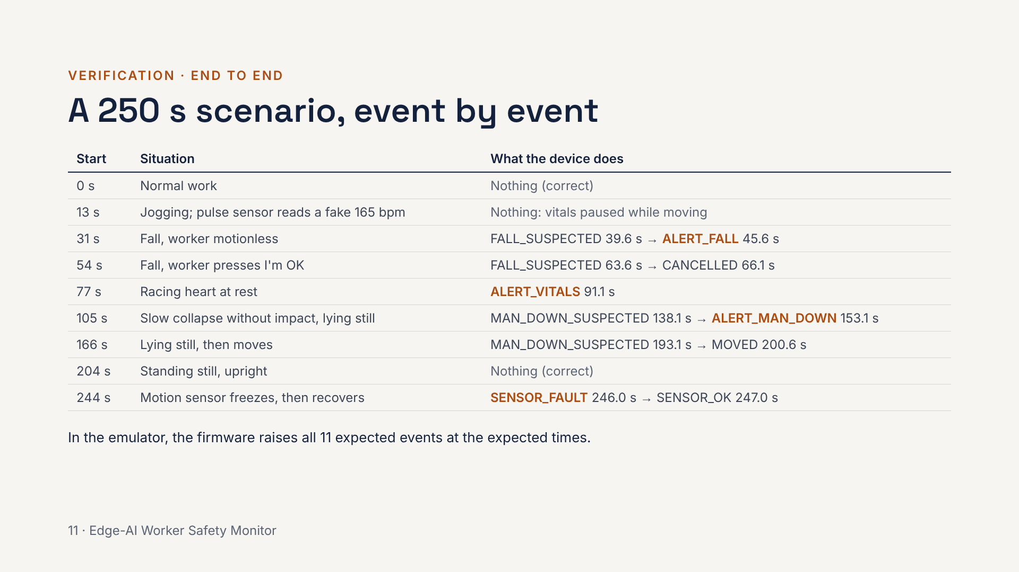
Notes:
The scenario is stitched from real KFall recordings plus synthetic pulse signals, generated by gen_replay.py. The firmware replays it in place of the sensors and compares every event it raises with the list the Python model of the device produced. Two rows matter most: jogging, where a naive device would raise a false heart-rate alarm, and the slow collapse, which the fall model alone cannot see. This is the same story the live demo plays, in real time.

Slide 12
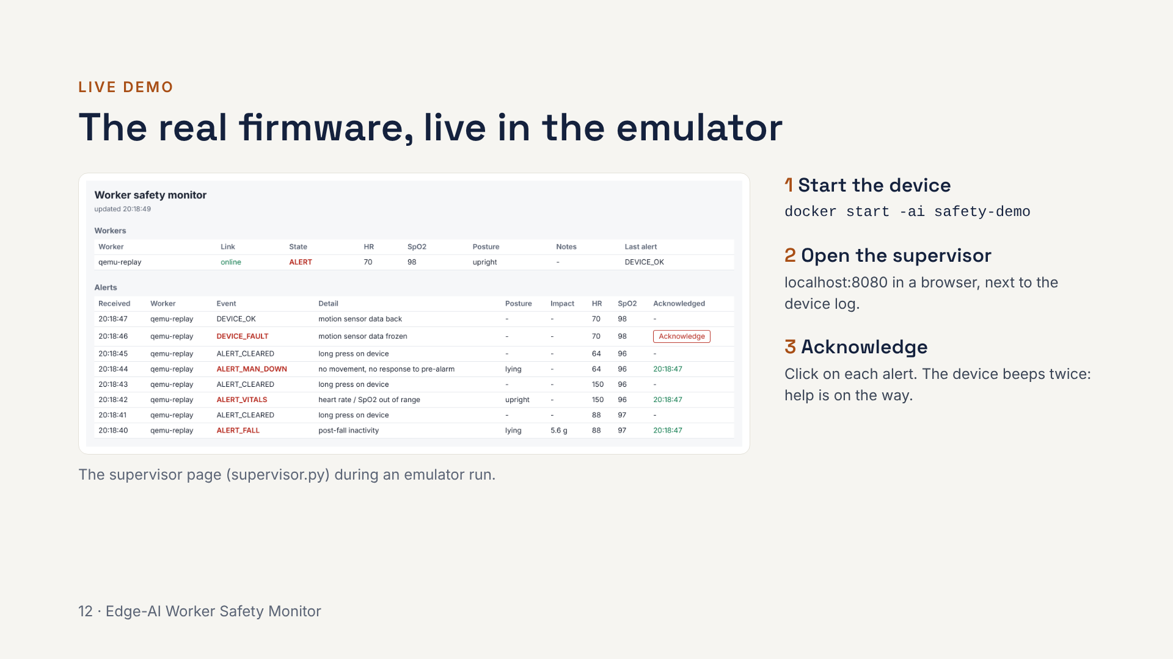
Notes:
Switch to the live demo here. Setup is in DEMO.md: Docker once, about 15 minutes, then docker start -ai safety-demo starts in seconds. Put the terminal and the browser side by side. The story runs about 5 minutes in real time: normal work, jogging with no false alarm, a fall and its alert, a cancelled false alarm, a racing heart, a slow collapse, and a sensor failure. Ask the professor to click Acknowledge. Backup if Docker fails: open the latest QEMU end-to-end job log on GitHub Actions, which shows the same story already run.

Slide 13
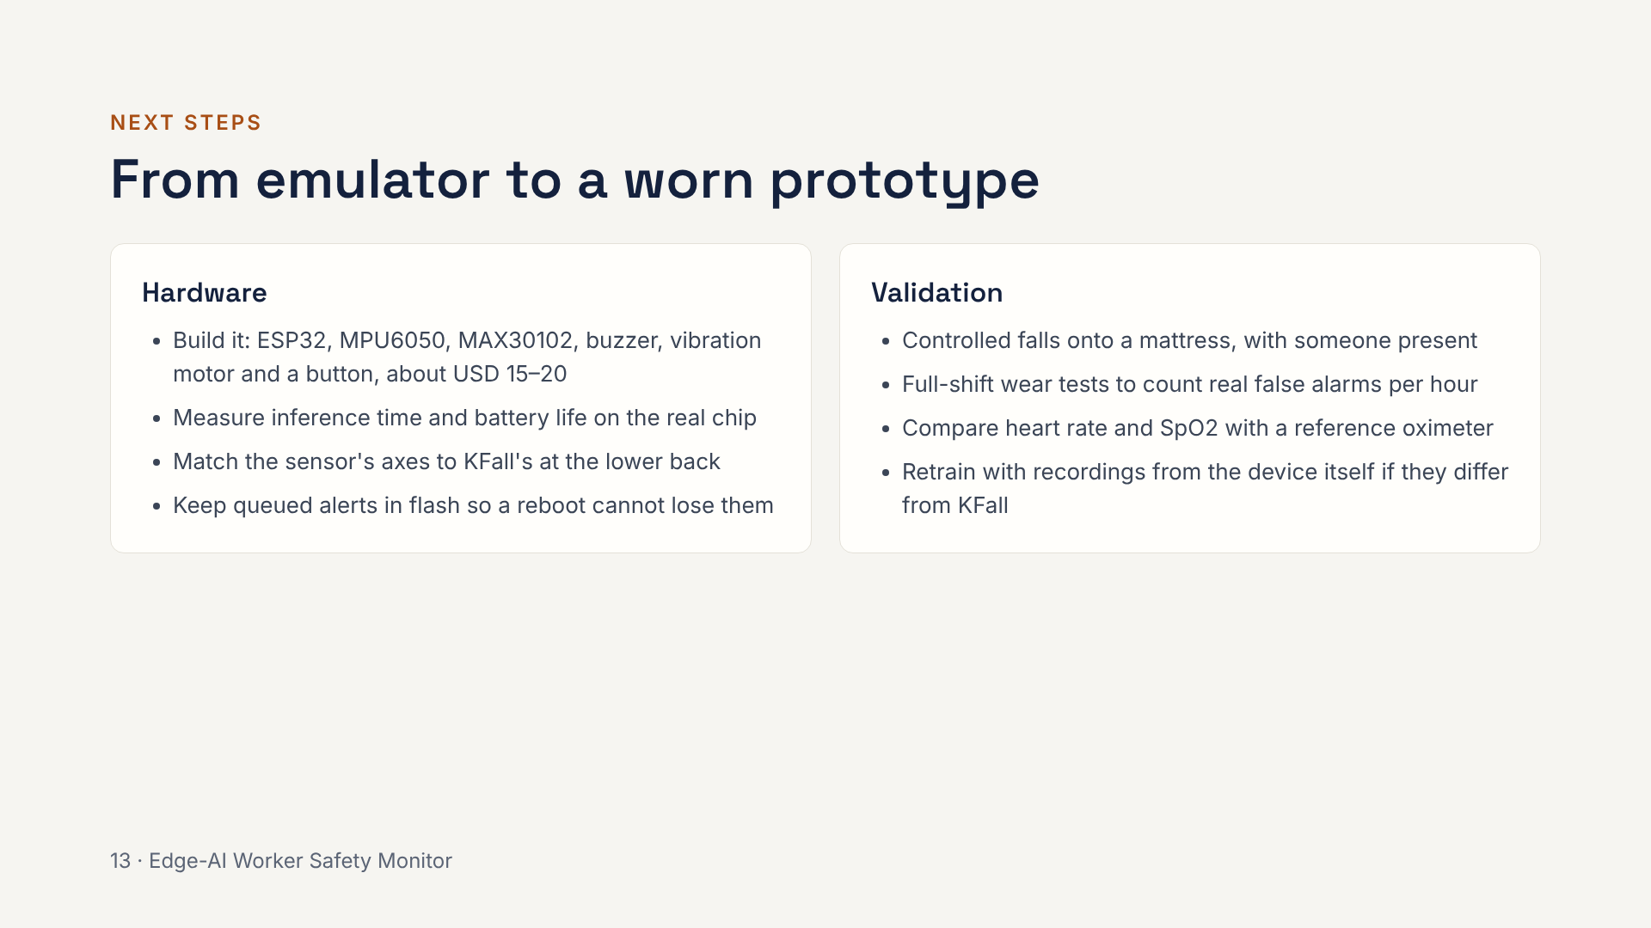
Notes:
Everything so far runs without a board, so the honest next step is hardware. The firmware README has the wiring and flashing steps. The vitals have only been checked on synthetic signals, so they are not clinically validated. False alarms per hour on KFall are pessimistic because the clips are short and full of hard movements; only a full-shift wear test gives the real number.

Slide 14
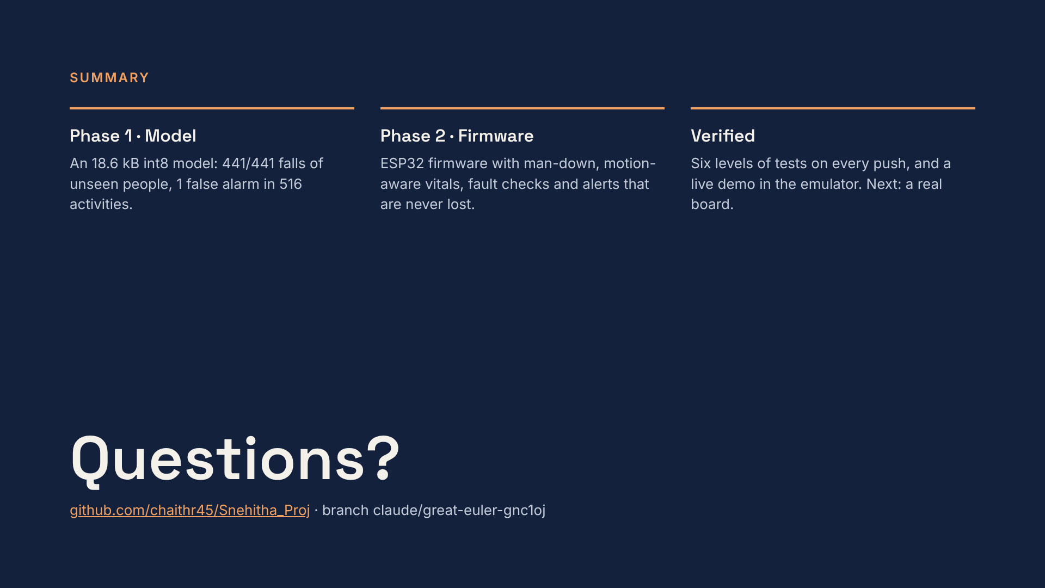
Notes:
Close on the three points: a small model that works on people it never saw, firmware that handles the cases a fall model misses and never loses an alert, and testing that runs automatically on every push. Be clear that nothing has run on a real board yet; that is the next step. Likely questions: why KFall (public, labelled impact times, lower-back sensor); why not cloud inference (coverage and latency); how the threshold was chosen (validation people only, middle of the tied range).

