Slide 1
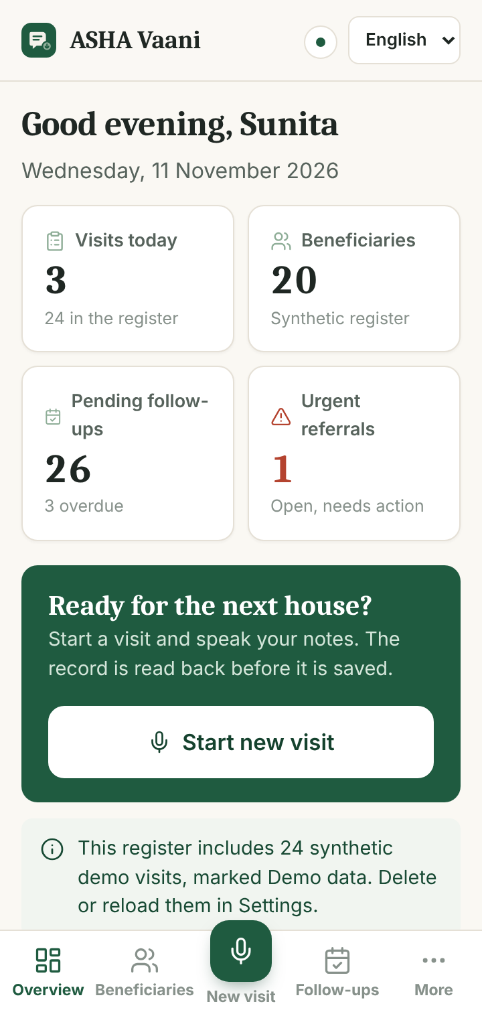



ASHA Vaani
A voice field register for ASHA workers
Today, every home visit ends with typing
Pregnancy, newborn and immunisation visits are logged in paper registers and phone apps, on small screens, while walking between houses.
Data entry eats into visit time, and records arrive late or incomplete.
A missed danger sign, such as bleeding in pregnancy or a newborn with high fever, can cost a life.
Low-end Android phone
Household and street noise
Hindi or Kannada + English health words
Notes:
The named user is the ASHA worker: one low-end Android phone, noisy households, Hindi or Kannada mixed with English health words. Today the visit ends with typing; that delays records and risks missing danger signs. Problem framing paraphrased from the official PS1 brief.

Slide 2






Speak once, confirm by voice, refer on time
Speak
Hear it back
Fix by voice
Confirm
Next actions
Dictate the visit naturally, code-mix welcome
Form read aloud, numbers spelled out
“No, weight is 54 kilo”: only that field changes
Saved only after an explicit yes
Follow-ups; urgent referral first
Danger signs interrupt the flow
When the notes mention a sign from the MCP Card 2018 list, the agent immediately says, in her language, to refer to the PHC now, and flags the record. It never diagnoses or suggests medicine. Negated mentions (“bleeding nahi hai”) are not flagged; unclear ones get one yes/no question.
Notes:
The product promise in five steps. The worker never types in the visit flow; the on-screen buttons (confirm, undo, repeat) are accessible fallbacks only. Danger escalation is deterministic and comes from the government MCP Card 2018 list.

Slide 3
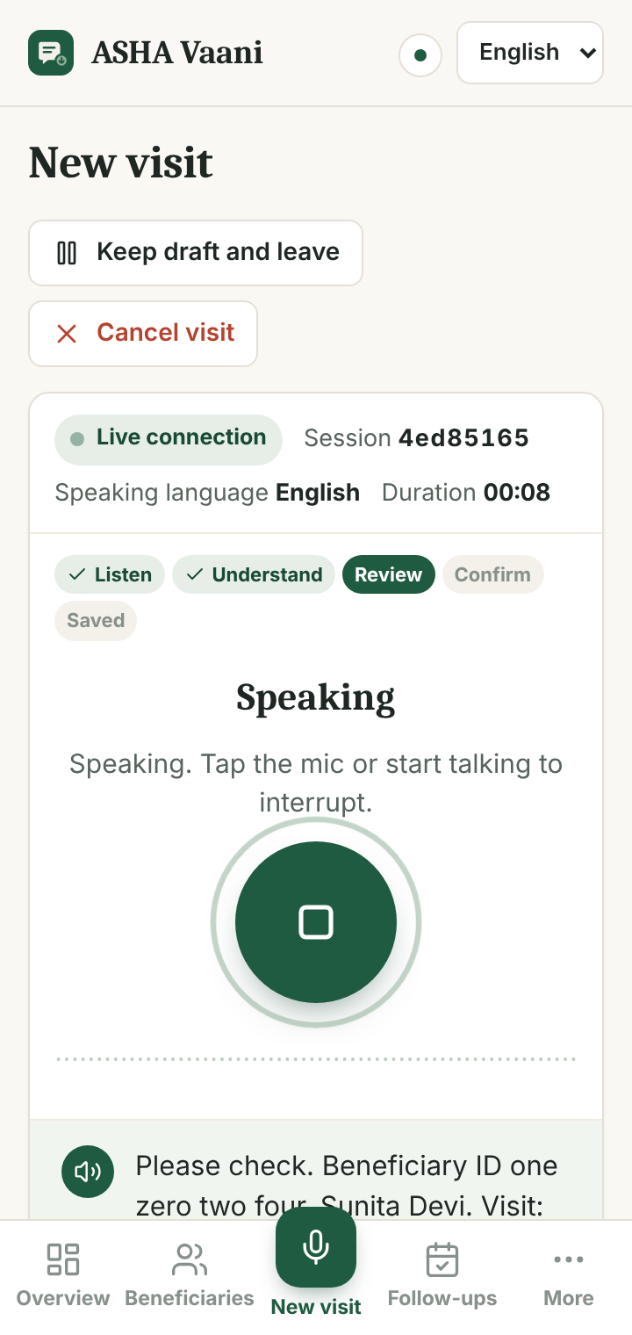
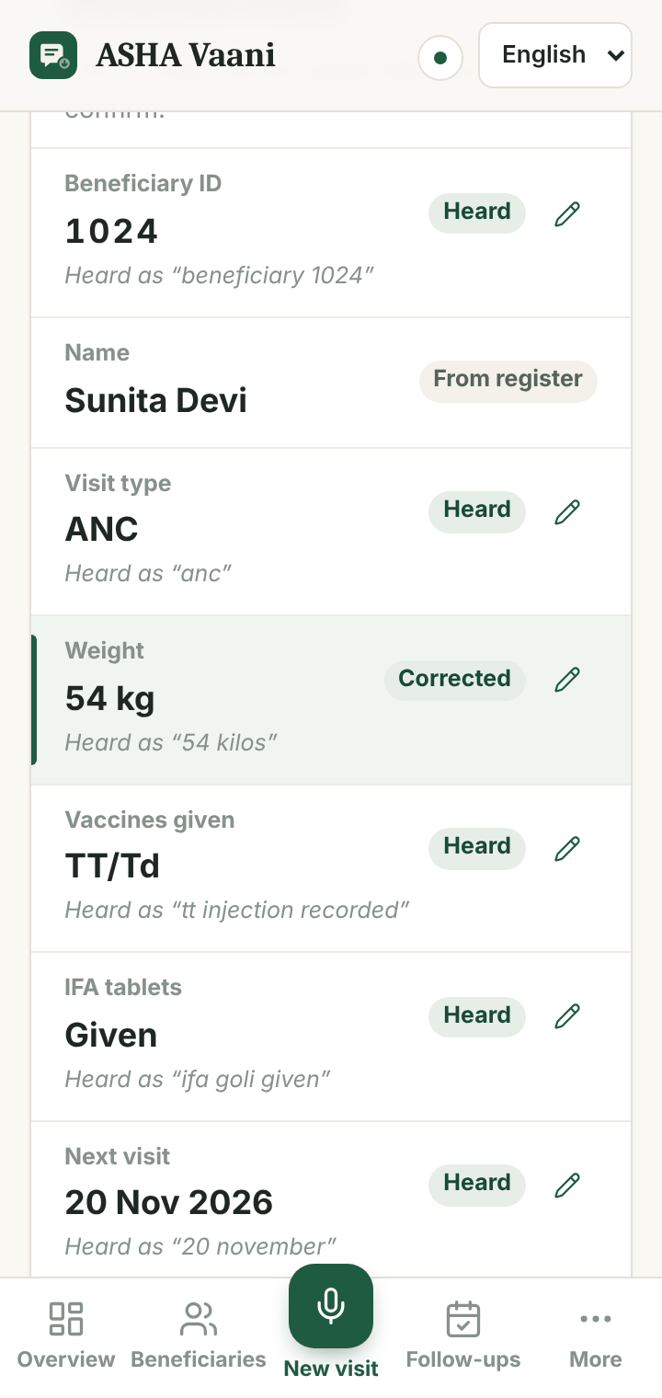
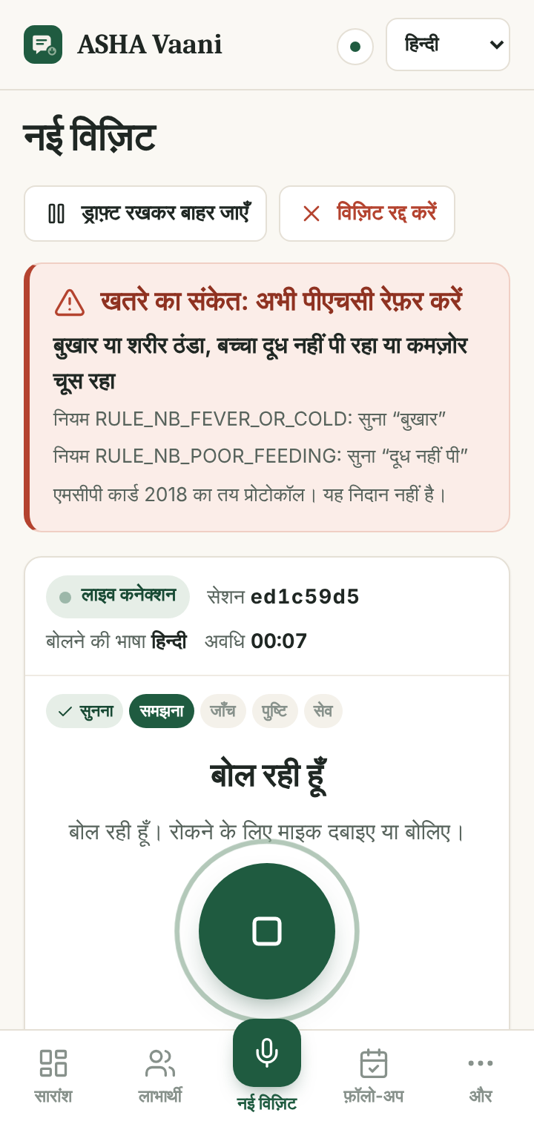
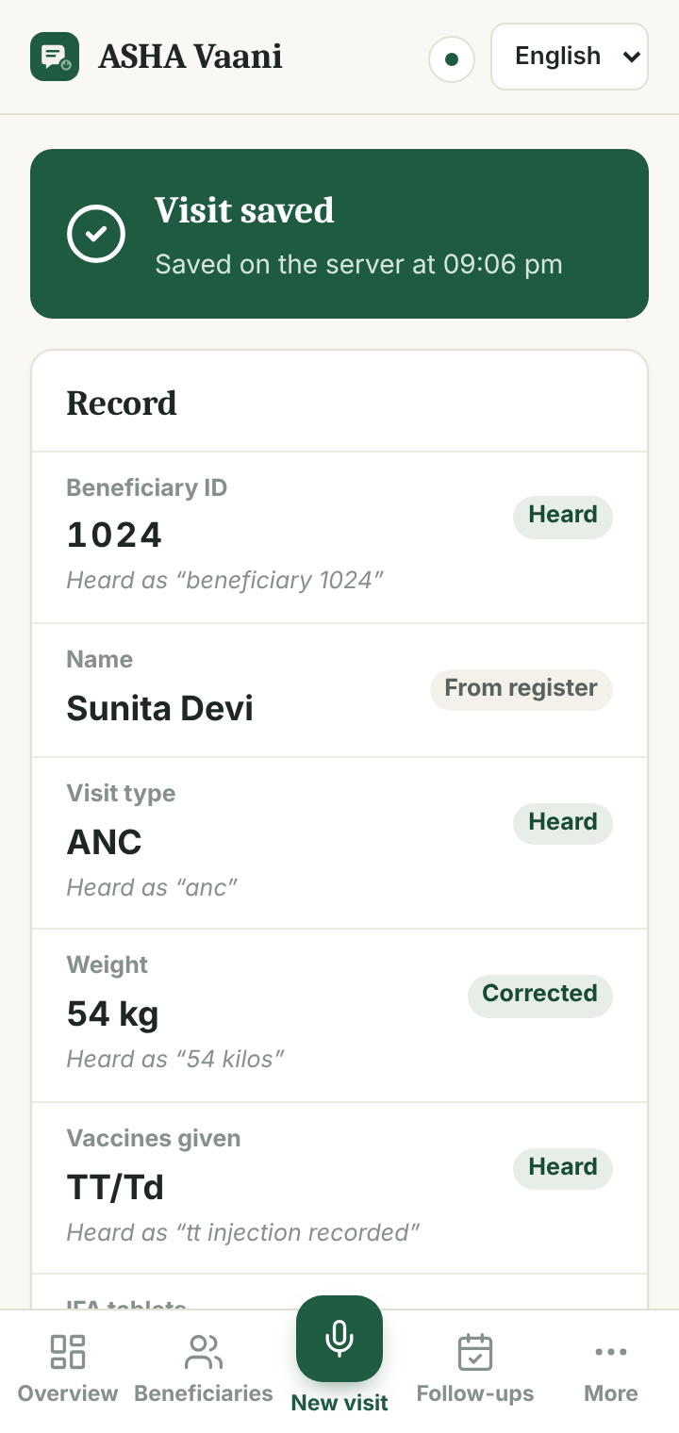
One visit, start to finish, without typing
Read-back of what was heard
Voice correction: weight only
Danger sign in Hindi: refer now
Saved, with next actions
Notes:
Screens are from our automated headless-Chrome test at phone width (Gnani responses simulated in that test because no key was available during the build). In the live demo the same screens run on Prisma v3.0 and Timbre v3.0. Show: transcript preview, register sheet with Heard / Please confirm chips, Changed highlight, red referral alert with the rule id and heard phrase, and the saved timestamp from the server.

Slide 4
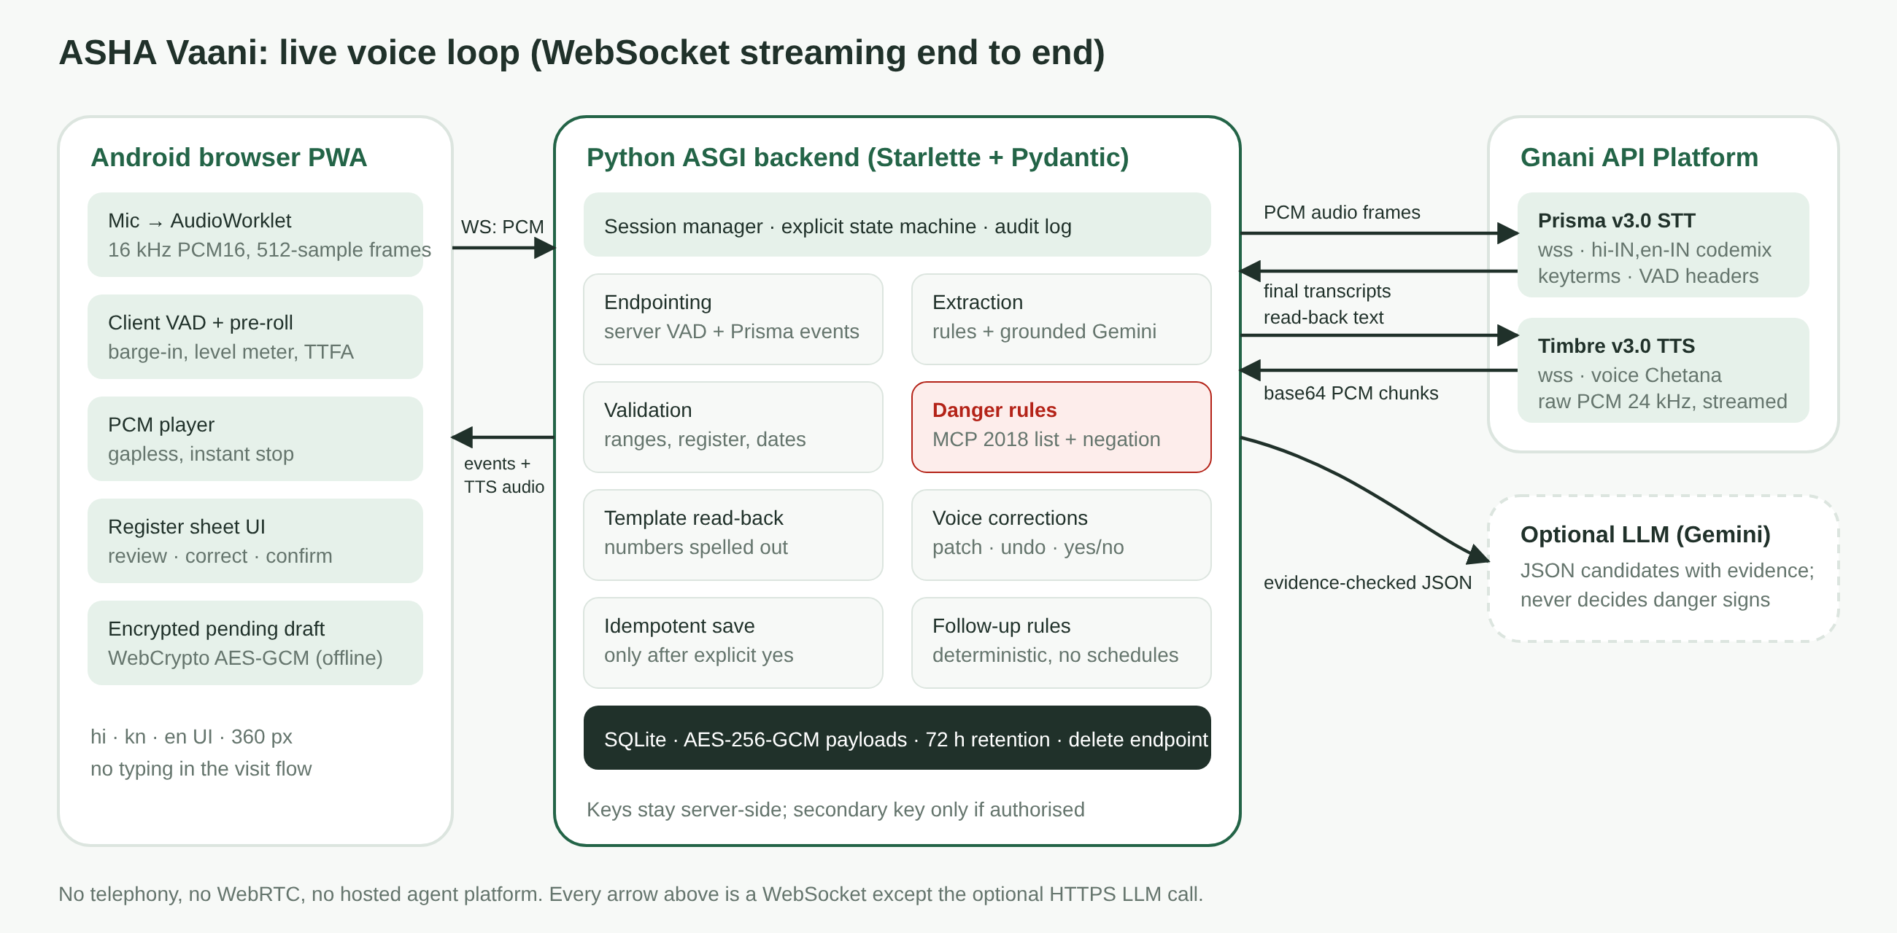
Streaming end to end on Gnani Prisma v3.0 and Timbre v3.0
Speech-layer depth
1,024-byte PCM frames at real-time cadence; final transcripts only, never invented partials
Endpointing tuned so pauses inside spoken IDs are not cut off
Barge-in: playback stops, Timbre stream dropped, 320 ms pre-roll kept
Code-mix: hi-IN,en-IN / kn-IN,en-IN plus medical keyterms; Hindi and Kannada number words
Every stage timed: median and p95 in the app
Custom orchestration (no hosted agent platform, no telephony). Optional Gemini extraction must quote evidence found in the transcript and can never raise or clear a danger flag.
Notes:
Prisma: wss://api.vachana.ai/stt/v3/stream, x-api-key-id, model prisma-v3.0, format codemix, VAD headers, keyterms, commit message. Timbre: wss://api.vachana.ai/api/v1/tts, voice Chetana, raw 24 kHz PCM streamed straight to the phone. Fixed prompts are cached after first synthesis to save credits.

Slide 5


Safe by design, measured honestly
16/16
0
0
10/10
danger signs caught
false danger alerts
invented fields
voice corrections applied
On our 65-utterance scripted set (Hindi, Kannada, English, code-mix, noisy text), written alongside the rules. It shows the rules work as designed; live accuracy and latency are measured in-app on real speech. Plus 175 backend and 6 frontend automated tests.
Deterministic safety
Responsible AI
Honest by construction
Fixed MCP Card 2018 list (MoHFW and MoWCD)
Negation, “not stopping”, uncertainty, past mentions
Alert spoken before the read-back
Says it is an AI in its first turn
Consent before recording; synthetic data only
No diagnosis, medicine or dosage advice
“Saved” only after the database commits
AES-256-GCM at rest; deleted after judging
Offline drafts labelled “pending, not saved”
Notes:
Innovation: one spoken note becomes a validated record, a fixed-protocol referral and a follow-up list, with confidence-aware read-back (unclear values are read slowly with 'please confirm'). Be explicit that the evaluation set was written by the team; add held-out judge-style utterances and live latency (median/p95 from Settings) before presenting.

Slide 6
A correct record before the next house
Try it live
What comes next
Dictate a visit in any of our languages, with noise
Correct one value by voice, or say undo
Say “haan” and watch the saved record and next actions
Mention a danger sign, then a negated one
Health-professional and native-speaker review of the danger phrases and referral wording
Consented field pilot to measure real accuracy and time saved per visit
More of Prisma’s 10 Indian languages, once each path is tested
Worker login, ANM review queue and export to official registers
Built on Gnani Prisma v3.0 and Timbre v3.0 · synthetic data only · not clinically validated
Notes:
Impact claim stays qualitative: no field deployment has happened. Close by inviting the judge to speak to the app. Add the public repository URL and hosted link here before submitting.

