Slide 1
HUMAN COMPUTER INTERACTION
UNIT -II

Slide 2
UNIT II Design process – Human interaction with computers, importance of human characteristics, human consideration, Human interaction speeds, understanding business Functions.

Slide 3
Design Process:
The design process is a series of steps that can be used to create any product, including computer systems.
The specific steps in the design process may vary depending on the project, but they typically include:
Define the problem: What are you trying to achieve with your design?
Gather information: Who are your users? What are their needs? What are the technical constraints?
Generate ideas: Come up with a variety of possible solutions.
Evaluate ideas: Which ideas are the most feasible and effective?
Implement and test: Build your design and test it with users.

Slide 4
Human Interaction with Computers
Understand how people interact with computers.
Understand the human characteristics important in design.
Identify the user’s level of knowledge and experience.
Identify the characteristics of the user’s needs, tasks, and jobs.
Identify the user’s psychological characteristics.
Identify the user’s physical characteristics.
Employ recommended methods for gaining understanding of users.

Slide 5
The Human Action Cycle
A goal is formed.
An execution plan is devised and implemented
General methods to achieve the desired goals are decided upon
The action sequence is planned
The actions are performed
The results of the actions taken are evaluated.
The resulting output is perceived and understood.
The outcome is interpreted based upon expectations.
The results are compared to the formulated goals.

Slide 6
Why People Have Trouble with Computers
Too much flexibility
Non-obvious design
Fine distinctions.
Disparity in problem-solving strategies
Design inconsistency
Responses to Poor Design- Unfortunately, people remember the one thing that went wrong, not the many that go right
Psychological -Confusion, Annoyance, Frustration, Panic or stress
Physical-Abandonment of the system, Partial use of the system, Indirect use of the system, Modification of the task, Compensatory activity, Misuse of the system

Slide 7
Human Characteristics
When designing computer systems, it is important to consider the human characteristics of your users.
Some of the key human characteristics to consider include:
Physical characteristics: This includes things like the size and strength of the user's body, as well as their sensory abilities.
Cognitive abilities: This includes things like the user's memory, attention, and problem-solving skills.
Social and emotional factors: This includes things like the user's cultural background, their level of experience, and their emotional state.

Slide 8
Importance of Human Characteristics in Design
People are complex organisms with many attributes that have an important influence on interface design.
Perception- people tend to match objects or sensations perceived to things already known.
Proximity
Similarity
Matching patterns
Three-dimensional projection
Top-down lighting bias -We interpret shaded or dark areas using lights.
Signals versus noise. Our sensing mechanisms are bombarded by many stimuli, some of which are important and some of which are not. Important stimuli are called signals; those that are not important or unwanted are called noise. This is known as figure-ground perception.

Slide 9
Memory - Memory is not the most stable of human attributes,
Visual acuity,
Foveal and peripheral vision,
sensory storage,
information processing,
learning skill
individual differences.

Slide 10
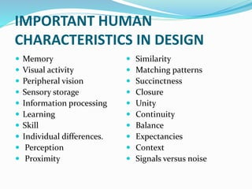

Slide 11
Sensory storage is the buffer where the automatic processing of information collected from our senses takes place.
It is an unconscious process, large, attentive to the environment,
quick to detect changes, and constantly being replaced by newly gathered
stimuli.
In a sense, it acts like radar, constantly scanning the environment for things
that are important to pass on to higher memory.
Have you ever been at a party when, across the room, through
the din of voices, someone mentions your name and you hear it? In spite of the noise,your radar was functioning.
Repeated and excessive stimulation can fatigue the sensory storage mechanism,
making it less attentive and unable to distinguish what is important (called habituation).
Avoid unnecessarily stressing it. Design the interface so that all aspects and elements serve a definite purpose. Eliminating interface noise will ensure that important things are less likely to be missed.

Slide 12
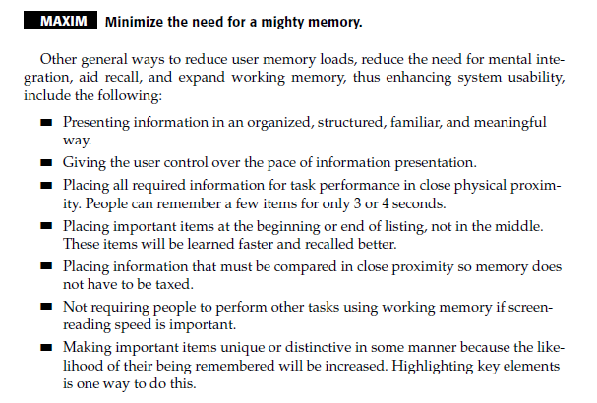

Slide 13
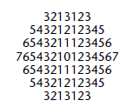
Visual Acuity The capacity of the eye to resolve details is called visual acuity.
The capacity of the eye to resolve details is called visual acuity.
If one assumes that the average viewing distance of a display screen is 19 inches (475 mm), the size of the area on the screen of optimum visual acuity is 1.67 inches , (41.8 mm) in diameter.
Assuming “average” character sizes and character and line spacing, the number of characters on a screen falling within this visual acuity circle is 88, with 15 characters being contained on the widest line, and seven rows being consumed

Slide 14
Foveal and Peripheral Vision
Foveal vision is used to focus directly on something; peripheral vision senses anything in the area surrounding the location we are looking at, but what is there cannot be clearly resolved because of the limitations in visual acuity
Peripheral Vision
In its cooperative nature, peripheral vision is thought to provide clues to where the eye should go next in the visual search of a screen

Slide 15
Information Processing
The information that our senses collect that is deemed important enough to do something about then has to be processed in some meaningful way.
In addition to this higher level, there exists a lower level of information processing, and the limit of its capacity is unknown. This lower level processes familiar information rapidly, in parallel with the higher level, and without conscious effort. “We look rather than see, perceive rather than read”

Slide 16
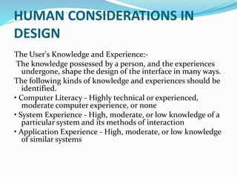
Human Consideration:

Slide 17
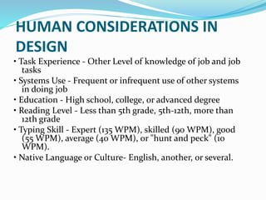
Human Consideration:

Slide 18
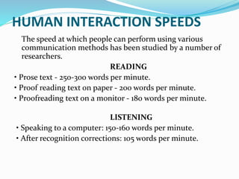
Human Interaction Speeds:

Slide 19
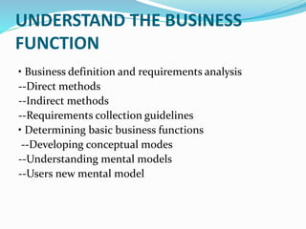
Understanding business Functions:

Slide 20
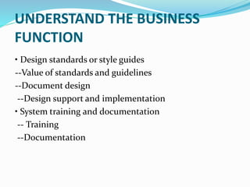

Slide 21
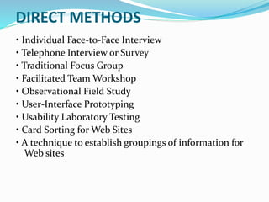

Slide 22
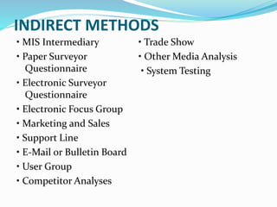

Slide 23
